Slide 1
WisDOT’s Local Public Agency Program September 27, 2017 2017 WisDOT Statewide Real Estate Training Conference Hotel Marshfield, Wisconsin
Presented by: Kerry Paruleski, Statewide LPA Facilitator
Cindy Michalski, SW-NW-NC LPA RE Coordinator
Moderated by: Bill Burki, SE Region LPA RE Coordinator
Notes:
Welcome
Introduce – KP, Cindy and Bill
Ask who is in attendance – WisDOT, LPA Consultant, LPA
Who is not familiar w/ the local program

Slide 2
Local Public Agency (LPA) Program
Overview of Presentation
Overview of WisDOT’s LPA Program
READS in the Local Program
Policy & Procedure Updates
Training Needs
Local Program in RE Oversight – Looking for Efficiencies and Savings
Notes:
Overview of WisDOT’s LPA Program
READS in the Local Program
Policy & Procedure Updates
Training Needs
Local Program in RE Oversight – A look for efficiency and savings
General LPA Overview – WHAT’s HAPPENING
Provide assurances and open forum on how to improve the LP in RE
Training
Results from the test webinar
Upcoming trainings
What kind of training do you want?
READS
How it’s important
Upcoming training
How it will help LPAs, consultants and oversight
Relocation
PR
License Agreements
Consultant – approval process
Oversight improvements/suggestions
Give us your feedback

Slide 3
WisDOt's Lpa program
A Brief Overview:

Slide 4
LPA Overview
Local Program is…
“LPA” Projects = local public agency highway (LPA) and RW acquisition projects that use state and federal funds
** State and federal funds come with some strings attached…
Notes:
Major “strings”:
Real Estate (“Uniform Act”)
Environmental (“WEPA/NEPA”)

Slide 5
LPA Overview
Local Program Participants
Sponsor - Local Public Agency (LPA)
Sponsor Consultants (Design, ROW, Construction, etc.)
WisDOT - Stewardship & Oversight on behalf of FHWA
Design
ROW
Construction
FHWA - When Federal Aid is used

Slide 6
Lines of Communication
LPA Consultant
FHWA LP (Gary Martindale)
Regional LP PDS Project Manager (numerous)
WisDOT LPA RE Staff (Cindy Michalski & Bill Burki)
C/O LPA RE Facilitator (Kerry Paruleski)
FHWA RE (Joel Batha)
C/O LP (Wayne Chase & Sandi Villiesse)
LPA
= Local Public Agency (LPA)
= Real Estate (RE) related
= Local Program (LP) – not RE related
= Additional lines of communication
Notes:
In order to ensure a successful a local program, FHWA has tasked State DOTs with overseeing the program. It is WisDOT’s duty to keep its LPAs from jeopardizing its projects for noncompliance.
One of the most important aspects of a successful program is communication. This diagram is attempting to illustrate the “Lines of Communication” within WisDOT’s local program real estate.
In order to aid in oversight, our local program utilizes a public private partnership in the oversight of LPA projects. As shown here, the LPA and its consultant deals directly with our contract management consultant – referred to as the MC.
WisDOT has decided to not continue w/ the use of Management consultants to aid in oversight of design, RE, and construction
Under contract until end of 2018
Every region is doing things a bit differently but one thing that is consistent is that they have taken the the MCs out of the Bridge program right away
If those locals and consultants in the audience who are wondering about their current projects or ones that are about to start – if you haven’t been notifided that the MC is not going to work on the project then you should continue as is. You will be of course notified of any oversight/contact person changes.

Slide 7
Real Estate Oversight Team
SW Region (Madison & La Crosse Offices)
Cindy Michalski, WisDOT LPA RE Coordinator
(715) 421-8350
Cynthia.Michalski@dot.wi.gov
NC Region (Wisconsin Rapids & Rhinelander Offices)
Cindy Michalski, WisDOT LPA RE Coordinator
(715) 421-8350
Cynthia.Michalski@dot.wi.gov
NW Region (Eau Claire & Superior Offices)
Cindy Michalski, WisDOT LPA RE Coordinator
(715) 421-8350
Cynthia.Michalski@dot.wi.gov
Notes:
KP
Our WisDOT staff LP Real Estate team consists of two regional LPA RE Coordinators who conduct the administrative work within the five regions of the state. And then I work for central office overseeing real estate program and policy within the local program.

Slide 8
Real Estate Oversight Team
SE Region (Waukesha Office)
Bill Burki, WisDOT LPA RE Coordinator
(414) 750-0390
William.burki@dot.wi.gov
NE Region (Green Bay Office)
VACANT, WisDOT LPA RE Coordinator
(920) xxx-xxxx
xx.xxx@dot.wi.gov
Central Office
Kerry Paruleski, WisDOT Statewide LPA RE Facilitator
Office :(414) 220-5461 or Cell: (414) 915-6558
Kerry.Paruleski@dot.wi.gov

Slide 9
Project Sponsor Responsibilities
Once a local government has applied and received an award of Federal funding for a project and the project agreement has been signed ….then what?
LPA's are expected to:
Follow proper procedures
Secure proper approvals
Ensure that all State and Federal procedures and laws are followed.
Honor the signed agreement – State Municipal Agreement (SMA)
Notes:
What does this mean for local municipalities? What is the local’s responsibility?
To:
Follow the procedures outlined in the WisDOT LPA manual.
Secure approvals needed to proceed with ROW acquisition on state or federal aid projects. This is especially important when there are federal/state funds in re. Reimbursement will be involved and a paper trail w/ the correct authorization is essential.
Goes almost w/out saying that State and Federal procedures and laws are followed. If the manuals are followed and the documentation is done correctly in the proper order then there should not be problems
Honor the signed agreement (that specifies that all aspects of the project will be done in compliance with federal and state statutes and regulations.
Remember, the project sponsor or LPA is responsible no matter who actually acquires the R/W…
There are many reasons why it’s a great idea to hire consultants to help with their real estate acquisitions but one thing that should always be clear – the LPA is ultimately responsible for its own project.
And maybe the biggest thing to take away today is that the LPA should NOT START UNTIL ALL OF THE NECESSARY APPROVALS or the notice to proceed is given

Slide 10
Sponsor ROW Consultant Responsibilities
ROW consultants are expected to:
Act as the expert
Know the WisDOT LPA RE manual and REPM
Guide the LPAs through the acquisition process
Ensure that all State and Federal procedures and laws are followed
Provide the LPA with complete and accurate project and parcel files.
Provide correct & adequate documentation
Notes:
Local Program ROW consultants (appraisers, review appraisers & acquisition/relocation agents) are hired for their expertise in working on transportation related projects.
ROW consultants are expected to:
Act as the expert regarding the process and procedures required to properly acquire ROW on a State/Federally funded transportation projects.
Familiar with the WisDOT LPA RE manual and the Real Estate Program Manual (REPM)
Guide the LPAs through the acquisition process to ensure that the ROW is acquired according to schedule.
Ensure that all State and Federal procedures and laws are followed and to inform LPAs when and if they are in jeopardy of any non-compliance.
Provide the LPA with complete and accurate project and parcel files.
Use the most up to date WisDOT LPA forms and provide adequate and accurate documentation (good complete diaries is especially important).

Slide 11
WisDOT LPA RE Responsibilities
The Federal Highway Administration (FHWA) provides funds to WisDOT to carry out highway projects. WisDOT passes on funds to local governments or private entities. Eligibility to receive Federal funds depends upon compliance with Federal laws, regulations, and policies.
WisDOT is expected to:
Provide adequate & competent stewardship and oversight of the local program.
Notes:
In order to ensure a successful a local program, FHWA has tasked State DOTs with overseeing the program. It is WisDOT’s duty to keep its LPAs from jeopardizing its projects for noncompliance.
One of the most important aspects of a successful program is communication. This diagram is attempting to illustrate the “Lines of Communication” within WisDOT’s local program real estate.
In order to aid in oversight, our local program utilizes a public private partnership in the oversight of LPA projects. As shown here, the LPA and its consultant deals directly with our contract management consultant – referred to as the MC.
Eminent Domain….The power of any sovereign government to take private property without the consent of the owner….
One of the main reasons that FHWA takes oversight so seriously is because of the power government agencies have to take private property without the consent of the owner.
Luckily, the US Constitution put limitations on the power of eminent domain. As the 5th Amendment states “…nor shall private property be taken for public use without just compensation.” And the 14th Amendment adds “…nor shall any State deprive any person of life, liberty or property, without due process of law…”
Additionally, in 1970 a law called the Uniform Relocation Assistance and Real Property Acquisition Policies Act was passed. It is commonly called the Uniform Act, and is the primary law for acquisition and relocation activities on Federal or federally assisted projects and programs.
And as many of you already know, its purpose is to treat individuals fairly and consistently, encourage acquisition by agreement and minimize litigation.
The Uniform Act applies when Federal dollars are utilized in any phase of a project. The Uniform Act applies even when Federal dollars are not used specifically for property acquisition or relocation activities, but are used elsewhere in the project, such as in planning, environmental assessments, or construction. The Uniform Act also applies to acquisitions by private as well as public entities when the acquisition is for a Federal or federally-assisted project.

Slide 12
FHWA Responsibilities
There are several reasons that the Federal Government retains a deep interest in the acquisition of real property for federally assisted projects.
FHWA is expected to:
The Fifth Amendment
Expedient acquisition
Proper use of Federal tax dollars
Notes:
There are several reasons that the Federal Government retains a deep interest in the acquisition of real property for federally assisted projects.
The Fifth Amendment mandates of due process and just compensation are met when property owners are affected by Federal-aid projects
To acquire property without delaying the project for which it is needed
Concerned that Federal tax dollars used to fund public improvement projects are spent in an appropriate fashion
This guide is intended to serve as a basic reference for local public agencies and others who receive Federal-aid highway funds for projects involving the acquisition of real property. Typically, the Federal Highway Administration (FHWA) provides funds to State governments who carry out highway projects. These funds are used to support activities related to building, improving, and maintaining designated public roads. In some circumstances, the States pass on the funds to local governments or private entities. Eligibility to receive Federal funds depends upon compliance with Federal laws, regulations, and policies. State and local governments often have additional requirements that apply.
One set of project activities eligible for Federal-aid funding involves the acquisition of real property and the relocation of residents, businesses, and others. Concern for fair and equitable treatment in acquiring private property for public purposes goes back to the beginnings of the United States. The founding fathers placed a high value on the protection of private property. The United States Constitution expresses this philosophy in the Fifth Amendment, where ‘due process’ and ‘just compensation’ are required for taking private property for a ‘public use.’
The 14th Amendment to the Constitution extends to States the requirement of following due process when they acquire privately owned property.
There are several reasons that the Federal Government retains a deep interest in the acquisition of real property for federally assisted projects. The most important is ensuring that the Fifth Amendment mandates of due process and just compensation are met when property owners are affected by Federal-aid projects. Another is the goal of acquiring property without delaying the project for which it is needed. Finally, the Federal government is concerned that Federal tax dollars used to fund public improvement projects are spent in an appropriate fashion.
Public Law 91-646, The Uniform Relocation Assistance and Real Property Acquisition Policies Act of 1970, as amended, commonly called the Uniform Act, is the primary law for acquisition and relocation activities on Federal or federally assisted projects and programs. Other Federal, State, and local laws also govern public project and program activities. The requirements of other Federal laws that affect the process of acquiring private property for public purposes are discussed, at least minimally. However, our primary emphasis in this document will be the Uniform Act and its requirements.
Federal real estate acquisition statutes and regulations include:

Slide 13
1. Reads (Real Estate automated data system)
Local Program:
Notes:
One of the most exciting and anticipated tools that we are going to be introducing to the local program is the use of the full side of READS.
I know all of the WisDOT and most of the LPA Consultants know what READS is and probably use it almost daily. I’m not sure about the LPAs though – is there anyone who is NOT familiar w/ READS?
READS is an automated data system that WisDOT uses to track and document ROW acquisitions for its projects. Up until now we have utilized a “light” version of READS to track projects mostly on a project information basis. We currently in the “light” version do not have the ability to track parcel information and utilize READS forms, letters, and reporting abilities w/ out extensive tweaking.

Slide 14
1. READS
READS will be introduced to the Local Program and Connecting Highway projects in 2018.
Why
Roll-Out Plan
How it will help LPAs, consultants and oversight
Upcoming Training

Slide 15
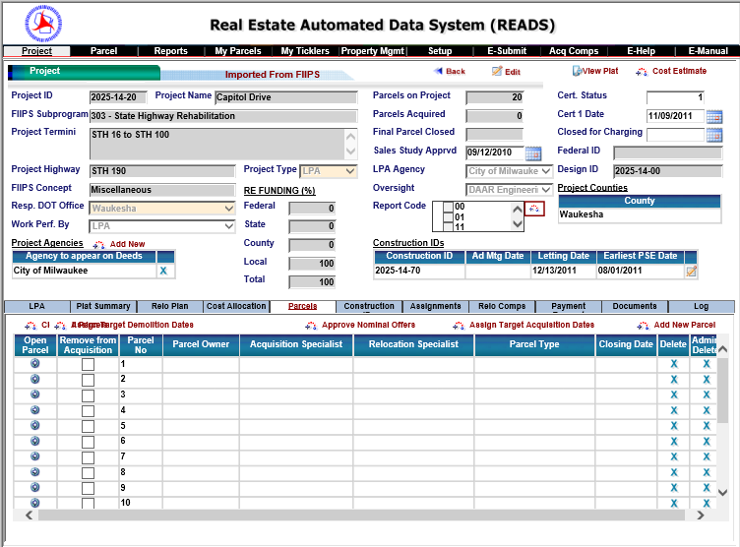
READS – Project Information

Slide 16
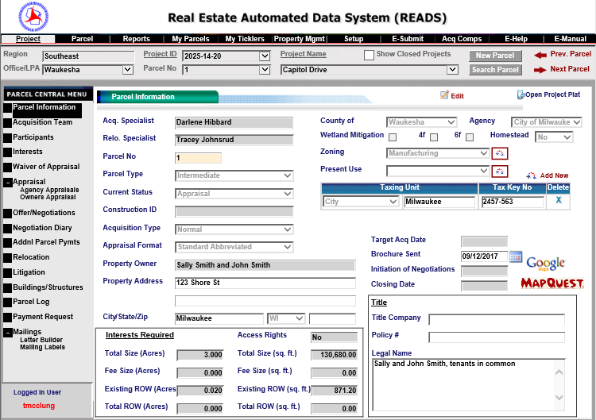
READS – Parcel Specific Information

Slide 17
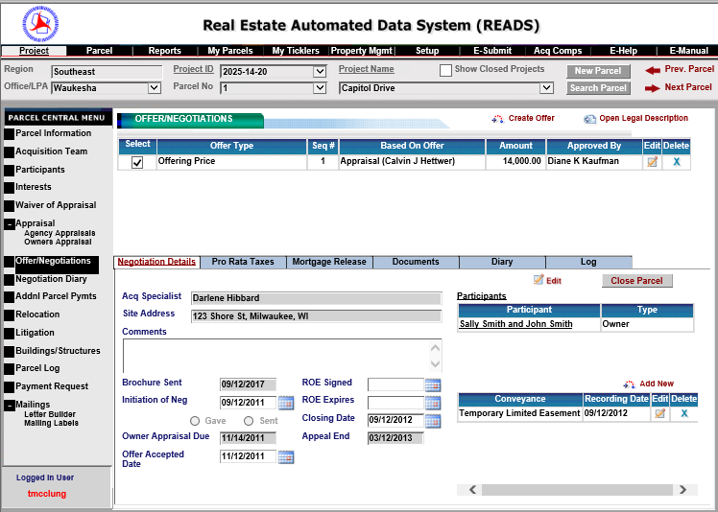
READS – Negotiation Information

Slide 18
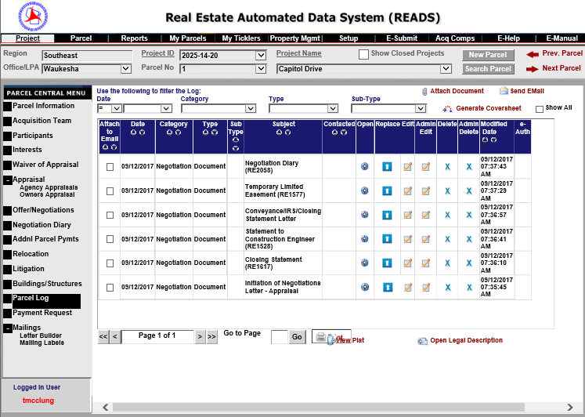
READS – Parcel Specific Documents

Slide 19
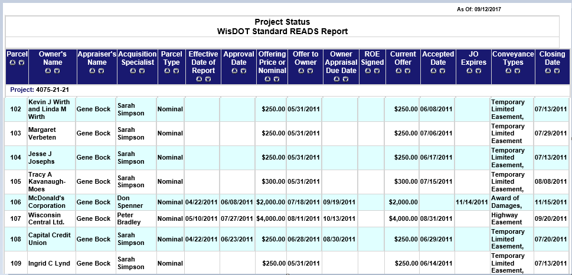
READS – Project Specific Reports

Slide 20
2. Policy & procedure
Updates:

Slide 21
2. Policy & Procedure Updates
Relocation
Clear Title
Less than Full Interest
Consulting in the Local Program for RE – approval process, evaluations
Notes:
Relocation
PR
License Agreements
Consultant – approval process
Oversight improvements/suggestions
Give us your feedback

Slide 22
2. Policy & procedure
Updates:
relocation
Notes:
Policy is in DRAFT form

Slide 23
Relocation
Currently LPA RE manual only references Chapter 5 of the Real Estate Program Manual (REPM) for assistance with relocation
Local Program specific information is being added to the LPA RE manual
Relocation Computation & Claim Approval Process, DRAFT
Relocation Computation/Claim Checklist, DRAFT
READS Relocation Parcel Checklist, DRAFT

Slide 24
2. Policy & procedure
Updates:
Clear title
Notes:
This policy has been extensively studied, been through many re-iterations and has now finally been approved
But has not yet been introducted to the local program

Slide 25
Clear Title – Summary of Policy Revision
Refer to the LPA RE manual 6.3.4 Clear Title for details.
Link: http://wisconsindot.gov/Pages/doing-bus/eng-consultants/cnslt-rsrces/re/lpa-manual.aspx
WisDOT’s policy is to obtain a partial release of mortgage (or lien release) on all acquisitions, except for temporary limited easements (TLE).
Sometimes a PARTIAL RELEASE OF MORTGAGE is not viable
Notes:
Refer to the LPA RE manual 6.3.4 Clear Title for details.
Is a sub-section of WisDOT’s Real Estate Program Manual (REPM)
Link: http://wisconsindot.gov/Pages/doing-bus/eng-consultants/cnslt-rsrces/re/lpa-manual.aspx
WisDOT’s policy is to obtain a partial release of mortgage (or lien release) on all acquisitions, except for temporary limited easements (TLE).
The policy applies regardless of the complexity or dollar amount
Obtaining clear title benefits not only the property owner
Protects the resulting highway facility and the traveling public.
Sometimes a PARTIAL RELEASE OF MORTGAGE is not viable
A jurisdictional offer (JO) is the acceptable alternative.

Slide 26
Clear Title – WARNING to LPA
Clear title protects the highway in two ways.
Protection from:
Mortgage foreclosure action
Lender can enforce its legal right to bring an action for possession
In either scenario, the LPA’s interest in the highway is threatened, and the highway itself is left subject to the superior legal rights of others.
Notes:
Clear title protects the highway in two ways. Protection from:
Mortgage foreclosure action, (any portion of the property previously conveyed to the project sponsor (LPA) for highway purposes would be “cut off” during the subsequent sheriff’s sale, leaving the sheriff sale purchaser with unencumbered title to the whole property. The consequence to the highway facility, is that the LPA’s conveyance gets nullified, by operation of law, as though it never occurred)
Lender can enforce its legal right to bring an action for possession, (when the landowner sells or conveys a portion of the land secured by a mortgage without first obtaining the lender’s consent, the conveyance permits the lender to accelerate the borrower’s debt and bring a foreclosure action)
In either scenario, the LPA’s interest in the highway is threatened, and the highway itself is left subject to the superior legal rights of others.
WARNING TO MUNCIPALITY: Securing clear title to lands encumbered by mortgages or liens protects the highway in two ways. First, if a land owner/borrower falls behind on their mortgage payments, the lender may commence a mortgage foreclosure action, which, if the arrearage is not timely cured, may lead to the sale of the property at sheriff’s sale. Any portion of the property previously conveyed to the project sponsor (LPA) for highway purposes would be “cut off” during the subsequent sheriff’s sale, leaving the sheriff sale purchaser with unencumbered title to the whole property. The consequence to the highway facility, is that the LPA’s conveyance gets nullified, by operation of law, as though it never occurred.
Failing to secure mortgage or lien releases (or subordinations) creates the unwelcome circumstance where the lender can enforce its legal right to bring an action for possession, by declaring a breach of the mortgage’s “due-on-sale; due on transfer” clause. When the landowner sells or conveys a portion of the land secured by a mortgage without first obtaining the lender’s consent, the conveyance permits the lender to accelerate the borrower’s debt and bring a foreclosure action. As described earlier, a successful foreclosure action leaves the sheriff sale purchaser in possession of the property, free and clear of any earlier conveyance to the LPA. In either scenario, the LPA’s interest in the highway is threatened, and the highway itself is left subject to the superior legal rights of others.

Slide 27
Clear Title – IMPORTANT for LPA to KNOW
Be clear with potential negotiation consultants
LPA should make clear title an item on the Start-up Meeting agenda
Notes:
So LPA can get consistant and comparible bids for acquisition
Be clear with potential negotiation consultants their bids should cover ALL aspects of ROW acquisition especially:
Title updates as needed
Partial releases of mortgages and/or subordination agreements
Condemnation process
LPA should make clear title an item on the Start-up Meeting agenda
Have a copy of the titles for the proposed parcels available
Have already reviewed the titles for the proposed parcels ahead of meeting
Be prepared to discuss parcels and if there looks to be any possible issues
IMPORTANT:
The LPA should be sure to have the matter of clear title as an agenda item for the Start-Up Meeting. The LPA should either have obtained a copy of the titles for the proposed parcels from the designers or order copies themselves. The title search should not be more than six months old and should go back in time at least 60 years.
The LPA should notify any potential negotiation consultants that obtaining partial releases of mortgages, subordination agreements, or required condemnation should be considered when bidding on its project(s).
**The following process applies only when NO federal or state funds are in real estate acquisition.

Slide 28
Clear Title – Risk Assessment
**The following process applies only when NO federal or state funds are in real estate acquisition.
Risk Assessment
If Nominal (under $10,000)
Minor/insignificant
Not complex
Notes:
Risk Assessment
If acquisition is nominal (under $10,000) and considered minor/insignificant and not complex, the LPA may choose to acquire the property without all of the encumbrances on the property being alleviated.
Note:
Contrary to WisDOT policy
LPA will risk having to re-acquire the parcel if the mortgage company becomes aware that a portion of the property owner’s land was sold without its consent
The LPA must be willing to risk delaying the project until all such matters are resolved.
6.3.4.1 Risk Assessment
When the project acquisition is nominal (under $10,000) and considered minor/insignificant and not complex, the LPA may choose to acquire the property without all of the encumbrances on the property being alleviated. This, however, is considered contrary to WisDOT policy. The LPA will risk having to re-acquire the parcel if the mortgage company becomes aware that a portion of the property owner’s land was sold without its consent. The LPA must be willing to risk delaying the project until all such matters are resolved.

Slide 29
Clear Title – Risk Assessment
Note:
Contrary to WisDOT policy
Risk having to re-acquire the parcel
Risk delaying the project
Notes:
Note:
Contrary to WisDOT policy
LPA will risk having to re-acquire the parcel if the mortgage company becomes aware that a portion of the property owner’s land was sold without its consent
The LPA must be willing to risk delaying the project until all such matters are resolved.

Slide 30
Clear Title – Risk Assessment
A project and parcel risk assessment must be conducted
Project assessment
Parcel Assessment (for each parcel where a mortgage encumbrance will not be cleared must also be assessed)
**Documentation must be included in each parcel file.
Notes:
A project and parcel risk assessment must conducted
Project assessment
Document WHY (for example, program or construction needs or time constraints)
This information must be saved in the project file.
Parcel Assessment (for each parcel where a mortgage encumbrance will not be cleared must also be assessed)
Document FACTORS [such as land type, fair market value, property acreage, total acquisition amount, type of acquisition, and damages (copy of the Nominal Payment Parcel – Waiver form)]
Verify and document that property owner(s) are in good standing with mortgage(s)
Document why a partial release of mortgage will not be obtained for each specific parcel (for example, difficulty in processing a lien release of the encumbrance due to time, cost, effort or past experience with the lien holder/financial institution)
Documentation must be included in each parcel file.
If the LPA opts not to alleviate all encumbrances on a property being acquired, a project and parcel risk assessment must conducted.
Project assessment
Document why a partial release of mortgage on all or some of the parcels will not be realized (for example, program or construction needs or time constraints). This information must be saved in the project file.
Parcel Assessment (for each parcel where a mortgage encumbrance will not be cleared must also be assessed)
Document factors such as land type, fair market value, property acreage, total acquisition amount, type of acquisition, and damages (copy of the Nominal Payment Parcel – Waiver of Appraisal Recommendation and Approval form).
Examine the title and mortgage information during the assessment to ensure that the property owner is in good standing and not in jeopardy of foreclosure. Document this.
Document a statement explaining why a partial release of mortgage will not be obtained (for example, difficulty in processing a lien release of the encumbrance due to time, cost, effort or past experience with the lien holder/financial institution).
Documentation must be included in each parcel file.

Slide 31
Clear Title – Risk Assessment
NOTE:
WisDOT will not sign a Cert. 1 if project and parcel files do not contain proof that an assessment was completed for each parcel where a partial release was not obtained.
WisDOT reserves the right to audit project/parcel files for proper and correct documentation
WisDOT HIGHLY RECOMMENDS that LPA consult its legal counsel prior to any decision is made to not obtain clear title on any project parcels.
Notes:
WisDOT will not sign a Cert. 1 if the project and parcel files do not contain proof that an assessment was completed for each parcel where a partial release was not obtained.
NOTE: The LPA should be prepared to provide WisDOT with assessment documentation for review. If WisDOT determines the documentation or assessments are inadequate or insufficient, the LPA will be subject to corrective actions and possible funding revocation.

Slide 32
Clear Title – New LPA Form
New LPA form – Property Owner Partial Release of Mortgage Acknowledgement
Property Owner Acknowledgement
Required for every parcel
Document in Parcel Diary when and how form issued
Use to help explain clear title to property owner and its importance
Must be signed and included in the parcel file
A required document for Cert 1 sign-off.
Notes:
New LPA form – Property Owner Partial Release of Mortgage Acknowledgement
Property Owner Acknowledgement
Required for every parcel
Document in Parcel Diary when and how form issued
Use to help explain clear title to property owner and its importance
Must be signed and included in the parcel file
A required document for Cert 1 sign-off.
This form will help the LPA/negotiator explain a partial release of mortgage, why it’s important, and the risks is to the property owner if a partial release is not obtained. The signed document must be included in the parcel file and is a required document for Cert 1 sign-off.
6.3.4.3 2.1 Property Owner Partial Release of Mortgage Acknowledgement (form lpa####)
This form is intended to assist the LPA/negotiator explain clear title, a partial release of mortgage and the risks to the property owner if a partial release is not obtained. It also includes a property owner partial release of mortgage acknowledgement page for the owner(s) to sign.
NOTE: If the property owner(s) disagrees with the LPA not contacting the mortgage company, the LPA or its consultant is required to pursue contact with the mortgage company to ascertain if one is necessary (property owner may also decide to contact the mortgage company). This contact with the mortgage company and the results of that contact must be documented. If the LPA determines costs to obtain a partial release of mortgage are excessive (based upon the LPA’s established limit) or project timelines won’t allow for obtaining a partial release of mortgage, a partial release does not need to be obtained. Instead, the LPA must acquire the property via the condemnation process and all parties of interest will be named on the check and submitted to the clerk of courts for disbursement.
WARNING: If federal or state funds are utilized in the project’s real estate acquisitions, all property titles must be cleared. There will be no exceptions granted. The LPA is reimbursed for real estate costs; therefore, the only option is to obtain partial release of mortgages when required. If this is not possible, then the LPA must acquire ROW via the condemnation process.

Slide 33
Clear Title – Property Owner
What if the property owner disagrees?
Mortgage Company should be notified
Ask if a partial release of mortgage or subordination agreement is necessary (property owner may also decide to contact the mortgage company).
Obtain the releases necessary
If unable to obtain necessary releases proceed with the condemnation process
Notes:
Mortgage Company should be notified
Ask if a partial release of mortgage or subordination agreement is necessary (property owner may also decide to contact the mortgage company).
Obtain the releases necessary
If unable to obtain necessary releases proceed with the condemnation process
NOTE: If the property owner(s) disagrees with the LPA not contacting the mortgage company, the LPA or its consultant is required to pursue contact with the mortgage company to ascertain if one is necessary (property owner may also decide to contact the mortgage company). This contact with the mortgage company and the results of that contact must be documented. If the LPA determines costs to obtain a partial release of mortgage are excessive (based upon the LPA’s established limit) or project timelines won’t allow for obtaining a partial release of mortgage, a partial release does not need to be obtained. Instead, the LPA must acquire the property via the condemnation process and all parties of interest will be named on the check and submitted to the clerk of courts for disbursement.
WARNING: If federal or state funds are utilized in the project’s real estate acquisitions, all property titles must be cleared. There will be no exceptions granted. The LPA is reimbursed for real estate costs; therefore, the only option is to obtain partial release of mortgages when required. If this is not possible, then the LPA must acquire ROW via the condemnation process.

Slide 34
2. Policy & procedure
Updates:
Less than full interest
Notes:
Policy is in DRAFT form

Slide 35
Less than Full Interest
Federal Regulations
23 CRF 710.105 (b) provides that “Real property or real property interest means any interest in land and any improvements thereto, including fee and less-than-fee interests such as: temporary and permanent easements, air or access rights, access control, options, and other contractual rights to acquire an interest in land, rights to control use or development, leases, and licenses, and any other similar action to acquire or preserve ROW for a transportation facility. As used in this part, the terms ‘‘real property’’ and ‘‘real property interest’’ are synonymous unless otherwise specified.
Notes:
§ 710.105 (b)
Real property or real property interest means any interest in land and any improvements thereto, including fee and less-than-fee interests such as: temporary and permanent easements, air or access rights, access control, options, and other contractual rights to acquire an interest in land, rights to control use or development, leases, and licenses, and any other similar action to acquire or preserve ROW for a transportation facility. As used in this part, the terms ‘‘real property’’ and ‘‘real property interest’’ are synonymous unless otherwise specified.

Slide 36
Less than Full Interest
Federal Regulations
23 CFR 1.23(a) provides that “The State shall acquire rights-of-way of such nature and extent as are adequate for the construction, operation and maintenance of a project.”
23 CFR 710.201(e), provides that “The real property interest acquired for all Federal-aid projects funded pursuant to title 23 of the United States Code shall be adequate for the construction, operation, and maintenance of the resulting facility and for the protection of both the facility and the traveling public.”
Notes:
1.7 Less Than Full Interest in ROW
The regulation at 23 CFR 1.23(a) provides that “The State shall acquire rights-of-way of such nature and extent as are adequate for the construction, operation and maintenance of a project.” The regulation at 23 CFR 710.201(e), provides that “The real property interest acquired for all Federal-aid projects funded pursuant to title 23 of the United States Code shall be adequate for the construction, operation, and maintenance of the resulting facility and for the protection of both the facility and the traveling public.” According to FHWA guidance, when acquiring property interests for a project, the LPA
“…should exercise caution and obtain fee title or a permanent easement unless there are compelling reasons or substantial cost or time savings in obtaining some other interest. In those rare or unusual instances, it may be reasonable to acquire less than fee title or a less than permanent easement. In cases where the right-of-way interest is not in perpetuity, there should be a careful evaluation to guarantee control of the property for the expected life of the facility or to ensure, at a minimum, that the facility can be expected to function as intended. Adequate legal instruments could be a license agreement, lease, covenant, or other document to allow the facility to operate or function for a specified period of time based on its typical useful life or other reasonable prescribed time based on the investment.

Slide 37
Less than Full Interest
WisDOT guidance
LPA RE manual will include a paragraph detailing the policy and procedures for projects needing license agreements
Add - Chapter 1.7 – Less Than Full Interest in ROW, LPA RE manual, DRAFT
Notes:
There may be some projects, such as shared use paths, where land is owned or controlled by another governmental agency other than the project sponsor. In these cases, an interagency agreement to allow construction, operation, and maintenance of the facility may be an acceptable interest. Another example would be a utility or other entity that would be willing to grant a license to construct a facility, provided the utility would retain the right to use the land if needed for its operations. In those situations, provisions should be included to have the facility reconstructed or relocated to continue serving the same need, or alternatively to repay the Federal funds.
In some instances, it may be appropriate to provide for the partial recovery of Federal funds if the facility does not fulfill its full useful life. An example would be a 20 year preservation agreement that would no longer be functional after 15 years due to unforeseen circumstances. The agreement between the State Highway Agency and the project sponsor should provide for either the full return of the Federal funds used, or some pro-rata portion based on the time elapsed. This agreement should be included in the Federal-Aid Project Agreement by reference. The conveyance document (deed, easement, permit, etc.) should specify the agreed upon recapture of the Federal investment.”
When considering the use of a “less-than-full-fee right-of-way” arrangement, the LPA should work with the region LPA RE Coordinator and MC to determine the best alternative for the proposed use.

Slide 38
Less than Full Interest – IMPORTANT for LPA to KNOW
According to FHWA guidance the LPA should:
Obtain fee title or a permanent easement unless
Compelling reasons
Substantial cost savings
Substantial time savings
Careful evaluation
Expected life of facility
Expected to function as intended
If a utility or other entity is granting a license to construct a facility, provide provisions that include reconstruction or relocating the facility to continue serving the facility’s need if the needs to temporarily use the land for its operations
Provide for partial recovery of Federal funds if the facility does not fulfill its full useful life.
DRAFT
Notes:
Obtain fee title or a permanent easement unless
Compelling reasons
Substantial cost savings
Substantial time savings
Careful evaluation
To guarantee control of the property for expected life of facility
To ensure that the facility can be expected to function as intended
If a utility or other entity is granting a license to construct a facility, provide provisions that include reconstruction or relocating the facility to continue serving the facility’s need if the needs to temporarily use the land for its operations
Provide for partial recovery of Federal funds if the facility does not fulfill its full useful life.

Slide 39
Less than Full Interest – IMPORTANT for LPA to KNOW
Provisions to be addressed:
Project purpose
Legal description
Map depicting location and shape
Term and expiration date of agreement (Should not be less than the anticipated design life of the project)
Conditions for payback if project purpose terminated prior to facility’s design life, or term of agreement
Scope of agreement
Rights and obligations
Permitted uses and activities
Prohibited uses and activities
DRAFT
Notes:
When considering the use of a “less-than-full-fee right-of-way” arrangement, the LPA should work with the region LPA RE Coordinator and MC to determine the best alternative for the proposed use.
The provisions to be addressed in the less-than-full-fee right-of-way project agreement should include but are not limited to the following:
Project purpose including an outline of how the property will be used throughout the life of the proposed facility
Legal description
Map depicting location and shape
Term and expiration date of agreement –
should be for not less than the anticipated design life of project
Conditions for payback if project purpose terminated prior to:
facility’s design life, or
term of agreement
Scope of agreement
Rights and obligations,
Permitted uses and activities
Prohibited uses and activities
Record of conveyance
Maintenance and landscaping, if applicable
Insurance provisions
Project Sponsor indemnification and hold harmless
Safety and security
Breach
Grantor/licensor’s right to enter
Restoration
Other provisions addressing what improvements may be constructed, operated and maintained
Rights retained by the land owner
Other
Any LPA considering use of a less-than-full-fee right-of-way arrangement must receive advanced review and approval by WisDOT.

Slide 40
Less than Full Interest – IMPORTANT for LPA to KNOW
Provisions to be addressed cont.:
Record of conveyance
Maintenance and landscaping, if applicable
Insurance provisions
Project Sponsor indemnifications and hold harmless
Safety and security
Breach
Grantor/licensor’s right to enter
Restoration
Other provisions addressing what improvements may be constructed, operated and maintained
Rights retained by land owner
Other
DRAFT
Notes:
Prohibited uses and activities
Record of conveyance
Maintenance and landscaping, if applicable
Insurance provisions
Project Sponsor indemnification and hold harmless
Safety and security
Breach
Grantor/licensor’s right to enter
Restoration
Other provisions addressing what improvements may be constructed, operated and maintained
Rights retained by the land owner
Other
Any LPA considering use of a less-than-full-fee right-of-way arrangement must receive advanced review and approval by WisDOT.

Slide 41
Less than Full Interest – IMPORTANT for LPA to KNOW
Any LPA considering use of a less-than-full-fee right-of-way arrangement must receive advanced review and approval by WisDOT.
DRAFT
Notes:
Any LPA considering use of a less-than-full-fee right-of-way arrangement must receive advanced review and approval by WisDOT.

Slide 42
2. Policy & procedure
Updates:
Real estate consulting in local program
Notes:
This Policy is in DRAFT form

Slide 43
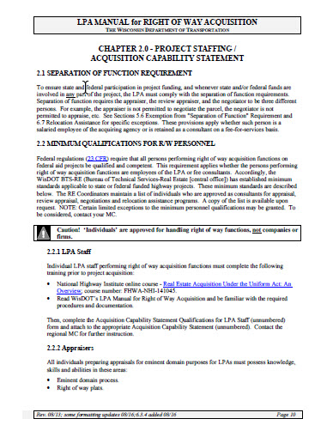
Consulting – Existing Policy
LPA Manual for Right of Way Acquisition – Chapter 2
Notes:
HAND OUT – existing LPA manual chapter 2.0
This is the current verbiage in the LPA RE Manual – It is pretty simple and vague
So with the elimination of the MC, the way WisDOT conducts its oversight duties will most likely be changing.
Up to this point we have been able to rely on the MCs to do detailed reviews of documentation. They have been instrumental in catching errors, explaining procedures, and guiding the LPA through the acquisition process. With this luxury disappearing, it’s going to be even more important for local municipalities to rely on our approved LPA consultants to provide expert services.
With that said WisDOT is looking at adding:
A continuing education component
A performance evaluation process for standard of practice
A project evaluation process
And a poor performance standard of practice
We will also be evaluating how LPA staff are approved for conducting their own acquisition services.
Again – this is completely in DRAFT mode and we are looking for all suggestions and recommendations - this needs to benefit all parties – it’s not intended to make it even more difficult for consultants doing LP work

Slide 44
Consulting – Proposed Policy
Add the following:
NOTE TO ALL CONSULTANTS:
The Statewide LPA RE Facilitator and Regional LPA RE Coordinators review all requests and will either approve or deny them. If denied, a reason will be sent via email. If approved, an email will be sent along with a LPA Approved Consultant Acknowledgement form (new form). This form must be signed, dated and returned before the consultant’s name will be added to the appropriate list.
DRAFT

Slide 45
Consulting – Proposed Policy
Add the following:
2.2.6 LPA Consultant Continuing Education/Expertise
Up to date on all the process, procedures, and requirements
Training / continuing education opportunities
DRAFT
Notes:
2.2.6 LPA Consultant Continuing Education/Expertise
The LPA Sponsor chooses its consultants from WisDOT’s Statewide List of Approved LPA Fee Appraisal Consultants and the Statewide List of Approved Fee Negotiation and/or Relocation Consultants lists. All consultants on this list are expected to be the experts in their chosen field. That includes being up to date on all the process, procedures, and requirements listed in both The Real Estate Program Manual (REPM) and this document, the LPA RE manual.
Periodically, WisDOT will offer real estate or appraisal related seminars, webinars, and trainings free of charge. It is expected that LPA approved consultants will always RSVP to invitations to these events. Attendance is taken at all events and attendees are cross referenced with the approved LPA lists. (If a consultant cannot make an offered event he/she must still RSVP with the reason for not attending.) All seminars and trainings offered will be posted on the Local Program Agency (LPA) Real Estate Acquisition Information website. All webinars will be posted on the WisDOT LPA RE website which will allow the consultant to fulfill the training requirement. The consultant should notify the Statewide LPA RE Facilitator upon completion (contact information found on the LPA RE website).
Up to date on all the process, procedures, and requirements listed in both The Real Estate Program Manual (REPM)
and
LPA approved consultants will always RSVP to invitations to these events. Attendance is taken at all events and attendees are cross referenced with the approved LPA lists. (If a consultant cannot make an offered event he/she must still RSVP with the reason for not attending.)

Slide 46
Consulting – Proposed Policy
Add the following:
2.2.7 LPA Consultant Performance and Evaluation
Consultant Standard of Practice
Up to date on all procedures and practices. The LPA relies on the consultant to provide expert guidance and to know all of the Federal and State regulations and laws. It is expected that the consultant will be familiar with both this manual and the REPM.
Know what type documentation is required, where to find the up to date documents and how to properly fill them out.
DRAFT
Notes:
2.2.7 LPA Consultant Performance and Evaluation
Consultant Standard of Practice
Approved consultants are expected to be up to date on all procedures and practices. The LPA relies on the consultant to provide expert guidance and to know all of the Federal and State regulations and laws. It is expected that the consultant will be familiar with both this manual and the REPM.
Proper documentation is paramount in the local program, and any consultant on the approved lists should know what type documentation is required, where to find the up to date documents and how to properly fill them out. The MCs and LPA RE coordinators are available to discuss any concerns and answer questions however they should not be relied upon for quality control.
Note: The official manuals, forms, and documents are found on the Local Program Agency (LPA) Real Estate Acquisition Information website and is subject to change without notice. The consultant should make it a practice to peruse the Table of Contents for both the REPM and the LPA RE manual regularly. This is where notification of changes are easily seen.
Consultant Project Evaluation
All consultants (and sub-consultants) hired by an LPA Sponsor will be evaluated by the regional MC upon either Cert. 1. The LPA Consultant Performance Assessment-Negotiator/Relocation Agent form (lpa2127) and The LPA Consultant Performance Assessment-Appraiser/Review Appraiser form (lpa2128) can be found on the LPA real estate website.
The evaluation will be used as a tool in verifying that the consultants listed on the LPA Approved List of Negotiation/Relocation/Appraiser Consultant lists are adequately performing by:
Meeting deadlines, especially PS&E deadline
Guiding LPA Sponsors throughout the project
Knowing the process, procedures, and requirements as listed in all of the manuals (REPM, FDM, LPA RE manual, etc.)
Submitting correct documentation in a timely manner

Slide 47
Consulting – Proposed Policy
2.2.7 LPA Consultant Performance and Evaluation CONT.
Consultant Project Evaluation
LPA Consultant Performance Assessment-Negotiator/Relocation Agent form (lpa2127)
LPA Consultant Performance Assessment-Appraiser/Review Appraiser form (lpa2128) can be found on the LPA real estate website.
DRAFT
NOTE: The evaluation will be used as a tool in verifying that the consultants listed on the LPA Approved List of Negotiation/Relocation/Appraiser Consultant lists are adequately performing.
Notes:
Consultant Project Evaluation
All consultants (and sub-consultants) hired by an LPA Sponsor will be evaluated by the regional MC upon either Cert. 1. The LPA Consultant Performance Assessment-Negotiator/Relocation Agent form (lpa2127) and The LPA Consultant Performance Assessment-Appraiser/Review Appraiser form (lpa2128) can be found on the LPA real estate website.
The evaluation will be used as a tool in verifying that the consultants listed on the LPA Approved List of Negotiation/Relocation/Appraiser Consultant lists are adequately performing by:
Meeting deadlines, especially PS&E deadline
Guiding LPA Sponsors throughout the project
Knowing the process, procedures, and requirements as listed in all of the manuals (REPM, FDM, LPA RE manual, etc.)
Submitting correct documentation in a timely manner

Slide 48
Consulting – Proposed Policy
2.2.7 LPA Consultant Performance and Evaluation CONT.
Poor Performance by a Consultant or Sub-Consultant
The WisDOT LPA RE Coordinator will contact the consultant in regards to inadequate performance and make suggestions for ways to improve. Continued inadequate/poor performance will result in removal of the consultant’s name from the LPA approved consultant list until corrective measures (to be determined) are done.
DRAFT
Notes:
Poor Performance by a Consultant or Sub-Consultant
The WisDOT LPA RE Coordinator will contact the consultant in regards to inadequate performance and make suggestions for ways to improve. Continued inadequate/poor performance will result in removal of the consultant’s name from the LPA approved consultant list until corrective measures (to be determined) are done.

Slide 49
3. Training
Upcoming:
Notes:
Most of these trainings don’t have a firm date – but we are working on it

Slide 50
Training
Summary of recent Test Webinar
Proposed Upcoming Training Offerings
Training Request / Suggestions

Slide 51
Training - Summary of Test Webinar

Slide 52
Training - Summary of Test Webinar
Key Results of the Follow-up Questionnaire
65% of the participants completed the voluntary questionnaire
10% were LPA
60% were LPA consultants
25% WisDOT staff
5% MC staff
When asked how long a webinar should last participants responded with…(could choose all that applied)
38% One hour or less
62% 1 – 2 hours max
14% 2 -3 hours max
5% Would prefer IN-PERSON training

Slide 53
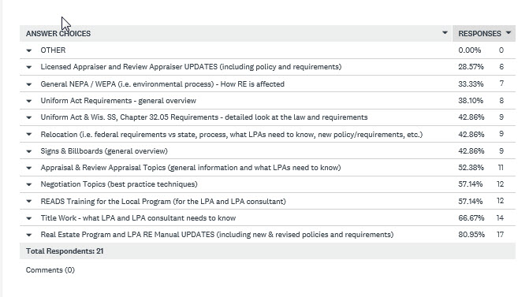
Training - Summary of Test Webinar
Q: Choose the training topics that interest you (check all that apply)

Slide 54
Training - Proposed Upcoming Training Offerings (webinars)
Nov – ’17 UPDATE Clear Title Policy and Acquisition & Negotiation Tips
2 HR Webinar
Overview: This webinar will go into detail over the revised clear title policy and requirements. It will also include best practice techniques regarding negotiation. It will discuss strategies for keeping a project on schedule and suggestions on negotiating with property owners (such as explain and obtaining partial releases).
Speaker(s): WisDOT LPA RE Staff and possible LPA negotiator consultant
Target Audience: Local Program Agency (LPA) staff, and LPA consultants
Nov/Dec – ’17 Relocation in the Local Program – What you need to know
2 HR Webinar
Overview: This webinar will go the revised policy, process, and requirements for local program and connecting highway projects. It will discuss the differences between Federal and State regulations and laws and how it affects a project.
Speaker(s): WisDOT – Kassandra Walbrun
Target Audience: LPA staff and LPA relocation consultants and consultants who want to be approved to be on the LPA consultant list
DRAFT

Slide 55
Training - Proposed Upcoming Training Offerings (webinars)
Early 2018 LPA Consultant – New Policy Changes & Evaluation/Approval Process
1 HR Webinar
Overview: This webinar will go over the revised LPA RE manual language in Chapter 2.2 Minimum Qualifications for R/W Personnel and how it will affect existing approved consultants and new consultants looking to get approved. It will go into detail the new evaluation policy and requirements.
Speaker(s): WisDOT LPA RE Staff
Target Audience: Local Program Agency (LPA) staff, LPA consultants. WisDOT staff involved in the LP
TBD Real Estate Program Manual (REPM) and LPA RE Manual UPDATES
2 HR Webinar
Overview: This webinar will go into detail over new and revised policies and requirements (i.e. partial release, license agreements, relocation, consultants, RFPs, existing ROW vs ROW bought in anticipation, etc.).
Speaker(s): WisDOT LPA RE Staff
Target Audience: WisDOT Local Program staff and associated RE staff, Local Program Agency (LPA) staff, and LPA consultants.
DRAFT

Slide 56
Training - Proposed Upcoming Training Offerings (webinars)
TBD Introduction to READS for the Local Program & Connecting Hwy
1 HR Webinar
Overview: This webinar will be a general overview of what READS is and how it is going to be used in the Local Program. It is intended to demonstrate to LPAs interested in participating in the pilot program how READS will be used, the benefits to a project. It will illustrate to WisDOT Local Program staff and its MCs how oversight will be positively affected.
Speaker(s): WisDOT – Drew Kottke, Camille Wilcox; LPA RE staff; and Teresa McClung?
Target Audience: WisDOT Local Program and connecting highway staff; LPA staff & WisDOT regional offices who have an upcoming project and is interested in participating in the pilot program; and LPA consultants
TBD READS Training for the Local Program & Connecting Hwy– Pilot Projects
2 – 4 HR TRAINING ON LOCATION
Overview: This is personalized READS training intended to be taught in person at the closest WisDOT region office to the LPA. The intention is to have a pilot project in each of the five regions – either an LPA project or a connecting highway project. Note, this should be a project billable task (?)
Speaker(s): WisDOT – Camille Wilcox and LPA RE Staff
Target Audience: The participating LPA and LPA consultant, and WisDOT LPA RE Coordinator.
DRAFT

Slide 57
Training - Proposed Upcoming Training Offerings (webinars)
Various TBD Connecting Hwy Training for WisDOT Staff
2 – 4 HR TRAINING ON LOCATION
Overview: This training will be held at each WisDOT office who is or is thinking about using its staff to acquired ROW on connecting highway projects (CH). This hand-on training will involve reviewing the differences between traditional projects and CH projects, tasks, requirements, process, etc.
Speaker(s): WisDOT LPA RE Regional Coordinator and KP
Target Audience: WisDOT RE Staff who are or will be involved in CH projects
12/12/17 AASHTO Peer Exchange with SDOTs
TO BE VERIFIED 2 HR Webinar
Overview: This webinar will be hosted by AASHTO using its webinar software. WisDOT will co-host and mediate. This meeting will include general topics that affect RE at the SDTOs but will also have LPA specific topics (TBD). Some topics of interest are:
Are SDOTs considering taking federal funds out of the LP?
How are SDOT running their LPA – centrally located or regional staff?
How is training conducted?
Working with consultants
Partial Release policy
Speaker(s): WisDOT LPA RE Staff
Target Audience: SDOTs
DRAFT

Slide 58
Training

Slide 59
4. suggestions
Local Program in RE Oversight:
Notes:
Oversight improvements / suggestions

Slide 60
SUGGESTIONS FOR SAVINGS &EFFICIENCIES

Slide 61
THANK
YOU!

