Slide 1
Litigation Issues and Case Law Update
Assistant General Counsel
Kathleen M. Batha
Assistant Attorney General
Peter S. Rank
September 28, 2017

Slide 2
118th Street Kenosha, LLC v. Wisconsin DOT
2014 WI 125
359 Wis. 2d 30, 856 N.W.2d 486
Wisconsin Supreme Court
Decided December 10, 2014

Slide 3
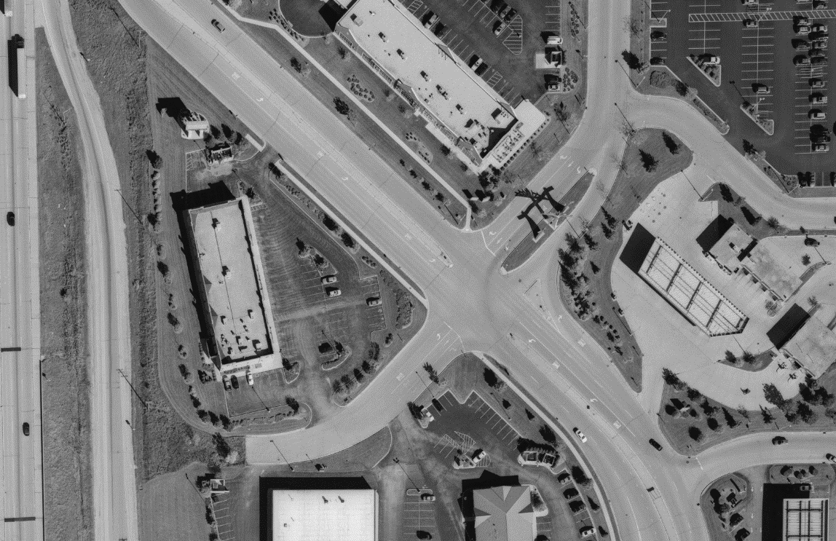
Before aerial

Slide 4
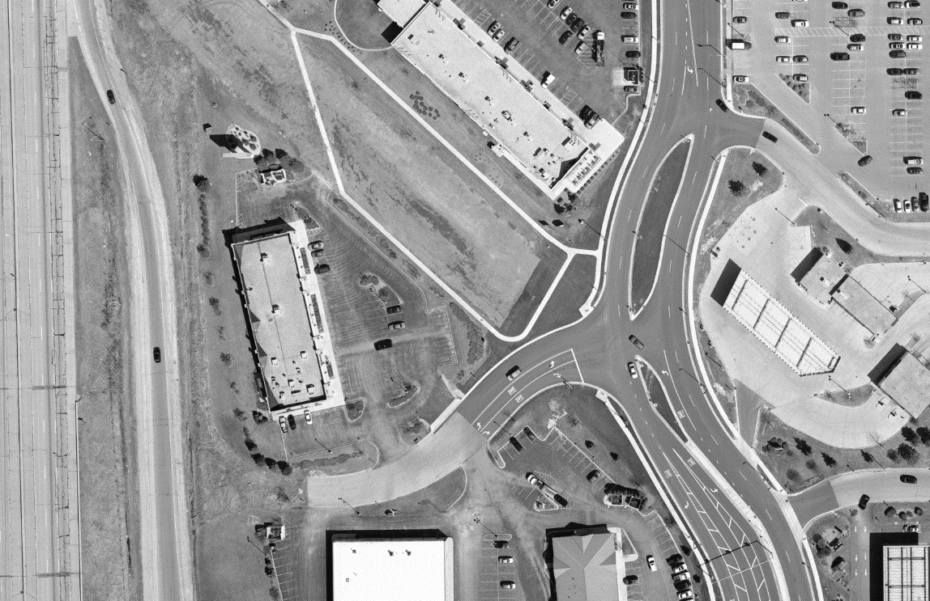
After aerial

Slide 5

Procedural History:
DOT recorded an award of damages for a temporary limited easement (TLE) to reconfigure a single driveway connection onto 74th Place, into a double-throated driveway onto 74th Place.
Separately, 118th Avenue was relocated farther to the east of the parcel.
No property was taken from the parcel.
The parcel’s boundaries remained intact.

Slide 6
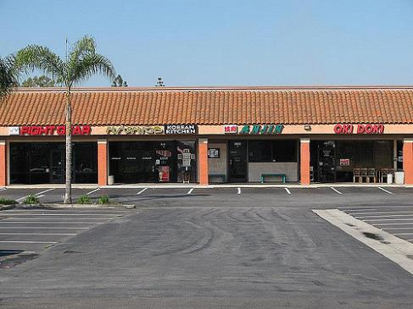
Supreme court’s recitation of the facts in 118th Street:
“The LLC owns commercial property consisting of a four-store shopping center in the City of Kenosha. Before 2010 the commercial property had direct access to 118th Avenue by a driveway onto 118th Avenue and indirect access to 118th Avenue by a driveway onto 74th Place, a private road that intersected with 118th Avenue.”
¶2 (emphasis added).

Slide 7

DOT’s three relevant acts…
In 2010 the DOT:
(1) relocated 118th Avenue to the east
one block, thus eliminating the commercial property's direct access to 118th Avenue;
(2) acquired a temporary limited easement [.262 acres] that authorized the DOT to construct a new double-throated driveway to 74th Place; and
(3) constructed that new driveway onto 74th Place.

Slide 8

The “after” condition:
In the after condition, the property had two driveways to 74th Place, indirect access to 118th Avenue via 74th Place, and no direct access to 118th Avenue.
DOT paid $21,000 for TLE.
The parties stipulated
that $21,000 was adequate
compensation for the TLE.

Slide 9

The LLC’s alleged damages due to the highway’s relocation
The LLC hired an appraiser who “determined that the commercial property's value declined by $400,000 because the relocation of 118th Avenue caused the commercial property to lose direct access and proximity to 118th Avenue.”

Slide 10

The LLC attempted to glue 1) the TLE to 2) the highway relocation
“Because the temporary limited easement and the relocation of 118th Avenue were both part of the same greater highway reconstruction project, the LLC argues its award for the temporary limited easement under § 32.09(6g) should include damages for the commercial property's decline in value caused by the relocation of 118th Avenue.” ¶3.

Slide 11
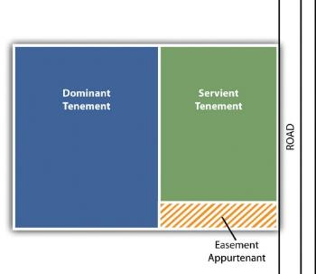
Wis. Stat. sec. 32.09(6g):
“In the case of the taking of an easement, the compensation to be paid by the condemnor
shall be determined by deducting from the
fair market value of the whole property
immediately before the date of evaluation, the fair market value of the remainder immediately after the date of evaluation, assuming the
completion of the public
improvement […].”

Slide 12

DOT moves to exclude any “damages” due to the highway relocation
In the circuit court, DOT filed a motion in limine to prohibit property owner from introducing any evidence related to seeking compensation “for any item whatsoever other than the temporary limited easement.”
The Circuit Court granted the motion, thus
giving DOT the win in circuit court.

Slide 13
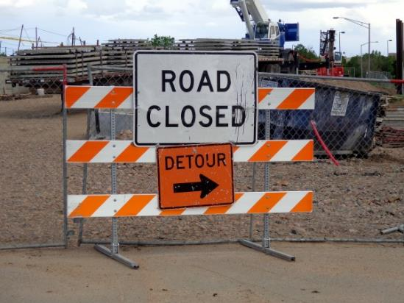
Circuit court’s reasoning:
The circuit court concluded that the LLC's loss of direct access and proximity to 118th Avenue “was caused by the vacation of the street [ 118th Avenue], not by the taking of any property from the plaintiff.”

Slide 14

The court of appeals reversed the circuit court…
On November 20, 2013, the court of appeals reversed the circuit court's decision granting the DOT's motion in limine. […] The court of appeals reasoned that “the temporary easement was integrally connected with the property's loss of direct access and proximity to 118th Avenue.”

Slide 15

DOT files a petition for review in the Wisconsin Supreme Court
The supreme court granted the petition.

Slide 16

In the Wisconsin Supreme Court
DOT argued the LLC's damages for the temporary limited easement may not include damages for the LLC's loss of direct access and proximity to 118th Avenue because the temporary limited easement did not cause the LLC to lose direct access and
proximity to 118th Avenue.
Instead, according to the DOT, the
relocation of 118th Avenue caused
the loss of direct access to 118thAvenue.

Slide 17

Relevant Wisconsin Caselaw
“The State may exercise its police power to authorize the relocation of a highway. Chicago & N.W. Ry. Co., 178 Wis. at 491, 188 N.W. 86 [1922] (‘The state has ample power, in the exercise of the police power, to authorize the relocation of the highway in order to protect the public....’) (citations omitted). ‘Where access to a highway is controlled under the exercise of the police power and reasonable access remains, no compensation is required.’ Schneider v. State, 51 Wis.2d 458, 462, 187 N.W.2d 172 (1971) (citing Nick, 13 Wis.2d 511, 109 N.W.2d 71). Eminent domain can occur contemporaneously with the exercise of police power. Wis. Stat. § 32.09(4).” ¶ 31.

Slide 18

Wis. Stat. sec. 32.09(4)
“If a depreciation in value of property results from an exercise of the police power, even though in conjunction with the taking by eminent domain, no compensation may be paid for such depreciation except as expressly allowed in subs. (5)(b) and (6) and s. 32.19.”

Slide 19
Police Power and Eminent Domain May Both Be Exercised in Same Project
“Distinct projects are frequently undertaken during a highway construction project, but that does not necessarily merge each project into one single compensable act. We explained in Jantz [1974] that the fact “[t]hat both undertakings are related to a single overall highway improvement purpose does not merge the actions into a single act....”

Slide 20
  Jantz v. DOT, 63 Wis. 2d 404, 217 N.W.2d 266 (1974)
  Pre-project (1966) Post-project (2003)

Slide 21

Jantz v. DOT
Jantz sought damages for a partial taking of land that occurred during a highway relocation. Jantz owned a bar and grill that abutted USH 41–45
and Maple Road in
Washington County.
Jantz's property had
access to Highway 41–45
only via Maple Road.

Slide 22
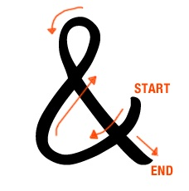
Jantz Project Described
DOT acquired .38 acres of Jantz's land adjacent to Highway 41–45. The property taken did not include Jantz's point of access to the highway. The DOT built additional highway lanes on the strip of land acquired from Jantz. DOT also relocated Maple Road. Jantz's property maintained access to Highway 41–45 via Maple Road. Jantz tried to persuade the court that the value of her bar and grill declined because the roadway relocation left her with circuitous access to the highway.

Slide 23

118th Street court discusses Jantz, cont’d.:
¶ 47. “On appeal, we upheld the circuit court's exclusion of […] evidence [that the circuity of access or change in grade reduced the value of Jantz's property]. We reasoned that the relocation of Maple Road was separate from the partial taking of land. In other words, damages for the circuitous access to the relocated highway were not included in the compensation for the partial taking because those damages were not ‘a consequence of the taking of .38 acre of land....’ ¶ 48 (citations omitted).

Slide 24

A Taking Does Not Necessitate Compensation for Exercise of Police Power in Same Project
“Even if the relocation of Maple Road and the partial taking of Jantz's land were somehow ‘related to a single overall highway improvement purpose,’ that fact would not transform the partial taking claim into a valid claim for damages based on the highway project's negative effect on Jantz's business.” ¶ 48 (118th Street).

Slide 25
  Jantz v. DOT, 63 Wis. 2d 404, 217 N.W.2d 266 (1974)
  Pre-project (1966) Post-project (2003)

Slide 26

The 118th Street court, having considered Jantz, and other cases…
“Here, the temporary limited easement provided the LLC with additional access to 74th Place, but the easement did not
cause the LLC to lose direct access
and proximity to
118th Avenue.” ¶ 36.

Slide 27
118th Street court rejects application of National Auto
The court in 118th Street distinguished National Auto Truckstops, Inc. v. DOT, 2003 WI 95, 263 Wis. 2d 649, 665 N.W.2d 198, in which “the truckstop's strip of land, which contained the only points of direct access to the highway, was taken. […] The DOT used eminent domain to acquire .27 acres from the truckstop to build a frontage road on the land taken and to widen the highway to four lanes.” ¶ 52.

Slide 28

Distinguishing National Auto, cont’d
“Central to the court's determination that the evidence [that the truckstop declined in value because of its loss of two points of direct access to the highway] was admissible, was the fact that the property taken
contained the access points.” ¶ 53.

Slide 29
Summary of why National Auto does not control in 118th Street:
In 118th Street, “[u]nlike the taking in National Auto Truckstops, the temporary limited easement at issue did not cause the LLC to lose direct access and proximity to 118th Avenue.” ¶ 55.

Slide 30

“[D]amages for a partial taking cannot include damages for the impact caused by loss of access to a highway if the loss of access resulted from the relocation of the highway, rather than from the taking.” ¶ 57.

Slide 31

Police power or Eminent domain or Both?

Slide 32


Key Points
1. Relocation of a highway is not compensable (citing Chicago & N.W. Ry. Co. (1922) and other cases in support).
2. Police power (noncompensable except in rare cases) can be exercised in same project as takings under eminent domain (citing Jantz and other cases in support).

Slide 33

Key Points, cont’d.
3. If a taking does not “cause” the change in access, compensation does not properly include damages for diminution in value based on that change in access:
“The temporary limited easement at issue did not cause the relocation of 118th Avenue nor did the LLC lose direct access and proximity to 118th Avenue because of the easement. Therefore, compensation due for this temporary limited easement does not properly include damages for the commercial property's diminution in value based on its lost direct access and proximity to 118th Avenue, which resulted from the relocation of 118th Avenue.” ¶ 55.

Slide 34
Hoffer Properties, LLC v. Wisconsin Department of Transportation
Facts:
  DOT eliminated Hoffer’s direct driveway connection with STH 19, a controlled access highway
  DOT acquired .72 acres of Hoffer’s land to extend Frohling Lane to provide Hoffer’s property alternate access. Hoffer did not challenge the award as it related to the .72 acres taken.
  Hoffer argued that there should be a jury determination as to whether the alternate access was reasonable, and also to the extent of damages resulting from closing of the direct access to STH 19.

Slide 35
Hoffer Properties, LLC v. Wisconsin Department of Transportation
Holding
  Wis. Stat. § 84.25(3) authorized DOT to change Hoffer’s access to STH 19 in whatever way it deems “necessary or desirable.”
    Exercise of the police power not compensable under Wis. Stat. § 32.09 as long as alternate access is given that “does not deprive the abutting owner of all or substantially all beneficial use of the property.”
  When DOT changes an abutting property owner’s access to a controlled-access highway but other access exists, “the abutting property owner is precluded from compensation pursuant to Wis. Stat. § 32.09(6)(b) as a matter of law”
  No jury determination of reasonableness is required.

Slide 36
Hoffer Properties, LLC
“After a valid controlled-access designation has been made, however, DOT may change an abutting owner’s access to the highway without compensation, pursuant to Wis. Stat. § 84.25(3), in whatever way it ‘deems necessary and desirable’ as long as it provides other access that does not deprive the abutting owner of all or substantially all beneficial use of the property.”
The lead opinion of 3 justices suggests any claim would be through inverse condemnation and must meet that standard for a regulatory taking.

Slide 37
Hoffer Properties, LLC
Separate and Distinct Actions
“Hoffer mistakenly styles its argument upon eminent domain when in actuality it prosecutes a separate and distinct claim based upon a challenge to DOT’s exercise of the police power.”
“Two separate acts occurred . . .”
“separately exercised its power of eminent domain”

Slide 38
Hoffer Properties, LLC
Separate and Distinct Actions
Take away: It is important for the DOT to ensure the separate and distinct acts
  Police power
  Taking of property rights by eminent domain
Clearly establish the separate actions
  Through clear communication
  Through documentation that establishes the separate and distinct acts

Slide 39
Hoffer Properties, LLC
Some questions are left unanswered
The Court is careful in limiting the language of the decision to police power actions under Wis. Stat. § 84.25

Slide 40
Hoffer Properties, LLC
Some questions are left unanswered
What about police power under other statutes?
The lead opinion suggests that the language of the statute is going to be important.
  References to 84.295
  Statutory interpretation of 84.25

Slide 41
Hoffer Properties, LLC
Final take aways:
  Hoffer Properties advances the 118th St. decision affirming use of DOT’s police power under 84.25 does not require compensation expect in limited instances.
    Alternate access must exist
    And the property must not be deprived of substantially all value.
  Use of the police power is a separate distinct act.
  Be aware that access control and use of the police power under authority outside of 84.25 will be evaluated based on that statutory language.
  When faced with a police power issue - seek necessary guidance.

Slide 42
RECENT DRIVEWAY DECISIONS:
LEE AND SLATER
Lee v. WisDOT, Appeal No. 14AP2304 (Unpublished per curiam) issued August 26, 2015
Slater v. WisDOT, Appeal No. 15AP1628 (Unpublished per curiam) issued July 27, 2016

Slide 43
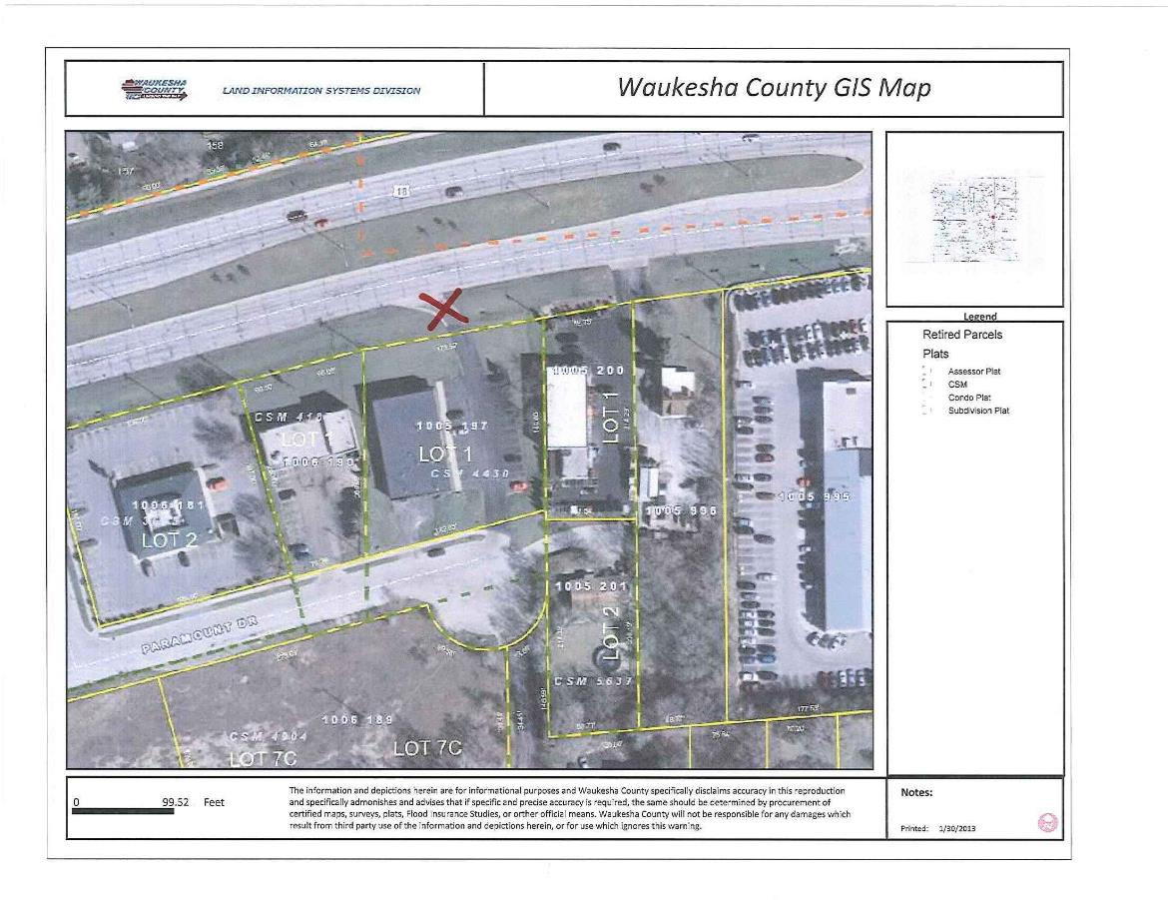
Lee Parcel

Slide 44
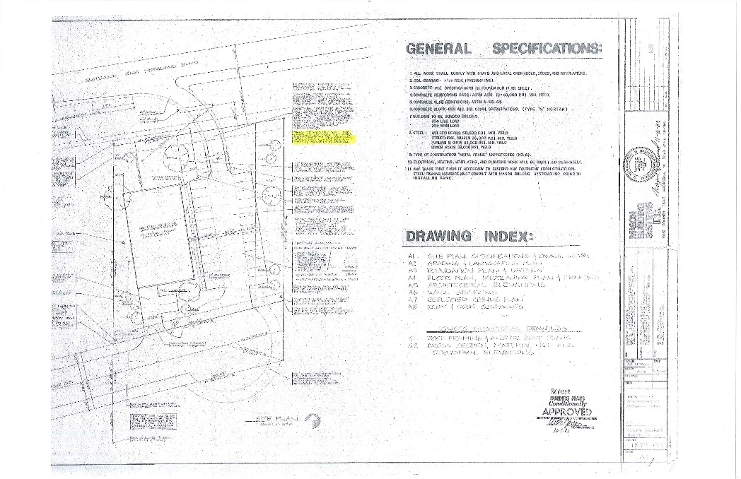
1983 Site Plan for Parcel Now Owned by Lee

Slide 45

1983 Site Plan Indicated Driveway to USH 18 was Temporary
Site plan approved by the Wisconsin Department
of Industry, Labor and Human Relations
on December 5, 1983 regarding the parcel
now owned by Lee indicates that the
USH 18 driveway was temporary
and would ultimately be removed.

Slide 46

1965 Award of Damages Leaves
Two Residential Access Points
By Award of Damages recorded December 22, 1965, WisDOT acquired a tract of land in Waukesha County, includinh “all existing future or potential common law or statutory easements or rights of access between the right of way of the highway, currently designated as [USH 18] and all of the abutting remaining real property of the owner[ …].” Excepted from this acquisition, however, was “the right of access to said highway from abutting lands by means of two residential access points on the south side of [USH 18] pursuant to the provisions of Section 86.07(2), Wisconsin Statutes.” “Said access points to be used for residential purposes only; such right to continue only so long as used for said purposes.”

Slide 47
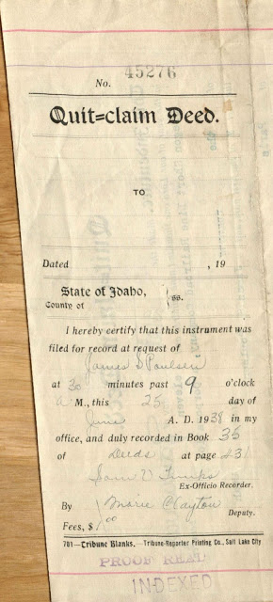
1983- One of Two Quit Claim Deeds Recorded
In 1983, the then-owner of the land now owned
by Lee, granted WisDOT “[a]ll right of title or interest
the grantors may have in any right of access between
USH 18” and their. “The purpose of this instrument
[was] to release the grantor’s rights of access to the
two residential access points allowed in the
[December 22, 1965 Award of Damages], but to reserve
to the grantors one private driveway granted to them by
a quit claim deed signed March 3, 1983.”

Slide 48
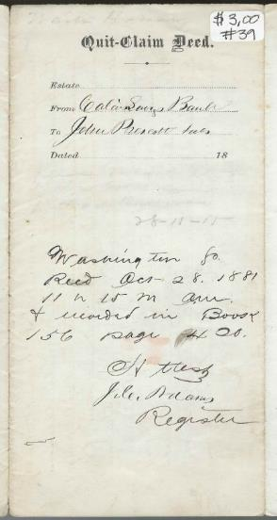
1983- The Other Quit Claim Deed
In 1983, WisDOT granted to the then-owner of the land
Western Development, “[t]he right to one private
driveway, to be constructed pursuant to the
provisions of Section 86.07(2), Wis[.] Stat[.],
between USH 18 and [land now owned
by Lee].
At some point thereafter, a one-way, right-in only driveway, was constructed to connect the property with USH 18. Lee purchased the property in 2001. The property had the right-in only driveway to USH 18, and two full driveways to Paramount Drive to the rear of the building.

Slide 49

Lee’s Driveway to USH 18 Revoked in 2013
WisDOT issued a driveway revocation to Lee in 2013, as part of an Access Management Project. Lee’s property had alternate access to the highway system by way of two driveways to Paramount Drive .

Slide 50

Division of Hearings and Appeals Upholds DOT’s Revocation of Lee’s driveway to USH 18
Lee appealed to the Division of Hearings and Appeals (DHA) from WisDOT’s driveway revocation decision.
In DHA, Lee argued that WisDOT must pay just
compensation for removal of the driveway to USH 18.
After a hearing in DHA, but before DHA issued its Decision, Lee filed a lawsuit against DOT in circuit court to seek just compensation.
While Lee’s lawsuit against DOT was pending, DHA issued its Decision upholding DOT’s revocation decision, concluding Lee had reasonable access to his property via Paramount Drive.

Slide 51
The Circuit Court and Court of Appeals Agree With Lee, that DOT is Required to Pay Just Compensation if the Driveway Connection is Removed
Applying contract law principles, the court of appeals concluded that the Quit Claim Deed in 1983, “conveys to Lee an irrevocable compensable property right because:
1. The Quit Claim Deed, under Wis. Stat. § 706.10(4), “pass[ed] all of the interest in or appurtenant to the land described which the grantor could lawfully convey.” Thus, the court reasoned DOT passed any ownership interest in the driveway connection to Lee’s predecessor.
2. DOT drafted the Quit Claim Deed and could have chosen words to make the driveway connection subject to permitting and revocation but did not do so.

Slide 52


The court of appeals, in effect, concluded that WisDOT had bargained away its police power to control driveway connections on USH 18 under Wis. Stat. § 86.07 by granting a driveway to Lee’s predecessor by Quit Claim Deed in 1983. Yet case law is clear: the state is almost never estopped (prevented) from exercising its police power.

Slide 53
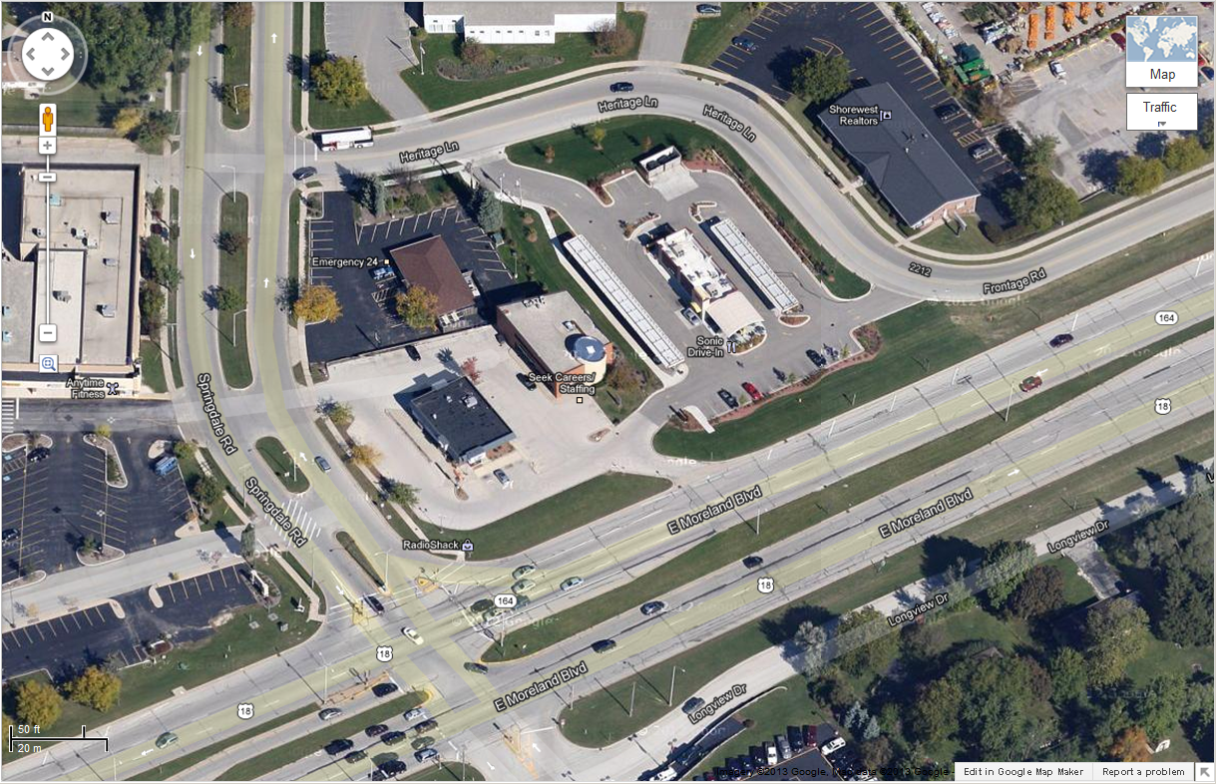
Slater v. DOT

Slide 54
Slater Facts
The Slater parcel is adjacent to USH 18 near the northeast quadrant of the intersection of USH 18 and Springdale Road, in the City of Waukesha.
The parcel has a 36 foot wide perpetual easement across the parcel to the west. The perpetual easement provides ingress and egress from the Slater parcel to Springdale Road. The Slater parcel is currently improved with an office building that includes an architectural business office, and four parking stalls. There is also a driveway to the east of the Slater parcel (to a Sonic Restaurant parking lot) marked with arrows directing traffic both east and west. There is also a driveway that provides one-way ingress from the USH 18 westbound lanes into the subject parcel; this is the “subject driveway” that was revoked.

Slide 55

1966 Driveway Permit Issued
In 1966, DOT acquired all access to the land at issue and provided the then-owner with the ability to apply for driveway permits under Wis. Stat. § 86.07(2). Also in 1966, DOT issued a permit to Sunray DX Oil Co., then-owner of land that included the parcel now owned by Slater.

Slide 56


Slater’s Driveway Permit Revoked, 2012
On September 6, 2012, DOT notified the Slaters that Permit No. 67-27-66 (issued in 1966) would be revoked under Wis. Stat. § 86.07(2) DOT explained: “the existing driveway is located within the right turn lane of the Springdale Road intersection. A driveway thus located can potentially increase the risk of crashes at the intersection […].”

Slide 57

Circuit Court Events
Slater appealed from the revocation of the driveway permit to the Division of Hearings and Appeals (DHA).
After a hearing, DHA determined there was ample evidence to support DOT’s decision to revoke the driveway permit. DHA found there was reasonable alternative access available to their property.
Slater appealed from the DHA decision to circuit court. The circuit court sent the matter back to DHA for more evidence. After the case returned to the circuit court, the circuit court reversed DHA’s decision that had been in favor of DOT.

Slide 58

DOT Appeals to Court of Appeals
The court of appeals, by law, reviews the decision of DHA, not the decision of the circuit court.
The court of appeals concluded: “The record contains substantial evidence that the Slaters have reasonable alternative access to their property from the west (via Springdale Road using the AT&T easement) and from the east (via Heritage Lane using the drive-through restaurant parking lot).”
“Because the Slaters’ property benefits from an easement, losing the driveway does not require the Slaters to trespass over the property of another to reach their property.”

Slide 59

Wisconsin Supreme Court Denies Review
Slater petitioned the Wisconsin Supreme Court for review; the petition was denied in November, 2016.

Slide 60
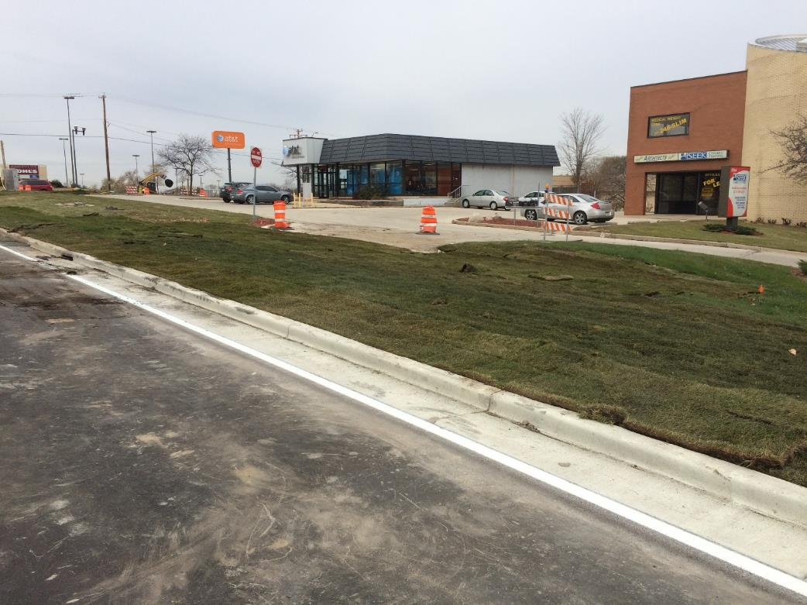
Slater Driveway Removed November, 2016

Slide 61


Slide 62
Oldies but still good (law)
The Blick Rule
Evidence of adjacent sales where the purchaser has the power to take by eminent domain are not admissible.
  No matter how comparable and physically similar. Kirkpatrick v. State, 53 Wis.2d 522, 192 N.W.2d 856
Not admissible because they do not reflect fair market value.
Rooted in the court’s opinion in Blick v. Ozaukee County, 180 Wis. 45, 192 N.W. 380 (1923)
Reaffirmed by Pinczkowski v. Milwaukee County, 2005 WI 161, ¶ 16, 286 Wis. 2d 339, 706 N.W.2d 642.

Slide 63
Oldies but still good (law)
The Blick Rule
“[G]iven the rationale behind the Blick line of cases, it makes no difference whether Pinczkowski sought to offer evidence of the sale price for the adjacent properties directly or whether she sought to have her appraisers rely on those prices as a basis for their estimates of value.” Pinczkowski, 2005 WI 161, ¶ 39.
The court went on to say: “The adjacent property sales were inherently unreliable indicators of market value and, in that sense, not comparable sales.”

Slide 64
Oldies but still good (law)
Offers to purchase
Pinczkowski also reaffirmed long standing Wisconsin law that unaccepted offers to purchase are not admissible as evidence of fair market value.
But… exceptions may arise that would allow for the admission of offers “when made with actual intent and pursuant to actual effort to purchase.” Fox Wisconsin Theatres, Inc. v. City of Waukesha, 253 Wis. 452, 456, 34 N.W.2d 782 (1948).

Slide 65
Oldies but still good (law)
Offers to purchase
Take away: don’t rely solely upon offers to purchase to support a conclusion of fair market value
But, if there is a well supported bona fide offer on a property, it may be relevant to support a conclusion fair market value that is supported by comparable sale data.

Slide 66
Oldies but still good (law)
Prior sale of the same property
“Evidence of the price paid for condemned real property on a sale prior to the proceedings in which condemnation is sought is generally admissible in such proceedings, at least where the sale is voluntary, is not too remote in point of time, or is not otherwise shown to have no probative value.” Huse v. Milwaukee County Expressway Comm, 16 Wis.2d 225, 228, 114 N.W.2d 429 (1962).
In Huse the lapse of time was 11 years from prior sale to condemnation.

Slide 67
Oldies but still good (law)
Prior sale of the same property
Admissibility will be based on the facts of the case, and the discretion of the trial court. The standard is whether it has probative value.
Generally the prior sale price is admissible- whether the sale was too remote in time, not representative of current market, etc goes to the weight of the evidence not admissibility. Herro v. Department of Natural Resources, 67 Wis.2d 407, 423, 227 N.W.2d 456 (1975).

Slide 68
Oldies but still good (law)
Prior sale of the same property
Take aways- prior sales can be relevant
And not just to support the final conclusion of the fair market value
  From a litigation stand point a prior sale price can be an anchor number for the decision maker.

Slide 69
Sai Ram v. DOT
Wisconsin Court of Appeals No. 2014AP133
December 18, 2014
Unpublished per curiam decision
Or, Why an Administrative Revision is Inadmissible in a Valuation Trial, and Should Fail to Provide a Basis for a Successful Right to Take Action

Slide 70


Sai Ram: The Facts
In a valuation case in circuit court filed by Sai Ram against DOT under Wis. Stat. § 32.05(11), Sai Ram demanded that DOT produce the appraisal report upon which the jurisdictional offer (JO) was based.
DOT’s award of damages = $250,000
DOT’s pre-JO appraisal report = $67,000 for just compensation
Another DOT appraisal report, made after the award = $80,000
Sai Ram’s pre-award appraisals = $244,000 and $950,000

Slide 71

What was Sai Ram’s goal? To convince the court to admit the Administrative Revision into evidence to increase the chances of an attorney fee award.
Sai Ram argued that because of the wide gap between DOT’s pre-award appraisal of $67,000 and the JO amount of $250,000, it followed that, in Sai Ram’s logic, the JO was not based on that appraisal.
Sai Ram tried to persuade the court that DOT violated Wis. Stat. § 32.05(2)(b), that the condemnor provide the condemnee with “a full narrative appraisal upon with the jurisdictional offer is based.”
Short of an appraisal concluding $250,000, Sai Ram asked that DOT produce the paperwork on which the $250,000 JO was based.

Slide 72

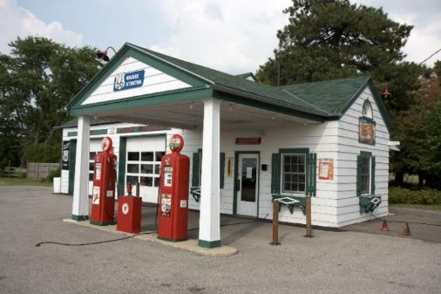
The Administrative Revision
DOT provided Sai Ram with a copy of its Administrative Revision which compared elements of DOT’s $67,000 appraisal with Sai Ram’s appraisal of $950,000.
The Administrative Revision contained a Justification that, in part, asserted that DOT’s pre-JO $67,000 appraisal failed to consider a cost to cure for realigning the entrance to Sai Ram’s gas station, whereas Sai Ram’s $244,000 appraisal did so. The authors of the administrative Revision stated they gave more
weight to the $244,000 appraisal.

Slide 73

DOT Moves to Exclude the Administrative
Revision
DOT filed a motion to exclude the Administrative Revision.
The circuit court granted DOT’s motion, concluding that the Administrative Revision was an “offer of compromise.”
Under Wis. Stat. § 904.08, with some exceptions not relevant here,
“Compromise and offers to compromise. Evidence of furnishing or offering or promising to furnish, or accepting or offering or promising to accept, a valuable consideration in compromising or attempting to compromise a claim which was disputed as to either validity or amount, is not admissible to prove liability for or invalidity of the claim or its amount. Evidence of conduct or statements made in compromise negotiations is likewise not admissible. […]”

Slide 74

What Else Was DOT Not Required to Produce?
Despite Sai Ram’s request, the judge ruled that DOT did not have to provide an appraisal report that equaled the amount of the JO.
Editor’s side note: The circuit court transcript shows: when Sai Ram argued, regarding the $250,000 administrative revision, that DOT "must return and produce a formal appraisal report by a licensed appraiser that justifies this $250,000 jurisdictional offer," the court responded, in part: "after what we've been through in this country, they're supposed
to call around to an appraiser and say we would like you to
appraise this property for $250,000—we would all be in jail.”

Slide 75


The Jury Trial
Results: the jury awarded Sai Ram $100,000.
Where the basic award = $250,000, Sai Ram was required to pay back $150,000. (Wis. Stat. § 32.05(11)(a)).
Editor’s side note: If the court had allowed the Administrative Revision into evidence, a hypothetical jury split may have been between $250,000 and $950,000, or just compensation of $600,000, resulting in eligibility for attorney fees under Wis. Stat. § 32.28.

Slide 76

Sai Ram’s Unsuccessful Appeal to the Court of Appeals
Among other things, Sai Ram argued that because DOT failed to provide it with the appraisal on which the JO was based, the case should be remanded to the circuit court for a new trial.
The Court of Appeals rejected Sai Ram’s argument, concluding that any such argument would have to be raised in a Right to Take case under Wis. Stat. § 32.05(5), filed within 40 days of the issuance of the JO.

Slide 77

Implications of the Sai Ram Decision
Looking ahead…

Slide 78


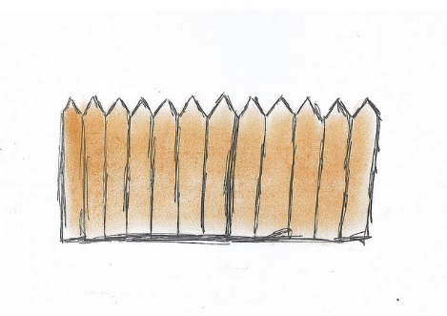

What if a Landowner Files a Right to Take Case Based on an Administrative Revision?
If a landowner files a Right to Take case under Wis. Stat. § 32.05(5) alleging that DOT failed to provide the landowner with an appraisal on which the JO was based (because the JO and the pre-JO appraisal reflect different conclusions of just compensation), there are numerous statutory and case law obstacles that the landowner must surmount.

Slide 79
Defenses in Right to Take Actions Based on Administrative Revision
1. The JO is based on DOT’s pre-JO appraisal even if the amount of just compensation reached in the pre-JO appraisal and the amount of the JO do not match.
Provisions in Wis. Stat. ch. 32, and case law, encourage DOT to negotiate prior to issuing the JO. E.g., Wis. Stat. § 32.05(2a), “Negotiation. Before making the jurisdictional offer provided in sub. (3), the condemnor shall attempt to negotiate personally with the owner or one of the owners or his or her representative of the property sought to be taken for the purchase of the same. In such negotiation the condemnor shall consider the owner's appraisal […].”

Slide 80



Wis. Stat. § 32.28(3)(d)
(3) In lieu of costs under ch. 814, litigation expenses shall be awarded to the condemnee if: […]
“(d) The award of the condemnation commission under s. 32.05 (9) or 32.06 (8) exceeds the jurisdictional offer or the highest written offer prior to the jurisdictional offer by at least $700 and at least 15 percent and neither party appeals the award to the circuit court”
Query: If the Legislature intended to preclude the condemnor from exercising its discretion to modify a pre-JO offer, for any reason, why would there be a reference within the statute to “highest written offer prior to the jurisdictional offer”?

Slide 81

Benson v. City of La Crosse, 101 Wis. 2d 691, 697, 305 N.W.2d 184 (Ct. App. 1981)
Citing Wis. Stat. § 32.28(3)(d) (the litigation expenses statute), the court observed: “The legislative purpose in providing litigation expenses to a claimant who improves a municipality’s highest written offer or jurisdictional offer by at least 15 percent is to encourage the municipality to engage in meaningful negotiations.”

Slide 82

Herro v. DNR, 67 Wis. 2d 407, 430, 227 N.W.2d 456 (1975) (citing
Connor v. Michigan Wisconsin Pipe Line Co., 15 Wis. 2d 614, 113 N.W.2d 121 (1962))
This court has held that offers to purchase land made by the condemnor during negotiations prior to the institution of condemnation proceedings are privileged and inadmissible.
The basis for the rule is the policy to encourage settlements.”

Slide 83
Conclusion
In Wisconsin, DOT’s determination of just compensation, while beginning with an appraisal, or series of appraisals, is followed by a statutorily mandated attempt at negotiation. There are minimum standards that appraisers must follow in determining just compensation. (Wis. Stat. §32.09). Although these rules guide appraisers in their analysis, this is merely a first step leading to the ultimate determination of just compensation. In the period between the first appraisal and the JO, the parties may attempt to convince each other of the strength of their relative views of the land’s value. The JO will be based on DOT’s pre-JO appraisal, but it need not reflect the exact amount of just compensation found by DOT’s appraiser.

Slide 84
A (slightly more recent) Oldie:
Income Approach
Leathem Smith Lodge, Inc. V. State of Wisconsin, 94 Wis.2d 406, 288 N.W.2d 808 (Wis. 1980).
Partial taking case
Issue: was trial court’s refusal to admit evidence of value utilizing the income method appropriate.
Holding: “Wisconsin law holds that income evidence is never admissible where there is evidence of comparable sales” citing Rosen v. Milwaukee, 72 Wis.2d 653, 662-63, 242 N.W.2d 681 (1976)

Slide 85
Income Approach
Reaffirmed in Rademann v. State Dept. of Transp., 2002 WI App 59, 252 Wis.2d 191, 252 Wis.2d 191.
“As a starting point, it should be noted that income evidence is never admissible where there is evidence of comparable sales.”
Income evidence involving commercial properties is inadmissible “because income is dependent upon too many variables to serve as a reliable guide in determining fair market value.”
“…it is nearly impossible to ascertain how much of the income can be attributed to the owner’s management …”

Slide 86
Income Approach
But…
The income approach may be appropriate in unique circumstances
(1) Profit is produced without the owner’s labor; (2) profits derived from the property’s use is its chief value; (3) When the property is so unique no reliable comparable sales data is available.
This comes from the lead opinion of Vivid, Inc. v. Fiedler, 219 Wis.2d 764, 580 N.W.2d 644 (1998) (case involving valuation of a billboard) citing Leathem Smith

Slide 87
Income Approach
But…
Don’t forget the cost approach to value improvements of unique special use properties
Nestle USA v. Wisconsin Dept. of Revenue, 2011 WI 4, 331 Wis.2d 256, 795 N.W.2d 46
  Nestle is a tax assessment case. The property was improved by a infant formula production facility, a highly specialized manufacturing plant not easily converted to other uses. Nestle appealed the tax valuation that was based upon the cost approach.
  Holding: DOR properly used the cost method in valuing the property.

Slide 88
Income Approach
Milwaukee Rescue Mission, Inc. v. Redevelopment Authority, 161 Wis.2d 472, 468 N.W.2d 663 (1991)
Cost approach was appropriate.
The property was a “special use property” built for a specific purpose and not easily convertible to other uses.

Slide 89
Income Approach
Take aways:
  The income approach is generally inadmissible in Wisconsin
  It may be appropriate, but only in very unique situations
  And for special use properties the cost approach may be favored.

Slide 90
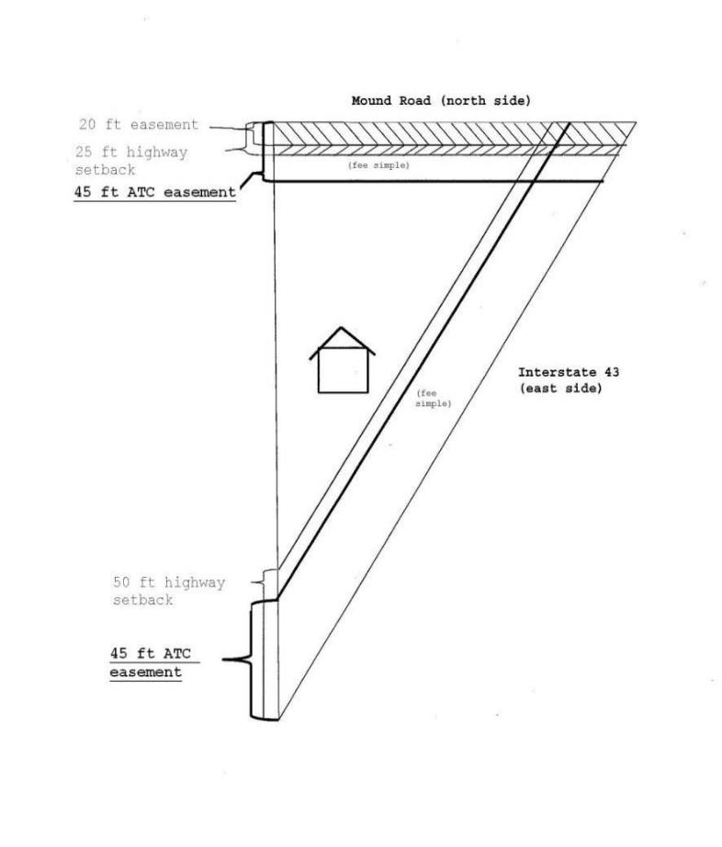
Waller v. ATC, 2013 WI 77, 833 N.W.2d 764
(Decided July 16, 2013)

Slide 91


Use of Right to Take Procedures to Compel Condemnors to Acquire Uneconomic Remnants
Kathleen Batha
Office of General Counsel
(revision of Joel V. Batha’s presentation)

Slide 92
Presentation Contents
Part 1: Implicated Statutes
Part 2: The Waller Property Acquisition
Part 3: Waller Commission Appeal and Simultaneous Right to Take Challenge
Part 4: Waller III, 2013 WI 77 (Wis. July 16, 3013)
Ramifications of the Waller III Decision

Slide 93
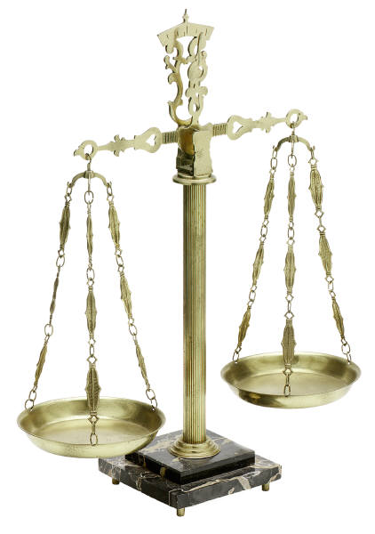
Part 1: Implicated Statutes
Wis. Stat. sec. 32.06(3m)
  Uneconomic Remnant
Wis. Stat. sec. 32.06(5)
  Right to Take
Wis. Stat. sec. 32.28(3)(b)
  Litigation Fee Shifting

Slide 94
Uneconomic Remnant Statute:
Wis. Stat. sec. 32.06(3m)
Definition. In this section, "uneconomic remnant" means the property remaining after a partial taking of property, if the property remaining is of such size, shape or condition as to be of little value or of substantially impaired economic viability.
If acquisition of only part of a property would leave its owner with an uneconomic remnant, the condemnor shall offer to acquire the remnant concurrently and may acquire it by purchase or by condemnation if the owner consents.

Slide 95
Court Action to Contest the Right of Condemnation: Wis. Stat. sec. 32.06(5)
When an owner desires to contest the right of the condemnor to condemn the property described in the jurisdictional offer for any reason other than that the amount of compensation offered is inadequate, such owner may within 40 days from the date of personal service of the jurisdictional offer […], commence an action in the circuit court of the county wherein the property is located, naming the condemnor as defendant. Such action shall be the only manner in which any issue other than the amount of just compensation […] may be raised pertaining to the condemnation of the property described in the jurisdictional offer. […].

Slide 96
Litigation Fee Shifting Statute:
Wis. Stat. sec. 32.28(3)(b)
(3) In lieu of costs under ch. 814, litigation expenses shall be awarded to the condemnee if:
(b) The court determines that the condemnor does not have the right to condemn part or all of the property described in the jurisdictional offer or there is no necessity for its taking;

Slide 97


Part 2: The Waller Property Acquisition

Slide 98
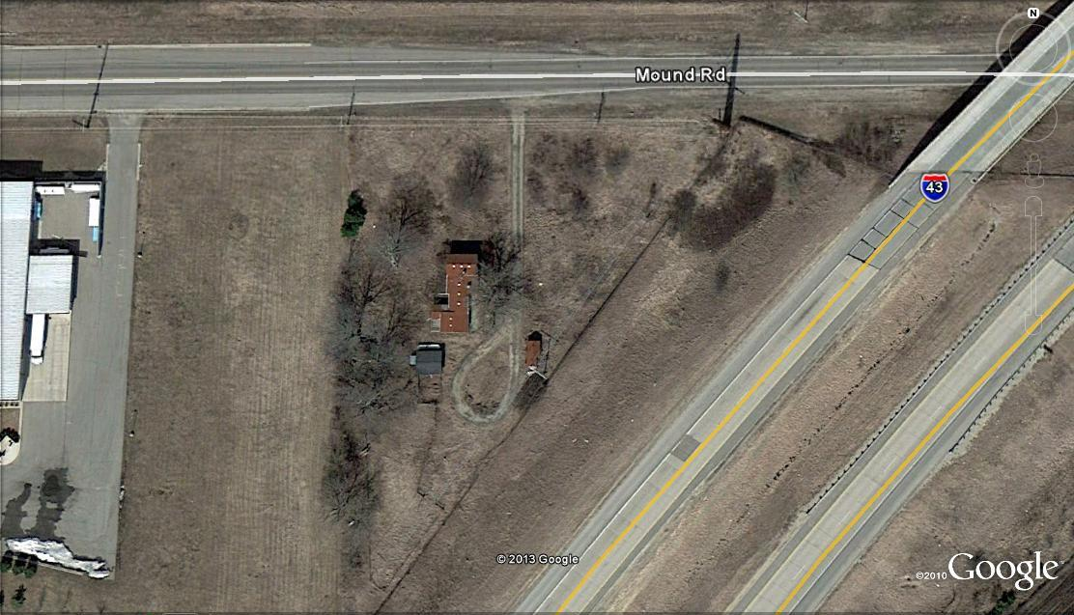
Images of the Waller Property:

Slide 99
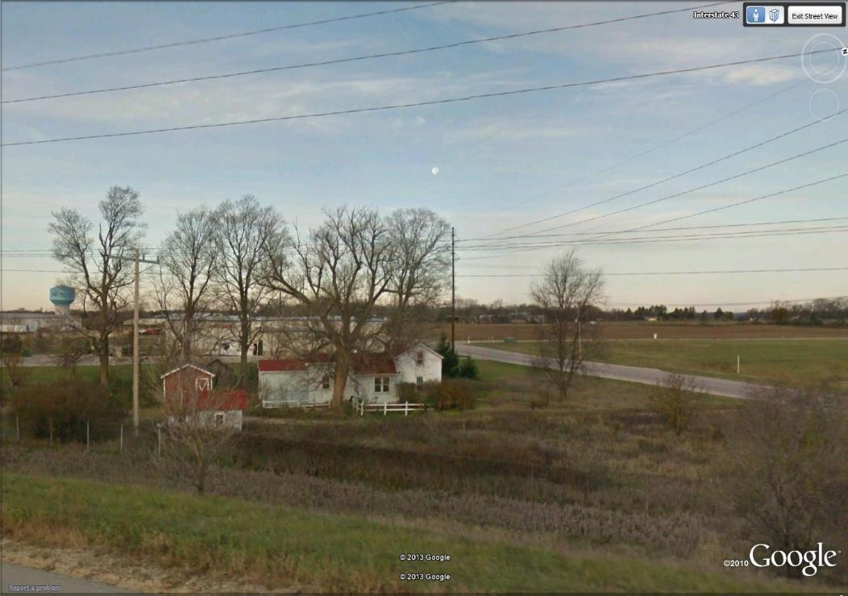
View of Waller Property looking North from I-43

Slide 100
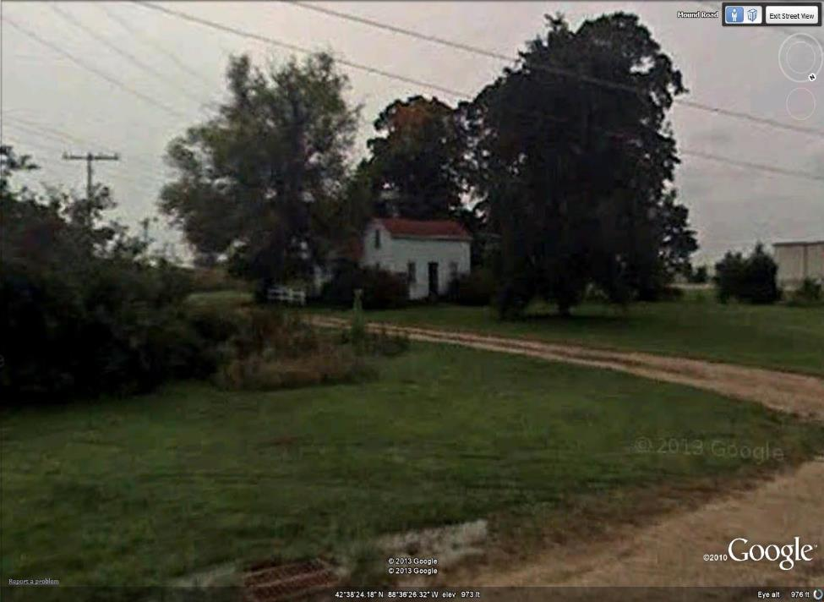
View of Waller Property looking South from Mound Road

Slide 101
Facts and Early Procedural History:
1989 Wallers purchased approximately 1.5 acres for use as residence and (farmette) hobby farm
Existing encumbrances:
  20 foot transmission line easement along north property line
  25 foot highway setback along Mound Road
  50 foot highway setback along I-43
Prior to March, 2008, ATC initiated negotiations to acquire two 45 foot utility easements for construction of high voltage overhead electrical transmission lines, which traversed two sides of triangular property
March 20, 2008, negotiations fail and ATC issues its Jurisdictional Offer

Slide 102

December 2008 – Wallers filed claim for relocation benefits with ATC – ATC denied Wallers were displaced
August 2009, the Wallers moved to new residence “after the [] transmission lines had been installed and fully charged”

Slide 103
Details of the Acquisition

Slide 104

Facts: Appraisals
  Before value:
    Rolling (for ATC) - $130K ($75.5K Land; $54.5 Improvements)
    Sullivan and Kielisch (for Waller) - $132
  After value:
    Rolling - $55,500
      “residential improvements [were] rendered totally obsolete. Highest and best use changes from improved residential to vacant industrial land.”
    Sullivan and Kielisch - $15,500
      “the restricted use of the property and the giving up of the right to control the easement area” represented a one hundred percent loss of property value to the Wallers.

Slide 105

ATC’s Various Offers:
October 8, 2007: $49K Easements Only later increased to $84,600 - Rejected
March 14, 2008: $99,500 Easements Only
  - Conditional Alternate Offer: $132K for entire property
    Required Relocation Benefits Waiver
March 20, 2008: ATC Issued Jurisdictional Offer for $99,500 Easements Only – Waller Rejected JO

Slide 106

Part 3:
Commission Appeal and Right to Take Challenge

Slide 107
Procedural History
April 25, 2008 – the Wallers filed action in Walworth County challenging ATC’s proposed acquisition under the right-to-take provisions found in Wis. Stat. sec. 32.06(5)
  alleged that ATC’s acquisition would leave them with an uneconomic remnant for their remainder property, which would therefore compel ATC to provide relocation benefits
June 11, 2008 – [Property Valuation No. 1] Condemnation Commission finds:
  FMV Before = $130K
  FMV After = $40K
  Award = $90K
Waller (by stipulation of parties) accepted Commission Award and Appealed Award to Circuit Court
Waller separately appealed circuit court denial of relief under right-to-take procedure

Slide 108
Trial Court Hearing (Kennedy, J.)
November 8, 2008. Wallers’ Right to Take Dismissed. Waller appealed.

Slide 109

Part 4:
The Long and Winding Appellate Court Journey

Slide 110
Waller v. ATC, 322 Wis.2d 255, 776 N.W.2d 612
(Wis. App. October, 2009) (Waller I )
  Court of Appeals to construe interplay between two statutes - Uneconomic remnant statute and right to take statute
Sole issue: whether the question of the existence of an uneconomic remnant is properly raised in an action under the right to take statute, Wis. Stat. sec. 32.06(5)
Held: Circuit Court should not have dismissed Wallers’ Right to Take. Decision Reversed and remanded with directions.

Slide 111
June, 2010 - Remand to Walworth County Circuit Court: (Race, J., Presiding over Right to Take and 3 day Jury Trial)

Slide 112

Jury Verdict No. 1 (Valuation No. 2)
  Jury found damages at $94K
    Special Verdict:
      Before value - $132K
      After value - $38K

Slide 113
  After subsequent evidentiary hearing, Circuit Court entered judgment dismissing Waller’s uneconomic remnant lawsuit
Waller appealed

Slide 114
Waller v. ATC, 334 Wis.2d 740, 799 N.W.2d 487 (Wis. App. May, 2011) (Waller II )
The Court of Appeals concludes: Whether the remaining property after a partial taking has “little value” or is “of substantially impaired economic viability” is a factual question for the circuit court to resolve!!

Slide 115

Waller II, Cont’d.
Held: Circuit Court Reversed and remanded with directions.
A court must first determine whether a property is an uneconomic remnant before moving on to the just compensation issue.
HMS Waller

Slide 116

January 2012 – Remand No. 2 (Carlson, J.)
Two day bench trial on right to take case on whether an uneconomic remnant existed
Most of same witnesses who testified in valuation trial testified again and their testimony was “largely the same.”
Lo and Behold - Held: Wallers’ remaining property meets the standard for an uneconomic remnant

Slide 117
Rationale for Outcome - Remand No. 2
Property suffered “substantially impaired economic viability” because:
  JO of $99,500 set damages at 76% of agreed upon before value of $130K
  Both appraisers agreed HBU after was as vacant industrial land
  Once both lines “activated” Wallers experienced “regular electronic interference” prompting health concerns for themselves and potential buyers
  Vegetation removal substantially reduced attractiveness of site and eliminated sound barrier between home and interstate highway
Final Judgment:
ATC to pay additional $47K compensation to acquire entire property
Waller to Quit Claim property to ATC

Slide 118
January, 2012 – Relocation Benefits Eligibility Tried in Walworth County Circuit Court (Carlson, J.)
Waller Testified that they moved based on ATC’s JO and appraisal conclusions that easements destroyed value of residential improvements
Dept. of Commerce staff testified that Waller home no longer decent safe or sanitary and that home had been “degraded to an industrial lot.”
Determined: Wallers displaced pursuant to Wis. Stat. sec. 32.19(4)(a)
Court found Wallers sustained $26K in costs associated with acquisition and relocation of replacement property

Slide 119
March 2012: Additional Two Day Hearing
on Litigation Expenses:
Found that ATC’s having conditioned purchase of entire property on waiver of relocation benefits constituted a failure to negotiate in good faith
When a condemnor fails to resolve the issue of uneconomic remnant prior to [issuing the JO], the cost of litigation shifts to the condemnor
Court awarded Waller $211K in litigation expenses
ATC appealed – petitioned for discretionary bypass of Ct. App., directly to Wisconsin Supreme Court, which was granted January, 2013

Slide 120
Supreme Court Review: (Waller v. ATC, 2013 WI 77, 833 N.W.2d 764, (July 16, 3013)(Prosser, J.)(Bradley dissent) (Gableman did not participate). (Waller III?)
  Held: Carlson AFFIRMED
  4 Issues:
    1. When must a property owner raise an uneconomic remnant claim? In a right to take action.
    2. Were Wallers left with an uneconomic remnant? Yes.
    3. Are the Wallers entitled to litigation expenses? Yes.
    4. Are the Wallers “displaced persons” entitling them to relocation benefits? Yes.

Slide 121
Issue 1: When Must a Property Owner Raise an Uneconomic Remnant Claim ?
    The Right to Take Statute sets out the proper and exclusive way for a property owner to raise an owner’s claim:
        When a condemnor fails to make such an offer, that failure indicates that the condemnor disputes the UR’s existence.
        When a condemnor makes an offer for an uneconomic remnant such offer acknowledges the existence of the uneconomic remnant

Slide 122

Issue 1: When to Claim UER– Cont’d.
Right to take action must be decided promptly by the court.

Slide 123

Issue Two: Were Wallers Left With an Uneconomic Remnant?
Yes. Waller’s property is uneconomic because of its size, shape and condition as to be of substantially impaired economic viability as either a residential or industrial parcel
  The easements “substantially diminished the desirability, practicality, and value of the Wallers’ property for either a residential or industrial user

Slide 124

Issue Three: Are Wallers Entitled to Litigation Expenses?
Yes. Because Waller prevailed on their uneconomic remnant claim, they were entitled to litigation expenses under sec. 32.28.

Slide 125

Issue Four: Are the Wallers Displaced Persons Entitling Them to Relocation Benefits?
Yes. Wallers were displaced persons under sec. 32.19(2)(e)1.a., because they moved “as a direct result” of ATC’s Jurisdictional Offer
  Circuit court’s factual findings held not to be clearly erroneous
Notes:
sec. 32.19(2)(e)1.a., says, in part, “displaced person” means any person who moves from real property, a. “As a direct result of a written notice of intent to acquire or the acquisition of the real property, in whole or in part or subsequent to the issuance of a jurisdictional offer under this subchapter, for public purposes […]”

Slide 126
Having Affirmed Waller II, What Was the Court’s Rationale? How Did We Get Here?
Answer: Quite a Journey!!

Slide 127
Ct. review of legislative history of UER statute dating back to 1977
Conclusions: related to Legislative History:
Legislative history shows condemnors were given authority to acquire uneconomic remnants, not the sole authority to determine when UERs exist
If the condemnor fails to acknowledge the existence of the uneconomic remnant, the condemnee must have some recourse to assert and prove the uneconomic remnant claim
Ct emphasizes the specific language of the right to take provision that such action shall be the only manner in which any issue other than the amount of just compensation or other proceedings to perfect title … may be raised.
Trial Court Application of UER Statute to Waller facts AFFIRMED

Slide 128
What About the Inverse Condemnation?
inappropriate because Waller never claimed ATC occupied entire property – only that easements substantially impaired the economic viability
Substantially impaired economic viability is shown where:
  appraisals reveal a picture of a property (so dramatically affected by the easements) that it has limited residential and industrial use after the taking;
  reduced sound barrier from the interstate; and
  perceived electromagnetic disturbances that would likely rattle any potential buyer, further diminish the attractiveness and usability of the property […]”
Such factual findings are not clearly erroneous.

Slide 129
Issue 3: Awarding Litigation Expenses
Awarding litigation expenses under [the circumstances in Warehouse II] furthered the statutory purposes “to […] recover litigation expenses for condemnees with legitimate challenges to the actions of condemnors” and “to discourage a condemnor from making a low-ball offer to save money.”

Slide 130
Litigation Expenses – Cont’d.
It is was not error for the circuit court to conclude Wallers were entitled to litigation expenses
Whether ATC negotiated in good faith was a factual determination “best addressed” by the circuit court
Because the Wallers could have been made whole only by a JO that included relocation benefits, accepting ATC’s offer for $132K would have short changed the Wallers and awarding litigation expenses furthers the purposes of the statute.

Slide 131
Issue Four: Eligibility for Relocation Benefits
The relocation statute contains no explicit requirement that a person’s move must be “forced” or involuntary in order to render that person “displaced.”
    If the legislature intended to provide for relocation benefits only for person who were “forced” to move, it could have done so.
  Circuit Court’s finding that Wallers move was “a direct result … in whole or in part” because of ATC’s JO is not clearly erroneous.

Slide 132
Ramifications of the Waller Decision?
How are condemnors to decide whether the remainder is uneconomic?
Q: Are property owner comments enough?
Q: How will appraisers and risk managers determine whether an acquisition has “substantially diminished the ‘desirability, practicality and value of [remainder of the] property’”?
Q: How will the courts make such determinations? What standards apply?
Q: Does Waller III invite evaluations that use prohibited use of income evidence when testing diminished viability?
Q: Is a change to the HBU enough to trigger the duty to ask?

Slide 133
Ramifications – Cont’d.?
Who will actually benefit from this change in the law?
  Land owners?
  Legal Counsel?
  Rate and Taxpayers?
In the end, only time will tell.

Slide 134
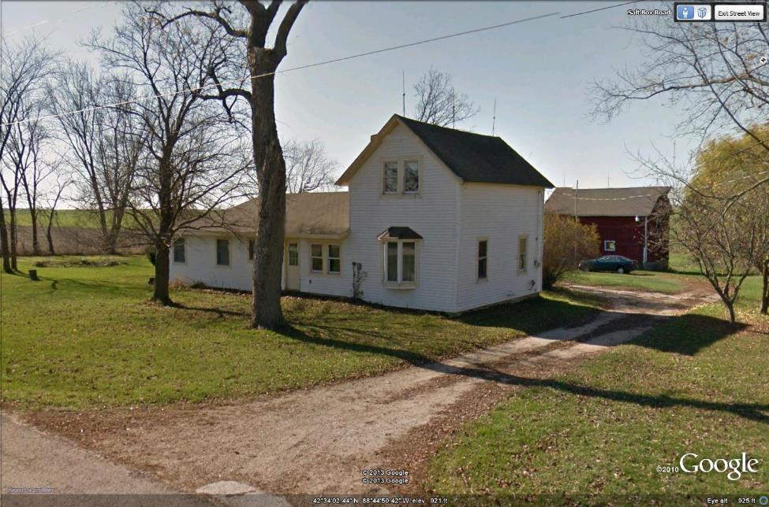
The Waller Replacement Property

Slide 135
Reviewing the Unit Rule
The Unit Rule requires that real estate be valued as a single entity.
A single award is made that represents the value of the property as a whole and not a sum of its parts.
Requires real estate to be valued in respect to its gross value as a single entity as if there were one owner.
“The compensation awarded is for the land itself and not for the sum of the different interests therein.” Green Bay Broad. Co. v. Redevelopment Authority of City of Green Bay, 116 Wis.2d 1, 342 N.W.2d 27 (1983).

Slide 136
Unit Rule
“The unit rule is designed to protect the interests of the condemnor and not to protect the interests of the condemnee.” Green Bay Broadcasting Co., 116 Wis.2d at 11
“Contracts between the owners of different interest in the land should not be permitted to result in a total sum which is in excess of the whole value of the undivided fee.” Green Bay Broadcasting Co., 116 Wis.2d at 11

Slide 137
Unit Rule
This was put to the test in City of Milwaukee Post No. 2874 Veteran of Foreign Wars v. Redevelopment Authority of City of Milwaukee, 2009 WI 84, 319 Wis.2d 553, 768 N.W.2d 749
Facts: VFW held a 99 year renewable lease in the condemned building for rent of $1/year. A jury determined that the fair market value of the building was $0. Cost of demolition = value of underlying vacant land. No value as improved.
VFW made the compelling argument that the terms of its lease were exceedingly favorable, and that leasehold interest had value notwithstanding the property’s lack of value.

Slide 138
Unit Rule
Unit rule “comports with the principle that just compensation ‘means a compensation that would be just in regard to the public, as well as in regard to the individual…” VFW, 2009 WI 84 at ¶ 50
“Under the unit rule, the public pays the full value of the property that it takes but is not required to pay excess value attributable to contracts between the owners of different interests in the property.” VFW, 2009 WI 84 at ¶ 51

Slide 139
Unit Rule
A lease favorable to the lessor does not increase the fair market value of the fee simple estate. VFW; Walgreen Co. v. City of Madison, 2008 WI 80, 311 Wis.2d 158, 752 N.W.2d 687.
Likewise a “negative lease” unfavorable to the lessor does not effect the fair market value of the real estate, or support an independent valuation of the lease. VFW

Slide 140
Unit Rule
We’re not in the business of indemnifying property owners against the risks that they undertake.
And likewise we’re not in the business of compensating for “sweetheart” deals made through business-contractual arrangments.

Slide 141
Unit Rule
But remember the unit rule doesn’t apply to immovable fixtures that are a “divisible interest”.
Green Bay Redevelopment Auth. V. Bee Frank, Inc., 120 Wis.2d 402, 355 N.W.2d 240 (1984).

Slide 142
Unit Rule
Legal issue on the horizon
The unit rule has been applied to many cases involving leases
But … the law on easements and the unit rule is less clear
  Valuing property encumbered by restrictive easements
  Access easements- subservient versus dominant properties
  Billboards
These are unsettled issues, so when faced with these types of issues seek necessary guidance.

Slide 143


