Slide 1
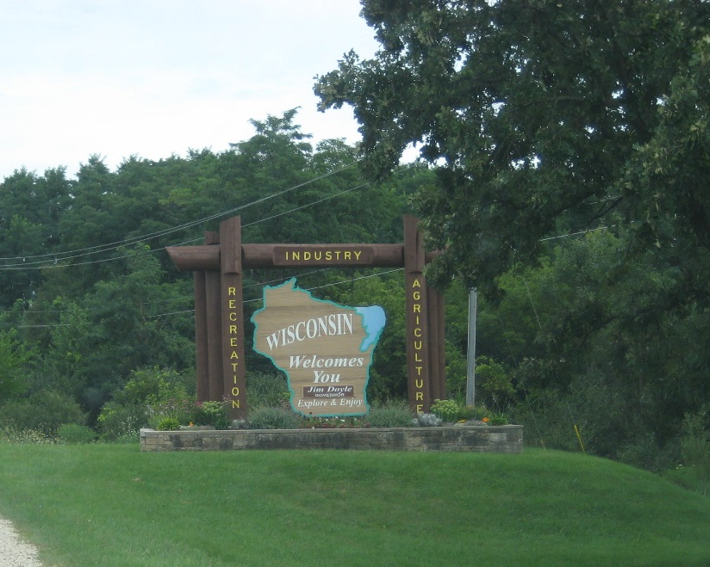

Influencing the Highway Project
September 27, 2017
WisDOT
2017 Real estate Conference

Slide 2
Presenters
Tom Beekman - NW Region Planning Chief
Cindy Flower - SE Region PM 30% Team
Brian Pluemer - SE Region PM PDS

Slide 3
Real Estate…Planning Studies
Expertise from Real Estate in WisDOT Planning Studies
Notes:
Start 9:00 or 12:30

Slide 4
Planning Studies
  Accurate quantification of R/E costs and impacts is one of the most critical elements of NEPA and WEPA.
  R/E elements can be largest determining factor in the benefit versus cost (B/C) which determines most appropriate preferred alternatives.
  R/E can also be one of the more volatile planning study costs to estimate, and thus expertise in risk probability is essential.
    No longer ‘wing and prayer’ estimates.
    Must be detailed and highly accurate in current year dollars.
    Must be part of risk analysis to ensure appropriate risk funding is part of any study estimate.

Slide 5
Planning Studies
  R/E is not just ‘how much land’ but rather any single element that can be identified as a ‘land interest’ by the private landowner. Said another way, any change that a private landowner can suggest has ‘damaged’ his current status.
  Access
  Wis Stat 84.25 Controlled Access Highways
    Recorded authorizations. Runs with title.
    Strong statutory authority which limits where compensation is required.
    Consult State Access Engineer and OGC
    FDM Chapter 7-15
  Wis. Stat 84.09 Purchased Access
    Recorded action on the property. Runs with the title.
    May limit or may expand the type of compensation required.
    Large variability in how they’ve been written. Parcel by parcel differences.

Slide 6
Planning Studies
Mapping
  Wis. Stat. 84.295…Freeway/Expressway Designation
    Recorded Action
    Not all freeways and expressways are so designated.
    Not all such designated freeways or expressways have mapping.
    ‘No rights of access accrue’ on relocated portions of new Wis. Stat. 84.295 designated highways.
    Pre-existing Wis. Stat. 84.09 remains in place.
    Does NOT automatically supercede any pre-existing Wis. Stat. 84.25 designations.
  Wis. Stat. 84.295(10)…Mapping of future right-of-way
    Recorded Action
    What are landowner and WisDOT obligations on ‘mapped lands’.
    Protective purchase vs hardship purchase.
    Full use by landowner allowed in lieu of protective purchase.
  FDM Chapter 7-40…New update coming out.

Slide 7
Real Estate…Programming
Expertise from Real Estate in WisDOT Programming
Notes:
Start 9:00 or 12:30

Slide 8
Programming Stability
Project Stability Depends on Two Project Elements
  The right project scope with right project milestones = Accurate schedule
  The right estimates for each project aspect = Accurate estimate
Program Stability Depends on Two Program Elements
  Fully Scheduled Program = Scheduled out for full 6-8 Years.
  Financially Balanced program = Scheduled within programmed budgets.
Performance Measures
  On Time = PLOT, PSOT, BDOT, DSRC
  On Budget = POBS, POBL, DOBI, DOTI

Slide 9
Programming Performance Measures
  On Time Measures…Schedule Stability… Annual July Snapshot
  Program Load on Time (PLOT)…PY 6…Program Scoping
    July 1 of each FY, PY 6 of 3R program will be loaded to within 10% of program funds allocated and be compliant with Program Effectiveness Measure (PEM). Balanced…accurate…relevant.
  Program Scoped on Time (PSOT)…PY…Project Scoping
    July 1 of each FY, PY 4 will have no less than 80% of allocated funds in LET projects, 100% of which will be at LC 11. Balanced…accurate…relevant…decisions made.
  Begin Design and Complete Design Study Report (DSR) on Time
    On July 1.

Slide 10
Programming Performance Measures
Program on Budget Indices (POBI)
  Program On Budget At Scoping (POBS)
    PSOT Estimate within 10% of PLOT Estimate. So…how accurate were you with program scoping?
  Program On Budget Let (POBL)
    PSOT estimate within 10% of LET award amount. So…how accurate were you with project scoping?

Slide 11
Programming Performance Measures
What Does This Mean to R/E
  Early Involvement…Continuous Involvement
    Need to part of the Program Scoping…PLOT…LC 10…PY 6-8.
    Need to part of the Project Scoping … PSOT…LC 11…PY 4
  If we are successful with these measures…you have no less than 3-1/2 years and up to 5-1/2 years to get R/E purchased on any project.
  PY 4 through PY 1 are the Delivery Years. They are not the ‘figure out what we’re doing’ years.

Slide 12
Advanceable Program
Statutory requirement that WisDOT have 30% of total program funds for State Highway Rehabilitation (SHR) and Major Projects as advanceable projects with completed designs.
  This equates to more or less 50% of the annual Regional 3R and BB Programs.
Advanceable Projects are identified in FIIPS having a date in the Early PSE (EPSE) field. If tagged with EPSE…EPSE is your completion date. No ifs…no ands…no buts. Repeat after me…ESPE is your PSE. ☺
There are performance measures for the Advanceable Program.
  Advanceable Program Levels…Ensures sufficient project $$ have been tagged in PY 1-4.
  Planned Advanceable Program (PAP)…Sets % complete amount and dates for current year advanceable program. 50% July 1…75% September 15…100% December 1.
  Risk Rankings…Will it get delivered as scheduled.

Slide 13
Protecting Our Schedule
Typically start with minimal/no RE
Determine rough # of Parcels by 30%
Meet with Real Estate Rep to determine appropriate timeline (12-24 mo)

Slide 14
Real Estate Liaison's Role
Attend meetings - scoping, 30%, owner, PIM’s, Any topic that may involve acquisition schedules, impacts, etc.
Ask Questions/Give input on:
  design
  scheduling for acquisition
  costs, etc.
Raise Flags if you see nearby:
  billboards
  Parkland 4f/6f
  relocations
  major access issues

Slide 15
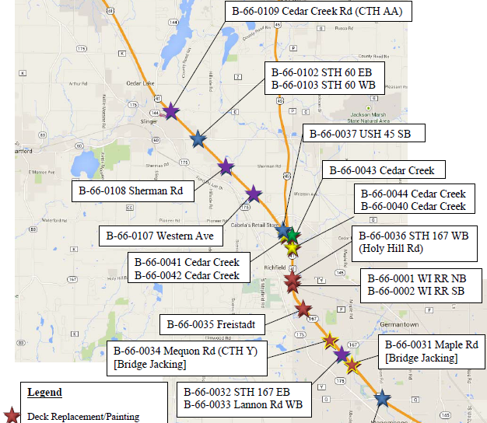
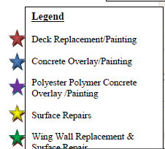
Communication - Early and Often
Overall Bridge Maintenance Project –
with Bridge Raising

Slide 16
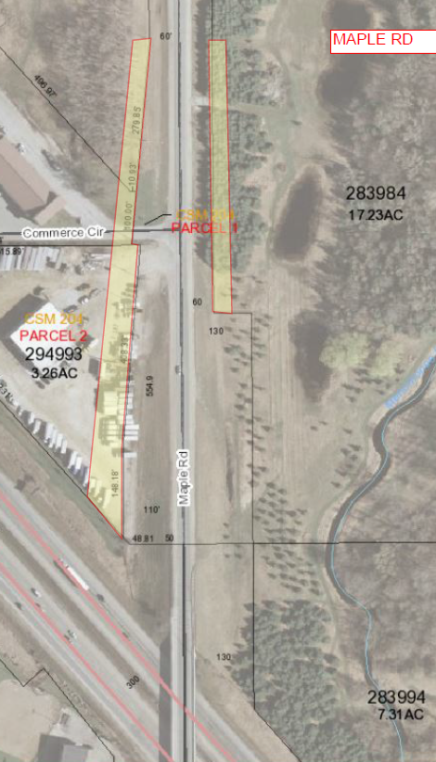
Communication -
Early and Often
$1,131,500 OMG
Cutting off the flow of traffic!

Slide 17
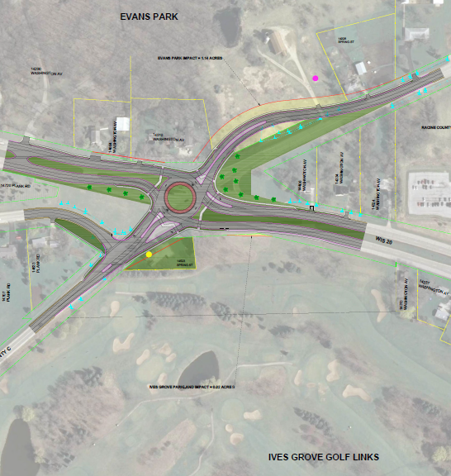
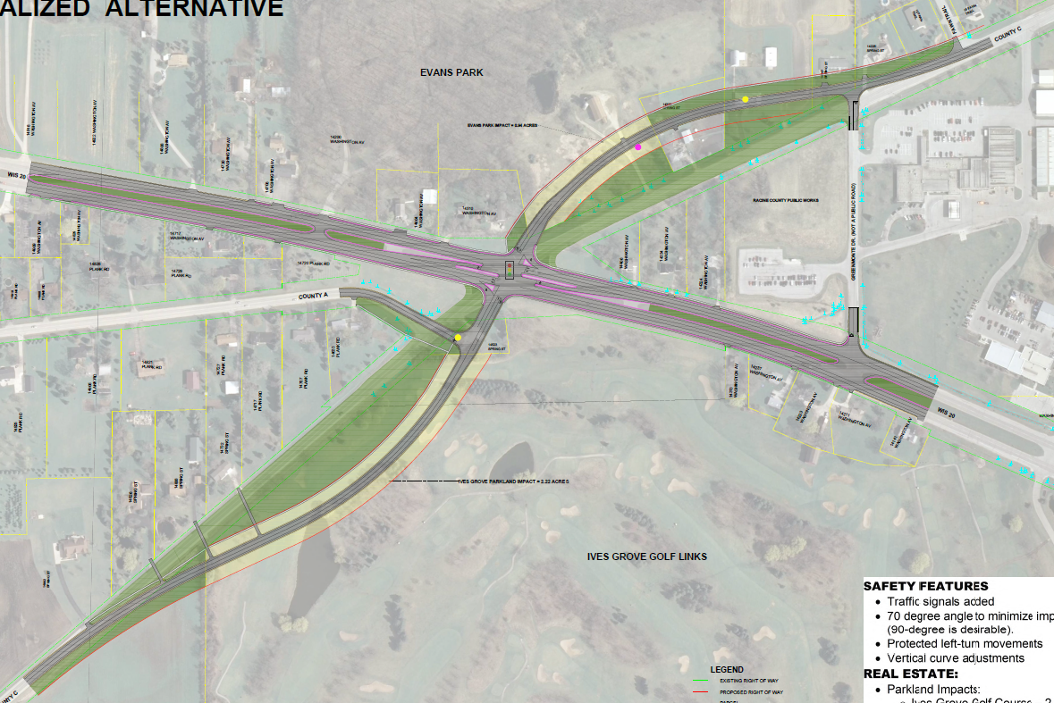
Alternatives – Result in 6 (f) Impacts
Safety Improvement
Weighing Alternatives
FDM Standards

Slide 18
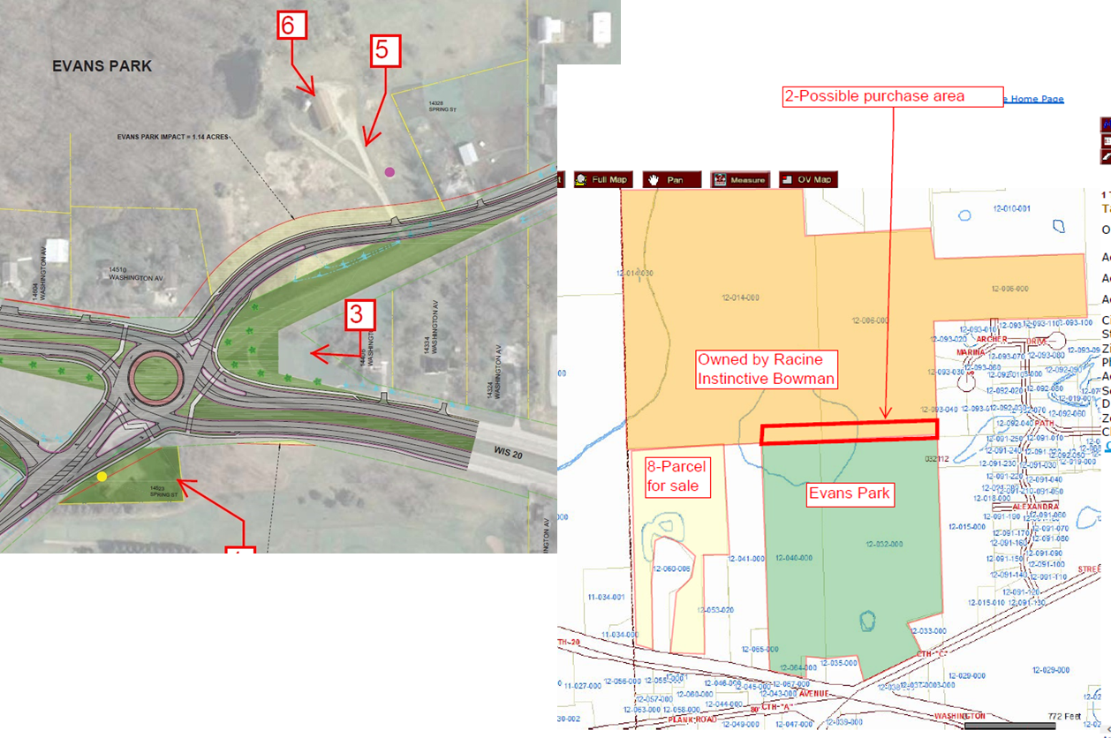
Alternatives – Result in 6 (f) Impacts
Long Process
Start Coordination Early

Slide 19
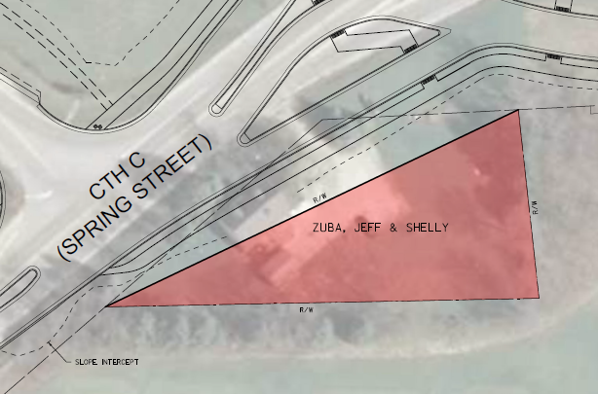
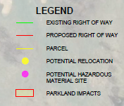
Relocations
Communicate with Relocation residents prior to public involvement meetings

Slide 20
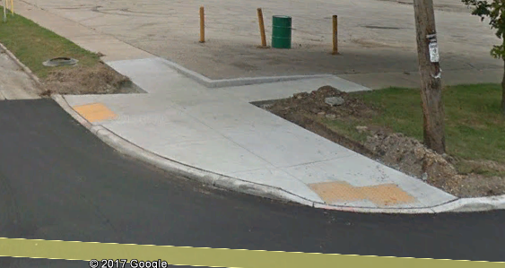
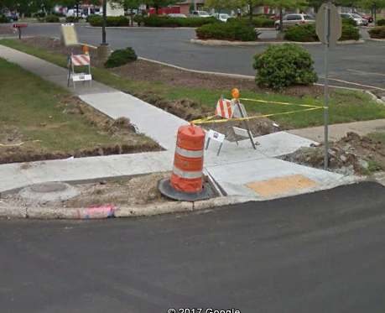
Curb Ramps
State Requirements - Trans 75
Federal Requirements
TLE or not to TLE? That is the question…..
Urban - Can result in hundreds of parcels

Slide 21
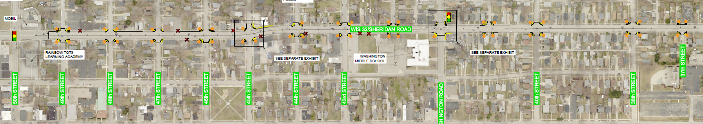
Curb Ramp Impacts - TLE vs No TLE?

Slide 22
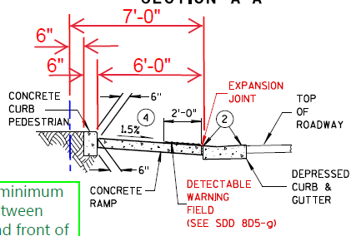
Curb Ramp Impacts - TLE vs No TLE?
Cost of TLE
  Plat
  Appraisal
  $ to Property Owner
Cost of curb ramp
  Sidewalk Ramp - increased cost to build from one side
  Pedestrian Curb
  Cost of ramp and Detectible Warning Field

Slide 23
Preliminary/Final Design
Design
  Typical Section
  Intersections
Relocations
Access
Encroachments
Appraisal/Negotiation

Slide 24
Design - Typical Section
Urban/Rural
Sidewalk/Shared Use Path
Clear Zone/Side Slopes
  Retaining Walls
    PLE/FEE for tie backs
    Excavation limits
  Guardrails
  Curb and Gutter

Slide 25
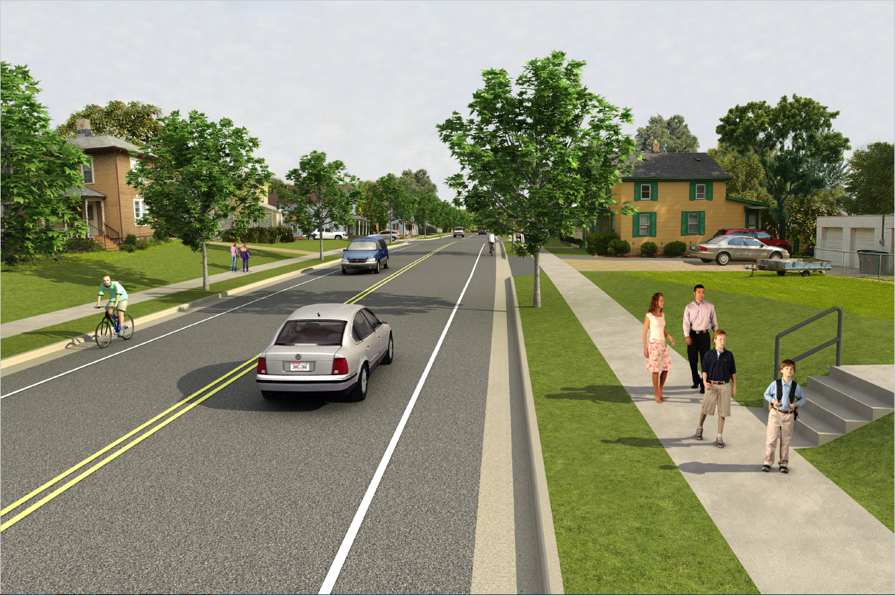
Design - Urban with sidewalk

Slide 26
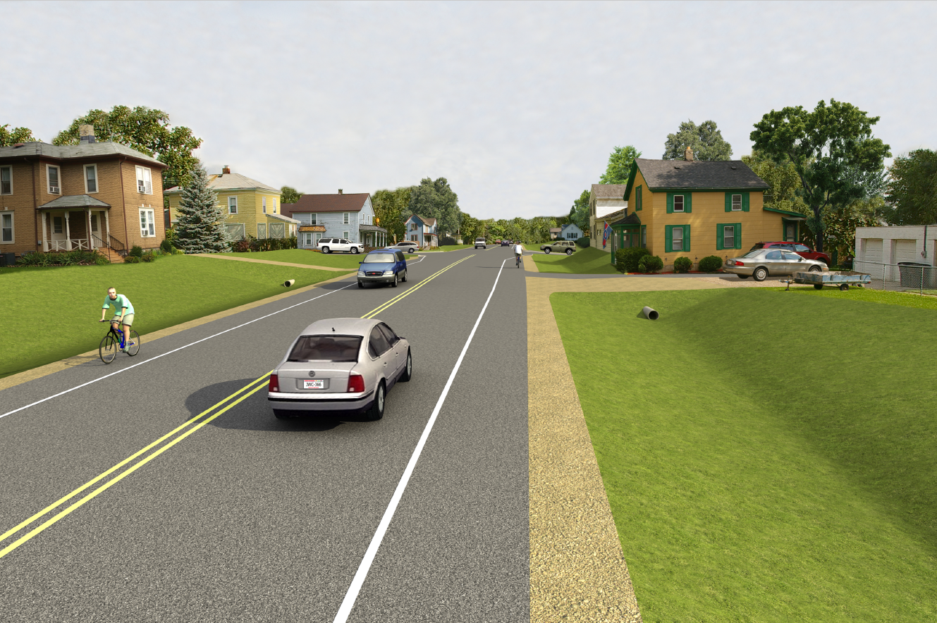
Design - Rural

Slide 27
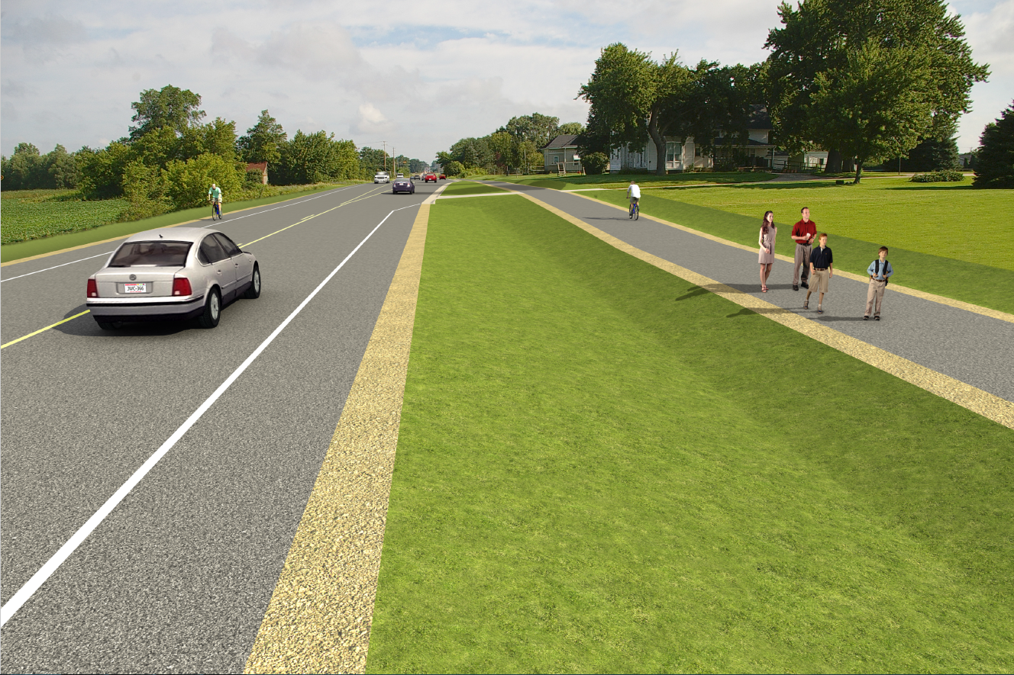
Design - Rural with Shared Use Path

Slide 28
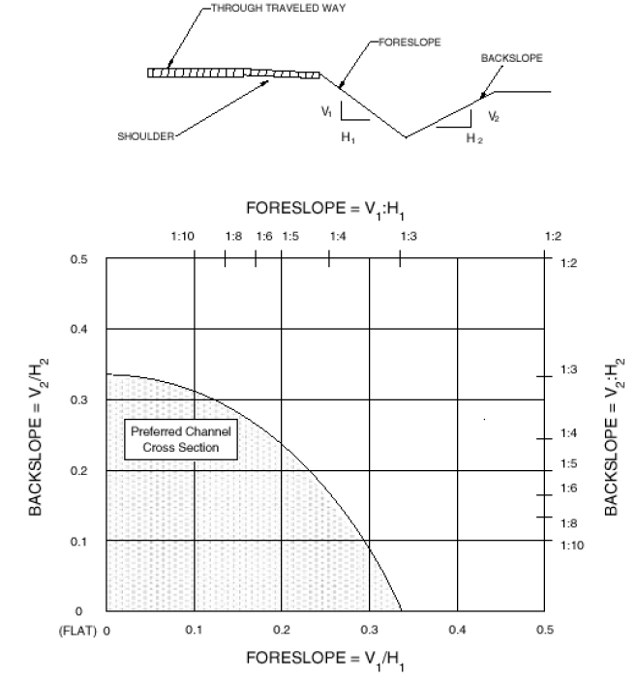
Typical Section - Side Slopes

Slide 29
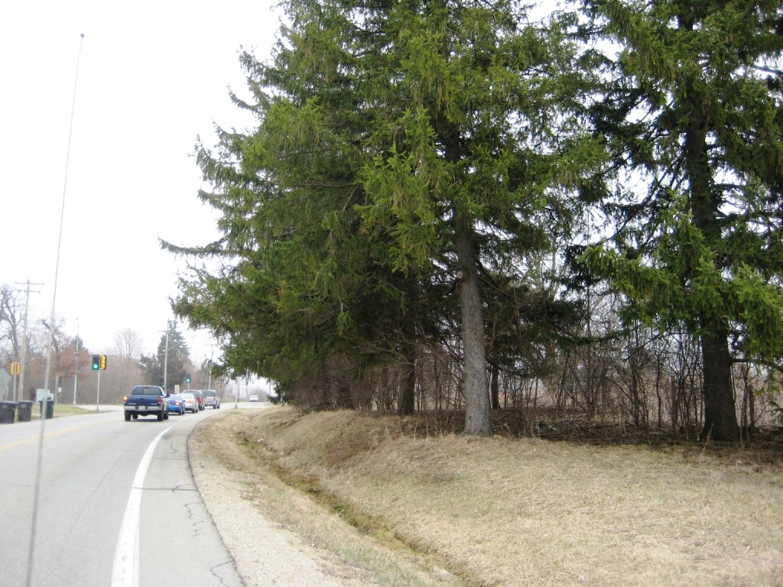
Typical Section - Side Slopes and Clear Zone

Slide 30
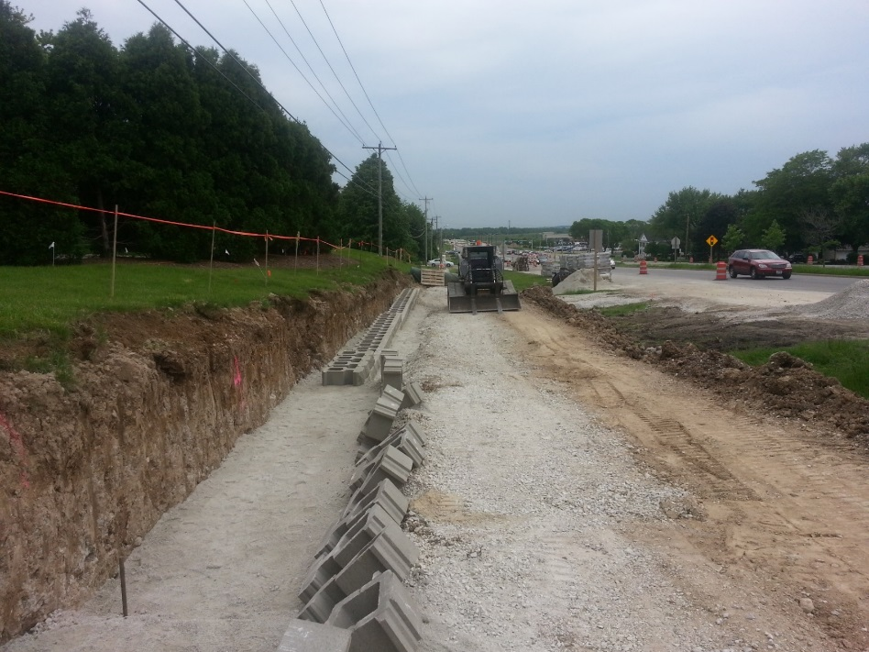
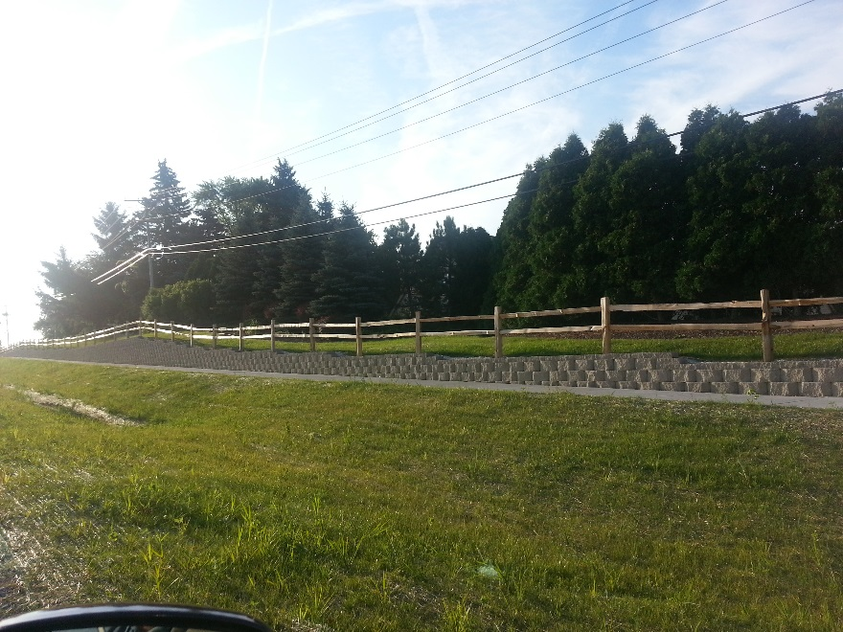
Typical Section - Retaining Wall

Slide 31
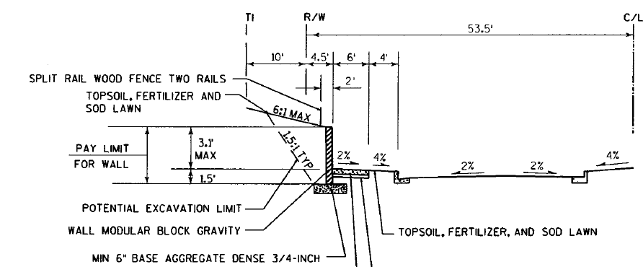
Typical Section - Retaining Wall

Slide 32
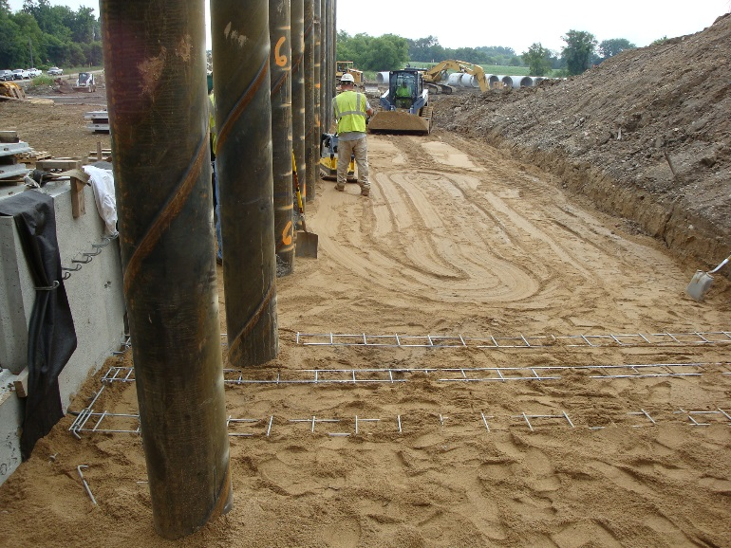
Typical Section - Retaining Wall

Slide 33
Design - Intersections
Intersections
  Intersection Sight Distance
  Roundabout
  Traffic Signals
  Turn Lanes

Slide 34
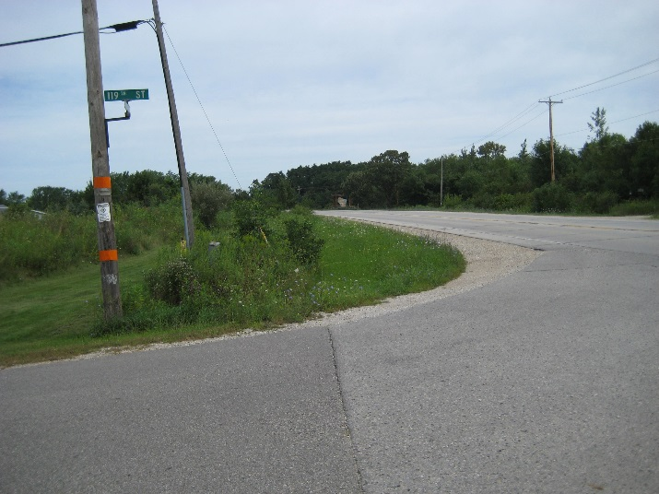
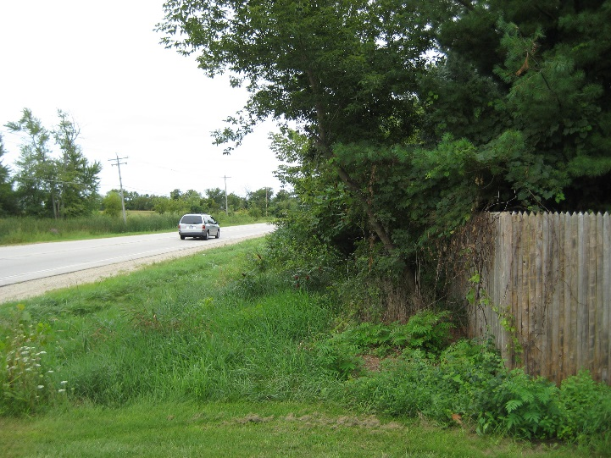
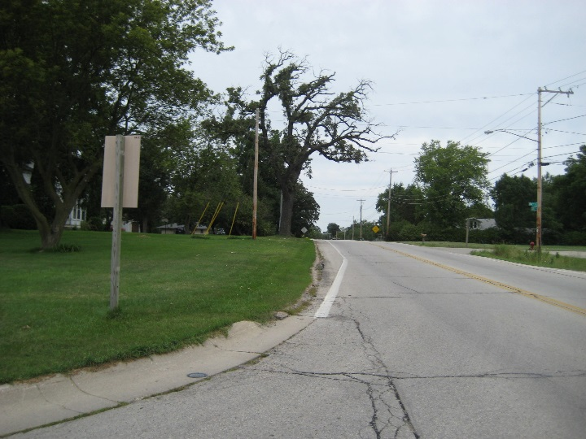
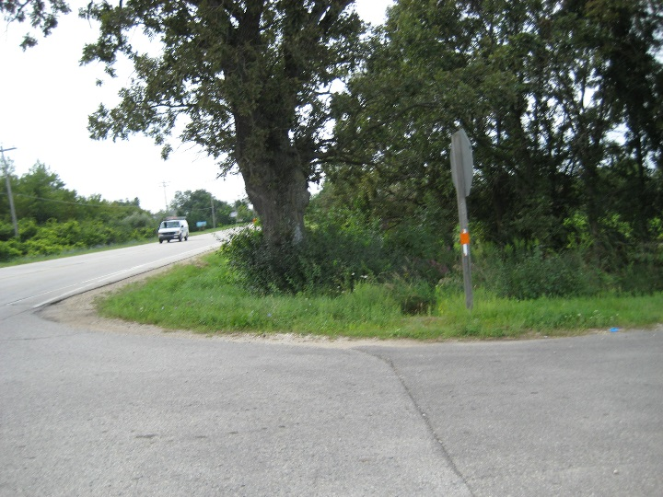
Intersection Sight Distance

Slide 35
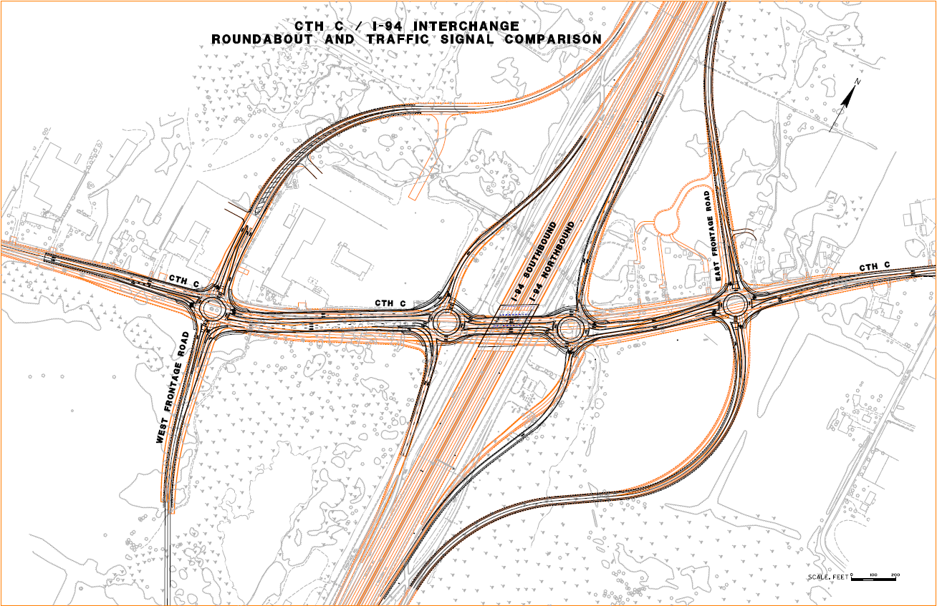
Intersection Alternative: Signal vs Roundabout

Slide 36
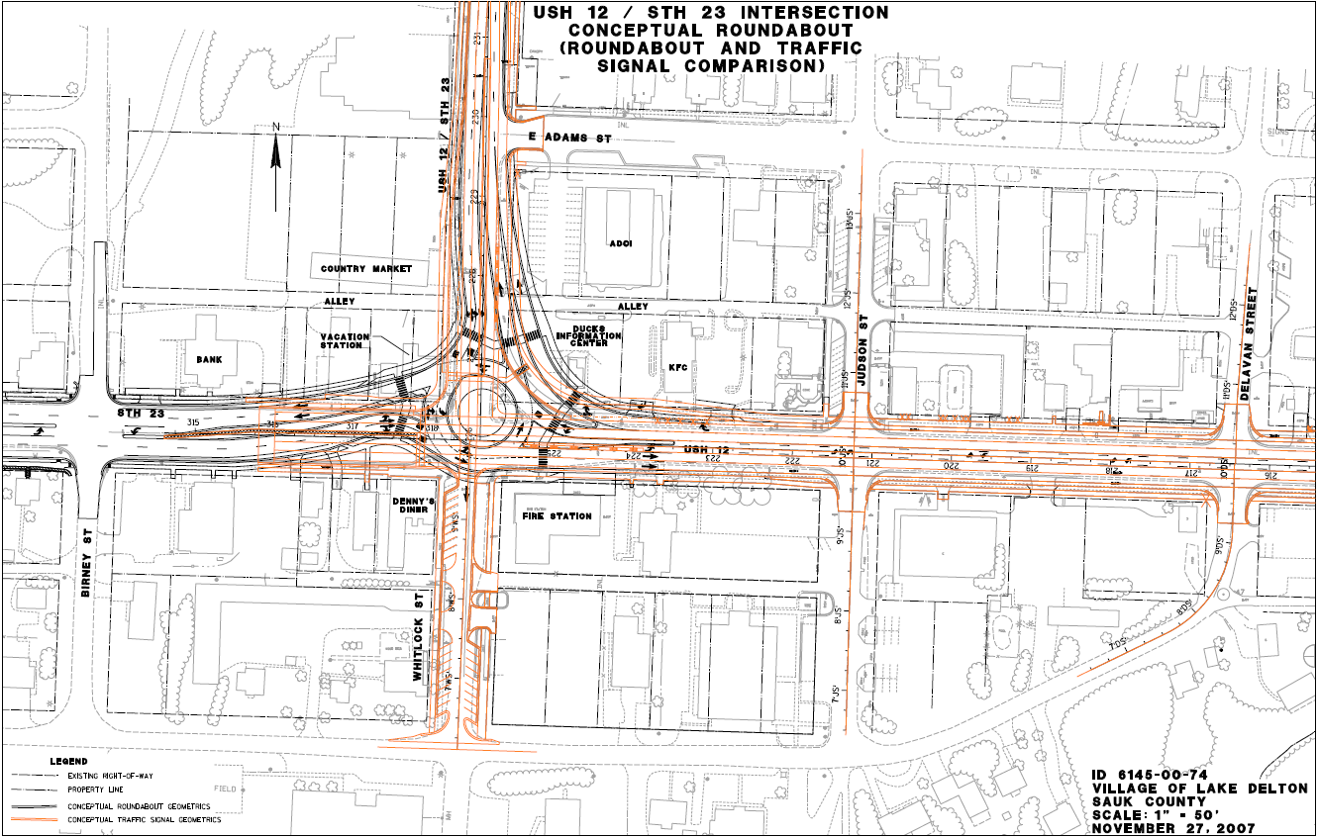
Intersection Alternative: Signal vs Roundabout

Slide 37
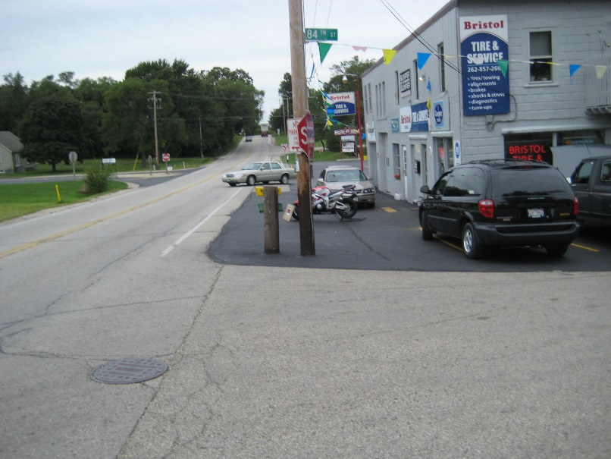
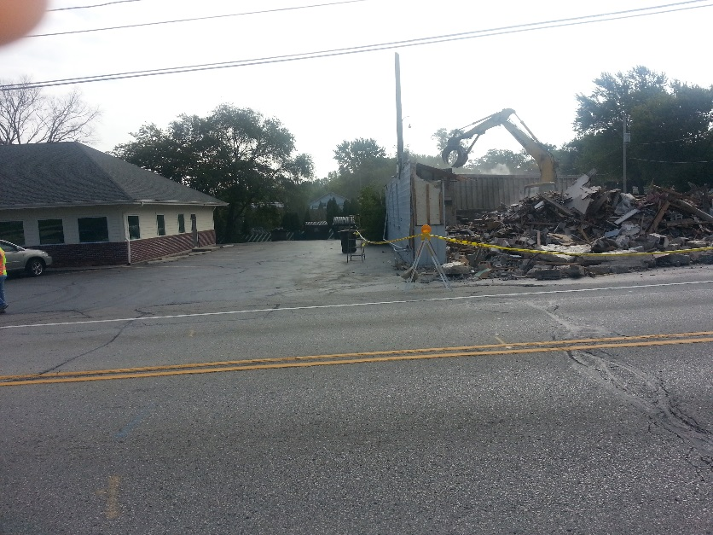
Relocations
Separate Plat ID
Early coordination with owner

Slide 38
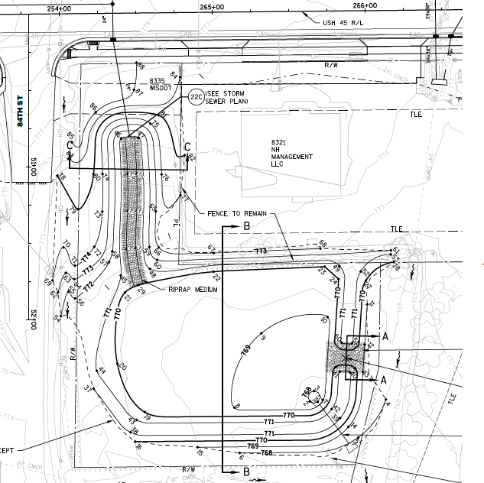
Relocations

Slide 39
Access
Speak with the Region Access Rep - Sue Voight
Access Locations
Number of Accesses
TLE vs Construction Permit
Notes:
# of accesses – Red School house, Diner 45 – get access involved, research titles/as-builts
Median Closures – USH 12, STH 23 – Close before project if possible
Driveway closures – police power if possible
Redesigning owner’s site – McDonalds…..get all in writing with General Counsel review

Slide 40
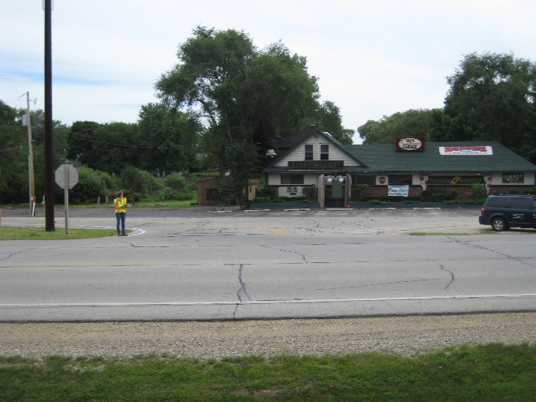
Access
Driveways Near Intersections
Driveway Width

Slide 41
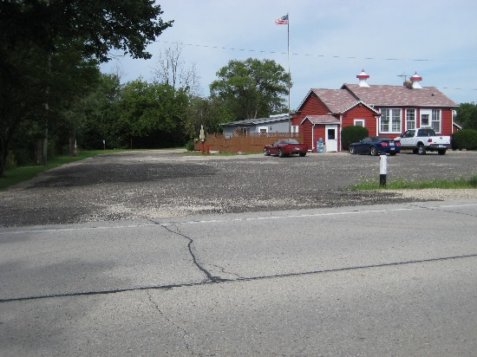
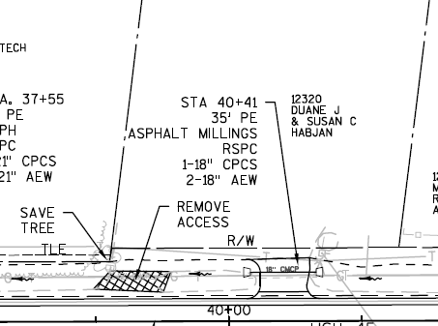
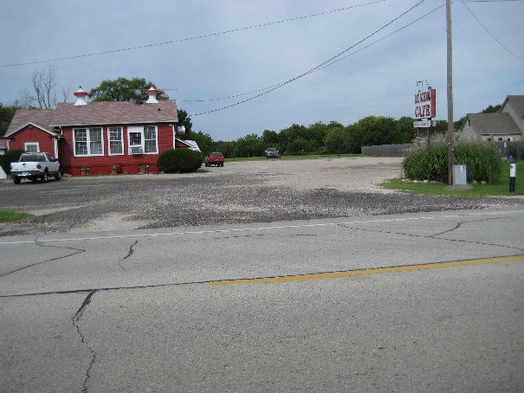
Access
Number of Accesses

Slide 42
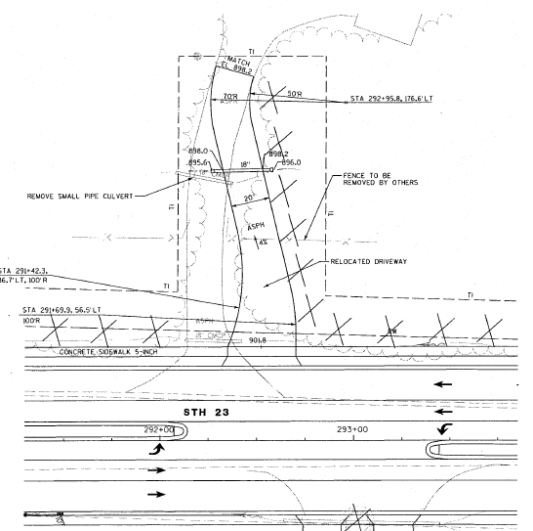
Access
Access - TLE vs construction permit

Slide 43
Access
Median Restrictions
  WisDOT Owns Median
  Safer to direct to controlled intersections
Driveway Closures
Modifying Access
  Do not redesign owner’s site (parking lots)

Slide 44
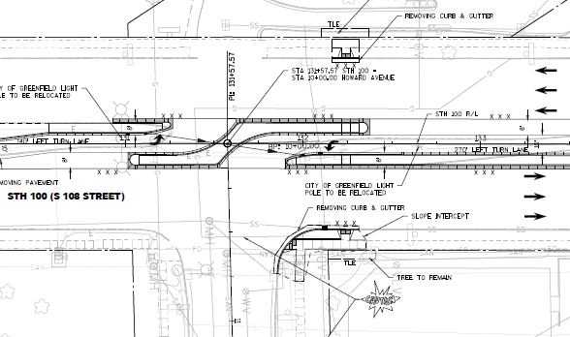
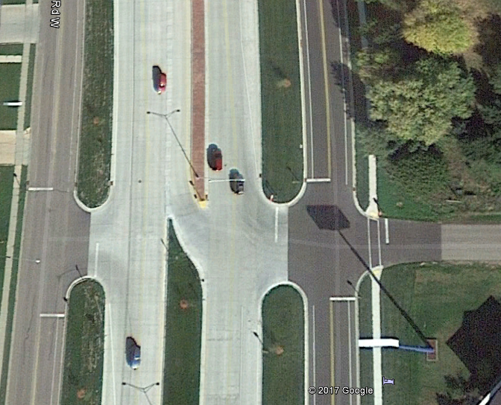
Access – Median Restriction

Slide 45
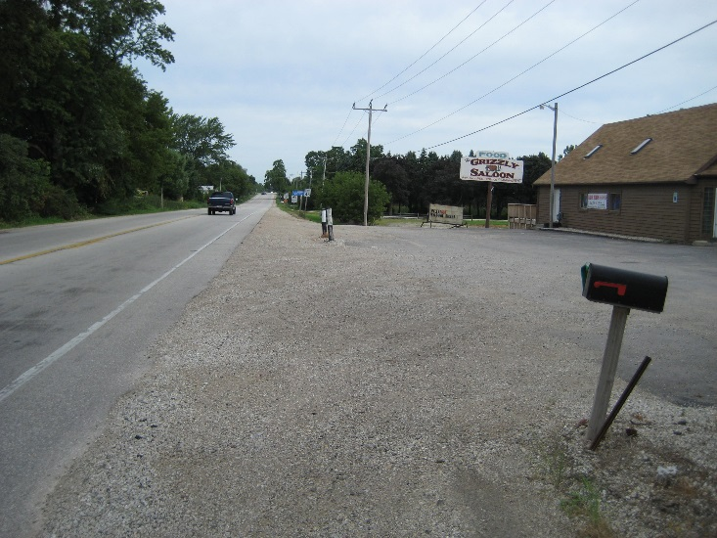
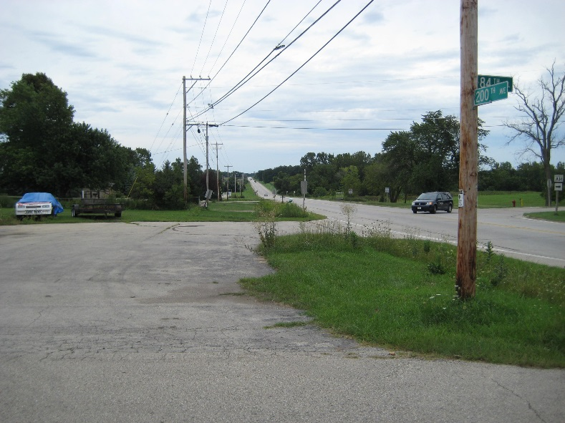
Encroachments
Encroachments
  Remove
  Revocable Permit
Billboards, Parking Lots, Trees, Landscaping

Slide 46
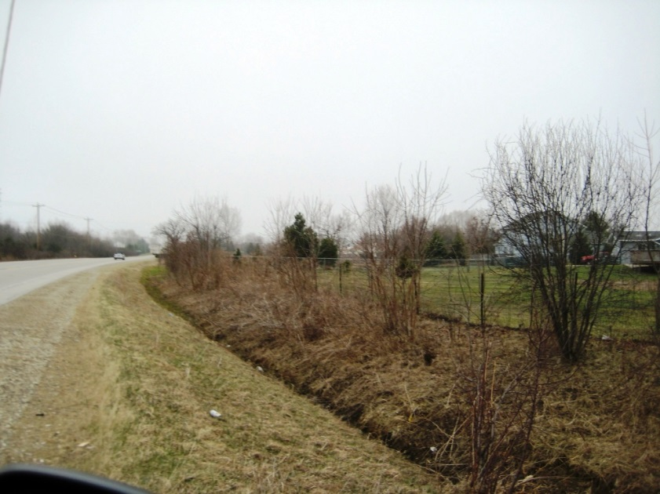
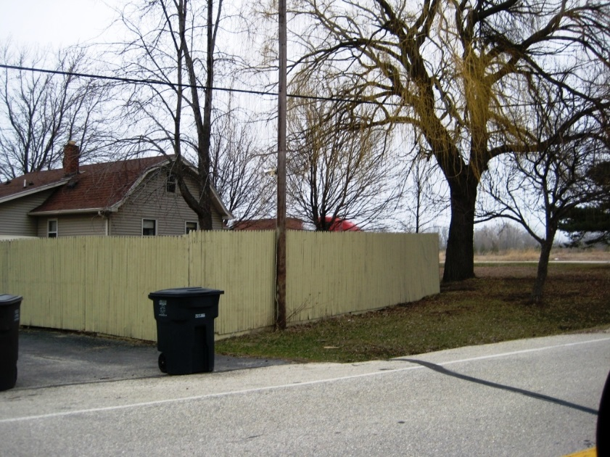
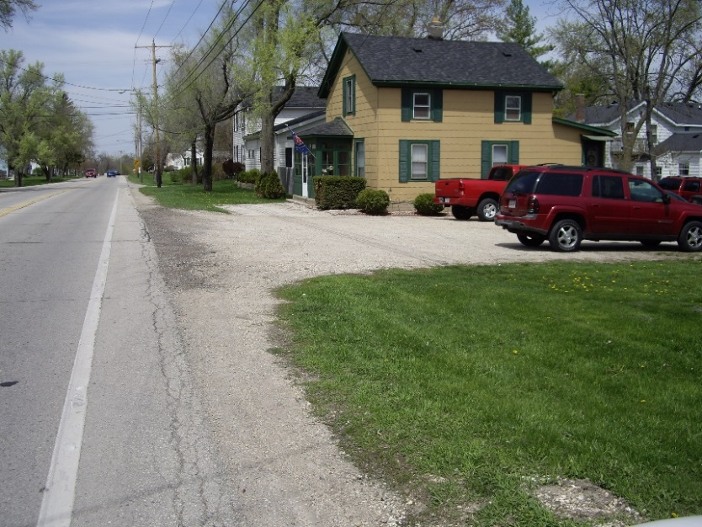
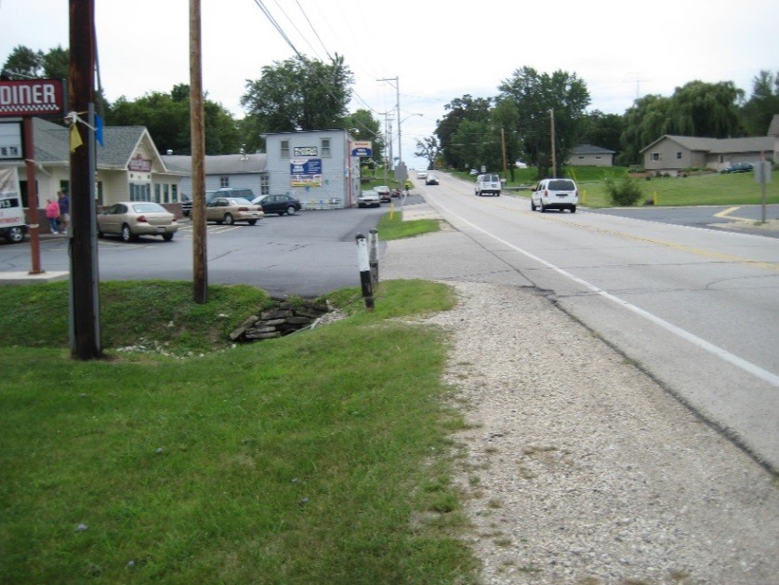
Encroachments

Slide 47
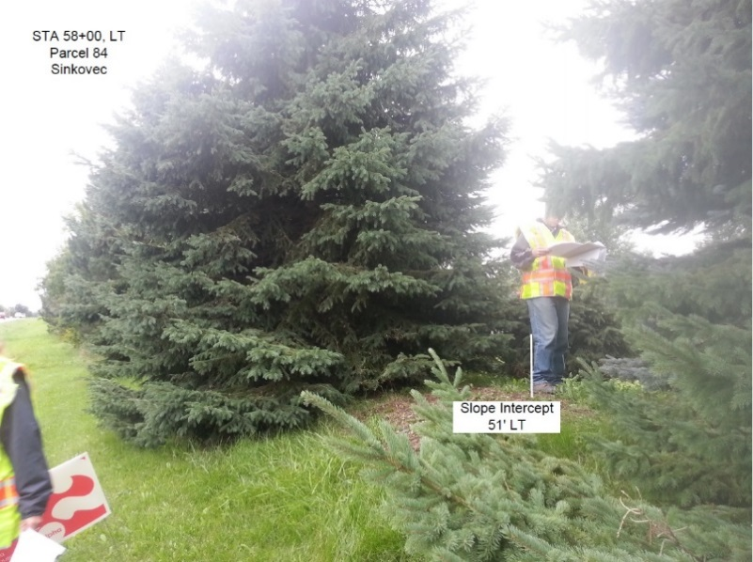
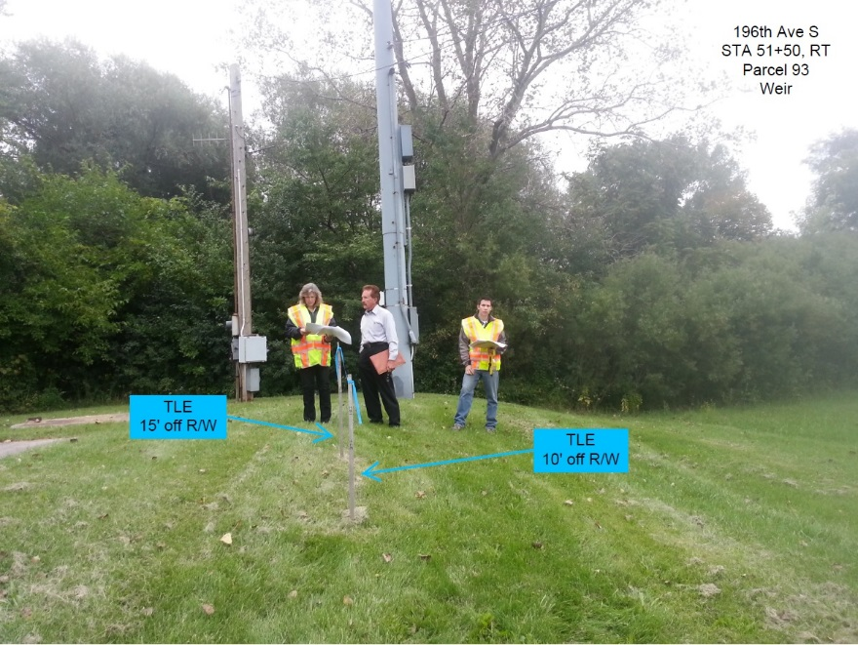
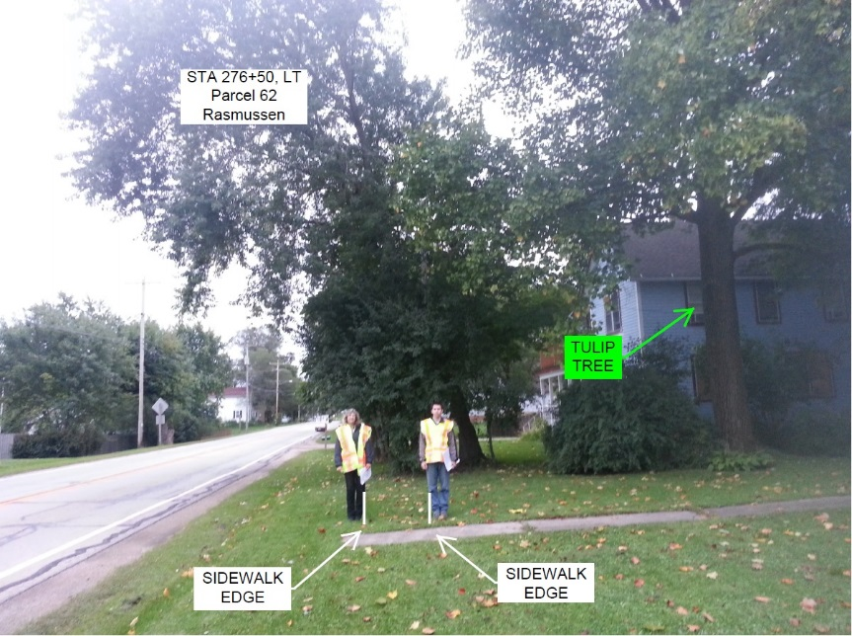
Appraisal/Negotiation - Site Visits
Site Visit Minutes
Two People

Slide 48
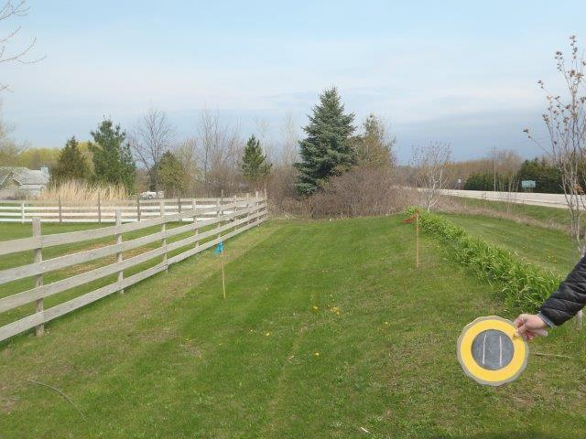
Appraisal/Negotiation - Staking
Photos of staked lathe

Slide 49


Questions/Concerns?

