Slide 1
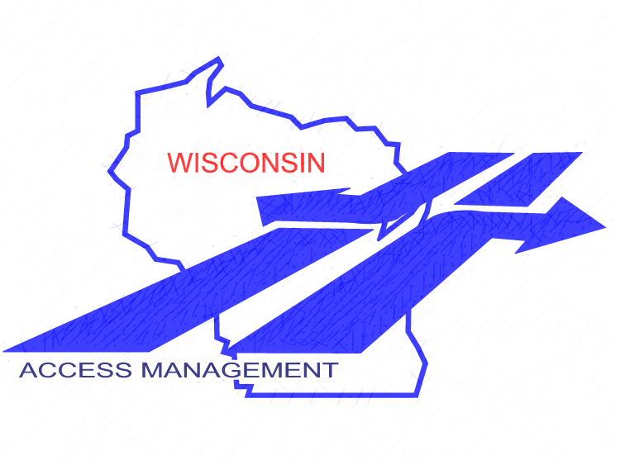
Wisconsin Department of Transportation
Access Management Module 8: References & Resources
Final: 1-13-18

Slide 2
Module Outline
This module details various references and resources on the topic of access management
Hyperlinks are also included
No formal presentation will be given or is necessary
Modules:
Summary of Principles and Practices
Introduction to Legal Foundations
Access Standards
Planning
Identifying Access Controls
STH Connection Permits
Special Topics
(8) References & Resources
References &
Resources
Notes:
Session format- This program is generally set up for ~50 minutes of presentation, to give you time for Q&A. If a hands-on component is included, you may also want to include a short break. Speakers should welcome everyone, explain where restrooms are located, describe Q&A protocol. Remind everyone of the informal, participatory atmosphere and to be respectful of other’s time. Encourage audience to save more targeted questions and “war stories” until after the session, unless it directly enhances the group discussion. Depending on audience size, it is suggested to limit questions to no more than 2 straightforward questions per individual, offer to take longer or additional questions after the presentation.
Speaker Introduction- give a brief intro of speakers, where they are from, background information and contact information if necessary

Slide 3
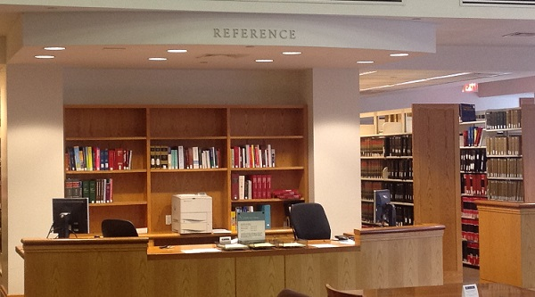
References & Resources – Outline
Facilities Development Manual
Real Estate Program Manual
Construction and Materials Manual
Highway Maintenance Manual
Access Management DOTNET Site
TRB Access Management Manual
Additional WisDOT Resources
Educational and outreach needs
Mentoring
References &
Resources

Slide 4
Facilities Development Manual
Chapter 11 – Design
11-05 General Design Considerations
11-5-5…Access Spacing
11-10 Design Controls
11-10-5…Vision Corners
11-15 Cross-section Elements for Rural Highways and Freeways
11-15-1…Rural Driveway Design
11-20 Cross-section Elements for Urban Highways
11-20-10…Urban Driveway Designs
11-25 Intersections at Grade
11-26 Roundabouts
Provides policy, procedural requirements, and guidance on WisDOT highway and street design process
Chapter 4 – Planning
Chapter 7 – Access Control
References &
Resources
Notes:
Another resource of interest is the WisDOT Facilities Development Manual.
This module makes many references to section Chapter 11 (Design). The primary sections mentioned in this module are listed on this slide. For reference, Chapter 7 (Access Control) also provides information related to assess management that may be of use to practitioners.
The link at the bottom of this slide goes to the WisDOT FDM. From this link, the user can easily get to any of the chapters or sections of interest.

Slide 5
Real Estate Program Manual
Valuing or appraising access rights
2.7.2 Appraisal / Special Improvements / Driveways
2.8.4 Appraisal / Common Appraisal Problems / Access Rights
References &
Resources

Slide 6
Construction and Materials Manual
Various access issues including:
2-30 Right-of-Way
Highway easements, limited easements, construction permits, etc.
7-80 Constructing and restoring access points
7-80.1 General: Checking plan information against state and local rules and regulations
7-80.2 Statutory basis for reconstructing driveways
7-80.3 Trans 231 driveway construction standards
References &
Resources

Slide 7
Highway Maintenance Manual
Chapter 9-10: STH Connection permit forms and process
Used in conjunction with s. 86.07(2)(a), s. 86.073, and Trans 231
Driveways
Local road connections
Trails & trail crossings
Criteria for permit approval / denial / appeals/ handling of illegal access
Provides some design and construction details
References FDM for additional details
References &
Resources

Slide 8
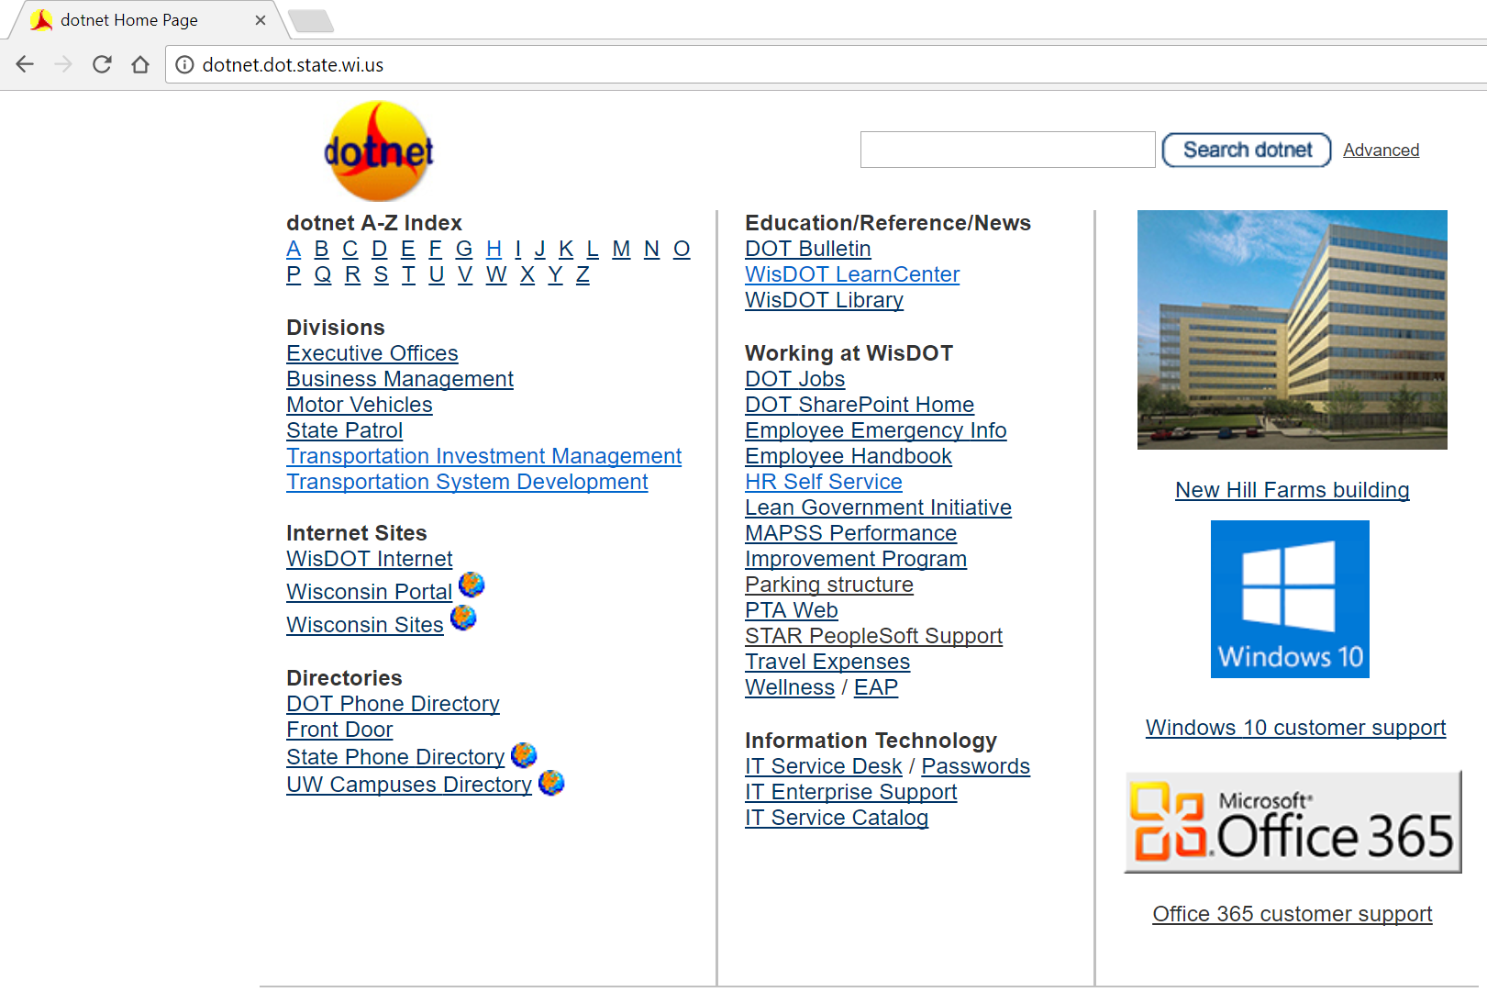
DOTNET Access Management Site
References &
Resources
Notes:
DOTNET Main page. Click on “A” for Access Management.

Slide 9
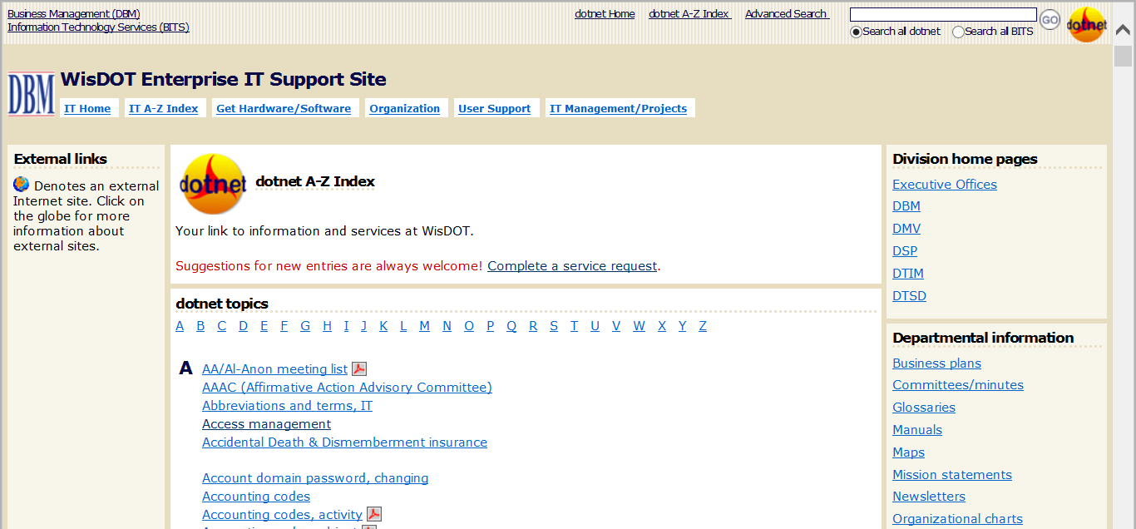
References &
Resources
Notes:
Where to find the Access Management information on the DOTNET

Slide 10
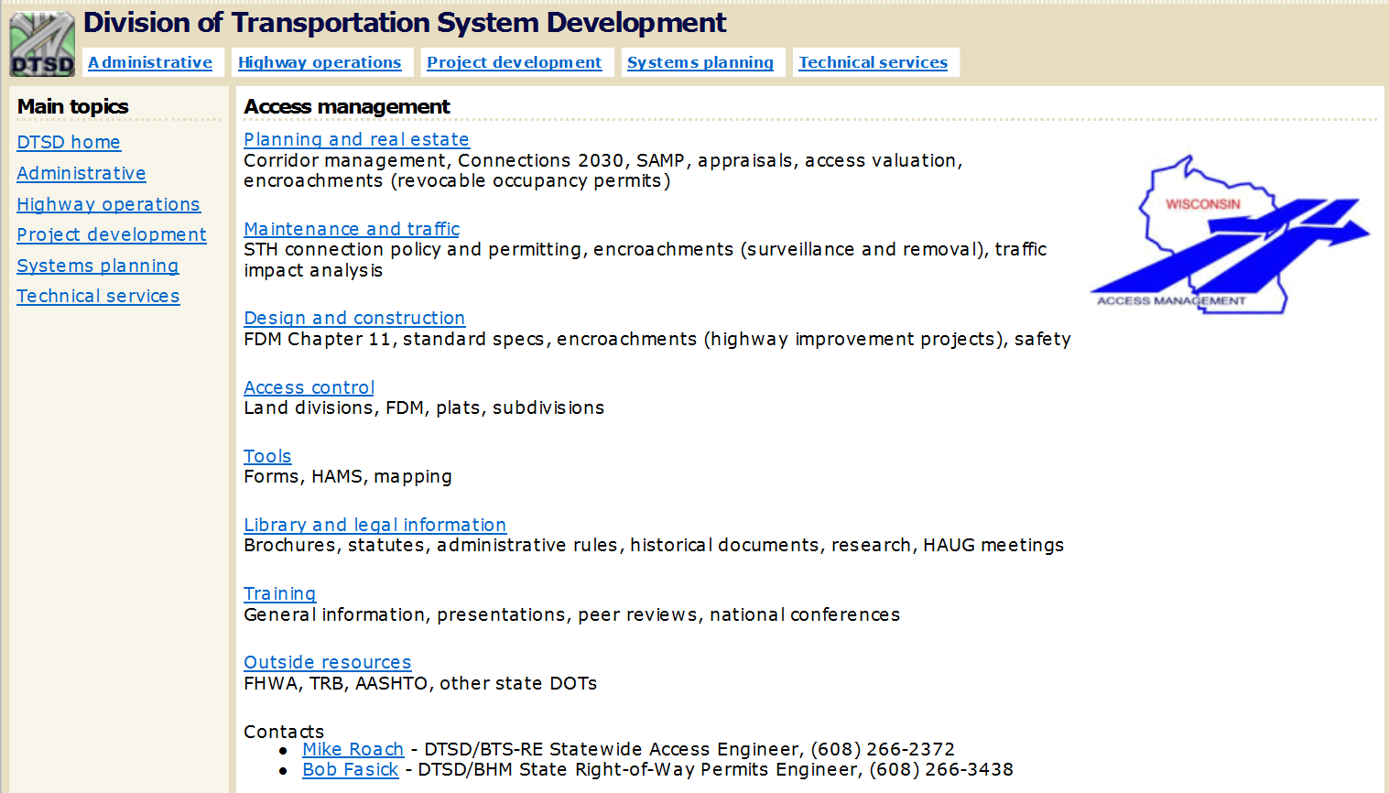
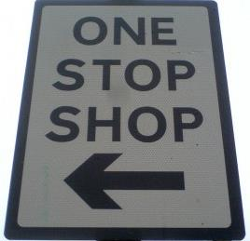
References &
Resources

Slide 11
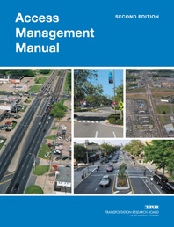
Transportation Research Board Resources
TRB Access Management Manual (2nd Edition)
To buy: http://www.trb.org/Main/Blurbs/171852.aspx
TRB Access Management Applications Guide
To buy: http://www.trb.org/main/blurbs/175418.aspx
TRB Access Management Committee Website
http://www.accessmanagement.info/
TRB interactive website
www.accessmanagement.gov
References &
Resources
Notes:
There are several primary sources of access management information for WisDOT staff implementing access management, as well as staff from WisDOT partnering agencies. These sources include the:
1. TRB Access Management Manual (2nd Edition) and
2. TRB Access Management Committee Website.
A link is provided on this slide to purchase the Access Management Manual. A link is also provided here for the TRB Access Management Committee website which is loaded with useful resources.

Slide 12
Additional WisDOT Resources
Traffic Engineering, Operations and Safety (TEOpS) Manual
Program Management Manual
Statewide Access Management Plan (SAMP)
ITE Trip Generation Manual and Guidebook (trip reduction factors for urban mixed use, modes etc.)
Traffic Impact Analysis (TIA) guidelines & TIA DOTNET Info
Highway Access Management System (HAMS)
Wisconsin Bike Facility Design Handbook
Brochures:
Benefits of Access Management (FHWA)
Trans 233 (WisDOT)
Access Management (WisDOT)
Access Management Issue Resolution
Contact the Statewide Access Engineer to have the issue discussed at a monthly Access Review Team meeting
References &
Resources

Slide 13
Educational and Outreach Resources
WisDOT Learn Center – AM Overview Training
National Highway Institute (NHI) courses
National Cooperative Highway Program
UW-Extension
Northwestern University
National Access Management Conference
Institute of Transportation Engineers (ITE)
FHWA: 1997 Access Management Video
References &
Resources

Slide 14
Mentoring
WisDOT Highway Access Users Group (HAUG)
WisDOT Highway Access Oversight Team
WisDOT internal “tech talks”
John Sobotik
Drew Jelinski Office of General Counsel
Kathy Batha
Tom Beekman, Planning Jedi Master
Mike Roach, Statewide Access Engineer
Steve Sydow, Statewide Access Coordinator
Bob Fasick, State ROW Permits Engineer
Region access management engineers and permit coordinators
References &
Resources

