Slide 1
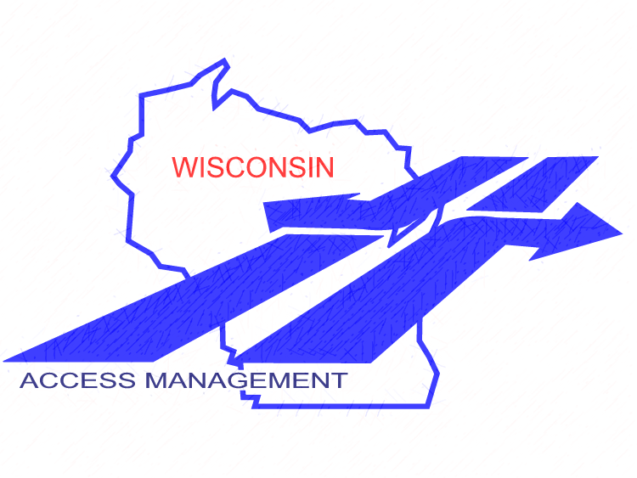

Wisconsin Department of Transportation
Access Management Module 5: Identifying Access Controls
Final: 1-13-18
Notes:
i.e., “May I have a driveway?”

Slide 2
Module Outline
This program discusses access management as it relates to acquisition of access rights and how to review plans to identify applicable access controls
It also includes the use of tools such as scenic easements and access covenants
Speaker introduction
Modules:
Summary of Principles and Practices
Introduction to Legal Foundations
Access Standards
Planning
(5) Identifying Access Controls
STH Connection Permits
Special Topics
References & Resources
Notes:
Session format- This program is generally set up for ~50 minutes of presentation, to give you time for Q&A. If a hands-on component is included, you may also want to include a short break. Speakers should welcome everyone, explain where restrooms are located, describe Q&A protocol. Remind everyone of the informal, participatory atmosphere and to be respectful of other’s time. Encourage audience to save more targeted questions and “war stories” until after the session, unless it directly enhances the group discussion. Depending on audience size, it is suggested to limit questions to no more than 2 straightforward questions per individual, offer to take longer or additional questions after the presentation.
Speaker Introduction- give a brief intro of speakers, where they are from, background information and contact information

Slide 3
Module 5: Identifying Access Controls
⇨ Objectives ⇦
Which Wisconsin statutes provide access management controls
How to answer questions such as, “May I have a driveway?”
How to identify the types of access controls on a specific property
How is access management linked with jurisdictional reassignments
What are the access management techniques most commonly used in real estate transactions
Notes:
This is Module 5 of the access management training.
This module is focused on access standards.
Upon completion of this module, you will be able to:
Explain the goals and benefits of using access management
Describe the different types of access management techniques used, and
Apply WisDOT access management design standards

Slide 4
WisDOT Access Management Authority
Statute/Rule | Title | Comment
s. 84.09 | ✓ Acquisition of Lands and Interests Therein | Eminent domain acquisition of access
s. 84.25 | ✓ Controlled-Access Highways | Most common police power regulation of access
s. 84.29 | ✓ National System of Interstate Highways
s. 84.295 | ✓ Freeways and Expressways
s. 86.05 | Entrances to Highways Restored
s. 86.07(2)(a) | ✓ Digging in Highways…(Permits)
s. 86.073 | Review of Denial of permit (Appeals)
Trans 231 | Permits for Driveways…in State Trunk Highways
Ch. 236 | Platting Lands and Recording & Vacating Plats | Police power – development tools
Trans 233 | Land, Subdivision Plats Abutting STHs…
✓ Statutes covered in this module
☞

Slide 5
Other Access Management Authority
Statute/Rule | Title | Comment
s. 32.09(6)(b) | Rules governing… just compensation | Eminent Domain
s. 66.1001 | Comprehensive Planning
s. 66.1003(10) | Discontinuance of a public way | Not if access denied
s. 66.1035 | Rights of abutting owners | To use highway
s. 86.09 | Access to Cemetery Preserved
s. 83.027 | County Controlled Access Highways | Local police power
Wis. Constitution | Municipal home rule | Local police power

Slide 6
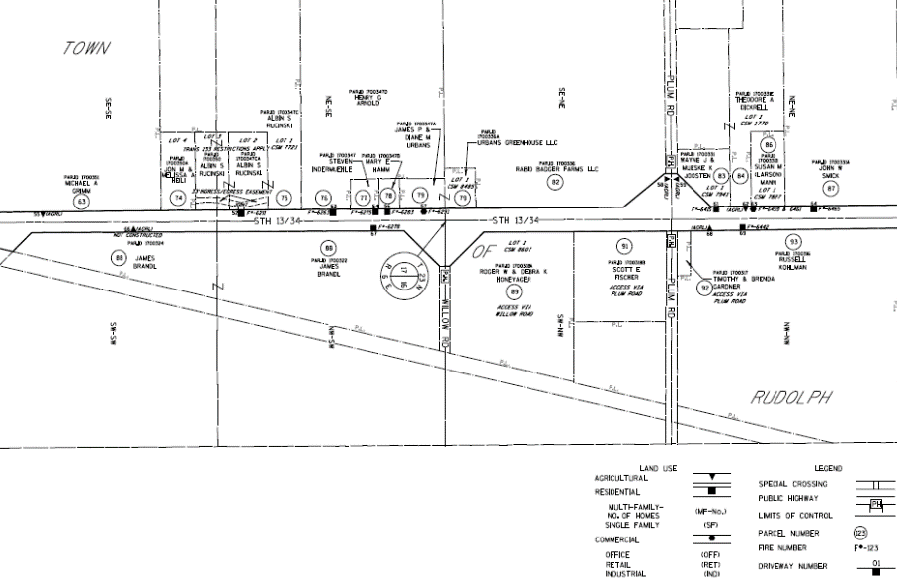
Public Ownership of Access Rights:
Including purchased access control
WisDOT may obtain an ownership interest in access rights from abutting property by:
  Acquisition under eminent domain (s. 84.09)
  Dedication by deed or plat
  Donation
  Non-accrual to abutting owner when highway is located on a new alignment
  Reservation of access rights when property is sold, such as a surplus land sale
Access-Related Wisconsin Statutes

Slide 7
Wis. Stat. s. 84.09 Acquiring Access Control:
Things to consider
Acquisition is used when outright ownership of access rights is sought
  Acquisition will require payment of just compensation for taking a land interest
  Use police power control when possible
    No compensation; provides more flexibility in managing access
Acquisition allows WisDOT to OWN the access rights acquired
  May be appropriate for particularly dangerous places, or
  Where WisDOT lacks police power authority to control access
    Such as along a local street within the functional area of an intersection
☞
Access-Related Wisconsin Statutes
Notes:
Additional considerations to mention for this slide:
Ownership remains with WisDOT even if jurisdictional authority is transferred to a local unit of government.
Older acquisitions that were made by local authorities, such as counties, on behalf of the State Highway Commission are State/WisDOT property that is held in trust by the local authority and cannot be sold by it.

Slide 8
Wis. Stat. s. 84.09 Acquiring Access Control: Things to consider (continued)
Once access rights are acquired, property owner cannot apply for an access (STH connection) permit
  WisDOT owns the right to seek permits for access rights it has acquired (Narloch)
Discuss individual access points during project scoping / investigation phase, and at time of right-of-way plat development (30% and 60% design reviews)
Typically not used when s. 84.25 (administrative control) is already in place, except in specific situations
Access-Related Wisconsin Statutes
Notes:
Additional considerations to mention for this slide:
Ownership remains with WisDOT even if jurisdictional authority is transferred to a local unit of government.
Older acquisitions that were made by local authorities, such as counties, on behalf of the State Highway Commission are State/WisDOT property that is held in trust by the local authority and cannot be sold by it.

Slide 9
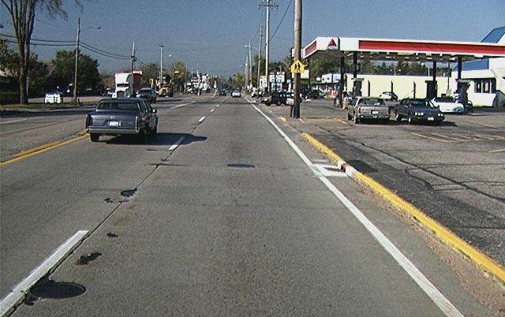
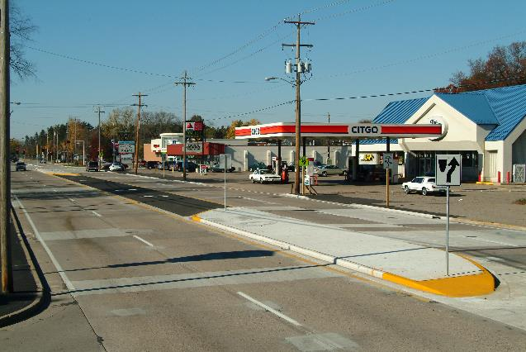
Wis. Stat. s. 84.09 Purchased Access Control: Example
USH 10 Access Management Project
BEFORE
AFTER
Access-Related Wisconsin Statutes
Notes:
Note: This was in prior program
What are “before” and “after” photos illustrating?

Slide 10
Sale of Surplus Land: Access Considerations
When WisDOT-owned land is designated as surplus for sale…
Review documents to identify any access restrictions
ANY conveyance of the land MUST re-reserve the access rights, or
WisDOT may find that it no longer owns those access rights
Access-Related Wisconsin Statutes

Slide 11
Surplus Land Sale: Case Study (Actual Situation)
WisDOT bought a parcel years ago that included access rights
WisDOT decided to sell the parcel as surplus property
The access controls from the original purchase merged with WisDOT’s outright ownership interest in the property
WisDOT needed to, but did not reserve the access rights as part of the sale
  WisDOT lost those access rights, and would have to pay to reacquire them
Access-Related Wisconsin Statutes

Slide 12
Wis. Stat. s. 84.25 Controlled-Access Highways:
What it does
Authorizes WisDOT to place access controls on properties abutting rural portions of a state trunk highway by following administrative procedures
Once designated, it is recorded and the highway is considered a controlled-access highway
No rights of access remain except the “controlled right of access”
Gives WisDOT “administrative control” to manage access while the highway is still in its rural state
  Remains in place after urbanization
☞
Access-Related Wisconsin Statutes

Slide 13
Wis. Stat. s. 84.25 Controlled-Access Highways
Access-Related Wisconsin Statutes
Notes:
84.25 plats are created and recorded that set the places at which authorizations for access exist.

Slide 14
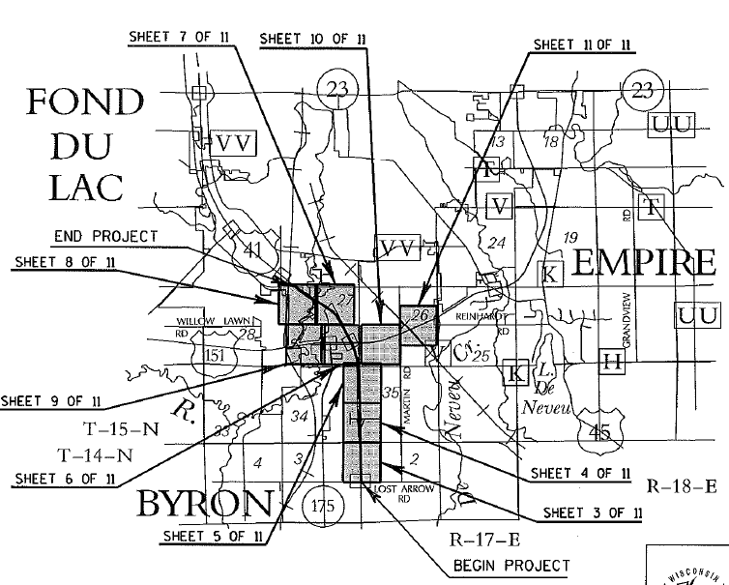
Wis. Stat. s. 84.25 Controlled-Access Highways:
When to Use It
Use on selected highway corridors on the map, not tied to an improvement project
Corridor designated based on need to limit direct access for public safety and welfare
Applied where future access requests are expected due to traffic or development pressure
Access-Related Wisconsin Statutes

Slide 15
Wis. Stat. s. 84.25 Controlled-Access Highways:
Considerations
What to consider after implementation
How to manage access as properties develop or the highway is improved
The processing of access permit requests
Updating the project over time
Effect on roadway improvement projects
Tip: Consult with Central Office before budgeting funds for a project
  FDM 4-5-1
Access-Related Wisconsin Statutes

Slide 16
Wis. Stat. s. 84.295 Freeways and Expressways: Explained
Determine future STH system needs
Allows access control on properties abutting freeways and expressways
Caution: Statutes require the purchase of existing access for designating freeways on existing alignments with no planned service roads
Access-Related Wisconsin Statutes
Notes:
AADT requirement of 4,000 to be a designated freeway or expressway

Slide 17
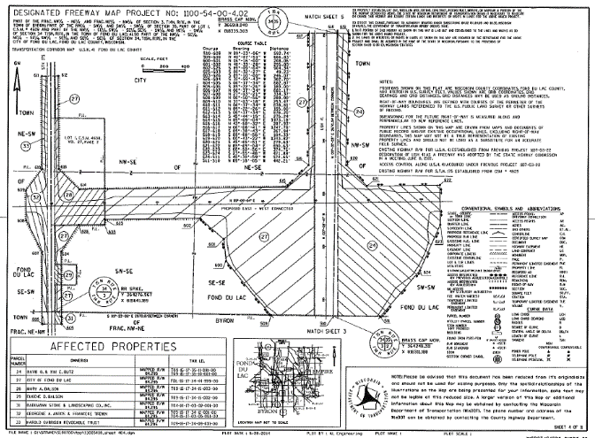
Wis. Stat. s. 84.295(10) Mapping Freeways and Expressways: Process
Determine future STH system needs
  Establish the future right-of-way
  Create “reserved area” maps indicating the need
  Record a notice of that action
Can acquire land in advance if a development is proposed
Any affected property owner must give WisDOT 60-days notice if they intend to erect or move into a new structure, or if they intend to rebuild, alter or add to any existing structure. WisDOT has 60 days to purchase ROW.
Access-Related Wisconsin Statutes

Slide 18
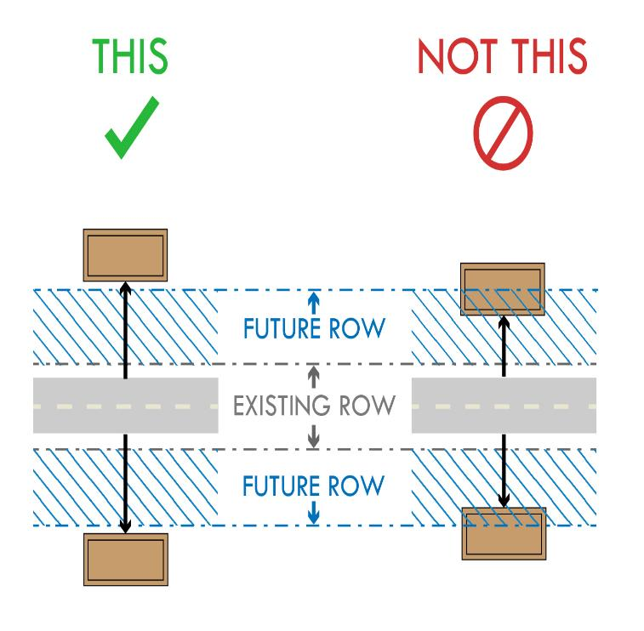
Wis. Stat. s. 84.295(10) Mapping Freeways and Expressways: Explained
Buildings placed outside future ROW
Buildings encroaching into future ROW need to be purchased or relocated, or project redesigned
Helps prevent costly relocations on lands needed for future highway construction or compromises to the project design due to insufficient ROW
Can plan ROW for frontage roads when a freeway/expressway will replace an existing road with access along it
Caution: Statutes require the purchase of existing access for designating freeways and expressways on alignment with no planned service roads
Access-Related Wisconsin Statutes

Slide 19
Wis. Stat. s. 86.05 Entrances to Highways Restored: Process
Review accesses along the highway being reconstructed
Coordinate with real estate when right-of-way is being purchased
NOTE: The law does not require every entrance to be reconstructed
  Do not construct additional accesses either during project
See Real Estate Program Manual sections 2.7.2 and 2.8.4
  Remove illegal accesses
  Restore only those necessary to serve properties
  Consolidate accesses wherever possible
  On relocation, no right of access accrues to any abutting property owner
Access-Related Wisconsin Statutes

Slide 20

Wis. Stat. s. 86.09
Access to Cemetery Preserved
“In all cases where the paving, improvement, change of grade or any other change in the condition of any street or highway in this state shall operate to cut off, impede or obstruct the access or approach from such highway to a cemetery, it shall be the duty of the local or state authorities … to preserve such access or approach in an equal degree of usability.”
Access-Related Wisconsin Statutes

Slide 21
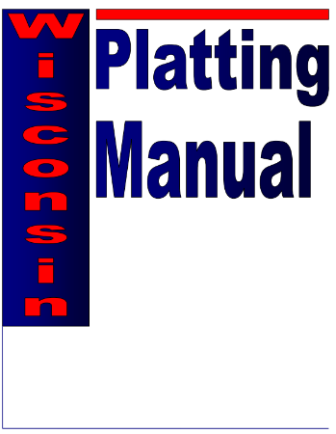
Wisconsin Access Statutes and Administrative Rules Related to Subdivision Plats
Chapter 236
  Region plat reviewer reviews subdivision plats
  Work with region access management engineer/coordinator and/or permit engineer/coordinator
  Subdivisions may include restrictions on access for initial development but also for future splits and changes
Trans 233: Admin Rule related to Ch. 236 Subdivision Platting Process (and WisDOT’s objecting authority)
  Special rules regarding the subdivision of land abutting state trunk highways and connecting highways
Access-Related Wisconsin Statutes

Slide 22
Trans 233 Division of Land Abutting a STH or Connecting Highway: Explained
Review land division to ensure it will not compromise WisDOT’s access management goals
Appropriate requirements are placed on a property to mitigate the potential impact of the development on the highway system
WisDOT may object to a proposed subdivision plat thereby preventing the plat from being recorded
  WisDOT Objectives:
  Provide for safety
  Preserve the public interest and investment in state trunk highways
  Enhance capacity and operations
  Support efficient movement of freight and goods
☞
Access-Related Wisconsin Statutes

Slide 23
Trans 233 Division of Land Abutting a STH or Connecting Highway: Explained (continued)
The process proactively ensures a long-term access plan
  Mitigate traffic impacts on the highway caused by increased access requirements from the subdivided lands
  Protects the subdivision lot purchasers from buying lands with limited or no access to the state highway
  WisDOT Objectives:
  Provide for safety
  Preserve the public interest and investment in state trunk highways
  Enhance capacity and operations
  Support efficient movement of freight and goods
Access-Related Wisconsin Statutes

Slide 24
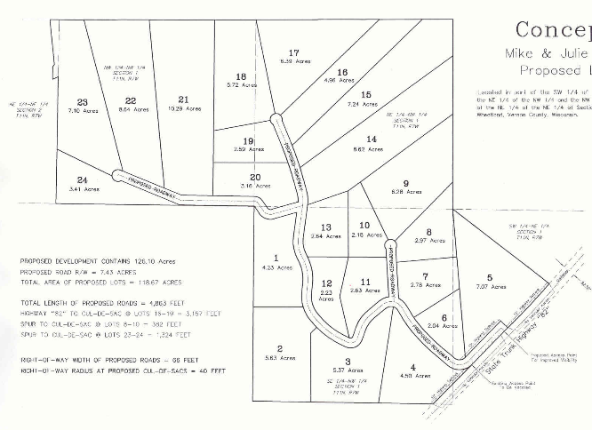
Administrative Trans 233 – Subdivisions
WisDOT has objecting authority for subdivisions with 5 or more lots
  Intersecting roads
  No direct access from internal parcels
  Setbacks
  Vision corners
  Drainage
Access-Related Wisconsin Statutes
Notes:
Under TRANS 233, WisDOT is an objecting authority for subdivisions with five or more lots of less than 1.5 acres each. Trans 233 governs what is allowed to be within the setback from the STH. The setback limits are either 110 feet from centerline of the STH or 50 feet from r/w line whichever is more restrictive. The Region Access Management Coordinator should be involved.

Slide 25
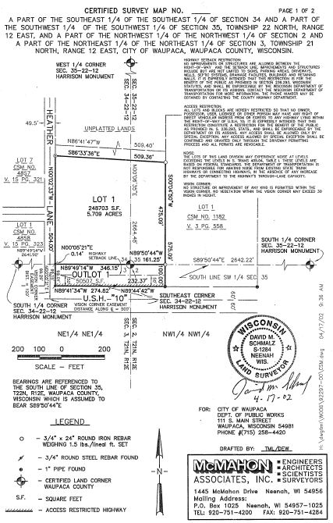
Trans 233 – History
Has always applied to subdivisions
2/1/1999 to 1/28/2004:
Included certified survey maps
and other land divisions
  These may have access restrictions
  in place
  May be modified with Central Office approval if it is in the public interest
Access-Related Wisconsin Statutes
Notes:
Discuss the misinformation on what happened as part of the rule changes.
Trans 233 has always applied to Subdivision Plats and still does, however, for a period of time (2/1/1999-1/28/2004), it also applied to CSM’s and all other land divisions that abutted the STH. During this time, CSM’s and all land divisions abutting the STH’s may have had access restrictions placed on them as well as the setback. Because a legal court case, it was decided that WisDOT only has the authority to review subdivisions. The flexibility to what was allowed in the setback has been removed for subdivisions.
Delete following text…
Some subdivision plats were illegally changed by surveyors removing the setback requirements as part of updates, so you may need to look back historically. Why CSM’s – because they may still have setbacks on them. The Region Access Management Coordinator should be involved.
WisDOT is only removing setbacks on CSM’s if requested.
By definition, Expanded CSM’s (need legal definitions) cannot contain only residential lots and must be for mixed use or commercial. A regular CSM can only have four lots. Expanded CSM’s can have an unlimited number of lots. In order to use Expanded CSM’s, the local government must enact an ordinance to allow them. Unlike Subdivisions, approval of Expanded CSM’s do not require DOA review.

Slide 26
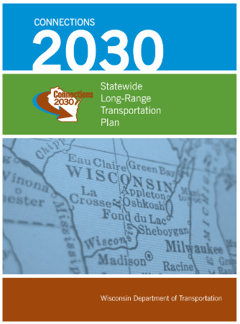
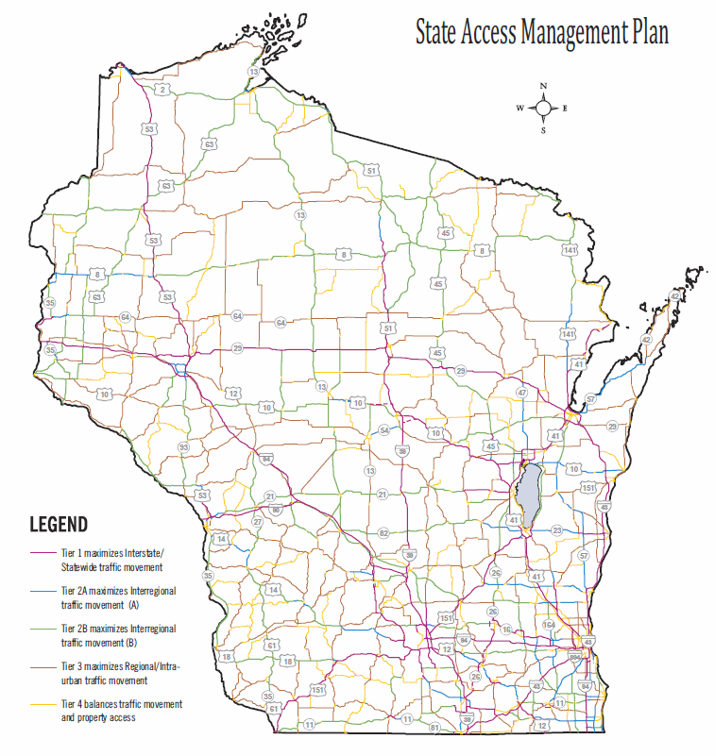
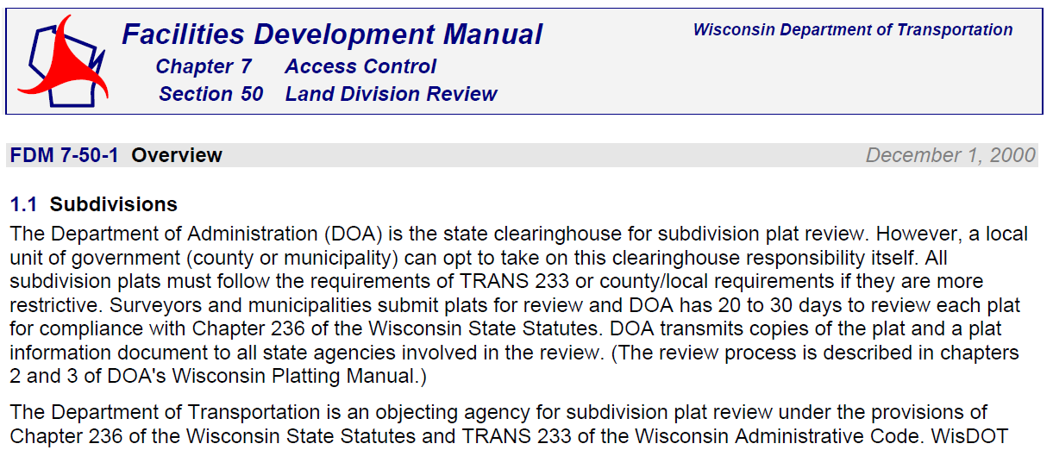
Chapter 236 Subdivision Platting: References
DOTNET Access Management site
DOA Plat Review Unit’s Platting Manual
Statewide Access Management Plan
FDM 7-50-1
Access-Related Wisconsin Statutes

Slide 27
Identifying Access Controls

Slide 28
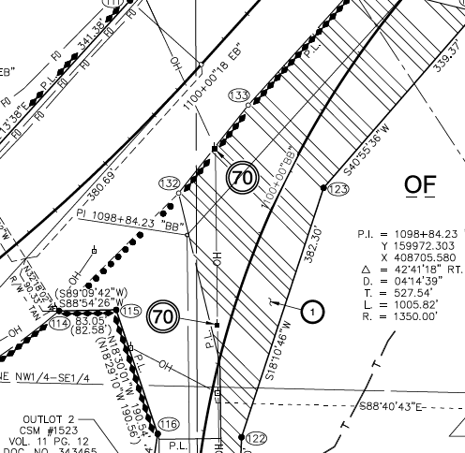
Current Access Related Symbols
Historical access symbols that may be found:
AP, special crossings, PD
AGR, FE, RES, etc.
Always check the map legend
|||
Access restricted by acquisition
Access restricted by previous project/controls
No access by statutory authority
(s. 84.295)
No access accrues (new highway)
Whiskers
Diamonds
Balls
Shark teeth (new)
Identifying Access Controls
Notes:
Historical Plats are not consistent in the meaning of symbols. These are the current meanings and best uses. CAUTION - Always first look at the map legend for that plat, and look at the recorded deed for clarification.
Note on this slide that the definitions of the varying symbols changed over time so the reader should look at the map legend for the correct interpretation. Example – Whiskers in the 1940’s-1960’s meant No Access, whereas they now mean Access Restricted through Acquisition. Diamonds refer to access controlled by prior access restrictions and should tell the reader to look at other sources such as the title to determine the exact restriction. A new symbol “Shark Teeth” denotes a new highway which does not have access because it is on a new alignment. Access rights do not accrue by default of creating a new roadway.
OGC Comments:
“Access” used in this presentation means the ability to enter and exit a property by means of driving a motor vehicle directly from the roadway onto abutting lands. Restriction of pedestrian or bicycle access applies only to freeways.
Whiskers – For the current project for which the map was created. Diamonds are used for previous controls.
Diamonds – Always refer to the instruments under which lands were acquired for the project to determine exactly what rights were actually acquired.
Shark Teeth – No access accrues to land abutting a new roadway constructed on a new alignment.

Slide 29
Where to Look for Access-related Symbols and Restrictions
Recorded property deeds
Official jurisdictional reassignment documents
Scenic easements
Access covenants
s. 84.09 Transportation
Project Plat
s. 84.295(10) Freeway and Expressway Official Map
s. 84.25 Controlled Access Map (driveway symbols)
Subdivision plats/CSM’s –
Trans 233
Identifying Access Controls
Notes:
There are different Access Control Maps to be aware of where symbols are commonly found:
The Transportation Project Plat, where access rights are purchased as part of a construction or other project
On an official map related to expressways/freeways
On the Controlled Access Map – This map also includes various driveway symbols such as “Access Point”, Field Entrance”, “Private Driveway”, Residential Use Only”, etc..
Also, “1-AP” Gives the right to request a driveway connection, it is not a guarantee of access because of conditions such as the use of the driveway.

Slide 30
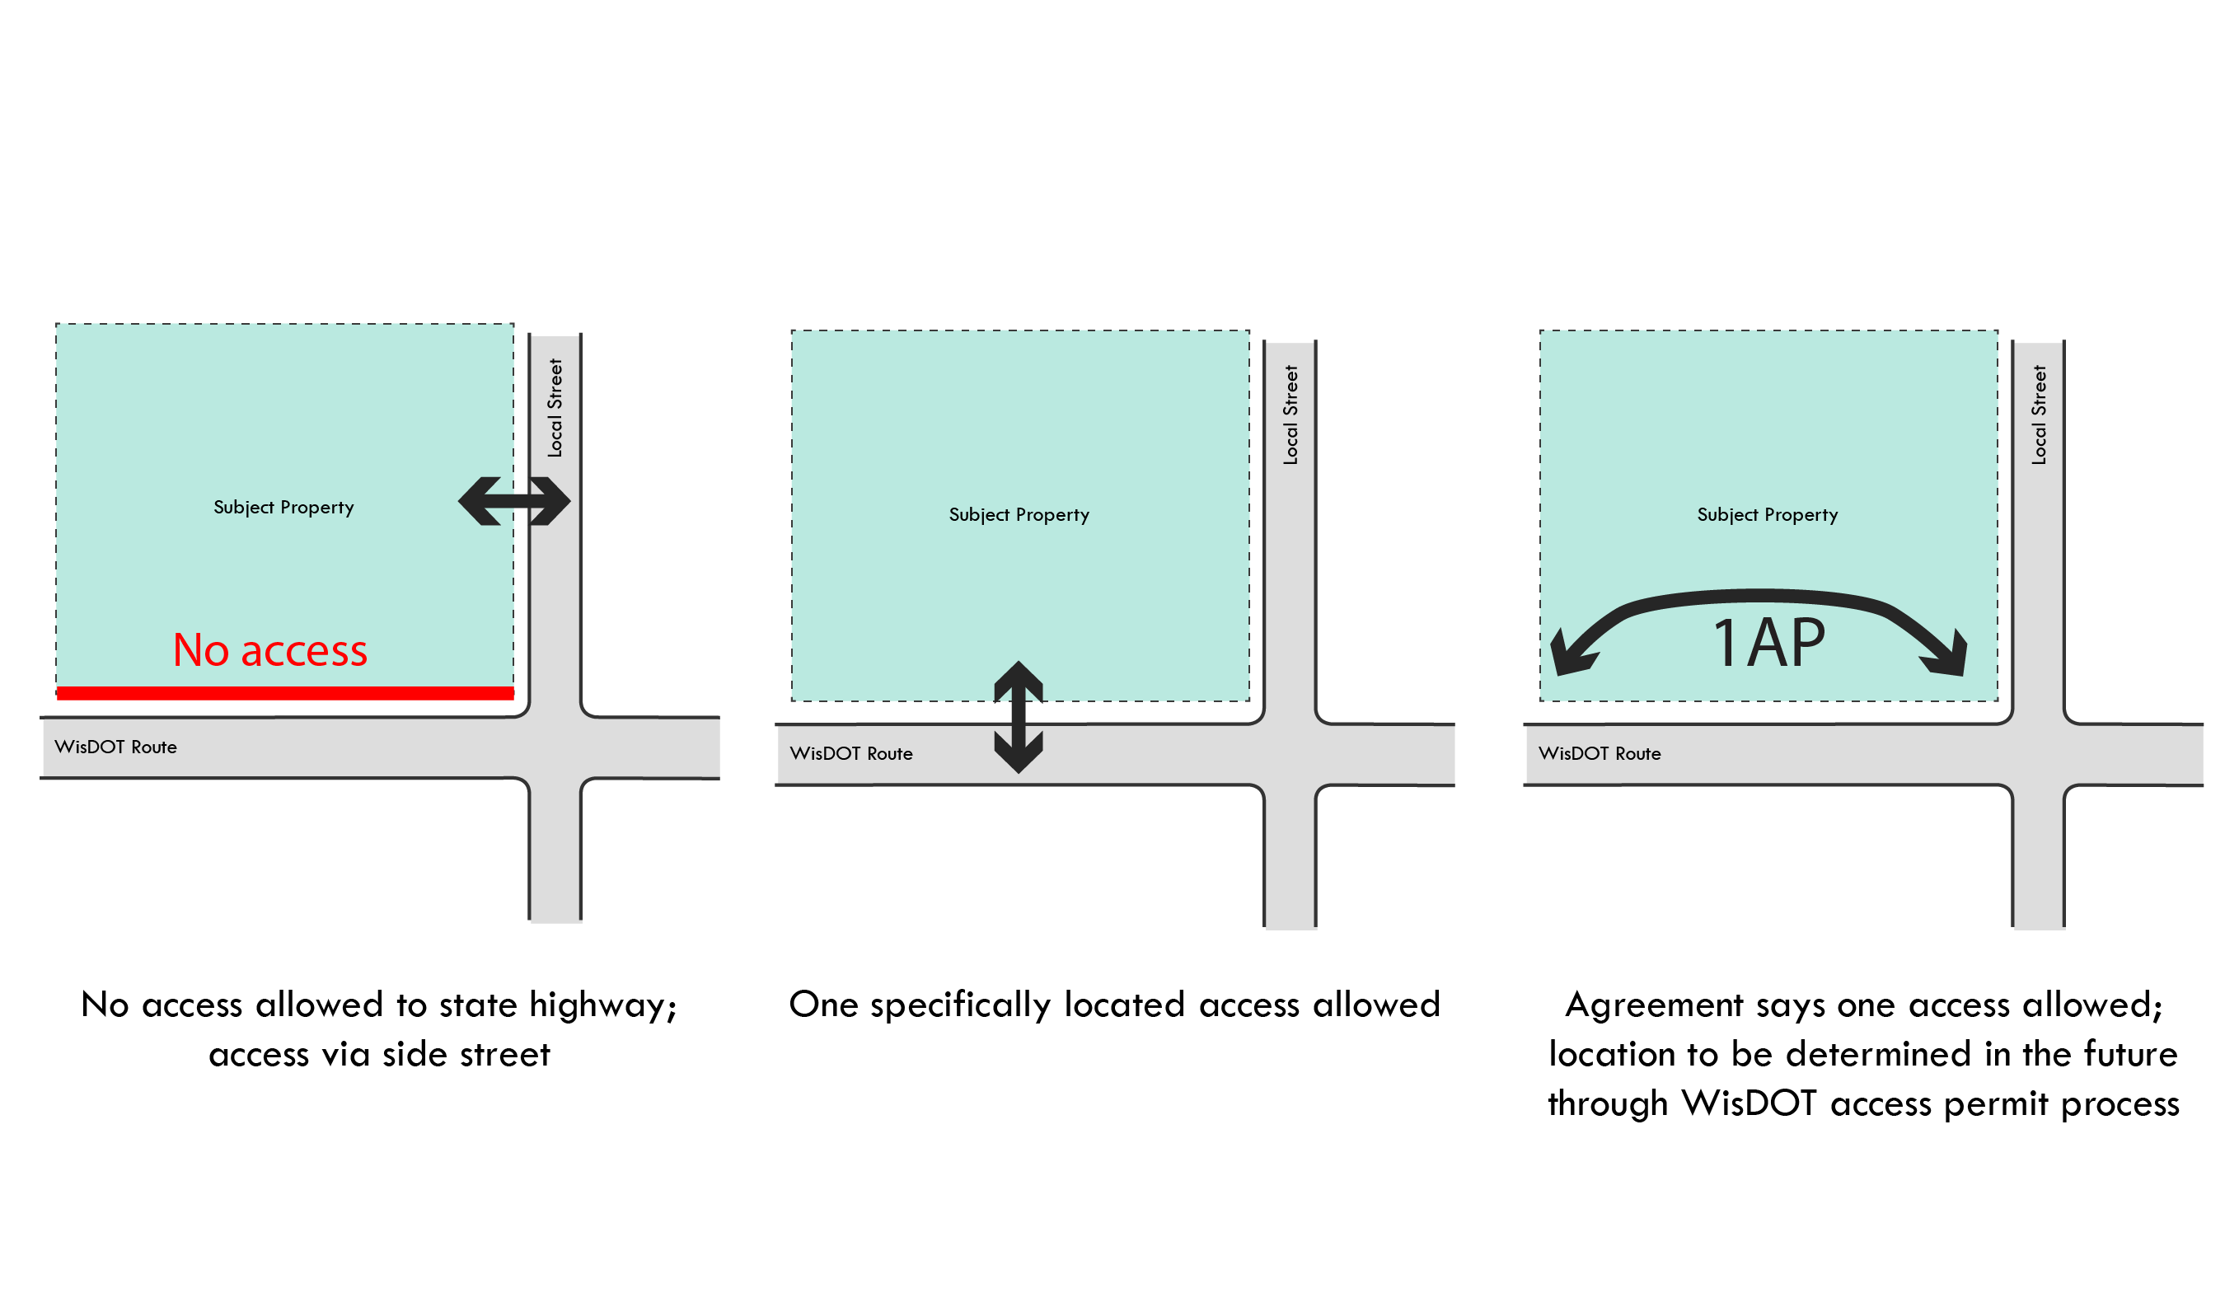
Examples of Acquired Access (s. 84.09)
No access allowed to state highway; access via side street (always shown on project RE plat)
One specifically located access allowed (may be shown on plat)
3. One access allowed between two points, as determined by WisDOT (No longer used)
In examples 2 and 3, a connection permit will be required to construct the access point
Identifying Access Controls

Slide 31
Sample Plat – One AP/PD Between Two Locations: No Longer Standard at WisDOT
AP = Access point
PD = Private drive
1 A.P.
Identifying Access Controls
Notes:
Here is an example of what an actual plat drawing may show. The 1 AP means one access point is allowed somewhere along the noted frontage area.

Slide 32
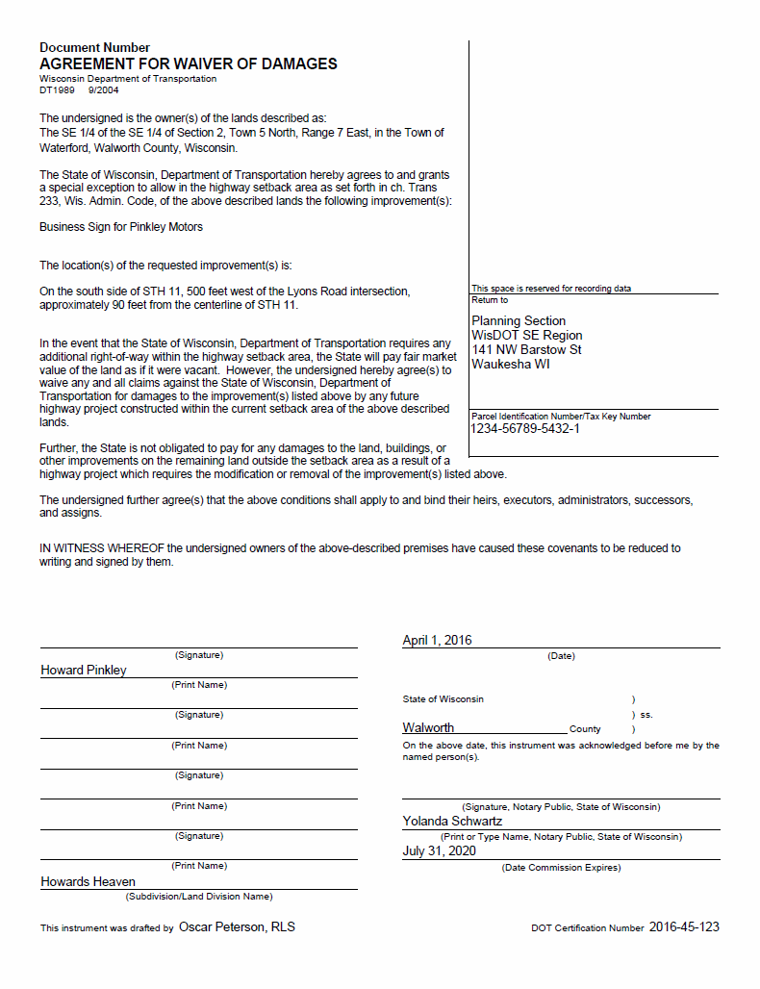
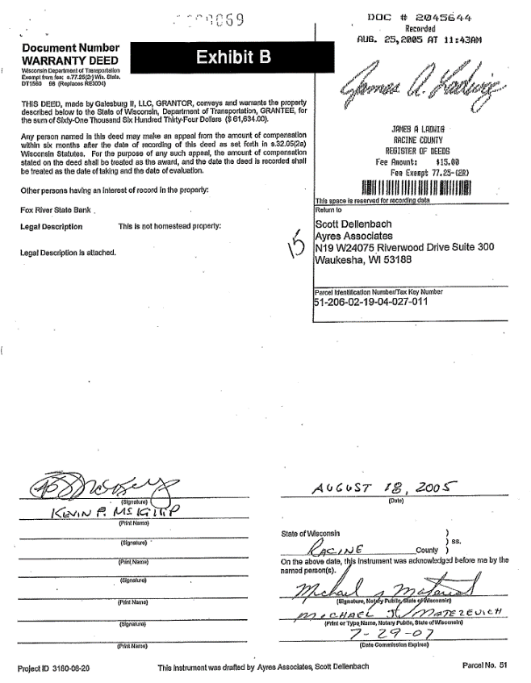
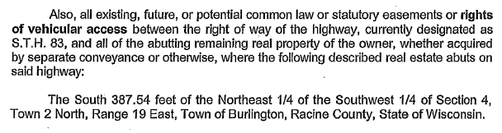
Recorded Property Deeds
s. 84.09 Acquired Access Controls
s. 84.09 Notice of No Access Rights Accrued
s. 86.07 Access Covenants
s. 84.25 Access Authorizations
Waiver of Damages
  Special circumstances required
Requires coordination between Planning, Real Estate and OGC Staff
{Insert picture of an 84.09 property deed with best access related language – use Sue V.}
Identifying Access Controls
Notes:
CAUTION - Access controls are documented on the deed. The deed is the ultimate location to confirm if access controls are in place on a parcel. Coordinate with Real Estate, the Region Access Management Coordinator and potentially OGC to avoid mistakes. Make sure to look for access control language that refers to prior deed documents as not all information may be on the last record.
Waiver of Damages are used for Trans 233 setback situations (today this occurs only where a variance is granted). It allows an improvement, such as landscaping, an access road, or building in the setback, but provides that it will be removed by the landowner without compensation if WisDOT opts to acquire the property for highway purposes in the future. These are usually reserved for improvements that are easily removed from the property.
It is typical for the Real Estate Staff to perform Title searches or reviews as part of planning projects, so both the planning group and real estate group should be looking for access language.

Slide 33
Jurisdictional Reassignments (JRs)
All access should be reviewed as part of STH to local JR so:
  Local government knows what they are getting (decide what it wants to continue)
  WisDOT may determine what controls to keep
All access should be reviewed as part of local to STH designation so:
  WisDOT knows what liability it may be acquiring
  WisDOT may negotiate with local government to correct access issues
    Avoid accepting a local highway where access is substandard to STH standards
    Avoid WisDOT costs to repair access problems that may result in costly safety or operational improvements in the future
Identifying Access Controls
Notes:
There are specific access situations to be aware of as part of jurisdictional reassignment. WisDOT has an obligation to identify which access controls are present on any highway being jurisdictionally reassigned to or from state highway status. As part of STH to Local JR, WisDOT should ensure the local recipient unit of government understands if and how access controls are affected by the reassignment. In addition, WisDOT may wish to retain some access controls, especially if the road still connects to an existing STH.
WisDOT should review access prior to accepting a local road for STH designation to ensure it is not inheriting an potential access problem that could result in costly improvements down the road to correct.
Jurisdictional Reassignments are included under §84.02. §84.02 (8) applies to situations where WisDOT has an ownership interest, whereas §84.02(3) requires an agreement from the local entity that had jurisdiction prior to the state highway designation in order to transfer the highway. Jurisdictional Reassignments cannot be written to include any ownership interests, access or otherwise, specifically acquired under §84.09.

Slide 34
Jurisdictional Reassignments
Various access controls to review for jurisdictional reassignments:
  s. 86.07 PERMIT – Remains in place unless it specifies it was only valid while on the STH
  s. 84.09 ACQUIRED – Runs with the property title as long as it is a public highway, and the acquisition deed does not state that the access rights extinguish if highway ceases to be a STH (can only be transferred by deed)
  s. 84.25 CONTROLLED ACCESS – These controls may be vacated once the STH designation is removed. Local government may enact an ordinance to perpetuate access controls. See WisDOT FDM 4-5-1 for more information
Identifying Access Controls
Notes:
Some types of access controls transfer with reassignment, some require separate actions to transfer, while some may simply extinguish. County may use s. 83.027 to maintain controlled access. Home rule is exercised by adopting an ordinance.
Access covenants are generally owned by the state, and need to be transferred like real estate.

Slide 35
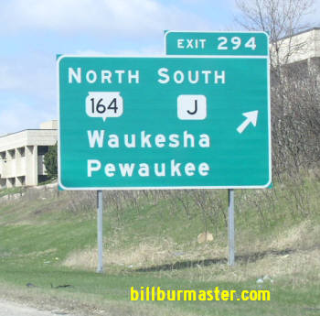
Example STH 164 (formerly CTH J)
Police Power Authority
STH 164 in Waukesha and Washington Counties
  Formerly existed as CTH J – County bought ROW for
  the county instead of for the State Highway Commission
  Highway was jurisdictionally reassigned by jurisdictional transfer action to WisDOT
  Counties that acquired access rights continue to own
  those rights today
  WisDOT is the permitting authority
  County could convey those rights to WisDOT if WisDOT was concerned about having ownership vested in the State
Identifying Access Controls

Slide 36


Scenic Easements
Typically were applied on entire segments of highway, but may occur in isolated locations
Restrictions can vary greatly from one parcel to the next, even on the same highway
Typically include development restrictions, but may include or involve access use restrictions placed on the recorded deed
Great River Road – WIS 35, La Crosse
Taliesin – WIS 23, Spring Green
Identifying Access Controls
Notes:
Scenic easements were typically applied to entire corridors to protect viewsheds such as along WIS 35 (Prairie Du Chen to Prescott), Great River Road located adjacent to the St. Croix National Scenic Riverway, a federally managed area. However, they can also exist on a spot location basis, such as along US 14 in the Black Earth area near Olson Drive. Or on WIS 23 in Spring Green to protect the scenic overlook near Taliesin.
Scenic easements were acquired in the 1950s with the cigarette tax…
Review the property title to determine if a scenic easement exists and review the easement document to identify any restrictions that may impact access. Changes to scenic easements may require Central Office approvals.

Slide 37
Access Covenants
Recorded agreement between a property owner and WisDOT that places STH access restrictions on owner’s property pertaining to:
  Number of accesses
  Location of access(es)
  Use or type of access
Used to clearly define a specific future action or unique restriction that must run with the property title rather than using permit alone
A covenant transfers the property owner’s rights specific to the item in the covenant
Identifying Access Controls
Notes:
This slide is intended to explain what an access covenant is and what to look for. Covenants promote planning for future development that minimizes the impact on the safety of the travelling public.

Slide 38
Driveway Permit Access Covenant
Owner wants a new driveway permit and has a lot of STH frontage
Potential for future development. Make the owner think about what s/he wants to do in the future and where the future access points should be.
Covenant is a condition of issuing the requested permit
Covenant identifies future access points at locations that meet WisDOT requirements
Identifying Access Controls

Slide 39
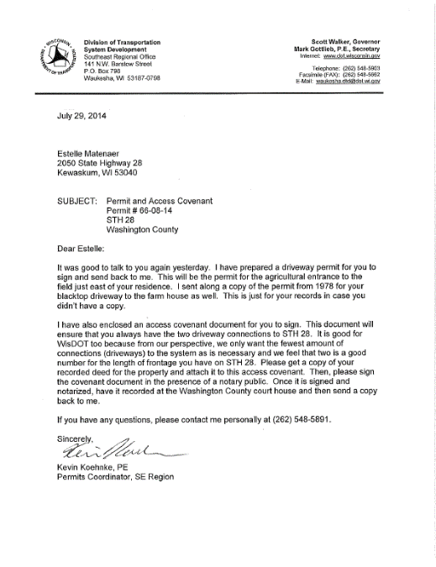
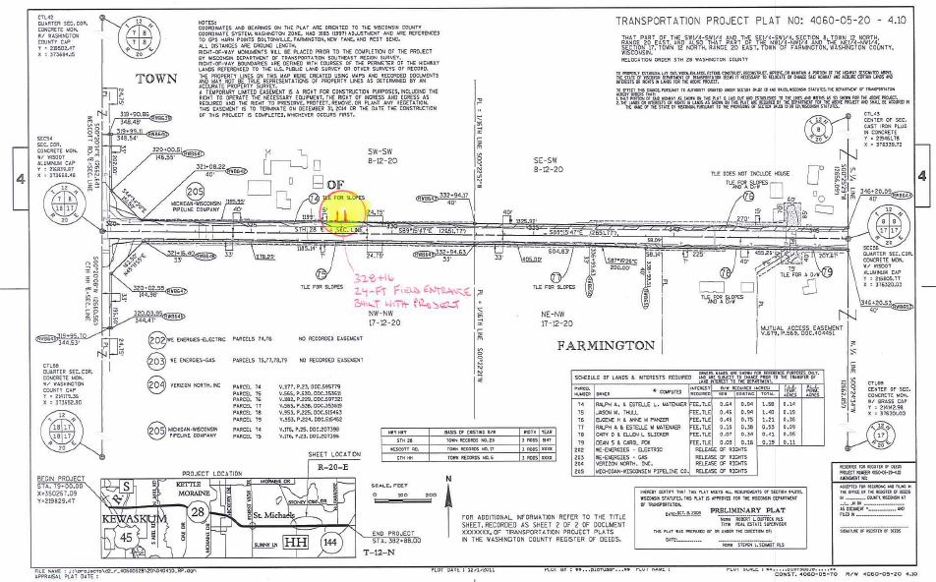
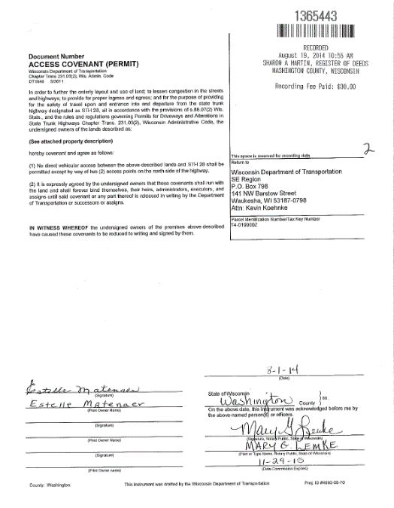
Access Covenant
Example:
Highway 28, Washington County
Identifying Access Controls
Notes:
This one actually came up during construction of a project. A lot of times an old ag access is being used and does not pose any safety issues. But the spot where the farmer is just driving off the road in the existing condition will not work after the project brings the roadway to current standards.
Projects replaces driveways in kind and in accordance with our ad-hoc review but some of the ag entrances are not even acknowledged on the plan. Since the access point has always been used, we get it permitted and lock up the rest of the frontage with an access covenant. I just fill it out and send it to them to have it recorded. When I receive it I issue the permit and include the access covenant.
A copy of the letter to the property owner is also attached.

Slide 40
Subdivision Access Covenants
Owner has more highway frontage than the proposed subdivision
Potential for future development. Make the owner think about what s/he wants to do in the future and where the future access points should be.
Access covenant is a condition of non-objection to the proposed subdivision
Covenant identifies future access at points at locations that meet WisDOT requirements
Identifying Access Controls

Slide 41
Access Covenants
When to use?
  SAMP Tiers 2a, 2b and 3
  Tie in with existing corridor plans
  Potential land division into many parcels fronting STH
  Advancing development; potential change of use
  Preserve functional area of an interchange or intersection
  Used to clearly define a specific future action or unique restriction that must run with the property title rather than by permit alone
  Used in anticipation of future changes along a STH corridor
Identifying Access Controls

Slide 42
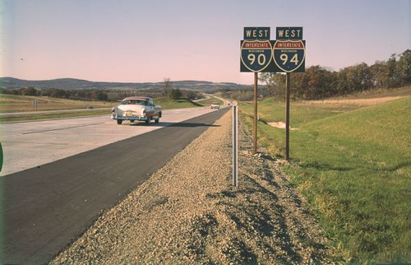
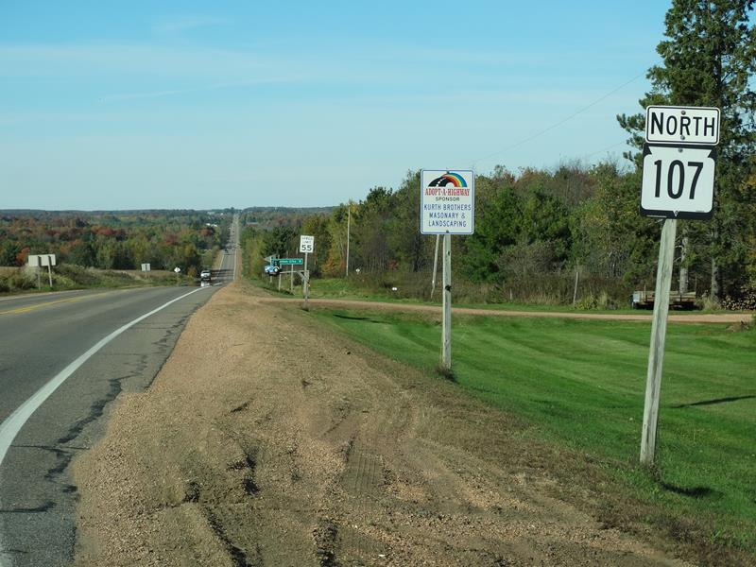
Access Covenants
When not to use?
  If existing access controls exist:
  ss. 84.09, 84.25, 84.29 or 84.295
  If STH is identified as a
  SAMP Tier 4 corridor
Identifying Access Controls

Slide 43
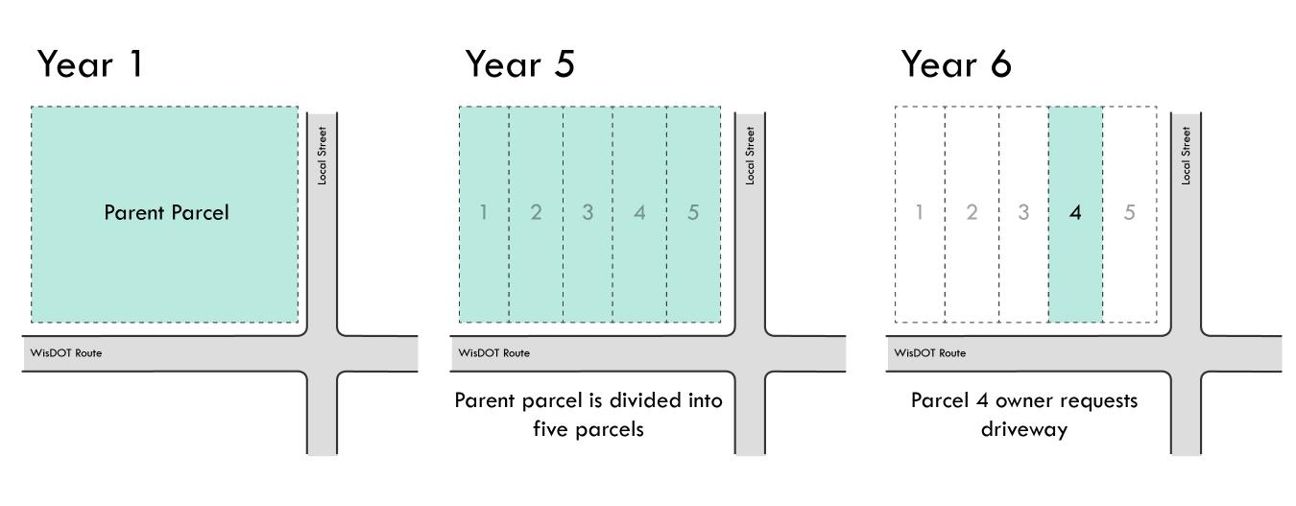
Case Study
It’s now year 6, the owner of lot #4 requests direct access to the STH
Do you approve the request?
What should you consider?
Identifying Access Controls
Notes:
Considerations: Width of lots, are there access controls in place, develop a plan for access with land owners and local government officials for all lots at this time, other ideas…?

Slide 44
Identifying Access Controls Takeaways:
Know how to distinguish eminent domain from police power
Don't pay for what WisDOT already owns
Communication is important – emphasize the benefits to safety and traffic flow with owners: Say, “We are improving the road” rather than, “We are reducing your access.”
Identifying Access Controls

Slide 45
Identifying Access Controls Takeaways:
Negotiators – don't offer compensation for police power controls
Appraisers – don't calculate value of access when its regulated by police power (i.e., don't pay for land being acquired and then more money for changes to access due to a change in road design or Wisconsin law)
Contact access management staff when excess land sales, jurisdictional transfers, and other transactions involve access issues
Identifying Access Controls

Slide 46
Acknowledgments
Special thanks to the WisDOT Access Management Team members who contributed their time, input, and experiences to develop this training program:
Mike Roach – Statewide Access Engineer
Sue Voight – SE Region Access Coordinator
Dave Nielsen – NE Region Access Engineer
Tom Beekman – NW Region Planning Chief
Ernie Peterson – Statewide Access Engineer (Retired)
Bob Fasick – State ROW Permits Engineer
John Sobotik – Assistant General Counsel
Kathy Batha – Assistant General Counsel
Consultants:
Brad Strader, MKSK, TRB Access Management Committee member
Charles (Chuck) Wade, TranSmart, consultant for WisDOT 2005 Access Management Training program
Bill Eisele, TTI and TRB Access Management Committee past member
Karen Dixon, TTI and TRB Access Management Manual co-author
Josh Penn, LSL Planning, a SAFEbuilt Company

Slide 47
Discussion

