Slide 1
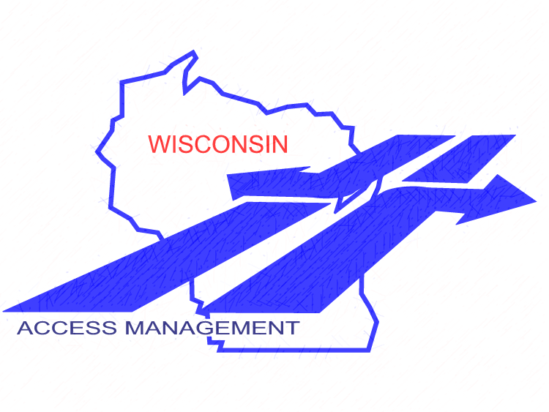

Access Management
Module 4: Planning
Wisconsin Department of Transportation
Final: 1-13-18

Slide 2
Module Outline
This program discusses access management as it relates to planning and the improvement program
Today’s session format
  Review of plans, programs
  Hands-on exercise
Speaker introduction
Modules:
Summary of Principles and Practices
Introduction to Legal Foundations
Access Standards
(4) Planning
Identifying Access Controls
STH Connection Permits
Special Topics
References & Resources
Notes:
Session format- This program is generally set up for ~50 minutes of presentation, to give you time for Q&A. If a hands-on component is included, you may also want to include a short break. Speakers should welcome everyone, explain where restrooms are located, describe Q&A protocol. Remind everyone of the informal, participatory atmosphere and to be respectful of other’s time. Encourage audience to save more targeted questions and “war stories” until after the session, unless it directly enhances the group discussion. Depending on audience size, it is suggested to limit questions to no more than 2 straightforward questions per individual, offer to take longer or additional questions after the presentation.
Speaker Introduction- give a brief intro of speakers, where they are from, background information and contact information

Slide 3
Module 4: Planning
⇨ Objectives ⇦
Which state plans include access management
Which local controls are related to access management
Where to find what access controls may exist for your projects
Which WisDOT studies specifically relate to access management
How planning considers area characteristics, especially “Main Streets”
When and how to coordinate with other WisDOT staff and stakeholders

Slide 4
Introduction
Access Management for Wisconsin

Slide 5

Wisconsin is an Access Management Leader
s. 66.1001 | Comprehensive Planning
s. 84.09 s. 32.09 | Acquisition of Lands and Interests Therein Rules Governing Determination of Just Compensation
s. 84.25 | Controlled-Access Highways
s. 84.29 | National System of Interstate Highways
s. 84.295 | Freeways and Expressways
s. 86.05 | Entrances to Highways Restored
s. 86.07(2)(a) | Digging in Highways…(Permits)
Trans 231 | Permits for Driveways and Alterations in STHs
s. 86.073 | Review of Denial of Permit (Appeals)
s. 86.09 | Access to Cemetery Preserved
Ch. 236 | Platting Lands and Recording & Vacating Plats
Introduction: Access Management for Wisconsin
Deeper Dive in Module 2
Notes:
Wisconsin is a leader in access management controls for preserving the function of our state highway system for safety and economic viability. We have several statutory and administrative controls that have been part of state law since the late 1940’s granting WisDOT more police powers than many other states. For this reason, you need to be aware that there may be several controls in place along a state highway, and what you do could impact access controls that may be in place. Never take a state highway at face value and be prepared to look back several years as individual issues arise. We’ll talk about some of the mechanisms that you may encounter later in the presentation. Statue s. 32.09 is not directly related to access management, however it is the mechanism for which the compensatory value of access is determined.

Slide 6
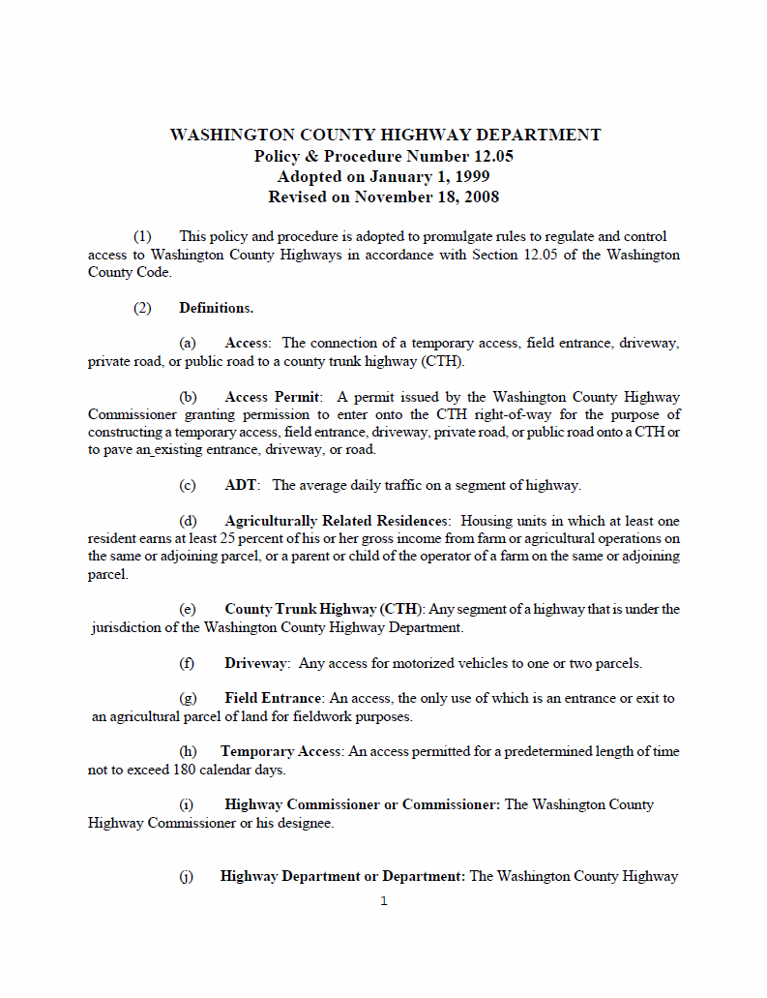
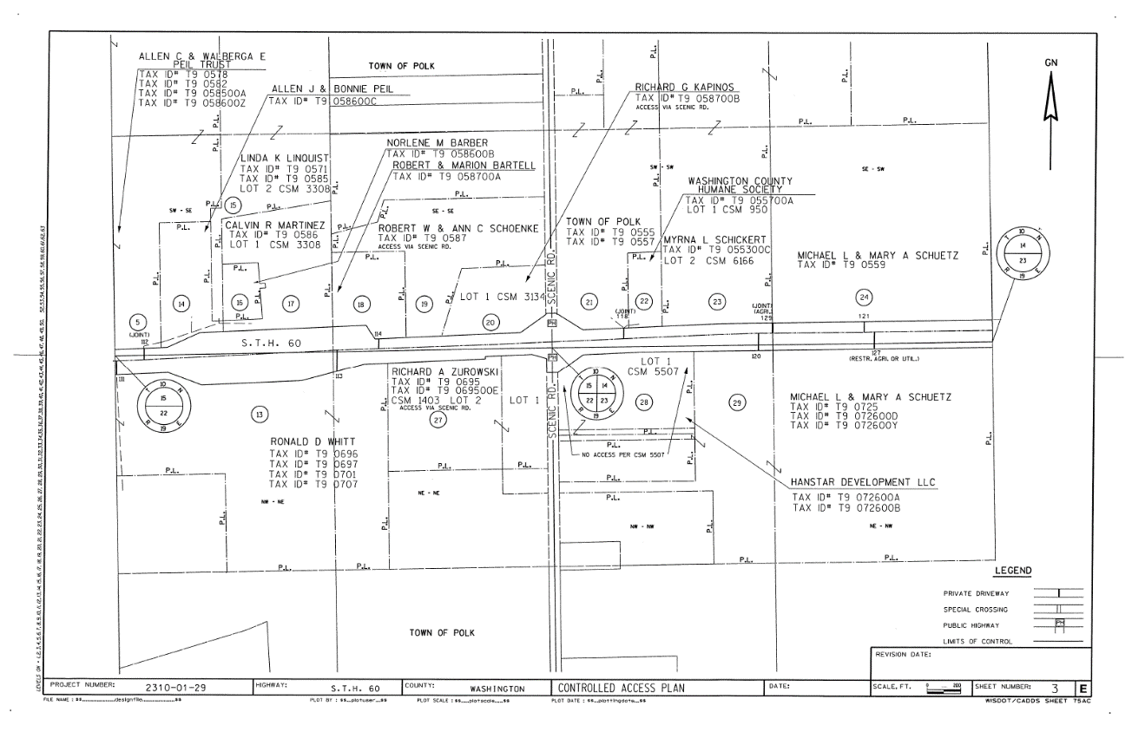
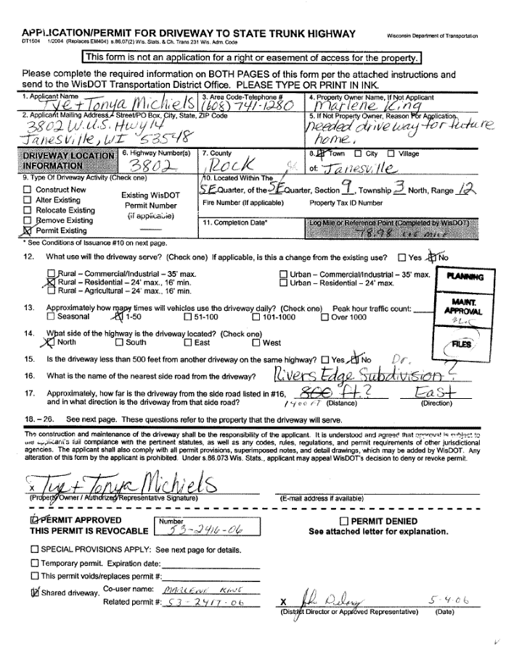
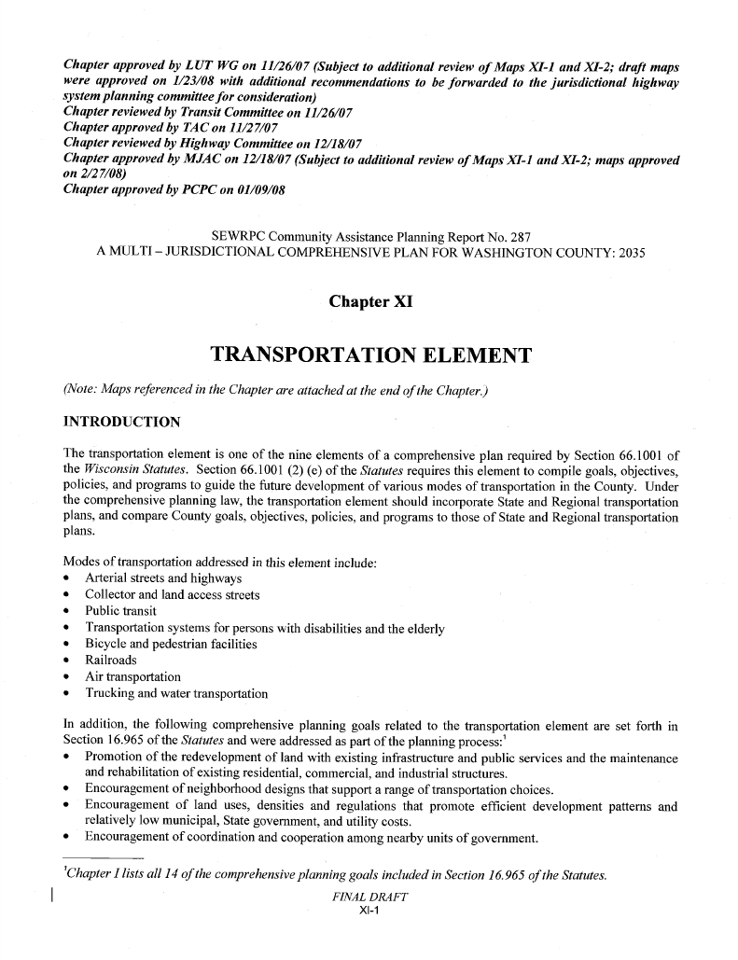
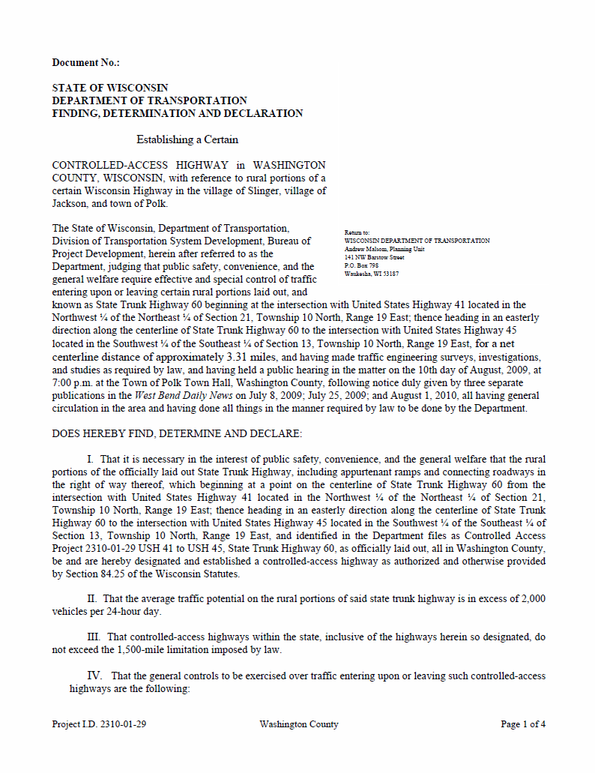
Plats
Declarations
Permits
Subdivisions
Be aware that there are several types of documents that implement access controls at both the state and local level
Deeds
Covenants
Introduction: Access Management for Wisconsin
Notes:
Because of the breadth of Access Management related statutes and Administrative Rules, there are several documents that you should be aware of including descriptions on property deeds specifically for access rights, permits to work along a state highway including driveway alterations (driveway permits), Declarations designating highways as expressways and freeways, which by definition have certain access controls, access control maps under state statue 84.25, Access Covenants, subdivision plats adjacent to state highways, and a few other more rare situations such as waiver of damages. In addition, local municipalities and Counties may also have identified access management strategies in the transportation elements of their comprehensive plans or specifically by ordinance, which may be more stringent than WisDOT requirements.
It is a good practice to include the Region’s Access Management Coordinator early as part of project scoping. There may be opportunities to meet with property owner’s prior to project design to explain access management, identify the potential for changes and provide an explanation of how including access changes as part of the project cost vs. the owner needing to make changes later at their on costs, which can be costly. It is a good practice to have these discussions ahead of initiating formal procedures such as issuing driveway permits, or before making design changes.

Slide 7
Statewide Plans
Related to Access Management
Access Management and Statewide Plans

Slide 8
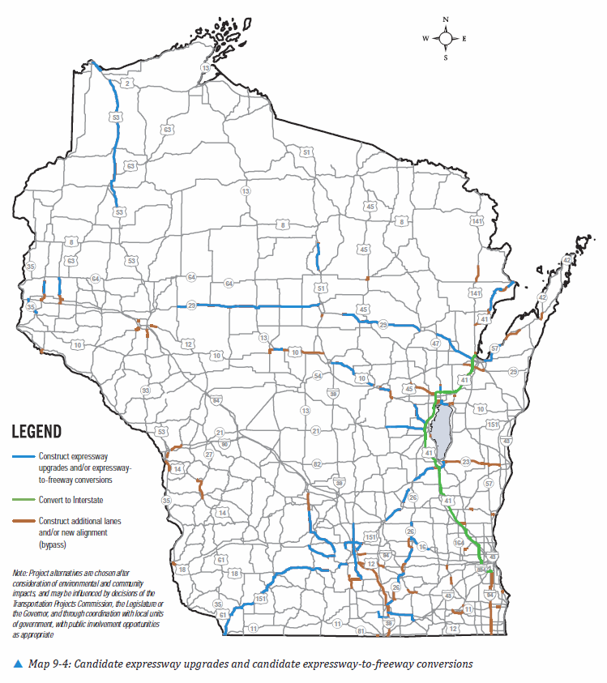
Long-Range Transportation Plan
Connections 2030:
  Corridors 2030 System
  Expressway Upgrade Plan →
  Expressway-to-Freeway Conversion Plan →
  State Access Management Plan (SAMP)
Access Management and Statewide Plans
Notes:
Connections 2030 is the state’s long-range transportation plan and includes strategies for several state highway corridors across the state. It was developed through an extensive public involvement process and is the foundation for more detailed study. For access management it identifies priority corridors for future freeway/expressway designation, upgrade, or conversion, includes priority corridors in the Corridors 2030 plan and State Access Management Plan (SAMP) that directly relates to the type and location of access controls on the STH system. This figure identifies potential corridors for upgrade to expressways and expressway-to-freeway conversion.

Slide 9
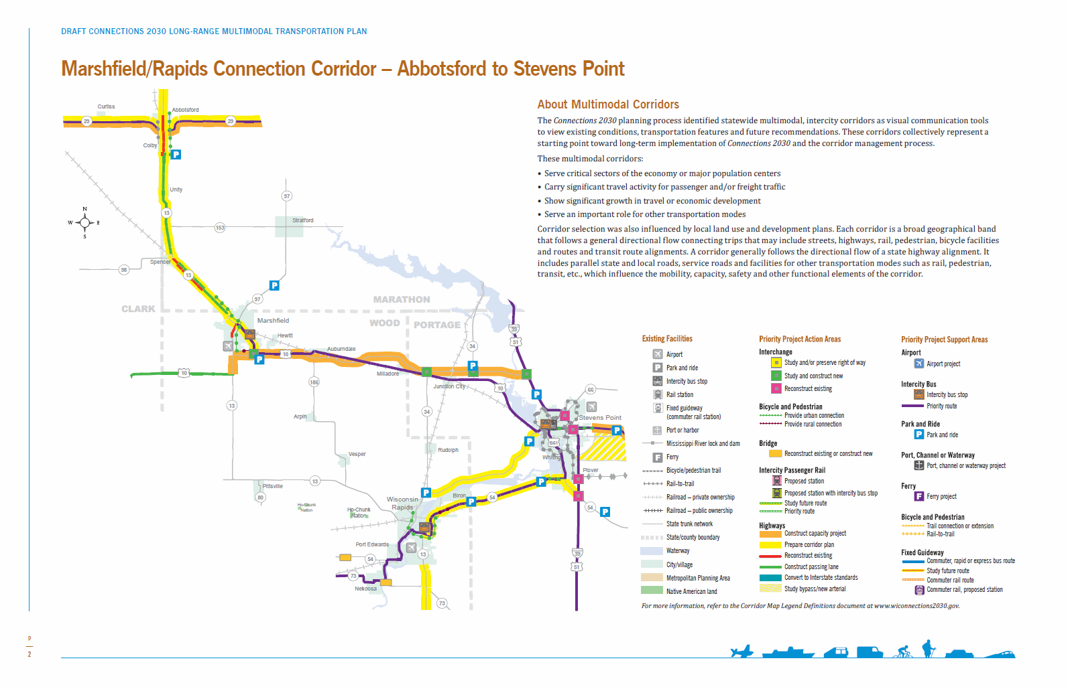
Connections 2030 Priority Corridor
Access Management and Statewide Plans
Notes:
Example of a priority Corridor included in the Long Range Plan. Reviewing the map legend and summary table can show if the corridor has been identified as a candidate for upgrade and or other access related implications.

Slide 10
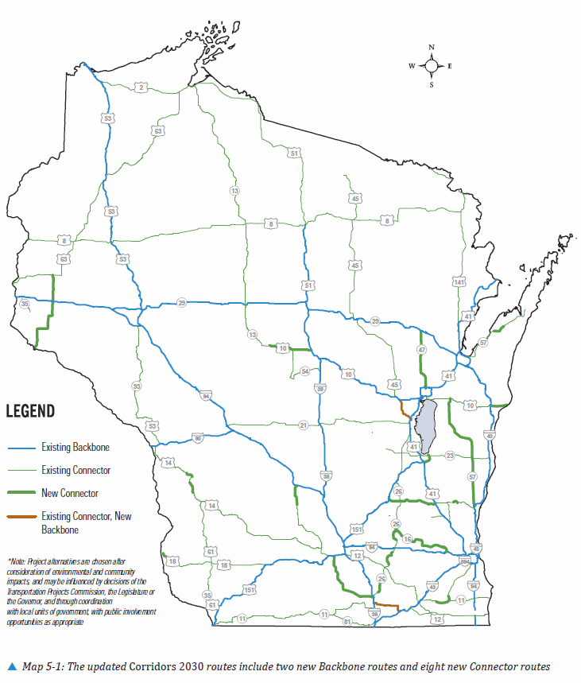
Corridors 2030
Backbone routes
  Are the highest value inter- and intra-state multilane highways connected
  to the national transportation system
  Typically where s. 84.295 projects
  are applied
Connecting routes
  Are high quality 2- and 4-lane highways connecting to backbone routes
  Typically where s. 84.25 projects are applied
Access Management and Statewide Plans
Notes:
Corridors 2030 – is the statewide plan identifying the Backbone and Connecting Route system. These routes are a vital component to Wisconsin’s economy for the movement of freight and services within and between our neighboring states. All backbone routes and most, but not all connecting routes are part of the National Highway System (NHS). Backbone routes are the most likely candidates for expressway upgrade, and expressway-to-freeway conversion projects under s. 84.295. Any new s. 84.25 projects would be located on connecting and other two-lane rural state highways where preserving regional mobility goals are desired.

Slide 11
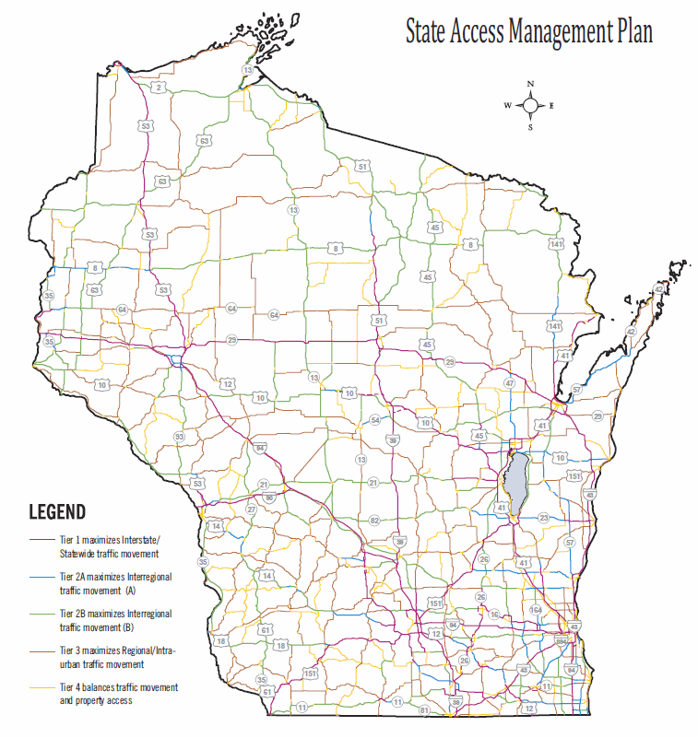
State Access Management Plan (SAMP)
Access Tier 1
  Freeways/expressways
    s. 84.295
Access Tiers 2A and 2B
  Corridor access control
    s. 84.25
Access Tier 3 and 4
  Spot location access control
    s. 86.07(2)(a)
Deeper Dive in Module 5
Access Management and Statewide Plans
Notes:
The State Access Management Plan (also located within Connections 2030) is the state’s plan for identifying the appropriate level of access controls that should be implemented along a state highway corridor. Generally, Tier 1 corridors are corridors designated as freeways/expressways. Most corridor level access controls would be located along Tier 2A and 2B corridors in an effort to preserve the long-term function of those corridors. Exceptions include some corridors located in urban areas of Milwaukee. For all other state highways falling under Tiers 3 and 4, typically access is managed through the permitting process under s. 86.07(2a). s. 84.09 which occurs as part of projects or case by case and can be applied on all of the SAMP Tiers.

Slide 12
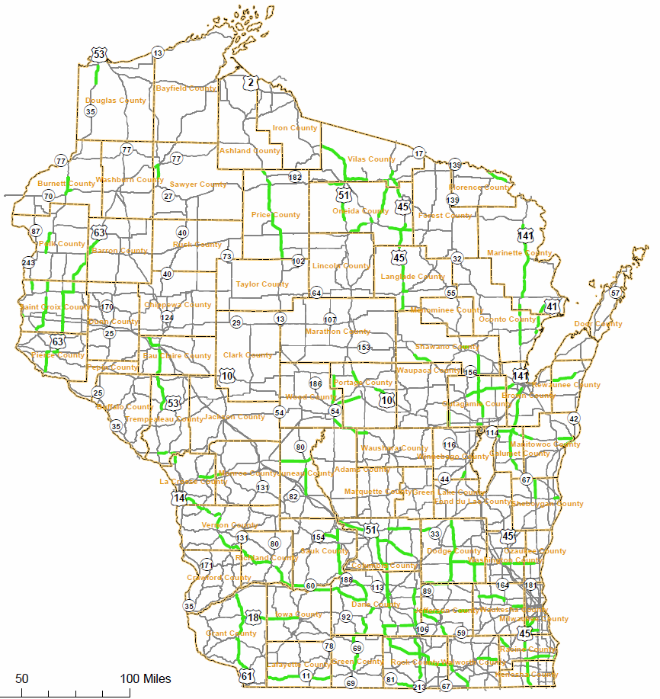
Map of Active s. 84.25 Projects
1,500 miles enumerated
  Requires state legislature to change
1,300 miles active
    Miles must be vacated to replenish available miles if needed
200 miles currently available
Access Management and Statewide Plans
Notes:
This map shows all of the STH segments with s. 84.25 in place across Wisconsin. There were 1,300 miles in 84.25 across the state in 2015. There are currently 200 miles available that can be used for s. 84.25. There can only be 1,500 miles in 84.25 at any given time unless a change by the state legislature would be made.

Slide 13
Local Government Plans/Controls
Related to Access Management
Access Management and Local Plans/Controls

Slide 14
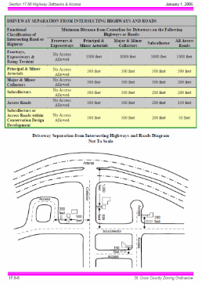
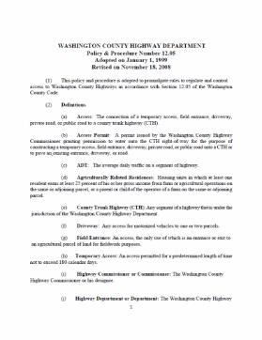
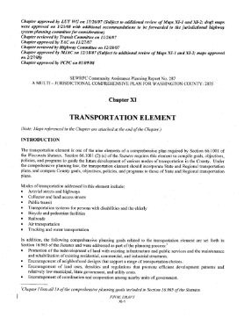

Plans/Controls with Access Management
Comprehensive plans under
s. 66.1001
Local zoning ordinances
Local access control ordinances
Access Management and Local Plans/Controls
Notes:
The next several slides will discuss local government implemented access management applications that may be encountered on public roadway connections to the state highway or in situations where the state highway runs through a municipality. We’ll touch on Wisconsin’s Smart Growth Legislation and why it influences access, local zoning ordinances, and other access control ordinances that should be considered.

Slide 15

Wis. Stat. s. 66.1001 Comprehensive Plans
To ensure zoning ordinances are consistent with the comprehensive plan
The transportation element of the plan emphasizes the land use/transportation relationship
  May influence access decisions on the state highway
  Opportunity for WisDOT to collaborate if asked as part of regular updates
Access Management and Local Plans/Controls
Notes:
If a comprehensive plan exists, coordinate with local officials to determine how it fits into WisDOT’s improvement project or access management goals for the state highway. Are local access management initiatives part of the plan?
Where are proposed future roads located?
Where are land use changes planned that could affect transportation needs?
Did WisDOT participate in the plan’s review?
Is there a future update planned that allows for WisDOT participation.

Slide 16
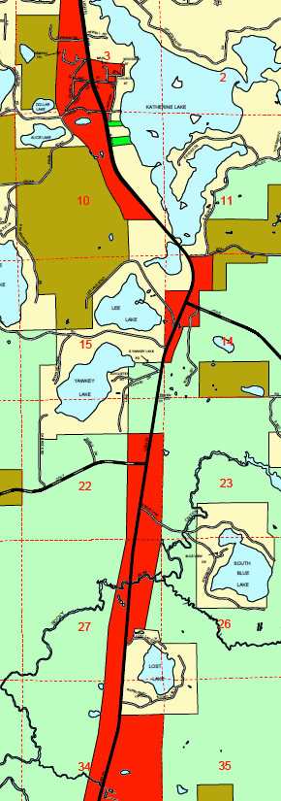
Local Zoning Ordinances
Local zoning ordinances may conflict with state highway access management goals
May propose a land use type that conflicts with STH access plans or existing controls
WisDOT is an abutting land owner for rezoning decisions along any STH and has a right to engage in those decisions
Deeper Dive in Module 1
Access Management and Local Plans/Controls
Notes:
Know that WisDOT is an abutting Land Owner for local decisions such as Rezoning from lower trip generating land use to higher trip generating land use. The example in this slide is not a zoning map, but a land use map where commercial activities are slated to be located along the state highway. These land use decisions need to consider incremental land use changes and WisDOT should work with communities to ensure they address local road system or cross access agreements as they make zoning decisions to implement these types decisions. Local zoning boards are required to notify WisDOT of a zoning change that abuts state owned property. This includes STH right of way.

Slide 17
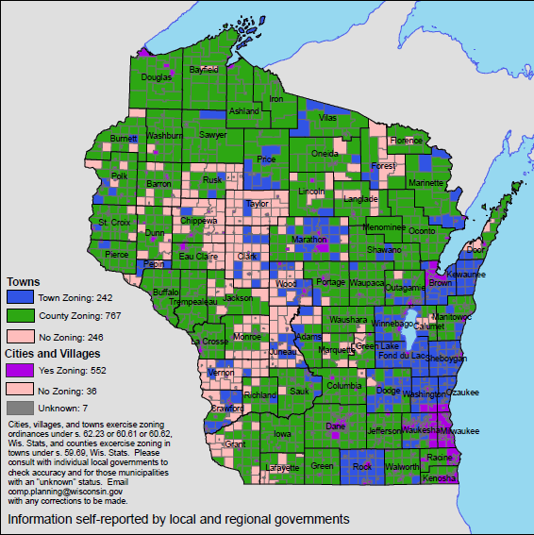
How Local Zoning Decisions are Made
Zoning changes are approved by elected body
Many do not require site plan review for use changes though those may significantly impact traffic
Few community officials/staff understand cumulative impacts of individual access decisions
2010
Source: www.doa.state.wi.us/compplanning
Access Management and Local Plans/Controls
Notes:
There are four types of zoning situations that can be encountered by Department staff when working through access related zoning issues: Cities and Villages, Towns that follow County Zoning, Towns that have there own zoning ordinances, and towns that have no zoning in place. Department staff should be aware that towns especially, tend to have local officials that are not experts in zoning and that may not have the continuity of staff that Counties, Villages and Cities have in making zoning decisions. Department staff may need to work more closely with local officials from the towns, and may need to visit with town officials more frequently in access related matters that are related to local zoning decisions. For these and other reasons, towns may also be more willing to make decisions in favor of local development where access management and zoning issues are concerned.

Slide 18
Local Government Access Ordinances
Local government access ordinances may conflict with STH access management goals, spacing standards and operational/capacity needs. For example, allowing:
Must consider side road access controls in ss. 84.25 and 84.09 projects
  CASE STUDY – St. Croix County
  Two or more driveways per property
  Shorter spacing between driveways on adjacent or cross-street properties
  Shorter spacing between driveways and public road connections (side roads/alleys)
  Larger widths on residential and/or commercial driveways
  Each property its own driveway rather than requiring shared driveways on adjacent properties
Deeper Dive in Module 3
Access Management and Local Plans/Controls
Notes:
Local government ordinances can be both good and bad. They may be more strict than the State requirements. They may also be written such that they cause conflicts with state access management goals or create unsafe conditions. These are a few considerations. WisDOT can include side roads outside of the state highway right-of-way if the local municipality agrees in writing to include an agreed to and specific distance within the §84.25 project. WisDOT engages in this cooperation to protect the intersection functional area. See Module 3 for a deep dive on intersection functional area.

Slide 19
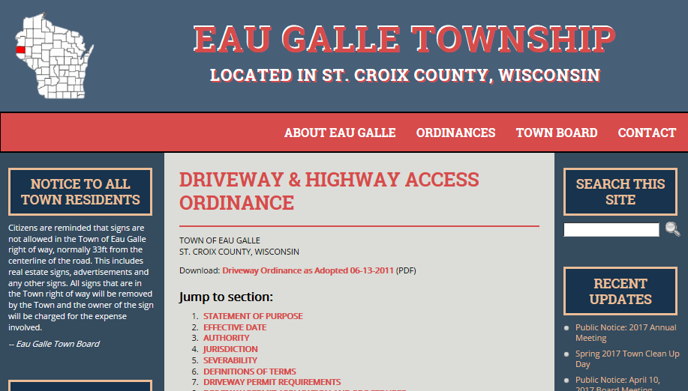

Slide 20
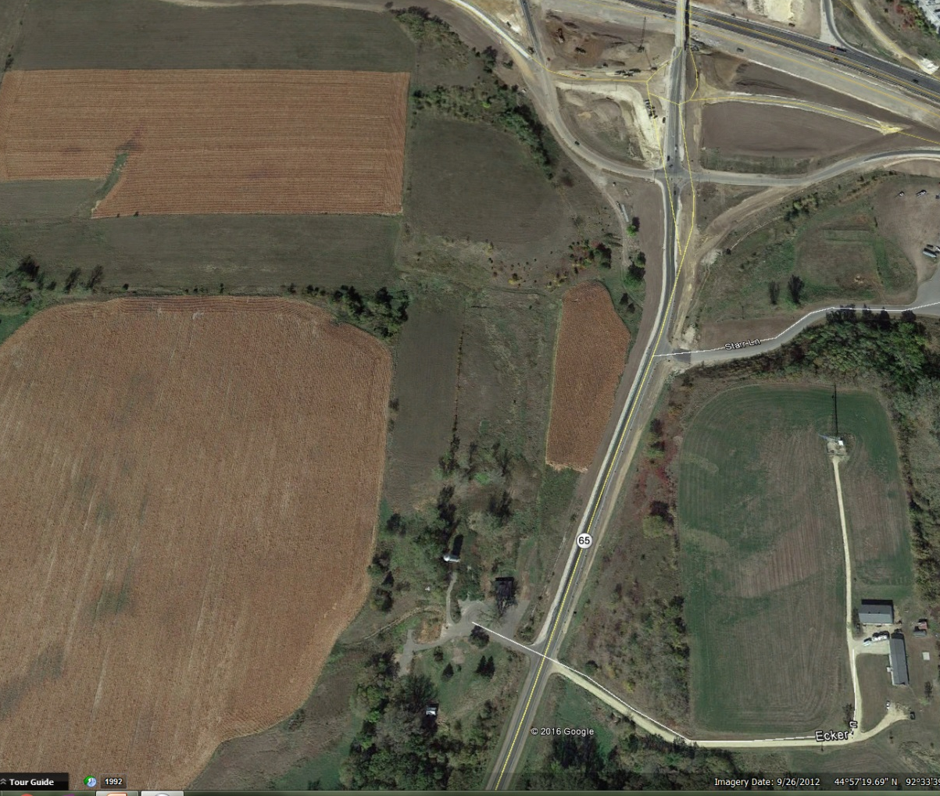
Collaboration Example – Ecker Lane
WisDOT and St. Croix County worked together
  Private driveway serving a farm residence and two other parcels
  Developer wanted conversion to a public road to serve additional development
  County and WisDOT worked through local ordinances and
  s. 84.25 driveway authorization
Proposed
Development
Ecker Lane
Access Management and Local Plans/Controls
Notes:
ST. CROIX COUNTY – An example of how the Department and the County have worked together to proactively ensure the future safety of WIS 65 and Eckers Lane. The shared public driveway, located on the west side of WIS 65, currently serves only two residential/agricultural parcels. The agricultural parcel served by the driveway is under development pressure for a new commercial subdivision. The developer felt the driveway should be converted to a public road to serve not only the farm residence and another parcel, but also provide direct access between the development and WIS 65. Both the Department and St. Croix County were concerned on the impact to safety of a substantial increase in traffic at this location south of the I-94/WIS 65 interchange. This portion of WIS 65 is controlled under §84.25. The development could provide access from 60th Avenue located further south.
As part of the authorization for the conversion of the driveway to a public road connection, WisDOT worked with the County to ensure only the access to the current parcels and current uses were allowed in the document. If the use changed, the document would become null resulting in the driveway not remaining authorized for direct access to WIS 65. The County was able to work with the developer to revise the site plan to show the access to 60th Avenue located further south on WIS 65.

Slide 21
When Local Officials Should Notify WisDOT
When WisDOT owns any abutting parcel
When the STH right-of-way is located adjacent to an affected parcel where a zoning change is proposed
Both of the above when located within ¼ mile of a certified survey map (CSM) – A lot split other than a new subdivision
When local roads connecting to the STH are proposed to be vacated
Access Management and Local Plans/Controls

Slide 22
Corridor Planning Tools
Corridor Preservation Studies, Access Management Plans,
and Official Mapping under s. 84.295(10)
Access Management and Corridor Planning Tools

Slide 23
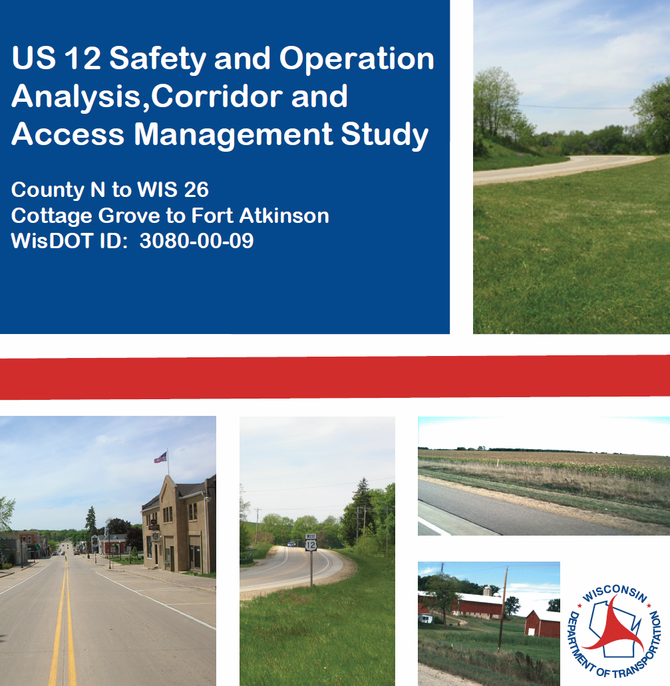
When to Use Studies (Planning Tools)
No WisDOT statutory or regulatory authority applicable
Therefore, collaboration with local officials is necessary to preserve the operational viability or safety with the existing geometry
A new corridor/expansion is not feasible/reasonable
Access Management and Corridor Planning Tools
Notes:
Corridor Preservation Studies are used to preserve corridors in situations where development pressures may result in safety or operational concerns in the future, and where other access controls may not be reasonable. Studies rely heavily on coordination with local units of government for implementation and include both land use and access considerations. They are used on corridors where WisDOT would like to preserve the regional mobility function of the roadway and where a new alignment or bypass is not possible.

Slide 24
Corridor Preservation Studies
Planning studies that determine the need for future improvements
Focus is to delay the need for capacity expansion
Usually evaluate access in combination with traffic and other geometric studies
  Access spacing criteria is used for rural state highways
  Applying best practices for developed areas
    TRB and Access Management Manual
    Use of overlay zoning districts
Studies differ by WisDOT region
See FDM 7-35-1 for more information
Access Management and Corridor Planning Tools

Slide 25
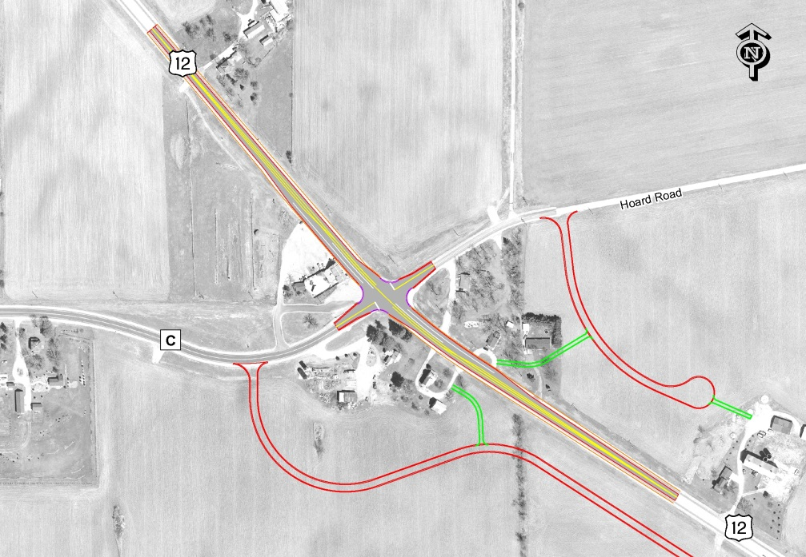
Example Corridor Preservation Study
Conceptual level
Consider access spacing
Consider future land use and traffic
Be aware of no-touch/no-take in development of concepts
Access Management and Corridor Planning Tools
Notes:
Corridor Preservation Studies include access considerations to reduce or maintain conflict points along the highway. They are typically taken through a conceptual level of detail that can be further developed as part of future project development process, but are of a sufficient level to allow for cooperation with local governments, or for programming future needs. WisDOT access spacing criteria for rural corridors should be applied to identify potential opportunities to consolidate or relocate driveway connections as land use changes occur over time. The Region’s access coordinator should be consulted as part of the study effort. Planners should be aware of concepts such as “No-Touch/No-Take” in applying access related recommendations in corridor preservation studies. Corridor Preservation Studies are a good mechanism to engage and start a cooperative relationship with local entities with regulatory authority. The costs of conducting the study should be evaluated to determine if it will be beneficial to future mobility goals.

Slide 26
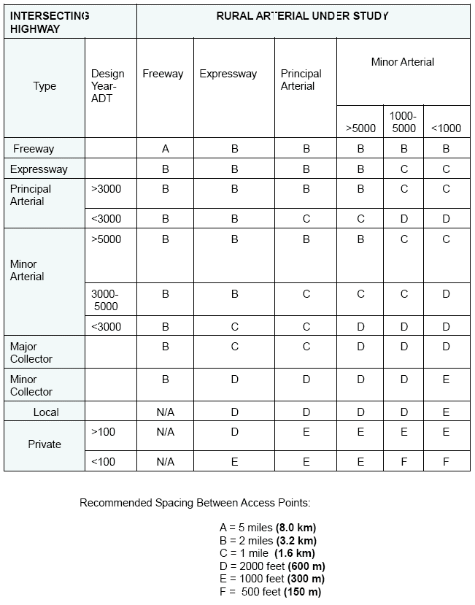
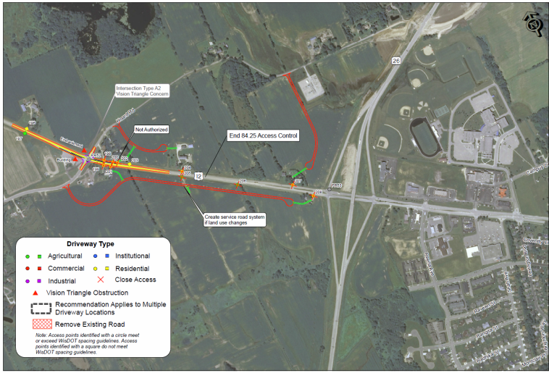
Rural Access Spacing Guidelines
INTERSECTING HIGHWAY
RURAL ARTERIAL UNDER STUDY
Type
WisDOT FDM 11-5-5, Attachment 5.1
Rural spacing minimum distances
Freeway
Expressway
Principal Arterial
Minor Arterial
Major Collector
Minor Collector
Local
Private
Recommended Spacing Between Access Points
A = 5 miles | B = 2 miles | C = 1 mile
D = 2000 feet | E = 1000 feet | F = 500 feet
Access Management and Corridor Planning Tools
Notes:
WisDOT has established access spacing guidelines for rural STH situations. The guidelines are located in FDM Procedure 11-5-5, attachment 5.1, and are based on the class of the STH as well as the intersecting connection or driveway. Spacing criteria include:
Type of facility
Type of connection
And the Design Year ADT for both
In this example, the area located west of the US 12/WIS 26 interchange is within the extraterritorial zoning area of the city of Fort Atkinson and is identified in the comprehensive plan as urban commercial and residential density. The existing agricultural and residential driveways are located closer than 1,300 feet of the interchange ramps, and with the planned development would not support the anticipated traffic volumes of higher trip generating commercial uses. Hoard road was constructed as a grade separated crossing of WIS 26 and functions as a back entry to the area from the city located to the east of WIS 26. This concept plan would provide alternatives to direct access to US 12 through the use of frontage roads. As the current land uses change, the concept allows for access to be removed from US 12. Intersection spacing is maintained and the interchange is preserved. This plan is coordinated with the public and the communities for reference as developers approach both the state and the city for future access requests. This study does not preclude the existing 84.25 controls in place on the corridor.

Slide 27
Access Spacing from Interchange Ramps
  FDM 11-5-5 (Attachment 5.2) & FDM 11-30-1
Access Management and Corridor Planning Tools
Notes:
As shown in the previous slide, this slide shows the minimum and desired spacing to prevent unsafe queuing on or near arterial ramps due to development-related congestion on the intersecting roadway. Chapter 11 of the WisDOT FDM provides the spacing guidelines.

Slide 28
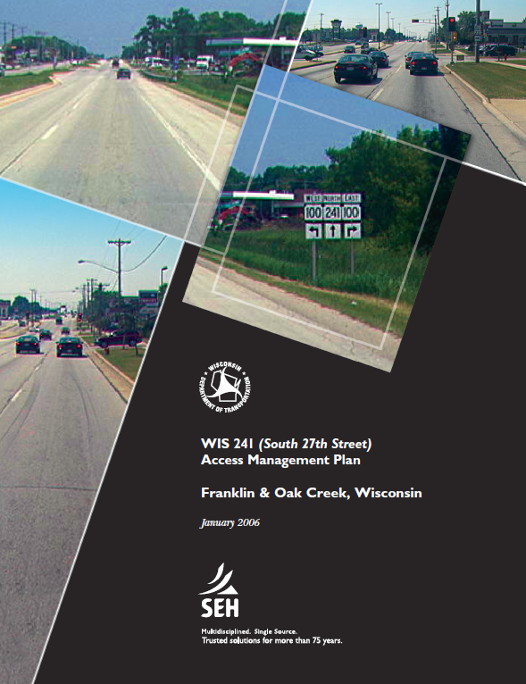
Access Management Plans
Prepared in conjunction with local units of government
  Goal is adoption by resolution
  Plan for future access and development
Weigh benefits against challenges first:
  What will WisDOT need to program to implement?
  Does the outcome justify cost to prepare the plan?
Access Management and Corridor Planning Tools
Notes:
Similar to corridor preservation plans in the planning toolkit, Access Management Plans are narrower in focus and the desire is to have greater longevity through the use of resolutions either adopting the plan or in support of the plan. This ensures that as local officials change through elections, etc., the decisions in the plan are preserved. The planner should determine if preparation of a plan would result in future costs to the Department to implement the findings of the plan and if those costs would be acceptable. Will the outcomes of the plan decisions make a real impact on preservation of the corridor, or delay the need for capacity expansion or other costly improvement projects?

Slide 29
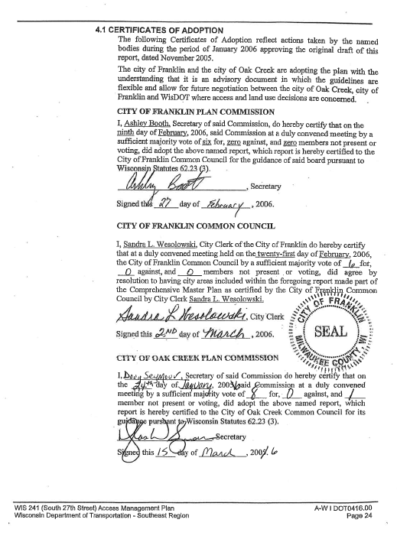
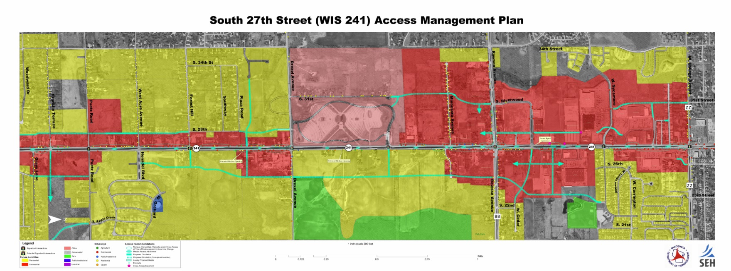
Access Management Plans
Example Map and Resolution Page
Access Management and Corridor Planning Tools
Notes:
This plan was prepared for WIS 241, South 27th Street located on the border between Oak Creek and Franklin (southwestern suburbs of Milwaukee). The corridor was experiencing commercial redevelopment with large scale medical, and hospitality services. This plan required coordination with both Franklin and Oak Creek to consider local circulation and access in conjunction with future development pressures. Both communities signed resolutions in support of the final plan.

Slide 30
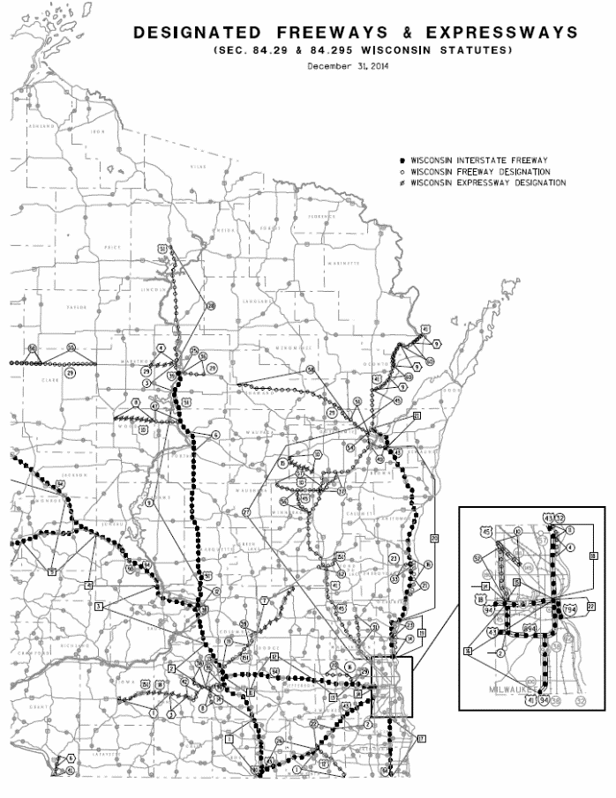
Freeway / Expressway Designation s. 84.295(1) – (9)
s. 84.295 allows WisDOT to designate a highway as a freeway or expressway
  Requires a Finding, Determination & Order (FD&O)
  Provides certain authorities to WisDOT for altering the local road system, determining maintenance agreements and establishing certain operational criteria
A highway may be constructed to and operate as a freeway or expressway without s. 84.295. It simply would not have the additional authorities granted under s. 84.295.
Access Management and Corridor Planning Tools
Notes:
There is a specific state statute in place for designating expressways and freeways within Wisconsin. In order to be designated as an expressway or freeway, a finding, determination and order must be signed by the DOT Administrator. Even though a highway can be constructed to expressway/freeway standards and operate as such. It is not afforded the same authorities as a designated expressway/freeway.

Slide 31
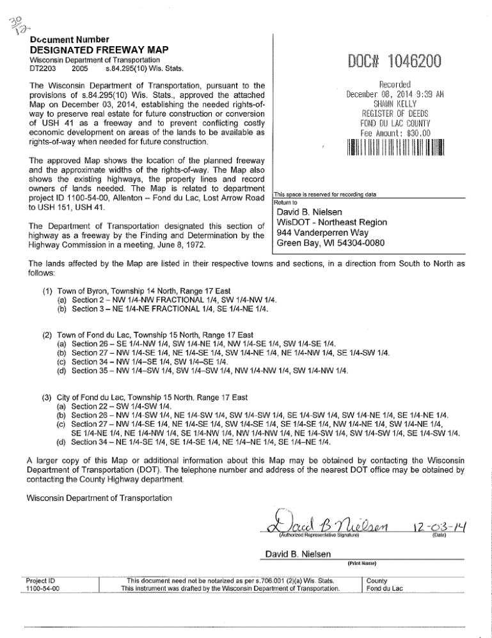
Designated Freeway and Expressway Upgrades, Official Mapping s. 84.295(10)
s. 84.295(10) allows WisDOT to preserve ROW for future freeway/expressway facilities
  Requires:
    Environmental documentation with preferred alternative
    Detailed design and impact analysis
    Official Mapping
  Results in a recorded Official Map of future ROW needed for planned expressway or freeway
  Allows WisDOT advance acquisition authority of the officially mapped ROW
Access Management and Corridor Planning Tools
Notes:
State statute 84.295 (10) is the statute that allows WisDOT to create an official map for planned expressway/freeway facilities. In order to preserve right-of-way, WisDOT needs to prepare an environmental document to ensure that there are no significant environmental constraints that would prevent the ultimate construction of the new facility. The official map is recorded with the property at the county register of deeds office. The official map identifies the area to be preserved for a future facility and provides the mechanism for which the Department can acquire lands in advance of a project, even if construction funding has not yet been identified.

Slide 32
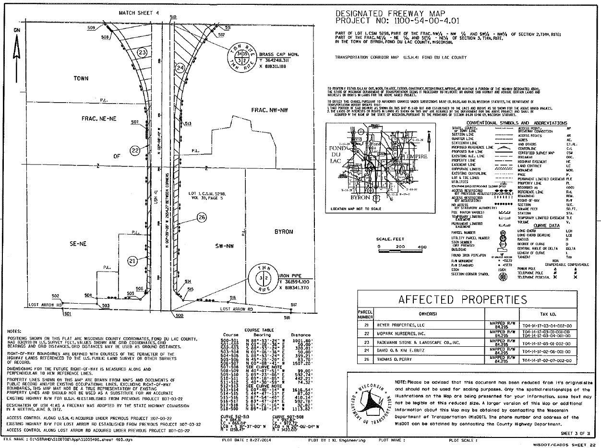
Designated Freeway and Expressway Upgrades, Official Mapping s. 84.295(10)
Access Management and Corridor Planning Tools
Notes:
This is an example of a Designated Freeway Map. The Official Map is prepared to similar standards as a Transportation Project Plat for streamlining if funding is secured and a project is programmed.

Slide 33
Other Planning Related Topics
Access Considerations
Other Access Considerations

Slide 34
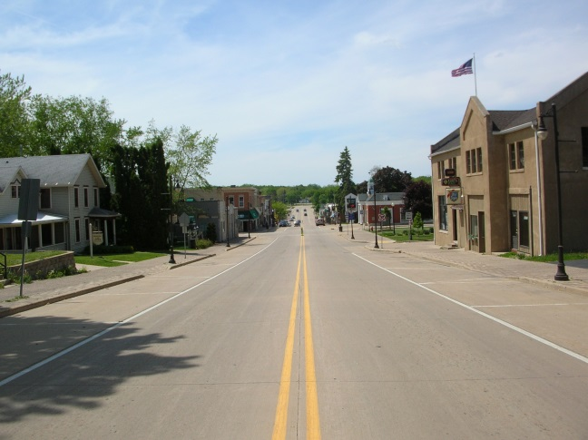
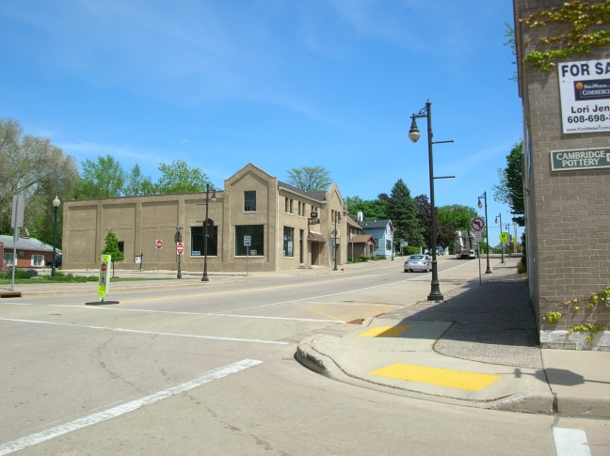
State Highway on Main Street
No established urban spacing distances in FDM
TRB Access Management Manual
  Use the 10 access management principles
  Chapter 10 – Corridor Plans, evaluating alternatives
FDM design guidelines – Chapter 11
  Median openings, corner clearance, intersection functional area, etc.
Deeper Dive in Module 1
Other Access Considerations
Notes:
Many STH corridor travel through small to medium sized communities. Within these communities, the STH is often functioning as “Main Street”. Challenges can arise between the conflicts associated with serving the local community’s access needs as well as WisDOT’s regional mobility needs. The FDM does not specify spacing criteria for urban conditions, however, there are many design guidelines within Chapter 11 that could apply. There are many factors to consider in these environments such as the spacing of signalized intersections if they exist, corner clearance, the volume and vehicle mix in the corridor, and many others. Review the Transportation Research Board’s Ten access management principles provided in Module 1 and the recently released Access Management Manual, 2nd Edition. Always coordinate with the Region Access Coordinator to assist in identifying the appropriate practices that should be employed for the specific context in which you are working.

Slide 35
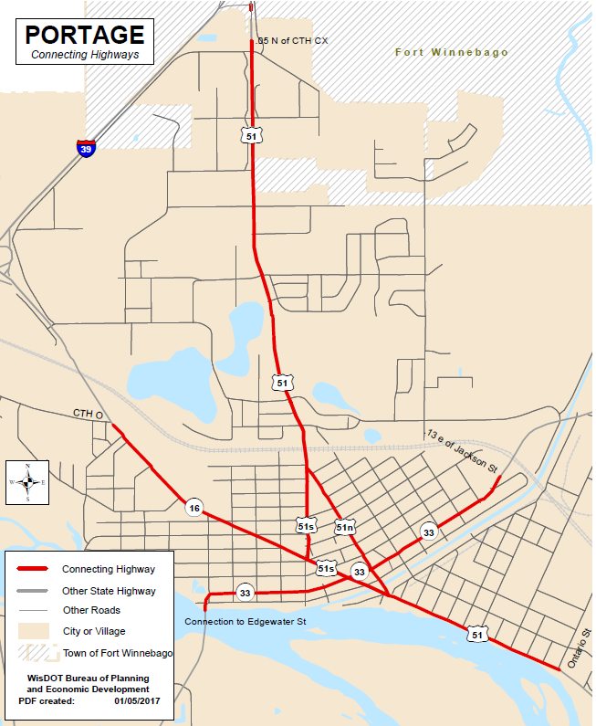
Connecting Highways
s. 86.32 “The department may designate…certain marked routes of the state trunk highway system over the streets or highways in any municipality for which the municipality will be responsible for maintenance and traffic control and the maintenance and operation of any swing or lift bridge.”
Other Access Considerations
Notes:
Both maintenance and traffic operations fall under the local responsibility. §86.32 should not be confused with Jurisdictional reassignment or changes in land rights occur under connecting highways designation. WisDOT (the Secretary) also has the right to rescind connecting highway status.

Slide 36
Connecting Highways
Municipality maintains the marked US or WIS route through a portion of its jurisdictional boundary. WisDOT maintains the route signing.
Large responsibility on municipality due to high percentage of local traffic use
Municipality has permitting authority, which includes driveways and street connections
  BUT…the municipality may not issue a permit to the property owner if WisDOT owns the access rights
Connecting highway maps available at: www.wisconsindot.gov/Pages/projects/data-plan/plan-res/connecting.aspx
Other Access Considerations
Notes:
This law does not specifically address access management, therefore, it should not be assumed that access controls become the local responsibility by default. A written agreement is needed to designate by whom and to what standards access control will occur on the connecting highway. It is typical for access control to be included under the maintenance authority granted to the locals. “May not” is prohibitory language → similar to cannot.

Slide 37
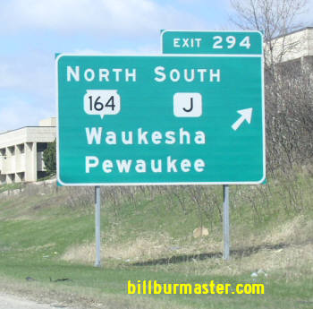
Example STH 164 (formerly CTH J)
Police Power Authority
STH 164 in Waukesha and Washington Counties
  Formerly existed as CTH J – County bought ROW for
  the county instead of for the State Highway Commission
  Highway was jurisdictionally reassigned by jurisdictional transfer action to WisDOT
  Counties that acquired access rights continue to own
  those rights today
  WisDOT is the permitting authority
  County could convey those rights to WisDOT if WisDOT was concerned about having ownership vested in the State
Other Access Considerations

Slide 38
Additional Resources
WisDOT website (public) – Let your stakeholders know
  www.wisconsindot.gov/pages/doing-bus/real-estate/access-mgmt
DOTNET (internal) – Links to several resources and groups (planning, real estate, maintenance)
http://dotnet/dtsd/access/index.htm
Facility Development Manual:
  Chapter 7 – Access Control
  Chapter 11 – Design

Slide 39
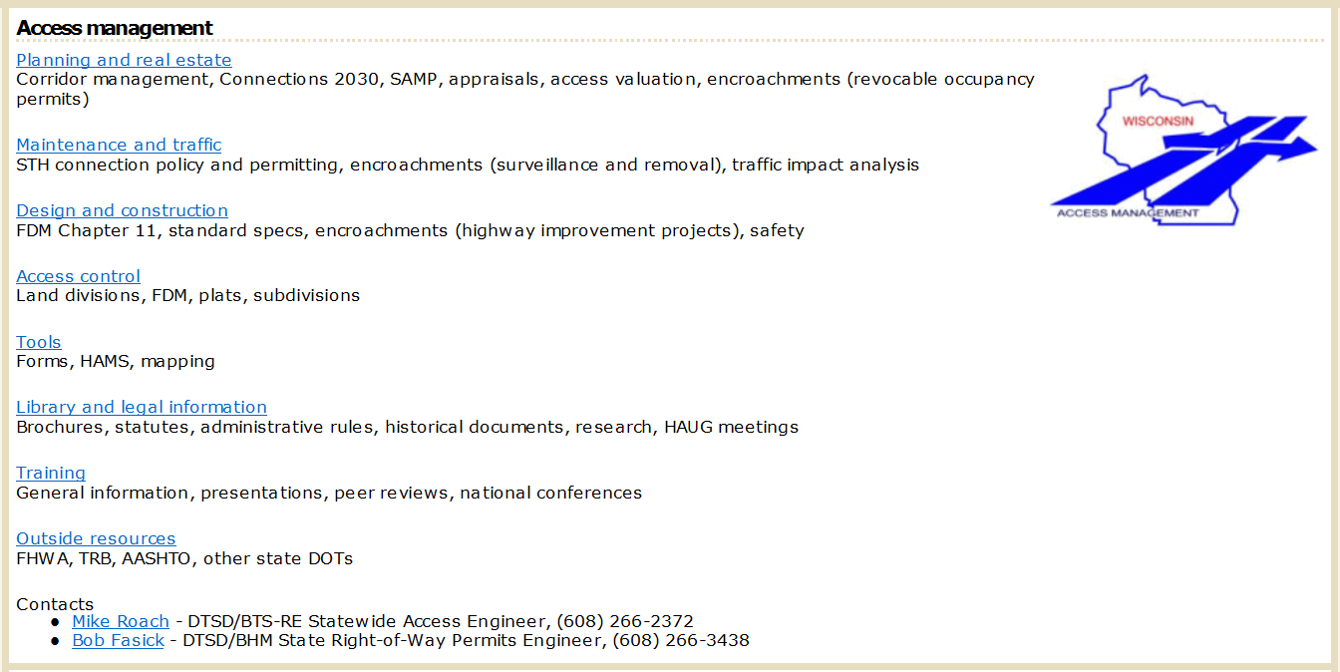
Access Management home page on DOTNET

Slide 40
Group Exercise
When to Coordinate and with Whom
Exercise

Slide 41

Exercise – When to Coordinate and with Whom
Two scenarios will be described
Identify if coordination is needed:
  Region access management engineer/coordinator
  Region real estate staff
Exercise

Slide 42
Scenario 1 – Moving a Field Entrance (FE)
A farmer has approached the construction engineer and would like his FE moved 1,000 feet as part of the project
  The driveway currently provides access to a large field and is located along the state highway
  Because of the large field size, no side road access is available
  The new location meets spacing requirements better per FDM and can be easily constructed to meet all design requirements
  The new location would continue to be used for field access, but would also help the farmer better access the field behind the new location from his current farm on the north side of the highway as the two are connected
Exercise

Slide 43
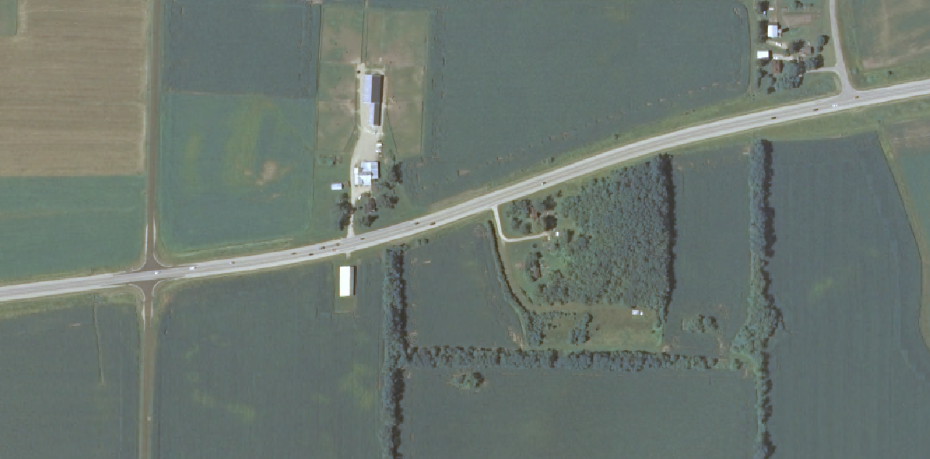
Scenario 1 – Site Plan
Farm
Proposed FE
Existing FE
Connection to Rear Field
Exercise
Notes:
Assume all surrounding parcels on the south side of the highway are separate owners. In this scenario the current field is not connected to the rear lot because a rare species of owl has nested in the treeline (or some other ridiculous reason), and the farmer can’t cut any trees to create a connection to the rear field. For several years, he has been forced to drive his tractor down farm lane (road located to the west on map) a half mile to access the rear field by another town road. He then uses the connection to access the east field currently abutting the r/w. A new driveway location would sure be helpful and save expense related to fuel costs. The property owner located between the two fields has already offered to purchase the west field from the farmer and does not need the current access point as his current plans for a new shed and dirt bike track will utilize the existing driveway. Can you shift the driveway and help everyone out?

Slide 44
Scenario 1 – Moving a Field Entrance
Is coordination with the region access management engineer/coordinator required to move a driveway if all criteria/standards are met?
  ANSWER: Yes – This person should be informed of ALL access changes connecting to the STH system BEFORE any change is made
Exercise
Notes:
Speaker should expand upon common situations that may occur, or a real world example.
Need to involve OGC because… may be better to do a covenant, etc. etc.

Slide 45

Bonus Question
What access controls are managed at the region level?
Which controls require Central Office approval?
  ANSWER: Driveway permits are the only state access control that can be managed solely at the region level.
  Any modification that results in a change to a Wis. Stat. s. 84.25 authorization or real estate access rights will require coordination with Central Office through the Statewide Access Engineer.
Exercise

Slide 46
Scenario 2 – Minor Reconstruct
Due to changes in ditch grade related to a minor reconstruction project, a driveway is required to be relocated to the side road
Coordination with the property owner is positive, and you have proposed to move the driveway as part of the project. The impact to the existing internal gravel drive is minimal.
Exercise

Slide 47
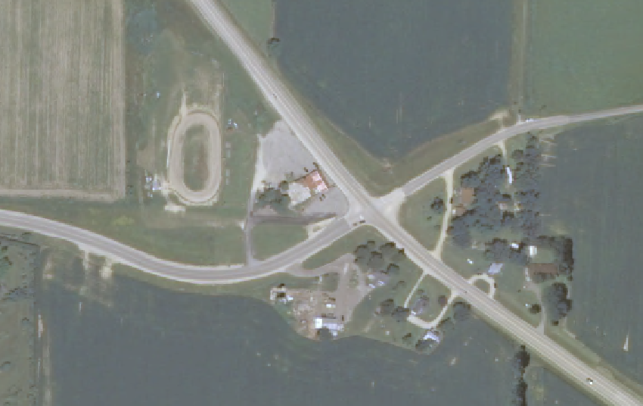
Scenario 2 – Site Plan
STH
Existing Driveway
(to be closed)
CTH
Restaurant
CTH
Proposed New
Driveway
STH
Exercise

Slide 48
Scenario 2 – Minor Reconstruct
Is coordination with the region’s real estate staff required to relocate the driveway as part of the project?
  ANSWER: Yes – The region access engineer/coordinator and region real estate staff should confirm the mechanism by which the driveway will be relocated, and be involved in the preparation of the documentation
Exercise

Slide 49

Bonus Question
Should WisDOT construct the new driveway for the property owner because of the project’s impact?
  ANSWER: Depends – The preferred mechanism is for the property owner to hire their own contractor to work on their property
Exercise

Slide 50
Planning Takeaways
Access management considerations start with the planning process
There are several statewide plans to reference to ensure you are applying the appropriate access management techniques
Be aware local plans and ordinances that affect access and work closely with local officials to be proactive
Access management tools include corridor studies, access management plans, s. 84.295(10) Freeway / Expressway Designation, and your region access staff

Slide 51
Acknowledgments
Special thanks to the WisDOT Access Management Team members who contributed their time, input, and experiences to develop this training program:
Mike Roach – Statewide Access Engineer
Sue Voight – SE Region Access Coordinator
Dave Nielsen – NE Region Access Engineer
Tom Beekman – NW Region Planning Chief
Ernie Peterson – Statewide Access Engineer (Retired)
Bob Fasick – State ROW Permits Engineer
John Sobotik – Assistant General Counsel
Kathy Batha – Assistant General Counsel
Consultants:
Brad Strader, MKSK, TRB Access Management Committee member
Charles (Chuck) Wade, TranSmart, consultant for WisDOT 2005 Access Management Training program
Bill Eisele, TTI and TRB Access Management Committee past member
Karen Dixon, TTI and TRB Access Management Manual co-author
Josh Penn, LSL Planning, a SAFEbuilt Company

Slide 52
Discussion

