Slide 1
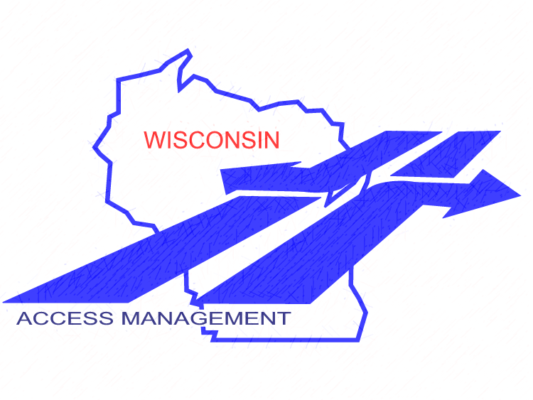

Wisconsin Department of Transportation
Access Management Module 1: Summary of Principles and Practices
Final: 1-13-18

Slide 2
Module Outline
This program provides an overview of access management
Session format
Speaker introduction
Modules:
(1) Summary of Principles and Practices
Introduction to Legal Foundations
Access Standards
Planning
Identifying Access Controls
STH Connection Permits
Special Topics
References & Resources
Notes:
Session format- This program is generally set up for ~50 minutes of presentation, to give you time for Q&A. If a hands-on component is included, you may also want to include a short break. Speakers should welcome everyone, explain where restrooms are located, describe Q&A protocol. Remind everyone of the informal, participatory atmosphere and to be respectful of other’s time. Encourage audience to save more targeted questions and “war stories” until after the session, unless it directly enhances the group discussion. Depending on audience size, it is suggested to limit questions to no more than 2 straightforward questions per individual, offer to take longer or additional questions after the presentation.
Speaker Introduction- give a brief intro of speakers, where they are from, background information and contact information if necessary

Slide 3
Module 1: Summary of Principles and Practices
⇨ Objectives ⇦
Identify opportunities to apply access management principles
Explain the goals and benefits of applying access management
Describe the different types of access management techniques and where to apply them
Apply the various WisDOT access management statutes, codes, and policies
Know the available access management resources and when to use them

Slide 4
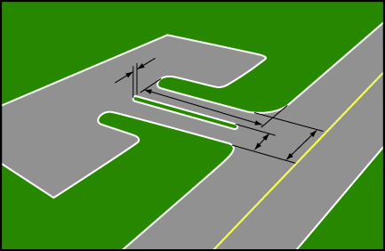
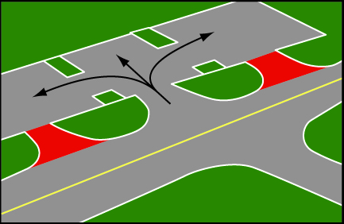
What is Access Management?
Standards for the number, location, spacing and design of access points to:
  Maximize existing road capacity
  Reduce potential for crashes
  Improve overall corridor conditions
  Provide reasonable access to land uses
Proper driveway design maximizes benefits of access management
Shared access reduces conflicts along the state highway

Slide 5
What Does Access Management Do?
Safety
  Reduces crashes
Mobility
  Improves highway operations by minimizing congestion
Economics
  Protects corridor longevity; reduces delays to commerce
  Safe access = better for businesses
  Delays highway expansion that may disrupt adjacent properties
  Helps avoid the need to build expensive bypasses around communities because of congestion and safety issues

Slide 6
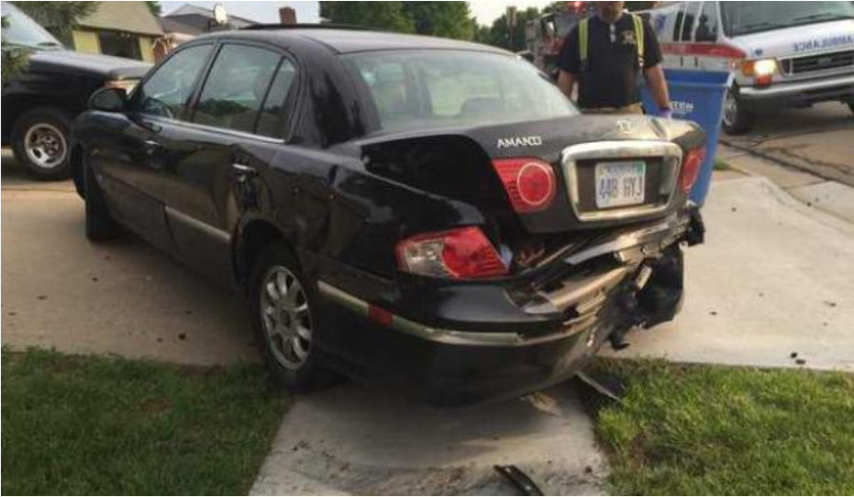
Why Does Wisconsin Manage Access?
Extends highway life by minimizing congestion
There is no such thing as a “safe” access
The most likely cause of a child’s death is a traffic crash
May increase through traffic by up to 30%
State highways are designed to move traffic
The most likely cause of an adult’s accidental death is a traffic crash
  Source: AASHTO Strategic Highway Safety Plan
Phil Anderson, The Topeka Capital-Journal, 5/23/16
Nationwide, there are 3,500 crashes every day directly related to access
Source: TRB
TRB = Transportation Research Board

Slide 7
Benefits of Access Management
Benefits of Access Management

Slide 8
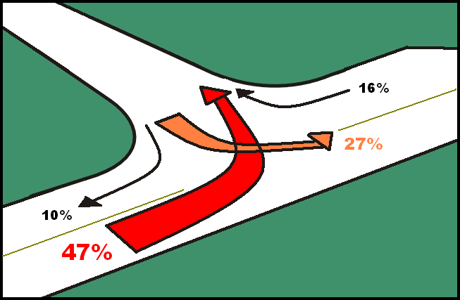
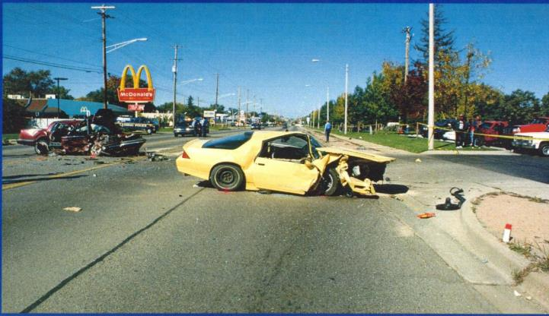
Access Influences Safety
Nearly 50% of all driveway crashes are left-in turns, while almost 75% of all intersection crashes are left-turn movements. There are many techniques available to prevent crashes or mitigate problems that already exist.
Source: National Highway Institute,
Access Management Training Course
Benefits of Access Management:
Safety
Notes:
Left-turns are the principal reason that crash rates go up with new driveways. That is also why so many techniques focus on reducing left-turns.

Slide 9
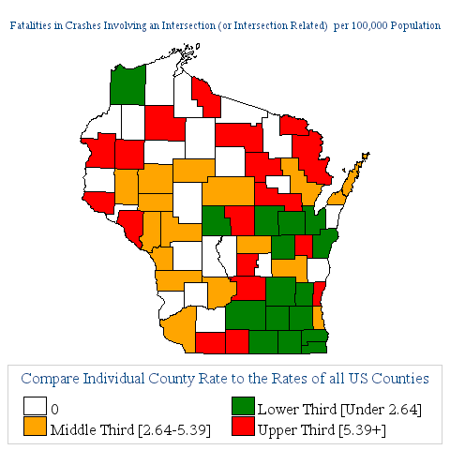
Crashes Across the State
Fatalities in crashes involving an intersection (or intersection related) per 100,000 population.
2012 Wisconsin Traffic Crash Facts – WisDOT
  56% of reported crashes were at non-intersections (includes driveways)
  34% of reported crashes were at highway intersections
Benefits of Access Management:
Safety
Notes:
Just because it’s a rural road and low-volume doesn’t mean that a driveway is safe.
Map source:
http://www-nrd.nhtsa.dot.gov/departments/nrd-30/ncsa/STSI/55_WI/2012/55_WI_2012.htm#TOP

Slide 10
Access Management Benefits: Improved Safety
Direct link between the number of driveways and number of crashes
Reduces injuries & damage due to crashes
Well-managed corridors often have 40-50% fewer crashes than poorly managed ones
  Source: Statistical Relationship between Vehicular Crashes and Highway Access, Mn/DOT, Report MN-RC-1998-27, [8/98]
Baseline
A late 1990s study found that an increase from 10 to 20 access points per mile on major arterial roads increases the crash rate by about 30%. Sources: TRB, NCHRP Report 420 [1999] and
Access Management Manual [2003]
Benefits of Access Management:
Safety
Notes:
10
This is a very important and very serious slide. Access management can greatly reduce crashes, injuries and deaths. This alone is ample reason to develop and implement an access management program. There are very few initiatives local governments can take that have the potential to improve safety and reduce crashes, injuries and deaths like access management does. Since most auto crashes involve local residents, it is family, friends, fellow employees or commissioners who benefit the most, not strangers.

Slide 11
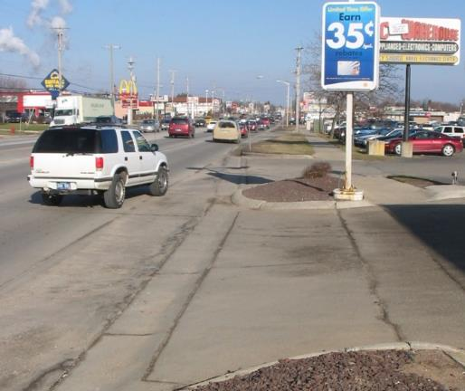
Access Management Benefits: Preserved Capacity and Mobility
      A cost-effective way to extend highway system life by preserving roadway capacity
Keep ramps free flowing
Fewer plus well-spaced access points reduce conflicts with through traffic flow
Efficient movement of people and freight by minimizing travel delay and congestion
Benefits of Access Management:
Mobility
Notes:
This is a very important and very serious slide. Access management can greatly reduce crashes, injuries and deaths. This alone is ample reason to develop and implement an access management program. There are very few initiatives local governments can take that have the potential to improve safety and reduce crashes, injuries and deaths like access management does. Since most auto crashes involve local residents, it is family, friends, fellow employees or commissioners who benefit the most, not strangers.

Slide 12
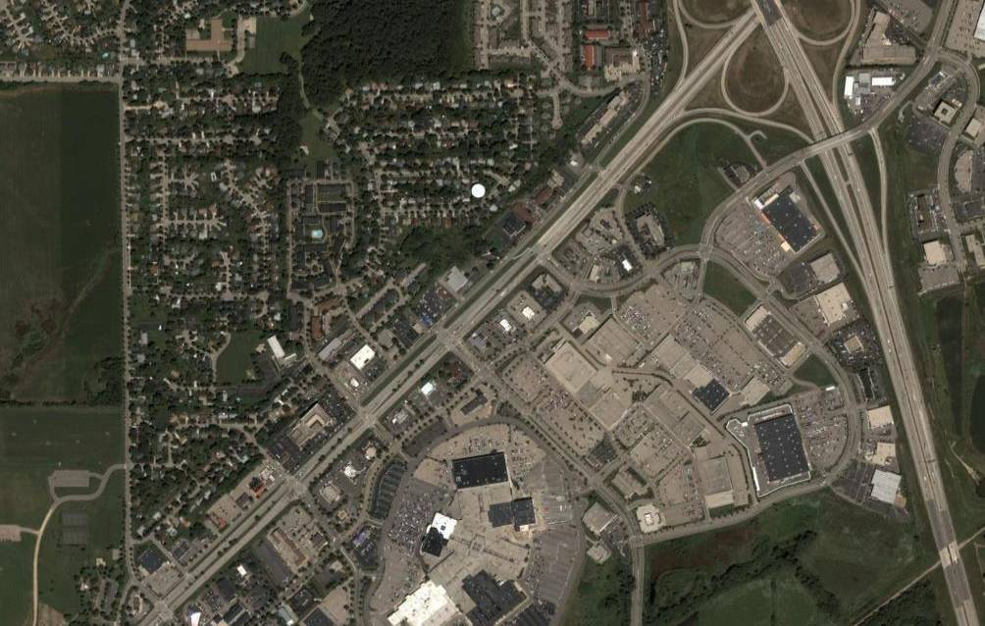
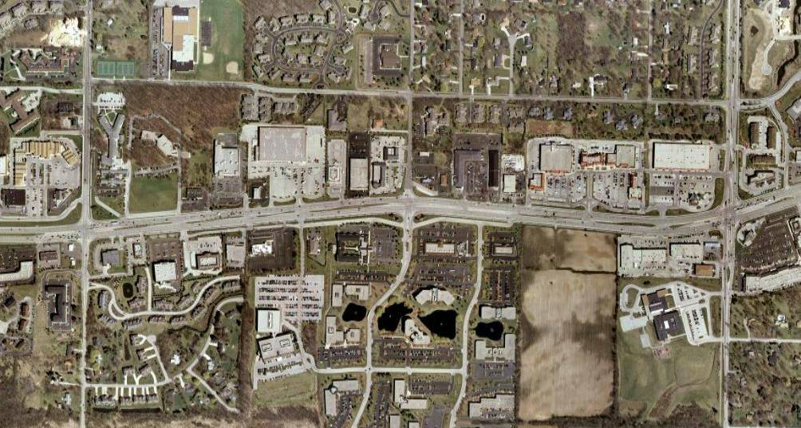
Access Management Impacts on Business Districts
USH 151 East Washington Ave, Madison, WI
USH 18 Bluemound Rd, Brookfield, WI
USH 151 East Washington Ave, Madison, WI
AADT = 44,000 to 50,000 vehicles per day
Access density = 13 access points / mile
Corridor Crash Rate = 375 crashes / HMVM
USH 18 Bluemound Rd, Brookfield, WI
AADT = 40,000 to 43,000 vehicles per day
Access density = 28 access points / mile
Corridor Crash Rate = 680 crashes / HMVM
1.0
Mile
1.2 Miles
Benefits of Access Management:
Mobility
Notes:
Here we contrast similar corridors: the first (East Washington) with good AM, and the second (Bluemound Rd. prior to recent improvements) with nearly double the number of access points. East Washington had 55% fewer crashes than Bluemound.

Slide 13
Economic Development Considerations
Access management may impact businesses depending upon their type and the extent of access management
Reasonable access may not be the design the business prefers
Cross access between businesses reduces conflicts along the road and encourages multiple shopping stops
Well spaced driveways make it easier for motorists to access a business
Still, the perception is often that less access = less business
Benefits of Access Management: Economic Development
Notes:
These are common benefits to retail businesses of access management improvements.

Slide 14
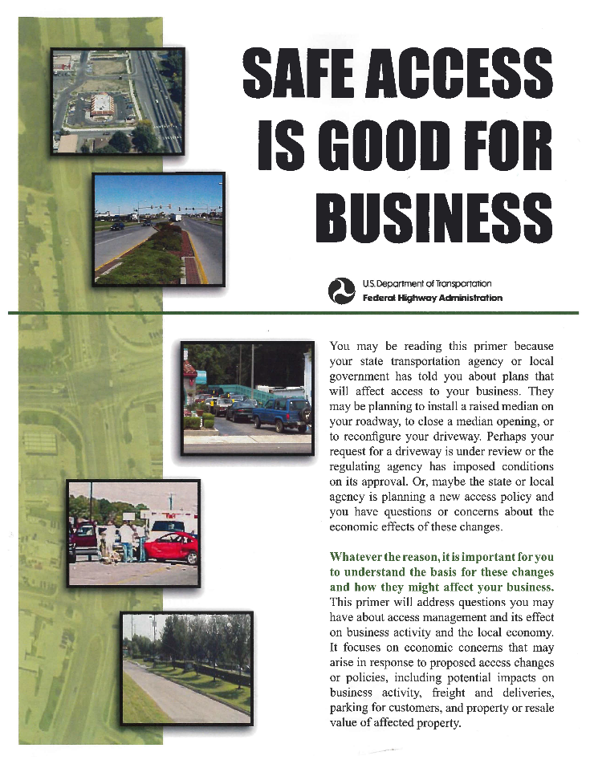
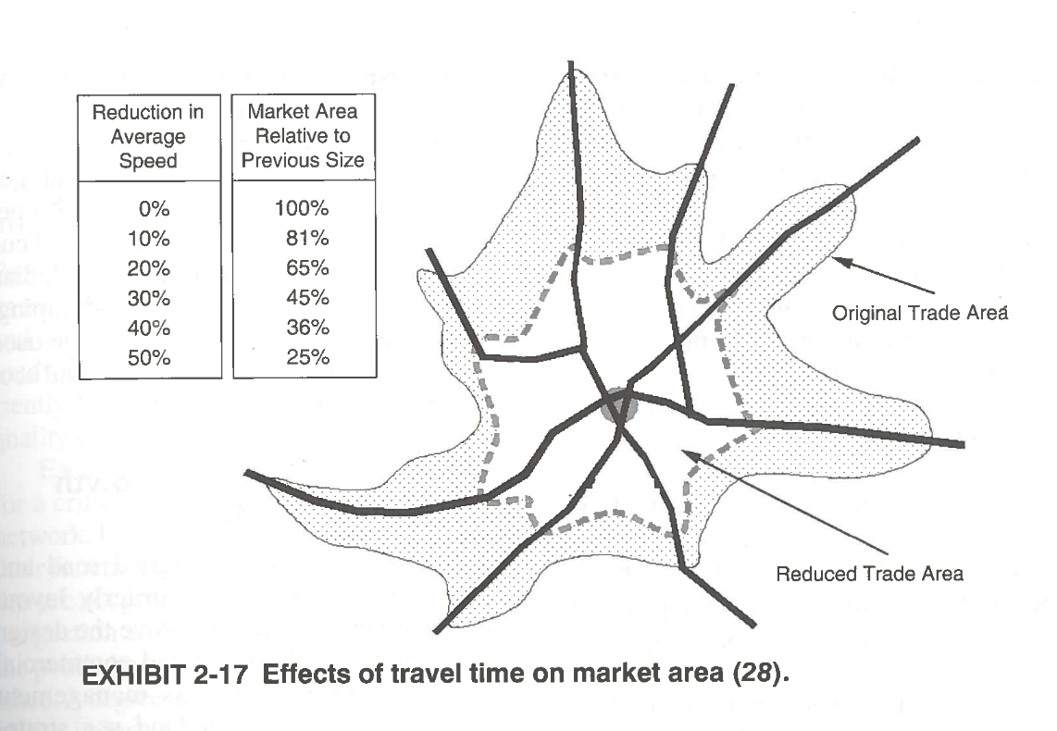
Safe Access is Good for Business
A well-designed corridor with good traffic flow is good for business
Too many driveways can lead to congestion and over time a decline in the business district
Less congestion can extend the commercial market area
Numerous studies show businesses do as well or better after an access management project (IA, MN, TX)
Benefits of Access Management: Economic Development

Slide 15
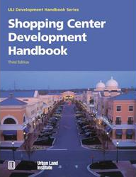
Safe Access is Good for Business Primer
In general, access management has no impact on the overall demand for goods and services
Main reason businesses fail is lack of management expertise (USA Today, 2004)
Main reasons businesses succeed:
  Management experience
  Customer service
  Quality of the products and services
  Financial backing and investment
  Well-trained employees
  Keeping costs competitive
Source: FHWA Safe Access is Good for Business
Benefits of Access Management: Economic Development
Notes:
Emphasize that direct STH access doesn’t necessarily make or break a business

Slide 16

Access Management Involves a Balance
Property owner rights
  Regulated access to a roadway
  Not to be landlocked by government action without compensation
Public rights
  Safe and efficient highway travel
  Avoid unnecessary and expensive capacity improvements
Benefits of Access Management: Economic Development
Notes:
Access to a roadway is context specific and can vary depending on the statute that applies. Does not have to be direct access to state highway.

Slide 17
Access Management Basics

Slide 18
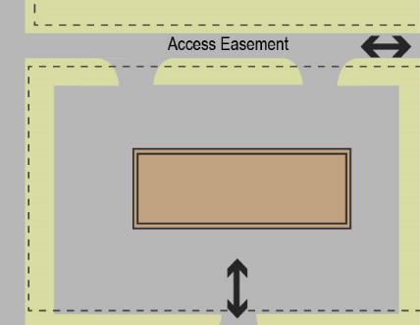
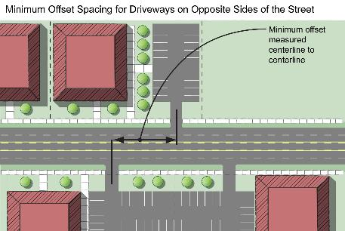
Types of Access Regulations
County and local governments have similar access management authority
Publicly owned access rights (acquired, etc.)
Self-imposed private property restrictions (e.g., deed restrictions, mutually enforceable restrictions)
Police power regulation & design (subdivisions, access connection permits, site plans)
Notes:
In a nutshell access control exists at three levels:
Ownership – 84.09
Covenants/Subdivision Restrictions – s. 236.293
Police Power – Includes 86.07, 84.29, 84.295, 84.25

Slide 19
Three Types of Access Management Techniques
1. Local Ordinances, Approvals and Plans
  Corridor plans for future access; overlay plan with zoning district
  Access retrofit strategies
  Local road and bike / pedestrian connectivity
2. Site Access and Design
  Driveway design standards
  Promote shared access systems and connectivity
  Coordinated lot split / site plan review
3. Road and Intersection Design
  Signal spacing
  Two-way left-turn lanes
  Medians
  Innovative intersections
Access Management Techniques:
Local Ordinances, Approvals and Plans

Slide 20
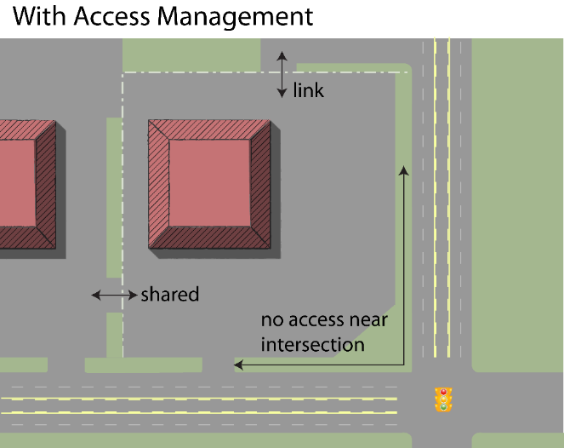
1. Local Ordinances, Approvals and Plans
Collaborate on access management planning
Promote connectivity
Local development regulations
  Lot splits and subdivision review
  Zoning and site plan review
  Changes to nonconforming sites
Coordinate reviews between WisDOT and municipality
Access Management Techniques:
Local Ordinances, Approvals and Plans

Slide 21
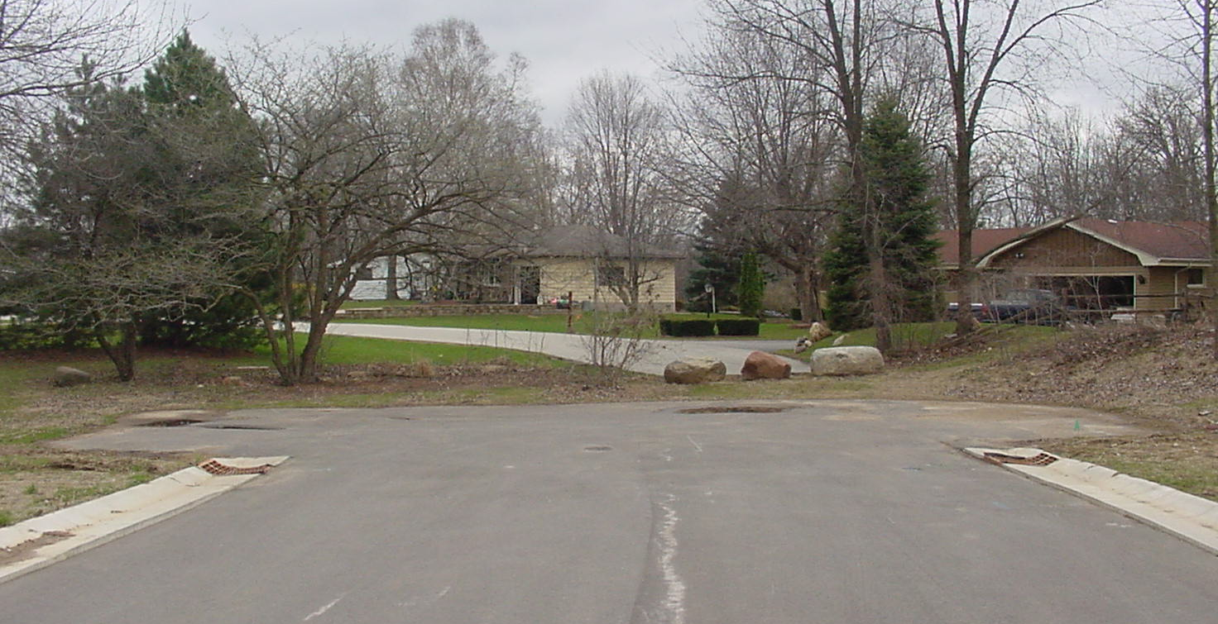
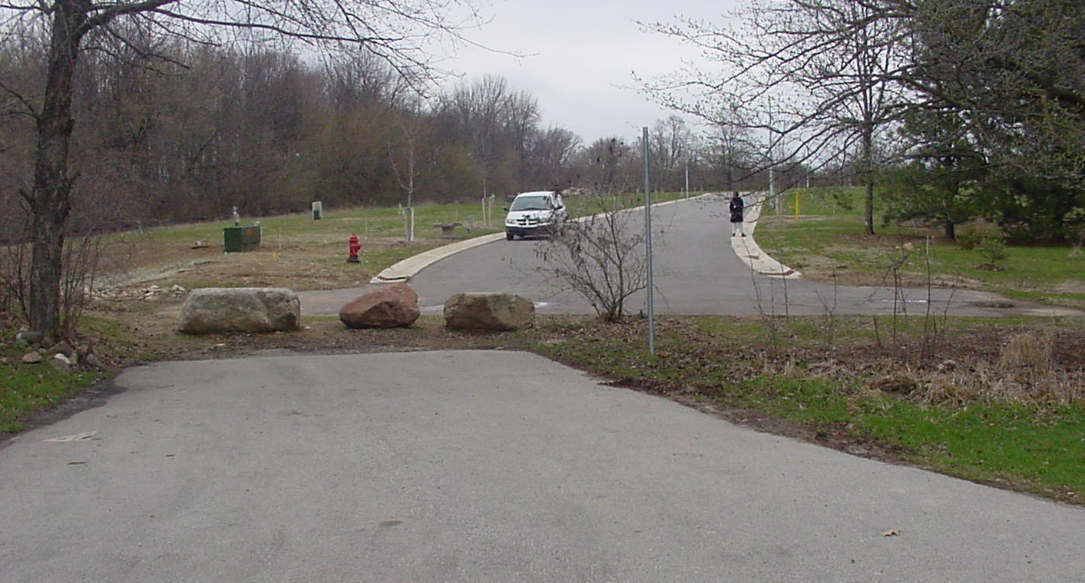
1. Local Ordinances, Approvals and Plans:
Benefits of Connectivity
Local road systems need connectivity as well
Access Management Techniques:
Local Ordinances, Approvals and Plans

Slide 22
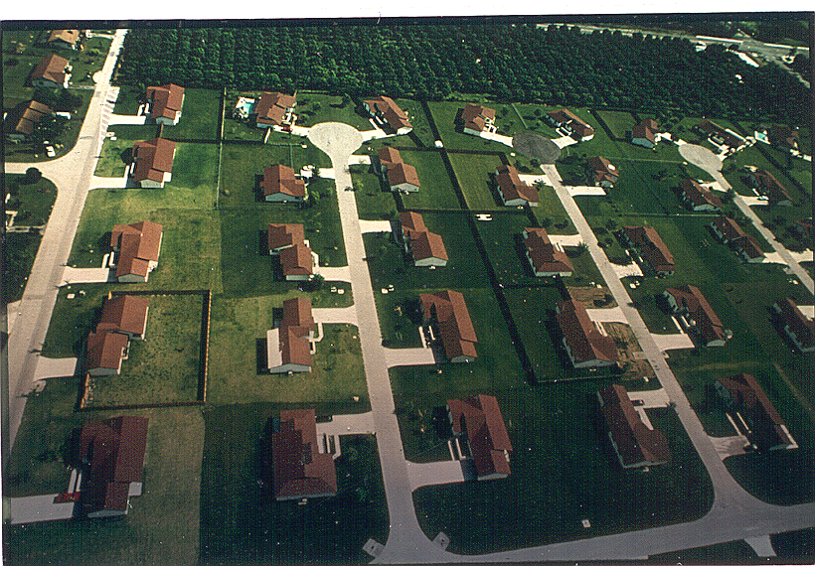
1. Local Ordinances, Approvals and Plans:
Connectivity/Circulation
Internal connections reduce access traffic and turning movements along state highways (better flow)
Lack of connections increases congestion, municipal cost and hazards (higher snowplowing cost, slower 911 response, more fire stations, etc.)
Access Management Techniques:
Local Ordinances, Approvals and Plans

Slide 23
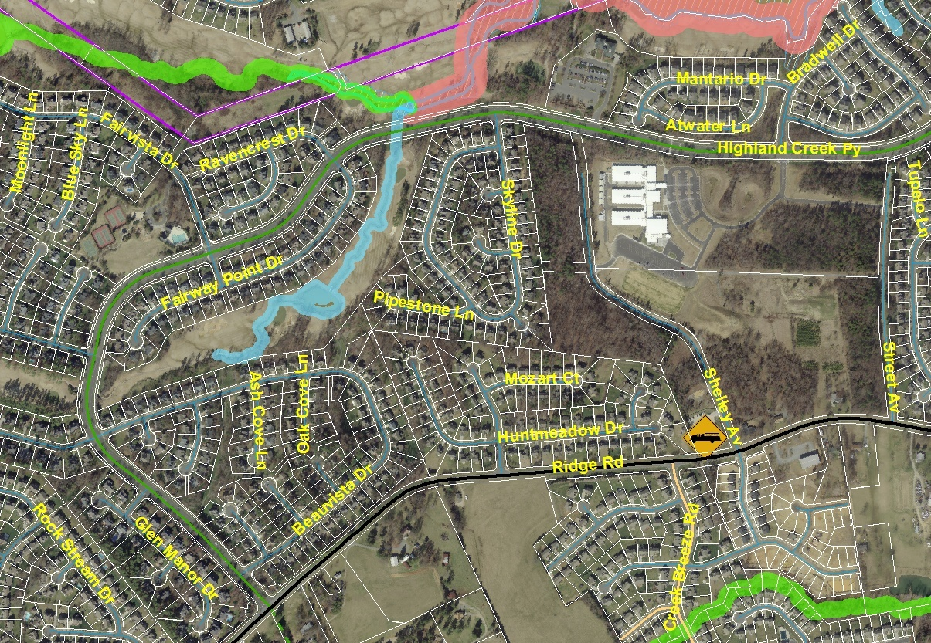
1. Local Ordinances, Approvals and Plans:
Benefits of Connectivity
Charlotte, NC study showed fire protection cost for areas with unconnected streets and cul-de-sacs was 4x greater than areas with connected streets (fewer stations, vehicles, firefighters)
300’ gap in road
~1½ miles
~½ mile
N
Access Management Techniques:
Local Ordinances, Approvals and Plans
Courtesy of Danny Pleasant, AICP Charlotte Dept of Transportation

Slide 24
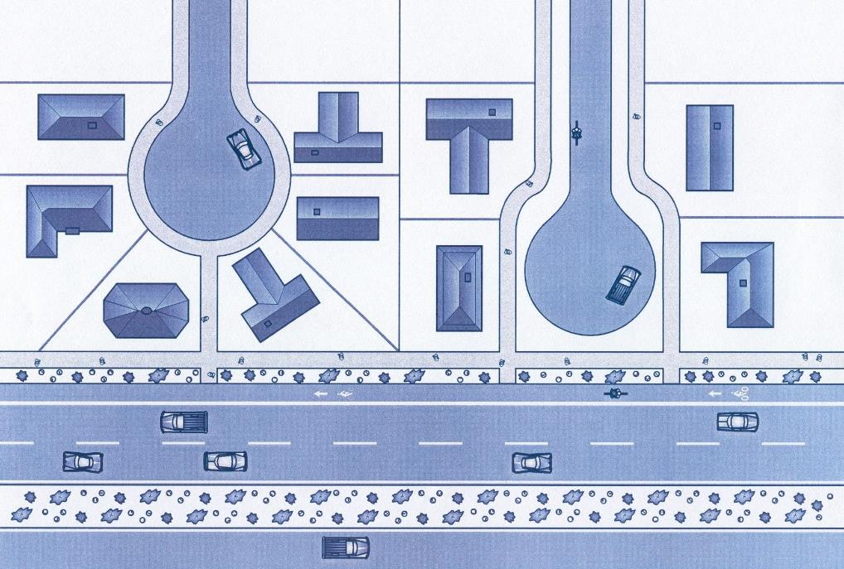
1. Local Ordinances, Approvals and Plans:
Bike/Pedestrian Connectivity
Consider bicyclists and pedestrians even if vehicular connections are not practical
Access Management Techniques:
Local Ordinances, Approvals and Plans

Slide 25
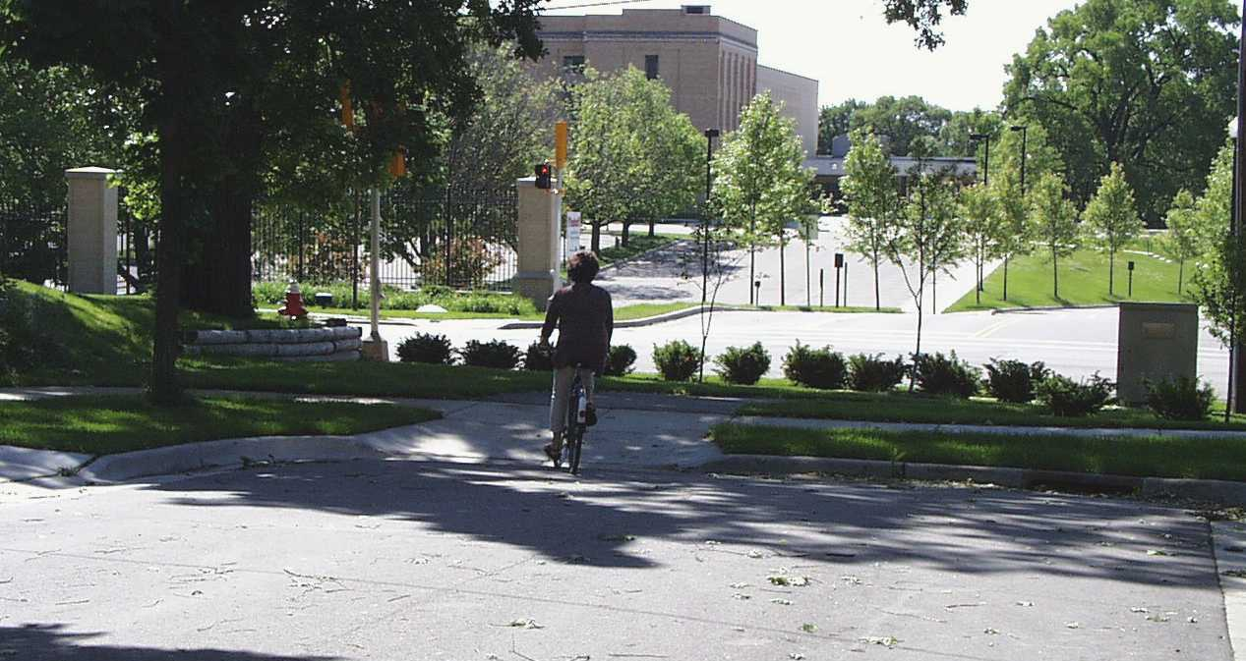
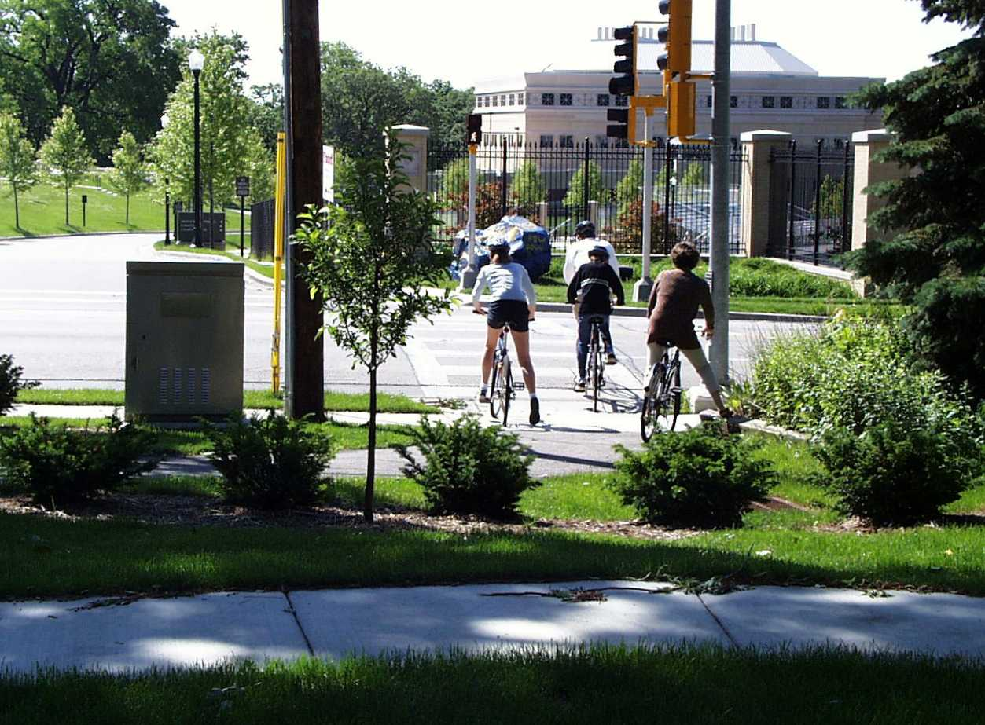
1. Local Ordinances, Approvals and Plans:
Bike/Pedestrian Connectivity
Access Management Techniques:
Local Ordinances, Approvals and Plans

Slide 26

1. Local Ordinances, Approvals and Plans:
Bike/Pedestrian
Connectivity
Jimmy’s house
Tommy’s house
Better to create internal access rather than using the state highway
State Highway
Access Management Techniques:
Local Ordinances, Approvals and Plans
Notes:
Local trips can conflict with mobility if a local circulation system is not built or maintained to accommodate such trips.
STH use required for the local trip.
Providing a local road connection helps minimize STH use (can’t totally prevent it).
Connections to future land divisions shown. These should be planned for.

Slide 27
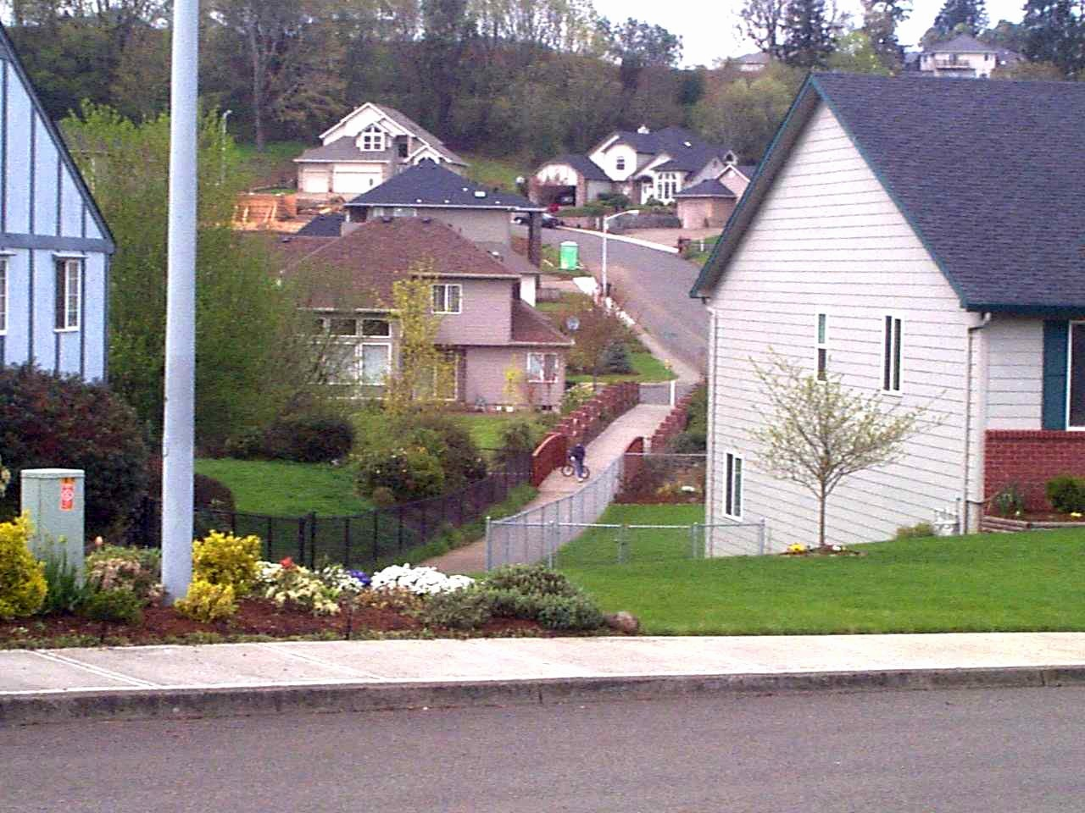
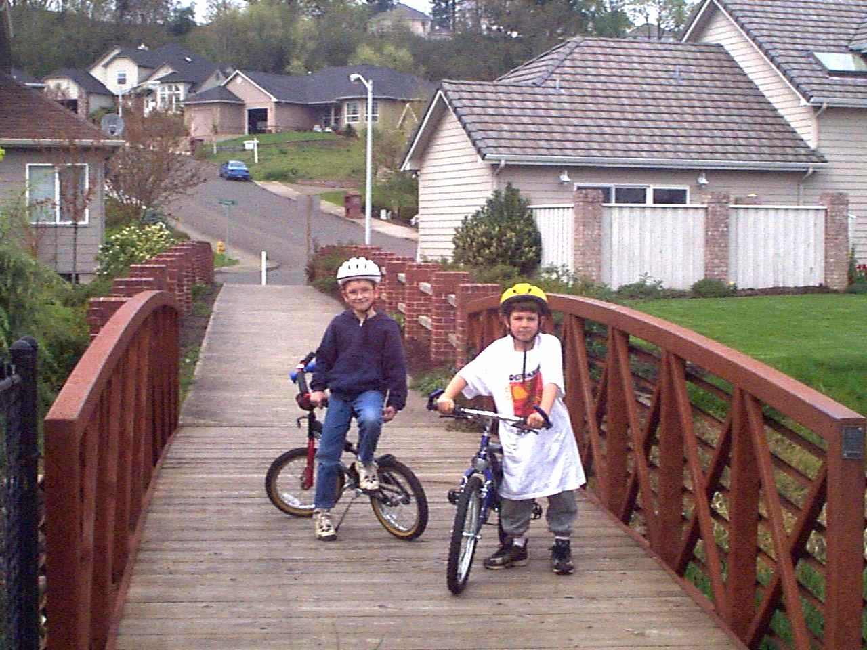
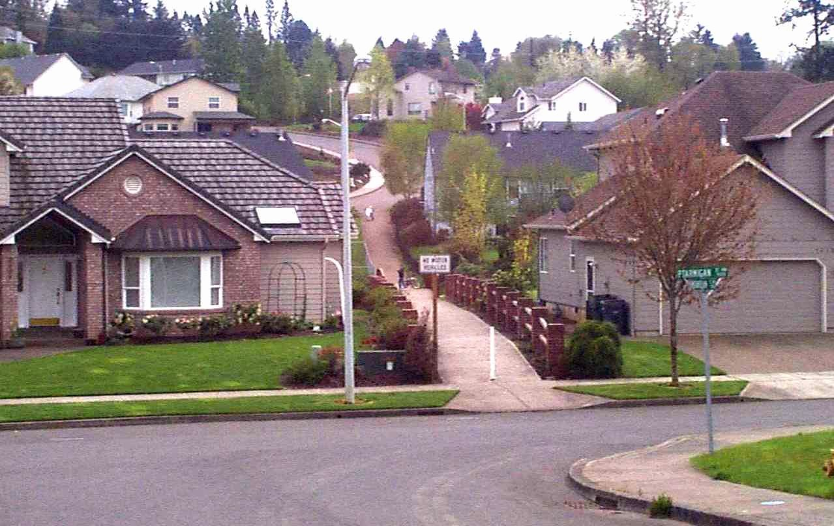
Bike / Pedestrian Connectivity
Bike/Pedestrian trail connecting neighborhood/local streets
Access Management Techniques:
Local Ordinances, Approvals and Plans
Notes:
2 potential rival gang leaders can now meet on a daily basis and build a lifelong friendship.
So here, connectivity is potentially preventing gang warfare in this sleepy Midwestern subdivision.

Slide 28
1. Local Ordinances, Approvals and Plans:
Local Site Plan Review Standards
Refer applicant to WisDOT standards
Avoid internal conflicts around driveway (e.g., parking maneuvers)
Look for options for (future) shared access
Coordinate the review and approval of access and traffic studies
Access Management Techniques:
Local Ordinances, Approvals and Plans

Slide 29
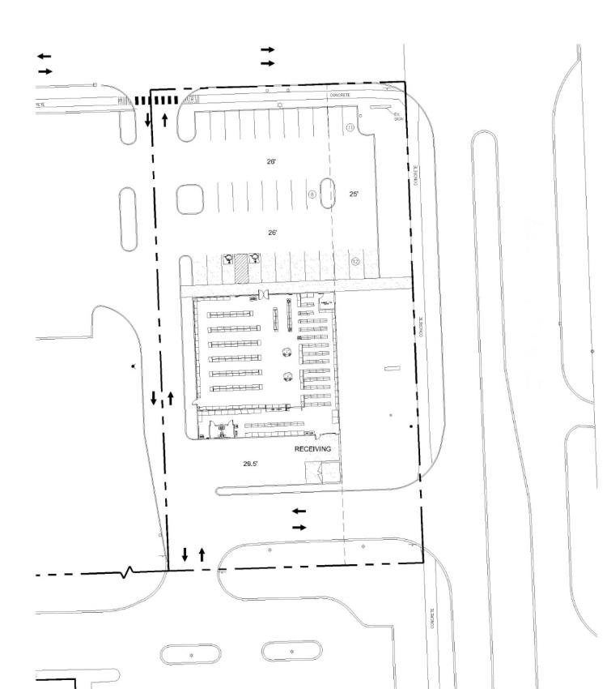
Sidewalk Connections:
From the public street to the building entrances
Frontage sidewalks: Helps complete the non-motorized system
Driveway Design:
Proper radius for speed, longer throat depth, and flow into parking lot
Parking Location:
In the side yard
Limited Number:
One driveway to public street with alternative access provided elsewhere
Crosswalk Striping:
Shows a commitment to protecting pedestrians & bicyclists
Service Road:
Rear service roads may provide access to even more sites than frontage roads
Cross Access:
Provided to adjacent sites
Shared Access:
Matched up to easement on adjacent site
Access Management Techniques:
Local Ordinances, Approvals and Plans

Slide 30
Three Types of Access Management Techniques
1. Local Ordinances, Approvals and Plans
  Corridor plans for future access; overlay plan with zoning district
  Access retrofit strategies
  Local road and bike / pedestrian connectivity
2. Site Access and Design
  Driveway design standards
  Promote shared access systems and connectivity
  Coordinated lot split / site plan review
3. Road and Intersection Design
  Signal spacing
  Two-way left-turn lanes
  Medians
  Innovative intersections
Access Management Techniques:
Site Access and Design

Slide 31
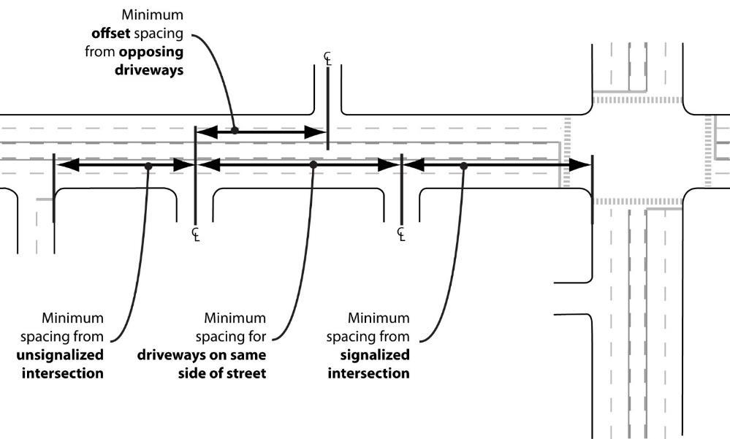
2. Site Access and Design:
Components
Sight distance
Driveway location
Driveway spacing
Offsets
Shared access
Driveway geometrics
Source: LSL Planning
Access Management Techniques:
Site Access and Design

Slide 32
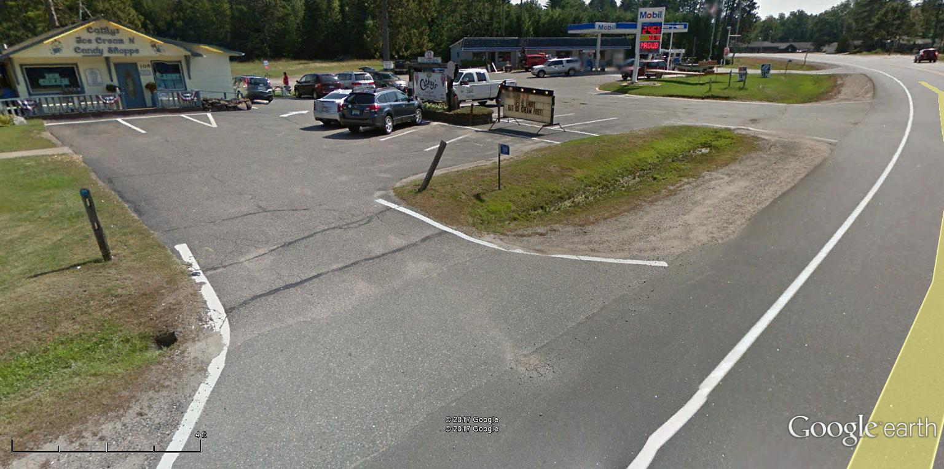


2. Site Access and Design: Driveways
Driveway design impacts safety and operation
  Sight distance
  Width, radii, etc.
  Driveway grade
15 Feet
Intersection Sight Distance
FDM 11-10-5
Access Management Techniques:
Site Access and Design
Notes:
The top picture shows three driveways for the two businesses (a seasonal ice cream store that is really very busy in the summer, and a gas station) in St. Germain. The middle drive is also used for access to some lake homes/cabins. Sight distance around the curve is difficult especially when there are multiple vehicles or vehicles with trailers waiting to exit. The first driveway acts as an entrance only due to the narrow width and angle parking, but not everyone follows this. In addition, someone backing out of the first stall may make an incoming vehicle wait or at least slow down to a point of affecting STH 70 traffic.

Slide 33
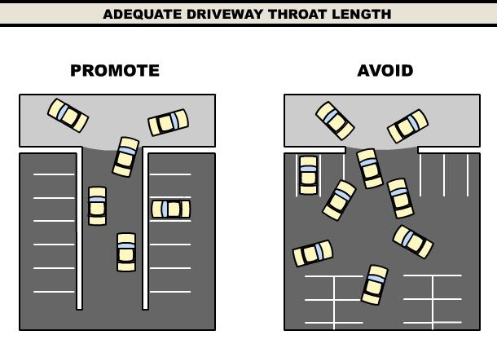
2. Site Access and Design:
Provide Adequate Throat Length
Longer driveway throat distance:
  Aids ingress and egress
  Reduces conflicts between drivers
  Helps separate exiting and entering vehicles
Access Management Techniques:
Site Access and Design
Notes:
An adequate throat length helps to channel traffic at the intersection.
It aids vehicular ingress and egress, reduces conflicts between drivers, and provides a clear definition of exiting versus entering vehicles.
The graphic here shows (at left) a relatively long distance between the major roadway edge and the first decision point for the entering vehicle (what we want to promote), while the graphic to the right shows inadequate throat length and subsequently minimal clarity for motorists resulting in increased vehicular conflict.

Slide 34
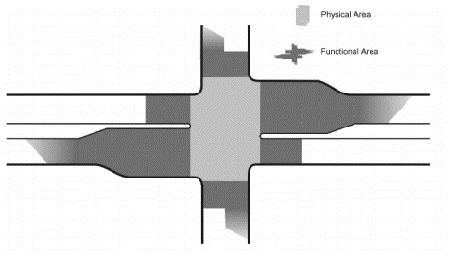
2. Site Access and Design:
Access Points Near Intersections
The Functional Area of an intersection varies from intersection to intersection, but it generally encompasses the areas where motorists are actively turning or preparing to turn at the intersection.
Driveways near intersections create potential for crashes and congestion
Access points within the functional area of an intersection are “strongly discouraged”
Physical Area
Functional Area
Access Management Techniques:
Site Access and Design

Slide 35
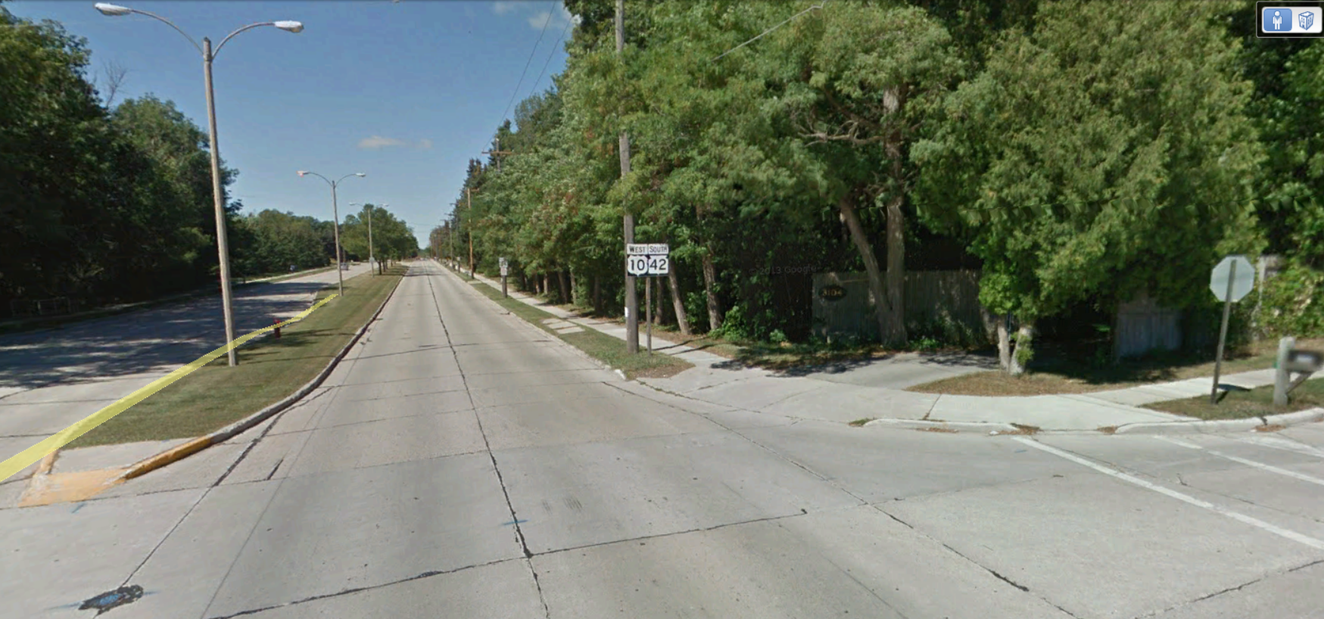
Notes:
This residential driveway is in the functional area of the intersection

Slide 36
2. Site Access and Design:
Driveway Spacing
Rural spacing: 500’ / 1,000’ / 2,000’
Urban spacing: Depends on traffic, existing access, type of use, R/W, etc.
Fewer driveways usually means better traffic flow and fewer crashes
Driveways need to be spaced far enough from other access points
Distance Varies
driveway spacing
New access should be spaced apart from other access points on the same side of the road
Access Management Techniques:
Site Access and Design

Slide 37
2. Site Access and Design:
Urban Spacing
Use right-turn conflict overlap
Source: TRB Access Management Manual,
2nd Edition, Page 372
Access Management Techniques:
Site Access and Design

Slide 38
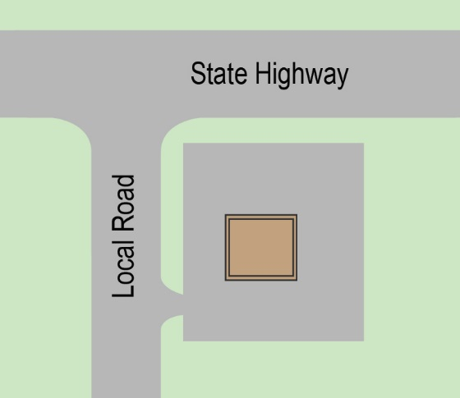
2. Site Access and Design:
Access from Local Road is Usually Better
Preserves vehicle capacity of the state highway
Driveway maneuvers along lower volume, lower speed roads are safer
Access Management Techniques:
Site Access and Design

Slide 39
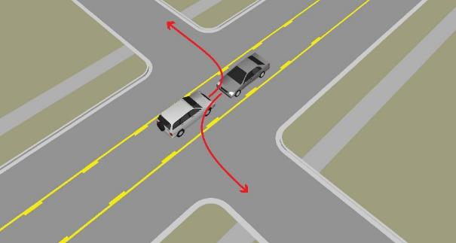
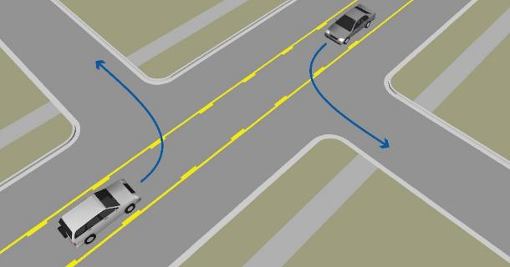
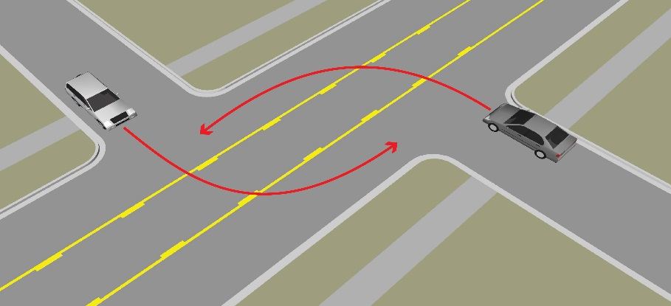
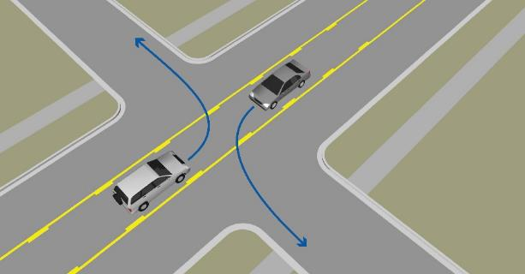
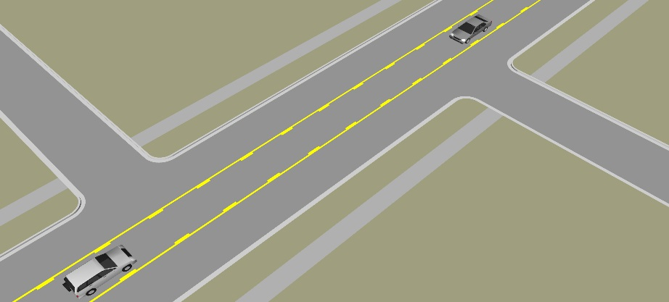
2. Site Access and Design:
Opposing
Driveways
Inbound
Outbound
A.
WORST
B1.
B2.
The spacing of driveways across the street from each other may affect traffic flow and safety
Better for inbound, but…
Conflicts for outbound
C1.
C2.
Best to align…
Or have wide spacing
Access Management Techniques:
Site Access and Design

Slide 40
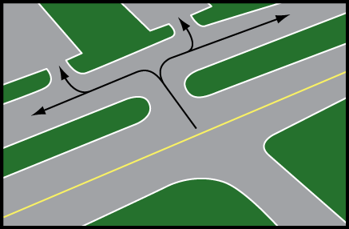
2. Site Access and Design:
Shared Access
Shared access provides access to more than one property
Can help meet spacing standards
Requires a shared access agreement
May include:
  Shared driveway
  Frontage road
  Rear service drive (backage road)
Access Management Techniques:
Site Access and Design

Slide 41
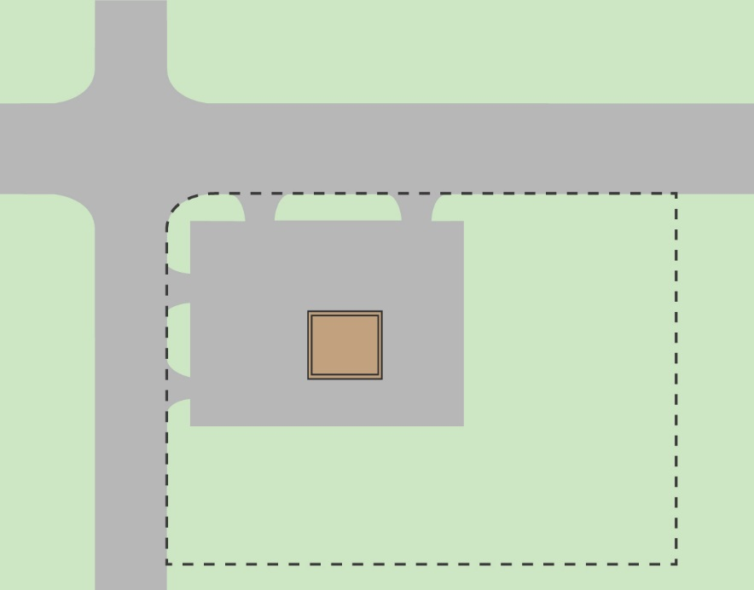
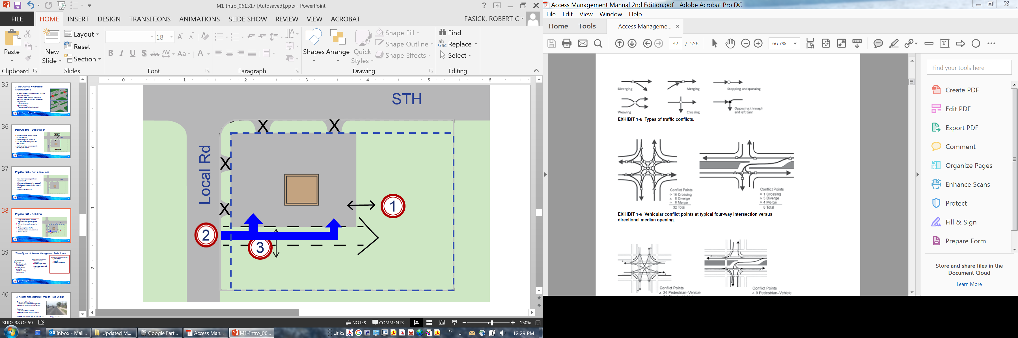
Exercise #1 – Description
Property owner selling corner for gas station
Wants to split off corner lot
Owner has no current plans for rest of land
Just wants four access points for the gas station
Lot Split
STH
Local Rd
Parent Parcel
Exercise #1
Notes:
Add lot line to show lot split

Slide 42
Exercise #1 – Considerations
How many access points are reasonable?
Where should access be located?
What about access for the parent parcel?
Other considerations?
STH
Local Rd
Exercise #1

Slide 43
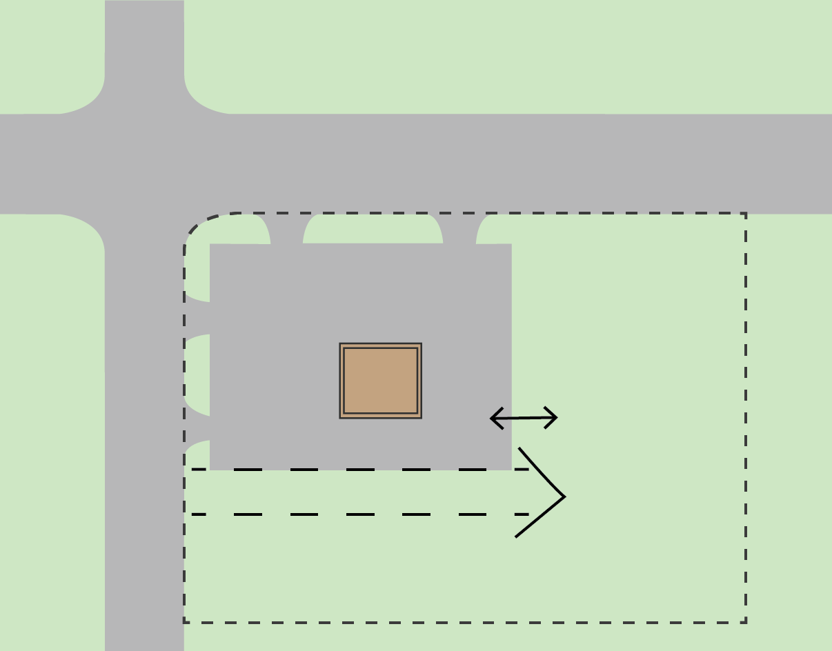
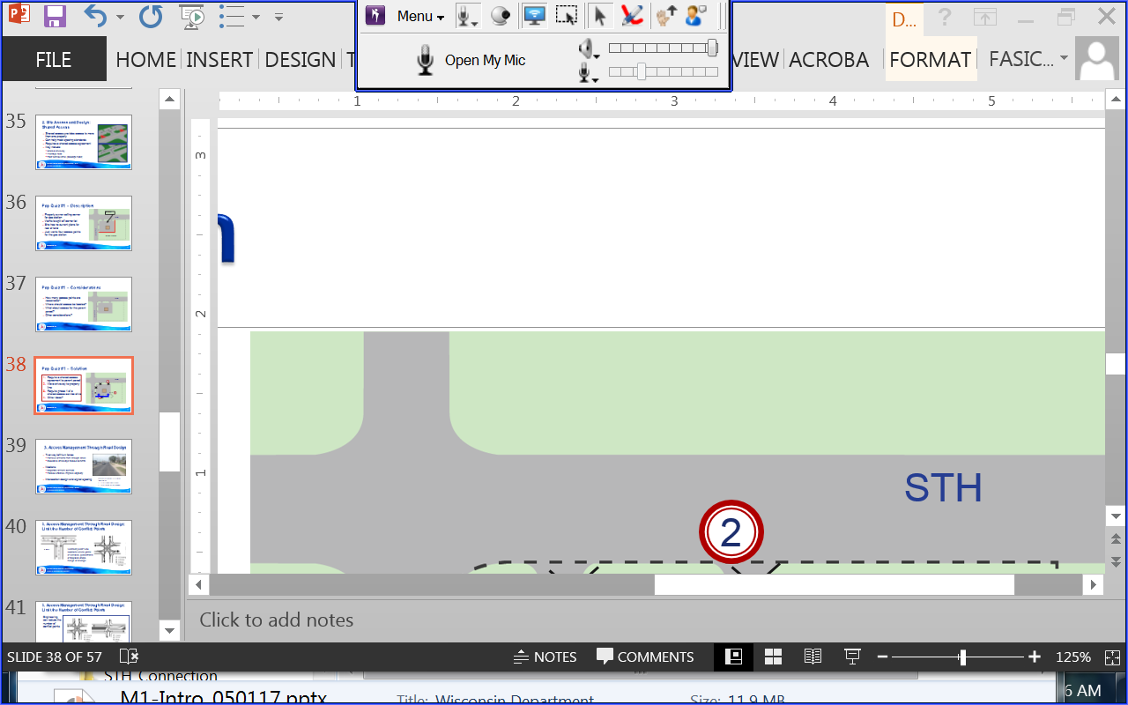
Exercise #1 – Solution
Limit direct access to state highway (as much as possible)
Close/move driveways to property line
Require a shared access agreement to parent parcel
Require phase 1 of a shared access service drive
Other ideas?
State Highway
2
X
1
X
X
Local Road
X
3
4
Exercise #1

Slide 44
Three Types of Access Management Techniques
1. Local Ordinances, Approvals and Plans
  Corridor plans for future access; overlay plan with zoning district
  Access retrofit strategies
  Local road and bike / pedestrian connectivity
2. Site Access and Design
  Driveway design standards
  Promote shared access systems and connectivity
  Coordinated lot split / site plan review
3. Road and Intersection Design
  Signal spacing
  Two-way left-turn lanes
  Medians
  Innovative intersections
Access Management Techniques:
Road and Intersection Design

Slide 45
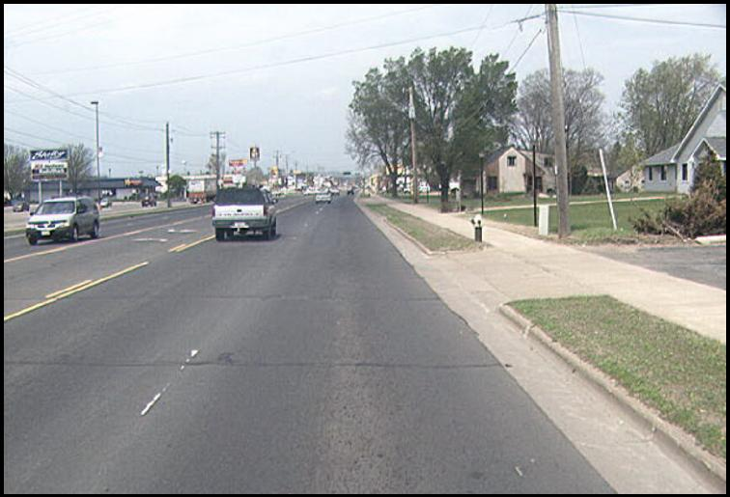
3. Road and Intersection Design
Two-way left-turn lanes
  Remove left turns from through lanes
  Excessive driveways reduce benefits
Medians
  Separate left turn conflicts
  Reduce crashes, improve capacity
Intersection design and signal spacing
Adding a center turn lane results in:
35% crash reduction
30% capacity increase
Access Management Techniques:
Road and Intersection Design

Slide 46
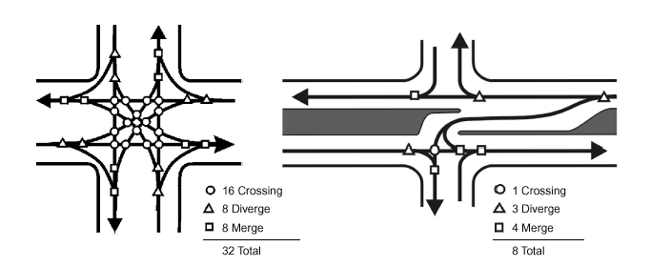
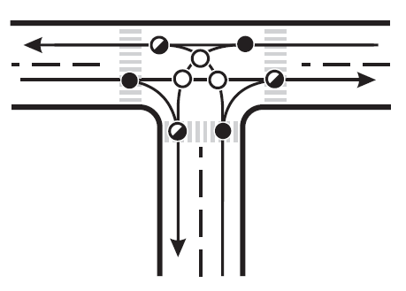
3. Road and Intersection Design: Limit the Number of Conflict Points
General goal is:
Fewer access points onto the highway
Sometimes access to the highway may be indirect
3 Crossing
3 Diverge
3 Merge
9 Total
Conflict points are locations where paths of vehicles, pedestrians or bicycles cross, merge or diverge
Access Management Techniques:
Road and Intersection Design
Notes:
Conflict points are locations where the paths of vehicles, pedestrians, or bicycles cross, merge or diverge.
The graphic on the left shows 9 conflict points for an intersection (driveway or cross-street) to an undivided road.
The graphic on the right shows 32 vehicular conflict points from crossing, merging or diverging maneuvers for a roadway with one lane in each direction.
Another way to limit the number of conflict points on higher classification roadways is to simply limit the number of roadway connections. Minimizing unnecessary access points is critical to preserving the roadway function.

Slide 47
3. Road and Intersection Design:
Limit the Number of Conflict Points
Engineering can reduce the number of conflict points
Access Management Techniques:
Road and Intersection Design
Notes:
Conflict points are locations where the paths of vehicles, pedestrians, or bicycles cross, merge or diverge.
The upper left graphic shows the conflict points for an intersection (driveway or cross-street) to an undivided road.
The graphic in the upper right shows (at its left) the 32 vehicular conflict points from crossing, merging or diverging maneuvers for a roadway with one lane in each direction. To the right is the same “main” road changed to a left-in only, demonstrating the reduction of conflict points from 32 to 8.
The lower graphic shows conflict points that occur between pedestrians-vehicles and bicycles-vehicles for the same intersection with the left-in maneuver. These pedestrian-vehicle and bicycle-vehicle conflicts are even higher when there is no left-turn control on the intersection.
Another way to limit the number of conflict points on higher classification roadways is to simply limit the number of roadway connections. Minimizing unnecessary access points is critical to preserving the roadway function.
The graphic in the upper left shows an example of this where the desire is to avoid the proliferation of driveways for each parcel of land and to promote shared access where one shared driveway serves several parcels of land.

Slide 48
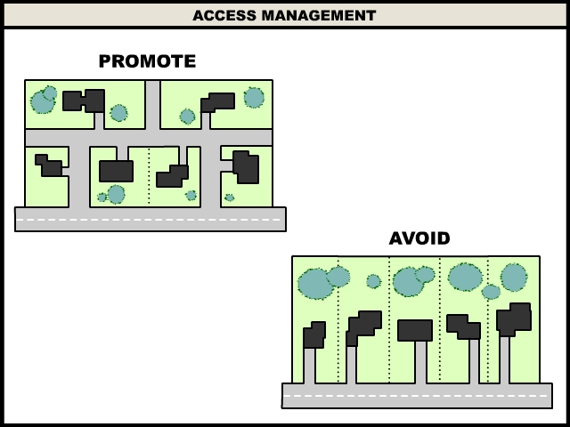
3. Road and Intersection Design
Limit the Number of Conflict Points
Fewer connections (driveways) =
  Fewer conflict points
  Fewer crashes
  Better mobility
General goal:
  Fewer access points onto the highway
  Sometimes, highway access may be indirect
9 conflict points
45 conflict points
Access Management Techniques:
Road and Intersection Design
Notes:
Conflict points are locations where the paths of vehicles, pedestrians, or bicycles cross, merge or diverge.
The upper left graphic shows the conflict points for an intersection (driveway or cross-street) to an undivided road.
The graphic in the upper right shows (at its left) the 32 vehicular conflict points from crossing, merging or diverging maneuvers for a roadway with one lane in each direction. To the right is the same “main” road changed to a left-in only, demonstrating the reduction of conflict points from 32 to 8.
The lower graphic shows conflict points that occur between pedestrians-vehicles and bicycles-vehicles for the same intersection with the left-in maneuver. These pedestrian-vehicle and bicycle-vehicle conflicts are even higher when there is no left-turn control on the intersection.
Another way to limit the number of conflict points on higher classification roadways is to simply limit the number of roadway connections. Minimizing unnecessary access points is critical to preserving the roadway function.
The graphic in the upper left shows an example of this where the desire is to avoid the proliferation of driveways for each parcel of land and to promote shared access where one shared driveway serves several parcels of land.

Slide 49
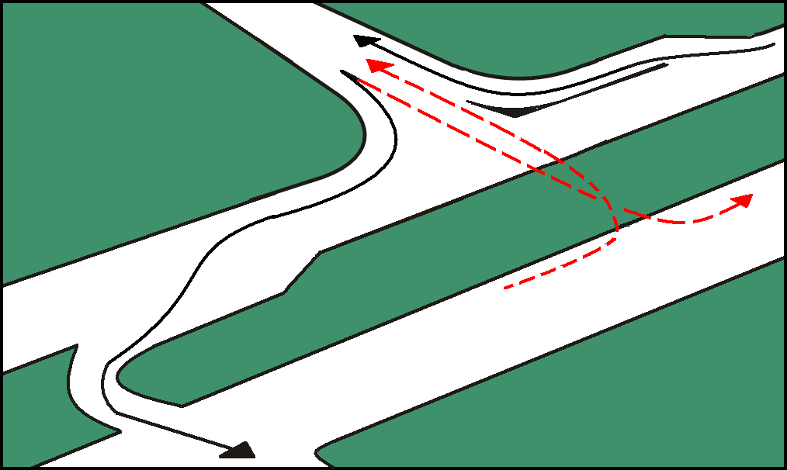
3. Road and Intersection Design: Medians
Help reduce crashes and improve travel efficiency by directing all traffic in one direction, and restricting left-turn movements to desired points
Access spacing from median openings should provide sufficient weaving area
Width needs to be sufficient to accommodate left turns
Are most effective with fewer median openings
Access Management Techniques:
Road and Intersection Design

Slide 50
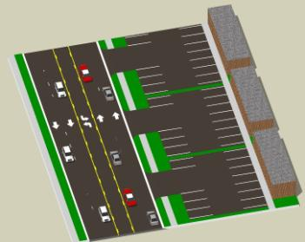
Collaboration Between Communities & WisDOT
WisDOT controls state right-of-way
Local governments regulate local zoning, lot splits and site plans
Most effective with municipal and WisDOT partnerships
Alert WisDOT about:
  Rezonings and new development
  Requested lot splits
  Change or expansions that may increase traffic
Zoning
Site Plan
Approvals
Zoning
WisDOT Permits
Site Plan
Approvals
Local Jurisdiction
WisDOT
Right-of-Way
Local Jurisdiction
Collaboration Between Communities and WisDOT

Slide 51
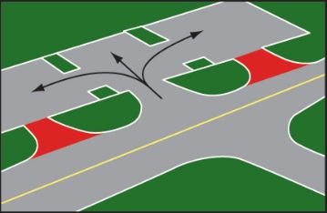


Recap: Top 10 ways municipalities and WisDOT can work to manage access
  Lay foundation for access management in the local
  comprehensive or corridor plan
  Locate driveways away from intersections and other driveways
  Consider access to future parcels when lot splits are requested
  Promote shared access (connect parking lots, consolidate driveways, use frontage and backage roads)
  Ensure site plan reviews reduce traffic conflicts (especially designs near driveways)
Collaboration Between Communities and WisDOT
Notes:
Changes in zoning regulations, rezonings, site-plans, access (location, design), or change in use to help trigger coordination with the WisDOT Region Access Coordinator to ensure standards are met, if applicable. {Have a handout of Region Map and direct audience to website for contacts statewide}
WisDOT as an abutting land owner needs to be notified of rezoning and should be notified about other changes related to AM.

Slide 52


Recap: Top 10 ways municipalities and WisDOT can work to manage access
  Set lot frontage on major roads so
  spacing standards can be met
  Promote connected streets
  Place access on side streets where practical
  Regulate driveway location, spacing, design under local zoning and other ordinances
  Notify WisDOT of land use, zoning
  and access changes
Collaboration Between Communities and WisDOT

Slide 53

Implementation Opportunities
Joint corridor planning
Local regulations and development review
Site plan review:
  Retrofit = Gradual implementation
  Access improvements through site plan review as businesses change and/or expand
Road projects:
  Close/consolidate/relocate when road improved
Communication:
  Alert WisDOT of changes and
  vice-versa
Implementation Opportunities
Notes:
53

Slide 54

Retrofit Implementation Example:
Monona Drive – Madison, WI
13
15
Crash rate up to 3 times state average
40% of crashes were rear-end crashes, some caused by left-turning vehicles waiting for gap
Credit: Strand Associates
Implementation Opportunities

Slide 55

Retrofit Implementation Example:
Monona Drive – Madison, WI
9
12
Combined Access: Access points reduced from 69 to 43 from Broadway to Pflaum
Added medians: 30% reduction in total crashes; 45% reduction in injury crashes
Credit: Strand Associates
Implementation Opportunities

Slide 56

Exercise #2 – Existing Situation
High crash rate at intersection along state highway
Queuing at signals frequently blocks existing driveways
Low volume side street
Property owner wants two driveways for small strip center
High activity shopping center across street
What problems do you see considering these factors?
Shopping Center
Exercise #2

Slide 57

Exercise #2 – Considerations
Access spacing from intersection?
Offsets with driveways across the street?
Other considerations?
Shopping Center
Exercise #2
Notes:
Add functional area of the intersection

Slide 58


Exercise #2 – Solution
  Access from local street
  Eliminate access in the intersection functional area
  Shift driveway left to align with access across the street
  Access to adjacent property
  Consider a median
  Other ideas?
1
4
2
5
3
Shopping Center
Exercise #2
Notes:
Add functional area of the intersection

Slide 59
Takeaways…
Access management is a cost-effective way to improve traffic flow and safety
Access management is better for businesses
WisDOT is a leader in access management using many types of controls, including eminent domain and police power regulations
Collaboration between municipalities and WisDOT leads to improved outcomes
☞

Slide 60

Takeaways (continued)
If access management is not applied consistently and vigorously, this may occur…
  High number of access points (49 per mile)
  Offset public road connections
  High crash rate (73% above state average)
WIS 33 – Baraboo, WI

Slide 61

Resources
Additional WisDOT Access Management Training
WisDOT Access Management webpage
  http://wisconsindot.gov/Pages/doing-bus/real-estate/access-mgmt/default.aspx
WisDOT Facilities Development Manual
TRB Access Management Manual (2nd Edition)
  To buy: http://www.trb.org/Main/Blurbs/171852.aspx
TRB Access Management Committee Website
  http://www.accessmanagement.info/
Notes:
There are several primary sources of access management information for WisDOT staff implementing access management, as well as staff from WisDOT partnering agencies. These sources include the:
1. TRB Access Management Manual (2nd Edition) and
2. TRB Access Management Committee Website.
A link is provided on this slide to purchase the Access Management Manual. A link is also provided here for the TRB Access Management Committee website which is loaded with useful resources.

Slide 62
STH Connection Permit Contacts
Please contact the appropriate region office that has jurisdiction in the county where the connection is or will be located
Revised 9/5/17

Slide 63
Acknowledgments
Special thanks to the WisDOT Access Management Team members who contributed their time, input, and experiences to develop this training program:
Mike Roach – Statewide Access Engineer
Sue Voight – SE Region Access Coordinator
Dave Nielsen – NE Region Access Engineer
Tom Beekman – NW Region Planning Chief
Ernie Peterson – Statewide Access Engineer (Retired)
Bob Fasick – State ROW Permits Engineer
John Sobotik – Assistant General Counsel
Kathy Batha – Assistant General Counsel
Consultants:
Brad Strader, MKSK, TRB Access Management Committee member
Charles (Chuck) Wade, TranSmart, consultant for WisDOT 2005 Access Management Training program
Bill Eisele, TTI and TRB Access Management Committee past member
Karen Dixon, TTI and TRB Access Management Manual co-author
Josh Penn, LSL Planning, a SAFEbuilt Company

Slide 64
Discussion

