Slide 1
SAFETY l EFFICIENCY l MOBILITY
Promoting Innovations & Partnerships for the Future
Wisconsin Department of Transportation
Don Gutkowski, PE
Bureau of Traffic Operations Director
TAPCO Open House & 60th Anniversary
October 19, 2016
1
1

Slide 2
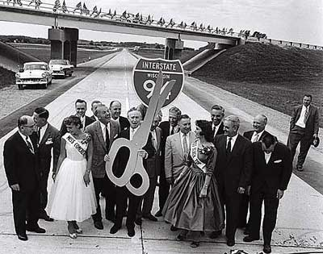
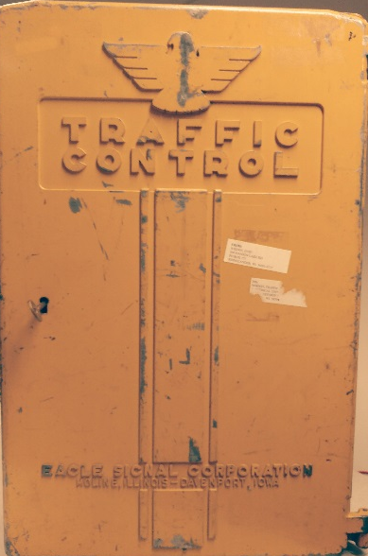
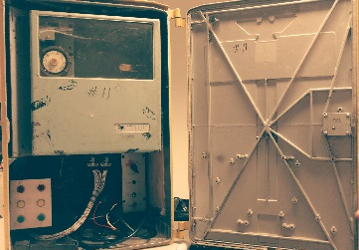
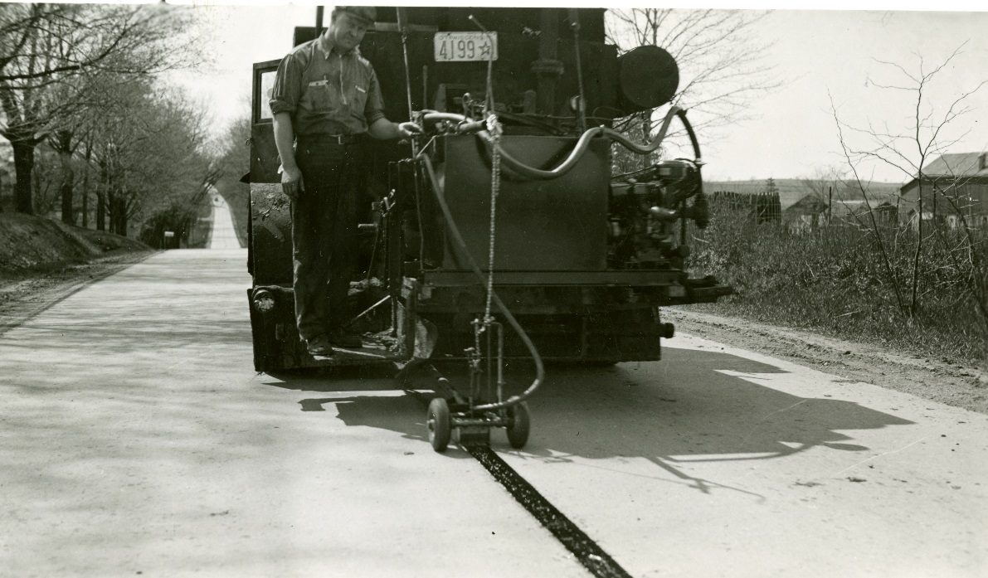
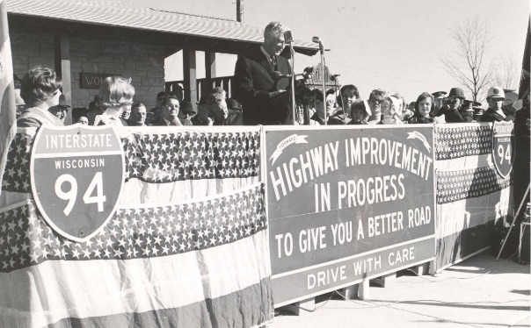
1950s
60 Years Ago…
Interstate highway ribbon cutting in 1958
Edgeline pavement marking started in 1959
Notes:
1958 - First segment of Interstate highway in WI dedicated - 7.5 miles of I-94 between Goerke's Corners and CTH "SS" in Waukesha County.
1959 - Edge line pavement marking started.
1950s Eagle traffic control cabinet that was used by WisDOT until mid 1990s.

Slide 3
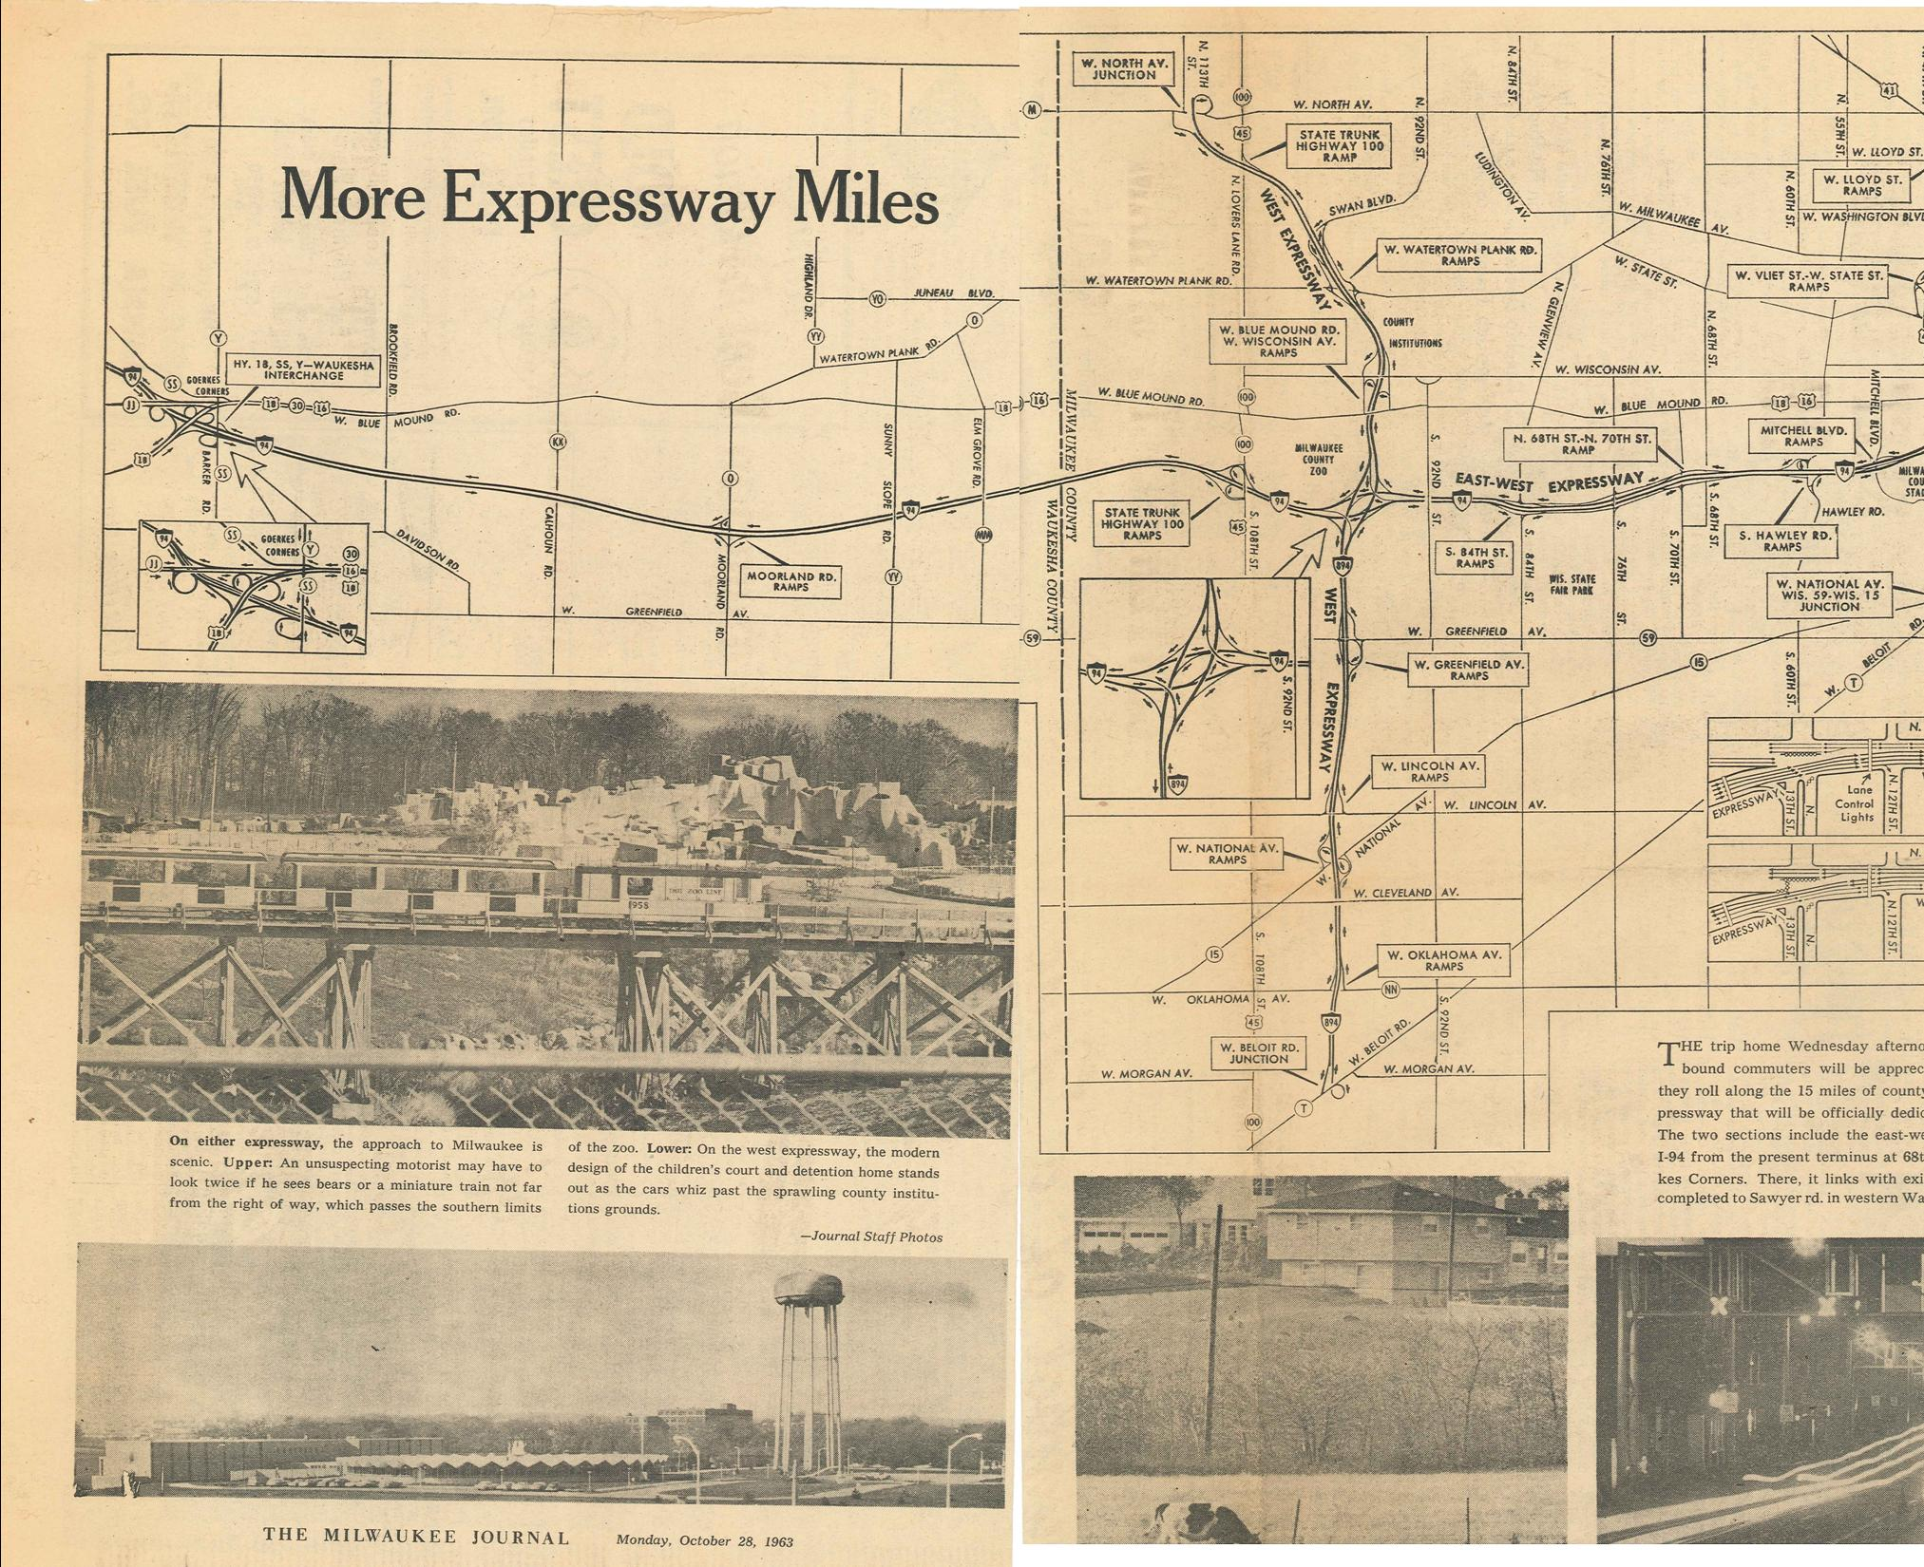
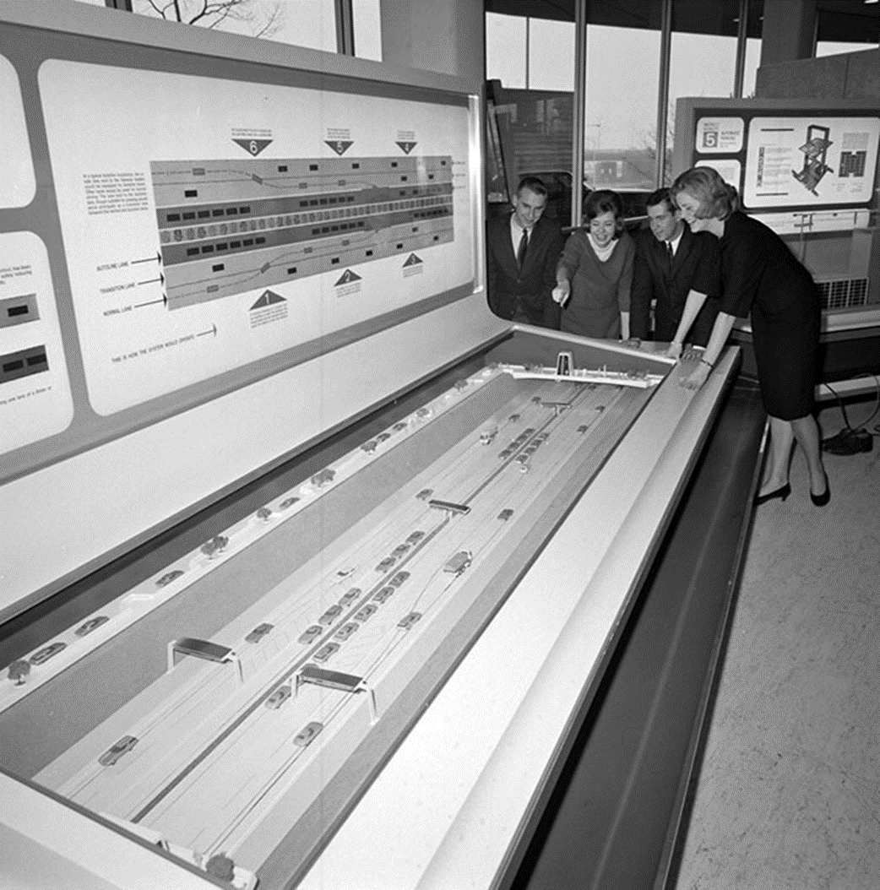
1960s
SEWRPC Adopted First Generation Land Use & Transportation Plan
Marquette Interchange construction begins in 1964 and opened in 1968
3

Slide 4
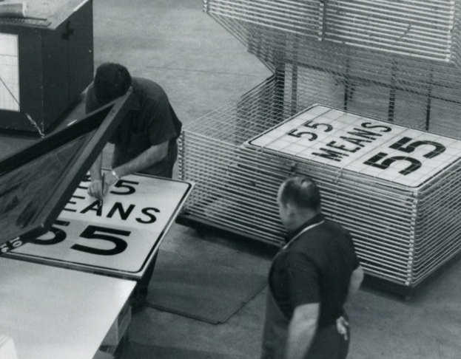
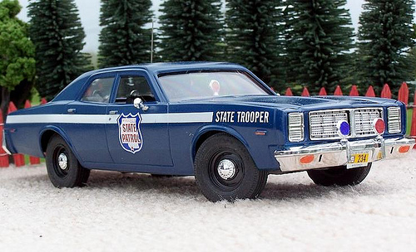
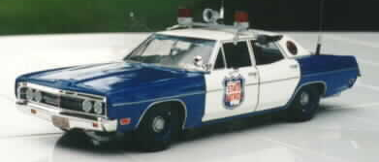
1970s
First ramp meters are installed on Milwaukee Freeways
Concept Illustration of Milwaukee Freeway System in 70s
4
Notes:
1973 - The oil embargo and energy crisis lead to the enactment of the 55 mph rural speed limit.

Slide 5
1980s
Ten-year moratorium (1977-1987) when no additional Milwaukee freeway miles were constructed
Six-year Highway Improvement Program approved
Wisconsin Interstate system continues to expand including Madison Beltline
Mandatory seat belt law enacted in 1987
5
Notes:
Beginning of “personal use” technologies and recognize the safety aspects of transportation

Slide 6
1990s
Milwaukee’s FTMS MONITOR designed and local traffic reporters share travel times
Began installing loop detectors to calculate volume, speed and report travel times
DMS and freeway cameras installed in Milwaukee
TIME Program initiated
Late 90s, Freeway Service Team begins in Milwaukee, Kenosha and Racine County
Madison area ITS installation begins
6
Notes:
1993 - Milwaukee’s FTMS MONITOR designed and local traffic reporters share travel times
1994 - Began installing loop detectors to calculate volume, speed and report travel times
1994 - DMS and Freeway Cameras installed in Milwaukee
1995 - TIME initiated
1998 - FST begins in Milwaukee, Kenosha and Racine County
1999 – Madison area ITS installation begins

Slide 7
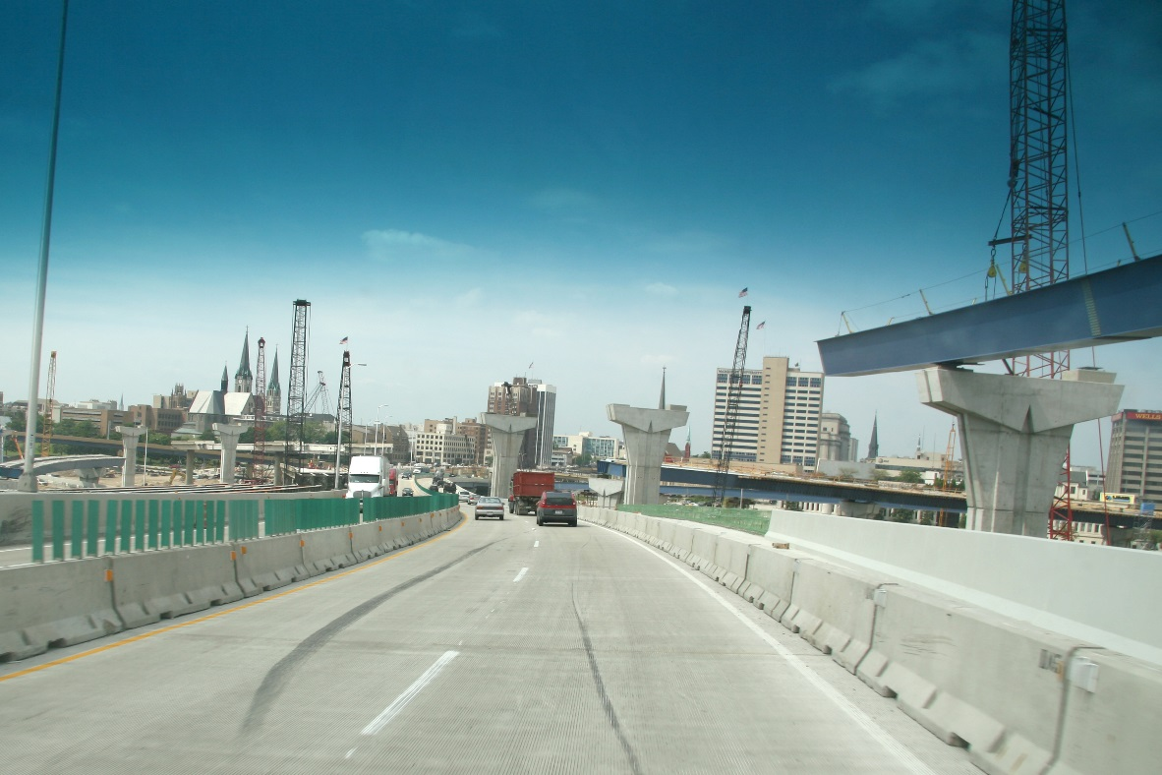
2000s
SE Region TOC goes 24/7, few years later becomes statewide
New Marquette Interchange (2004-2008)
State Patrol Liaison appointed at STOC
511 phone line & website launched
7

Slide 8
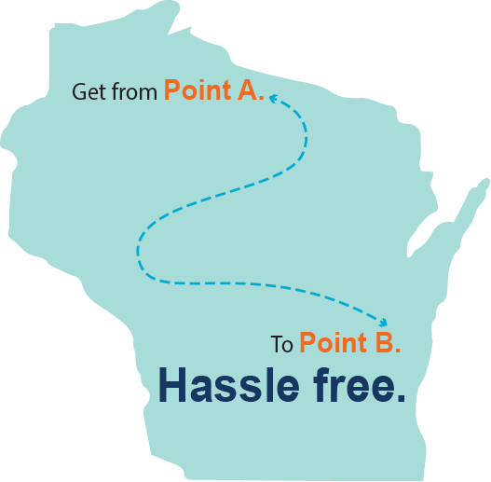
Today
In 2015, the state had
7,673,566 hours of delay
$238,999,629 of user delay cost
&
What is WisDOT doing to Help?
Managing congestion and improving transportation safety, mobility and efficiency on Wisconsin’s state highways through the use of:
Statewide Traffic Operations Center (STOC)
Intelligent Transportation Systems (ITS)
Traveler Information
Traffic Incident Management
8

Slide 9
The Transportation Environment is Changing
Defined in MAP 21, “Transportation Systems Management and Operations (TSM&O) is an integrated program to optimize the performance of existing multimodal infrastructure through implementation of systems, services, and projects to preserve capacity and improve the security, safety and reliability of the transportation system.
9

Slide 10
TSM&O Strategies
Work Zone Management
Traffic Incident Management
Service Patrols
Special Event Management
Road Weather Management
Transit Management
Traffic Signal Coordination
Surveillance and Monitoring
Traveler Information
Ramp Management
Managed Lanes
Active Traffic Management
Integrated Corridor Management
Truck Parking
Current Initiatives…..
10
Notes:
Want to highlight key initiatives and projects happening in BTO in the following slides…..
Promoting partnerships to help get things done efficiently and effectively.

Slide 11
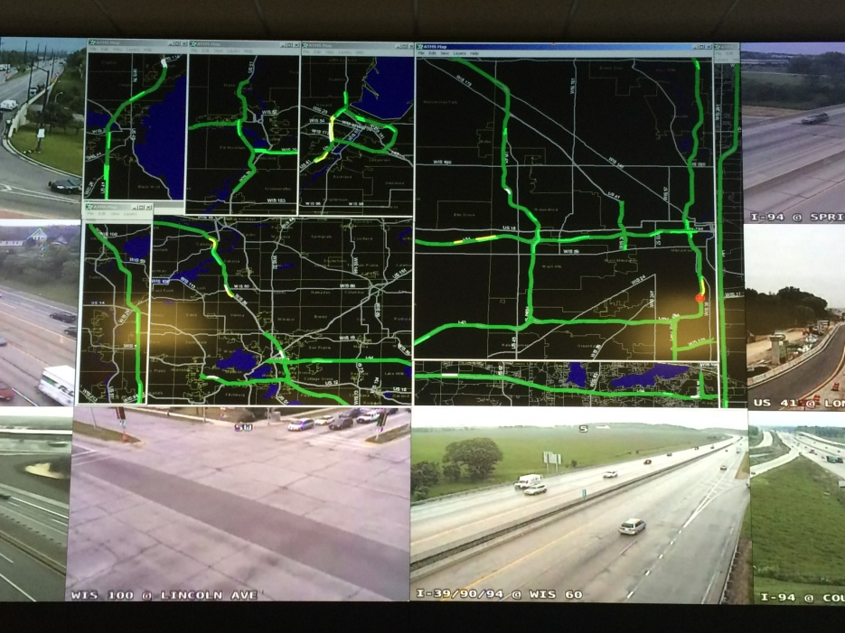
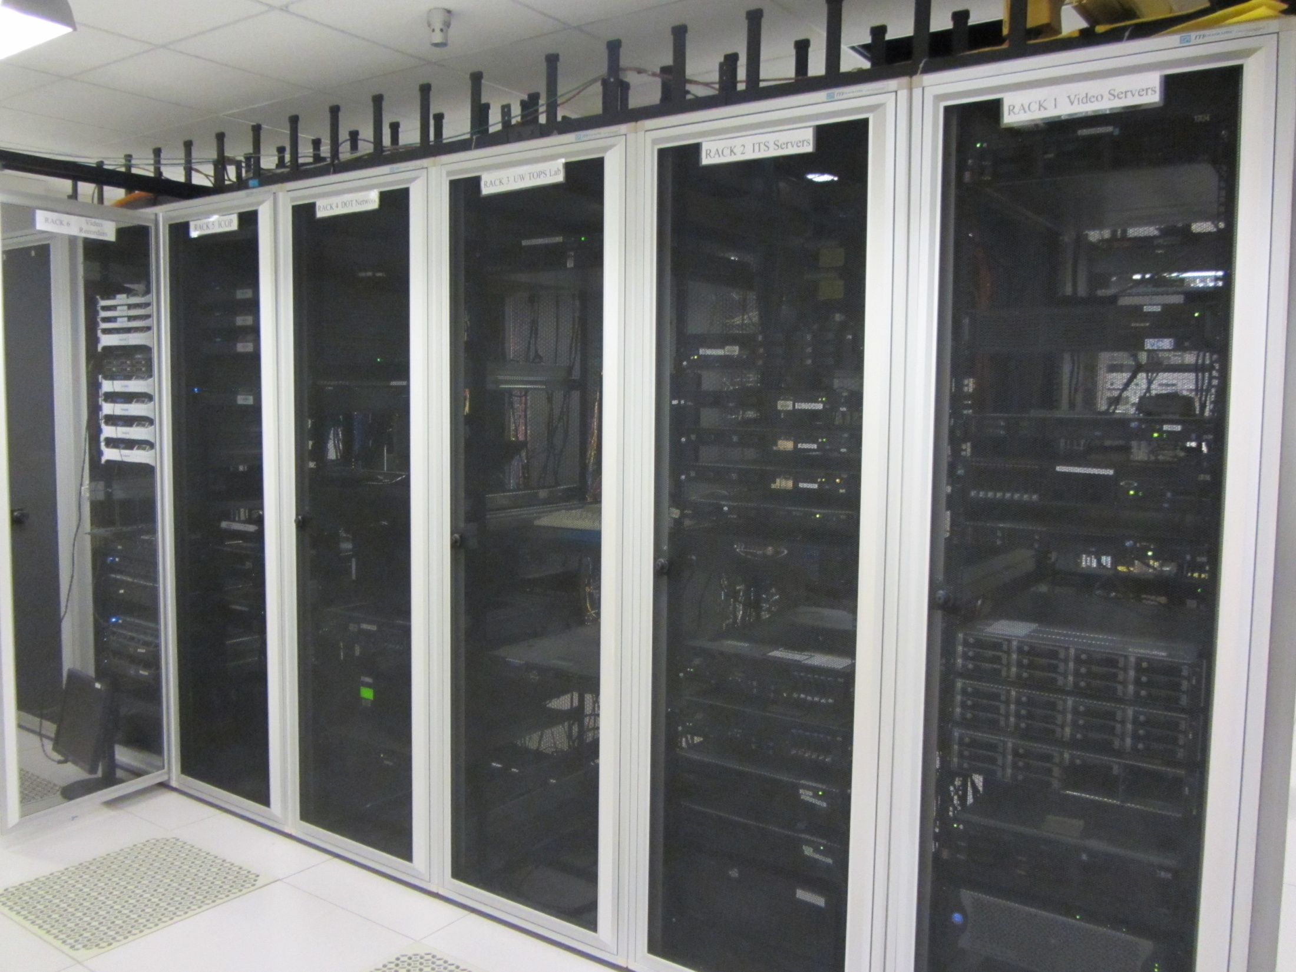
Next Generation ATMS
IBI providing a tool for WisDOT and its partners to take traffic management, traveler information and traveler warning to the next level
Building IT requirements for full integration with previously separate systems
11
Notes:
Will be able to quickly and comprehensively enact decisions that benefit end users by helping them avoid delays and keep them out of harms way. “Saving dollars and saving lives”
$3.5M contract with IBI
TAPCO will help with integration of the ATMS system to field devices

Slide 12
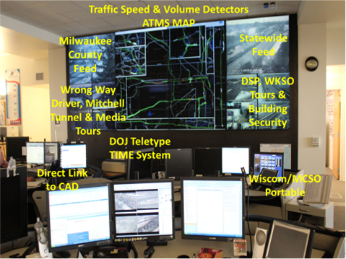
Control Room
The STOC is a control room that is operated by staff
24 hours
7 days a week
365 days a year
Operators use live camera feeds, data from infrastructure, info from other state agencies, and advanced software to help mitigate congestion and keep the commuting public safe
12

Slide 13
Traveler Information
The ATMS also populates
511 Wisconsin Travel Information
Allowing public to receive up-to-date information
Winter road conditions
View traffic cameras
Incidents
Road construction
19,484
160,544
2,251,735
4,011
mobile app downloads
voice calls
website visits
Twitter followers
2015 Totals
13
Notes:
2015 Totals

Slide 14
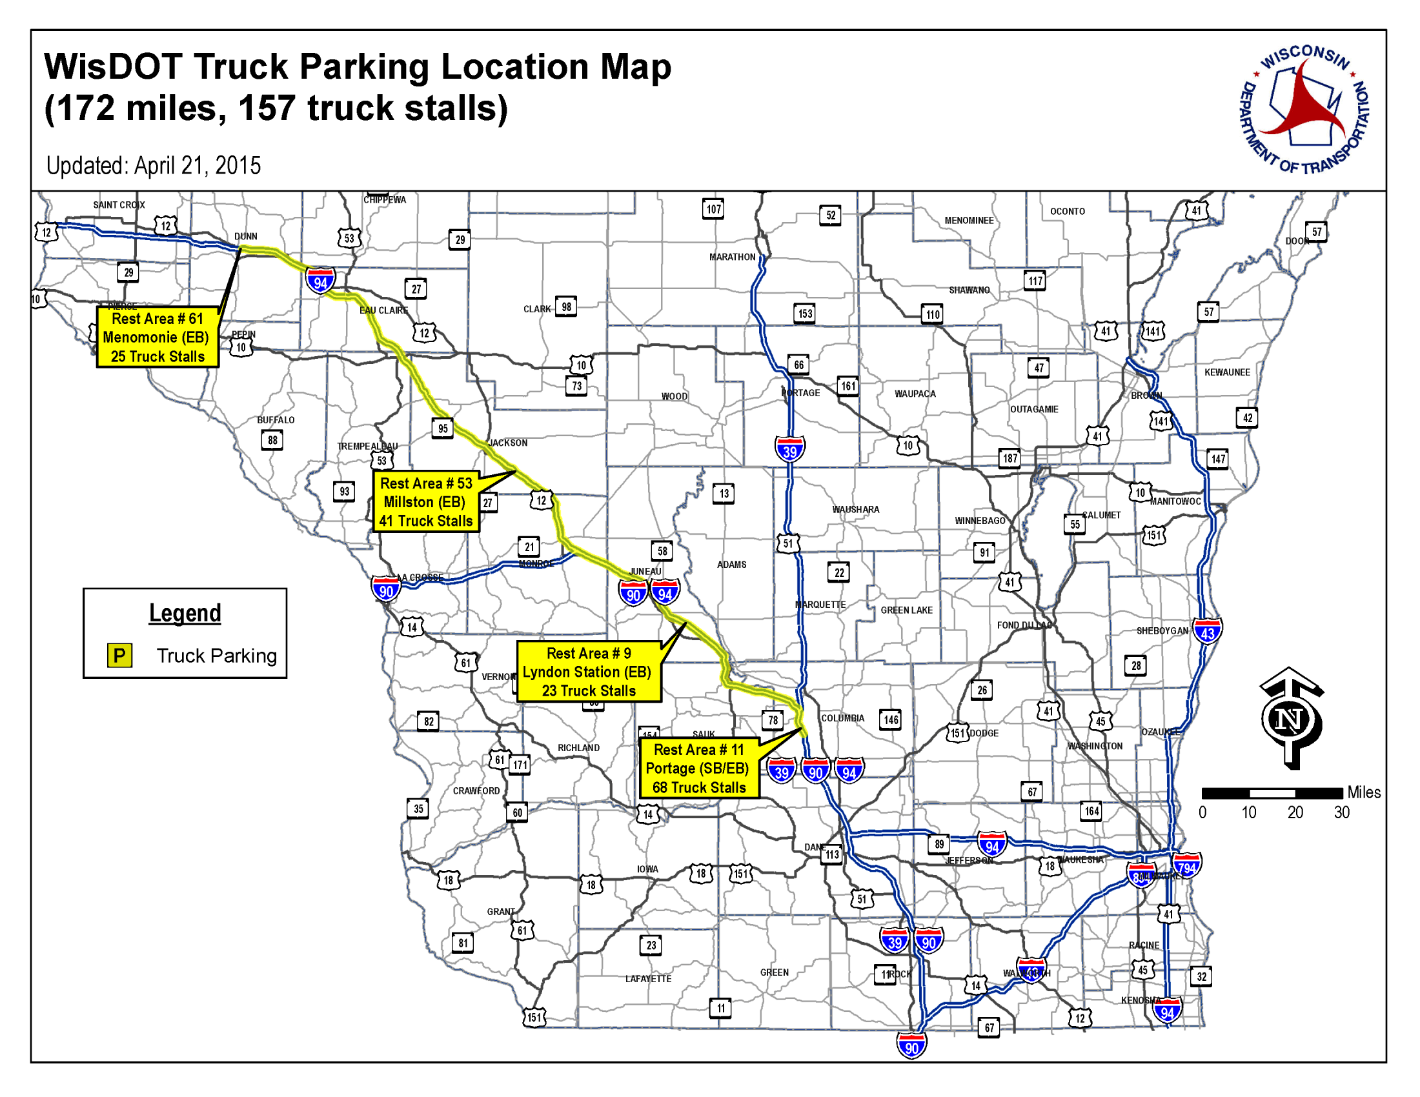
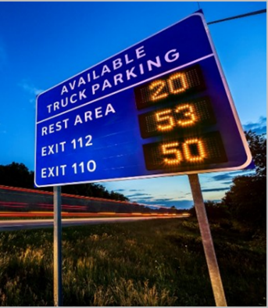
Traveler Information: Freight Component
Truck Parking Information Management System
Four rest areas along the I-94 corridor between Hudson and Madison
Use video pattern recognition systems, sensor based detection systems, data management server system, and a data distribution system
Truckers able to better plan their rest periods without exiting the freeway - saving time
14

Slide 15
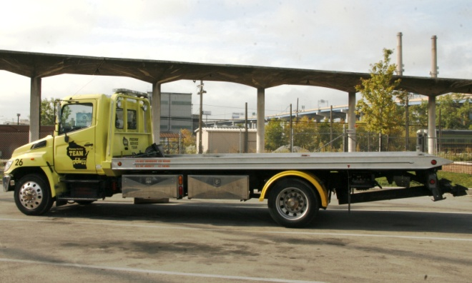
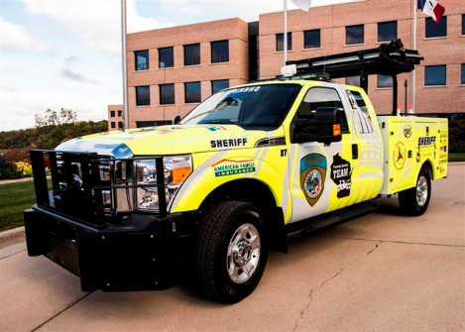
Freeway Service Team (FST) Sponsorship
Issued an RFP for work zone FST sponsorship in June 2016
Currently in contract negotiations
Expected kickoff beginning of 2017
15
Notes:
WisDOT issued an RFP for work zone FST sponsorship in June, 2016
Currently in confidential contract negotiations
Expect sponsorship kick off after January 1, 2017

Slide 16
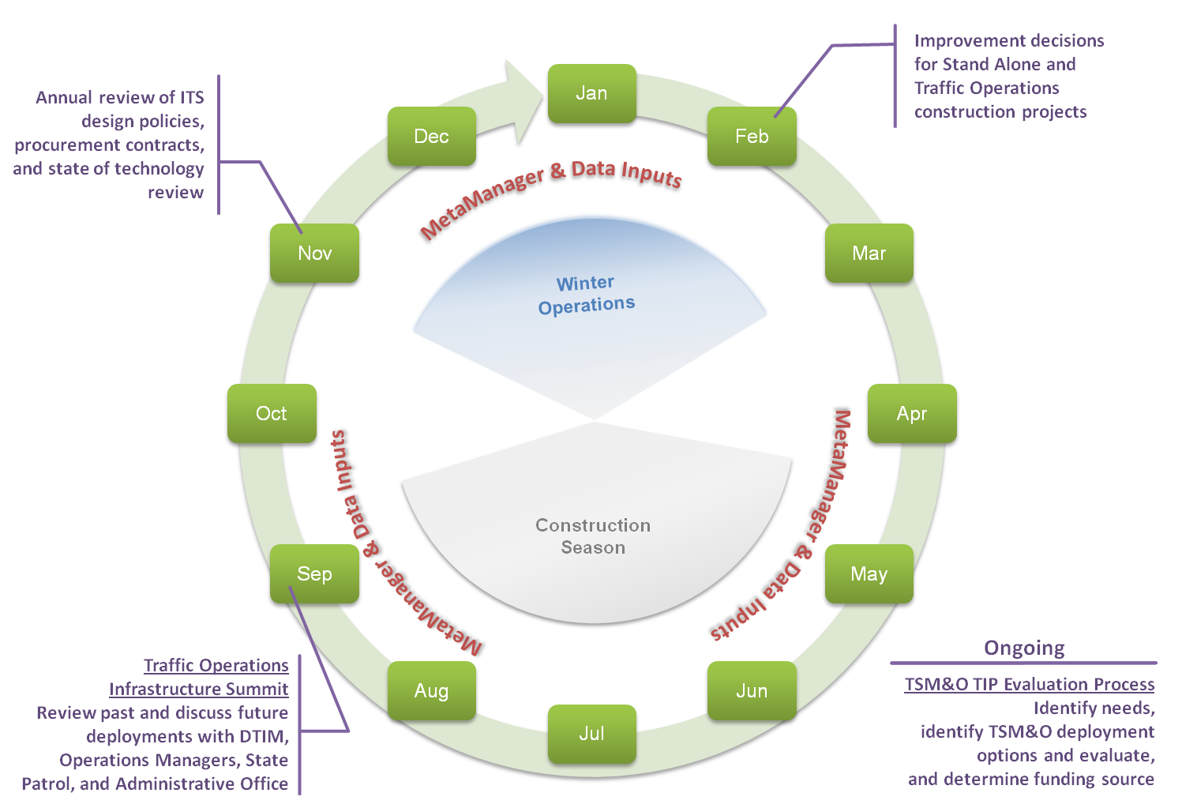
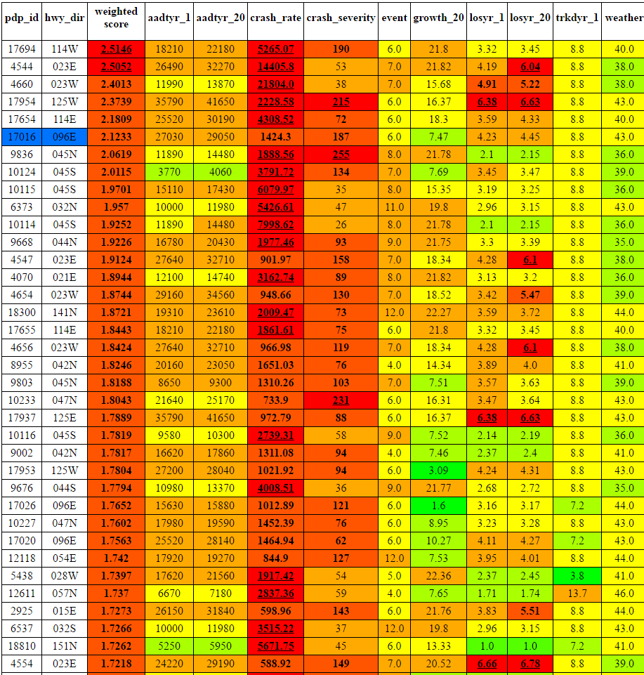
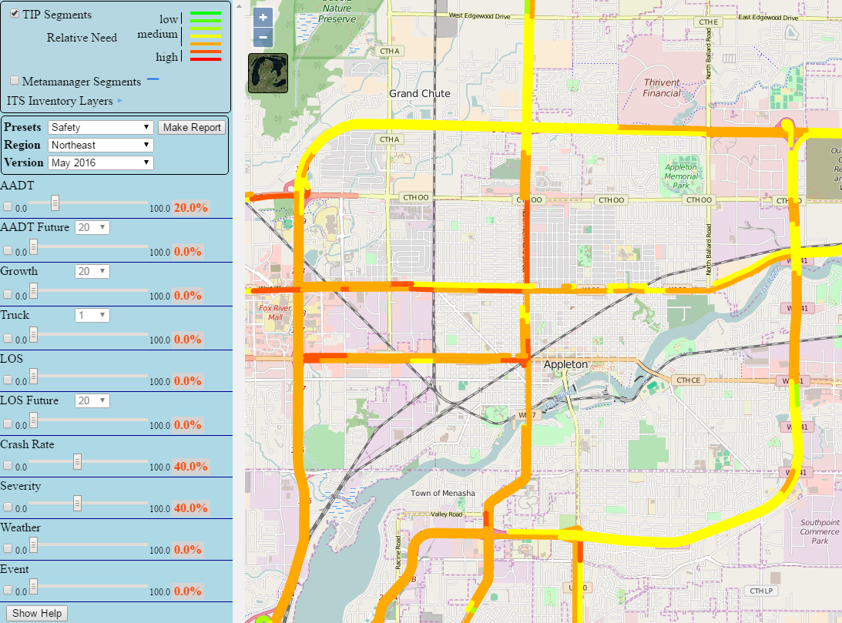
ITS Planning/TSM&O Traffic Infrastructure Process (TIP)
Annual process
Takes advantage of available data sources
Consistent statewide methodology
Uses Needs Analysis Tool and Benefits Analysis Tool
Increases efficient and effectiveness of limited funding resources
Potential use of Signals and ITS Standalone Appropriation
16
Notes:
There is a thought process including B/C Analysis and Needs Analysis to help determine ITS installations.
Increases efficient and effectiveness of limited funding resources (use various funding sources including $10M)

Slide 17
Lighting Opportunities
Remote Lighting Control Pilot Project with Philips Lighting
I-94 College Ave NE Park and Ride
Installed LED lighting for $13k
30-40% reduction in energy usage
Highway Lighting Needs Analysis
Looking at potential partnership to upgrade lighting to high-efficiency LED in SE Region
17
Notes:
Looking into partnerships

Slide 18
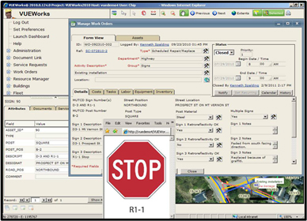
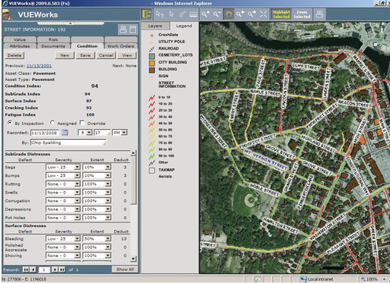
Next Generation Traffic Operations Asset Management System
DTS the makers of VUEWorks selected as new asset management vendor in April 2016
Order of implementation will be signing assets, then signals/lighting, ITS and pavement marking
18
Notes:
$1.2M contract with DTS out of Florida
Still developing functional requirements for program and analyzing old Cartegraph data to place in VUEWorks.

Slide 19
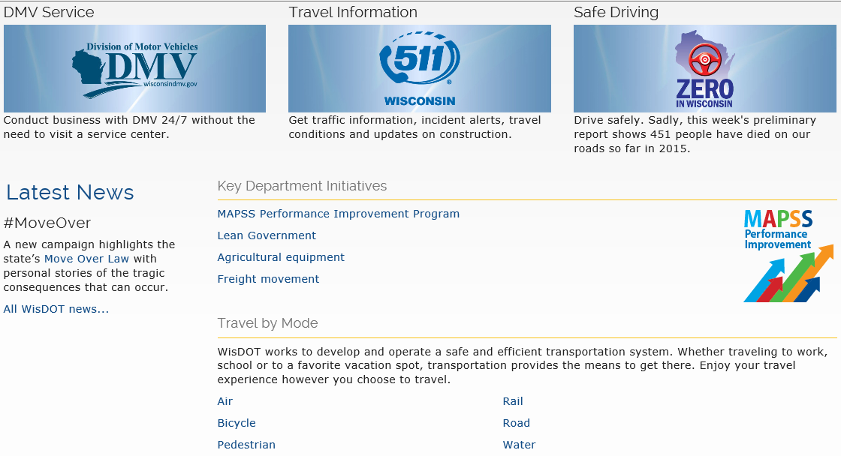
Performance Measures & Management
www.WisconsinDOT.gov
19
19

Slide 20
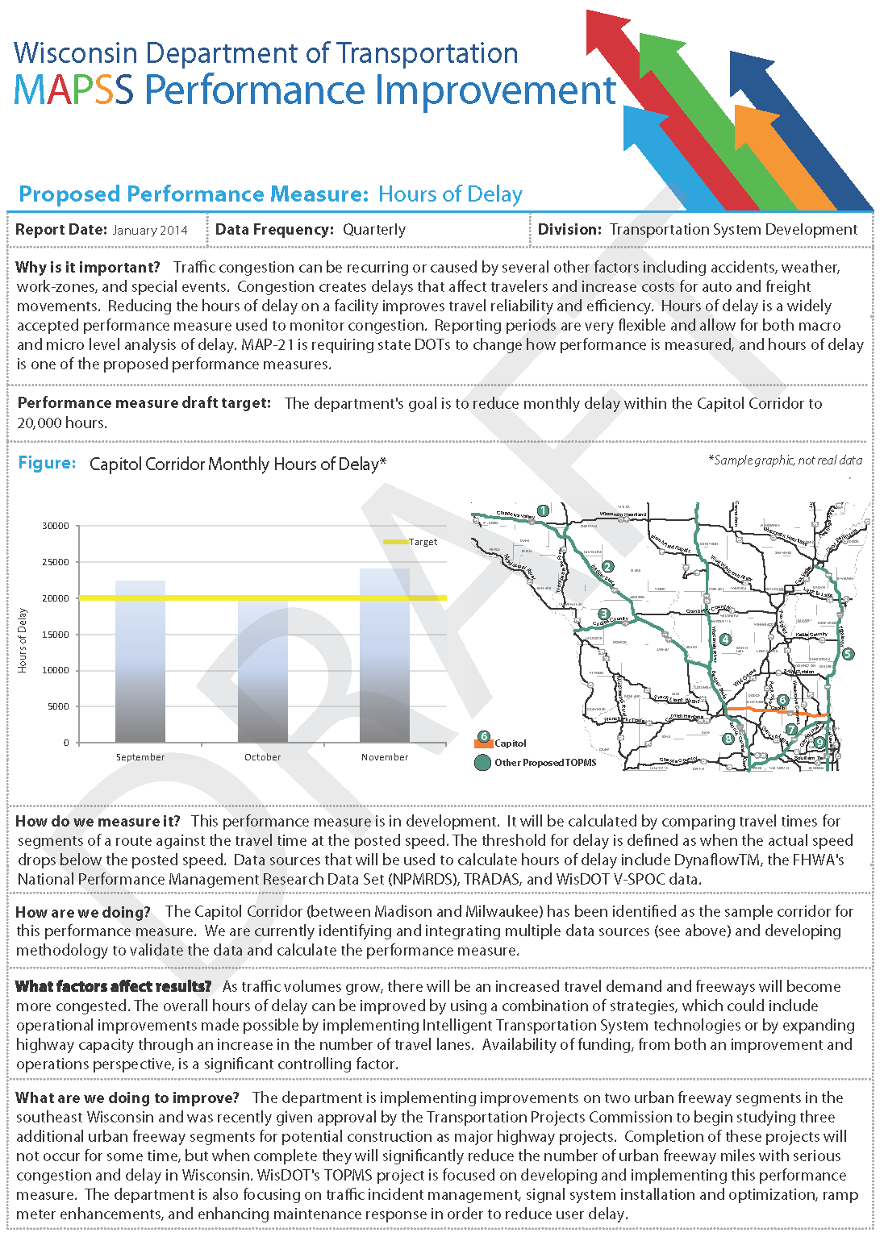
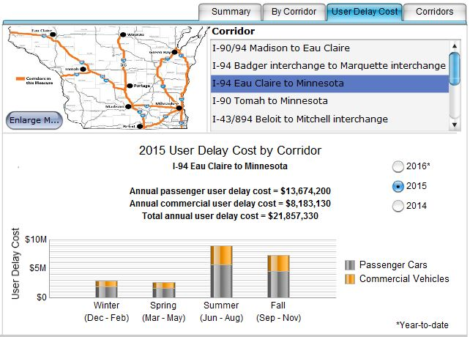
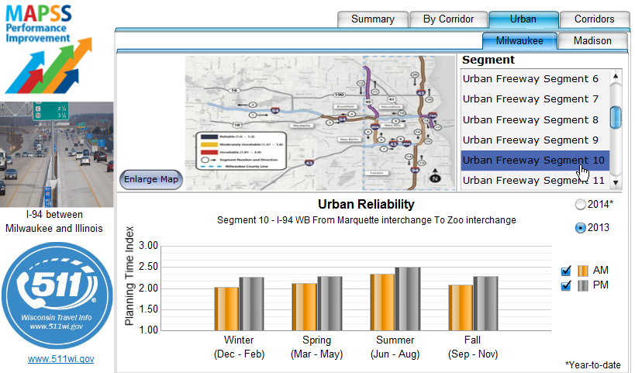
MAPSS Performance Reporting
20
Notes:
FHWA has proposed national reliability and delay performance measures.
WisDOT investigating the impacts of the 55 MPH speed declaration at the WI 67 interchange work zone on I-94 in Waukesha County.
We wanted to demonstrate the impacts of reference speeds (posted, temporary or average) to performance results for delay and reliability.
Our current evaluation will compare expected delay and queueing documented in the TMP for the I-43 project in Manitowoc County with measured data.

Slide 21
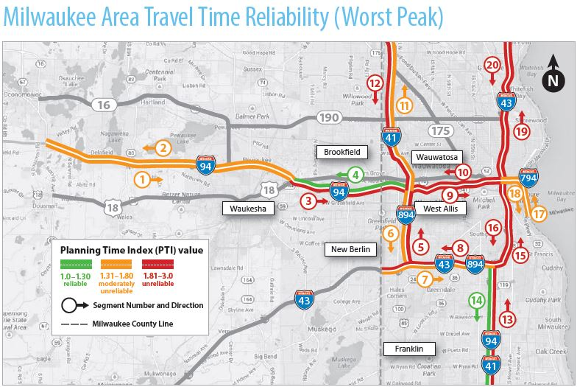
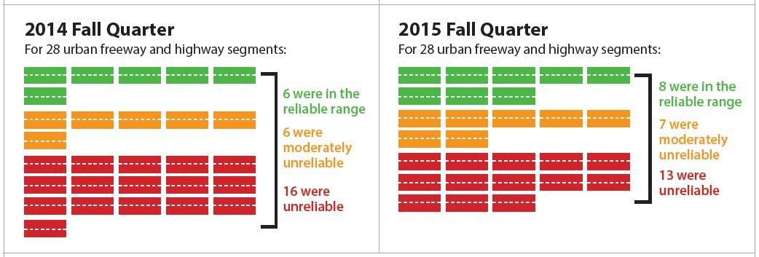
Travel Time Reliability
21
Notes:
Improved reliability when comparing 2014 to 2015

Slide 22
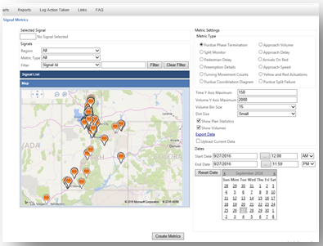
Signal Performance
Signal Performance Metrics
Collecting data at approximately 240 intersections
Provides day-by-day/hour-by-hour statistics on the operations of a signal
Allows engineering staff to identify detection failures and operational deficiencies from their desk.
22
Notes:
Also called “WISBOOM”

Slide 23
Adaptive Signals
Locations
Zoo ICM InSync Deployment – approx. 60 intersections on 7 corridors
Brown Deer Road InSync Deployment – 15 intersections on 1 corridor
Capitol Drive InSync Deployment – 6 intersections on 1 corridor
Verona Road Centracs Adaptive Deployment – 14 intersections on 3 corridors
Janesville Centracs Adaptive Deployment – 15 intersections on 2 corridors
Benefits
Reduced fuel consumption, delay and number of stops along a corridor
Responds quickly to changing traffic conditions
23
Notes:
Have adjusted signals real time during incidents, but it takes a dedicated staffperson in SE Region to make these changes.
When We Look to Deploy It
Corridors/areas that see high variation in traffic volumes, are designated as alternate routes for incidents/major construction, and/or are projected to see significant additional traffic due to diversion.
Benefits
Reduced fuel consumption, delay, and number of stops along a corridor.
Responds quickly to changing traffic conditions – both daily variations in volume as well as incidents/construction/special events.
Lessons Learned
Requires close monitoring and detailed configuration.
Introduces a significant amount of additional equipment (detection, signal cabinet components, software, ITS, etc.) to deploy and maintain.
Proper use of the systems engineering process is necessary to identify whether or not a corridor/area can see benefits from an adaptive signal system or other types of advanced traffic signal systems (i.e. traffic responsive).

Slide 24
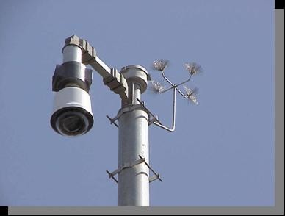
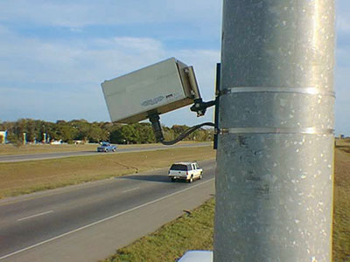
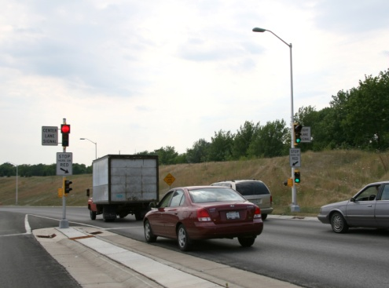
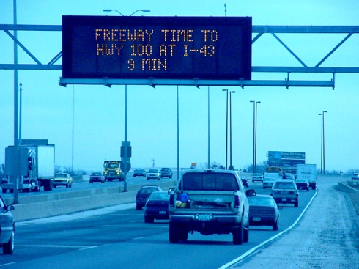
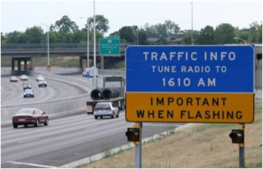
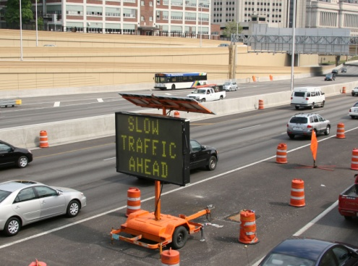
ITS
CCTV Cameras
Detector Stations
Ramp Meters
423
320
133
Highway Advisory Radio (HAR)
DMS Signs
Portable Signs (PCMS)
145
15
124
24
Notes:
TAPCO is WisDOT’s ITS Maintenance contractor – repairs ITS devices in field and assists with integration and fiber
TAPCO provides WisDOT with most of these devices above and RTMS detection (detector stations)

Slide 25
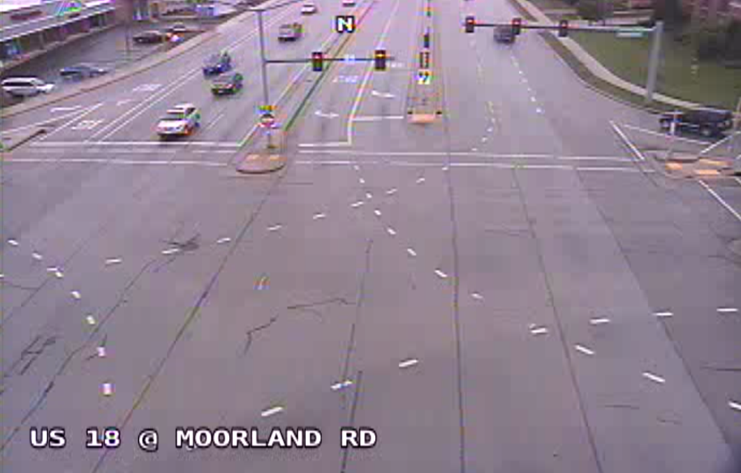
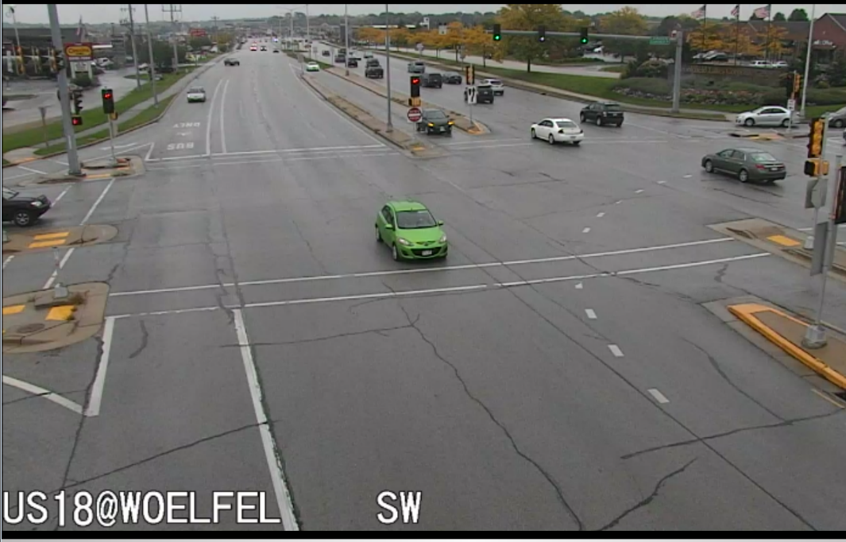
New Technologies
Traffic Camera HD Upgrade
Lower installation and maintenance cost (less equipment)
Allows for increased ability to assess incidents and better TIM training material
SD vs HD
25

Slide 26
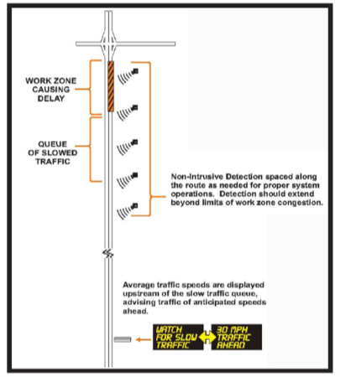
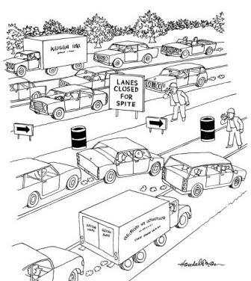
Smart Work Zones
Queue Warning System for Work Zones
Warns drivers of reduced speed conditions
Reduces work zone crashes
Reduces driver anxiety
Zipper Merge
Backups reduced
Crashes decreased
Driver education is very important
26

Slide 27
Waze Connected Citizens Program (CCP)
WisDOT Statewide Data
Incident data
Route data (travel times)
DMS data
Lane & ramp closures
Winter road conditions
Google Data
Road hazards reported by users
Closures reported by users
Data confidence levels
From Iowa DOT website
27
Notes:
(this info has been OK’d by Liz S)
Department has been working with Google on an agreement and in final stages of approval of this free program
CCP exchanges data with public agencies
Public providers share information about incidents, traffic speeds, road closures, etc. in return or Waze’s crowdsourced user data and quality indicators.
This program has the potential to make WisDOT’s traffic data and 511 services more robust.

Slide 28
Additional Projects
NTPEP Pavement Marking Test Deck Host in 2017
Data-Driven Safety Analysis in Project Development – EDC 3
Developing HSM implementation plan and Wisconsin specific crash modification factors
Data-Driven Safety Analysis in Safety Management – EDC 3
Automate parts of WisDOT’s Safety Screening Analysis (SSA) process
Develop a web-based mapping tool to map crashes alongside of roadway geometric deficiency data to assist with WisDOT’s Programmatic Exception to Standards process.
28
Notes:
NTPEP - National Transportation Product Evaluation Program
Data-Driven Safety Analysis in Project Development – EDC 3 Brian Porter lead
Developing HSM implementation plan and Wisconsin specific crash modification factors
Data-Driven Safety Analysis in Safety Management – EDC 3 Brian Porter lead
Automate parts of WisDOT’s Safety Screening Analysis (SSA) process
Project will develop a web-based mapping tool to map crashes alongside of roadway geometric deficiency data to assist with WisDOT’s Programmatic Exception to Standards process.
NTPEP Pavement Marking Test Deck Host in 2017 Matt Rauch lead
WisDOT will host the northern pavement marking test deck beginning in 2017

Slide 29
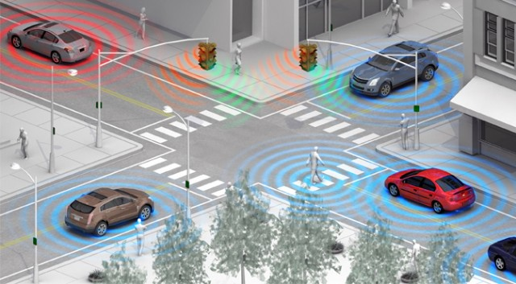
Connected & Autonomous Vehicles
BIG Question: How do we Prepare?
Communications networking enhancements
Next generation controllers
DSRC radios at roadside and in fleet vehicles
Connected vehicle pilots
Private and public sector partnerships
V2V V2I V2X
29
Notes:
WISDOT continues to be involved at the national level.
NCHRP 20-102(09) Providing Support to the Introduction of CV/AV Impacts into Regional Transportation Planning and Modeling Tools
AASHTO Subcommittee on Transportation Systems Management and Operations
Connected Vehicle Pooled Fund Study

Slide 30
Thank You
30

