Slide 1
Salt Shed Inspection/Condition
Salt sheds are broken down into 4 different categories, Apron and Pad, Ceiling and Roof, Walls, and Doors. Each category will be given a condition rating.
For sheds within these categories, if there are multiple items, after every item of that asset is looked at, the lowest rating that could be given to one of those items should be recorded. A comment should then be added in the comment field stating which specific items of the category are causing the low rating. For example, the ceiling trusses have been damaged several times. But in each case the damage has been repaired and the category is functioning as intended. But there is one hole in the roof that has not been repaired and water is leaking onto the salt. If the hole looks like it can be repaired then the rating for this category is a 4. If the damage is extensive and beyond repair then the rating is a 5.
Rating | General Condition Description
1 | Excellent – Component is essentially new and requires no maintenance
2 | Good – Component functions as it should and may have deficiencies that are mostly aesthetic
3 | Okay – Component needs some minor repairs to improve function or aesthetic properties.
4 | Poor – Component requires significant repair, is obsolete, or is not fully functional. A description of the needed repair should be added into the comments field.
5 | Bad – Component is unsafe to use and requires major repair or replacement, beyond repair.

Slide 2
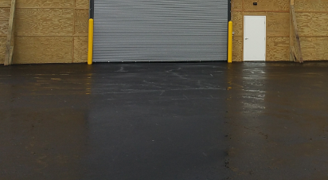
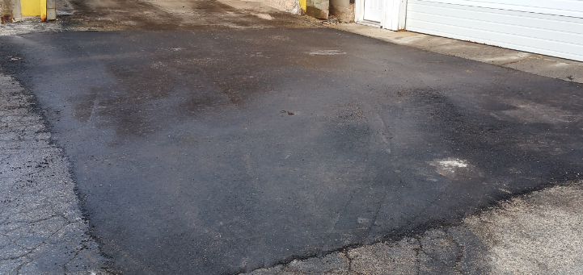
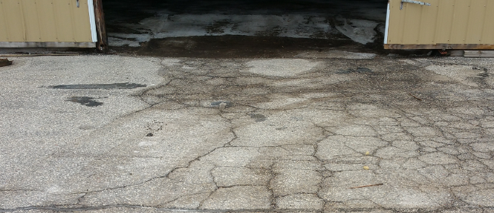
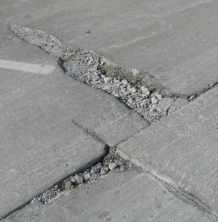
Shed Apron and Pad
Rating | Condition/ Action | Description | Example
1 | Excellent | Building apron and pad are functioning as originally intended and are in good condition.
2 | Good | Building apron and pad are functioning as they should, they only contain some minor cracks or stains.
3 | Okay | Building apron and pad have some cracks and may have a few small potholes.
4 | Poor | Building aprons and pad have large cracks and/or potholes.
5 | Bad | Building apron and pad have a large number of large cracks and potholes.

Slide 3
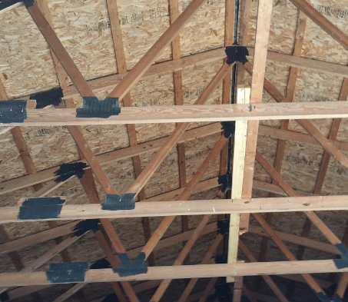
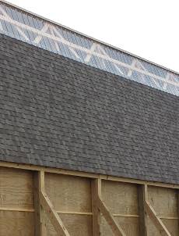
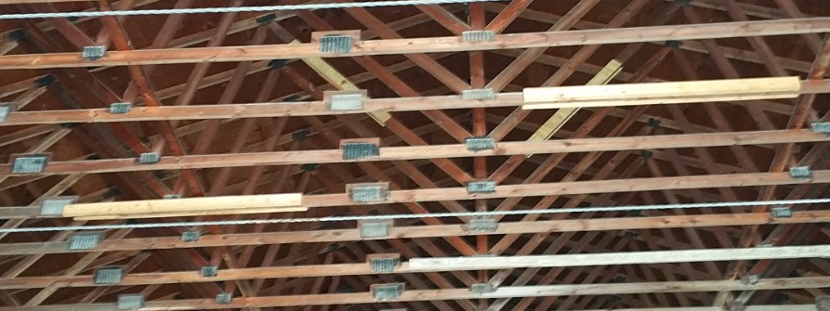
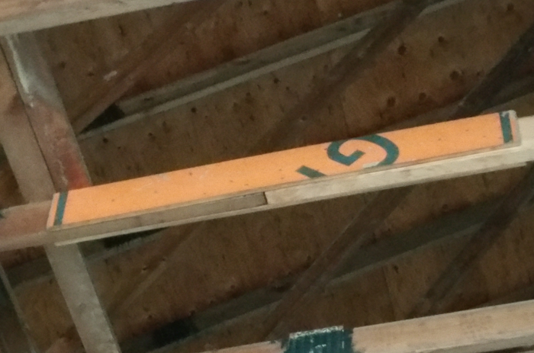
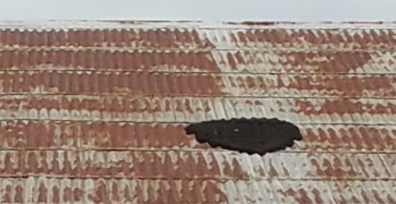
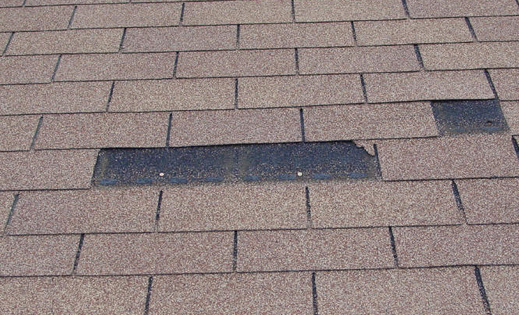
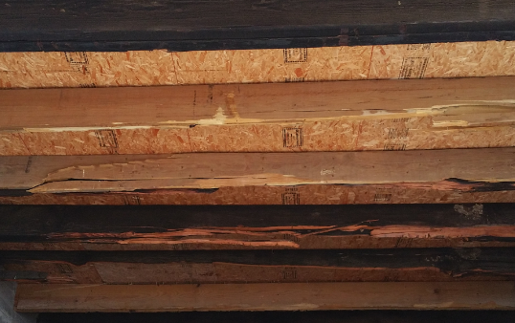
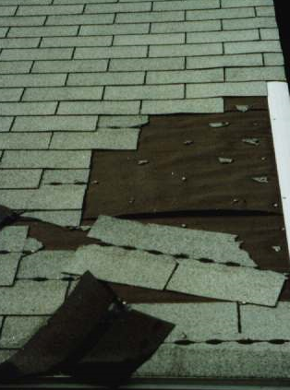
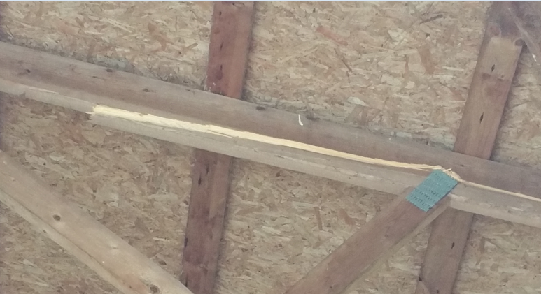
Shed Ceiling and Roof
Rating | Condition/ Action | Description | Example
1 | Excellent | Ceilings and Roof are functioning as originally intended and are in good condition.
2 | Good | Ceiling and Roof are functioning as they should but it may contain a few cracked or repaired trusses. Proper truss repairs were made.
3 | Okay | Ceiling trusses may be damaged but are still functioning and temporary truss repairs were made. Roof may be rusted and repaired but is still functioning as intended.
4 | Poor | Ceiling trusses may be damage and have not been repaired. Roof shingles may be missing or weathered.
5 | Bad | Multiple ceiling trusses are damaged beyond repair. Roof is no longer weather tight and needs to be replaced. | Split

Slide 4
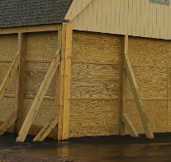
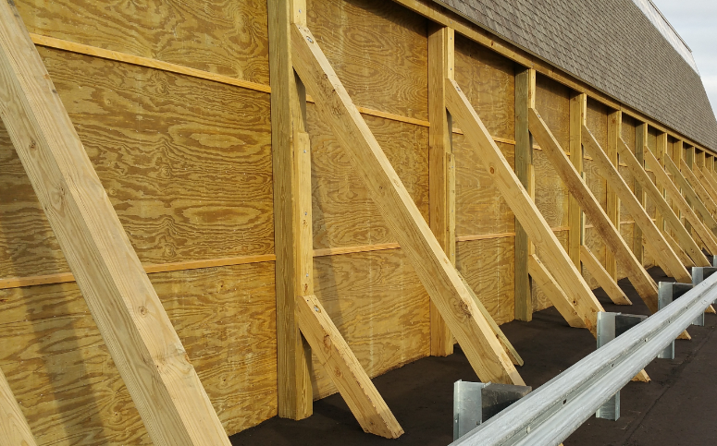
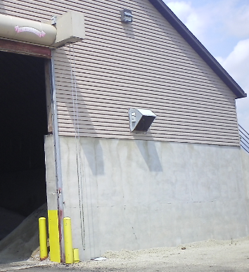
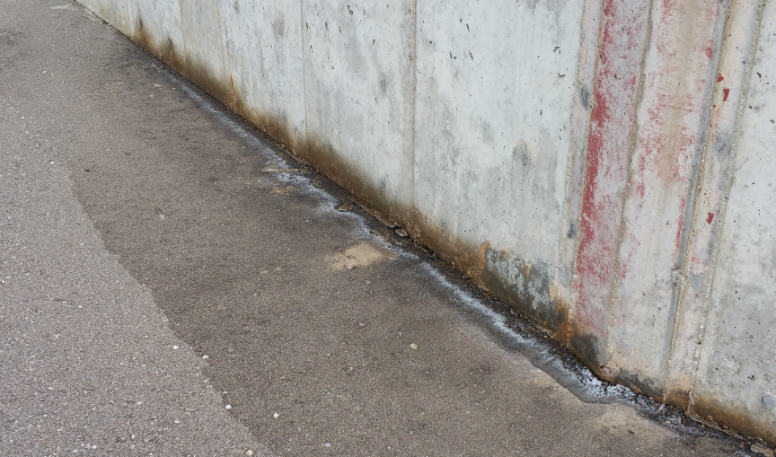
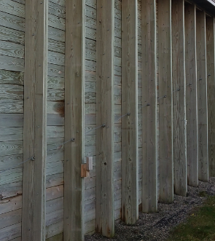
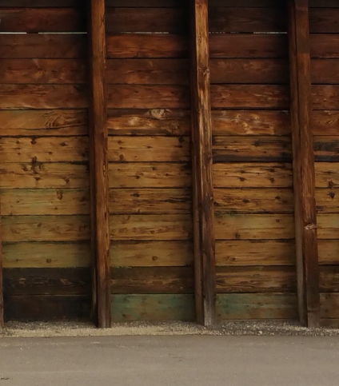
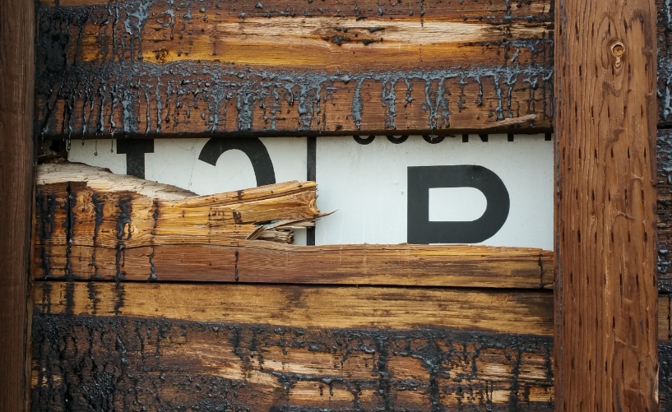
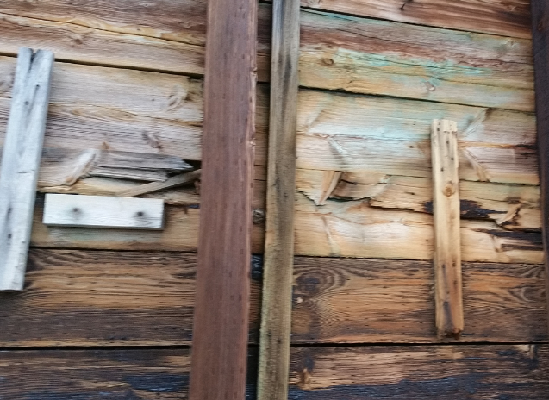
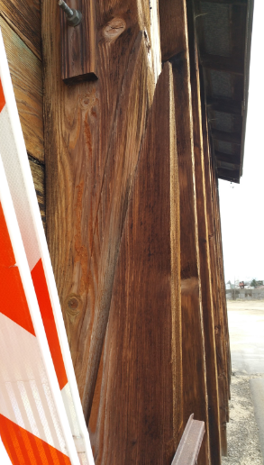
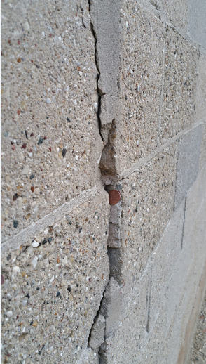
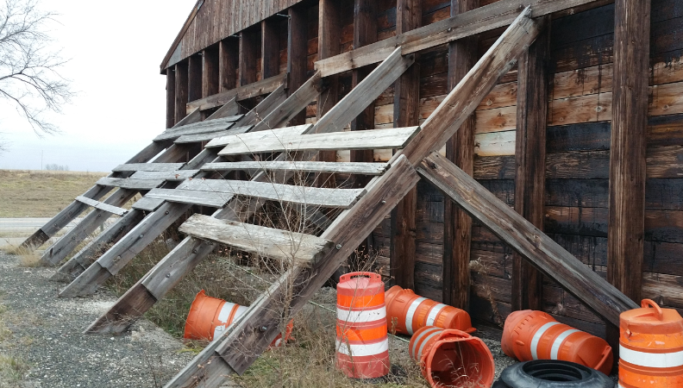
Shed Walls
Rating | Condition/ Action | Description | Example
1 | Excellent | Walls are functioning as originally intended and are in good condition.
2 | Good | Walls are functioning as they should but, siding may be slightly faded or have small dents, small areas of paint may be chipping or concrete walls may have hairline cracks. | Good condition but should be caulked.
3 | Okay | Siding on walls may have some cracks, walls may be slightly bowed, or concrete may have some cracks or deteriorating grout, or there may be some water damage. | Slightly bowed
4 | Poor | There are missing pieces of siding, walls are bowed out more than slightly, large areas of grout are missing, or there are large areas with water damage.
5 | Bad | Structural wall timbers broken and not repaired. If concrete, cracks in wall that you can see through.

Slide 5
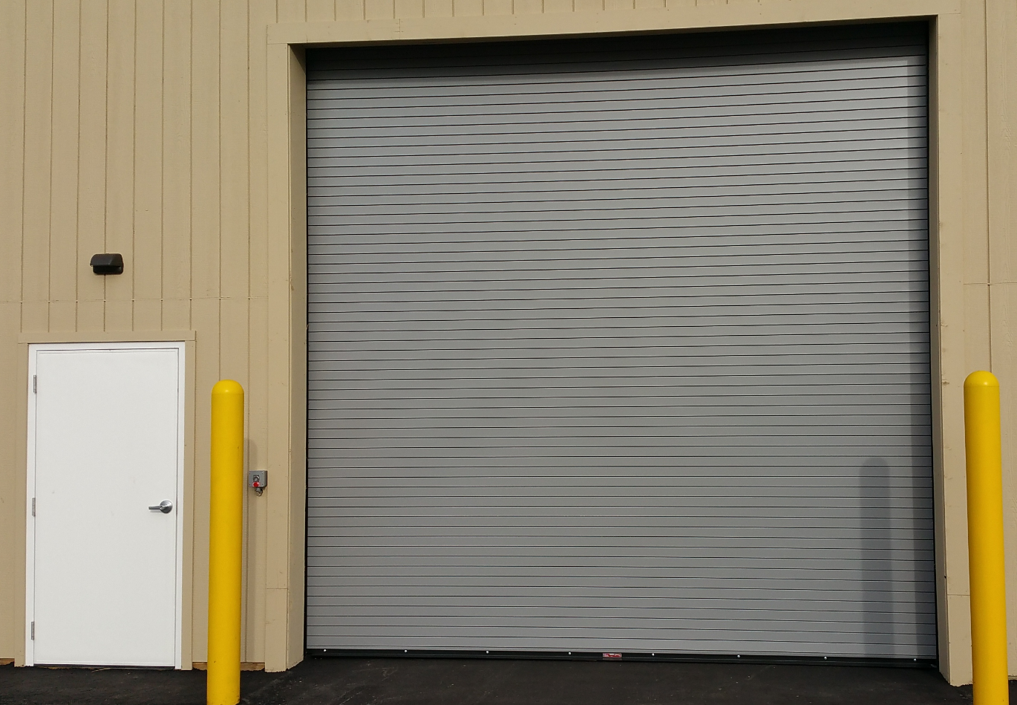
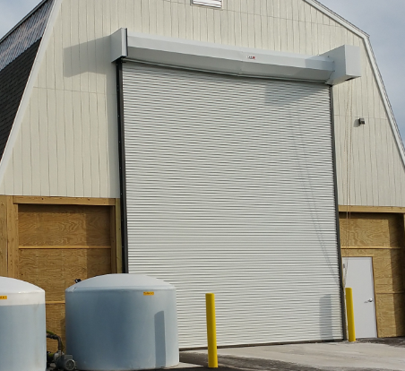
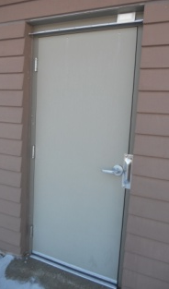
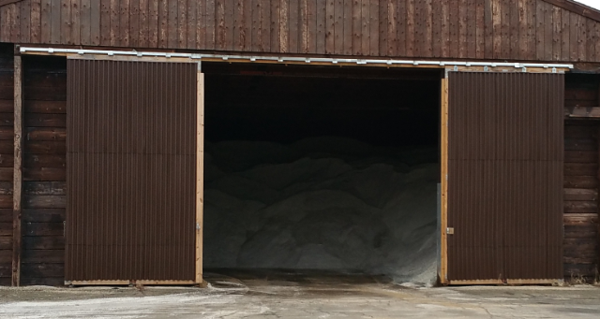
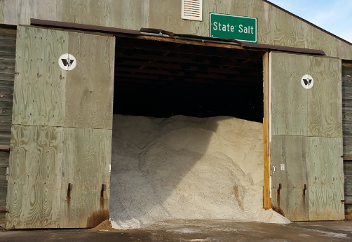
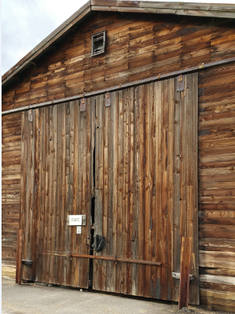
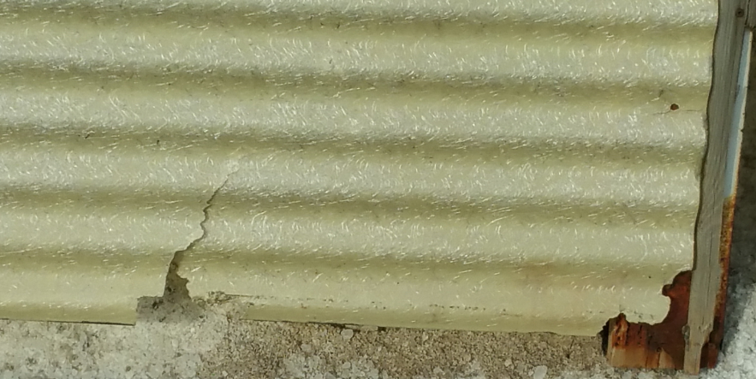
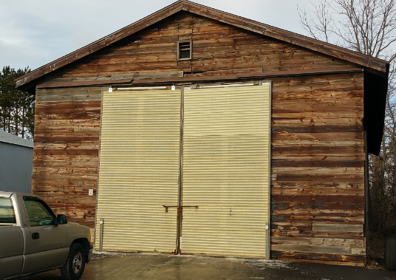
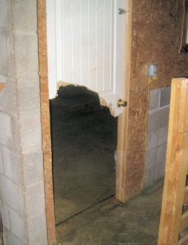
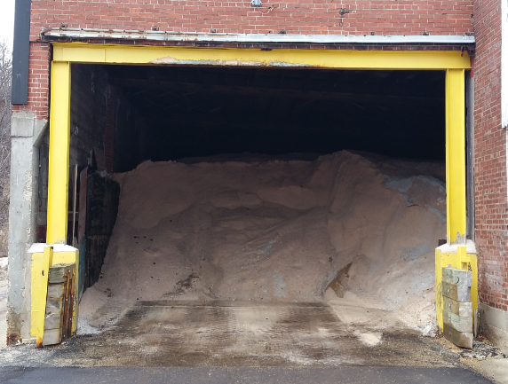
Shed Doors
Rating | Condition/ Action | Description | Example
1 | Excellent | Doors are functioning as originally intended and are in good condition.
2 | Good | Doors function as they should but may have small areas of chipping paint or rust.
3 | Okay | Doors may have dents, areas of chipping paint, areas of rust, may not fully close properly, or the handle may be difficult to use.
4 | Poor | Doors handle or lock is broken, the hinges may not hold the door secure in place, there are large areas of chipping paint or rust, or glass is cracked or broken.
5 | Bad | Door is dented and can no longer open and close properly, it is rusted through, or it no longer sits properly on the hinges. Or no doors present. | no door

