Slide 1
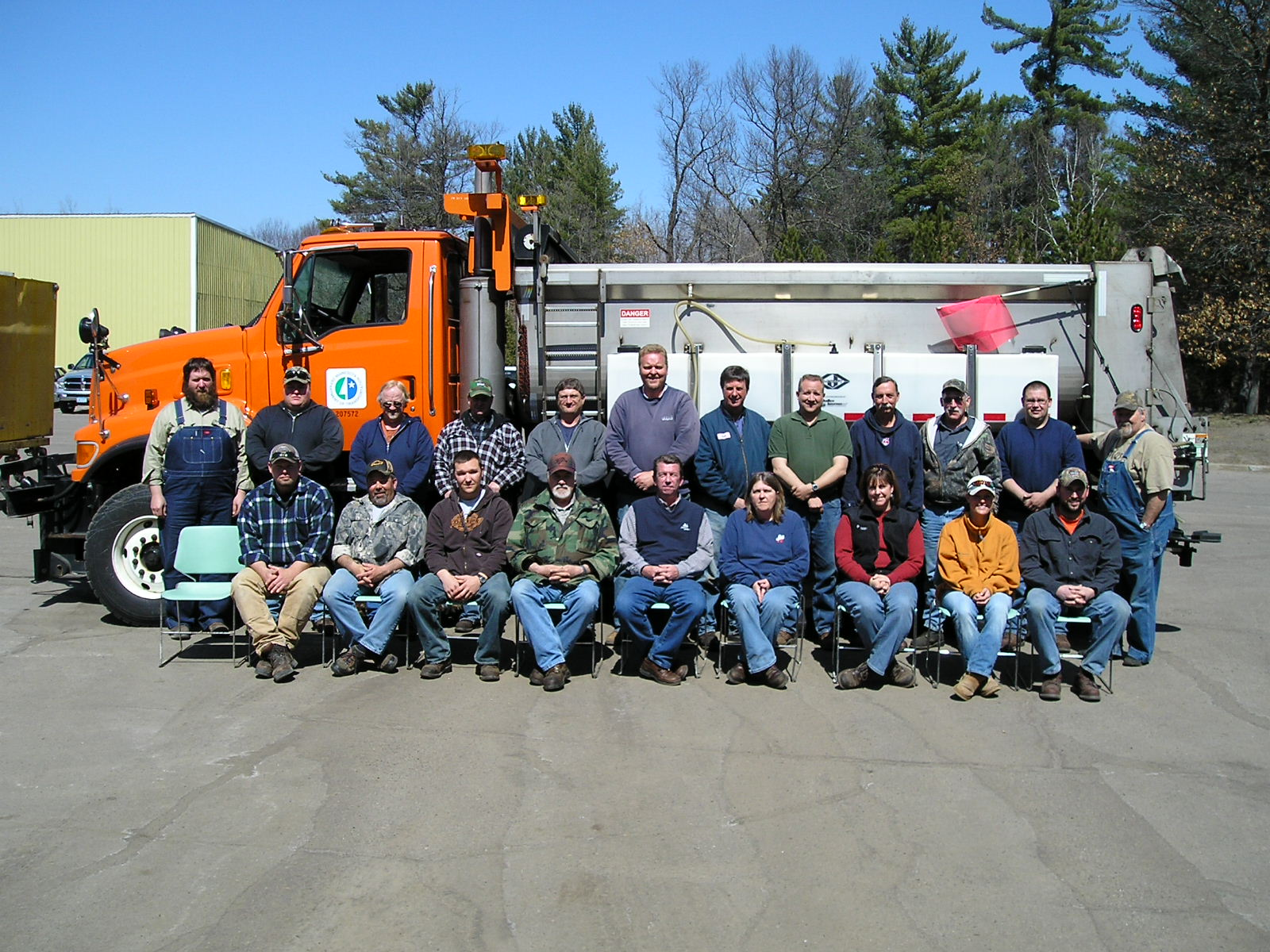

Module 9: Safety
Put picture of your crew, your logo, or your facility here
Connie Fortin – Fortin Consulting 2015
slides are for entry level plow drivers
slides are for experience plow drivers
slides are for supervisors
Notes:
Photo: MnDOT
Images: microsoft clipart
You can replace this cover photo with a photo of your crew, your facility, your logo.
This is a priority 1 module to be developed for clearroads national training.
It will address 3 audiences: ½ circle symbol = entry level plow drivers
¾ circle symbol = experienced plow drivers
Full circle symbol = supervisors
White slides are for everyone

Slide 2
Background ( do not show)
The objective of this training module should be to describe the issues that require special considerations to stay safe during a winter operation. The trainee should gain understanding of the various hazards that they will be exposed to including slippery surfaces, cold weather, poor visibility, both in the yard and out on the highway, working at night, working long hours, etc. At the end of the training the trainee should be prepared to take those extra precautions, to not get in a hurry, to watch out for others, and to promote safety among the crew"

Slide 3
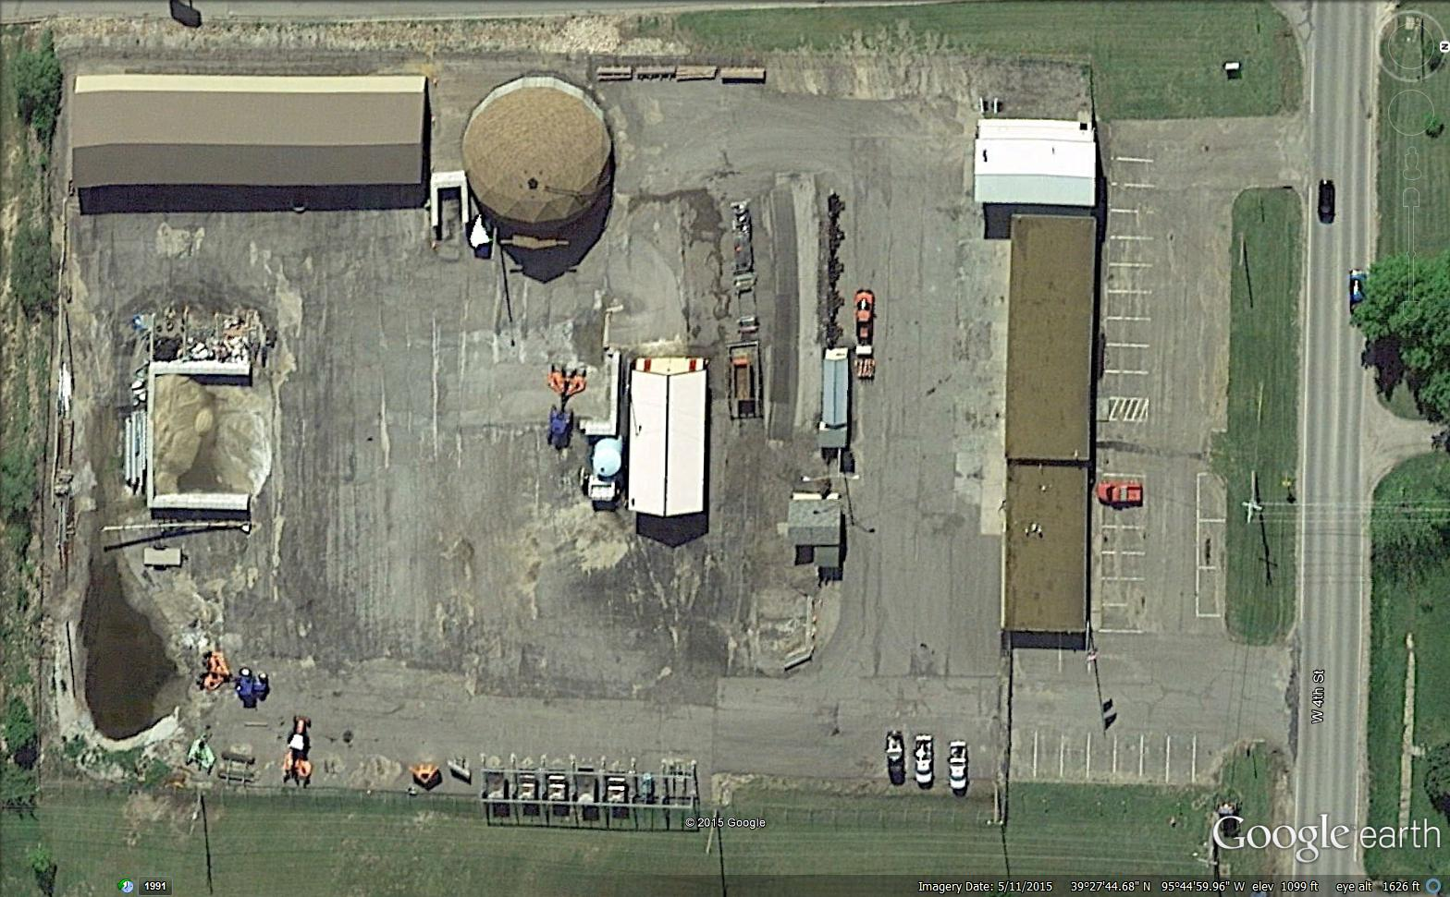
Safety in the Yard
Notes:
Photo: KSDOT
This is the first of 3 safety sections
Safety in the yard
Safety on the road
Personal safety
This section is a collection of tips about safe practices while working at the truck station. There is an endless list of safe practices that can be added to this and really all of the sections. Use the module as it has been developed and add any other safety concerns or suggestions to it to meet your needs.
To start this training module we have an aerial view of a yard or truck station. Which areas on the photo have safety concerns associated with them? All of them. Use this as a opening class discussion to get people looking and thinking about safety.

Slide 4
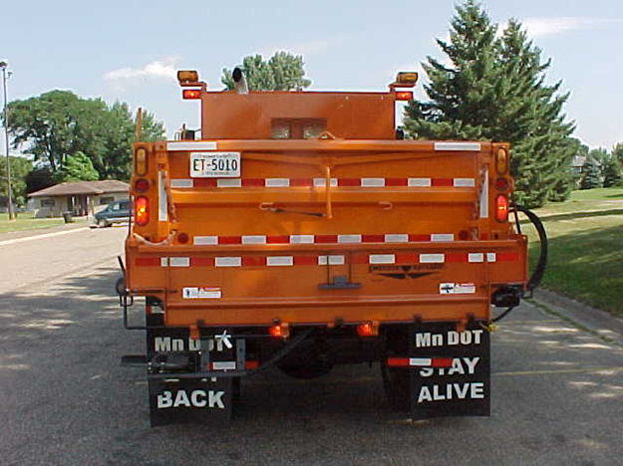
Backing up Tips
  Avoid backing if possible!
  Use a spotter
  Verify swing clearance
  Get out! check above, under, to the sides and rear
  Warn others that truck is backing
  Turn off radio/music
  Go slow
  Use mirrors
  Back towards drivers side if possible
  Other?
Beep ….Beep… Beep …Beep…
Backing up: #1 cause of CMV crashes
Notes:
Photo & bullet points taken from Mndot 9-SPOT-Ripley_Backing.ppt
This is one of the most frequent yet one of the most dangerous maneuvers. Present this slide and ask for safe backing tips from the audience. There are many more precautions that can be taken other than those listed on this slide. Your organization may have more official backing procedures. If so this is a good time to cover them.
Test Question:
What is one of the most dangerous maneuvers in the yard?
Driving forward - No
Backing up - Yes
Loading salt – No
Washing trucks - no

Slide 5
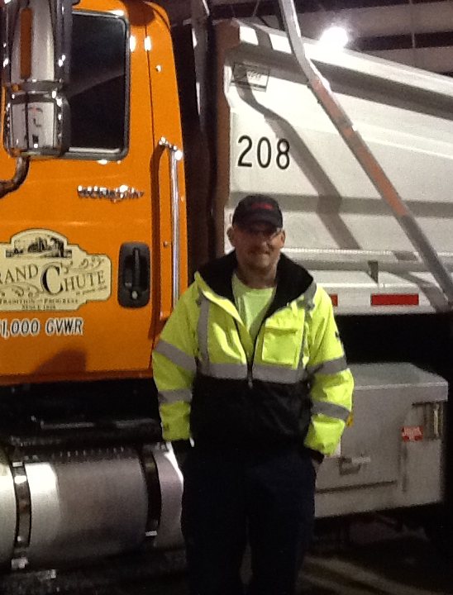
“The circle of safety”
  Walk around your truck before moving it
    Especially before backing up
    You are not able to see things behind or on the side of the truck
Notes:
Right Photo FCI

Slide 6
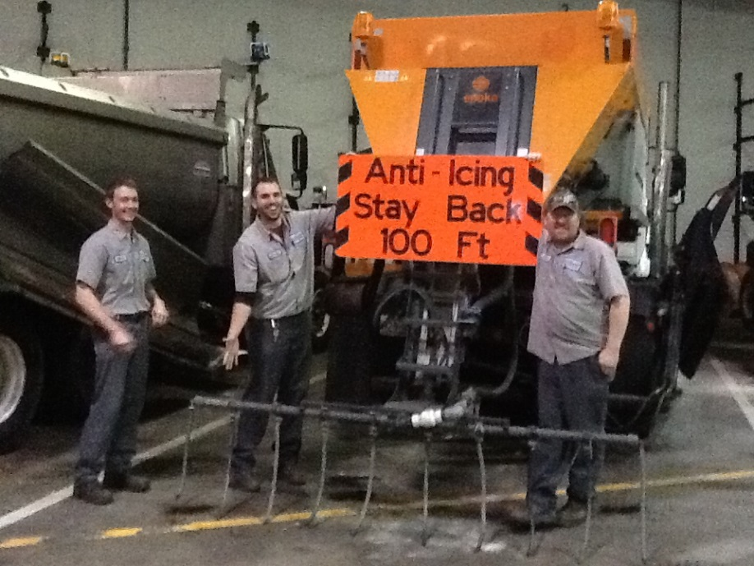
What is on the back of your truck ?
Spinner
Chute
Trailer
Lights
Tailgate down
Tailgate tanks
Raised box
Spray bar
All of these items are easily damaged by backing maneuvers .
Notes:
Photo: FCI
The back end of your truck may have a variety of equipment attached to it or be in various states of open/close, up/down. Take time to think about what is behind your truck, or better yet take a walk around and view your situation. It takes time which, we are all short on , but it takes less time than it would to fix a new problem we might cause.

Slide 7
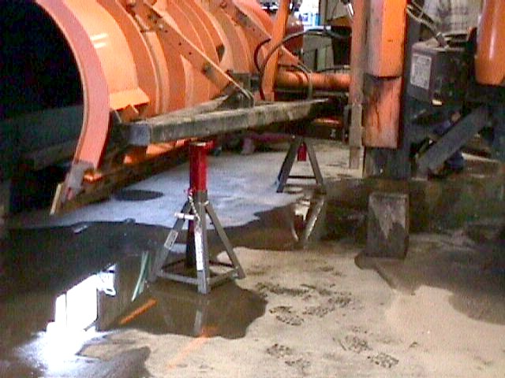

Changing blades
Block plow before changing blades
Notes:
Photo: CDOT

Slide 8
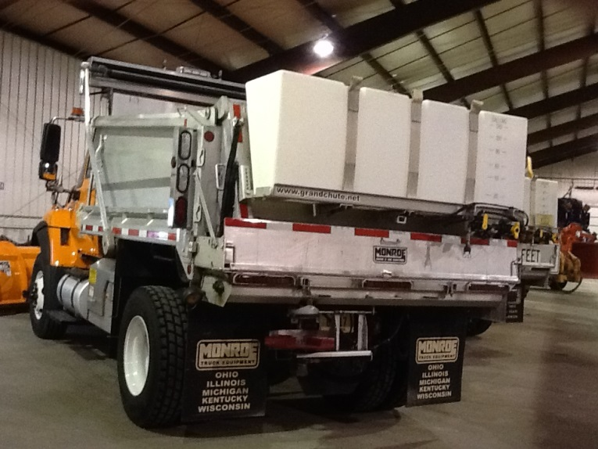
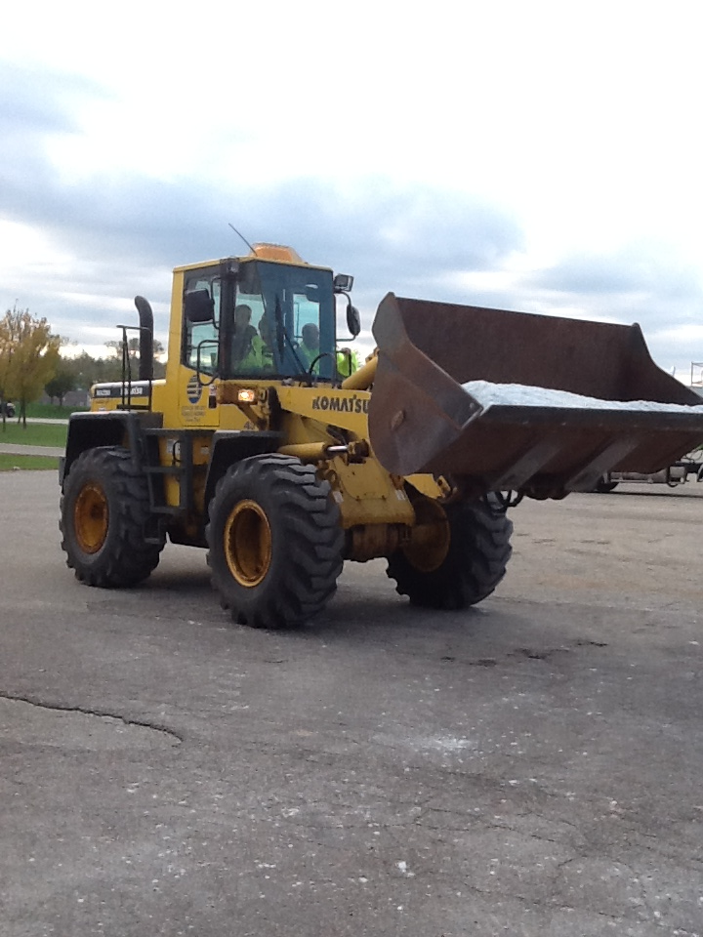
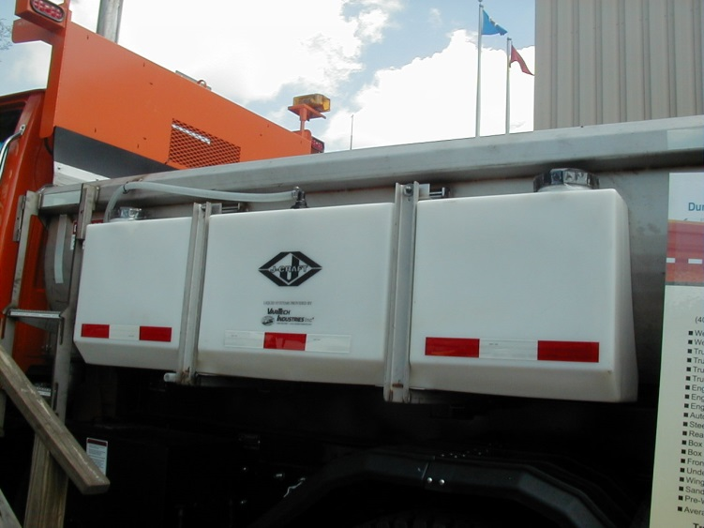
Loading
I’ve learned the tanks aren’t loader proof
Notes:
Photos: FCI
Take your time and fill the box with caution. The tanks aren’t very forgiving when it comes to a run in with the loader.

Slide 9
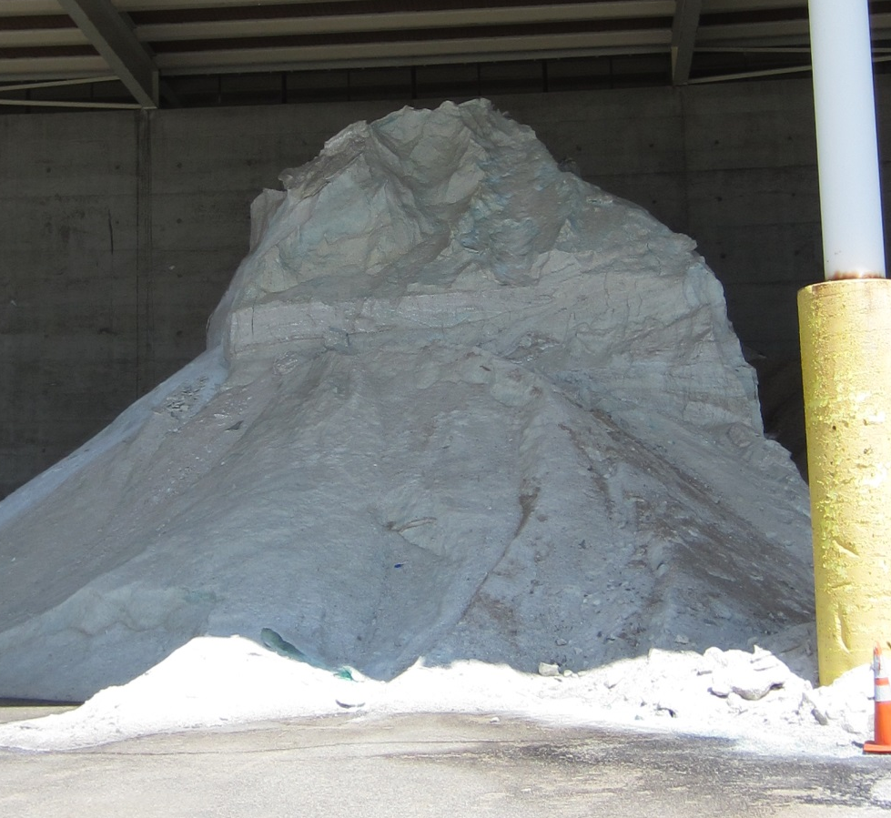
Stockpile Safety Tips
Be aware that stockpiles can avalanche or collapse
Keep space behind you so you don’t get pinned in (no walls or equipment immediately behind you)
Don’t get too close to vertical faces of the pile
Review your safety procedures for working near stockpiles
Notes:
Photo: FCI
If you have stockpile safety guideance put it here. Otherwise use this slide as it is, below is the salt institutes guidance which has more detail than the slide. Would be good for the instructor to read through that as well.
Source: Salt institute http://www.saltinstitute.org/wp-content/uploads/2013/09/Salt-Storage-Handbook-2015.pdf
“Never approach the vertical face of a stockpile on foot or in a vehicle closer than the vertical dimension of the pile; it might collapse and cover you in an avalanche.
Never park next to a stockpile or next to equipment working a stockpile.
Never position yourself between the face of a stockpile and an immovable object (such as a loader or other vehicle).
When working on top of a stockpile, never approach the crest closer than 15 feet.
Always ensure that you have proper footing when accessing the top of a stockpile, and always be alert for sinkholes or other openings in the surface of the pile.

Slide 10
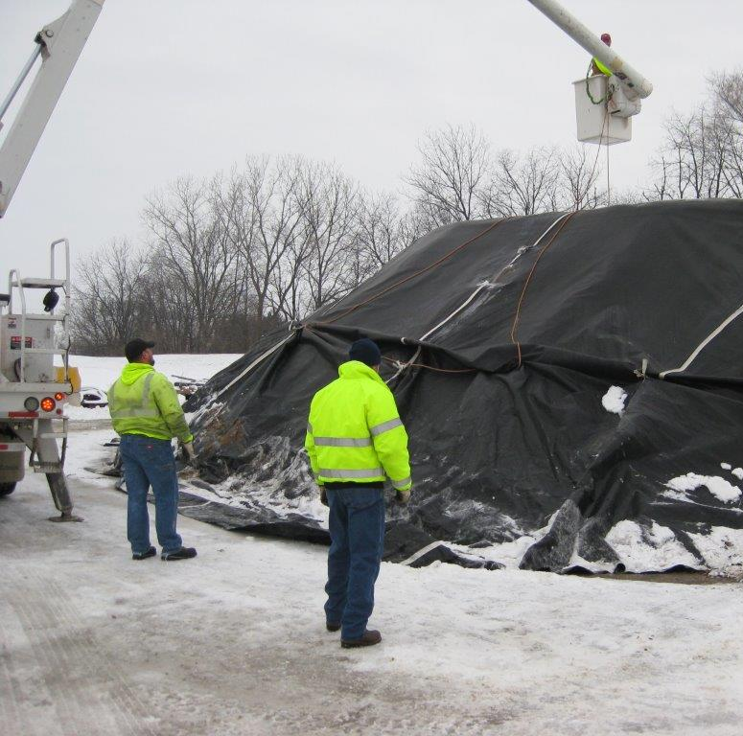
Avoid walking on stockpiles, sinkholes are possible.
Notes:
Photo: City of Beloit
Find other ways to get your work done besides walking on the top of a stockpile. It is dangerous.
Test Question
Are salt stockpiles safe to walk on?
Yes – no
No - yes

Slide 11
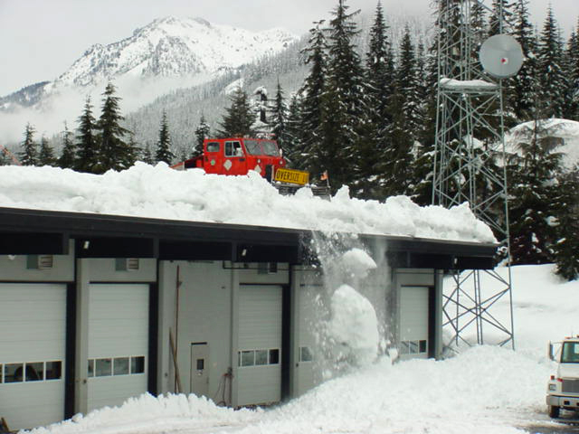

Look up
We don’t need a mountain for an avalanche…snow will also avalanche off of roofs.
http://www.dailymotion.com/video/x2yk8ve
Ann – can you embed this video so the training can access it without internet connection?
Notes:
Photo:Washington DOT
Here is a video that shows how sensitive snow accumulating on a roof might be. Our concern in this training module is not how to clear the snow but to be aware of snow accumulating on the buildings in your work area and stay safe around them.
http://www.dailymotion.com/video/x2yk8ve

Slide 12
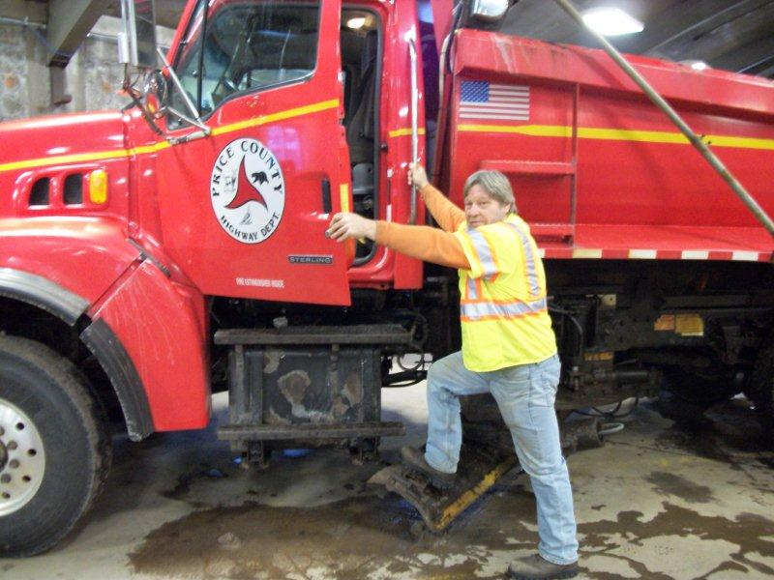
Time to get on the road!
Proper Entry and Exit
Face the machine
Maintain 3 points of contact
Keep boots clean
Keep the steps clean
Never jump out of the truck
Expect steps to be icy and slippery
Notes:
Photo: Price Co. WI
Take your time and use proper technique to enter and exit the cab of your truck. If you take shortcuts the chances of hurting yourself greatly increase.
Test question:
How should your enter and exit the cab of your plow?
Face the truck and maintain 3 points of contact - yes
Face away from the truck and maintain 3 points of contact - no
Climb in and jump out of the truck- no
Any way that works best for you - no

Slide 13
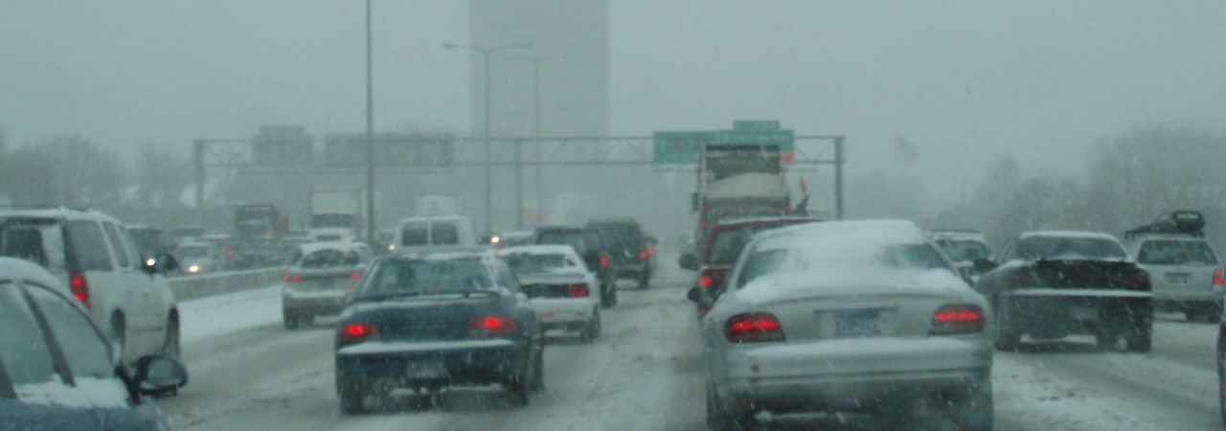
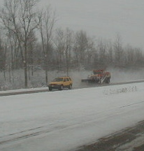
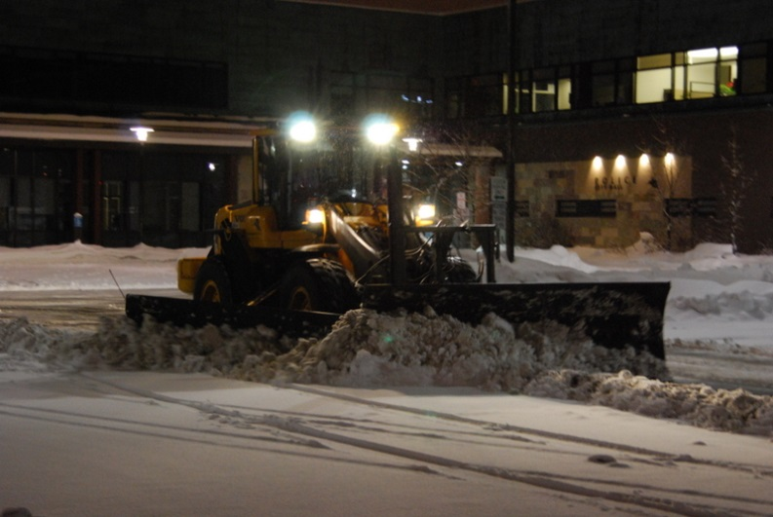
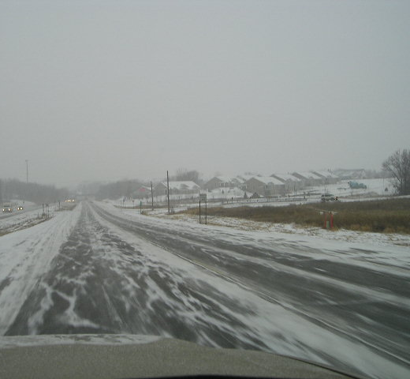
Safety on the Road
Notes:
This is the second of 3 safety sections
Safety in the yard
Safety on the road
Personal safety
This section is a collection of tips about safe practices while driving winter maintenance equipment. There is an endless list of safe practices and concerns that can be added to this and really all of the sections. Use the module as it has been developed and add any other safety concerns or suggestions to it to meet your needs.
What safety concerns do we have on the road?
To start this training module we have a few pictures to start discussion about safety on the road. What areas on the photo have safety concerns associated with them? Use this as a opening class discussion to get people looking and thinking about safety.

Slide 14
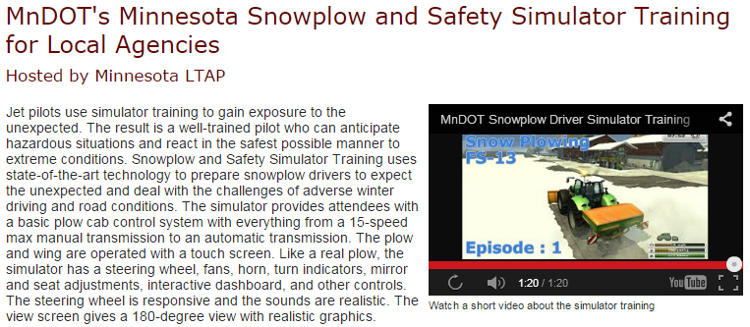
Simulator Training
Enter information about your simulator training or hide this slide
Notes:
This slide is for plow drivers only: If you offer snow plow simulator training and it covers safety issues that you should include information about it on this slide. If this is not available to you, hide this slide.

Slide 15
Simulator Training
If you have simulator training put it here and instead of discussing how to get simulator training, discuss how to improve simulator training
To view simulator video clip: https://www.youtube.com/watch?v=vrkw_meK2fI
Notes:
Simulator training http://www.mnltap.umn.edu/training/topic/maintenance/snowplow/index.html
This slide is for supervisors only. Supervisors, would this type of simulator training be useful for your plow drivers? Consider talking to MnDOT or other states using this tool to discuss the cost and benefits they are seeing this this program.

Slide 16
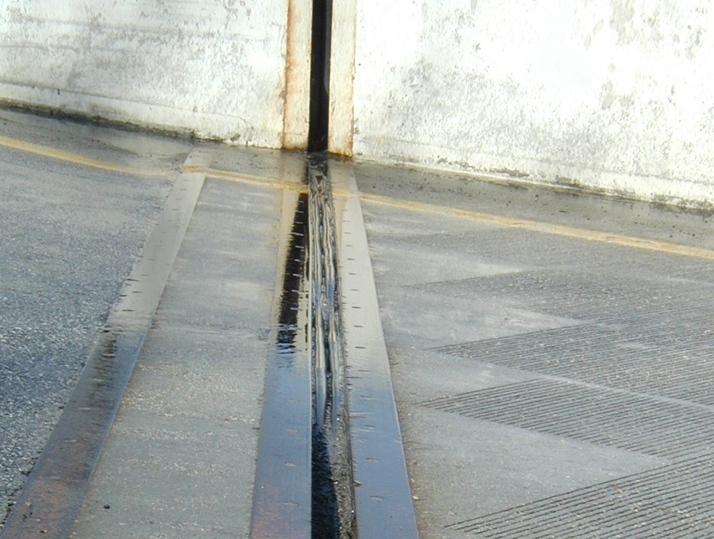
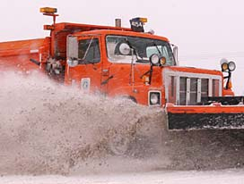
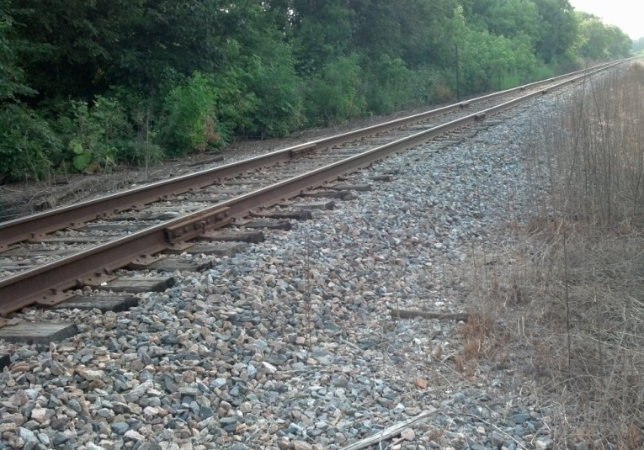
Know your route: Road hazards
RR crossing
Manhole covers
Expansion joints
Curbs
Guardrails
Storm drains and so on
Tips from experienced operators: drive your plow route in the fall and make notes of any obstacles
Notes:
Left Photo: MnDOT
Right lower Photo: FCI
Right upper photo: MDDOT
The plow can catch on a variety of raised surfaces causing injury to the plow and possibly to yourself. Drive your routes before winter and note where these obstacles exist. Put them on your route map of create some easy reminder for yourself. There will be someone, perhaps everyone in the room who has hit or has some experience with these obstacles. Can ask the room for advice, especially good for new operators to pay close attention to the discussion.
Examples of hazards:
1) bridge rails
2) expansion joints at bridges
3) accident sites where debris could be on road
4) gore areas at cloverleafs and ramps where curb can catch the plow
5) guardrail that may have been hit and sticking out into traffic
6) keep truck tires on pavement at all times when plowing shoulder to prevent losing control
7) erratic drivers
8) broken curb areas that could hook plow
9) light pole bases that can be hit with a plow
10) curb areas that can be covered by snow and not seen

Slide 17
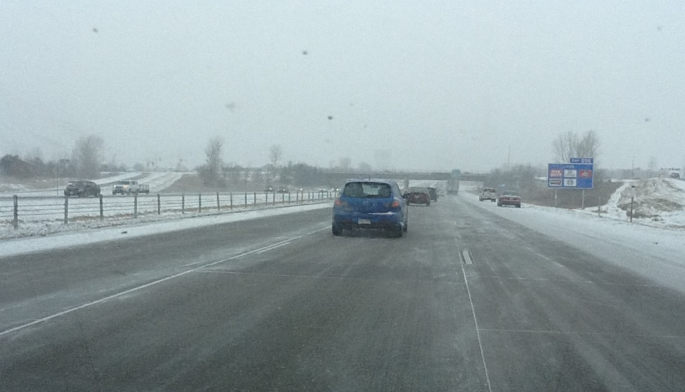
Defensive Driving
Drive in such a way that you do not involve yourself in the actions or mistakes of others
Look 10 to 12 seconds ahead in the city
Look 15 to 18 seconds ahead on the highway
Notes:
Photo: FCI
Look ahead, stay alert to changes
Observe the entire situation
Recognize potential hazards
Decide on an appropriate response
Carry out your plan
Look 10 to 12 seconds ahead in the city
Look 15 to 18seconds ahead on the highway
In this photo we see cars pulled over on the shoulder. We see a bridge, see semi truck in left lane, line of traffic in right lane. Entrance ramp up ahead. Conditions of road and weather, oncoming traffic. All are good to keep an eye on and be aware of.

Slide 18
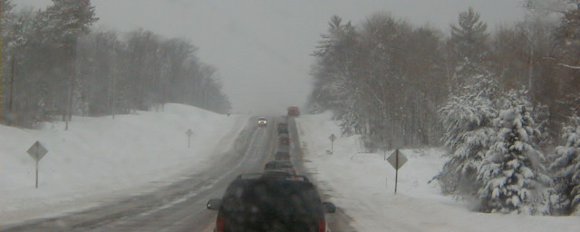
What are your strategies to control your truck?
How fast can your truck stop with a full load?
How does your truck handle with an empty load?
How does your truck perform with the box up?
Notes:
Photo: FCI
Plow trucks do not maintain a constant center of gravity
Load stability changes constantly during a shift
Load stability is in constant flux
Load can shift front to rear and side to side
Plow and wing components can increase instability
Raising/lowering the dump box will change the center of gravity
Amount of material in the dump box will change the center of gravity

Slide 19
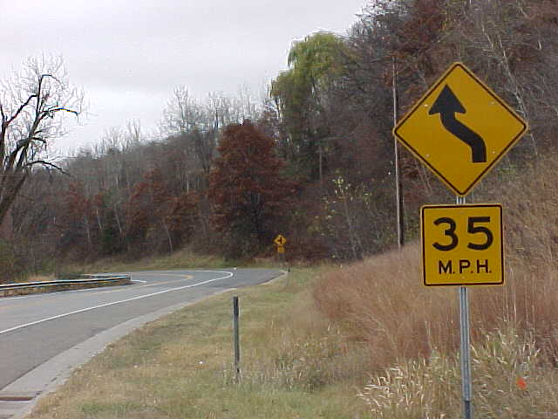
Negotiating curves
Enter curves at least 5 mph below posted speed limit
Avoid braking in curve
Start at a slower speed and accelerate when moving into the curve
Notes:
Photo: MnDOT

Slide 20
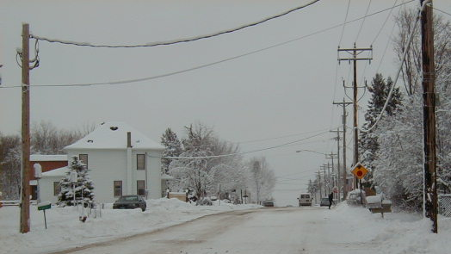
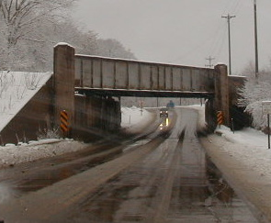
Box height
Lower box before going in buildings, under bridge, under wires.
Tips from experienced drivers: The higher the truck bed, the lower the truck’s speed should be
Notes:
Photos: FCI
The higher the truck bed, the lower the truck’s speed should be - MDDOT_Snow-College-Part-1_slides_9-12.pptx
In most classes there is someone who has experienced or witnessed problems associated with raised boxes. You can ask the class this to get a rumble across the room. Everyone knows this is an issue but the key is how to keep it on the fore-front of your thoughts during winter operations. Ask for suggestions from the class.
Test Question
What should you be looking for on a pre-season route inspection?
Raised surfaces that could catch the plow blade- no
Low overhead hazards - no
Bridges, curves, steep hills - no
All of the above - yes

Slide 21
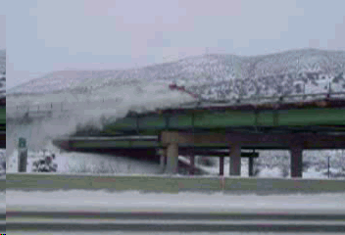
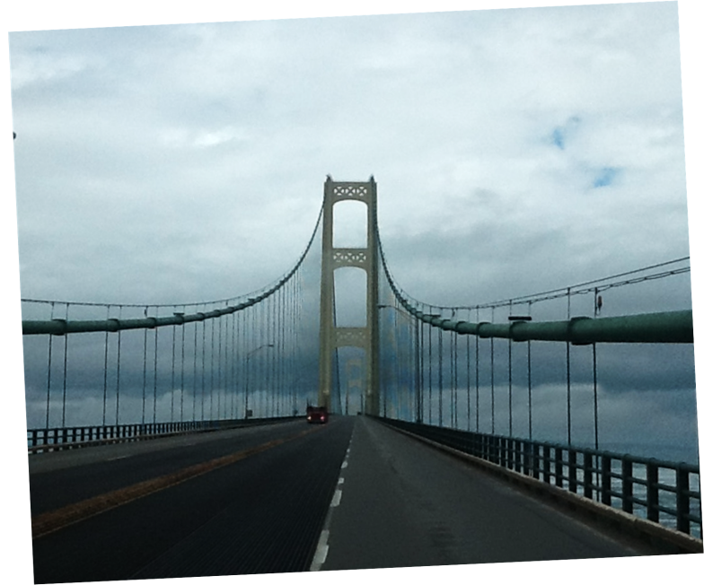
Beware of Bridges
Bridge surface temperatures change faster than roads. May become icy faster.
Beware of expansion joints with the plow
Don’t plow snow over bridge
Low overhead may cause problems with raised boxes.
Tip from experienced operator: During rain events feel the backside of your mirror if it is starting to freeze, so are the bridges.
Notes:
Top photo: CDOT
Lower 2 Photos: FCI
Bridges create different areas of concern in maintenance. They are often the first to freeze over or ice up. The have expansion joints which can catch on the plow blades. Plowing snow over the bridge may create a hazard for motorists or pedestrians below. Plowing snow over the bridge may cause water pollution to rivers, lakes or wetlands below.
Test question:
Do bridge decks change temperature faster than roads?
Yes, air surrounds them and air changes temperature faster than land– yes
No, air surrounds them and air changes temperature slower than land - no

Slide 22
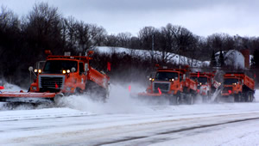
Group plowing
Concentration and communication are keys to keeping yourself, others in the group and traveling public safe.
Notes:
PHOTO: MNDOT
Remember the faster your speed the more unstable your truck. The group should move at a reasonable speed set by an experienced driver.
Tips:
Maintain safe following distance
Try to prevent traffic from passing between trucks
Use warning signs when possible (VMS)
Use caution, be alert
Communicate with other Plows

Slide 23
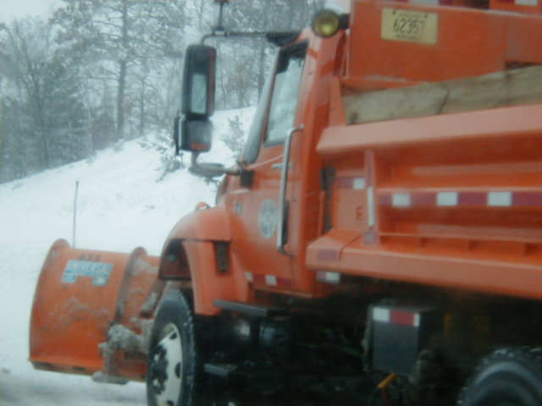

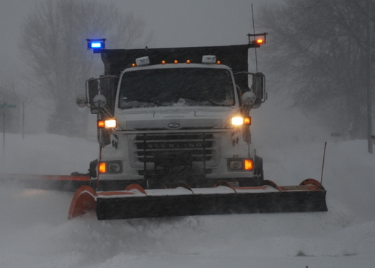

Strive for the best visibility
Strive for the best visibility
you can achieve while plowing.. Keep windshield, lights and mirror clean
Insert your guidelines for stopping operations until adequate visibility
Notes:
Photos: FCI
There are many innovations on lighting and equipment that can improve visibility for the driver. It is up to the driver to keep the windshield, mirror and lights as free of snow and ice as possible. There are conditions when visibility is not adequate to continue plowing. Each organization has their own guidelines of how to stop and resume operations. This is a good time to discuss your guidelines. Your guidelines may also discontinue operations in extreme cold.

Slide 24
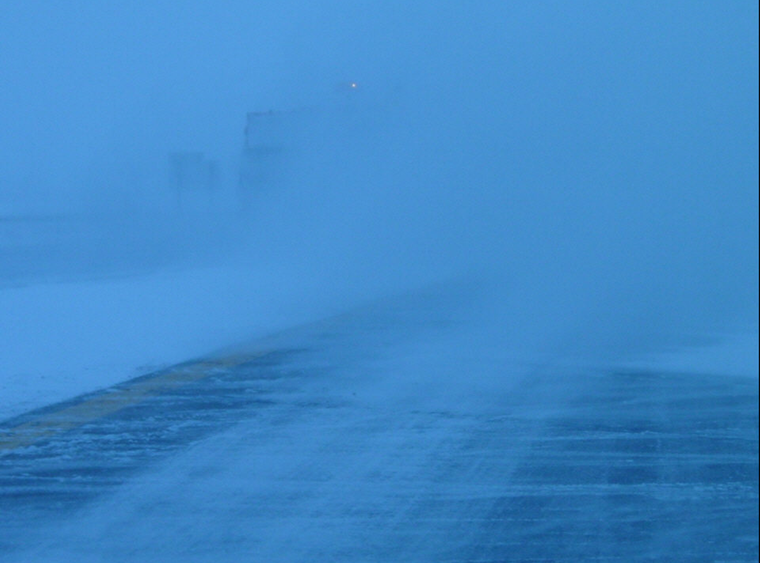
Poor visibility
If visibility is too poor stop plowing operations
Tip from experience drivers: use power poles or other roadside features as a rough guide for where you should be during periods of heavy snowfall when you have "lost" the roadway in rural areas.
Notes:
Photo: Iowa DOT
Tip from Monty Mills Washington state DOT
Test question:
If visibility is too poor for you to see…
Keep plowing - no
Stop plowing - yes

Slide 25
Night Plowing
Tips from experienced drivers
“During heavy snowfall use the truck headlights on dim rather than the high mounted "plow lights". The plow lights tend to reflect heavy snowfall blinding the operator.”
“If the road is wet the temp is likely to drop as it gets dark which could cause ice. Keep a close eye on the surface temp, as it starts to set up it might sparkle under the head lights, use bridge decks as a first read. “
Notes:
First tip from Monty Mills Washington state DOT
Second tip from Justun Juelfs MTDOT
Third tip:” I have driven on roads were the wind is blowing in the same direction as travel and at the same speed you are trying to travel. ie; Wind from the west at 25 mph and you are travel east bound at about 25 mph because there is no visibility. The snow appears to be falling straight down but is usually thicker than soup.
May have to drop speed so that you are not travelling at the same speed as the wind. May have to adjust plow direction so the snow plume is not adding to the snow fall and reducing visibility even more. “ Cliff Spoonmore, Wyoming DOT.

Slide 26
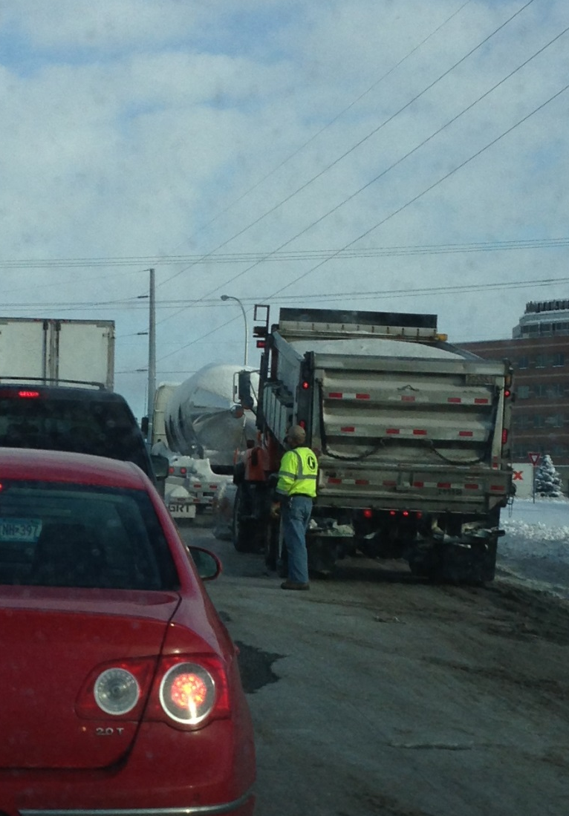
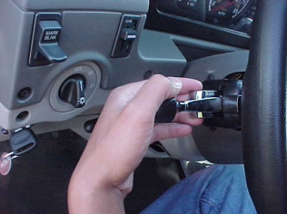
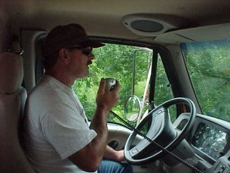
Truck problems
Protect yourself – do not get out of the truck until safe
Protect other motorists – put flags out, lights on to warn others
Call dispatch/state patrol for help with traffic
Protect your vehicle – shut off anything that might compound the breakdown.
?
Discuss your policy/guideline for stalled or disabled vehicles
Notes:
Left Photo: FCI
Right photos: MnDOT
If you experience truck problems….
Get to the side of the road if possible
Protect yourself – do not get out of the truck until safe
Protect other motorists – put safety triangles, flares, turn lights on to warn traffic
Call dispatch/state patrol/supervisor for help with traffic
4) stay with vehicle until help arrives, especially important if during a storm or cold weather
Protect your vehicle – shut off anything that might compound the breakdown.
What is good or bad with this photo? Good opportunity for class discussion.
One set of suggestions from an experienced supervisor: He should be watching for oncoming traffic. Unless he has a good reason to be out of the truck he should either be in the truck or off to the side where he would have an escape route if a vehicle approached from the rear. Flashing lights should be on. The truck bed should be lowered so that any lighting installed on top of the cab would be visible to the rear. It is good that he is not standing in front of the dump truck. This last winter we had a dump truck broke down on the shoulder and another dump truck came and parked behind it. The rear truck was rear ended and crushed an employee between the two trucks. He just now has returned to work with restrictions.
Test question: If you have truck problems what should you do?
Call your supervisor -no
Stay in the truck until it is safe to exit -no
Put out safety cones or flags to warn traffic- no
All of the above - yes

Slide 27

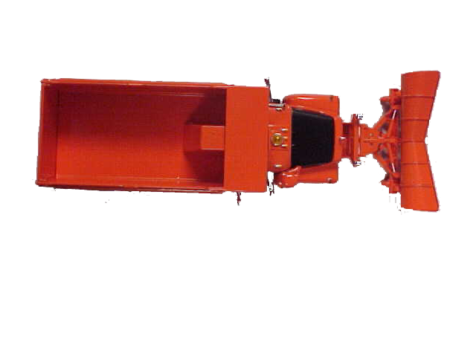
Warning device placement
Two-lane two way road
100 ft
10 ft
100 ft
Modify image if your standards are different
Notes:
Image: MNDOT
As you are placing the warning devices, hold the devices in front of you and watch for vehicles that may not see you

Slide 28
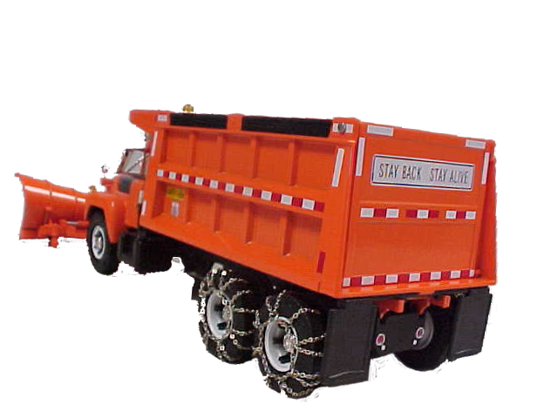
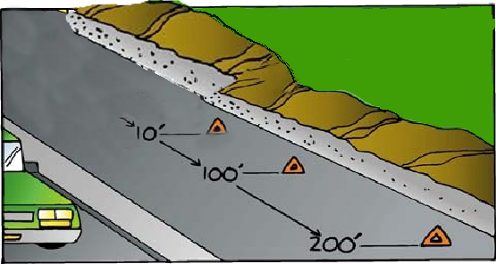
Warning device placement
One-way or divided highway
Modify image if your standards are different
Notes:
Image: MnDOT
As you are placing the warning devices, hold the devices in front of you and watch for vehicles that may not see you

Slide 29
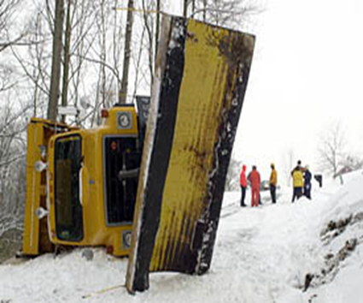
Be prepared for the unexpected
Insert your guidelines for emergencies
Notes:
Photo: Iowa DOT

Slide 30

Personal Safety
Personal protective equipment is self-defense. ~Author Unknown
Notes:
This is the last of 3 safety sections
Safety in the yard
Safety on the road
Personal safety

Slide 31
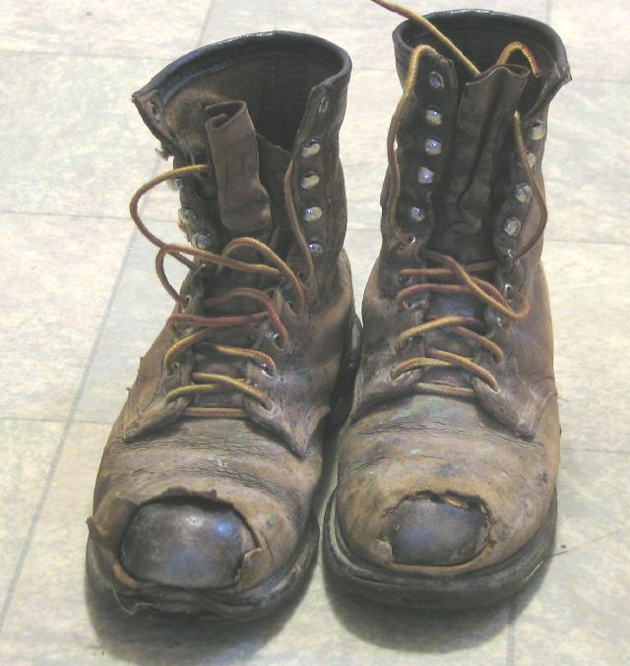
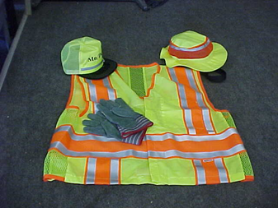
Clothing
Be seen, be safe!
Wear proper protective equipment to match the task !
Steel toe boots, high visibility clothes, ear protection, eye protection, gloves, …
Insert your guidelines for personal safety equipment/clothing
Notes:
Photo: mndot
Left photo: https://powerplantmen.files.wordpress.com/2014/02/old-work-boots.jpg
Various tasks will demand different safety equipment. However high visibility clothing and steel toe boots are always recommended.
Test question:
What is the advantage of high visibility clothing?
You can see each other and the public can see you - yes
Keeps you warm -no
Can also be used for fishing and hunting- no
Costs less than other clothing- no

Slide 32
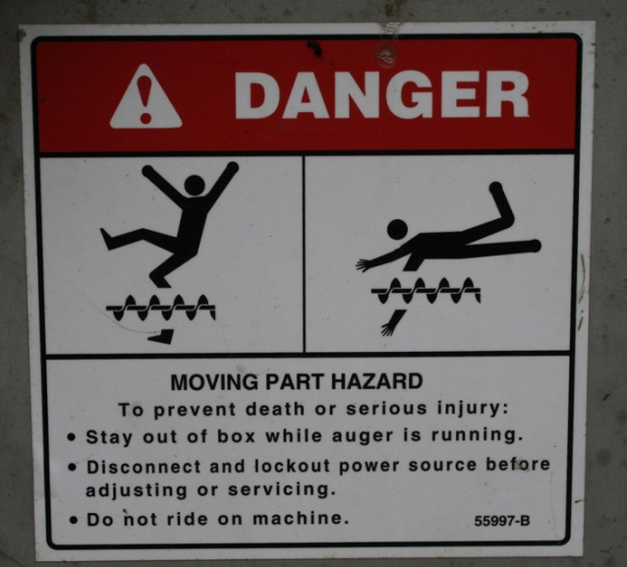
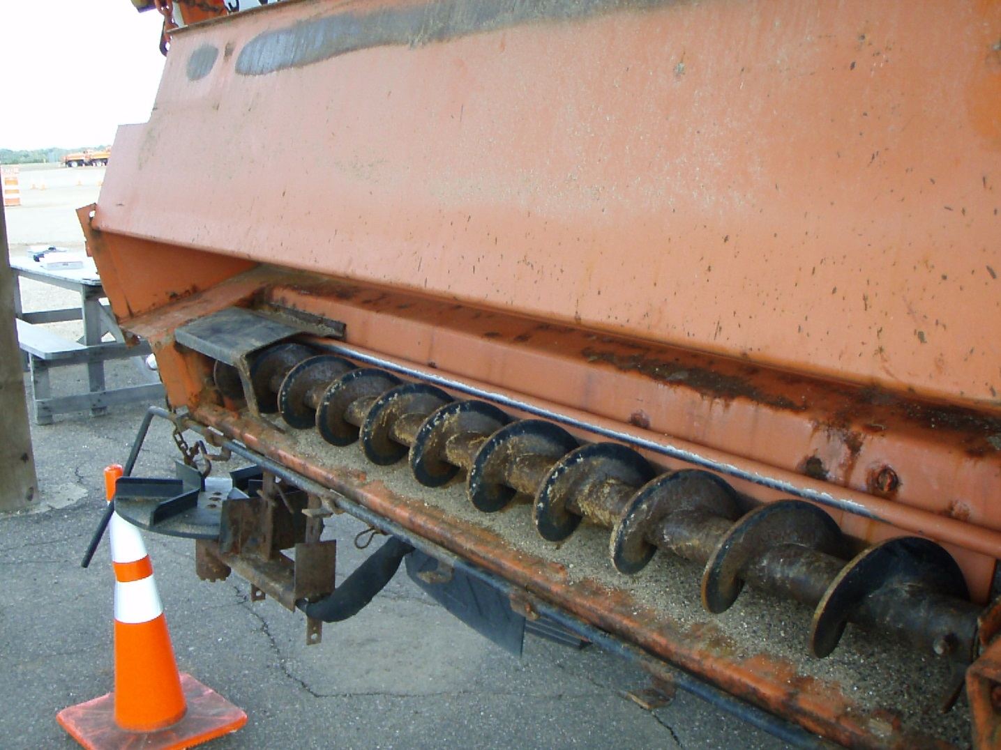
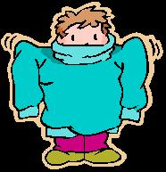
USE EXTREME CAUTION WHEN WORKING AROUND EQUIPMENT
Loose clothing and jewelry is discouraged when working around moving parts
Don’t use foot or hand to unclog auger or spinner
Notes:
Images: microsoft clipart
Photo: FCI
PennDOT_Snow-Academy-Part-4_slides_11-16.pptx
Turn off truck motor, release hydraulic pressure, and then still use a tool carefully to unclog the spreader. Don’t get into the habit of sticking your hand into the auger area.
Test Question:
Are loose fitting clothes a hazard when working around equipment?
Yes – yes
No - no

Slide 33

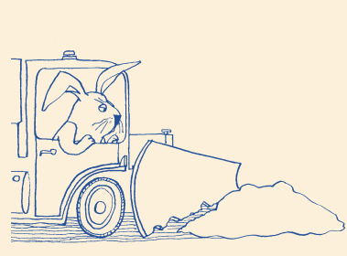
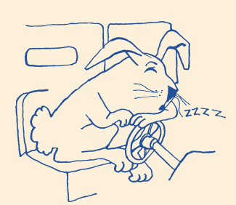
Stay alert
Tips from experienced operators: Although there are many tips for how to stay alert it will require you to come up with a system that works best for you. Each operator is different.
Come in rested for your shift
While plowing:
Stay hydrated – drink water
Eat healthy snacks – keep even energy level
Avoid the ups and downs of high sugar or high caffeine drinks/foods
Open the window
Keep a cool cab
Get out and walk around when re-fueling, re-filling
Sing/talk out loud
Move during your breaks, don’t just sit
Communicate with supervisor if longer breaks are needed
Other suggestions?
Notes:
Tip from Cliff Spoonemore – WYDOT
Plow Images from MaineDOT
Eye images- microsoft clipart
What works to keep one operator alert may not work for the next. Above are some tips that have been shown to help operators. Would be good to ask the audience, especially the senior operators what works for them.
Test Question:
Which of these strategies would be most likely help you stay alert while plowing?
In the fall, practice staying awake all night - no
Eat sugary foods and drink highly caffeinated beverages- no
Come to work rested, bring healthy snacks and a water bottle- yes
Put in your ear buds and listen to your favorite music- no

Slide 34





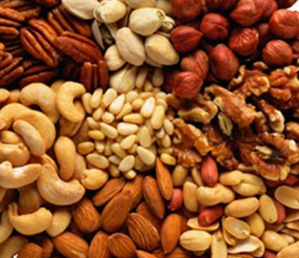
Be prepared
Dress in layers
Gloves, winter hat
Healthy snacks
Water
Long hours
Variable weather
Notes:
Images: microsoft clipart
Dress in layers, so you have the ability to remove layers to stay comfortable in the cab but have adequate protection from the cold when you need to be outdoors.

Slide 35
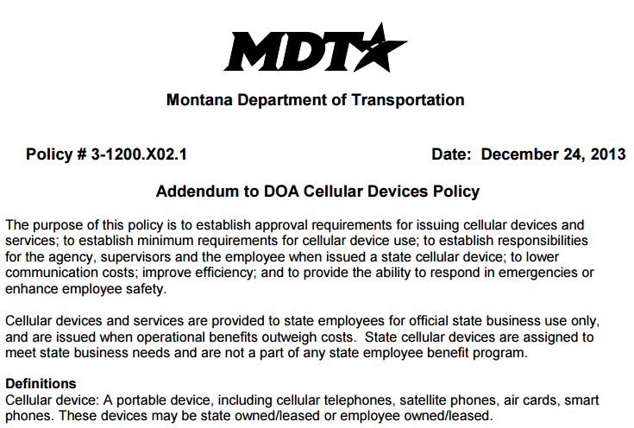

Reduce distractions
Music
Phone calls
Texting
Other?
Put your policy here
A new FMCSA rule restricts the use of all hand-held mobile devices by drivers of commercial motor vehicles (CMVs). This rulemaking restricts a CMV driver from holding a mobile device to make a call, or dialing by pressing more than a single button. CMV drivers who use a mobile phone while driving can only use a hands-free phone located in close proximity.
Notes:
To increase safety, decrease distractions. Allow yourself the opportunity to focus on your job, your safety and the safety of the driving public. Discuss your policy at this time or refer people to a location where they can read the details of your policy. If giving general guidance to a mixed group, can use your policy as an example.
http://www.fmcsa.dot.gov/driver-safety/distracted-driving/mobile-phone-restrictions-fact-sheet “A new FMCSA rule restricts the use of all hand-held mobile devices by drivers of commercial motor vehicles (CMVs). This rulemaking restricts a CMV driver from holding a mobile device to make a call, or dialing by pressing more than a single button. CMV drivers who use a mobile phone while driving can only use a hands-free phone located in close proximity.”
Test Question:
Is it ok to text and plow?
Yes if it is an emergency-no
Yes if the visibility is ok- no
Yes if the traffic volume is low - no
No it is never ok to text and plow - yes

Slide 36

Safety doesn’t happen by accident.
~Author Unknown
Don’t be in a hurry, watch out for others and promote safety among the crew.

Slide 37
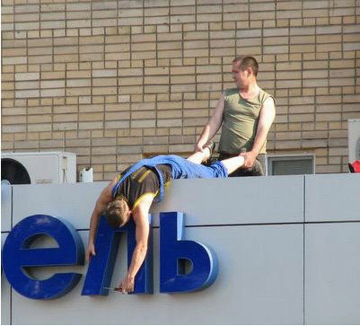
Safety
Is
#1
Safety is a component of everything you do and should be foremost in your thoughts and actions always!!
Notes:
Slide courtesty of: IowaDOT_New-Operator-Snow-and-Ice-Training_Slides_25-27.pptx
As our background slide mentioned: “…be prepared to take those extra precautions, to not get in a hurry, to watch out for others, and to promote safety among the crew"

Slide 38
Additional resources
AASHTO, Clear Roads Computer Based training:
  Proper Plowing Techniques: Unit 3 covers safety tips
  Deicing: Unit 3 Material Manufacturing, Handling and Storage
Safety around stockpiles: Salt Institute Salt Storage handbook
http://www.saltinstitute.org/wp-content/uploads/2013/09/Salt-Storage-Handbook-2015.pdf page 13

