Slide 1
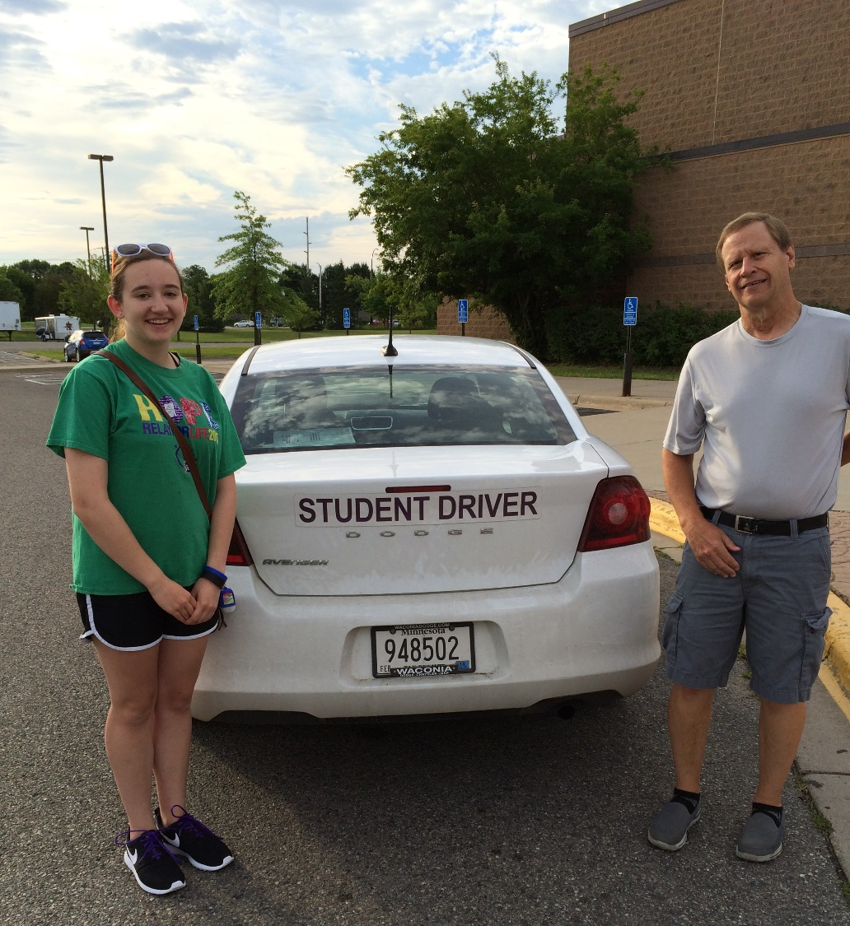

Module 24: Drivers Education
Draft
2016 Created for Clear Roads by:
U of MN Center for Transportation Studies &
Fortin Consulting Inc.
Notes:
Photo credit: Fortin Consulting, Inc.

Slide 2
This module will contain these topics:
Preparing your car for winter
  Check to make sure all is working
  Tires/chains, laws
  Safety kit
Be aware of weather
  Check for road conditions, closures
  Radio, TV, internet that is state or area specific such as MNDOT 511​, know that 511 is in all states but that cell towers determine which 511 you receive close to state borders.​
Notes:
This slide is for instructors only
This module covers what student drivers should know about driving in the winter including getting prepared for winter, being aware of weather, driving tips, and sharing the road with plows.

Slide 3
This module will contain these topics:
Winter driving tips
  Don't drive if you don't have to
  Clear all snow off car, snow and frost off all windows
  Slow down!​ - know the route(s) and give yourself extra time​
  Safe following distance – 3 second rule
  ABS/pump brakes​ - know which brake system is on your vehicle​
  Dealing with different road conditions - freezing rain, skidding, etc.
  ​share the word you are traveling. Let people know you left and that you arrived. Be aware that cell service is not everywhere.​
  ​Watch out for other drivers who may not have experience driving in winter conditions​
Sharing the road with plows
  Safe following distance
  Avoid passing plows
Notes:
This slide is for instructors only
This module covers what student drivers should know about driving in the winter including getting prepared for winter, being aware of weather, driving tips, and sharing the road with plows.

Slide 4
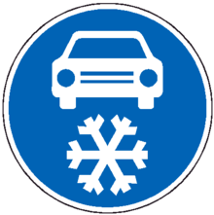
Preparing your car for winter
Be prepared:
Car maintenance
Tires
Emergency kit
Notes:
Making sure that your car is in working order is important year round, but heading into winter months when the roads are slippery and weather can be dangerous it is extra important to be sure that your vehicle is in tip top shape. We are going to go through the steps that you should take to make sure that you and your vehicle are ready for the winter season.
Picture credit: Microsoft clipart

Slide 5

Check to make sure your car is in working order
Antifreeze
Battery
Brake fluid
Brakes
Defroster
Emergency flashers
Exhaust
Fuel
Heater
Ignition
Oil
Radiator
Tires (air pressure and wear)
Windshield wiper fluid (wintertime mixture)
Notes:
Car maintenance is always recommended. Winter conditions stress the cars ability to perform therefore it is even more important that your car be in great condition to avoid problems. There are many parts that can be checked to make sure that your car is in good working order. These listed are some examples.
Antifreeze
Battery
Brake fluid
Brakes
Defroster
Emergency flashers
Exhaust
Fuel
Heater
Ignition
Oil
Radiator
Tires (air pressure and wear)
Windshield wiper fluid (wintertime mixture)
Picture credit: Microsoft clipart

Slide 6

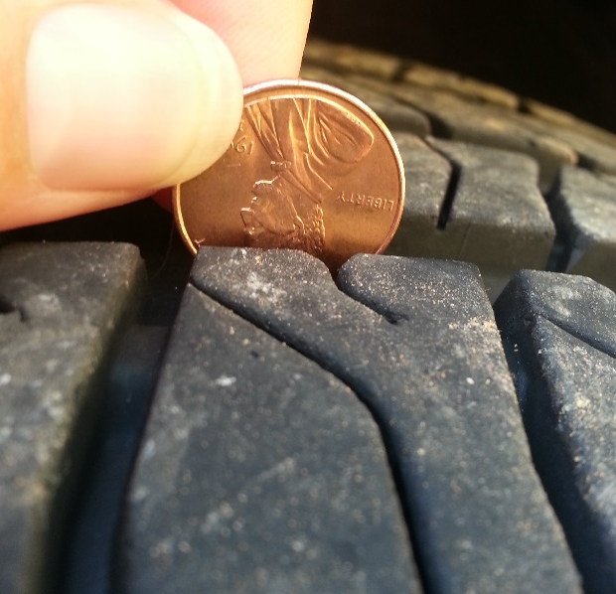
Check Tire Tread
The U.S. Department of Transportation recommends replacing tires when they reach 2/32”, this may not be adequate for winter conditions
To check you can use a penny. If it is at or below Lincoln’s head you should consider replacing your tires.
Notes:
Tires with good tread are important. Worn tires are more likely to slip on ice or compacted snow than tires with good tread. One way that you can check your tires is my using a penny. If it is at or below Lincoln’s head you should consider replacing your tires.
Photo credits: Fortin Consulting, Inc.

Slide 7
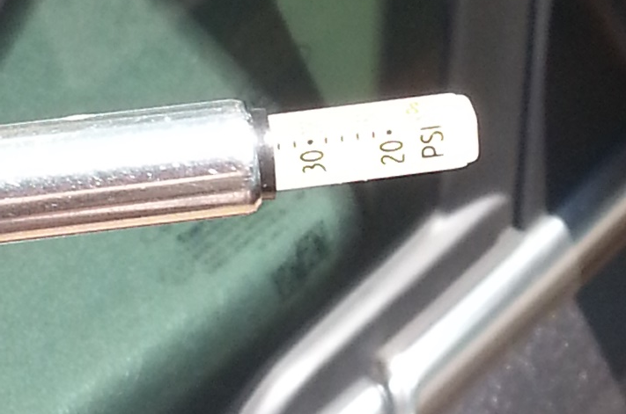
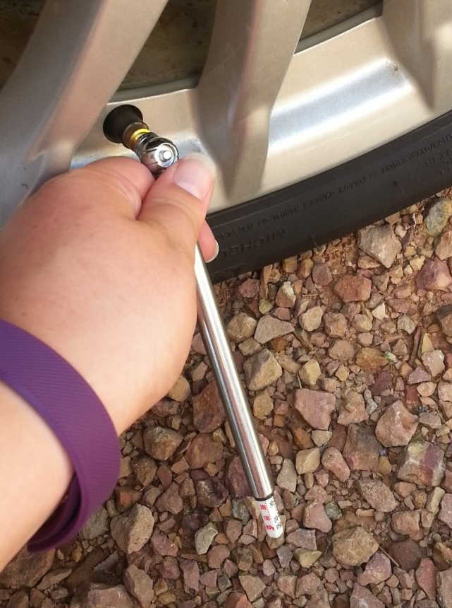
Check Tires Air Pressure
Properly inflated tires will guarantee the best possible contact between the tire and the driving surface.
When it gets cold tires can lose pressure
Notes:
Tire pressure is especially important during the winter, because traction is often at a minimum due to wet or snowy conditions. Properly inflated tires will guarantee the best possible contact between the tire and the driving surface. In winter's lower temperatures, however, the cooler air contracts, and the air pressure in your tires can drop. That's why it's advisable to do a check for proper inflation as fall turns to winter, and then continue to check periodically throughout the season. Proper inflation also saves money because it minimizes tire wear.
Read your owner's manual to find the correct tire pressure, or look for the sticker in the driver side doorjamb.
Photo credits: Fortin Consulting, Inc.

Slide 8
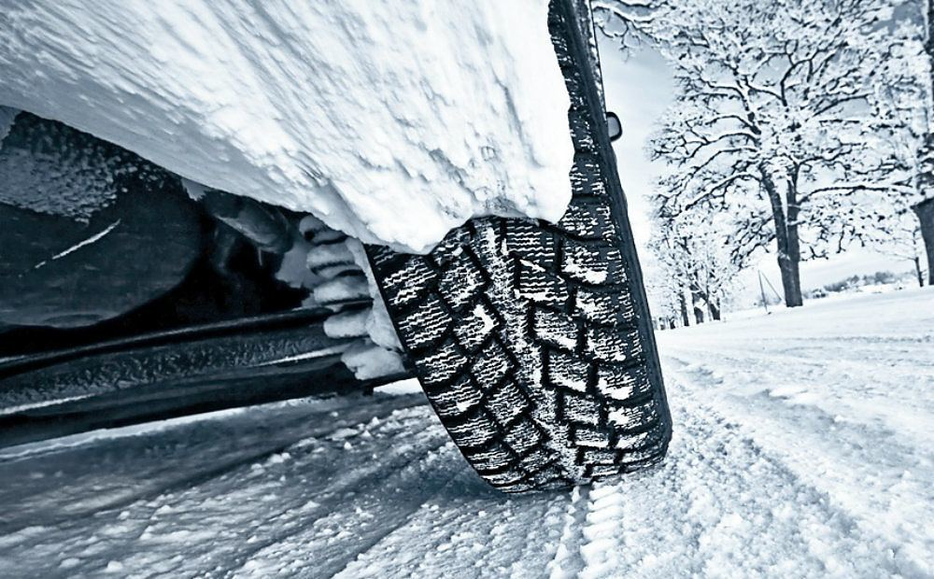
Winter tires
Winter tires provide more control in snow and ice conditions
Notes:
Winter tires look like normal all season tires, but they are made out of a different rubber and have a different tread depth and pattern to give more traction in winter conditions. They are not studded tires.
White colored tire treads are gripping the roadway. Solid black or wet looking tire treads means you are spinning the tire and generating ice on the roadway.
Winter tires are a possible tool for safer driving in the winter.
Photo credit: Creative commons http://www.automoblog.net/2016/04/09/5-low-cost-fuel-economy-solutions/

Slide 9
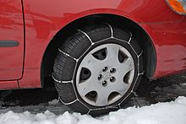
Chains
Chains give extra traction on snowy roads
Insert the chain law for your state here
Notes:
Chains are a method to give extra traction for tires in winter conditions. Go over your state laws about wearing chains.
Photo credit: creative commons https://en.wikipedia.org/wiki/Tire_chains

Slide 10
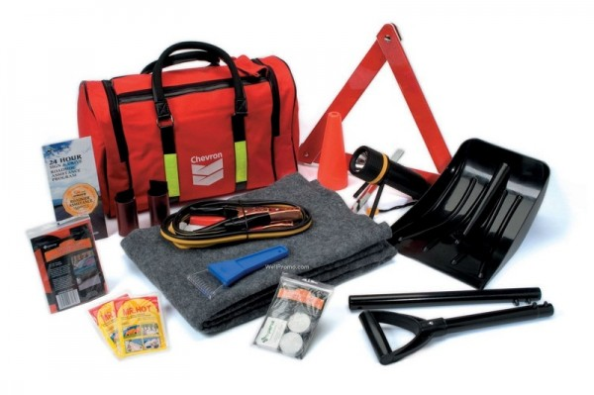
Emergency Kit
Some items that can be useful in a kit:
Shovel
Small bag of sand or kitty litter
Snow brush and ice scraper
Blanket or sleeping bag
Non-perishable foods
First-aid kit
Flares or cones
Flashlight
Hand warmers
Hat and mittens
Jumper cables
Notes:
Having an emergency kit is important to be prepared in case of any car trouble you may encounter. Many companies sell pre-assembled kits or you can build one of your own. Some of these items may be found around the house. This list are things you may want in your kit.
Photo credit: http://www.automoblog.net/2012/12/04/winter-survival-kit/

Slide 11


A prepared car is a safe car
Prepare your car in the fall – September, October, or November
When your car is in tip top shape you you’ll stay safe on the winter roads
Notes:
A car that is in good working order will help keep you safe on the winter roads and having an emergency kit will help if you do run into trouble. This is an important part of safe winter driving. Make sure that you car is prepared for winter in the fall – September, October, or November
Photo credits: Microsoft clipart

Slide 12
Test Question
When is a good time to prepare your car for winter?
Spring – March, April, May
Fall – September, October, November
Summer – June, July, August
Winter - December, January, February
Notes:
Note to presenters: you may choose to hide this slide.
Test question: When is a good time to prepare your car for winter?
Spring – March, April, May (no)
Fall – September, October, November (yes)
Summer – June, July, August (no)
Winter - December, January, February (no)

Slide 13
Be Aware of Weather
Make sure that weather and road conditions are favorable before you set out.
Always ask the question “Do I need to make this trip?”
Notes:
You should always be aware of the weather when you are driving. Checking more than one source can give you a better picture of what the weather is going to be like. Checking these sources may also give you a good idea of road conditions.
There are many sources, including TV, internet, radio and other sources. If you’re not going far you can look out the window!
Picture credit Microsoft clipart

Slide 14
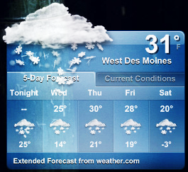
Check on weather conditions
Checking more than one source can give you a better picture
There are many sources: TV, internet, radio, or look out the window!
Notes:
You should always be aware of the weather when you are driving. Checking more than one source can give you a better picture of what the weather is going to be like. Checking these sources may also give you a good idea of road conditions.
There are many sources, including TV, internet, radio and other sources. If you’re not going far you can look out the window!
Picture credit left: Jake Bouma, Forecast: snow. https://www.flickr.com/photos/30885355@N00/2245250544 are licensed under a Creative Commons Attribution Share-Alike 3.0 License

Slide 15
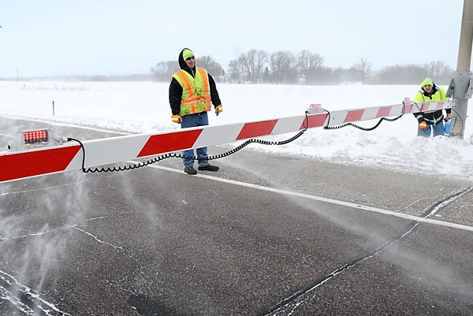
Check for Road Conditions and Closures
Notes:
You can use the same sources you are using to look at weather to find out if there are any road closures and road conditions. Being prepared will help to keep you safe in severe winter condition.
One example would be knowing that a crash is coming up and traffic will be slowing down, possibly very quickly. This may allow you to gradually slow instead of having to quickly brake and possibly lose control on slick winter roads.
Remember roads can close behind you, so you may end up being alone on the highway.
Photo credit: MNDOT http://www.newsline.dot.state.mn.us/archive/10/jan/27.html

Slide 16

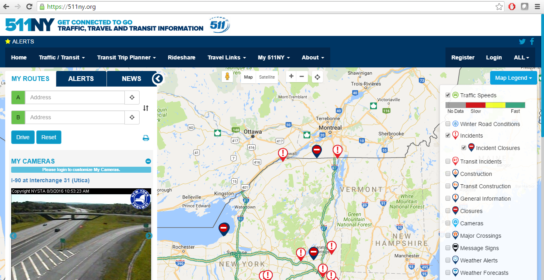
Check your state’s 511
Example:
Call the number 1-800-XXX-YYYY
Visit the website 511ny.org
Receive Email/Text updates
Download the app 511NY
Insert your state’s 511 info here
Notes:
One good source for learning about road closures and conditions is your state’s 511 service. Talk about the different ways to access this information in your state.
Top photo credit: WYDOT
Bottom photo credit: NYDOT

Slide 17
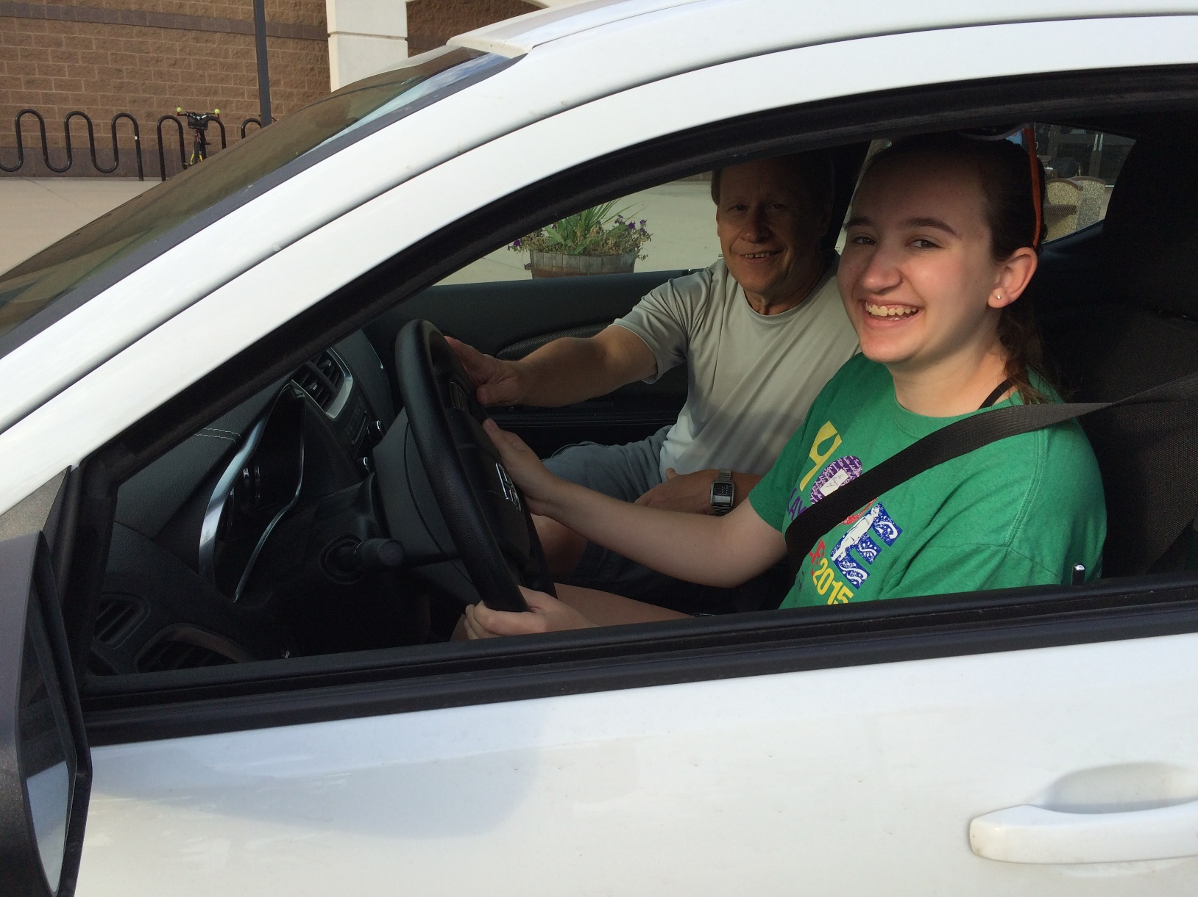
Driving Tips
Notes:
Now we are going to talk about some driving tips for winter driving conditions
Photo credit: Fortin Consulting, Inc.

Slide 18
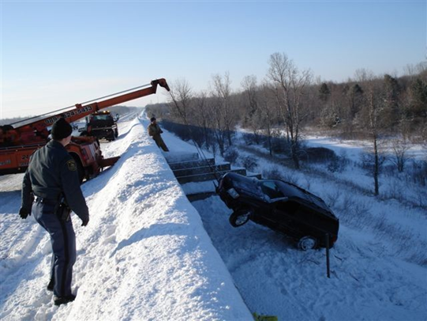
If it’s snowing or the roads are icy, consider if you need to be driving
Notes:
Driving in weather conditions greatly increases your risk of being in an accident. It is always best that if you do not NEED to drive, you shouldn’t .
Doing this also allows time for the plow drivers who are removing snow and salting to do their job cleaning off roads.
Photo credit: WYDOT

Slide 19
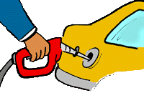
During the winter
Frequently check to make sure your car is still prepared
Do you have gas?
Enough windshield wiper fluid?
Are your wipers working?
How do your tires look?
Notes:
Throughout the winter you should continue to frequently check to make sure your car is still prepared
Do you have gas?
Enough windshield wiper fluid?
Are your wipers working?
How do your tires look?
Photo credit: Microsoft clipart

Slide 20
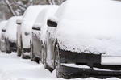
Clear all snow off your car
clear snow off car. Pay careful attention to window, mirrors, lights and license plates
Snow from your vehicle can blow off and impair your or other people’s vision while driving.
Notes:
It is important to clear all snow off your car before driving. This includes from the hood, roof, trunk, lights, license plates, as well as windows.
Snow from your vehicle can blow off and impair your or other people’s vision while driving.
Photo credit: Shutterstock.com Mr Twister under creative commons

Slide 21
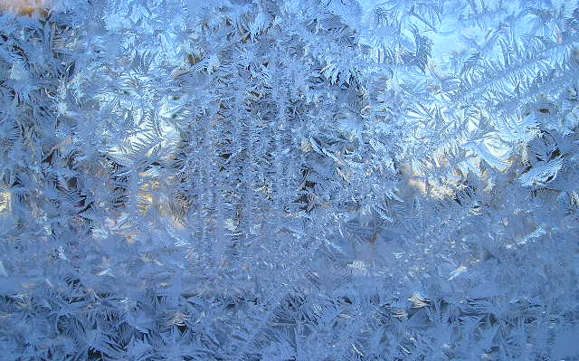

Ice may form on your windows and mirrors. Scrape everything clean…not just a little patch to peek through.
Is this safe for driving?
Notes:
If you cannot see what is in front of, behind, or beside you car you are not engaging in safe driving practices. It greatly increases your risk for getting into an accident. Take time to scrape off, defrost, or remove snow, ice, or frost from all of your windows and mirrors.
Ice Photo credit: Fortin Consulting, Inc.
Child image: microsoft Clipart

Slide 22
Test Question
Which should you clear before driving?
Front and back windows
Mirrors
Side windows
All of the above
Notes:
Note to presenters: you may choose to hide this slide.
Test question: Which should you clear before driving?
Front windshield (no)
Back windshield (no)
Side windows (no)
All of the above (yes)

Slide 23
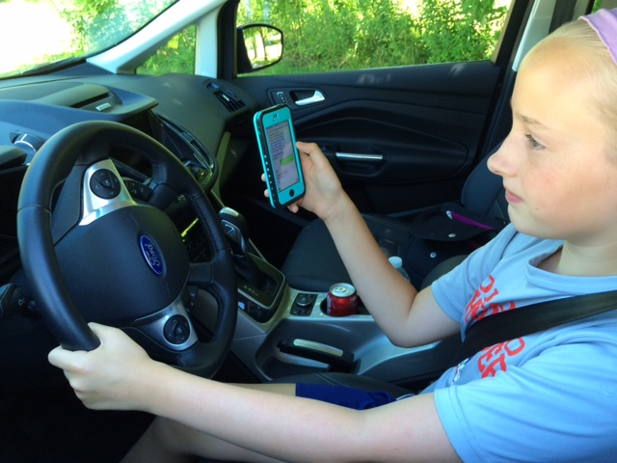
If you decide to drive: limit distractions
No matter what the driving conditions are it is important to avoid distractions. This could include:
Phone
Radio
Eating or drinking
Passengers
Putting on makeup
What else could you be distracted by?
Notes:
Photo: FCI

Slide 24
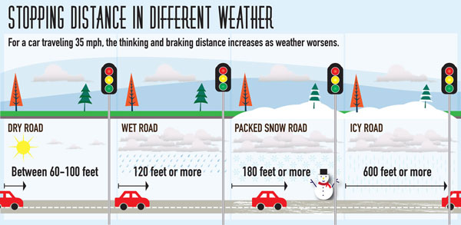
Leave a safe following distance
In the winter it takes you longer to stop, so you need to leave more room
Notes:
In the winter it takes you longer to stop, so you need to leave more room. You can see in the graphic that on a snowy road it can take 2-3x the distance to stop than it does on a dry road, and on an icy road it can take as much as 10x as long. It is very important that you leave extra room between yours and the next vehicle during the winter months.
Graphic credit: https://www.lesschwab.com/blog/post/how-to-drive-safely-on-ice-top-tips-for-keeping-your-car-on-the-road

Slide 25
SLOW DOWN!
The faster you are going, the longer it takes to stop
Notes:
On top of it taking more room the stop in the winter, the faster you are going the more space it will take you to stop. Reduce your speeds for safe driving in snowy or icy conditions.
Data from https://assets.publishing.service.gov.uk/media/559afb11ed915d1595000017/the-highway-code-typical-stopping-distances.pdf

Slide 26
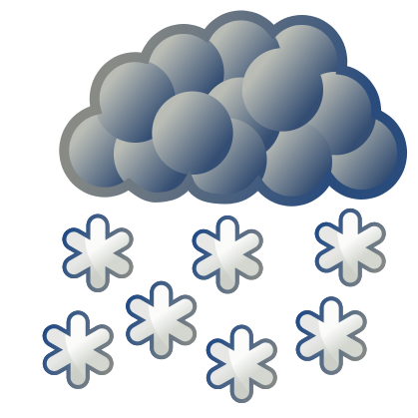


In summary: When there is snow or ice on the road slow down and increase following space
Notes:
In summary: When there is snow or ice on the road slow down and leave more space between you are the car in front of you.
Many states use the 3 second rule (http://dor.mo.gov/forms/Driver_Guide.pdf) for determining following distance. In winter weather you should increase this distance. Pick a fixed object like a light post, when the car in front of you passes it start counting slowly – one Mississippi, two Mississippi, three Mississippi... When you reach that object you should find that you have 3+ seconds between your car and the car in front of you.
Photo credits: Microsoft clipart

Slide 27
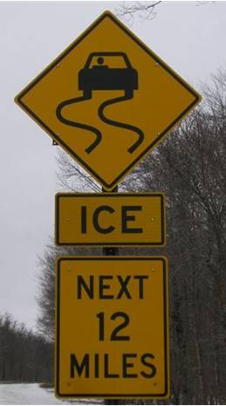
Know which kind of brakes you have
Try to keep control of your vehicle. Drive slow, test traction by touching your brake pedal.
If you are losing control
ABS*
Pumps for you. Press down on brake pedal and hold. ABS will allow you to steer.
*most common
Manual
Pump brakes slow and consistently
until the wheel locks, then release.
Repeat. Pump faster as you slow.
Notes:
Many cars have Anti-lock Breaking Systems (ABS) built in, but not all. It is important to know whether or not you have ABS on your car because it will change how you will react in a skidding or sliding situation.
If you have ABS the best thing to do is to press hard on the brake pedal and hold. The ABS will function to keep your steering wheel from locking up.
If you have manual brakes you should use the pumping technique. Pump your brakes slowly, just until your wheel locks, then release. Repeat this action. As you slow down you will have to pump faster because it will take less to lock up your wheel.
Photo credit: NYDOT

Slide 28
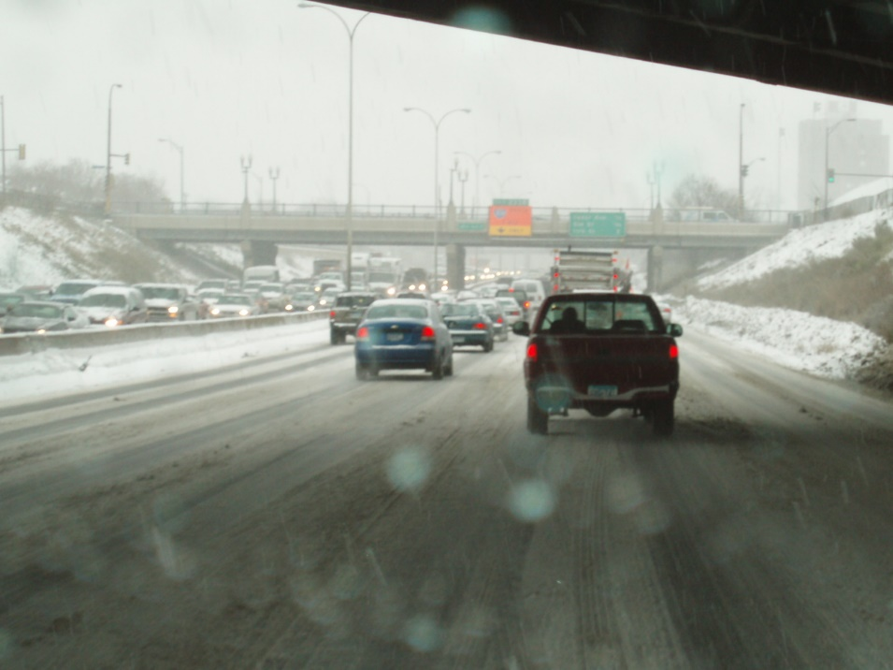
Dealing with Road Conditions
When dealing with bad road conditions take the cautious approach
Don’t use cruise control!
Eliminate distractions
Slow down
Brake early
Don’t do anything quickly. Steering or braking should be gradual
Notes:
When dealing with bad road conditions take the cautious approach
Be aware of what’s going on around you
Keep speed down
Don’t use cruise control
Brake early
Don’t do anything quickly. Steering or braking should be gradual
Photo credit: Fortin Consulting, Inc.

Slide 29
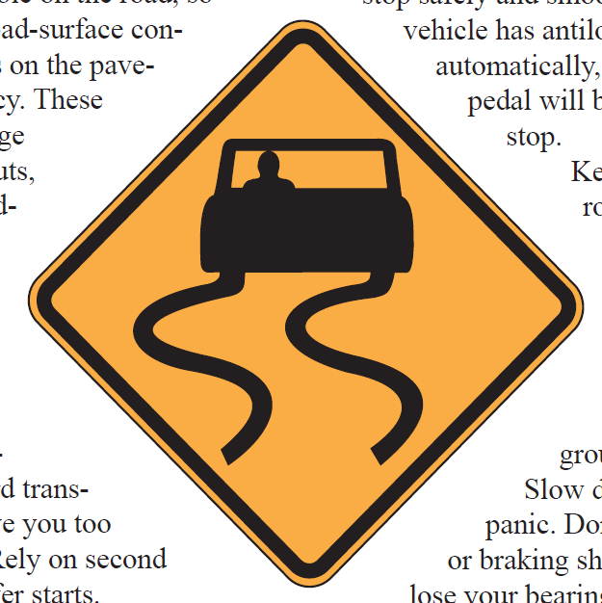
Skidding
If you start skidding:
Don’t panic
Gently turn into the skid
Ease your foot off the accelerator
Do not brake
Notes:
To reduce risk of skidding:
Keep speed down
Don’t do anything quickly. Steering or braking should be gradual
If you start skidding:
Gently turn into the skid
Ease your foot off the accelerator
Do not brake
If you are already skidding avoid the break. You are already sliding, breaking will guaranty you will continue to slide.
Photo credit: WYDOT

Slide 30
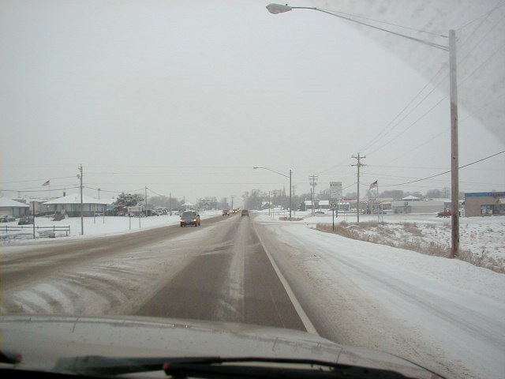
These are conditions that will make driving more difficult
Weather conditions
Freezing rain
Sleet – snow and rain
Snow
Road conditions
Frost
Ice
Black ice
Compacted snow
Blowing snow
Notes:
Weather conditions are coming from the sky. They will hit your windshield and the road.
Road conditions are sneakier and you won’t see this hit your windshield. You must be aware of what’s going on under your tires.
You will sometimes experience both at the same time!
Photo credit: Fortin Consulting, Inc.

Slide 31
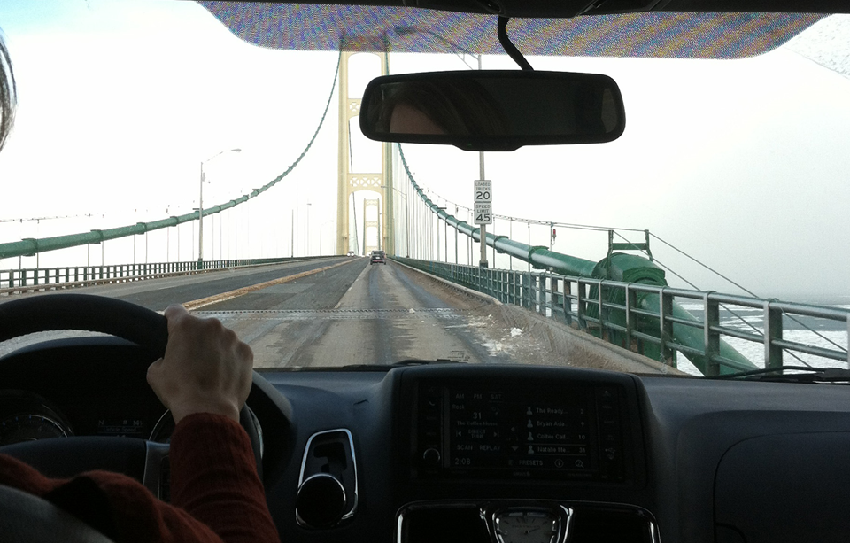
Did you know that ice often forms on ramps and bridges first?
This is because bridge and ramp pavement temperatures change faster than road pavement temperatures because they are surrounded by air
Notes:
Bridges and ramps often have ice form on them before roads because bridges and ramp pavement temperatures change much faster than road pavement temperatures because they are surrounded on all sides by air.
When the air temperature changes, the road which is buffered by the ground on all but one side changes more slowly than the bridge because it is buffered by the soil while the bridge is exposed, the bridge pavement temperature will change faster with the air temperature.
Photo credit: Fortin Consulting, Inc.

Slide 32
Test Question
What is likely to ice up first?
Side streets
Bridges
Highways
Country roads
Notes:
Note to presenters: you may choose to hide this slide.
Test question: What is likely to ice up first?
Side streets (no)
Bridges (yes)
Highways (no)
Country roads (no)

Slide 33
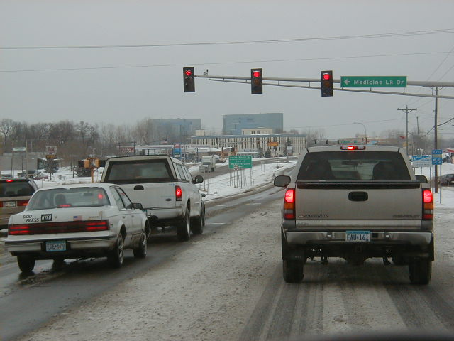
Tell people when you are travelling
Alert people to your travel plans. Tell them when you leave and let them know when you have arrived
Be aware that cell service is not everywhere
Notes:
Share the word you are traveling. Let people know you left and that you arrived. Be aware that cell service is not everywhere.​
Photo credit: Fortin Consulting, Inc.

Slide 34
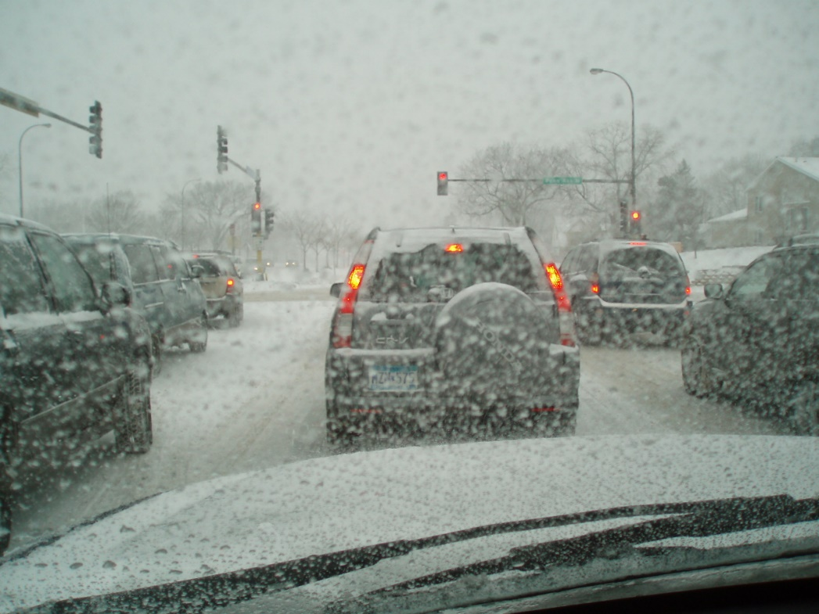
Watch out for others on the road
Watch out for the other people on the road. Leave space to react if another driver has a problem.
If you are following someone's taillights and they drive off the road, you’ll drive off right behind them
Notes:
Watch out for the other guy that thinks he/she knows how to drive in winter conditions. They maybe from a southern state.​ Leave space to react if another driver runs into a problem.
If you are following someone's taillights and they drive off the road, you’ll drive off right behind them.
Photo credit: Fortin Consulting, Inc.

Slide 35



Drive at the speed you’re comfortable with, but watch out for other drivers
60 mph 40 mph
Notes:
Different people are comfortable driving at different speeds, especially in difficult weather conditions. But if someone comes up too fast on a slower driver and isn’t able to slow down it could become dangerous. Don’t drive faster than you are comfortable with for the conditions, but make sure you are looking out for other drivers
Photo credits: Microsoft clipart

Slide 36
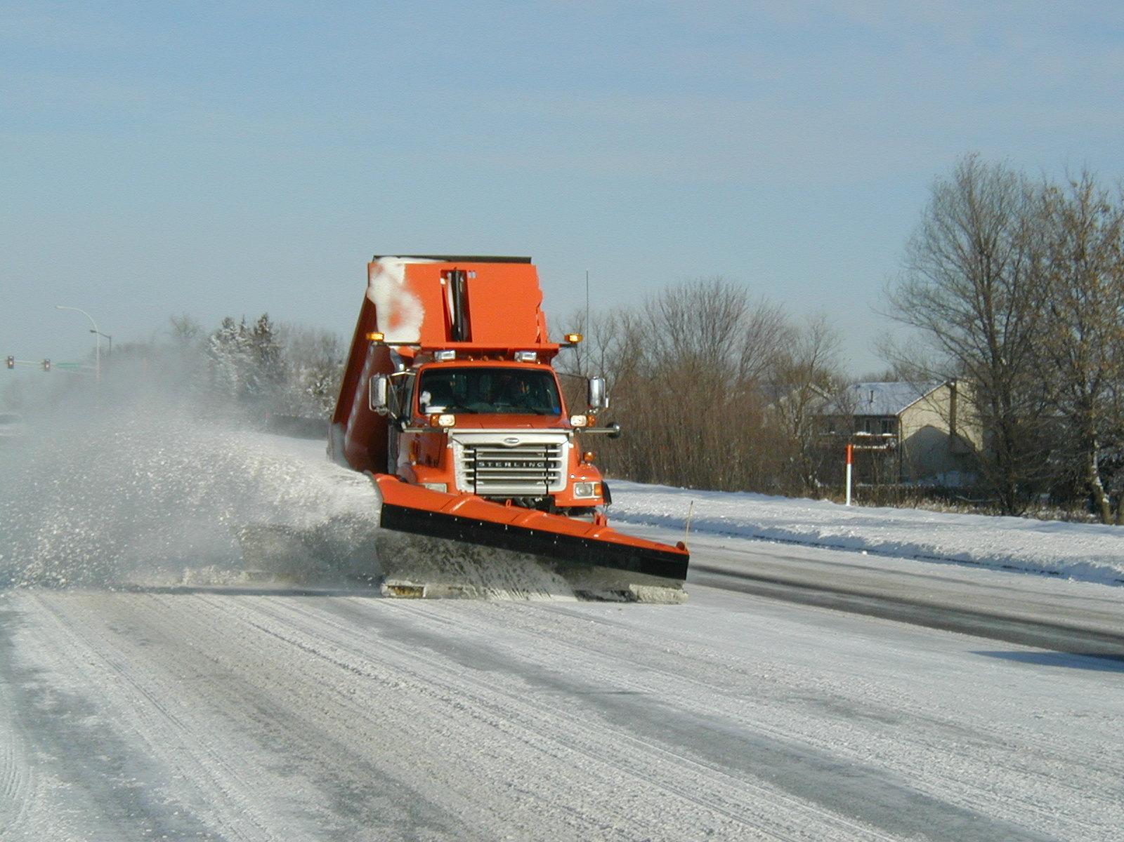
Sharing the road with plows
Snow plow driver’s field of vision is restricted. You may see them, but they may not see you.
Notes:
Besides other drivers you will also have to drive along side plows. We will discuss how to drive safely around plows.
Snow plow driver’s field of vision is restricted. You may see them, but they may not see you. Be cautious around plows and understand that
Photo credit: City of Eagan, MN

Slide 37
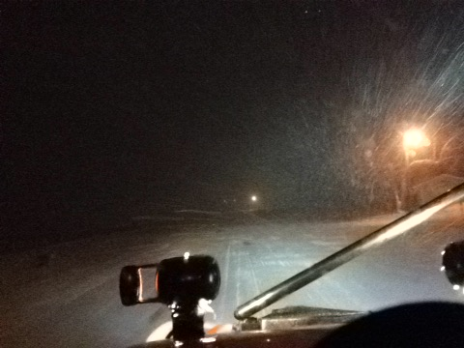
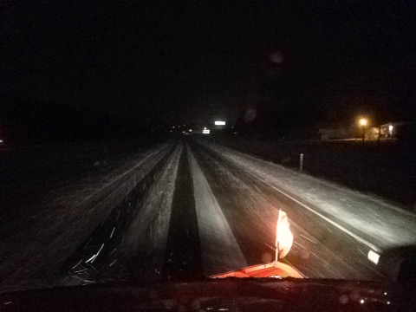
Passing
In front of plow
Behind plow
The road is in worse condition in front of the plow than it is behind. Stay behind the plow.
Notes:
Plows travel below the posted speed limits to help remove more snow and keep more salt on the road. Be patient if you are behind a plow. The road is likely in worse condition in front of the plow than it is behind the plow where you are.
Photo credit: IowaDOT

Slide 38
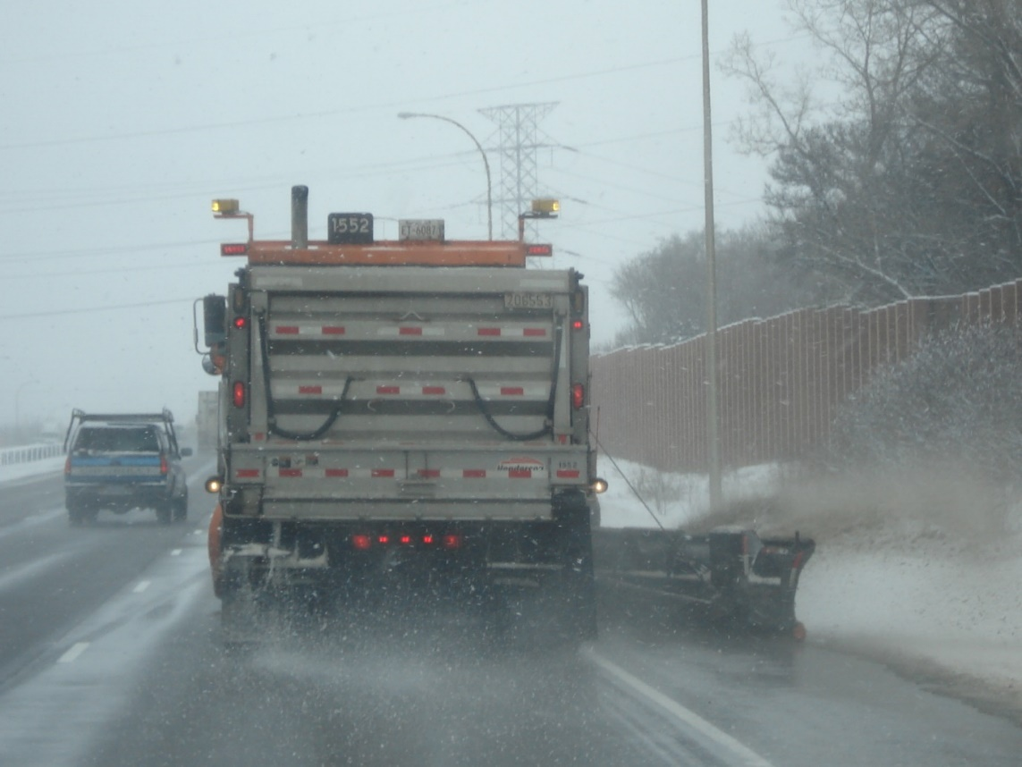
Passing
Don’t pass unless absolutely necessary and safe
Plows stick out beyond their lane
The road is in worse condition in front of the plow than it is behind. Stay behind the plow.
Notes:
Plows travel below the posted speed limits to help remove more snow and keep more salt on the road. Be patient if you are behind a plow. The road is likely in worse condition in front of the plow than it is behind the plow where you are.
Also, plow trucks are wide and can cross the center-line and shoulder. If you must pass, be safe.
Photo credit: MnDOT

Slide 39
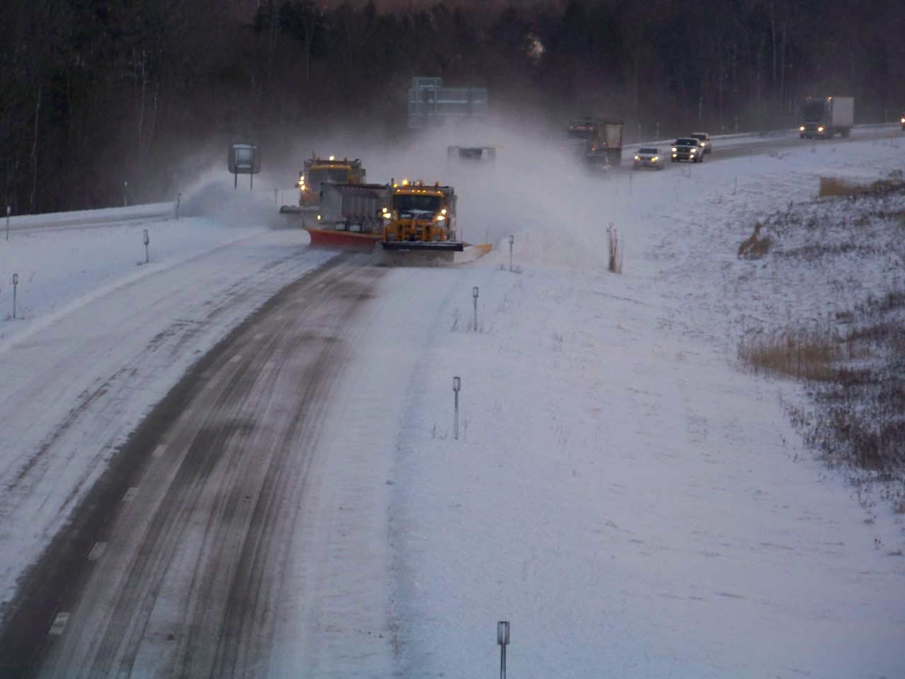
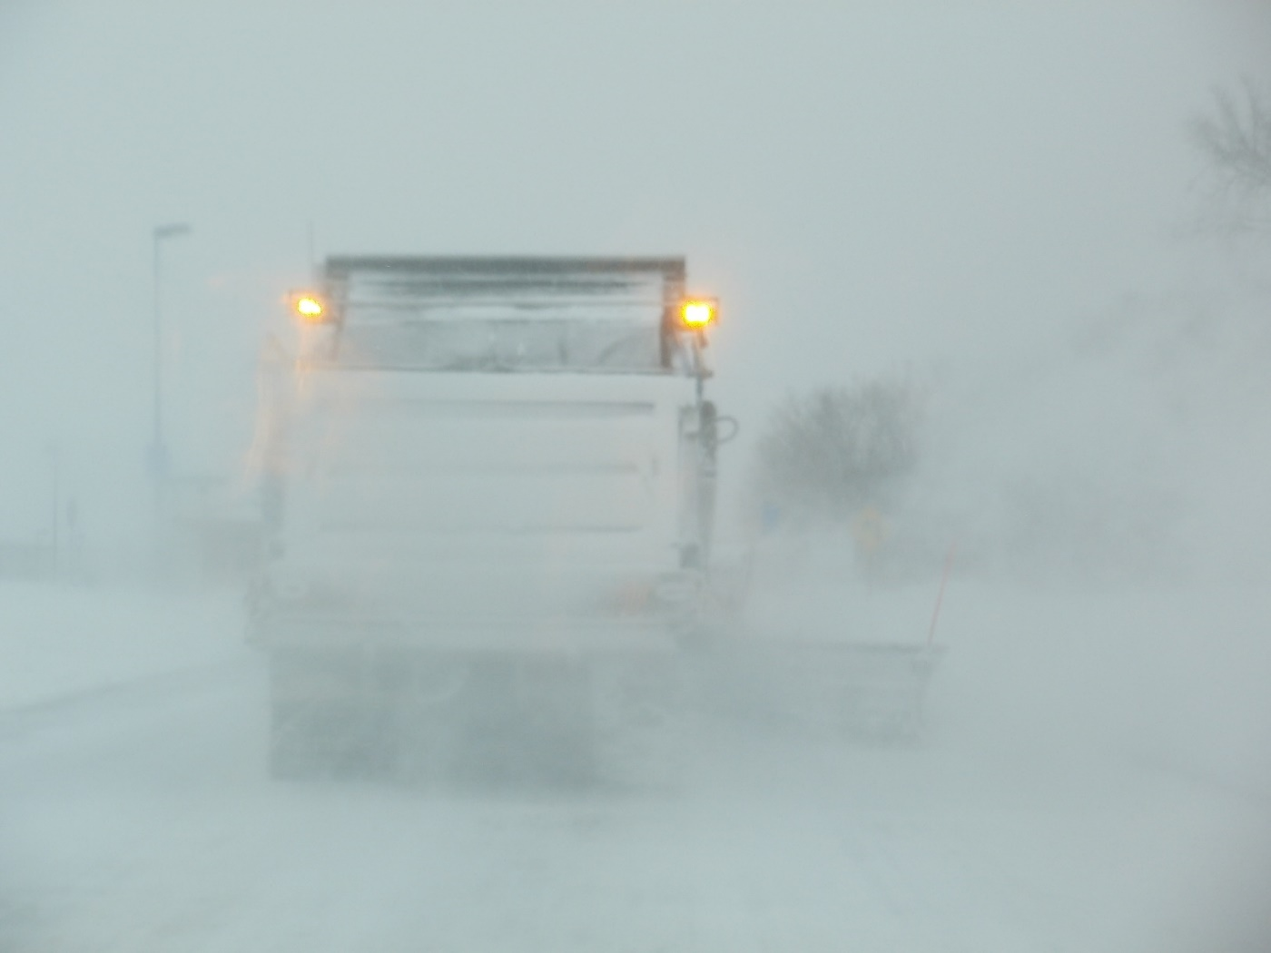
Snow plume and following
Could you see the hazard in front of the snow plow?
Notes:
When in service plows can create a plume of snow behind them that can impair driver’s ability to see if they follow to closely or see what is coming up ahead. Leave a safe distance between you and the plow to give yourself better vision.
Don’t tailgate. Leave a safe distance so you aren’t in the snow plume, you won’t be able to see!
Plow drivers have had people rear end them because they couldn’t see and get stuck under the plow.

Slide 40
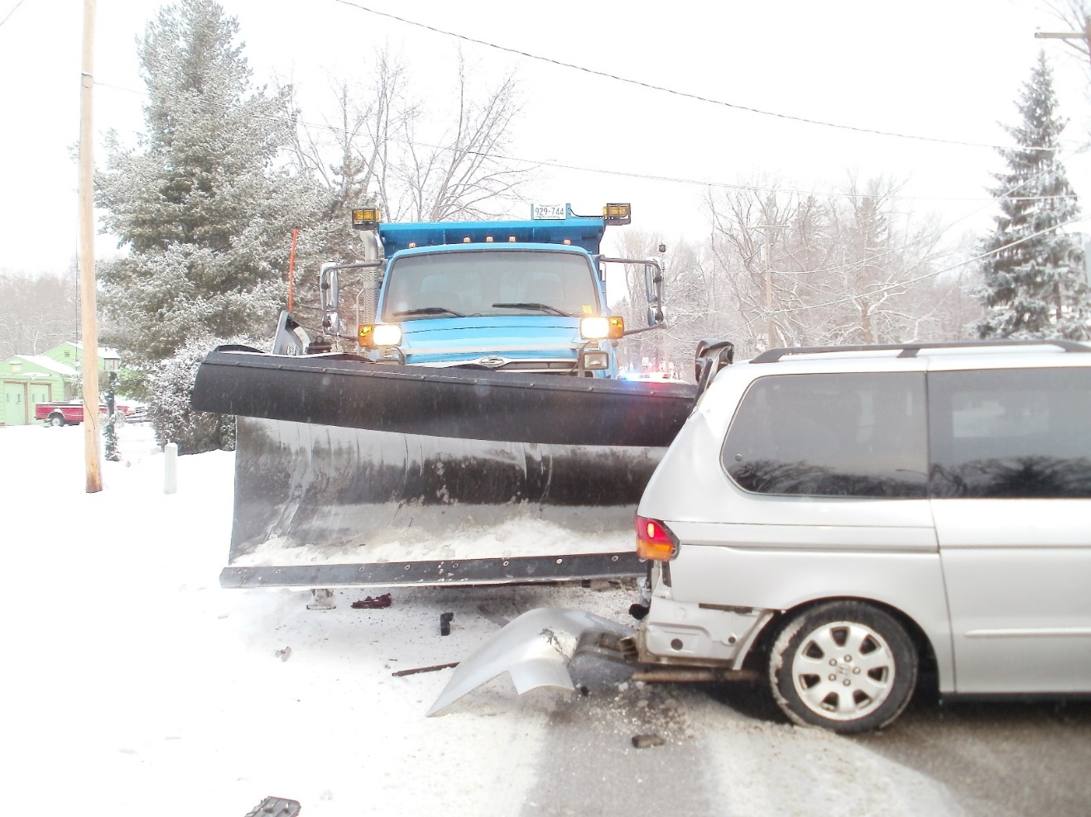
What are some of the mistakes this car may have made?
Notes:
What are some of the mistakes this car may have made? Some of the possible examples:
Passing the plow
Tailgating the plow
Distracted driving
Bald tires., spun out
Remind them: Plows are bigger and heavier than you, give them space.
Photo credit: Ramsey County, MN

Slide 41
Who wins in a crash, you or the plow?
How heavy is your vehicle?
Compact cars 3,000 – 4,500 lbs.
Midsize cars 4,500 – 5,500 lbs.
Full size cars 5,000 – 6,000 lbs.
Minivans 5,500 – 6,500 lbs.
Truck 7,500 – 12,000 lbs.
How heavy is the plow?
Snow plow – 60,000 lbs.
Who wins in a crash, you or the plow?
Notes:
Note to presenters: you may choose to hide this slide.
How heavy is your vehicle? (average)
Compact cars 3,000 – 4,500 lbs.
Midsize cars 4,500 – 5,500 lbs.
Full size cars 5,000 – 6,000 lbs.
Minivans 5,500 – 6,500 lbs.
Truck 7,500 – 12,000 lbs.
(http://www.autos.com/car-buying/vehicle-weight-averages-for-certain-models)
How heavy is the plow?
Snow plow – 60,000 lbs.
Source: NDDOT https://www.dot.nd.gov/divisions/maintenance/docs/plowtruck.pdf
Who wins in a crash, you or the plow?

Slide 42
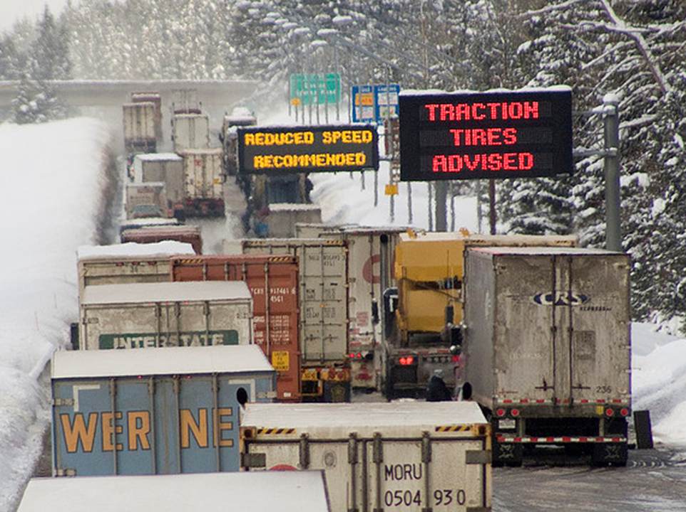
You are now better prepared for winter driving!
Be aware of road and weather conditions. Evaluate if you really need to be on the road. If you do, take your time, and be safe!
Notes:
Thank you for your time today. Have a good winter!

Slide 43
Acknowledgements
Training contents were developed by Fortin Consulting Inc., under the direction of the Clear Roads Advisory Team.
Connie Fortin – Connie@fortinconsulting.com
Lauren Tjaden – Lauren@fortinconsulting.com
Professional formatting and training aids were developed by the University of Minnesota, Center for Transportation Studies.
Jim Grothaus – Groth020@umn.edu
Ann Johnson – Johns421@umn.edu
Members of the Clear Roads Advisory Team include:
  Mike Sproul, Dave Wieder, Cliff Spoonemore, Monty Mills, David Frame,
  Mike Lashmet, Clay Adams, Justun Juelfs, and Tom Peters

Slide 44
This presentation was developed with funding from the Clear Roads research program, which brings together transportation professionals and researchers from around the country to drive innovation in the field of winter maintenance.
Find additional information and resources at
http://clearroads.org/

Slide 45
Additional resources
  511 for your state
  “CDOT Colorado Winter Driving Video” Colorado DOT https://www.youtube.com/watch?v=GjBFaivABYA
  “Driving Tips – Winter” CCOHS https://www.ccohs.ca/oshanswers/safety_haz/icesnow.html
  “Installing Tire Chains Video” Washington State DOT http://www.wsdot.com/winter/video.htm
  NOAA Weather Service http://www.noaa.gov/weather
  “Winter Travel Tips and Information” Oregon.gov https://www.oregon.gov/ODOT/COMM/Pages/winterdriving.aspx

