Slide 1
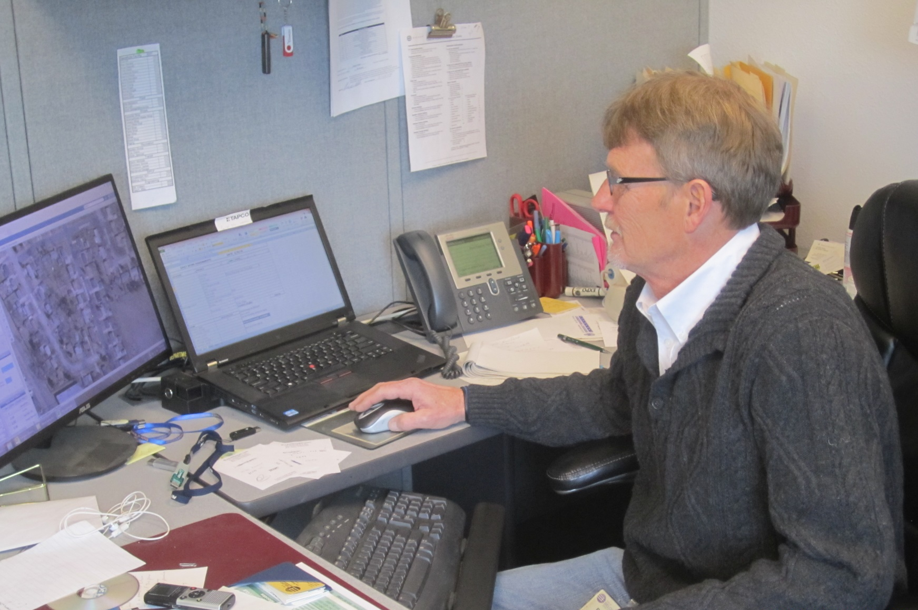
Module 20: Record Keeping
Draft
2016 Created for Clear Roads by:
U of MN Center for Transportation Studies &
Fortin Consulting Inc.
Notes:
Photo credit: City of Beloit, WI

Slide 2
FACILITATOR NOTES (do not show during class)
This is a priority 1 module to be developed for Clear Roads national training. It will address three audiences. Slides can be customized for the audience.
Slide Legend
Entry-level plow drivers
Experienced plow drivers
Supervisors
Notes:
Note: this slide does not get shown during class. It is only to inform the presenters of the symbology:
This is a priority 1 module to be developed for clear roads national training.
It will address 3 audiences:
Circle symbol = entry level plow drivers
Triangle symbol = experienced plow drivers
Star symbol = supervisors
Some slides without symbols are for everyone
Also note: To hide a slide in a power point presentation, select the slide and then select “slide show” tab. Select “hide slide”.

Slide 3
Record Keeping
The objective of this training is to convey the importance of accurate record keeping and how it can help you make better decisions in your snow and ice program. Various types of information is recommended and discussed with respect to how it can support informed decision making before, during and after winter storms and winter seasons. At the end of this session, the trainee should be able to better assess the information that they should be collecting to better support their program or better understand the importance of the expectations that have already been established within their organization.

Slide 4
Importance of Record Keeping
Show that you follow the policies including Levels of Service
Show where efficiency can be improved
Decision Making Before the Storm
Record material purchasing
Record material quality control
Decision Making During the Storm
Record material Application
Record storm information, pavement temperature
Record fuel Log
Record timecards
Record pre and post trip inspections
Decision Making After the Storm
Record equipment repairs
Record regain time (time to bare pavement)
Decision Making After the Season
Look at all records to summarize season and plan for next season
Pep talk
Notes:
This is the list of record keeping topics that suggested by Randy Geaumont of Maine DOT. If your state has other important record keeping that is not covered you should add it to this module. You may also want to delete some of the topics if they do not apply or time does not permit.
Importance of Record Keeping
Show that you follow the policy
Improve efficiency of operations
Decision Making Before the Storm
Pre-Storm meeting, staffing and equipment levels
Record material purchasing
Record material quality control
Decision Making During the Storm
Record material Application
Record storm information, pavement temperature
Record fuel Log
Record timecards
Record pre and post trip inspections
Decision Making After the Storm
Post Storm meeting, what worked/didn’t work
Record/verify total material(s) used
Record equipment repairs
Record regain time
Decision Making After the Season
Look at all records to summarize season and plan for next season
Pep talk

Slide 5
This module will contain these topics:
Importance of record keeping
What to record
How records can affect decision making
before, during, and after the storm
before and after the season
Notes:
This module covers the importance of record keeping, what to record, and how records can affect decision making before, during, and after the storm, and after the season.

Slide 6
This training module will:
Look at the importance of record keeping
Look at what records to keep
Examine how records can impact decision making
The other 22 training modules in this series:
Will give you ideas on how we can perform winter maintenance in a more efficient and effective way
Will help you reduce potential problems
Notes:
This slide is important to set the stage for all of the training modules. In this module you will learn how road chemicals and abrasives impact the eco-system. In the other training modules, we will cover best practices and industry innovation to help minimize these impacts and do the best possible job of winter maintenance.

Slide 7
Importance of Record Keeping
Show that you follow policies including Levels of Service
Show where efficiency can be improved
Help with planning
Notes:
Record keeping is important as a means of material accountability, budgeting/cost tracking, performance tracking, support in the event of legal actions, media inquiries, and planning.

Slide 8
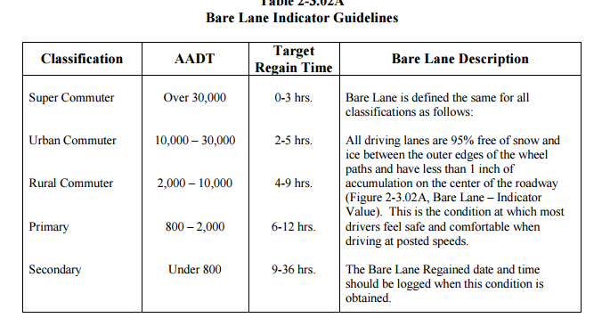
Get to know your policy
Get familiar with the policy contents including EXAMPLE:
Public Safety
Levels of service
Education
Coordinating with other jurisdictions
Insert details of your policy here
Notes:
Cover the details of your winter maintenance policy. This policy may be updated on a yearly basis depending on changes in treatment areas, equipment, or materials.
Credit: MnDOT Maintenance Manual http://www.dot.state.mn.us/maintenance/pdf/manual/Ch2.pdf

Slide 9
Get to know your policy
Get familiar with the policy contents including EXAMPLE:
Public Safety
Levels of service
Education
Coordinating with other jurisdictions
Insert details of your policy here
Notes:
Cover the details of your winter maintenance policy. This policy may be updated on a yearly basis depending on changes in treatment areas, equipment, or materials. Make sure that all employees are familiar with the parts of the winter maintenance policy that apply to them and that they know where they can access your winter maintenance policy.
Credit: MnDOT Maintenance Manual http://www.dot.state.mn.us/maintenance/pdf/manual/Ch2.pdf

Slide 10
Level of Service is one part of your Winter Maintenance Policy
Keep good records to show you meet your level of service
Following policy and keeping good records helps with law suites
Notes:
When is it not possible to meet your level of service and how would you document this?
Credit: MnDOT Maintenance Manual http://www.dot.state.mn.us/maintenance/pdf/manual/Ch2.pdf

Slide 11
Where can you find your policy
Example:
Website
Break room
Poster
Training
Etc.
Insert a list where employees can find your policy here
Notes:
It is important for everyone to be familiar with your policy and to follow the record keeping procedures. Stress that following and keeping good records helps when dealing with law suites.
Credit: Winter Operations Plan ASHTO and Clear Roads

Slide 12
Torte Response
Crashes are going to occur
Your organization’s defense will depend on following your plan and recordkeeping
Make sure all employees know, follow, and keep records of actions to prove they follow policy
Notes:
Discussion could include: Safety is the number 1 concern for DOTs. Plow drivers do not want their routes to be unsafe either. Despite our best efforts, crashes will occur. Organizations can protect themselves by having a good policy in place, following the policy and documenting your actions in following the policy. First let’s talk about having a plan.
Credit: Winter Operations Plan ASHTO and Clear Roads

Slide 13
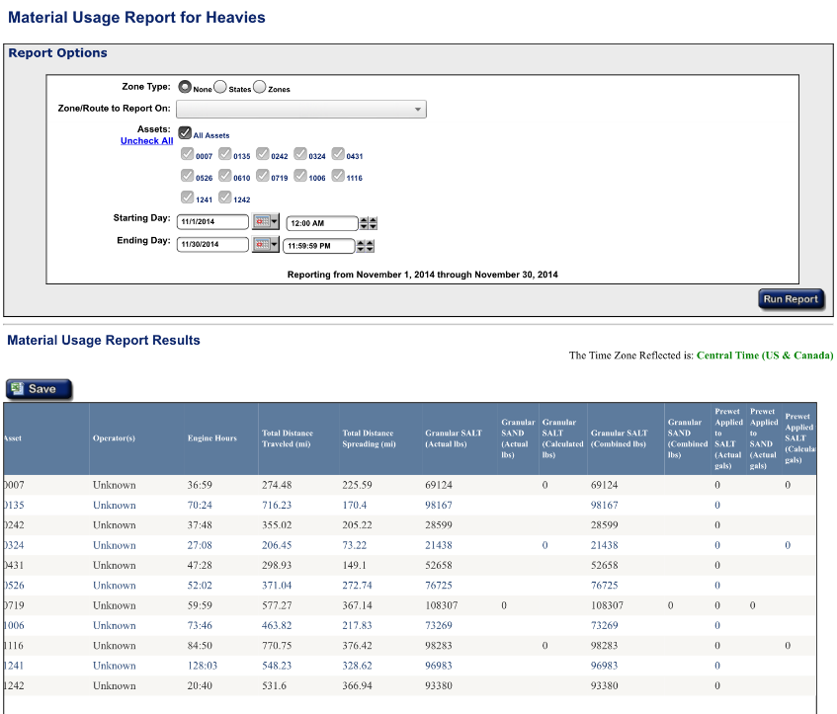
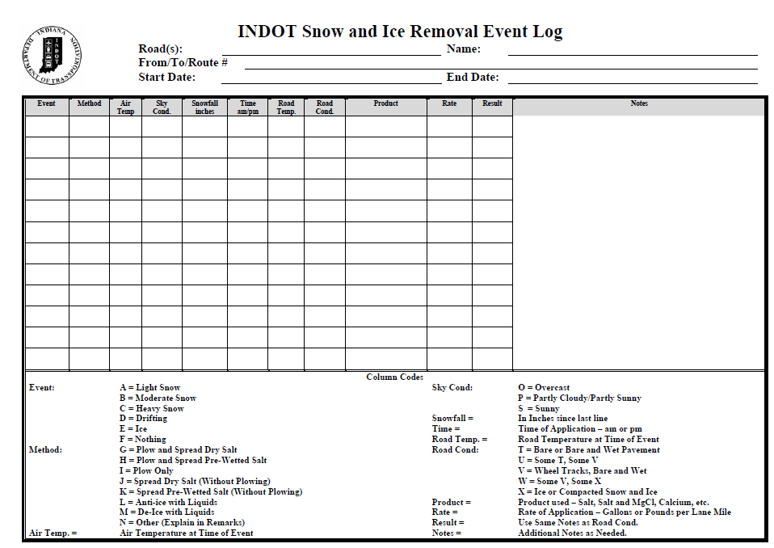
Options for how to Keep Records
Paper
Electronic
Automated
Notes:
There are many ways to keep records. For a long time paper was the primary method, but electronic record keeping such as spreadsheets are an effective option. There are also automated options such as AVL.
Top photo credit:
Bottom left photo credit: INDOT

Slide 14
Test Question
Which is not an effective way to keep records?
Electronic
Automated
Memory
Paper
Notes:
Note to presenters: you may choose to hide this slide.
Test question: Which is not an effective way to keep records?
Electronic (no)
Automated (no)
Memory (yes)
Paper (no)

Slide 15
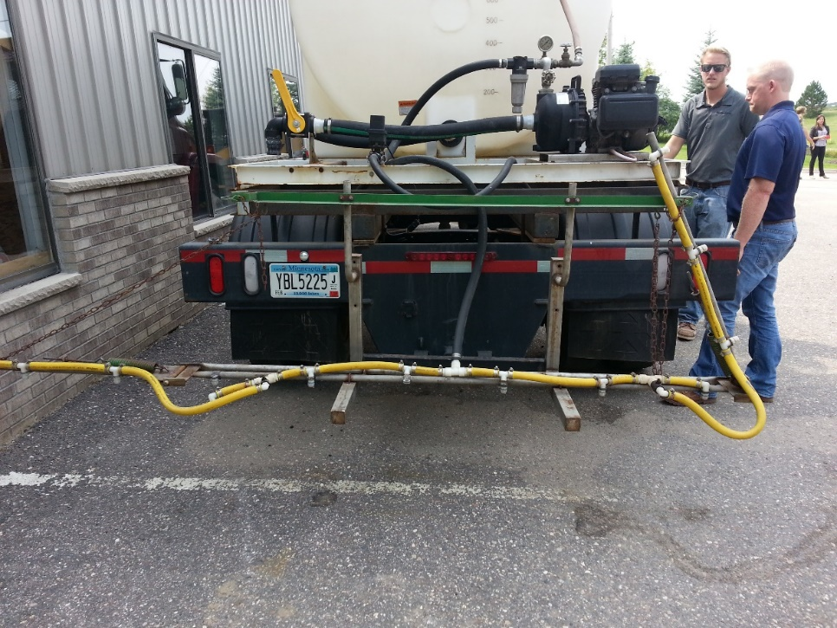
Before the Season
Records of material purchasing
Records of material quality control
Record truck inspections
Record truck calibration
Insert a list of record keeping needed in your operation to prepare for the season
Notes:
More about these topics can be found in Module 23 – Getting Ready for Winter

Slide 16
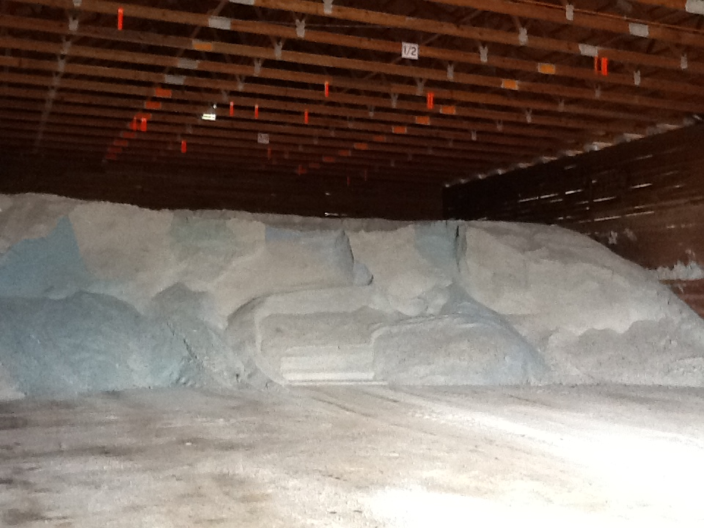
Material Accountability
Know how much you have
Know how much you use
Notes:
It is important to know how much salt you start with, how much you have throughout the season and how much salt you use. Knowing this helps with evaluating salt application efficiency, and for predicting order numbers in the future.

Slide 17
Record Keeping and Quality Control
What’s the big deal? We order material and we get what we ordered.
Test the material
Liquids- test the specific gravity and send in a sample
If you see something wrong or suspicious- tell your supervisor
Get what you order-keep accurate records on quantities ordered and used
Make adjustments
If it isn’t working, try a different application rate, adjust up or down, use the minimum you can get results with
Stay open minded and try new products Communicate and learn from others mistakes, failures, achievements and success’
It is absolutely vital. Every experienced user will inform you just how vital it is. If you do not have a quality control process in place you can receive very different materials. This translates into effective vs. ineffective operations, environmental contamination, handling difficulties, equipment issues, and on and on.
How essential is a quality control program?
Notes:
One of the most important things they can do – and the most often overlooked by new users until they learn their lesson the hard way.
Many factors making it more difficult for them --- not visual like other materials, new to them, do not see the potential downside by not having a good QC program in place.
If specific gravity test doesn’t met the material ordered, we can reject the delivery.
Slide credit: CDOT Snow Removal Operator Training

Slide 18
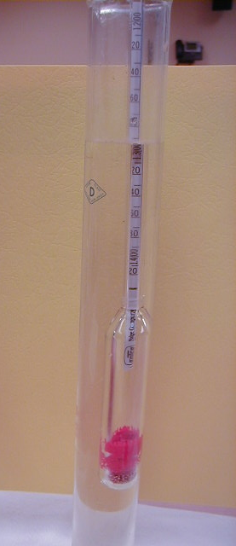
Record keeping and Materials Testing
Liquids: specific gravity (initial test and final test)
Document % and compare to specification
Share information with drivers to use for setting application rates
Insert your state’s policy here
Notes:
If you have a form or policy regarding record keeping for materials testing, include that information here. Possibly take a snapshot of the cover of your document to include here.
There is more about material testing in Module 10 Deicer Management Policy
Picture credit:

Slide 19
Test Question
Is it important to record the concentration of your solution when making brine?
True
False
Notes:
Note to presenters: you may choose to hide this slide.
Test Question: Is it important to record the concentration of your solution when making brine?
a. True (yes)
b. False (no)

Slide 20
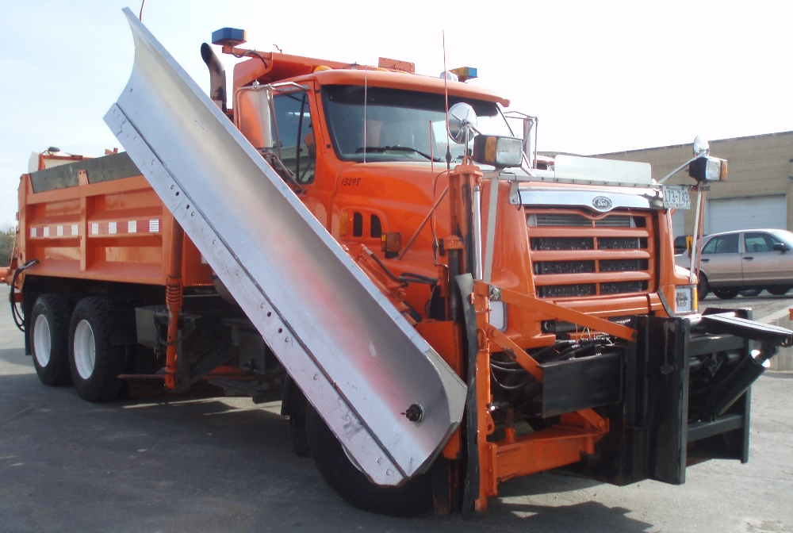
Pre-season Truck Inspections
Example:
Ensure the “attack angle” is set correctly on the plow and wing
Inspect the plows and plow gear for any damage
Ensure bed chains and spinners are operating properly
Insert your pre-season truck inspection method here
Notes:
This slide is probably a mechanic’s task rather than a drivers task. As a manager you should get records of everything that is done.
Before winter trucks must be made winter ready, such as adding plows, tanks, and spray bars. This should all be done and records made before the first event occurs.
Photo credit: Fortin Consulting, Inc.

Slide 21
Records of truck inspections
Insert a copy of your truck inspection check list and procedure
Notes:
Go over the basics of how to fill out the truck inspection sheet. These sheets should be filled out and handed in to the supervisor to keep as a record.
For more about truck inspections see Module 23 Getting Ready for Winter

Slide 22
Records of truck inspections
Insert a copy of your truck inspection check list and procedure
Notes:
Make sure your crew fills out an inspection for each truck and turns it in to you. Keep them in a safe place. If an action is needed based on this inspection, take the appropriate steps to have any needed repairs or equipment purchased in a timely fashion.
For more about truck inspections see Module 23 Getting Ready for Winter

Slide 23
Calibrate and Record
Setting | Output
2 | 153
3 | 224
4 | 327
5 | 394
Notes:
Before the season starts all trucks should be calibrated. If you are using more than one material, each material should be calibrated for. Calibration is an important part of keeping track of materials. It also allows you to better meet your level of service goals as well as estimate how much material is being applied.
Photo credit: Steve Chlebeck

Slide 24
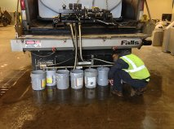
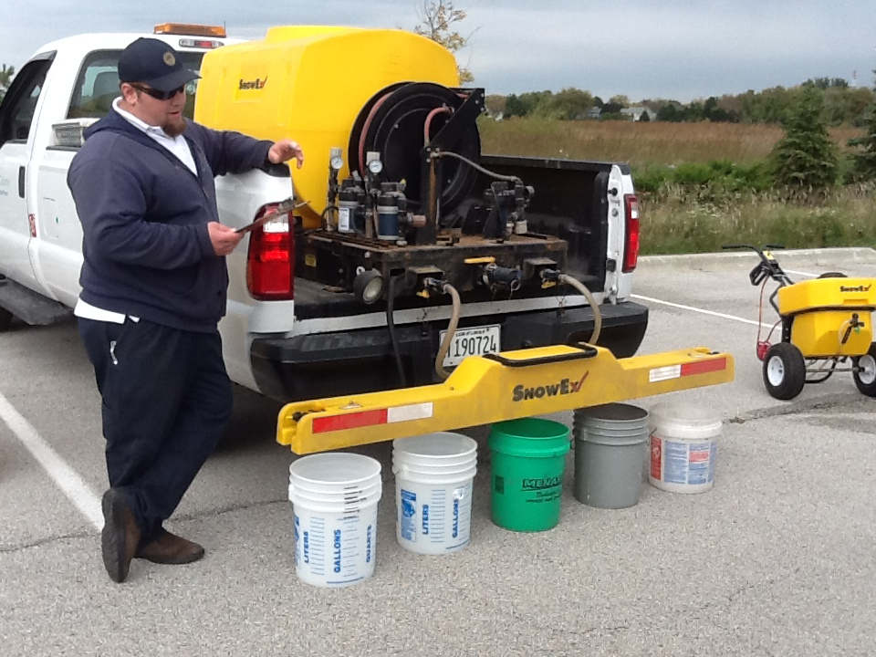
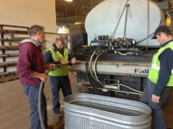
Calibrate and record for liquids too
Notes:
If liquids are used in your operation they should also be calibrated.

Slide 25
Records of truck calibration
Insert a copy of your truck calibration form and any instructions
Notes:
Usually there will be a team of people who will calibrate, not all of the drivers. This slide is so that everyone knows that this is taking place.
Photo credit: MnDOT http://www.dot.state.mn.us/maintenance/pdf/research/SaltSanderCalibrationGuide.pdf

Slide 26
Decision Making Before the Storm
Pre-storm meeting
Insert a list of record keeping needed in your operation to prepare for a storm
Notes:
Talk here about what your pre-storm procedures are and any record keeping that may be needed

Slide 27
Pre-storm Meeting
Make a plan for the storm, for example:
Storm and weather forecast
Staffing
Equipment levels
Insert your pre-storm meeting objectives
Notes:
Take time before the storm to get together to make a plan. You can discuss the forecasted storm, staffing, equipment levels, and expectations for the storm.

Slide 28
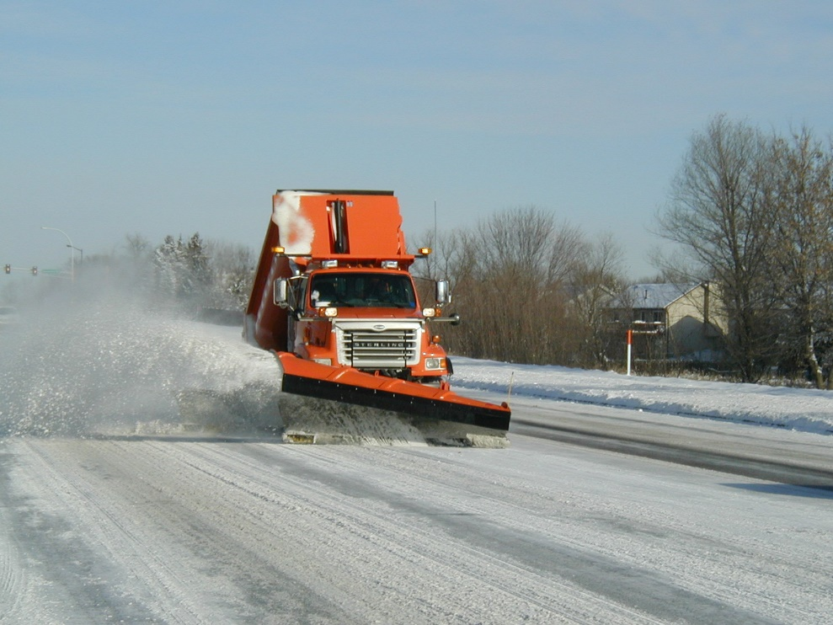
Decision Making During the Storm
Record pre and post trip inspections
Record storm information, pavement temperature
Record material Application
Record fuel Log
Record timecards
Insert a list of record keeping needed in your operation during the storm
Notes:
You should have an example of each of these forms that you use in your operation, the operators should know how to fill them out. Have a plan in place for saving them and how you can go back to access them later.
Photo credit: City of Eagan, MN

Slide 29
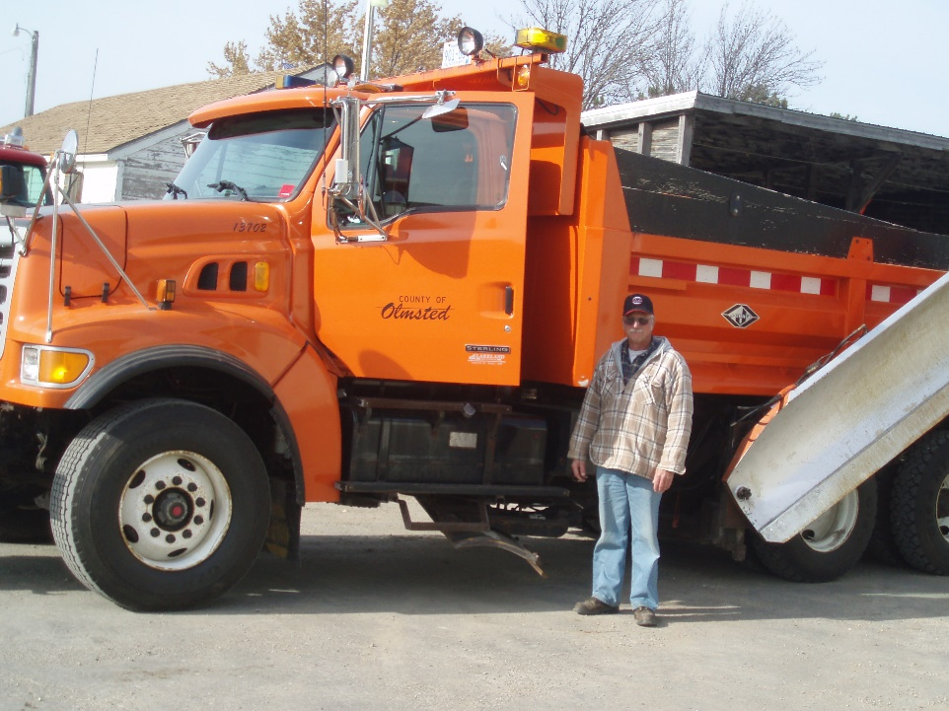
Pre and Post Trip Inspections
Insert a your document for pre and or post trip inspections
Notes:
Talk through the your pre and post trip inspections. Cover what needs to be looked over and common problems that operators may come across.
Photo credit: Olmstead County

Slide 30
During the storm these are the things you must fill out:
Example:
SAP Workorders
Patrol log
Material usage log
Equipment work orders
Fuel logs
Time sheets
Diary
TAPER log
Insert a list of forms needed to be filled out by operators in your organization for a storm
Notes:
Slide credit: CDOT Snow Removal Operator Training

Slide 31
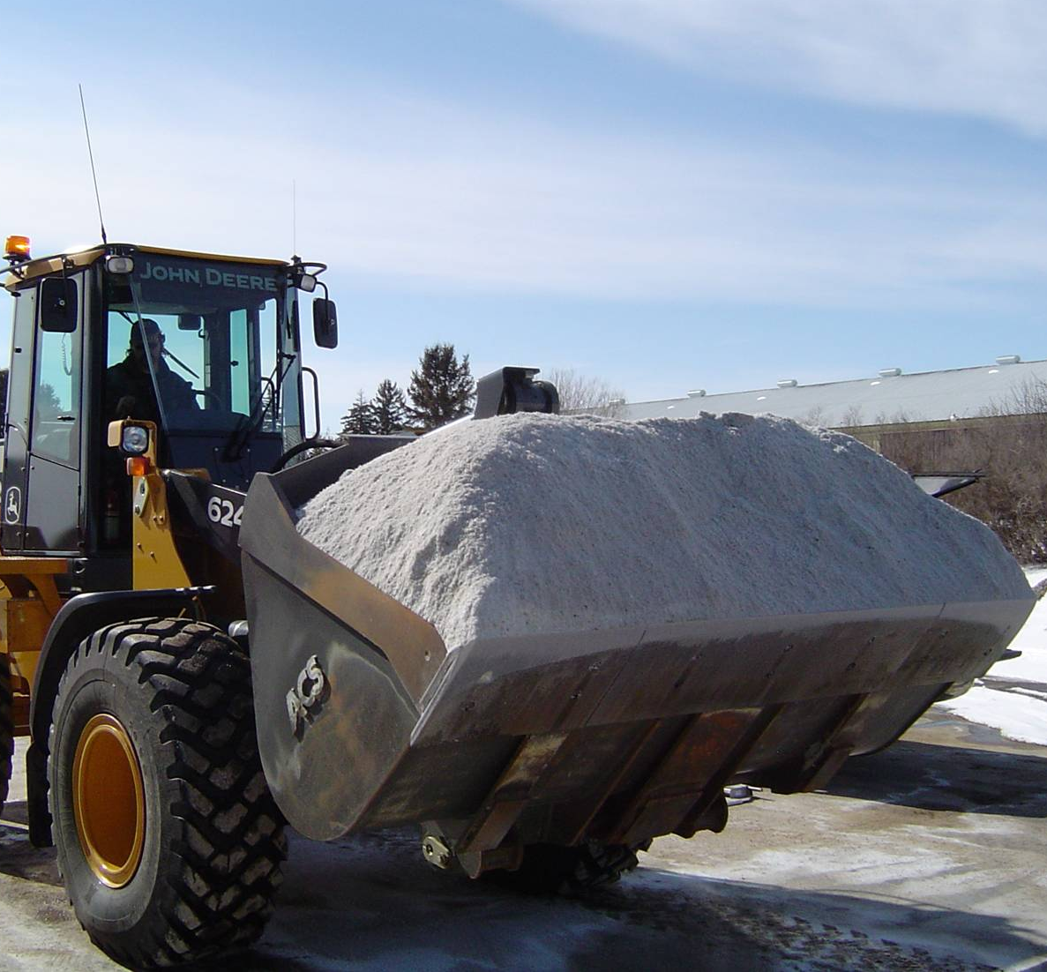
Track by Material Type
Solids
Liquids
Any time you apply material it should be recorded
Notes:
Along with the total amount used it is important to know what materials were used. This can help to predict the amount needed for future seasons as well as help in evaluating how well treatment went for an event.
Photo credits: Fortin Consulting, Inc.

Slide 32
Test Question
Which material should you track?
Salt per storm and per season
Sand per storm and per season
Liquid per storm and per season
All of the above
Notes:
Note to presenters: you may choose to hide this slide.
Test question: Which material should you track?
Salt per storm and per season (no)
Sand per storm and per season (no)
Liquid per storm and per season (no)
All of the above (yes)

Slide 33
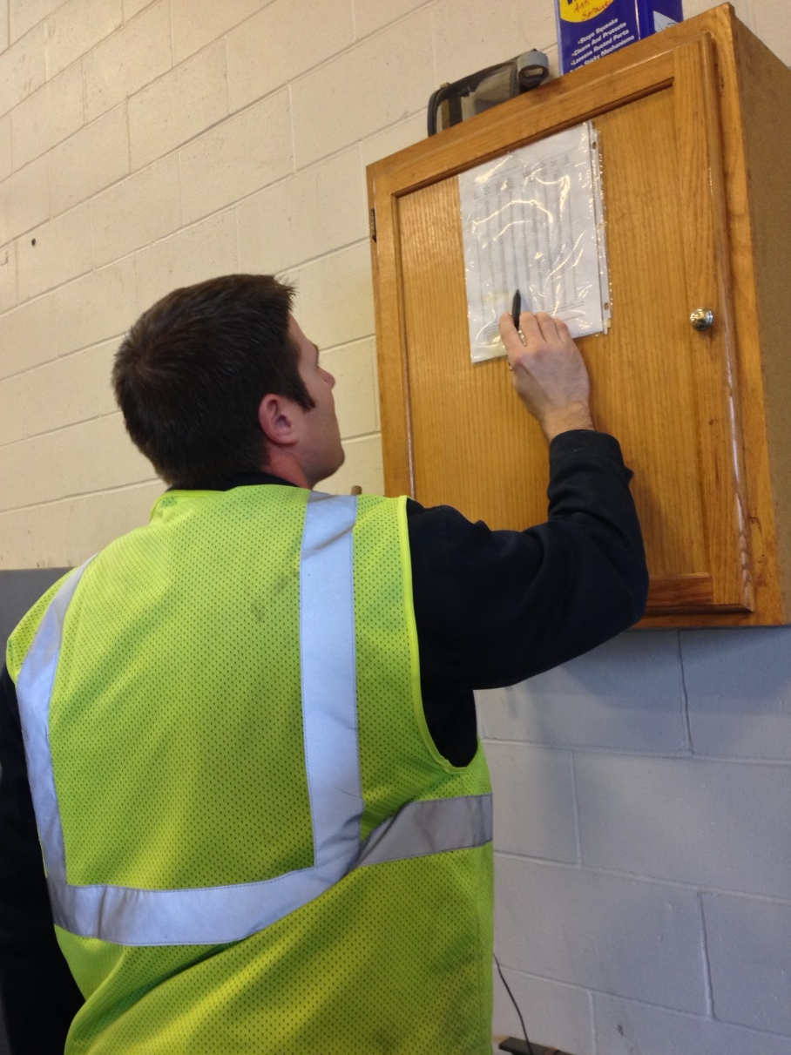
Recording Material Use
Keep track of
Driver use
Individual storms
Different product totals
Winter season total
Leftover to store for next season
Notes:
You should record several different levels of material use, by driver use, for individual storms, the winter season total, and what is leftover to store for the next season.
Having all this information helps in evaluating the efficacy of individual storm treatments went, how the whole winter went, and helps in next seasons ordering. It can also help in proving that policy is being followed if a law suite is brought against you.
Photo credit: Fortin Consulting, Inc.

Slide 34
Document Your Operations
Example:
Conditions- weather and road, pavement temp
Material type and quantity used
Timing
# Passes and when
Unusual conditions/circumstances
Insert an example of your states event log and explain how to fill it out
Notes:
It is very important that plow drivers document the actions taken in response to a snow/ice event
This will include the road conditions throughout their shift, type and amount of deicer/anti-icer used, timing of operations, and the number of passes and when. If there are unusual conditions that affect the operations, those should be recorded. For example, road construction, accidents, major compaction problems, etc.
Photo credit: INDOT

Slide 35
Example: T A P E R
T = Temperature
A = Application
P = Product
E = Event
R = Results
Notes:
Use this slide if your state uses the TAPER system to help explain
Slide credit: CDOT Snow Removal Operator Training

Slide 36
Test Question
What should you record during the storm?
Type of product used
Application rate
Pavement temperature
All of the above
Notes:
Note to presenters: you may choose to hide this slide.
Test question: What do you need to record for the TAPER log?
Product (no)
Results (no)
Temperature (no)
All of the above (yes)

Slide 37
Insert an example of your states event log
Notes:
Go over this sequence of events as illustrated on this report, pay particular attention to the changes that took place in the highlighted entries.
This taper log really paints a good picture of what was done, when it was done, how it was done, who did it with what and what the outcome was like. If you had this information coming on to shift, would you really even need to talk to the person you are relieving?
Slide credit: CDOT Snow Removal Operator Training

Slide 38
A job well done is a job well documented
Filling out paperwork is important because it
Shows that you follow policy
Improves efficiency of operations
Helps with planning
Notes:
Give a pep talk here! Everyone knows that filling out paperwork during or at the end of a long shift can be hard to be motivated to do, but it is very important because it:
Shows that you follow policy
Improves efficiency of operations
Helps with planning

Slide 39
Test Question
When you’ve been working all night and you’re tired do you still have to fill out your paper work?
No
Yes
Notes:
Note to presenters: you may choose to hide this slide.
Test question: When you’ve been working all night and you’re tired do you still have to fill out your paper work?
No (no)
Yes (yes)

Slide 40
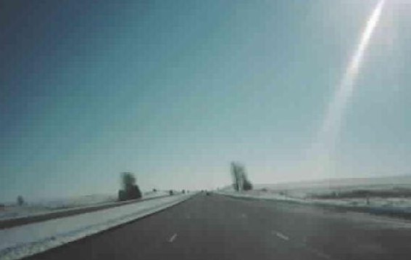
Decision Making After the Storm
Post storm meeting, what worked/didn’t work
Record/verify total material(s) used
Record equipment repairs
Record regain time
Insert a list of record keeping needed in your operation after the storm

Slide 41
Post Storm Meeting
Discuss what went well and what could be improved for the next event
Notes:
You should have a record of what everybody did during the storm with you at the meeting to go over during the meeting, discuss how the storm went, how equipment worked, and any other important topics pertaining to the event.

Slide 42
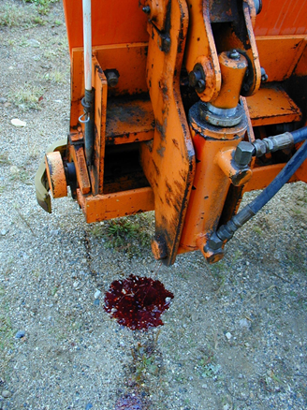
Equipment Maintenance
Notes:
Keeping track of when and what maintenance happens on each piece of equipment is an important piece of record keeping.
This information can help to predict the lifespan of different pieces of equipment and how to budget for new equipment.
It could also help to indicate if someone is being harder on equipment than other operators, for example if one person wears through plow blades more quickly than everyone else, maybe they are placing their blade too low.
Photo credit: MnDOT

Slide 43
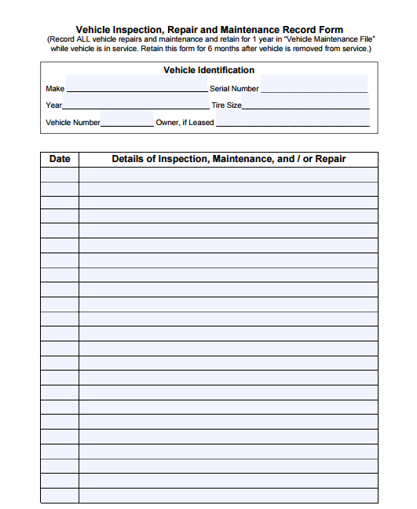
Equipment Repairs
After the storm if you need any repairs submit this form
Insert your equipment repair form
Notes:
If any problems are noted in your post trip inspection be sure to record them and submit the information so that the truck can be repaired in time for the next event.
Go over your equipment repair form and how to fill it out.
Picture credit: Ohio, http://www.puco.ohio.gov/emplibrary/files/Trans/Enforcement/forms/Vehicle%20Inspection,%20Repair%20and%20Maintenance%20Record%20Form.pdf

Slide 44
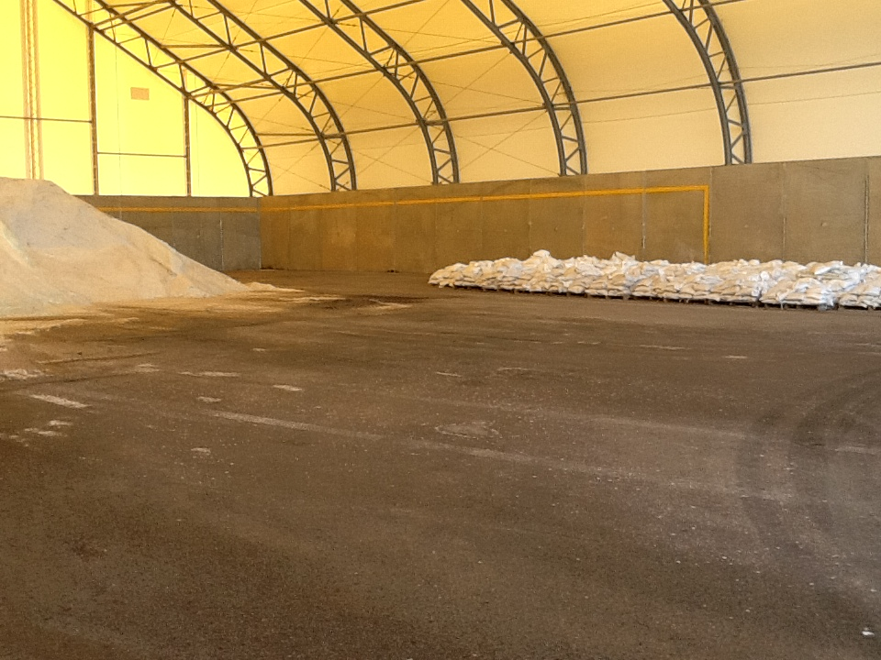
Check Records and Verify Total Materials Used
Notes:
As the winter progresses, reviewing records and verifying how much material has been used can help with planning, seeing if and when you need new shipments of salt, if a driver is over plowing, how well records are being kept.
This can be looked at on a storm to storm basis and up to the current point of the season.
Photo credit: Fortin Consulting, Inc.

Slide 45
Evaluate Your Plowing Strategy
What went well? What can be improved next season?
Notes:
The end of the season is where you can look at your plowing strategy: When do you start plowing? How efficient is it? Where can you make improvements?
Photo credit: Bloomington, MN

Slide 46
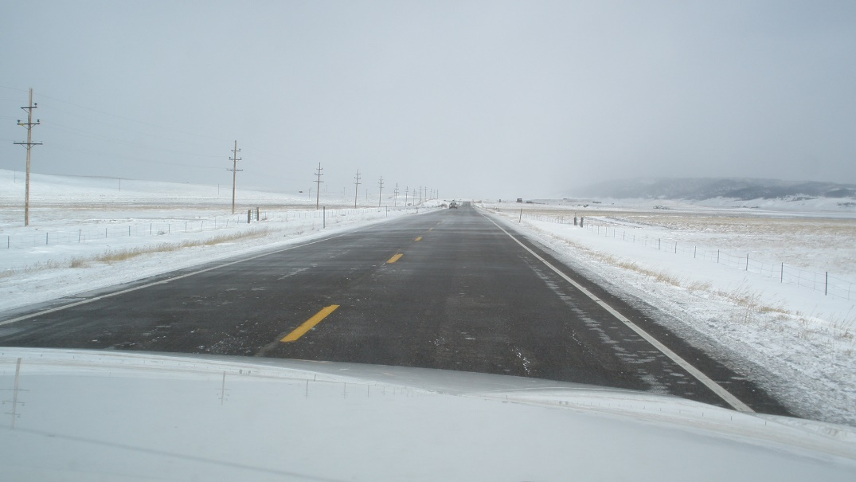
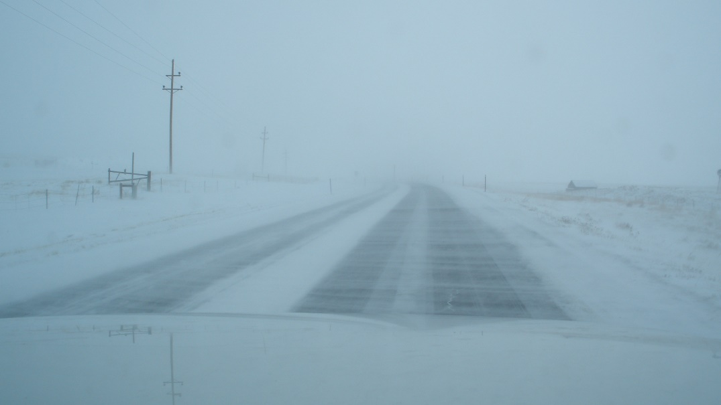
Regain Time
Materials Used + Plowing Strategy = Regain Time
How did you do?
Notes:
Looking at regain time to analyze how well material and plowing strategy was used for efficiency.
How did you do and how can you improve for the next event?

Slide 47
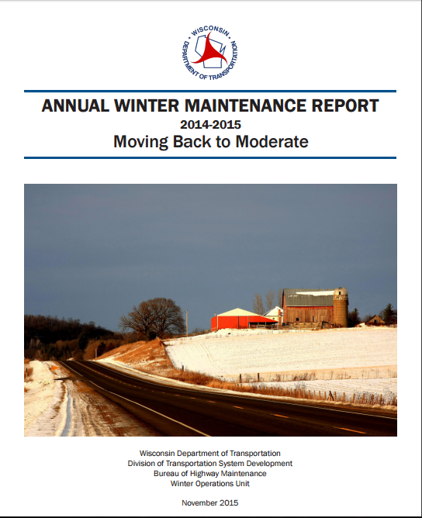
Decision Making After the Season
Look at all records to summarize the season
Insert a list of record keeping needed in your operation after the season
Notes:
Once you have the season summarized you can share a high level summary with your operators, you may release a report to the public. Get everybody on the same page.
Photo credit: Wisconsin DOT

Slide 48
Cost-tracking
At the end of the year look at your costs to see where you can be more efficient
Per storm
Winter season total
Equipment purchases
Material purchases
Labor
Fuel
Maintenance
Notes:
Cost tracking is an important part of keeping things running. Costs per storm, for the entire winter season, equipment purchases, material purchases, labor, and fuel and maintenance all go into overall costs. Part of your job is to keep track and manage these costs.

Slide 49
Planning
Use records of previous years to help predict future needs in materials, equipment, and maintenance.
Notes:
While no season or even event is the same, you can use records of previous years to help predict future needs in materials, equipment, and maintenance.

Slide 50
Record Keeping is Important!
You can’t break any records if you’re not keeping track!
You are an important part of the record keeping puzzle!

Slide 51
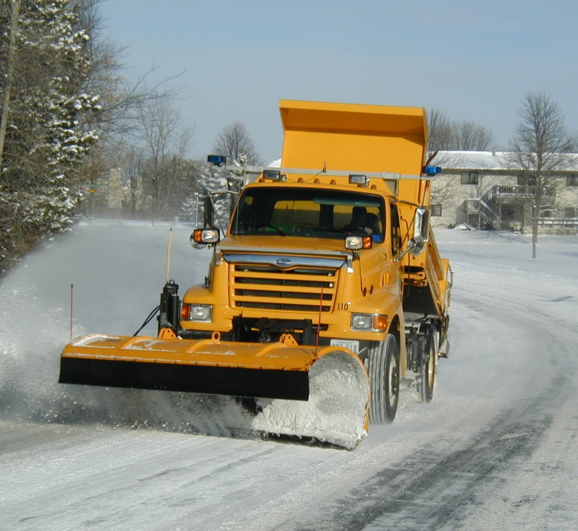
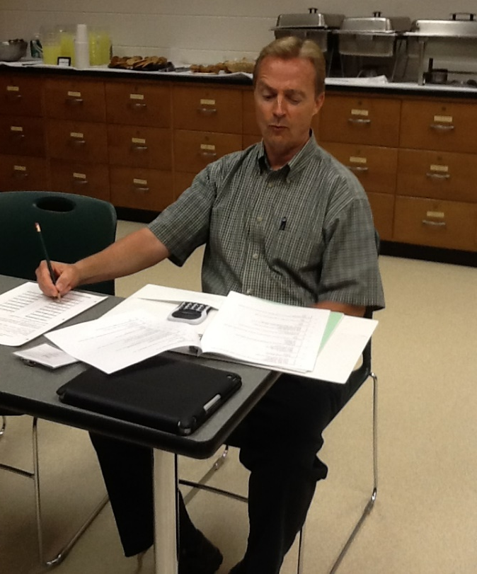
Thank you for your good work!
Notes:
Thank you for your time today. Have a good winter!

Slide 52
Acknowledgements
Training contents were developed by Fortin Consulting Inc., under the direction of the Clear Roads Advisory Team.
Connie Fortin – connie@fortinconsulting.com
Professional formatting and training aids were developed by the University of Minnesota, Center for Transportation Studies.
Jim Grothaus – Groth020@umn.edu
Ann Johnson – Johns421@umn.edu
Members of the Clear Roads Advisory Team include:
Mike Sproul, Dave Wieder, Cliff Spoonemore, Monty Mills, David Frame,
Mike Lashmet, Clay Adams, Justun Juelfs, and Tom Peters

Slide 53
This presentation was developed with funding from the Clear Roads research program, which brings together transportation professionals and researchers from around the country to drive innovation in the field of winter maintenance.
Find additional information and resources at
http://clearroads.org/

Slide 54
Additional resources
AASHTO Computer Based Training
Equipment Maintenance
Clear Roads Training Module 3: Spreaders
Clear Roads Training Module 23: Getting Ready for Winter

