Slide 1
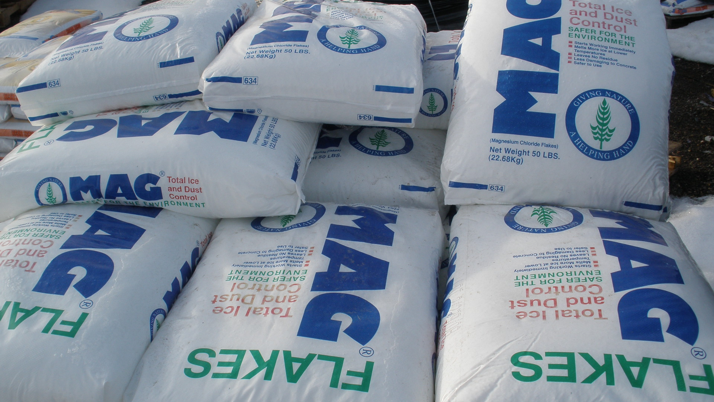

Module 4: MATERIAL USE
2015 Created for Clear Roads by:
U of MN Center for Transportation Studies &
Fortin Consulting Inc.

Slide 2
Training for Winter Maintenance Supervisors and Operators
2015 Created for Clear Roads by:
U of MN Center for Transportation Studies &
Fortin Consulting Inc.

Slide 3

Winter maintenance professionals are a very powerful and important group
Notes:
Note to presenters: These first 7 slides can be used or hidden.
Or, replace with photos of your staff.

Slide 4
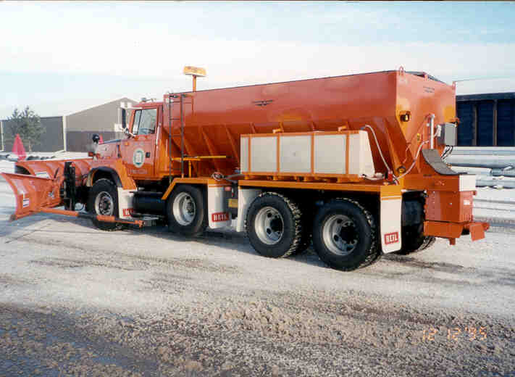
You do a great job of taking care of our roads!

Slide 5

…but we have big challenges as an industry:
Salt is our primary tool for winter maintenance,
as we continue to use salt, it accumulates in our water, and
we don’t have a silver bullet that can replace salt or remove it from the water.

Slide 6
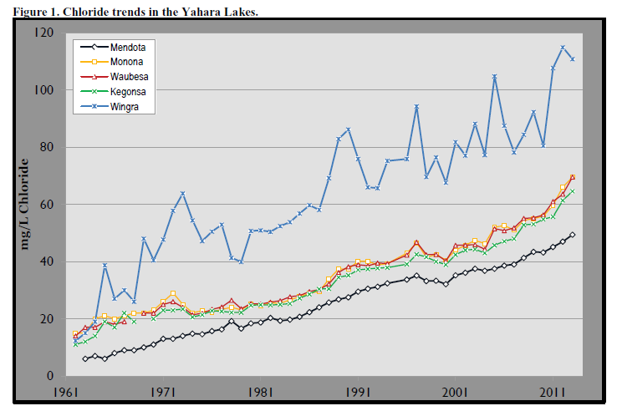
Here’s what’s happening locally:
Chloride levels in Madison lakes
Notes:
Slide credit: http://www.publichealthmdc.com/publications/documents/RoadSaltRpt2013.pdf
Note to presenters: you may insert a slide here with your own chloride use. Or, hide this slide if you don’t have that data.

Slide 7

Here’s what’s happening nationally:
Notes:
7

Slide 8
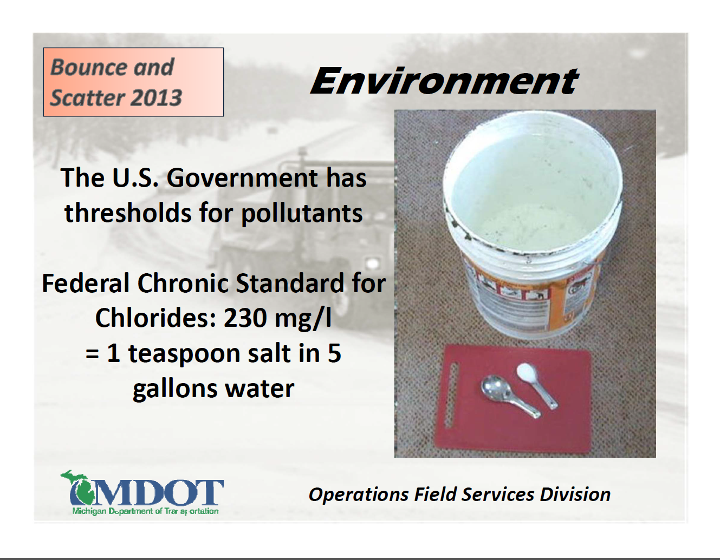

Slide 9
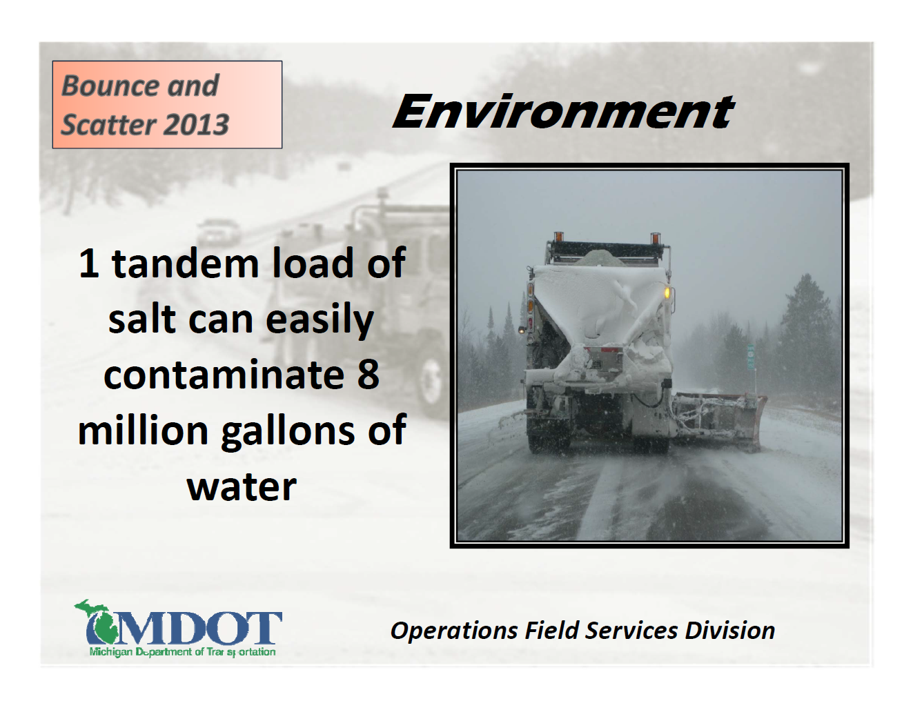

Slide 10
Module 4: MATERIAL USE
2015 Created for Clear Roads by:
U of MN Center for Transportation Studies &
Fortin Consulting Inc.

Slide 11
FACILITATOR NOTES (do not show during class)
Text is provided with each slide for the trainer to review, with the goal of giving the trainer speaking tips for each slide. This slide show can be customized for the audience; suggestions for the different audiences are provided with the legend below.
Slide Legend
Entry-level plow drivers
Experienced plow drivers
Supervisors
Notes:
This slide does not get shown during class. It is only to inform the presenters of the symbology:
This is a priority 1 module to be developed for clear roads national training.
It will address 3 audiences:
Circle symbol = entry level plow drivers
Triangle symbol = experienced plow drivers
Star symbol = supervisors
Some slides without symbols are for everyone
Note: To hide a slide in a power point presentation, select the slide and then select “slide show” tab. Select “hide slide”.

Slide 12
This module contains these topics
How to identify common, cost-effective snow and ice control materials
The use of the right amount of material at the right time
Strategies to minimize material use
Notes:
This module covers common snow and ice control materials, use of right materials at the right time, and strategies to minimize material use.
Note: The topic of bounce and scatter was originally listed to be included in this module but the clear roads advisory team changed that since it was thoroughly covered in the “spreaders” module. A tiny bit of review on bounce and scatter is included in this module but it is no longer listed as an objective for this module.

Slide 13
How to identify common, cost-effective snow and ice control materials

Slide 14
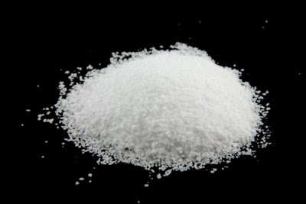

Most common snow and ice control materials for roads
Rock salt
Treated rock salt
Sand
solid
Brine (liquid rock salt)
Magnesium Chloride
Calcium Chloride
Carbohydrates (beet juice)
Potassium acetate
Liquid blends
liquid
Notes:
Sand, Rock salt and treated rock salt are granular products
The rest are liquids. All are available in any form, but the cheapest and most widely used forms for road maintenance are described here.

Slide 15
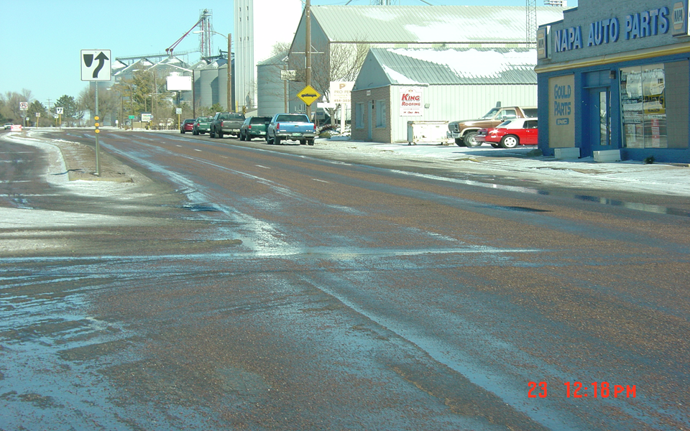
Sand
Does not melt snow and ice
Most useful at super cold temps when de-icers don’t work
Provides short term traction on top of snow or ice
Naturally occurs as a solid
Most effective on low speed, low volume roads
Notes:
Sand was more commonly used years ago to provide traction on top of snow and ice. Today’s drivers have insisted on a higher level of service that includes bare winter roads. In order to get this higher level of service, sand is no longer the tool of choice. Sand is now more commonly used as a supplemental tool. It is applied when conditions are too cold for salt to work, in an ice storm, on steep hills and has a smaller circle of use than salt.
Some organizations that have low volume or low speed roads still use quite a bit of sand. That is fine as long as their customers are fine with the level of service that sand provides.
Photo credit: CDOT

Slide 16
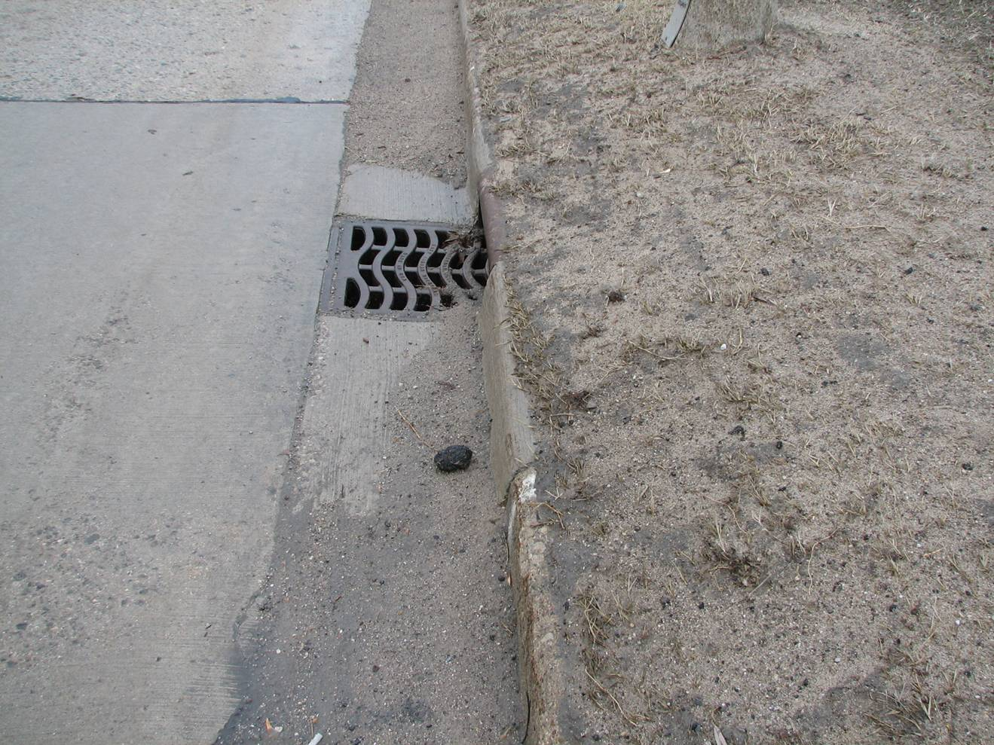
Sand – before cleanup
De-icers - Do the exact same thing, we just cant see it and can never recover them
Notes:
Here is a photo of urban roadway before the spring clean-up
Sand is a mess in the spring requiring a lot of work to sweep and dispose of the sweepings. This is a reason many shops have enjoyed moving away from sand use. However sand does not create more of a “mess” than salt. Salt’s mess is invisible so we don’t see it, but presents a bigger problem, since we don’t have any way to recover salt once it has been applied. Salt is a permanent pollutant in our lakes, rivers and groundwater.
Photo credit: MDOT

Slide 17
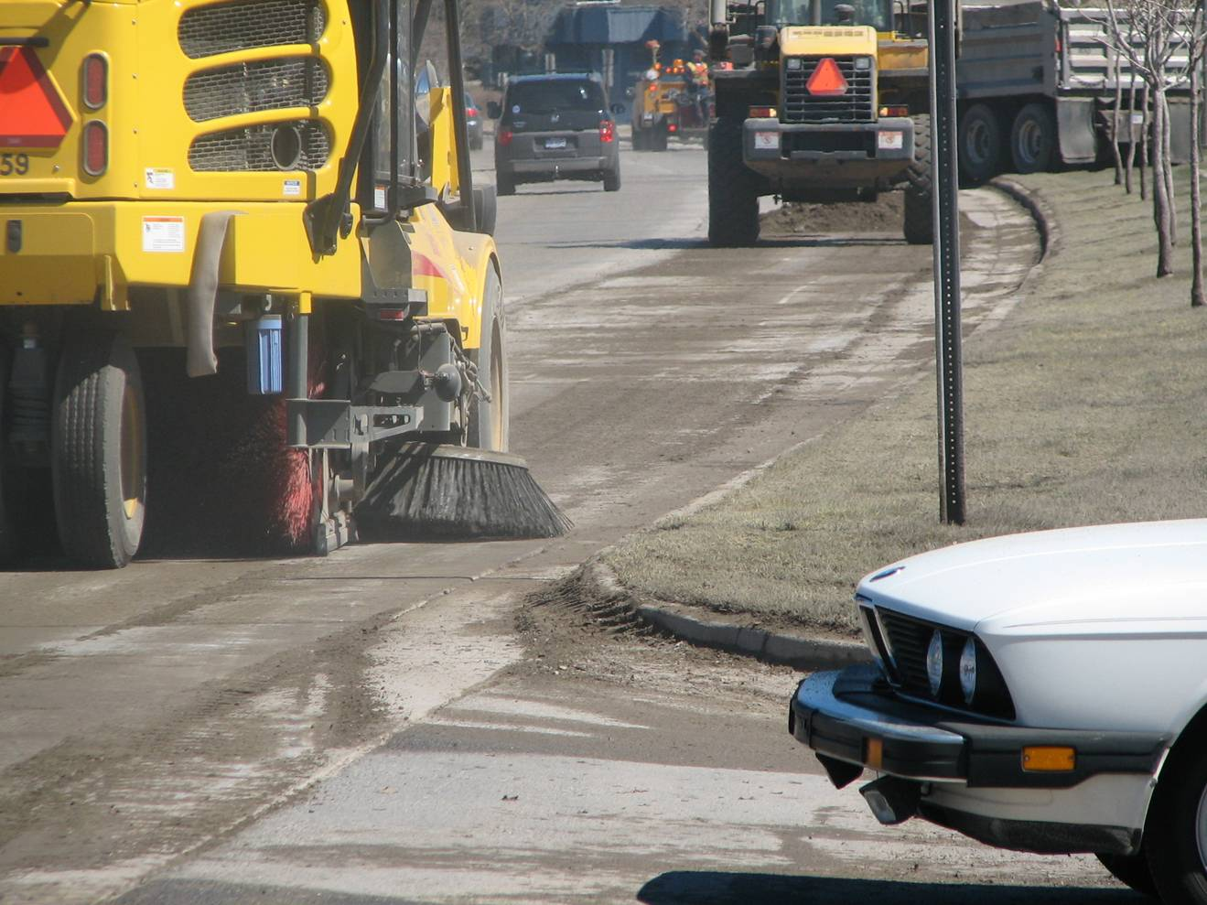
Sand cleanup
Sweep during winter and spring to recover excess sand as soon as snow melts
Notes:
If you use sand, you need to recover it as soon as the snow and ice melts. Implement a year round sweeping program. Colorado is a leading state in this and has aggressive policies on winter sweeping.

Slide 18
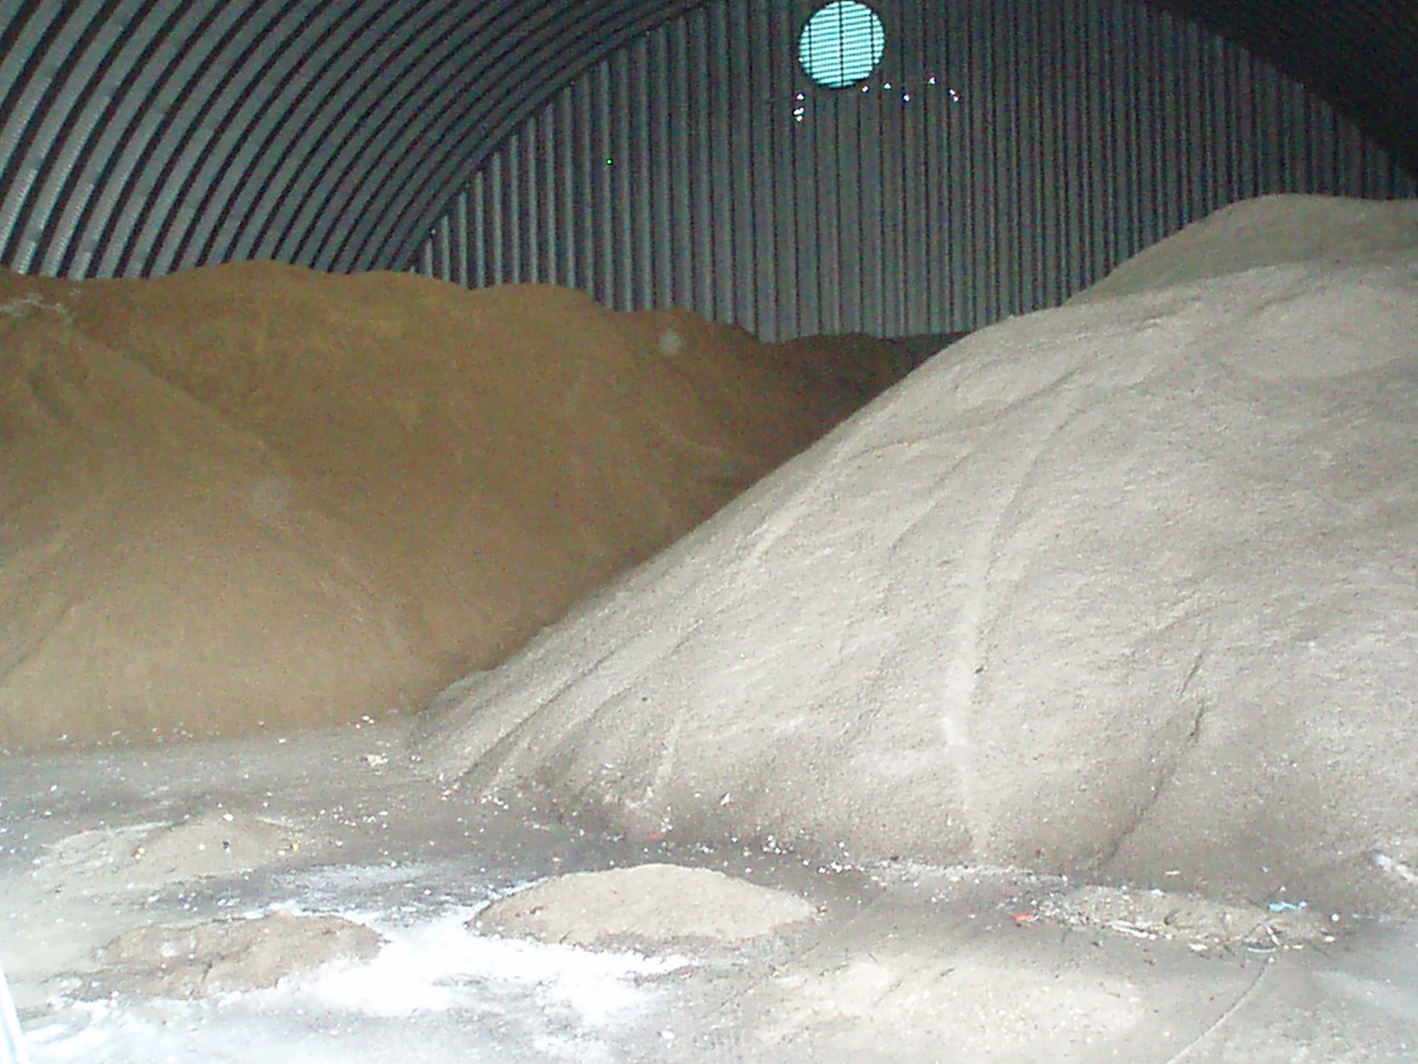
Salt Sand Mix
Not recommended
Keep them separated!
Salt and sand work against each other: salt melts sand into snow and ice, making it useless.
A small amount of salt (5% or less) is needed to keep sand pile from freezing in winter
Notes:
Salt/sand mix is not recommended but is often used in more rural areas. Typically if you calculate how much salt you are applying when you put down a salt sand mix, you are applying enough salt to do the job. Leave the sand at home. One of the barriers to applying straight salt at a low application rate is not just the effectiveness of it, rather the equipment that we are using has been designed and built to deliver high application rates. This is not a justification for using a salt/sand mix. It is a justification for upgrading equipment.
One inexpensive upgrade is to change augers. If you use an auger with a bigger center core and smaller flighting, the truck can still deliver material at a consistent rate but less will be discharged.
Photo credit: Fortin Consulting Inc.

Slide 19
Test Question
Is a salt sand mix recommended:?
Yes
No
Notes:
Note to presenters: you may choose to hide this slide.
Test question:
Is salt sand mix recommended?
Yes ( no)
No (yes)

Slide 20
Test Question
Is a salt sand mix recommended:?
Yes
No
Notes:
Note to presenters: you may choose to hide this slide.
Test question:
Is salt sand mix recommended?
Yes ( no)
No (yes)

Slide 21
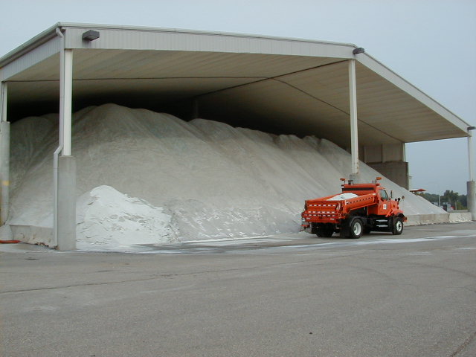
Sodium chloride, Road salt, NaCl, Rock salt
Applying dry salt is not recommended
Least expensive, sold in bulk
Does not attract water from air so it works slower
Most effective at pavement temps > 15º F
No corrosion inhibitor
Naturally occurs as a solid, and does not stay on the road well
Notes:
Rock salt is a great de-icer for warmer pavement temperatures. One the the big problems with it is it does not stay on the road long enough for it to melt snow and ice. Much of it dissolves after it leaves the road wasting our time, money and ruining our natural resources. For this reason applying dry salt is not a recommended practice. Applying rock salt in conjuction with a liquid improves the performance and reduces bounce and scatter. Less material wasted, less problems for the environment.
Photo credit: Fortin Consulting Inc.

Slide 22
Test Question
Is dry salt recommended:?
Yes
No
Notes:
Note to presenters: you may choose to hide this slide.
Test question:
Is dry salt recommended?
Yes ( no)
No (yes)

Slide 23
Test Question
Is dry salt recommended:?
Yes
No
Notes:
Note to presenters: you may choose to hide this slide.
Test question:
Is dry salt recommended?
Yes (no)
No (yes)

Slide 24

Dry salt will get you on the WANTED list! Get off the WANTED list by adding liquids
DO NOT apply dry salt…it is extremely wasteful
Notes:
Poster credit: MDOT
Applying dry salt is wasteful in all of the areas discussed in previous slides. Adding a liquid improves performance and allows us to lower our application rates. The purpose of this section isn’t so much to talk about that but to outline some of the choices in our material selection.
Which material will work the best in a given situation? Many choices exist in the liquid arena. The following slides will cover some of the basic choices.

Slide 25
Test Question
If you add liquids to granular products will you improve performance?
Yes
No
Notes:
Note to presenters: you may choose to hide this slide.
Test question
If you add liquids to granular products will you improve performance?
Yes (yes)
No (no)

Slide 26
Test Question
If you add liquids to granular products will you improve performance?
Yes
No
Notes:
Note to presenters: you may choose to hide this slide.
Test question
If you add liquids to granular products will you improve performance?
Yes (yes)
No (no)

Slide 27
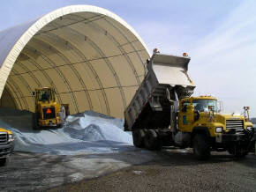
Treated rock salt
Mixed at 4-6 gallons/ton
Need less of this than dry salt
Effective to colder temps than straight salt
Goes to work faster than straight salt
Can leach from pile - store carefully!
This is a good first step into liquids
Notes:
Treated salt is often dyed to make it obvious which pile is treated or untreated. Dry salt is mixed with a liquid at about 4 to 6 gallons per ton. This makes the salt work faster when applied and often allows it to work at slightly colder temperatures. The liquid mixed into the stockpile is generally a hygroscopic product like MgCl2 or CaCl2 or an organic. Salt brine is not recommended to be mixed into the stockpile as it will easily leach or evaporate out.
Treated salts are often an organization’s first step into using liquids since it requires no new equipment for storage or application. The two principles to keep in mind when using a treated salt is to turn down your application rate because you will not need as much. The second principle is to have good storage, as treated stockpiles are more likely to leach than dry stockpiles. Some organizations get around the storage issue by creating their own treated stockpiles on an “as needed” basis just before the storm. If you do this, the ratio of 4-6 gallons per ton is not as critical because you will be using it, not storing it so leaching isn’t a concern.
Photo credit: Penn DOT

Slide 28
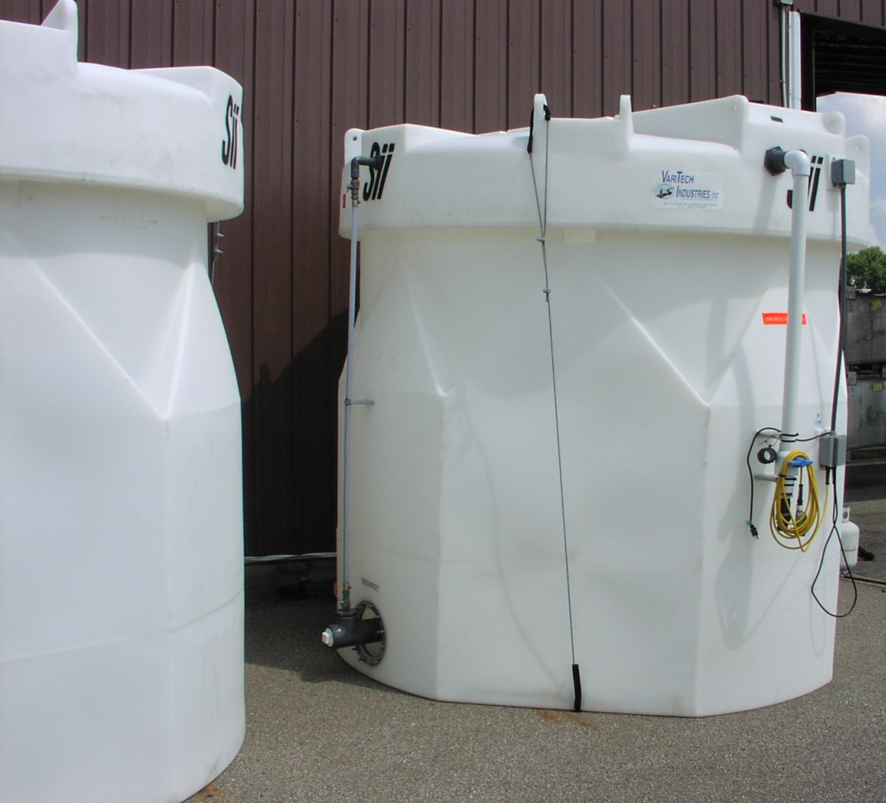
Advantages of liquids
Faster than solids
No bounce
Prevents bonding
Speeds up granular products
Allows us to use less salt
Notes:
Liquids can help reduce wasting de-icing materials. There is a wide variety of de-icers available in liquid formulations. You can buy directly from the manufacture or you can blend them yourself. This market is continually changing as new blends and new additives are being created. If you want to be a pro in snow and ice management, you need to master the art of using liquids.
Photo credit: Fortin Consulting Inc.

Slide 29
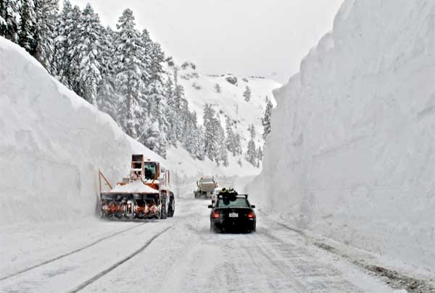
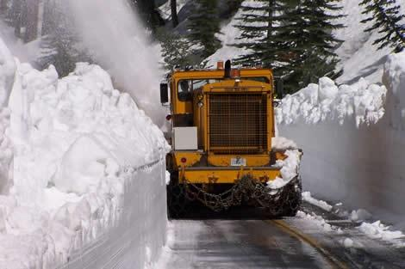
Liquid challenges
Has less melting power
Need new storage and equipment
May need to manufacture it
Have to be good at testing concentrations
Have to understand when and when not to use it
Notes:
The primary challenge with liquid is it doesn’t have much melting power. However we shouldn’t need much melting power if we have been able to prevent bonding. If we need more melting power, granular salt added into the liquid can give us a boost in melting.
Some organizations shy away from using liquids because they need to re-equip and re-train their operations to work with a new product. Granular salt is not very effective but on the other hand it also is very reliable and well understood. The risks in using granular salt lay mostly in cost of wasted material, infrastructure and environmental damages. Those risks have been highly ignored. The risks in using liquids are you can take a dry road and make it icy and that is a danger to the driving public and your reputation.
Overcoming the challenges of liquids is possible and frequently done. Integrating liquids into your operation can bring you much further ahead than if you decide not to face the challenges and shy away from the use of liquids.
Photo credit: Mono County Public Works, California

Slide 30

Salt Math
One gallon of brine requires 2.3 pounds of salt.
For 100 gallons of brine, 230 pounds of salt is needed.
Consider: 100 gallons of brine gives you more options than 230 pounds of salt!
Notes:
Think how many miles of roads you could spread with 100 gallons of brine. Then think about how many miles of roads you could spread with 230 lbs of dry salt. Now think of a road with heavy traffic: the liquid will stay, but the rock salt will blow off the road.
Note to presenters: Discuss with your students this concept of “salt math”. Work with them to visualize this relationship and the advantages liquids can give us.

Slide 31
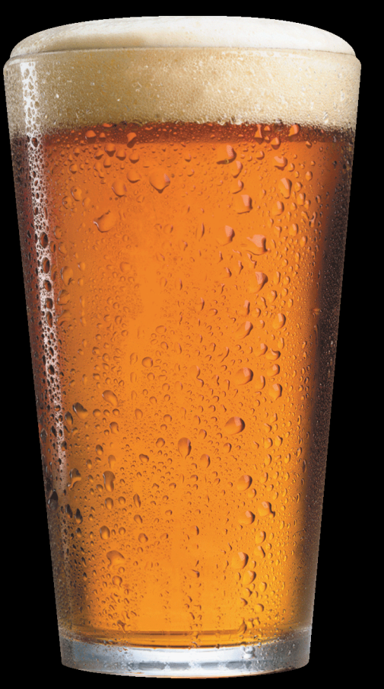
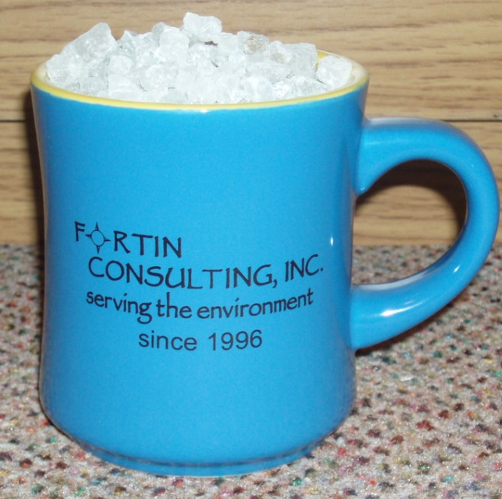
Which do you chose?
In general: Any time you can use a pound of liquid instead of a pound of solid, you protect the environment.
One pound of salt approximately fills this coffee mug
One pound of brine approximately fills this pint glass
Notes:
For every pound of salt you can replace with a pound of liquid you are doing something good for the earth. Liquids aren’t generally measured in pounds, but everyone can visualize what size container a pound a water would fit into.
A pound of salt is about 1 heaping coffee mug. A pound of water is about a pint.
This isn’t always true: you could have a very toxic liquid that would cause more environmental damage than a granular product. But in the winter maintenance world when we focus on salt brine and rock salt, this statement is generally true.

Slide 32
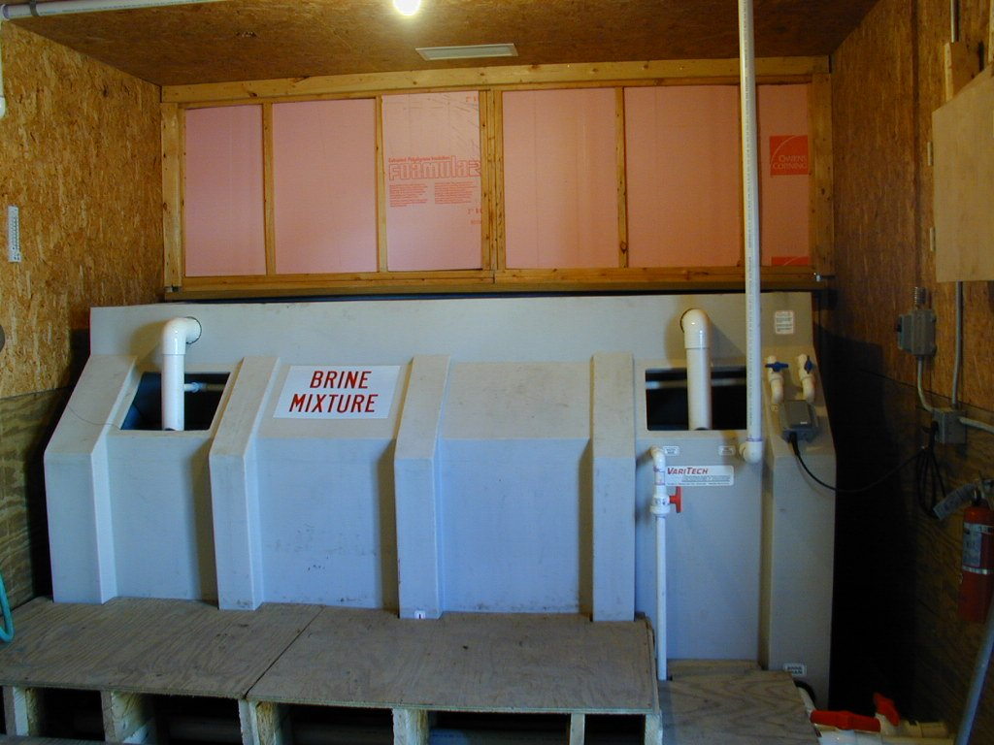
Brine: rock salt + water
Works faster than salt
Is cheaper than salt
Works at same temperature range as salt
23% optimal concentration
Store indoors if you expect colder than -6° F
Creates less environmental damage than rock salt
Notes:
The optimal concentration for brine is 23% if using a hydrometer, and a 85% reading is what you want if you are testing using a salinometer.
The advantages of brine are many. It is the basis for most of the liquids put on the road today. It is relatively inexpensive to make or buy since the ingredients are only rock salt and water.
If you want to try it on a small scale, get a hydrometer, a 5 gallon bucket, 2 to 3 gallons of water and about 5 pounds of rock salt. Put 2 gallons in the bucket and 4 ½ pounds of salt and test it. If it is below 23% add salt, if it is above 23% add water. Keep adding water or salt until your hydrometer reads 23%.
Photo credit: Fortin Consulting Inc.

Slide 33
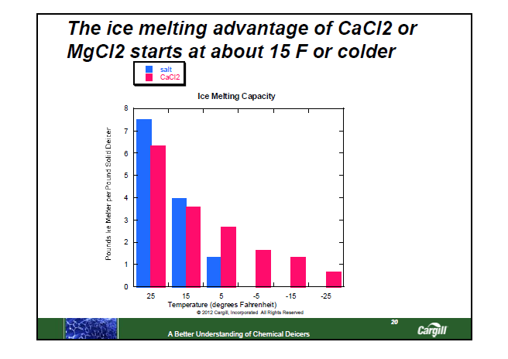
For pavement temps below 15 degrees:
Need something besides rock salt or brine.
What is your plan?
Notes:
When pavement temperatures drop below 15 degrees F, and if we want to melt snow or ice, we need to change our de-icing strategy. The most common change is to incorporate liquids in higher and higher quantities and to change our liquids to MgCl2 or CaCl2.
This chart shows how the ice melt capacity of our most common deicers fades off as the pavements cool. It also shows that MgCl2 or CaCl2 have some ice melt capacity at these colder temperatures.

Slide 34
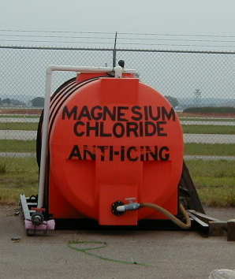
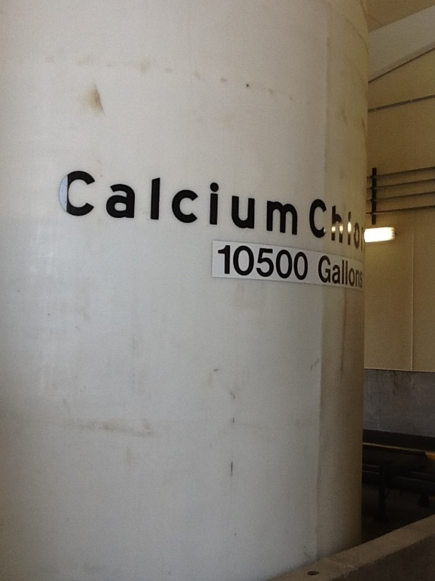

Magnesium Chloride (MgCl2) and Calcium Chloride (CaCl2)
MgCL2 or CaCL2…which is better? That’s like asking, “Coke or Pepsi: which is better? “ Everyone has an opinion, but the truth is they are more alike than different.
Notes:
MgCl2 or CaCl2…which is better? Everyone has an opinion but the truth is, they are more alike than different. The biggest distinguishing factor is that CaCl2 is easier to mix with salt brine. However if you use straight MgCl2 or CaCl2 which is expensive but also powerful in cold temperatures, the differences are probably not big enough to convince anyone to use the more expensive product. And the more expensive product changes depending on where you are located. Shipping costs are the main factor in the cost of these products.
Photo credit: Fortin Consulting Inc.
Note: Coke/Pepsi graphic from Microsoft clipart

Slide 35
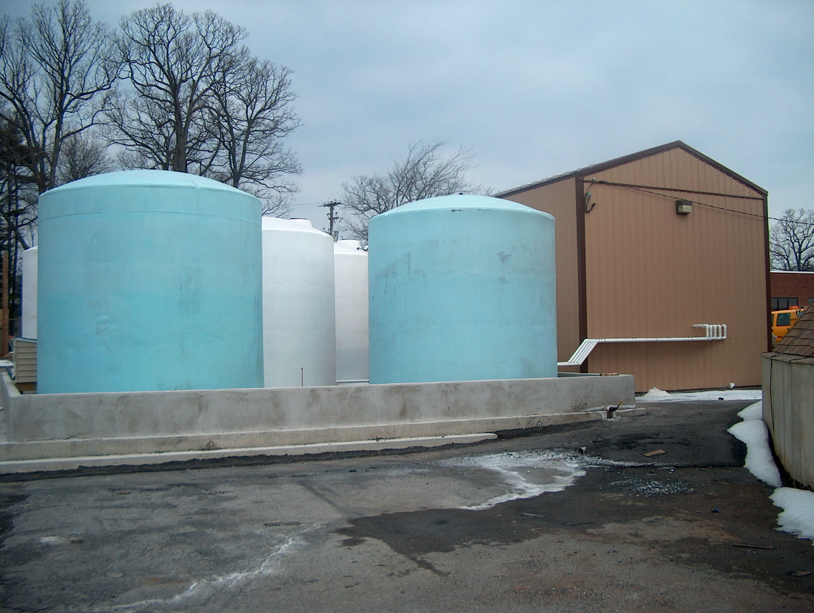
Note to presenter: Use this slide to have a discussion as to why you use one or the other. Or, beforehand, list those reasons on this slide or insert reasons on a new slide to follow.
Magnesium Chloride (MgCl2) and
Calcium Chloride (CaCl2) both:
Work better than rock salt in cold weather
Can become greasy if over-applied or applied in humid or warm conditions
Naturally occur as a brine
Are hygroscopic: attract moisture
Don’t get chalky and flake away
Stay moist and active since it is drawing moisture to the surface
People tend to use the one cheapest in their area
Calcium destroys leather gloves and shoes
For mixing with brine, CaCL2 shows less problems
Notes:
Note to presenters: Use this slide to have a discussion as to why you use one or the other. Or, beforehand, list those reasons on this slide or insert reasons on a new slide to follow.
Both MgCl2 and CaCl2 are commonly used for dust control on gravel roads. They bring the moisture from the air to the road surface. The road looks damp. This is also how they work in the winter. Be aware that the concentration of MgCl2 or CaCl2 is different for dust control than for de-icing so don’t be tempted to use one formulation for winter and summer.
You can buy both products in solid forms but that is much more expensive since they both are naturally occurring brines.
Photo credit: Penn DOT

Slide 36
Test Question
Do magnesium and calcium chloride bring moisture from the air to the pavement surface?
Yes
No
Notes:
Note to presenters: you may choose to hide this slide.
Test question:
Do magnesium and calcium chloride bring moisture from the air to the pavement surface?
Yes (yes)
No (no)

Slide 37
Test Question
Do magnesium and calcium chloride bring moisture from the air to the pavement surface?
Yes
No
Notes:
Note to presenters: you may choose to hide this slide.
Test question:
Do magnesium and calcium chloride bring moisture from the air to the pavement surface?
Yes (yes)
No (no)

Slide 38
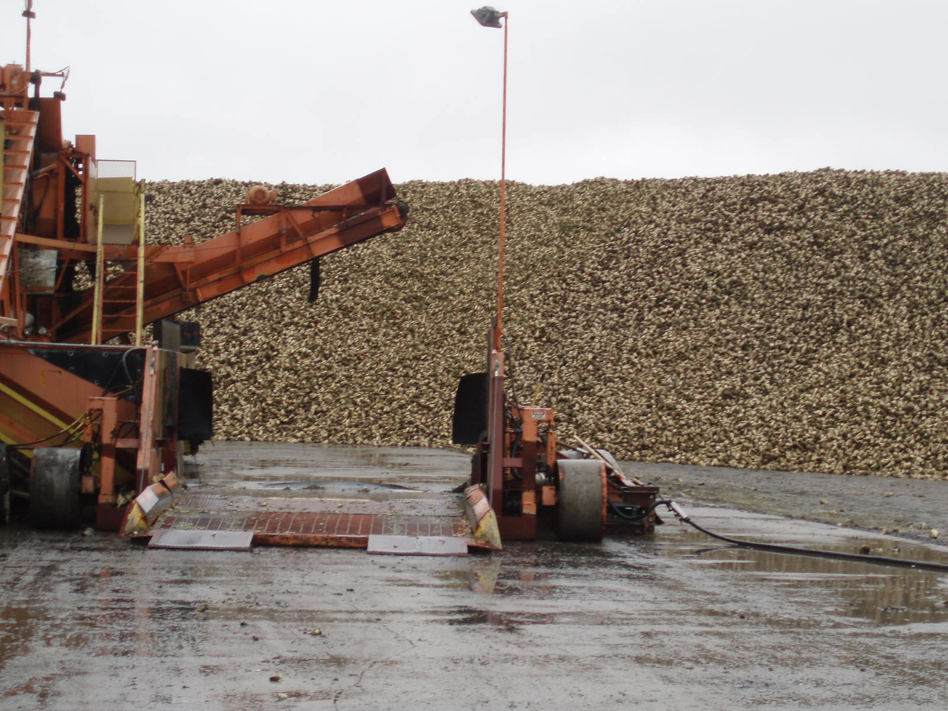
Organic additives
Beet juice, corn syrup,
molasses, etc.
Notes:
Sugars or carbohydrates are often an additive to liquid deicers. They come in a variety of “flavors” but for the most part they do the same thing. The picture above is sugar beets.
Photo credit: Fortin Consulting Inc.

Slide 39
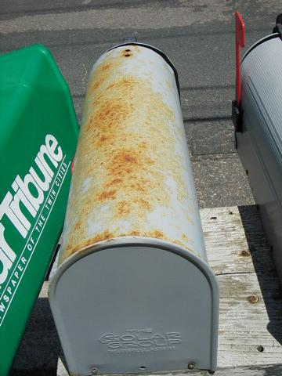
What do they bring to the game?
Good:
Reduce corrosion
Decrease eutectic temps
Interesting:
Is sticky
Can be mixed into stockpile or brine
Expands in storage tanks when gets hot in summer
Bad:
Does not melt snow and ice
Notes:
39
Organic additives are confusing to the industry. Some love them, some hate them, and many are on the fence. This is true for the chemists, sales people and winter maintenance professionals. Opinions are wide ranging. Because of this, it is wise for the user to test it themselves and see how it performs. If it can reduce your overall salt use then it is a good tool for you.
Photo credit: Fortin Consulting Inc.

Slide 40
Eutectic freeze point lowers with organics
Ability to melt ice lowers with organics
Notes:
Note to presenters: You may want to hide this slide, and only use it if questions arise about the ability of organics/sugars to melt ice.
The first graph shows 2 deicers and how their freeze point changes as we add organics to it. The more the organic, the lower temps it freezes. That might be an advantage for us looking to store liquids in cold temperatures. But the second chart shows the same two compounds. And, as we add more and more organics we lose more of our ability to melt ice. And in fact our highest ability to melt ice is before we add any organic to the de-icer.
This represents laboratory testing results. We shouldn’t discount field testing. Those that use organic additives love them or hate them. Our goal is to get people to use products in the lowest volume. For those that have been able to use organic additives and reduce their application rates that is a bonus. It may be that what the scientists can capture in the lab doesn’t tell the whole story of how organics can be helpful to the industry. There is a lot of discussion and opinions on both sides of the organics issue.
Slide credit: Cargill Deicing Technology

Slide 41
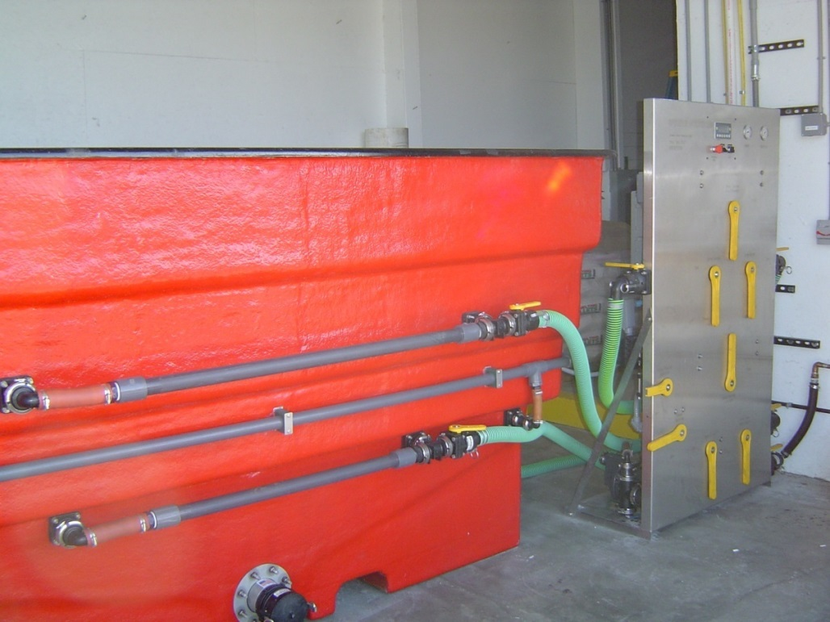
Blends
Many exist; the most common is a mix of brine and calcium chloride with or without an organic compound.
Each mix will have its own practical and eutectic characteristics.
If you blend it, then you are responsible for the QA of the product, and for gaining a better understanding of its eutectic and practical melting points.
Notes:
Creating blends is serious business. If you are doing this you need to be accurate in your procedures, testing, and recording. Quality assurance should be top priority. If you are not up to this it is better for you to buy your liquids and let someone else worry about that. If you buy your liquids you should still know the target density of your product and test each load to make sure to matches the target density.
Photo credit: Fortin Consulting Inc.

Slide 42
Chloride vs non-chloride deicers
Chlorides are generally:
Less expensive
Very available
More corrosive
Permanent pollutant in water
Other deicers are generally:
  More expensive
  Less available in large quantities
  Less corrosive
  Short term pollutant in water
Notes:
This presentation provides very high level and over simplified comments. Any de-icer could have a variety of properties and each should be understood thoroughly before it is used. The use of “short term” is interesting. Most of the non-chloride de-icers do biodegrade so given the right conditions they will break down. Now there is also the category of additives that can have long or short term toxicity depending on what they are. This isn’t discussed in this slide.

Slide 43
Test Question
Are chloride-based de-icers a permanent pollutant in our lakes, rivers and groundwater?
Yes
No
Notes:
Note to presenters: you may choose to hide this slide.
Test question:
Are chloride based deicers a permanent pollutant in our lakes, rivers and groundwater?
Yes (yes)
No (no)

Slide 44
Test Question
Are chloride-based de-icers a permanent pollutant in our lakes, rivers and groundwater?
Yes
No
Notes:
Note to presenters: you may choose to hide this slide.
Test question:
Are chloride based deicers a permanent pollutant in our lakes, rivers and groundwater?
Yes (yes)
No (no)

Slide 45
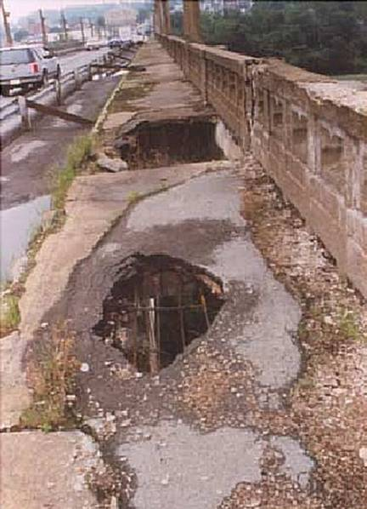
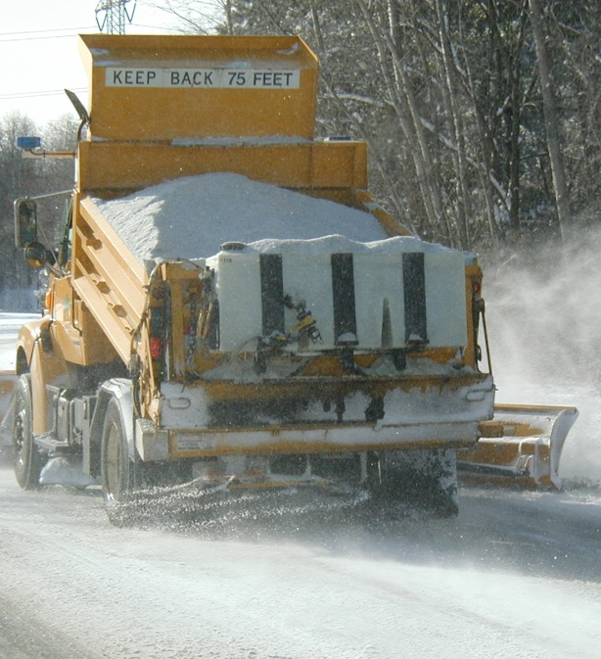
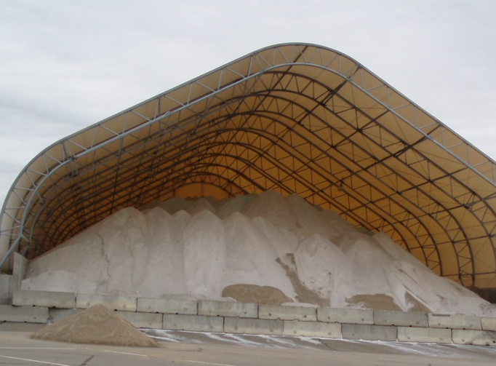
Cost-effective snow and ice control materials
Let’s look at the life cycle costs:
    #1. The cost to buy it
    #2. The cost to apply it
    #3. The long term cost to fix the problems it creates
#3
#1
#2
Notes:
Slide credit: The Real Cost of Salt Use for Winter Maintenance
http://www.pca.state.mn.us/index.php/view-document.html?gid=21766
Photo credit: Fortin Consulting Inc.

Slide 46
Damage costs per ton of salt used
 | Cost per ton (low) | Cost per ton (high)
Damage to infrastructure | $600 | $1,460
Vehicle corrosion | $30 | $113
Damage to trees | $75 | $110
Ecosystem damage | $172 | $227
Overall Damage | $803 | $3,341
For every ton of salt applied,
set aside $800 for damages
Stefan et al, 2008; TRB 1991; Sohanghpurwala, 2008; Murray and Ernst, 1976; Murray and Brenner, 1977; Adirondack Council, 2009; Vitaliano, 1992; Kelting and Laxson, 2010
Notes:
Slide credit: The Real Cost of Salt Use for Winter Maintenance
http://www.pca.state.mn.us/index.php/view-document.html?gid=21766
The slide reflects the low end estimate and the high end estimate for what it would cost if we fixed some of the problems salt creates. The most conservative estimate is that for every 1 ton of salt applied to the roads we should put $800 into our banking account so we can fix the problems it causes. The $800 estimate includes damage to infrastructure, vehicles, and vegetation. The higher $3300 figure includes estimates of damage to water supplies and potential impacts on human health. Some of the costs for repairing damage not included in either estimate is replacing sod, replacing indoor flooring, altered lake mixing, and impacts to ​aquatic life, wildlife, and soil.​

Slide 47
Test Question
What is the minimum cost for the damages that one ton of salt will cost?
$8
$80
$800
It does not cause damage
Notes:
Note to presenters: you may choose to hide this slide.
Test question:
What is the minimum cost for the damages that one ton of salt will cause?
8 dollars(no)
80 dollars(no)
800 dollars (yes)
It does not cause damages (no)

Slide 48
Test Question
What is the minimum cost for the damages that one ton of salt will cost?
$8
$80
$800
It does not cause damage
Notes:
Note to presenters: you may choose to hide this slide.
Test question:
What is the minimum cost for the damages that one ton of salt will cause?
8 dollars(no)
80 dollars(no)
800 dollars (yes)
It does not cause damages (no)

Slide 49
Potential savings with salt reductions
Total
Damages
Salt and application
Source: “The Real Cost of Road Salt Use for Winter Maintenance in the Twin Cities Metropolitan Area of Minnesota” Prepared for the Minnesota Pollution Control Agency by Fortin Consulting, Inc. August 2014.
* TCMA baseline salt use is approximately 349 thousand tons/yr (Sander 2007).
** Estimated based on $73/ton material cost (Schaefer 2012, Mn/DOT ca 2012, U.S. Salt 2012), and $150/ton labor and equipment cost (Stefan et. al 2008).
† TCMA estimated baseline combined cost is $358 million/yr on low overall damages basis and $1,243 million/yr on high overall damages basis
Notes:
Slide credit: The Real Cost of Salt Use for Winter Maintenance
http://www.pca.state.mn.us/index.php/view-document.html?gid=21766
The 7 county Twin Cities Metro area has been studied to understand its salt use. If you look at the bottom line, it is the cost to purchase and apply salt, the middle line is the damages caused by applying salt, the top line is a combination of the cost to purchase, apply and fix the problems salt causes. This is all based on the lowest projection of the true cost of salt use as shown in the previous slide.

Slide 50
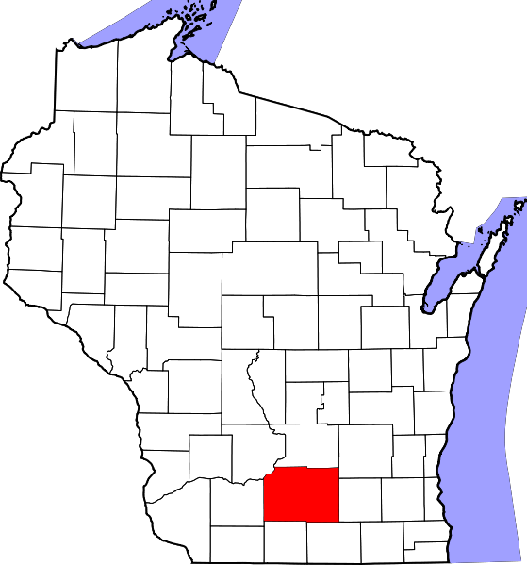
Salt savings
Note to instructors: To calculate your savings for your state or truck station: take salt use per year in tons and multiply by $800. Then multiply by 20%. That is roughly how much you would save in not having to fix problems if you dropped your salt use by 20%
Dane County could save roughly $6.6 million in damages in one year if they reduced salt use by 20%
Map from: malefi.org
Notes:
Note to instructors: To calculate your savings for your state or truck station: take salt use per year in tons and multiply by $800. Then multiply by 20%. That is roughly how much you would save in not having to fix problems if you dropped your salt use by 20%

Slide 51
Use of right materials at the right time

Slide 52

Use of right materials at the right time
Will:
Save us $
Reduce waste
Reduce water pollution
Notes:
The very basic principle that one material cannot meet all of our needs is so true. If we look at the science, it will guide us on a good path. The practical melting range of the de-icers, the pavement temperature and trend, the application rate are all variables to consider before determining what to use, when to use it and at what application rate.

Slide 53
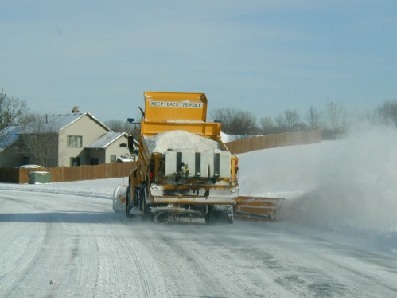
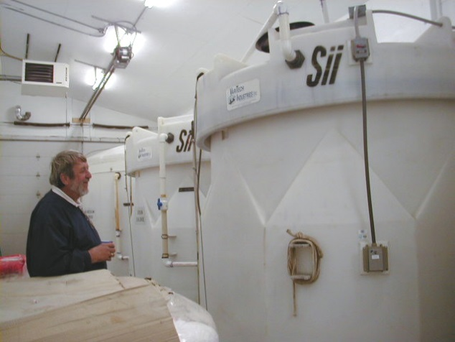
Practical temperature is more valuable than eutectic temperature to help you make decisions on road applications.
Eutectic temperature is valuable for understanding when the liquid will freeze in your tanks
Indoor or outdoor storage?
Notes:
Pay attention to the practical temperature for applying material to roads. Pay attention to eutectic temperature when figuring out if you need indoor or outdoor storage
Photo credit: City of Eagan, MN

Slide 54
Know the lowest practical melting
temperature for each material
Chemical | Lowest Practical Melting Temp. | Eutectic Temp. | Optimal Concentration
Sodium Chloride | 15º F | -6º F | 23%
MgCl₂ Magnesium Chloride | -10º F | -28º F | 27 to 30%
CaCl₂ (Calcium Chloride) | -20º F | -60º F | 30%
CMA (Calcium Magnesium Acetate) | 20º F | -18º F | 32%
KAc (Potassium Acetate) | -15º F | -76º F | 50%
Blends | Talk to supplier | Talk to supplier | Talk to supplier
Winter Sand/Abrasives | Never melts -- traction only | Never melts -- traction only
Notes:
Slide credit: MN snow and ice control field handbook for snowplow operators
Note: don’t use your de-icers on pavement temperatures outside of their practical melting range. They will work too slowly and likely be blown off of the road before they have a chance to do anything.

Slide 55
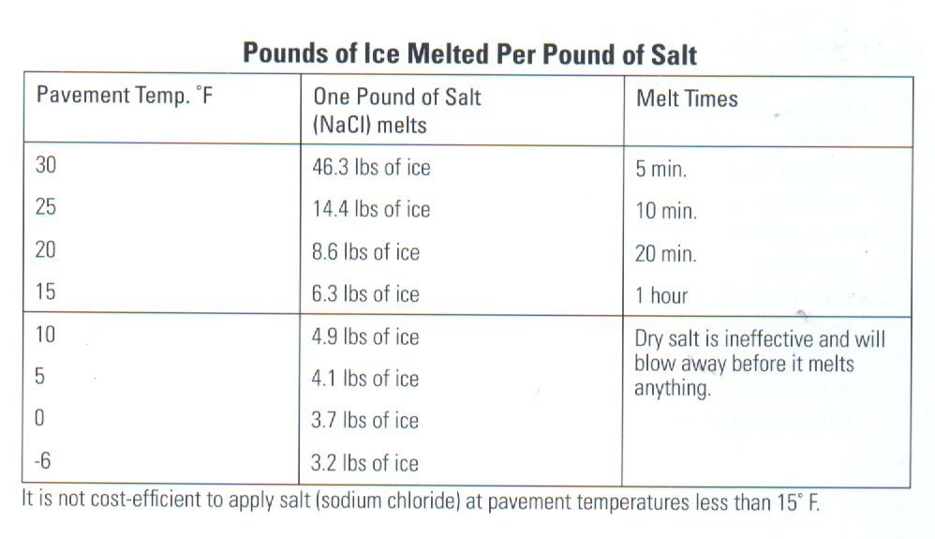
Salt is not effective at pavement temperatures below 15 degrees
At 15 degrees, it must stay on the road for over
one hour for it to work.
Notes:
Slide credit: MN snow and ice control field handbook for snowplow operators
Look at the speed of melting and consider your roads and the traffic on them when you are applying salt. You have a good feel for how long the salt will stay on the road before traffic blows it off. If the chart tells you it takes 20 minutes for salt to work at a 20 degree pavement temp and you know that traffic at 8 am will blow it off in 3 minutes, change your approach. Use a different product!

Slide 56
Test Question
What is a good strategy to minimize salt use?
Use liquids
Use MgCl2 or CaCl2 on colder days
Do not apply de-icers if it is too cold for them to work
All of the above
Notes:
Note to presenters: you may choose to hide this slide.
Test question:
What is a good strategy to minimize salt use?
Use liquids (no)
Use mag or calcium chloride on colder days(no)
Do not apply de-icers if it is too cold for them to work(no)
All of the above(yes)

Slide 57
Test Question
What is a good strategy to minimize salt use?
Use liquids
Use MgCl2 or CaCl2 on colder days
Do not apply de-icers if it is too cold for them to work
All of the above
Notes:
Note to presenters: you may choose to hide this slide.
Test question:
What is a good strategy to minimize salt use?
Use liquids (no)
Use mag or calcium chloride on colder days(no)
Do not apply de-icers if it is too cold for them to work(no)
All of the above(yes)

Slide 58
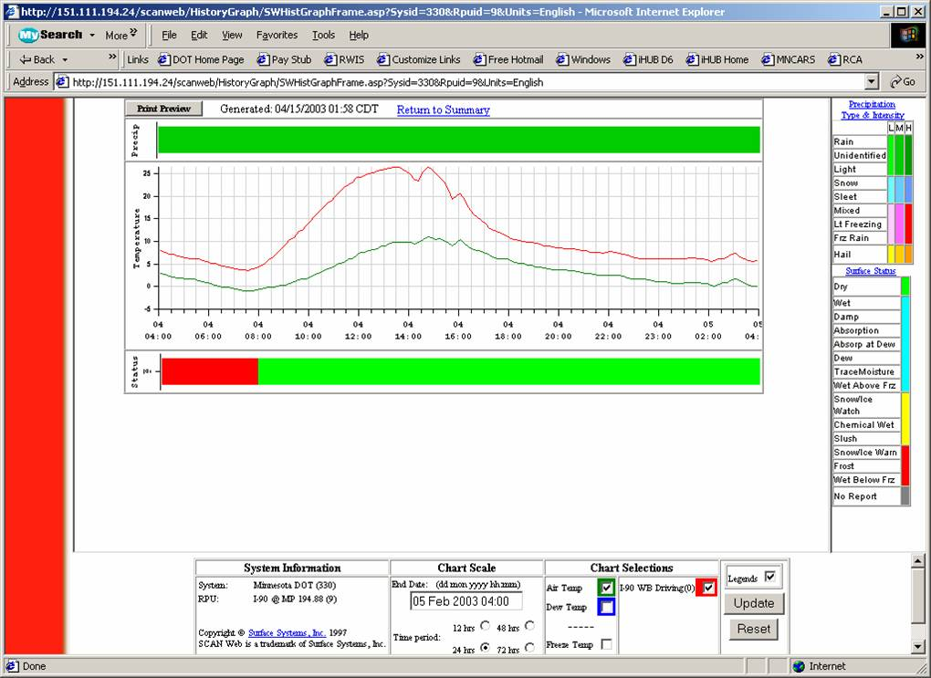
On this day we could use salt between 10 am & 2 pm and it would work. At other times dry salt would not work fast enough; it would be lost to the shoulder before it could work.
Notes:
The red line is pavement temperature, the green is air temperature. If we follow our own advice and not apply salt at pavement temperatures below 15 degrees, then we can see on this day that the time when our salt would work best is between 10 and 2. At other times the temperature is colder than 15 degrees and a different approach to de-icing is needed.
Slide credit: This picture is taken from MN RWIS.

Slide 59
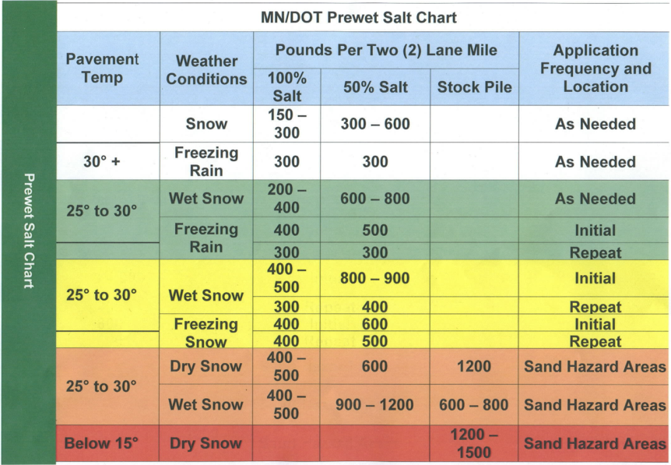
Use an application rate chart
It should be based on all available information such as:
Pavement temperature
Types of materials available to apply
Temperature trend
Type of precipitation
Notes:
If we standardize our practices by using a chart and if we pay attention to our results, we can continue to optimize it. Eventually the chart should provide the lowest application rates necessary given each set of conditions (i.e. pavement temp, chemical selected). Note that application rate charts are not really designed for melting compaction. If you are dealing with compaction, you have already lost the game and efficient practices will not longer work. Do not set up your application rate chart for these conditions.
For a good example of an application rate chart with lower values, see the Minnesota snow and ice control field handbook for snowplow operators.

Slide 60
Deicing Application Rate Guidelines 24’ of pavement (typical two-lane road)
These guidelines are a starting point Reduce or increase rates incrementally based on your experience.
Pavement Temp. (ºF) and Trend (↑↓) | Weather Condition | Maintenance Actions | Lbs/two-lane mile
 |  |  | Salt Prewetted/ Pretreated With Salt Brine | Salt Prewetted/ Pretreated With Other Blends | Dry Salt | Winter Sand (abrasives)
25-30°↓ | Snow | Plow, apply chemicals | 120-160 | 100-140 | 150-200 | not recommended
 | Frz. Rain | Apply chemical | 160-240 | 140-210 | 200-300 | 400
20-25º ↑ | Snow or Frz. Rain | Plow & apply chemical | 160-240 | 140-210 | 200-300 | 400
20-25 ° ↓ | Snow | Plow and apply chemical | 200-280 | 175-250 | 250-350 | not recommended
 | Frz. Rain | Apply chemical | 240-320 | 210-280 | 300-400 | 400
15-20º ↑ | Snow | Plow & apply chemical | 200-280 | 175-250 | 250-350 | not recommended
 | Frz. Rain | Apply chemical | 240-320 | 210-280 | 300-400 | 400
15-20º ↓ | Snow or Frz. Rain | Plow and apply chemical | 240-320 | 210-280 | 300-400 | 500 for frz. rain
0 to 15 º ↓ ↑ | Snow | Plow, treat with blends, sand hazardous areas | not recommended | 300-400 | not recommended | 500-750 spot treat as needed
<0 º | Snow | Plow, treat with blends, sand hazardous areas | not recommended | 400-600 | not recommended | 500-750 spot treat as needed
Notes:
This chart is from Minnesota snow and ice control field handbook for snowplow operators.

Slide 61
Lucky for you, Wisconsin uses MDSS.
This is like an automated application rate chart.
The truck’s computer will recommend what you apply based on all of the information gathered.
This has been shown to be very effective at reducing material use.
Notes:
MDSS - Maintenance Decision Support System

Slide 62
Strategies to minimize material use
Dane county uses approximately 41,100 tons per year.
There are roughly 35 winter patrol sections
That means, on average, each section spreads 1175 tons of salt.
At $74/ton that’s a little less than $87,000 per truck.
A 20% savings would save $17,400 in salt per plow route.
And a total of 8,220 tons of salt not going into the environment.
Notes:
Most of the salt we apply to the road is wasted. It bounces off the road before it ever melts snow and ice. Choosing the right chemical for the situation is important and advice is giving in preceding slides. However the delivery of the material is crucial in reducing our waste. All of the following suggestions will be covered in more depth in other modules but it is a good review to include brief reminders in this section as well.

Slide 63
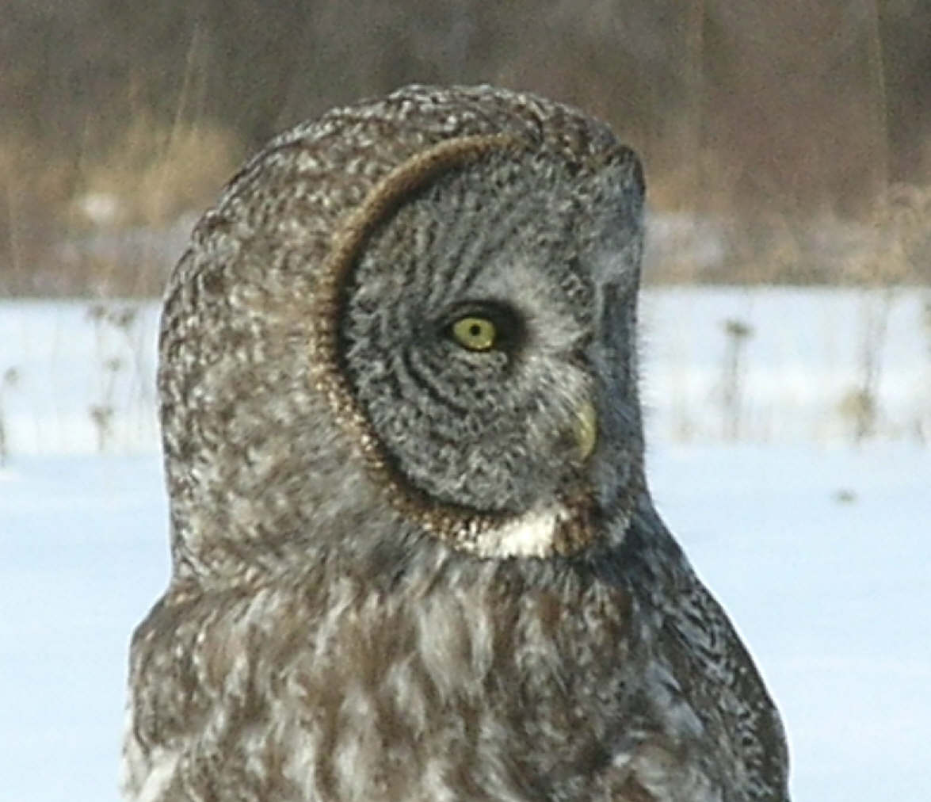
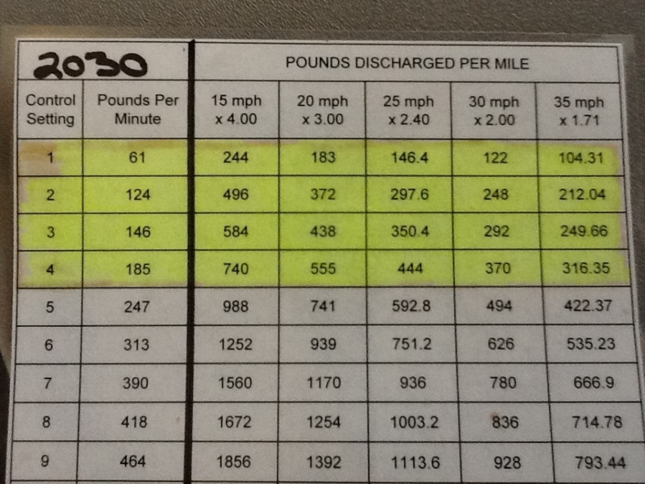
Calibrate your equipment
Be confident that the rate you are selecting is the rate you are discharging.
Don’t use your eyes to be the judge of the right application rate. You will over apply!
Notes:
Calibrate your equipment. Trust that it will discharge the proper application rate. Do not use your eyes to determine the application rate. Our eyes underestimate the amount of material and lead us to over apply.
Photo credit: Fortin Consulting Inc.

Slide 64
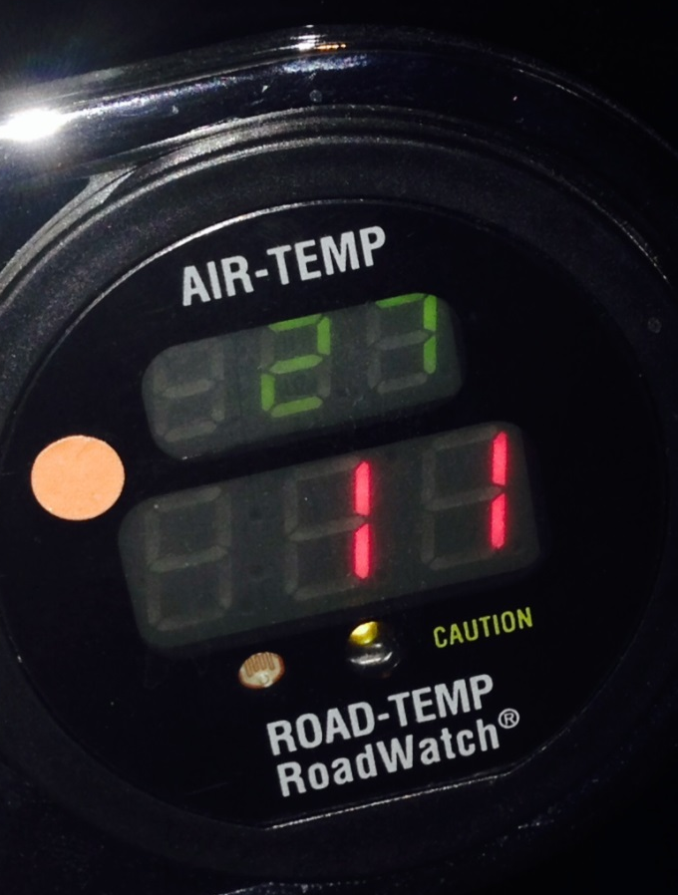
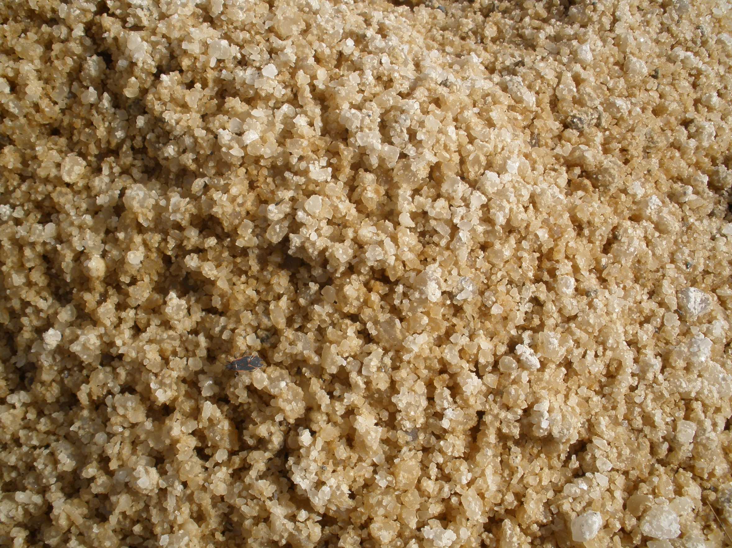
Understand your deicers
Chose the right material for your conditions
A one material shop is a wasteful shop!
Notes:
Each deicer and abrasive has a set of conditions in which it will work the best. Be aware of the limitations of your materials. Don’t use them when they are not effective. Keep an eye on the pavement temperature and trend that coupled with the practical melting range of your deicers will help you make better decisions.
Photo credit: Fortin Consulting Inc. and City of Grand Rapids, MN

Slide 65
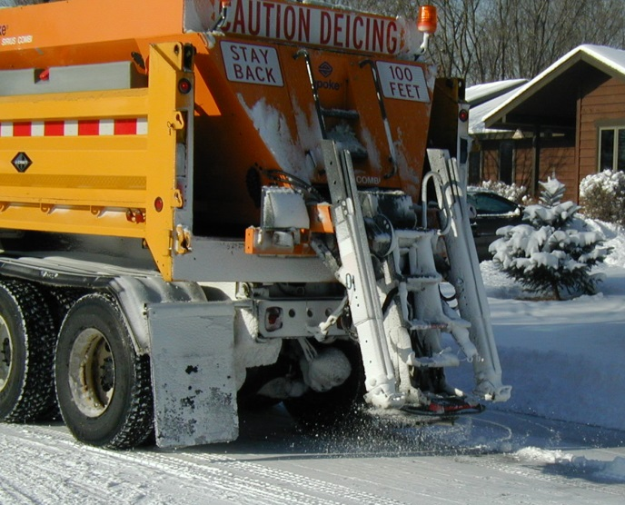
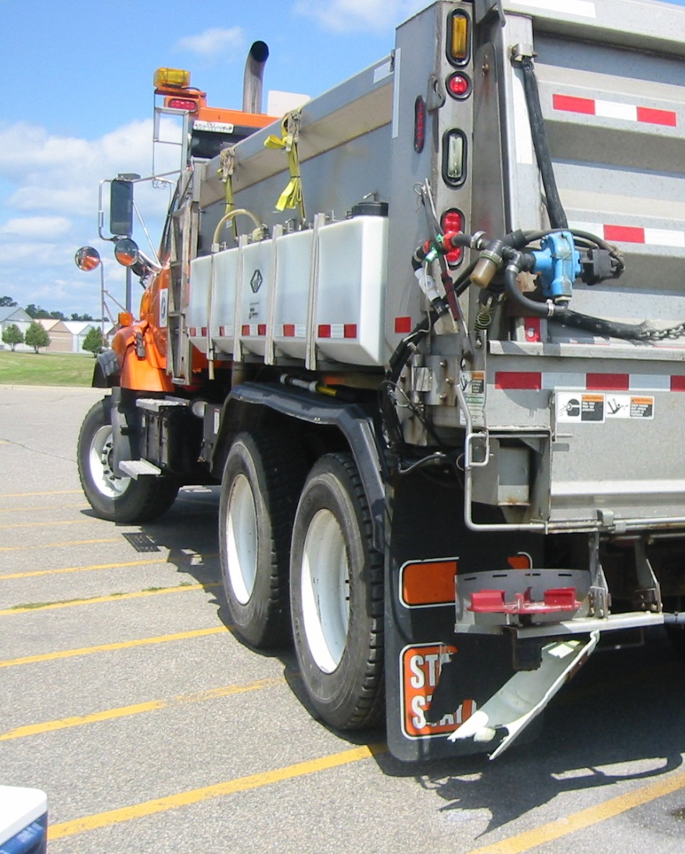
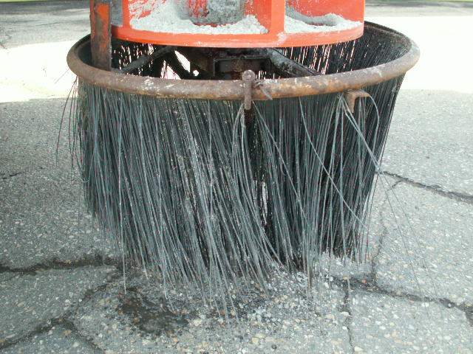
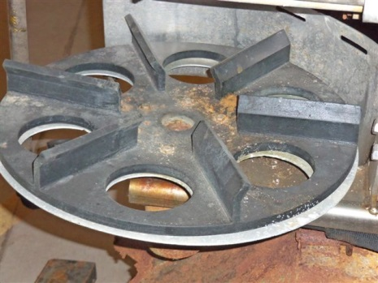
Reduce bounce and scatter
Slow down
Apply wet salt
Ease salt onto pavement
Target center of road
Turn spinner off
Reduce spread pattern
Lower discharge point
Notes:
Bounce and scatter reduction strategies are covered in more depth in the “Spreader” module. It is included here as a one page refresher and also to make sure everyone is exposed to this idea. Not every person will study the spreader module.
Note to presenters: This would be a good place to stop and get feedback from audience on what they have tried. There are an unlimited number of ways that we can reduce bounce and scatter. If you put it out to the group as a goal, they can figure out what might work best for their route and situation.
Photo credit: Fortin Consulting Inc.

Slide 66
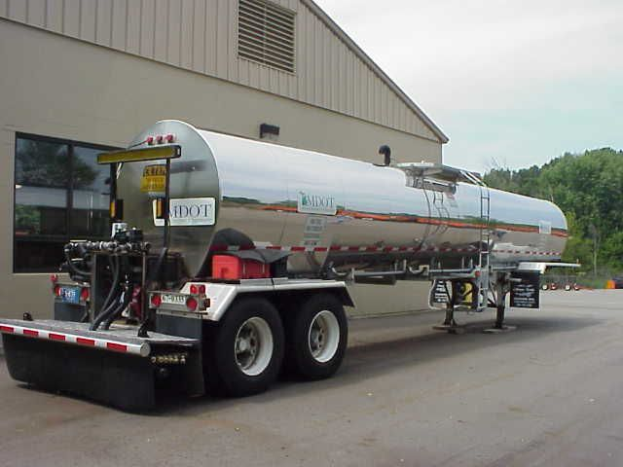
Save salt by anti-icing
Be pro-active!
Notes:
This photo shows a case where the operator should have anti-iced. There is not enough moisture on the road for this to do any good, so the material will be wasted.
Photo credits: MDOT and Fortin Consulting Inc.

Slide 67
Salt so no one is plowing it off
Note which trucks are applying salt, and don’t apply salt where it can be plowed off.
Notes:
Note which trucks are applying salt. Do not apply salt where it can be plowed off.
Slide credit: MDDOT snow-college-part-1_slides_37-73

Slide 68
What works for you?
To minimize salt use:
Don’t plow off salt
Smaller auger flighting
Wet salt
Chutes
MDSS
More aggressive plowing
Drive slower when applying
Anti-icing
Use mag on cold days
Ground speed controllers
Notes:
Note to presenters: This is a good slide to solicit audience comments or small group discussion. Each truck station and each driver likely has a variety of techniques that they use to reduce salt use. Almost all of the training modules will offer advice on how to minimize salt use. Some of the ones listed on this slide are not discussed in this module.

Slide 69
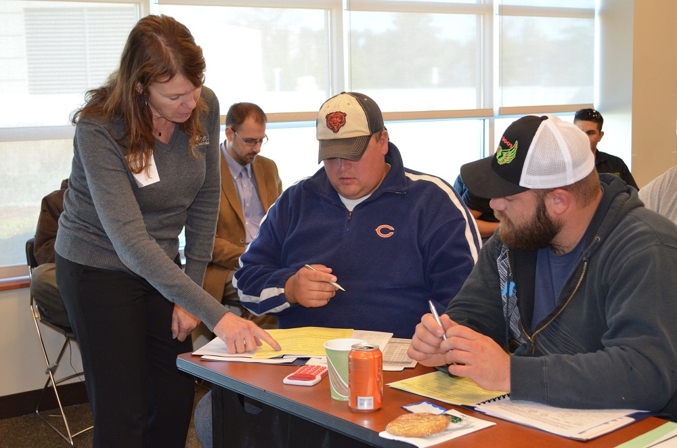
Prepare for success
Take the time to understand your options.
Develop a strategy for optimal material selection based on the conditions.
Materials are changing and improving, stay tuned in and take advantage of these advances.
Your efforts will help improve performance and protect the environment!
This is the way we’ve always done it no longer works.
Notes:
A successful winter maintenance operation is made up of a series of good choices. Look for ways to integrate science into your operation, keep an open mind, the industry is changing at a fast rate. Stay with the changes and be a leader in winter maintenance with reduced environmental and infrastructure impacts. If you do you will likely save your organization money and improve your performance. Good luck!
Photo credit: Fortin Consulting Inc.

Slide 70
Acknowledgements
Training contents were developed by Fortin Consulting Inc., under the direction of the Clear Roads Advisory Team.
Connie Fortin – connie@fortinconsulting.com
Professional formatting and training aids were developed by the University of Minnesota, Center for Transportation Studies.
Jim Grothaus – Groth020@umn.edu
Ann Johnson – Johns421@umn.edu
Members of the Clear Roads Advisory Team include:
  Mike Sproul, Dave Wieder, Cliff Spoonemore, Monty Mills, David Frame,
  Mike Lashmet, Clay Adams, Justun Juelfs, and Tom Peters

Slide 71
This presentation was developed with funding from the Clear Roads research program, which brings together transportation professionals and researchers from around the country to drive innovation in the field of winter maintenance.
Find additional information and resources at
http://clearroads.org/

Slide 72
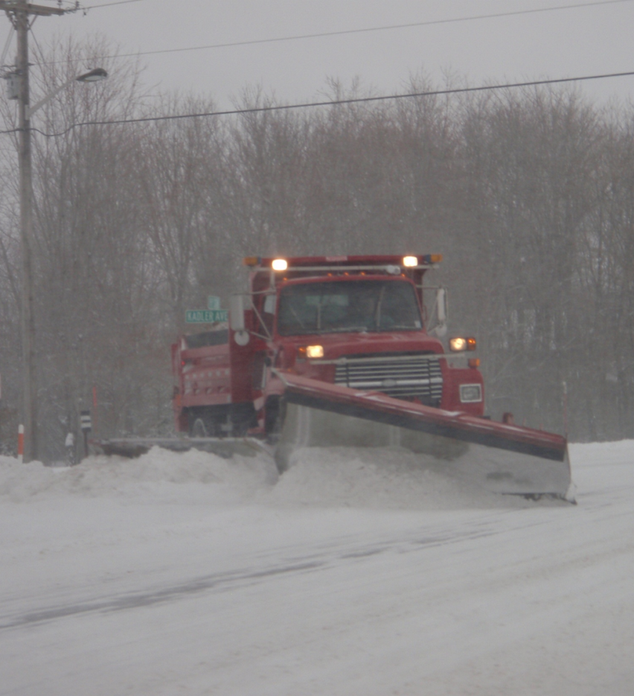
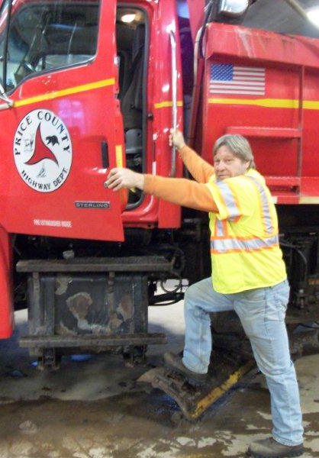
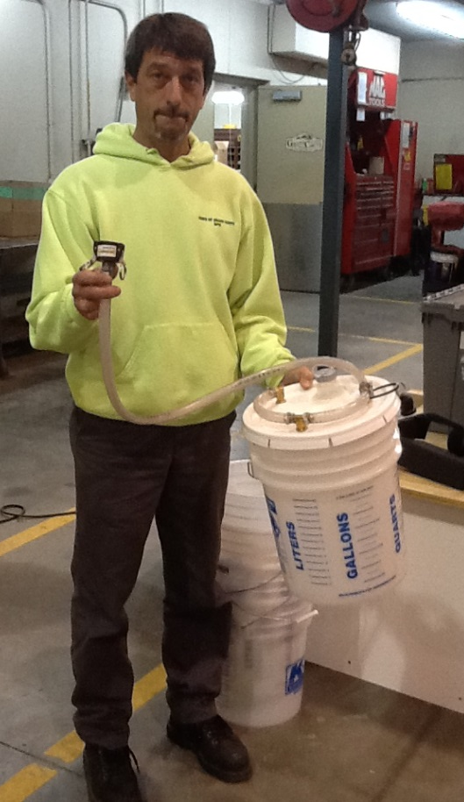
Thank you for your good work!
Notes:
Thank you for your time today. Have a good winter!

Slide 73
Additional resources
AASHTO, Clear Roads Computer Based training:
  Deicing:
    Unit 1, “Introduction to De-icing and Common De-icing Materials”
    Unit 5, “Application Guidelines”
    Unit 6, “Application Techniques”
  Winter Maintenance Management:
    Unit 4, “Selecting Snow and Ice Control Materials”

Slide 74
Additional resources
MDSS research study on how MDSS works:
http://www.meridian-enviro.com/mdss/pfs/
Application rate chart - Minnesota snow and ice control field handbook for snowplow operators:
www.pca.state.mn.us/programs/roadsalt.html
The short-term toxicity of very common de-icing materials and the toxicity of deicing materials:
http://clearroads.org/wp-content/uploads/dlm_uploads/11-02_12-30-13-Final-Fact-Sheet.pdf
Video on material use (Iowa DOT posted on U-Tube)
  https://www.youtube.com/watch?v=tVY4y4cE2vo&index=11&list=PLurY2WfsVWKn1Ekx7H_v8DjwJvXlolN9n

