Slide 1
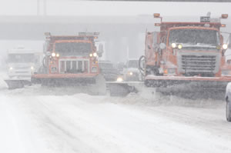
Plowing Procedures
Connie Fortin – Fortin Consulting 2014
slides are for entry level plow drivers
slides are for experience plow drivers
slides are for supervisors
Photo: MnDOT metro
Notes:
Plowing Procedures: Module 2
This is a priority 1 module to be developed for clear Roads national training.
It will address 3 audiences: ½ circle symbol = entry level plow drivers
¾ circle symbol = experienced plow drivers
Full circle symbol = supervisors
White slides are for everyone

Slide 2
This module contains
One-person and two person plowing operations.
Operating with various plow configurations (nose plow reversible and one-way; right wing only; left wing only; double wing; underbelly plows).
Echelon/gang plowing and tandem plowing techniques/strategies.
Whiteout condition actions.
Tips from experienced drivers
Notes:
In discussions with Michael Lashmet from NYSDOT: Low priority for this module is cleanup operations. May need a new module someday for clean up operations. These are the topics he suggested to be covered in this module.

Slide 3
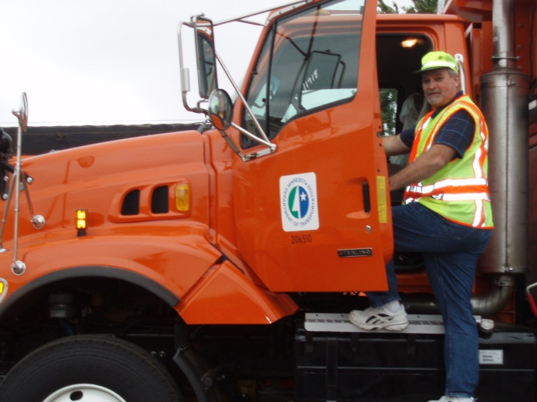
One-person and two person plowing operations ( in the cab)
  The majority of plowing operations are conducted with one person in a truck
  Exceptions are:
    Excessive traffic
    Truck is out of radio contact
    When driver is tired from long shift a second person is useful to stay alert.
    As deemed appropriate by supervisor
Insert State specific recommendations for 2 people in one truck here
Remove this slide if your state never uses 2 people in one truck
Photo: Fortin consulting
Notes:
In discussions with retired MnDOT Woody Woodruff, MnDOT doesn’t have the luxury of that many people so rarely are 2 people put in one truck. Michael Sproul from WiDOT says WI doesn’t use 2 people in one truck. Michael Lashmet from NYSDOT says it is still used sometimes in NYS and would like a mention of it in this training.
Two person clean up (2 in one truck) operations after the storm such as benching or widening the roads will not be discussed here per discussion with Michael Lashmet from NYSDOT. However clean up seems to be the most widely used time for 2 people in one truck.

Slide 4
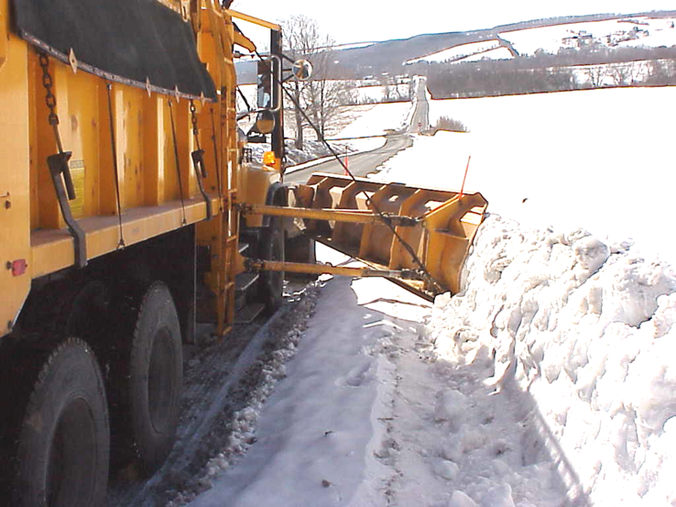
Benching
Example of 2 people in one truck operation. Note that 2 people are not required but it makes it easier
Photo: NYS DOT
Notes:
Clean up operation to expand storage are for future snow events
Benching is one operation where it is helpful to have 2 people in the truck. Much easier to see and guide a benching operation from the right seat.

Slide 5
Illustration of benching
  Better sight distance for public
  More room for next snow storm
Penndot snow-academy-part-4_slides_76_83
Notes:
When the roadside snow piles become extremely high, the wing plow can be used for benching, cutting off the top of these large piles.
This serves to provide better sight distance for the motorist and will give more room if another storm hits in the near future.
Test Question:
What is benching?
Clean and paint park benches (no)
Wing back snow from side of road(yes)
Attach bench to front of truck instead of plow (no)
A way to create more storage for later snowfalls (yes)

Slide 6
Operating with various plow configurations (nose plow reversible and one-way; right wing only; left wing only; double wing; underbelly plows).
Notes:
This section will describe the various types of plows.

Slide 7
Front or Nose plows
Reversible Plows
One way Plows
V Plows
Anything mounted to the front of the truck
Notes:
Nose plow is a term sometimes used to describe a plow attached to the front of the truck. It would include the v plow, the reversible and the one-way plow.
Nose plows are the easiest to operate and a good starting point for new operators.
Test question:
Which can be front mounted Plows:
Wing Plows (no)
One-Way Plows (yes)
V Plows(yes)
Reversible Plows(yes)

Slide 8
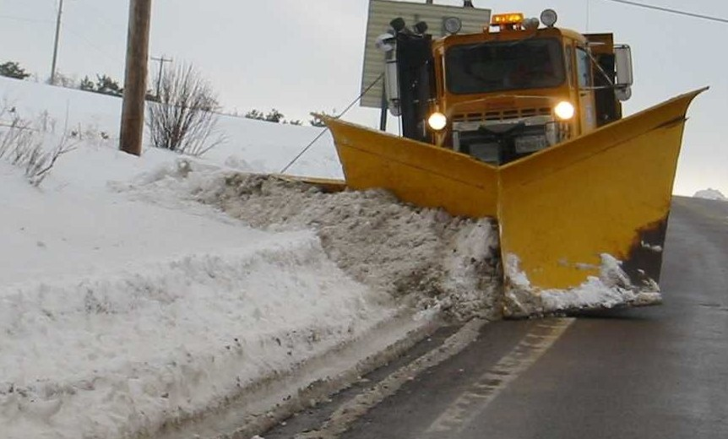
V - PLOW
MDDOT snow-college-part-1_slides_37-73
Notes:
Truck mounted V plow.
Advantage – can bust through drift better than other nose plows
Advantage – can plow in both directions at the same time
Disadvantage – if used in regular plowing, only gives ½ the coverage
Disadvantage – can discharge windrows in 2 directions, need to be careful
If you use this the road is probably blocked with snow. Can only go thru short drifts or will get stuck because snow will accumulate behind the truck and trap you. Go side to side and take small bites of snowbank.

Slide 9
Tip from experienced drivers
Truck mounted V plow. If the road is blocked with snow, go side to side and take small bites or you will get stuck because the snow will accumulate behind you and trap you.
Retired MnDOT supervisor: Woody Woodruff
Notes:
Can plow through a small drift but be wary of large drifts, if you try to plow through them you are likely going to be stuck. Since you are dealing with severe snow conditions there is likely no one to help you get unstuck.

Slide 10
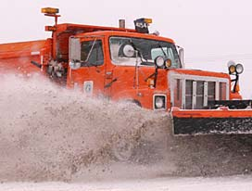
Reversible plows
Operator controlled from the cab, can direct snow right or left of the truck
Photo: MnDOT
Notes:
Reversible plows allow the driver to determine if the discharge will be to the right or left of the truck.
These are very common and highly used types of plows

Slide 11
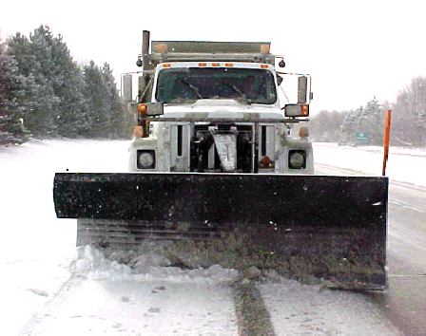
Front Mounted Reversible Plows
The standard plow angled correctly will clear 8 to 9 feet per pass.
Standard driving lane is 12 feet wide
ohioDOT_snow_and_ice_control_course-presentation-105_slides_135_138_151_154
Notes:
Characteristics include same width at both ends. For reversible plows that are often used in one direction you might see one end more tapered with the widest side being the side where the snow is most often discharged.

Slide 12
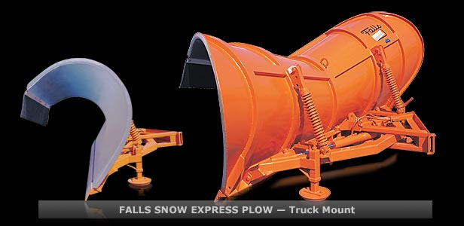
High discharge reversible plow
Cutting edge is straight so snow only goes out one side. Good for rural settings. This is a lot of plow, it discharges higher, it moves it off the road farther.
Photo: http://www.fallsplows.com/truck.html
Notes:
This is termed a high discharge because it has a tall end that allows the snow to be discharged higher or thrown further from the road. Reversible so it can discharge either way.

Slide 13
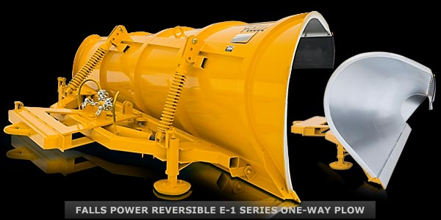
Reversible one-way plow
Can move snow to left if needed but this plow is intended for moving snow to the right
Photo: http://www.fallsplows.com/truck.html
Notes:
Note the sides are not equal in height, this plow is designed to move snow to the right for most of the time, however it can discharge to the left if the operator needs it. It wont be as efficient as moving snow to the right but is useful and possible to move snow to the left.

Slide 14
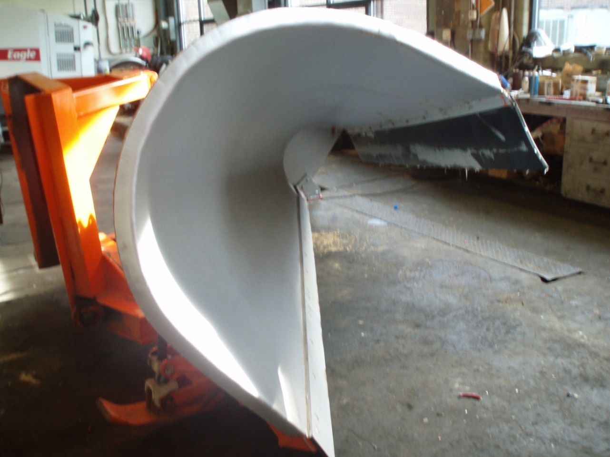
One-way plows
Snow is always moved in one direction
Photo: Fortin consulting
Notes:
One way plows direct the snow discharge in only one direction. They are very efficient at what they do but are not very good as an utility plow.

Slide 15
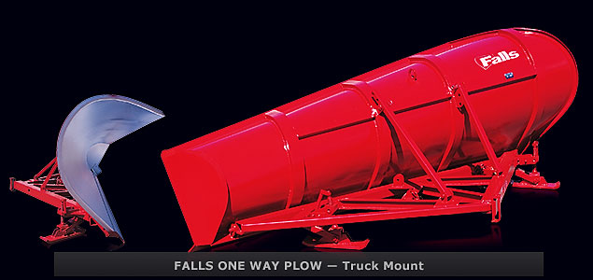
High discharge one-way Plow
Note: extra tall discharge end for moving snow further distances
Photo: http://www.fallsplows.com/truck.html
Notes:
This is termed a high discharge because it has a taller end that allows the snow to be discharged higher or thrown further from the road.

Slide 16
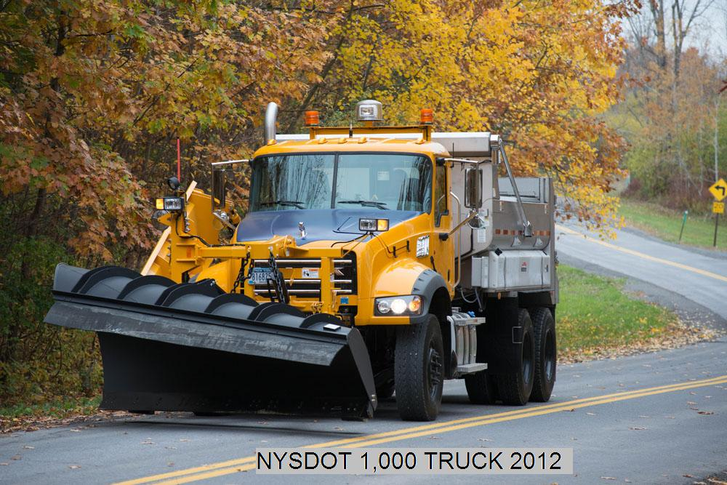
Is it reversible or not?
One-way plow
Photo: NYSDOT
Notes:
One way plows can be fixed or reversible. They always work best if discharge is directed towards the larger end of the plow. However with reversible mounting they can be used in either direction if necessary. It is difficult to tell if the plow is reversible or one way from looking at the front of the plow. However in this picture we know the truck is set up to mainly push snow to the right and in this case we also know it is not a reversible plow.

Slide 17
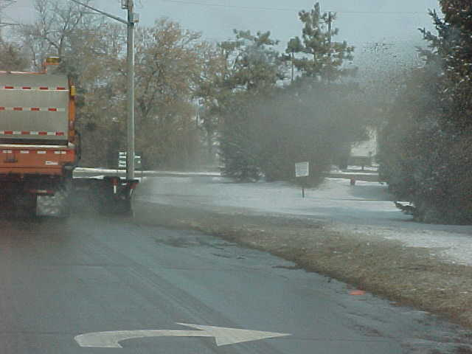
Right wing
Yep, that’s the one
Photo: MnDOT
Notes:
Right wings are the most commonly used wings since the majority of the snow in plowing is pushed to the right.
They are typically used in combination with a nose or front mounted plow to allow the driver to plow a wider area in one pass.
Wings are more difficult to control than front or nose plows so often drivers will not be assigned a wing until they are quite comfortable with the front plow and are ready to take on a new challenge.

Slide 18
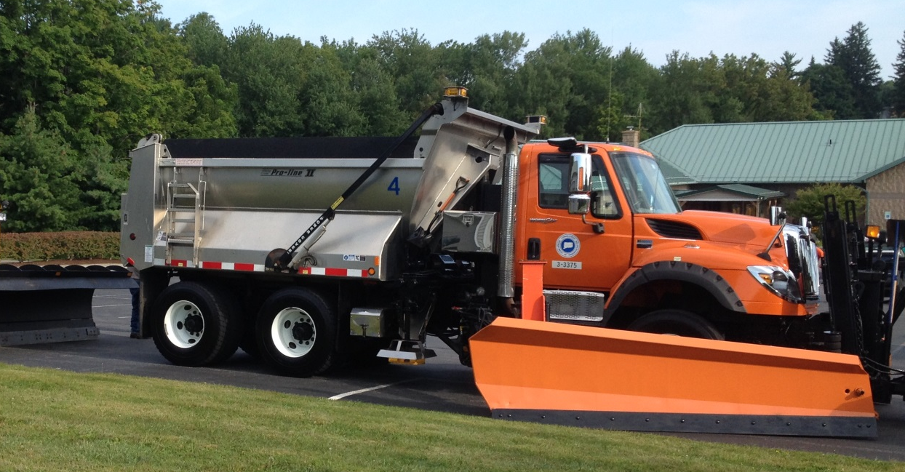
Front mounted wings
BE SAFE: Do not drop a wing in an open lane without another plow or truck behind it
Photo: NYSDOT
Notes:
Front mounted wings are easier for the operator to see.
Both wings (front or rear mounted) work well to clear larger zones. Both wings push snow to the same place
Advice on slide is from NYSDOT, that is their policy. …e.g. in a two lane section, if a plow truck by itself is in the left lane, the right wing won’t be dropped onto the right lane because a passing vehicle could hit it. The right wing could be down if a plow truck is behind it plowing the right lane(s). The wing can be “exposed” on a shoulder.

Slide 19
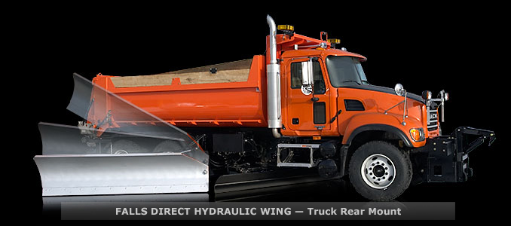
Rear mounted wings
Photo: http://www.fallsplows.com/truck.html
Notes:
Rear mounted wings are becoming more popular as the newer pollution equipment for exhaust is mounted up front.
Both wings (front or rear mounted) work well to clear larger zones. Both wings push snow to the same place

Slide 20
Tip from experienced drivers
When raising or lowering the wing:
  Put the back of the wing down first
  Raise the front end of the wing first
good
bad
City of Beloit plow operator: Rick Sarri
Notes:
If the front tip of the wing is down and the back end is up you will dig in to the snow or pavement.

Slide 21
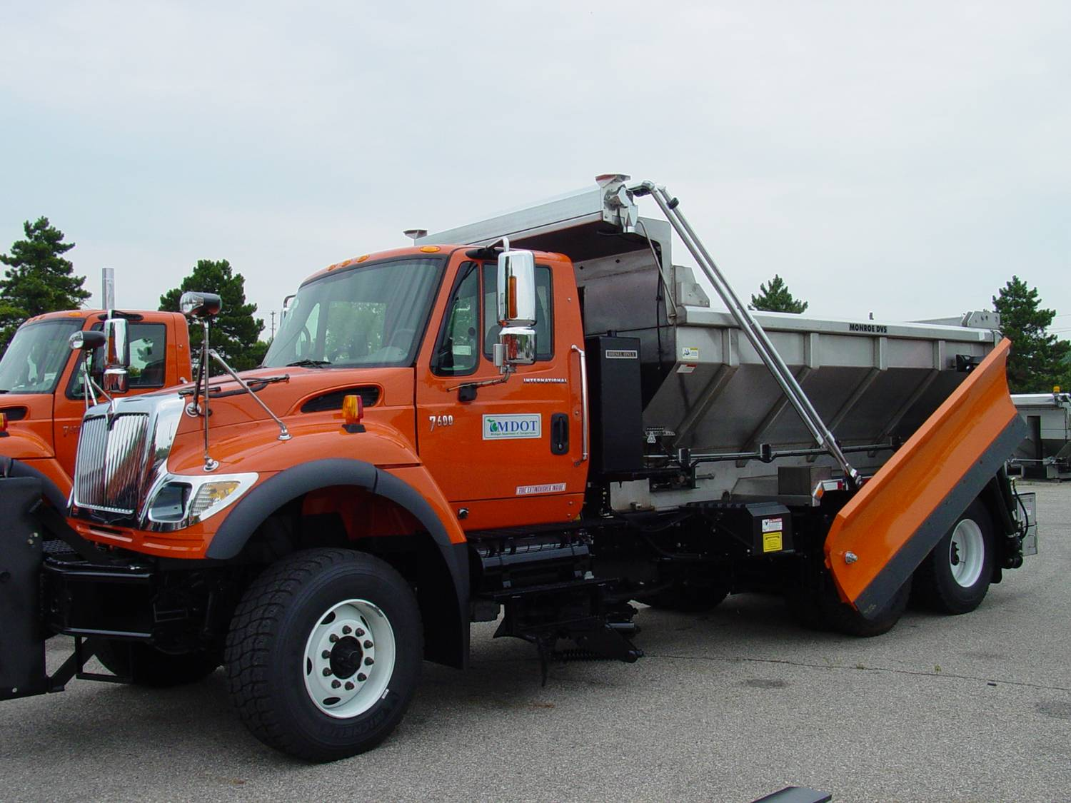
Left Wing
What are you looking at?
Photo: MNDOT
Notes:
Left wings are not used as frequently as right wings simply because more snow is pushed to the right of the road than the left of the road. They work in the same way as right wings by increasing the width of the plowing pass. They work well for roads with storage on left side of the road such as an open ditch.

Slide 22
Tips from experience drivers
Avoid ‘down winging’ –( lowering the back of the wing lower than the road) may damage equipment
Could also cause damage to roadside
Push arms level with moldboard
Penndot snow-academy-part-4_slides_76_83
Notes:
Down winging means to lower the back of the wing lower than the road surface. You should avoid down winging. The push arms should always be level with the wing moldboard. Not only can down winging cause undue stress on the equipment, but can cause damage to the roadside and create higher drifting in windy conditions.

Slide 23
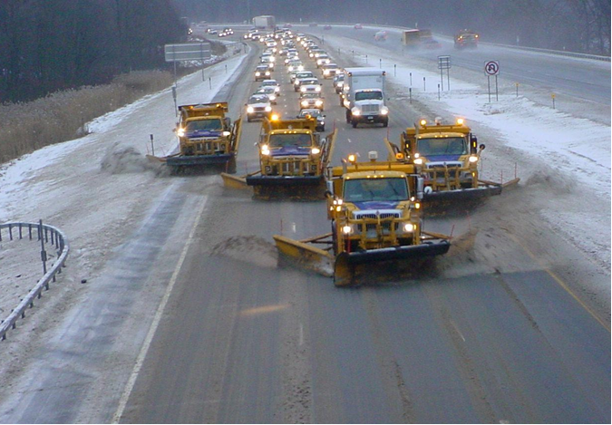
Double wing
Photo:NYSDOT
Notes:
To plow and even wider path, the double wing strategy can be used. This is more difficult for the driver and only experienced operators that are confident with this configuration should use it. However as you can see in this photo the truck can be configured with right wing and left wing and depending on the plowing situation either right wing or left wing or both wings can be utilized.

Slide 24
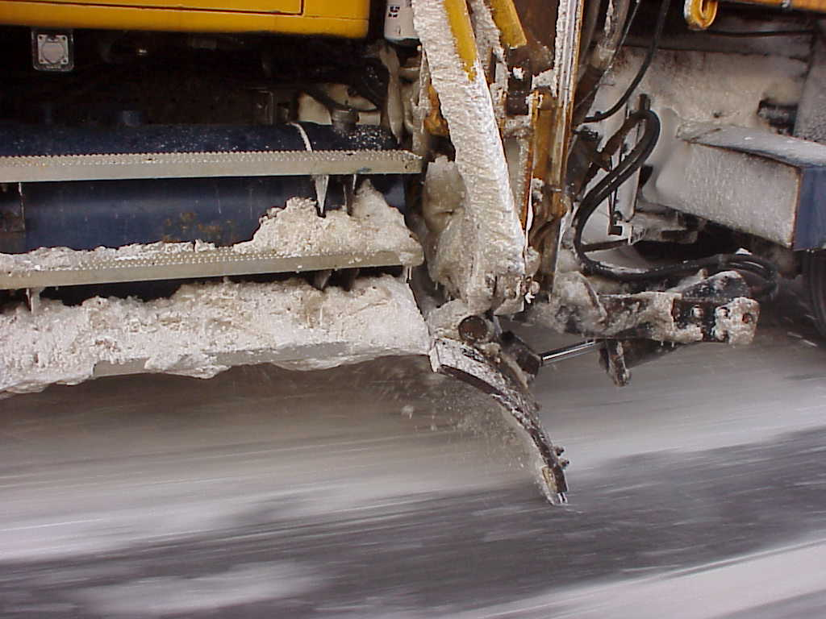
Underbelly or underbody plows
Photo:NYSDOT
Notes:
Plows can be mounted under the truck as well on the front or sides of the truck. The underbody plows allow for the most down pressure of all of the plows. They are ideal for breaking up compaction.
With 500 psi, you can almost lift the front end of the truck in the air.
Underbody plow can be fixed or reversible just like the nose or front plows
Test question:
Which type of plow is the best at removing compaction?
Right Wing (no)
Tow Plow (no)
Front Blow (no)
Underbody plow (yes)

Slide 25
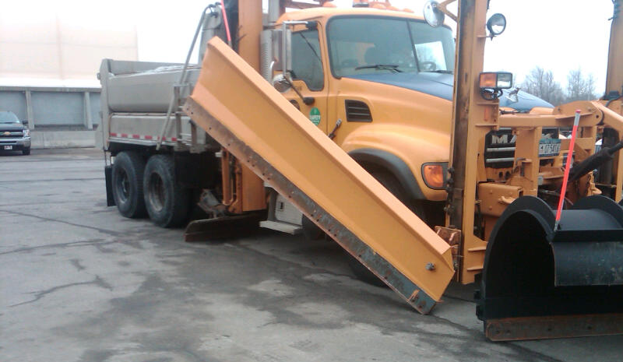
Combinations
Many configurations exist. In this example we see and underbody plow, a front mounted right wing, and a reversible front plow
Photo: NYSDOT
Notes:
There are many combinations of plows that can be put onto a truck. Very common is a front plow, wing and underbody. Good class question, what is the advantage to having a combination of plows on the truck. What are the operators concerns in controlling multiple plows.

Slide 26
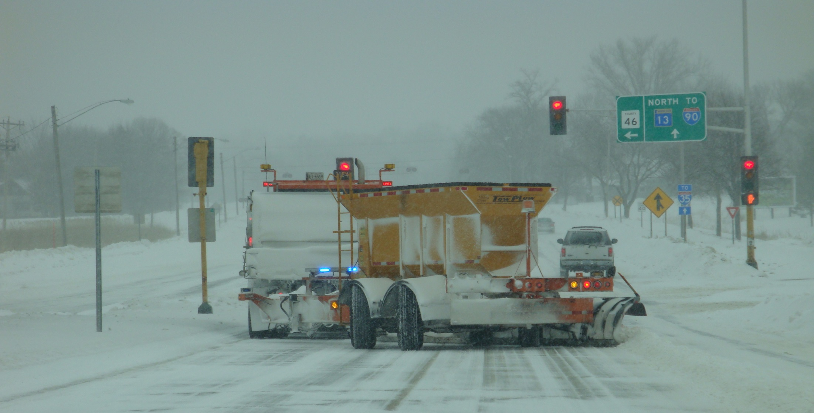
Tow plows
Picture: MnDOT
Notes:
Advantages of the tow plow:
increased efficiency and production (One pass clearing, improved cycle times, wider clearing path)
Reduction in manpower and equipment
Environmental benefits from using less fuel Safety improvements due to improved cycle times
Longer service life than snow plow trucks.
(taken from AASHTO website http://aii.transportation.org/Pages/TowPlow.aspx)

Slide 27
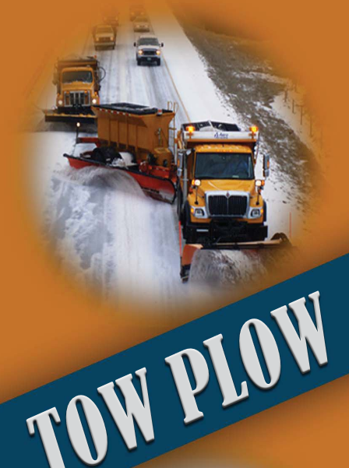
Class A commercial drivers license needed
More plowing faster
To learn more about tow-plow operations visit this AASHTO website http://aii.transportation.org/Pages/TowPlow.aspx
Illustration from: http://clearroads.org/training-reviewed-modules/files/MoDOT_Tow-Plow-Manual.pdf
Notes:
Plowing Operations (http://clearroads.org/training-reviewed-modules/files/MoDOT_Tow-Plow-Manual.pdf)
While plowing multiple lanes, be familiar with the crown of the
road in relation to the Tow Plow’s position. Experience has shown
that the Tow Plow should be positioned, if possible, with the
crown between the tow vehicle and the Tow Plow in order to pre-
vent damage to the road surface. If this is not possible try to keep
the center of the Tow Plow mold boards at the crown of the road.

Slide 28
Stay current and explore new plow options
Photo:MNDOT
Notes:
This is an example of a MnDOT district 8 plow that they are experimenting with
“ Inspired by district 8 staff, this new experimental plow incorporates two designs into one versatile plow. The main intent is to use wind direction to help cast snow from the road without impeding on traffic or the operator’s view. This design eliminates the large “ear” on the left hand (driver) side of a batwing style plow that sticks out into oncoming traffic during centerline snow removal. “ source: MnDOT maintenance research bulletin fall 2014

Slide 29
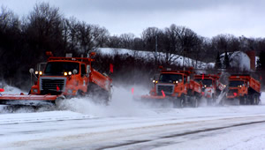
Echelon/gang plowing and tandem plowing techniques/strategies
(these terms may change waiting on Mike for advice)
Photo:MNDOT
Notes:
Using more than 1 plow truck working together to achieve a clear road. Echelon or gang plowing
The number of trucks depends on the width of the road and the width of the clear path each plow makes. By adding wings to the trucks in gang plowing, fewer trucks are needed.

Slide 30
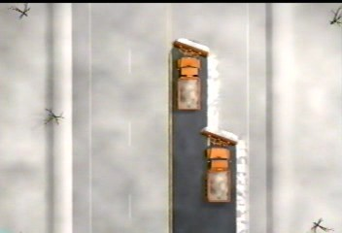
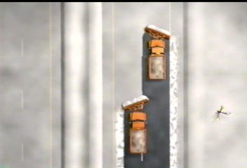
Two truck operations
Where you have space to push snow determines your plowing strategy
Avoid windrows in driving lanes
without median
with median
Penndot snow-academy-part-4_slides_76_83
Notes:
If you have the truck and operator resources to do tandem plowing, clearing multiple-lane roads is much more efficient and effective, clearing the road and making it safer in less time.
With a median area for pushing the snow, the lead truck can plow the left lane pushing the snow to the left into the median.
The second truck follows plowing the right lane, pushing snow to the right.
Without the median, the lead truck plows the left lane pushing snow to right.
The second truck plows the right lane, picking up the snow plowed by the lead truck and continues to push the snow to the right.

Slide 31
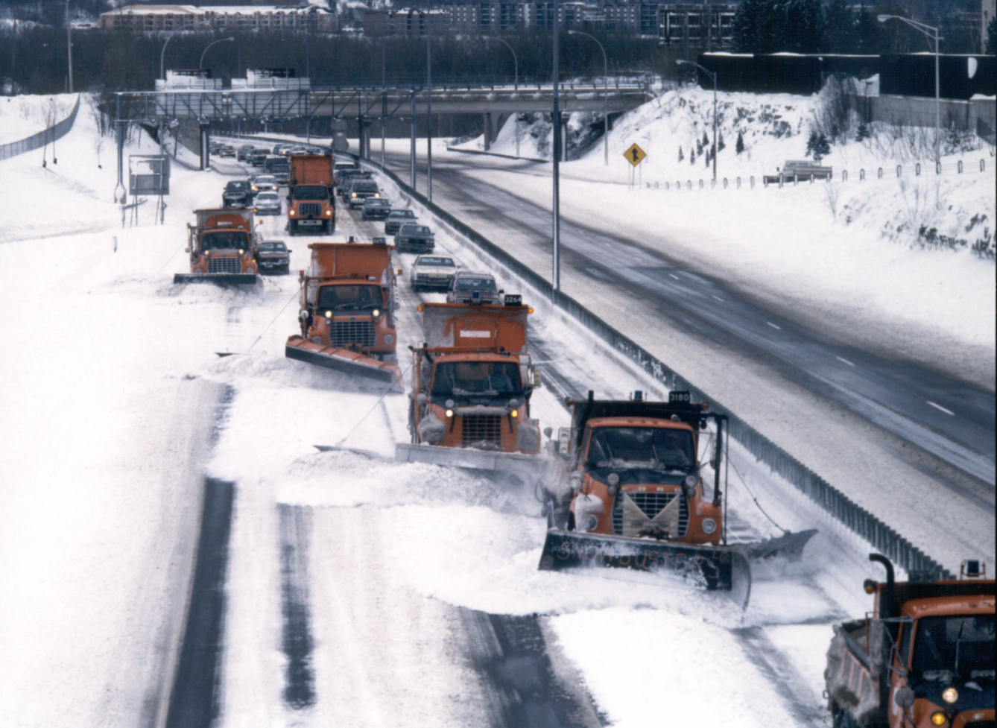
Let’s ramp it up, multiple trucks!
CDOT_Pulling-Dowd-Canyon.MPG
Photo:MNDOT
Notes:
CDOT_Pulling-Dowd-Canyon.MPG
Show this video to get the audience in the mood for reviewing tandem plowing operations at a larger scale. It is a very short video. If you don’t want to run the video skip it and move on to the following slides that diagram the basic maneuvers for tandem plowing

Slide 32
Instructions - 1
PRACTICE ONLY, realistic details in field
Top strobes only – why?
Left wing in front
Don’t plow beyond road
Pick up windrow
Close gap SAFELY
Maintain “feel safe” distance – practice
Notes:
Practice is essential. Don’t want your first try to be during the snow event. Debrief after practice to review what went well and what to improve upon.

Slide 33
Instructions - 2
Plow entire road (2-way)
Form multiple sections
Max speed 20 mph
Watch lights
Avoid brakes – why?
Drive all trucks, yours and those behind
Advise Gang of invasion of group
Notes:
Remember the faster your speed the more unstable your truck. The group should move at a reasonable speed set by an experience driver.

Slide 34
Instructions - 3
Radio silence – except emergency, why?
Lead truck
  Communicate emergency or condition
    Vehicles, objects, or hazards in plow path
    Not signs, hydrants
    Stalls, driveways with cars, and pedestrians
  Lead by moves and speed
  Hills, corners (not able to see)
  Check gang in mirror
    Adjust speed and actions accordingly

Slide 35
Instructions - 4
Hill, corner, or traffic: lift wing & move right
Gang moves like links of a chain
Same for all sections
Move left again only when safe

Slide 36
Instructions - 5
Tail truck
  Communicate emergency or conditions
  Advise Lead/Gang of passing traffic and if need to move right
Additional info for all
  Use box and sander, if comfortable
  Incident pull safely to right shoulder, stop, engage parking brake
Questions ?

Slide 37
Turn Lanes
Left wing out and plow reversed to right it will tend to pull you in the ditch, be careful.woody
Pick up windrow moving with turns
Remember left over discharge on right
Crossovers
Remember to plow right turn lanes

Slide 38
Right Corner
Plow wide, full half of corner – why?
1-way road only
Pick up windrow

Slide 39
Left Corner
1-way road only
Pick up windrow
Be aware of right windrow remains

Slide 40
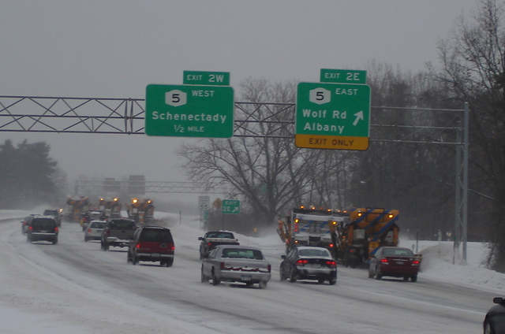
Plowing exits
Photo:NYSDOT
Notes:
Need to stay open for the traveling public
You should break off one or two trucks from the gang to do ramps. Two trucks should clear the common ramp in one pass.

Slide 41
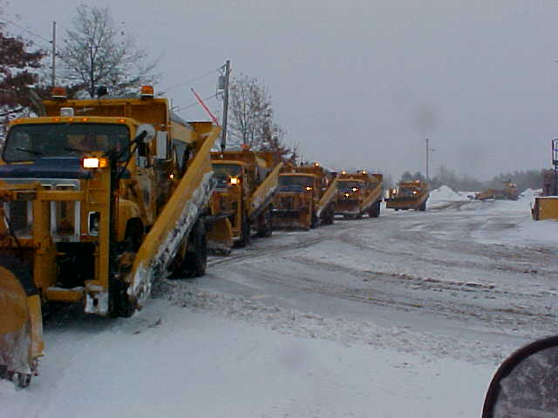
Get ready…lets go!
Photo:NYSDOT
Notes:
Keep a tight pattern, don’t let traffic break into the line up!
Test question: What is the advantage of group plowing?
Everyone gets the same lunch break(no)
Entire road cleared in one pass(yes)
Looks impressive to TV news(no)
No windrows in driving lanes(yes)

Slide 42
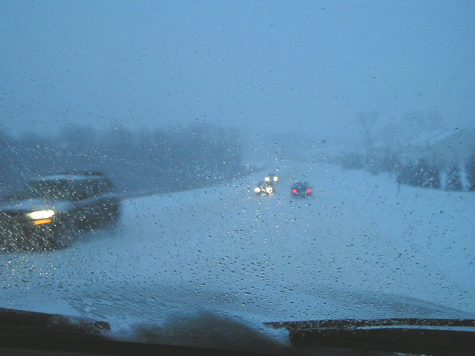
Whiteout condition actions
Most important point: If you run into whiteout conditions. Stop. Get off to safe location. Turn off your lights so no vehicles see you and draw toward you.
Each state or organization may have different guidance on what to do in white out conditions
Photo: fortin consulting inc
Notes:
Every person has a different threshold for pulling over. You should pull over when you do not feel you are in control of your truck. Wait until visibility comes back. Talk to your supervisor
For example: section 5.3309 in the NY Snow and Ice Guidelines discusses Whiteout/Blizzard conditions.

Slide 43
Tips from experience drivers
Because there are so many plowing tips, I have put a collection of them together in one section. Experienced drivers may not need to see these tips but I have included them so you could work them into a class discussion or small group break out with a mix of experienced and new drivers. I have included the supervisors in this section too because they would likely be interested to hear the conversation of the class exercise and interject some of their own experiences.
Ann - Would be good for a class discussion or mini group activity during training to see what other tips the local experienced drivers have to offer
Notes:
You can change and improve these tips as you collect tips from your own organizations experienced plow drivers.

Slide 44
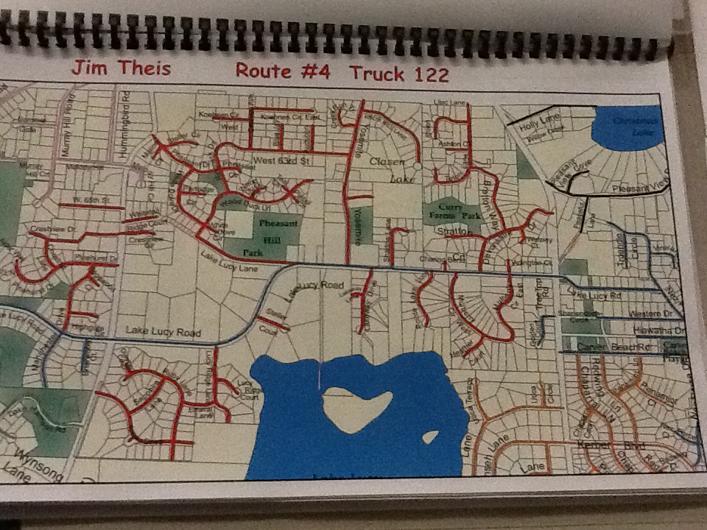
Before winter, drive your route
It is good to drive your route before winter, paying attention to where you cannot push your snow as you normally would, for example; intersections & bus stops
Note all obstacles such as train tracks and low bridges
Photo: fortin consulting inc
Notes:
Other areas to consider for pushing snow includes lakes, rivers, bridges, downtown areas, bike lanes.
Pay attention to hazards for your plow or box such as train tracks and low bridges.
Develop a plan for how you will change your plowing pattern to be most successful

Slide 45
Tips from experienced drivers
Plow from centerline out to shoulder.
Keep your speed down and plow towards low side of ramps or curves.
Plow away from wind when possible.
Reduce your left shoulder plowing speed when Jersey barriers located in the median.
MDDOT snow-college-part-1_slides_37-73 Photo: mndot

Slide 46
Tips from experienced drivers
Raise blade before making sharp turns.
Don’t leave windrow across an intersection. (Empty your plow before the intersection)
Know your turn around points.
Refuel with meal breaks or reloading.
MDDOT snow-college-part-1_slides_37-73
Notes:
At intersections works best , make a right, feather it out, return to intersection, continue plowing. Don’t go straight through intersection. Woody Woodruff MnDOT retired.
It is good to drive your route before winter, paying attention to where you cannot push your snow as you normally would, for example; intersections, bus stops, lakes, rivers, bridges, downtown areas. Develop a plan for how you will change your plowing pattern to be most successful

Slide 47
Tips from experienced drivers
Wet snow requires more plow angle to discharge snow from plow moldboard.
Plow must still clear a path for the truck tires.
MDDOT snow-college-part-1_slides_37-73

Slide 48
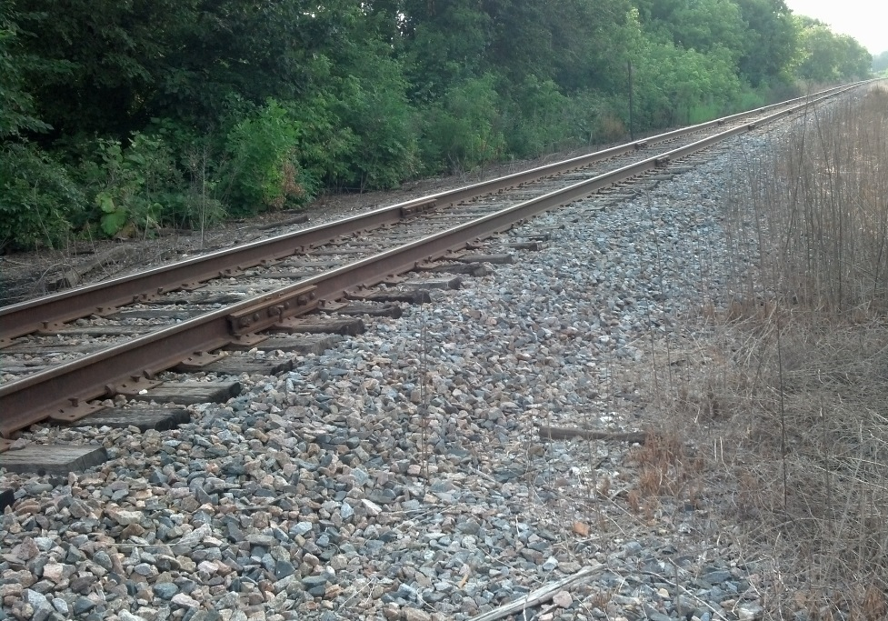
Tips from experienced drivers
DO NOT PLOW OVER RAILROAD TRACKS
  Lift plow components before the tracks
  Verify plow components lifted off of roadway
  SLOWLY pass over the tracks
  Lower components after clearing the tracks
Photo: fortin consulting inc
Notes:
Your plow blade will stop the truck if you do not raise it when going over the tracks (even at slow speeds). In the spring when you drive your routes make note of all obstacles not just train tracks that you will need to be aware of. Some items to pay attention to include; manhole covers, low bridges, bridge segment joints, overhead wires, train tracks.
I

Slide 49
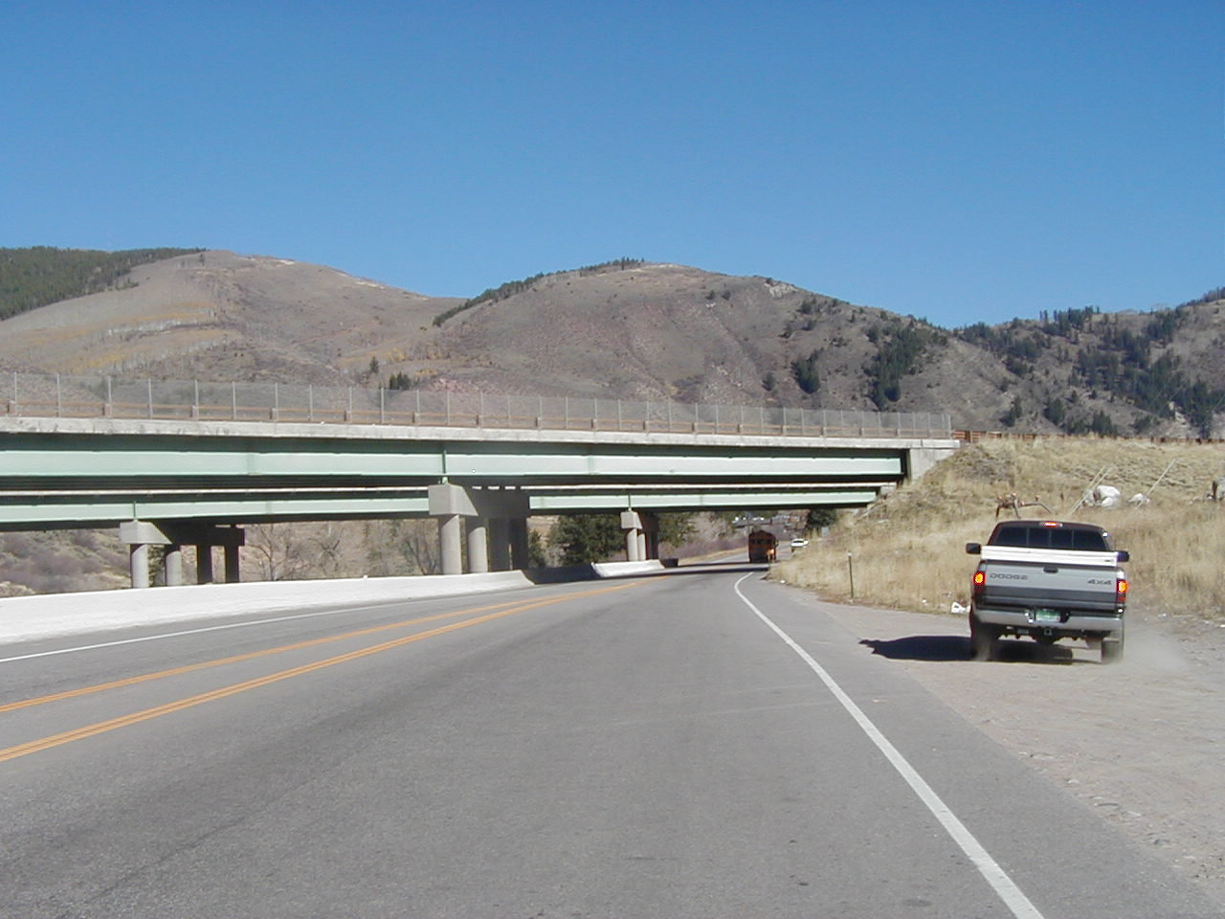
Tips from experience drivers
On Bridges:
  Slow down to keep snow from falling onto highway below
  Only plow snow off bridges under controlled situations
  Bridges may be icier than road
CDOT snow_removal_operator_training_slide_204
Notes:
Bridges change temperature faster than roads since they are surrounded by air. Often in the winter bridges are colder than the roads meaning that they may be icer or that the de-icer works slower. Plowing bridges can be more difficult because of the different driving conditions than you find on the roads and may surprise you if you are not paying attention.

Slide 50
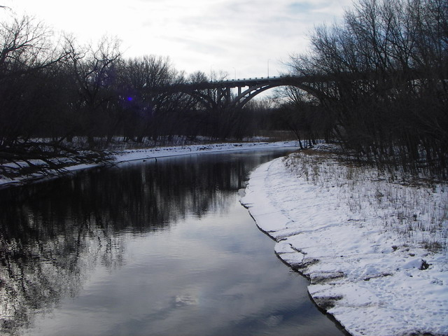
Here is what not to do:
CDOT_Bridge-Plowing.MPG
Bad example video about bridge plowing
Photo: fortin consulting.
Notes:
Do not discharge snow over side of the bridge if road is below or other sensitive area:
lake, river, wetland, train tracks, people….
It is slower to move the snow across the bridge but we know how to do that. This is safer for the water and the travelling public.
Test Question:
Why shouldn’t we plow snow from bridge into the river?
Salt will enter the river (yes)
Debris will enter the river(yes)
Could hurt fish swimming in the river below(no)
Will make the river too full of snow (no)

Slide 51
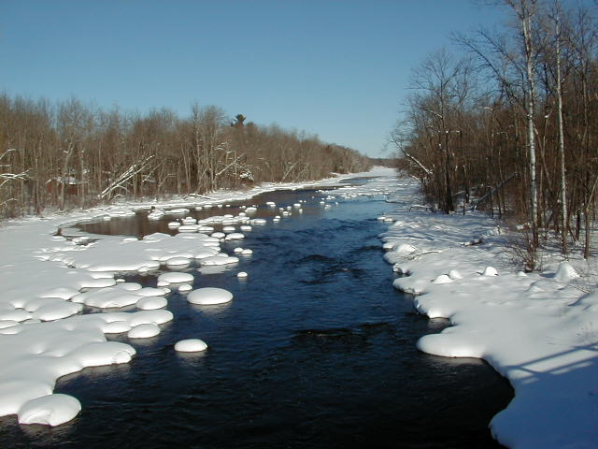
Environmental Tip
Don’t plow snow into lakes, rivers, wetlands, ponds or rain gardens
We can never reclaim the salt we have applied but…
We can prevent the garbage mixed into our snow from entering our water resources
Photo: fortin consulting. Chippewa river WI
Notes:
This topic will be further discussed in the snow disposal module

Slide 52
Additional resources
Tow Plow Information
http://aii.transportation.org/Pages/TowPlow.aspxAASHTO
White out conditions per your state or organization:
  Example: section 5.3309 in the NY Snow and Ice Guidelines discusses Whiteout/Blizzard conditions.
AASHTO, Clear Roads Computer Based training:
Sections that apply to plowing include: Proper Plowing Techniques: Unit 4 Common Types of Snow Removal Equipment, Unit 5 Roadway Plowing Techniques, Unit 6 Plowing Special Areas, and Unit 7 Using Specialty Equipment; Deicing: Unit 4 Deicing Equipment, Unit 5 Application Guidelines, and Unit 6 Application Techniques; Anti-icing/RWIS: Unit 7 Anti-icing Practice in Winter Maintenance Operations
Clearroads Training-reviewed-modules:
CDOT_Bridge-Plowing.MPG
CDOT_Pulling-Dowd-Canyon.MPG

