Slide 1
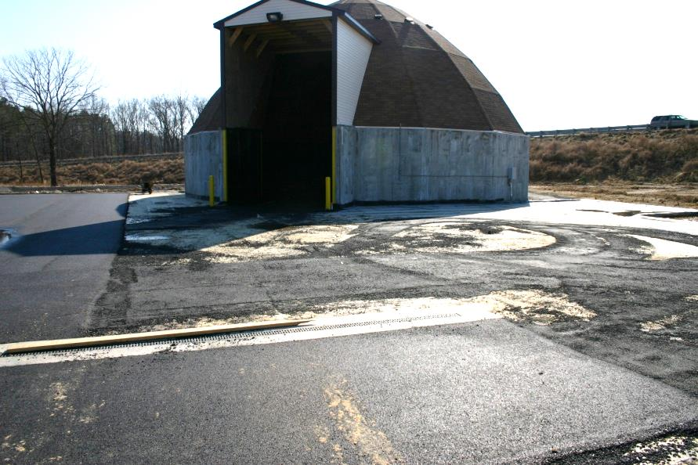
Deicer material management policy
Photo: Virginia DOT
Connie Fortin – Fortin Consulting 2014
slides are for entry level plow drivers
slides are for experience plow drivers
slides are for supervisors
Notes:
This is a priority 1 module to be developed for clearroads national training.
It will address 3 audiences: ½ circle symbol = entry level plow drivers
¾ circle symbol = experienced plow drivers
Full circle symbol = supervisors
White slides are for everyone

Slide 2
This module will contain these topics
Storage of liquid and granular products
QA of materials delivered both granular and liquids
Good housekeeping
Storage inspection
Notes:
This module covers storage, QA and good housekeeping of de-icing materials and abrasives.

Slide 3
Storage of Liquid and Granular material
Notes:
Start of a mini section

Slide 4
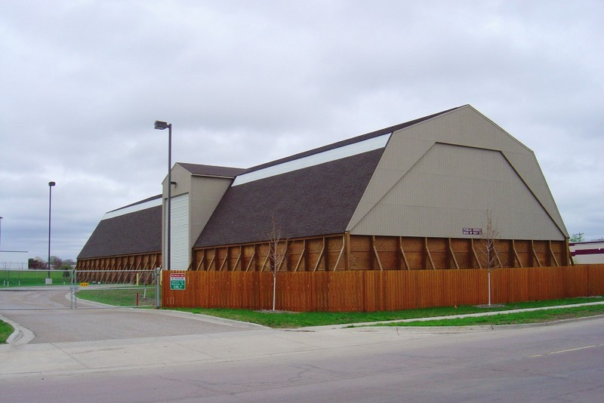
Proper Stockpile Storage
Rock salt – indoors
Winter sand – indoors
Treated salt – indoors
All on impermeable pad ( no liquid can seep through the floor)
Photo: fortin consulting inc
Notes:
All granular materials should be stored indoors. Various states may have laws governing this.
This includes Rocksalt, winter sand, salt/sand mixes and pretreated stockpiles. Anything that has salt in it is not stable and should not be stored outdoors.
Test question: what should be stored indoors:
Rock salt (yes)
Winter sand(yes)
Treated salt (yes)
Salt/sand mix (yes)

Slide 5
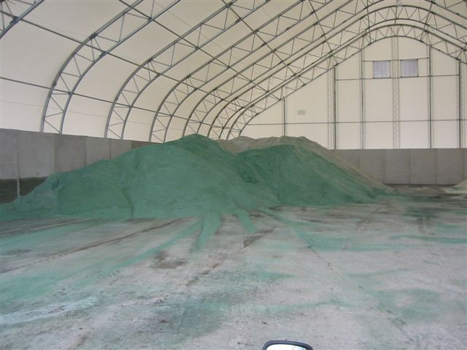
Good stockpile storage
Allows for delivery indoors
Loading indoors
Covered
Impermeable floor
No risk of overfilling
Photo: Fortin Consulting Inc
Notes:
Good example: Large structure with good air circulation and protection against rain, snow and wind.
Test question: Show this picture, what good features are shown on this storage shed
Large enough for all materials (yes)
Indoor loading area(yes)
Indoor delivery area(yes)
Impermeable floor (yes)

Slide 6
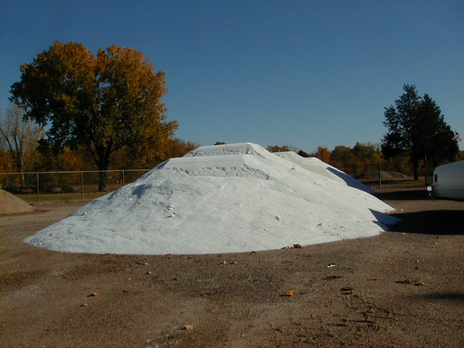
Example: Poor stockpile storage
Must be on impermeable ( waterproof) pad
Photo: fortin consulting inc
Notes:
Salt easily dissolves and moves through the soil to the groundwater. Make sure your salt is on an impermeable (waterproof) pad. Make sure the pad is in good repair.
Each state may have a different law governing storage of salt.
However if you ask around, many DOTs have contaminated wells do to poor storage.
Test Question: show this picture, what basic storage guidelines are violated:
Should be on waterproof pad (yes)
Should be covered (yes)
Should be mixed with sand (no)
Should be placed closer to trees (no)

Slide 7
Can’t keep salt in Can’t keep moisture out
Example: Poor stockpile storage
Photo: fortin consulting inc
Notes:
Moisture should not enter the shed, but if it does is should not be directed out of the shed to flow across the parking lot. It should be sumped out or directed to a contained storage area. Your state may have laws regarding runoff management from your storage area.
The safest approach for the environment is to not allow salty runoff water leave your facility. It is common to direct the runoff from the parking lot where your salt is stored into a holding pond or storm drain or ditch. These all are conveances to rivers, wetlands, or lakes. Salt water should be flow into any of these areas.
Jimmy White, Virginia DOT has a good example of runoff management where the water is captured and re-used for brine making.

Slide 8
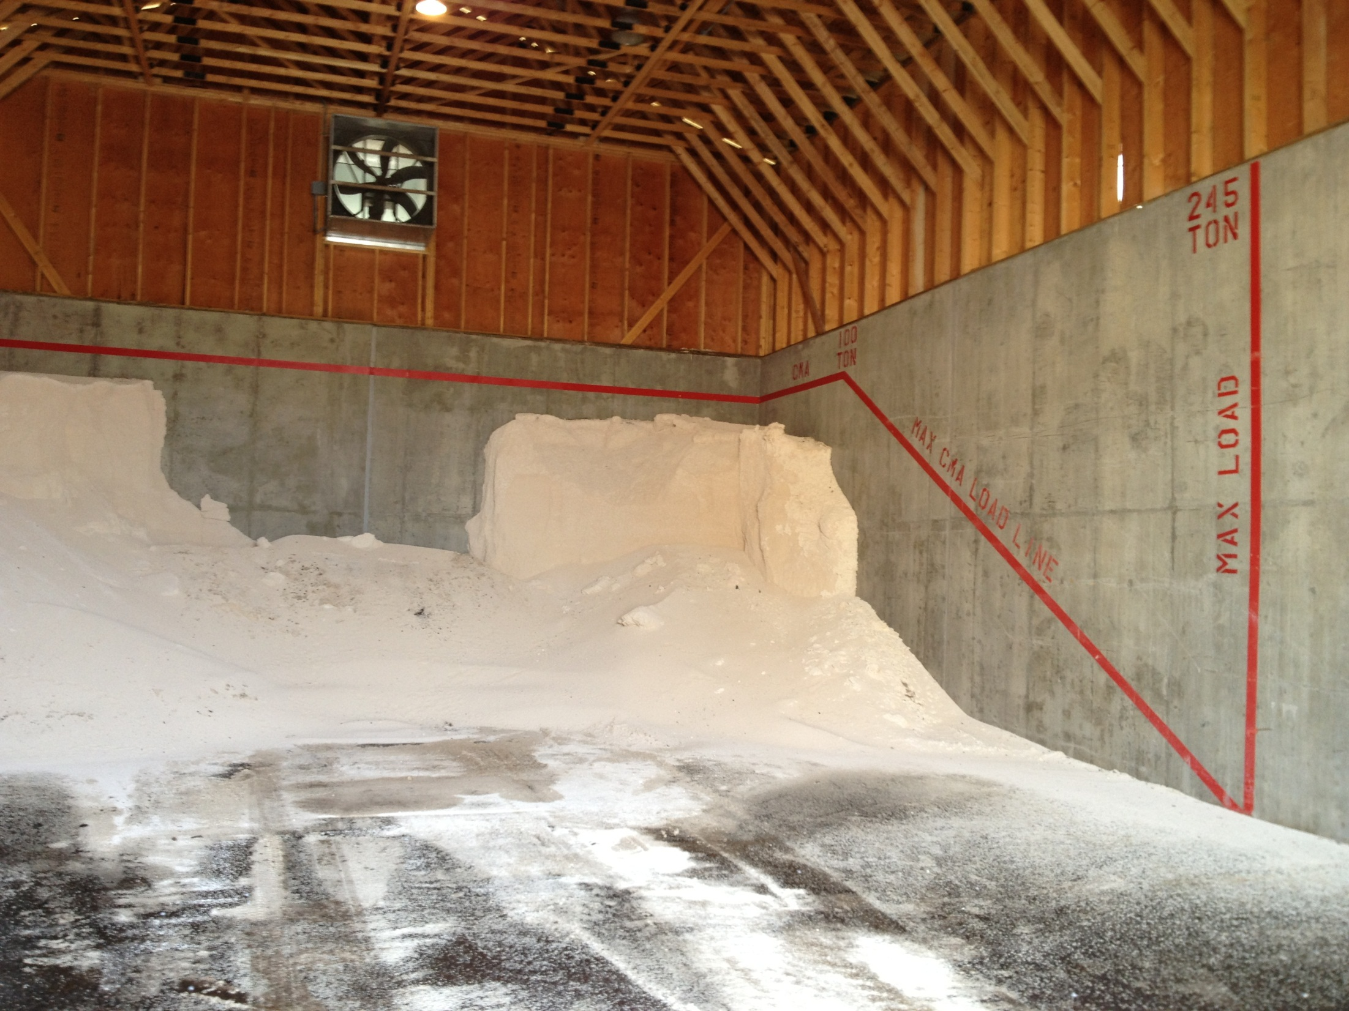
Positioning of granular products
Place granular stock piles away from door of shed.
To get best control, paint a top fill line and a forward fill line in your shed. No salt beyond that point ( safety of the structure, and runoff control)
Photo: Michigan DOT
Notes:
Note the line that marks the fill location and amount. Notice the salt is placed in the back of the shed allowing space for loading indoors. Placing salt in the back of the shed also protects it from wind and rain if your shed does not have doors.
Note the sand bags against the wall are being temporarily stored here, is not the permanent home for them. This city had a lot of spring flooding the year this picture was taken.

Slide 9
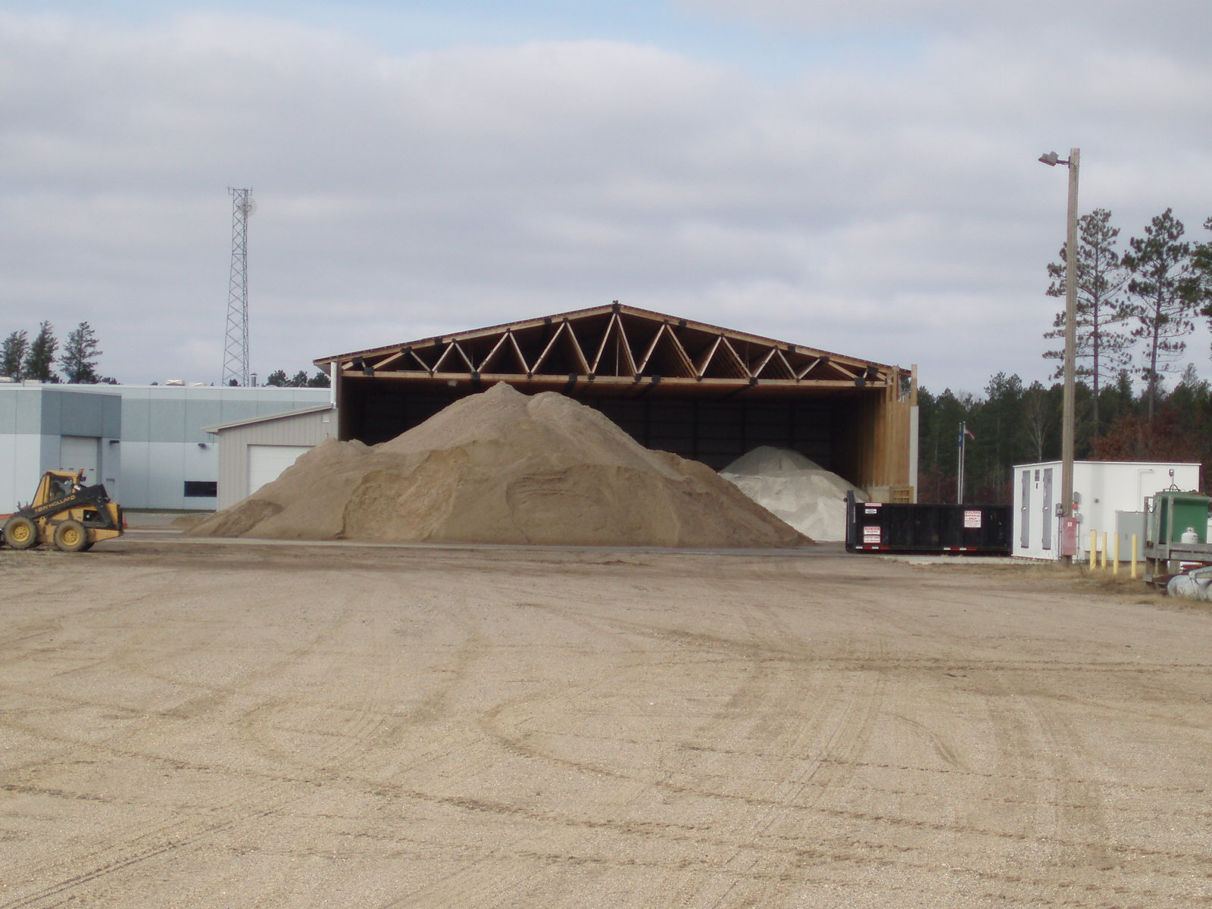
How about a new shed?
Add doors
Orient shed away from direction of rain
Allow loads to be delivered indoors
Allow trucks to load indoors
Big enough to hold all of your materials
Floor sloped in, not out
Photo: fortin consulting inc

Slide 10
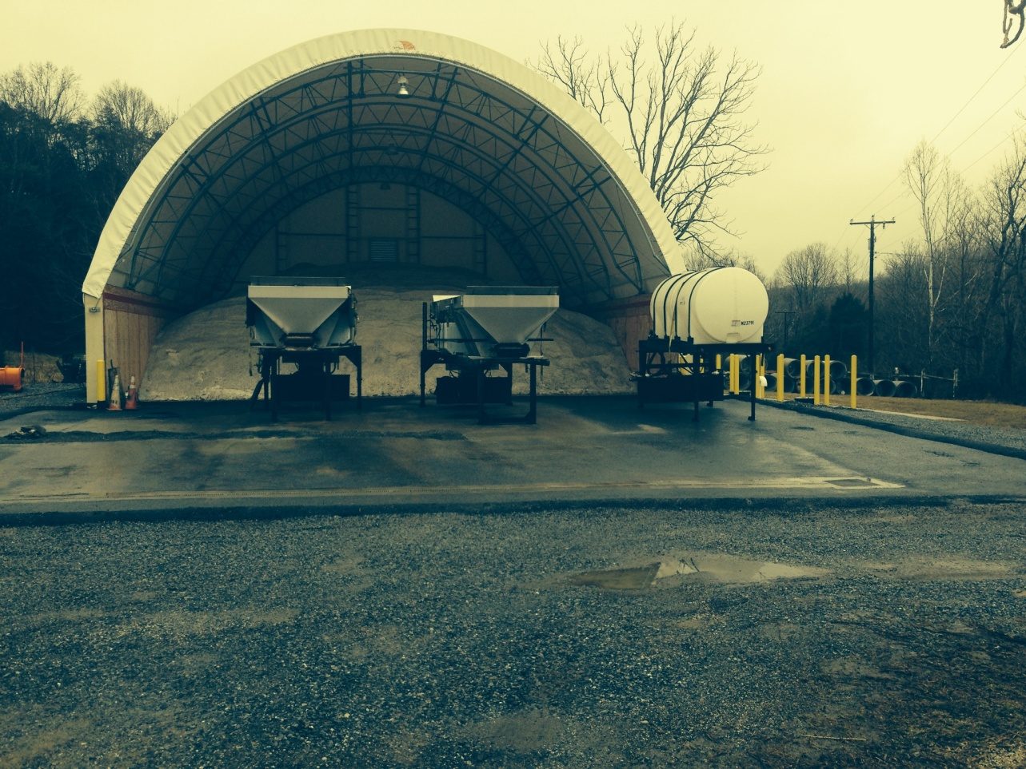
Why not re-use runoff water
Runoff gathering and reuse system
Route runoff into brine making system
Photo: Virginia DOT
Notes:
This storage area of Virginia DOT drains all run off water into a holding tank that is reused in brine making . If the pad has no salt on it they can turn a valve and direct water away from holding tank.

Slide 11
Proper liquid Storage
Labeled containers
Secondary containment
Follow your states guidelines
Photo: Michigan DOT
Notes:
As we shift to more and more liquids in winter maintenance proper storage is more and more important. Each state should have guidance on above or underground storage tanks. Sometimes states will not have specific guidance on salt brine or similar products. As a minimal best practice, tanks should be labeled and have double protection against leaks. Common methods of protection or secondary containment include purchasing a double walled tank ( more expensive than single wall tank) and/or setting the tank in a containment area so that if the tank leaks the liquid can be recovered.
Above jersey barriers with a rubber liner form a secondary containment area for this tank.

Slide 12
Secondary Containment for liquids
No matter what the regulations state, one or both of these are good housekeeping:
Double wall tanks
Contained,recovery area for spills
Each state may have different regulations for liquid storage. Put a synopsis of that here.
Photo: fortin consulting inc
Notes:
This is a good example of secondary containment. Notice the short cement wall which creates a bathtub for leaking tanks.
Also of interest in this picture, the tanks are all labeled with the contents and the organization has determined that indoor storage is appropriate for their climate and site.

Slide 13
Positioning liquid products
Look at the eutectic freeze point of the liquid. If it is warmer than that outside in the winter, you can store the tanks outdoors.
For example, this product has a eutectic freeze point of -26 degrees f.
Illustration: CDOT_De-Icer-Sampling-Program.pdf
Notes:
Example salt brine has eutectic of -6 degrees f. This may or may not allow for outside storage depending on the range of winter temperatures in your area. Consider the eutectic freeze point to help you decide if it should be stored indoors or outdoors. The manufacture can give you this information. If you blend your own mix, you are the manufacturer.
Test question: Should you store liquid deicers outdoors?
Yes, always a good idea in case the tank leaks
No, protect against hitting the tanks with your loaders
Sometimes, depends on eutectic freeze point of the liquid (right answer)

Slide 14
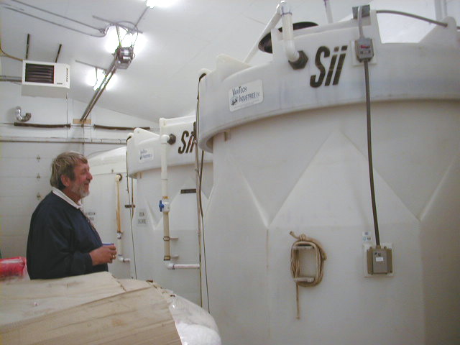
Example:Indoor storage
Photo: fortin consulting inc
Notes:
This is an example of double wall tanks. The idea with double wall tanks is if one layer fails, the other holds the liquid. Double wall tanks are not fool proof but they are much more reliable than single wall tanks. They are also much more expensive.
It is a best practice to have secondary containment.
Double wall tanks
Area surrounding tank that will catch all of the liquid should the tank leak. Where you can recover the liquid from. ( drain is the not answer)

Slide 15
Example:Outdoor storage
Photo: Virginia DOT
Notes:
Example of outdoor storage.
Know the eutectic temperature range of liquids. That will help you determine if it can be stored outdoors or indoors
For example Eutectic of salt brine is -6 degrees Fahrenheit, Eutectic of calcium chloride is -60 degrees Fahrenheit. It all depends on your temperature range.

Slide 16
QA of materials delivered both granular and liquids
Notes:
Start of a mini section

Slide 17
Testing liquid products
Photo: Fortin Consulting Inc

Slide 18
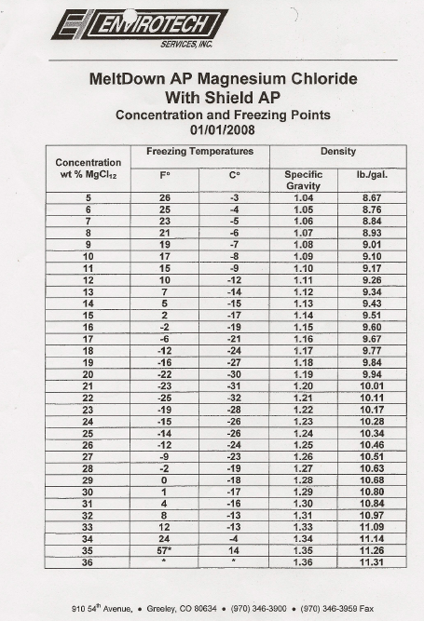
Must know your target before you test
Example of specific gravity information you should get from your vendors
Need this prior to testing!
Illustration: CDOT_De-Icer-Sampling-Program.pdf
Notes:
Specific gravity is the same as density. A hydrometer is a good tool to measure specific gravity. It However if you want to get accuracy to the 10ths, 100ths, or more, you need a more precise analytical tool.

Slide 19
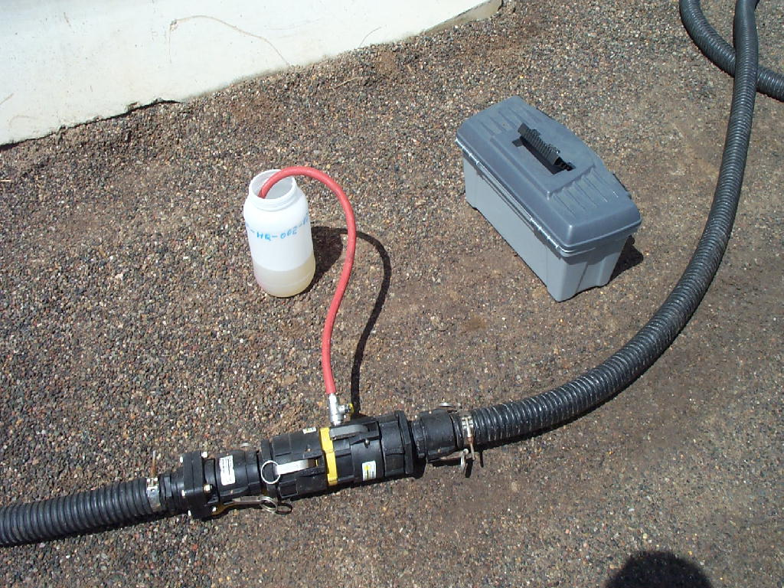
Quality testing of liquid deicers
Take a sample in sterile container
The more samples per delivery, from various fill levels of the delivery tanker the more accurate the results.
Label and send to lab for analysis or do it yourself
Photo: CDOT_De-Icer-Sampling-Program.pdf
Notes:
When purchasing liquid deicers, the vendor should supply the target specific gravity or acceptable range of specific gravity. When you receive a load you should test to make sure what you received meets the specifications. If the product does not meet the specifications it will not perform as expected.

Slide 20
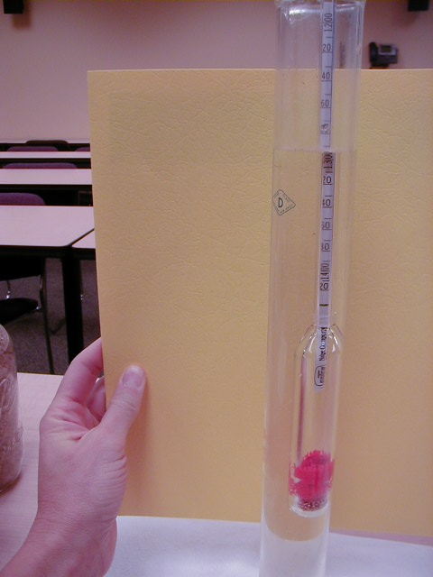
Do it yourself
Fill a beaker or jar with your liquid
Float a hydrometer in the liquid
Read the density at the top of the liquid
Compare the reading to your specification for that product
Photo: fortin consulting inc
Notes:
A simple hydrometer can be used to measure density. More advanced testing equipment many also be used and can be more precise. However the level of precision with the hydrometer is accurate enough for our uses.
Hint: plastic hydrometers are as accurate as glass hydrometers and less likely to break.

Slide 21
Example: Magnesium Chloride Specific Gravity Chart
% By Weight Specific Gravity Freezing Point F Freezing Point C
10
11
12
13
14
15
16
17
18
19
21
21
22
23
24
25
26
27
28
29
30
1.086
1.096
1.105
1.114
1.123
1.132
1.142
1.151
1.161
1.170
1.180
1.190
1.200
1.210
1.220
1.230
1.241
1.251
1.262
1.273
1.283
17.9
15.7
13.1
10.3
7.3
4.0
0.4
-3.5
-7.7
-12.2
-17.2
-23.0
-27.0
-20.0
-14.0
-10.0
-6.0
-3.0
-1.0
1.0
3.0
-7.8
-9.1
-10.5
-12.1
-13.7
-15.9
-17.6
-19.7
-22.1
-25.6
-27.4
-30.5
-32.8
-28.9
-25.6
-23.3
-21.1
-19.4
-18.3
-17.2
-16.7
Source:
Source: CDOT_Snowremoval-operator-training_slides_112-114_118-120_122.pptx
Notes:
Example of specific gravity for one product. Each product is likely to have a different specific gravity.

Slide 22
Quality testing of rock salt
Take a small sample from each load
Weigh it as soon as you take it
Remove the water, weigh it again
Determine % moisture
Compare to your spec
Take appropriate action
Photo: Fortin Consulting Inc
Notes:
Reference: Mn Snow and ice control field handbook for snowplow operators explains how to do this step by step. (Pg 23-25)
http://www.lrrb.org/media/reports/200501REV.pdf

Slide 23
Example: Drying out your sample
Photo: Fortin Consulting Inc
Notes:
Note that you do not need a large sample to test for moisture. You do need a representative sample. Cook it on the stove, in the microwave or other methods. Do it gently, salt will pop like popcorn and leave your container ruining your test. You could also put the sample in a sealed waterproof container and send it to a lab for analysis.

Slide 24
Compare to your salt moisture specification
Example Salt Specification
Insert your states salt moisture specification here
Chart: http://rebar.ecn.purdue.edu/snownice/documents/NaCl%20Midwestern%20States%20Specs.pdf
Notes:
States will vary on their specifications for salt, insert your states specifications here.

Slide 25
Good Housekeeping
Poor storage is linked to groundwater pollution and that can be traced back to you.
Don’t take shortcuts on storage
Invest time to keep you storage areas well maintained
Photo: Fortin Consulting Inc
Notes:
Start of a mini section
Good example of labeled storage, clean and tidy site.

Slide 26
Photo: Virginia DOT
Keep doors closed
Keep pad clear of salt
Fix holes or cracks in building
Notes:
Good housekeeping tips:
Make sure all salt is contained in the shed
Don’t overfill the shed
- Sweep salt from pad back into shed
- Keep doors closed when not in use
Test question: Which are good housekeeping practices:
Don’t overfill shed(yes)
Sweep pad in front of shed frequently (yes)
Hose off pad in front of shed frequently (no)
Close doors when not in use (yes)

Slide 27
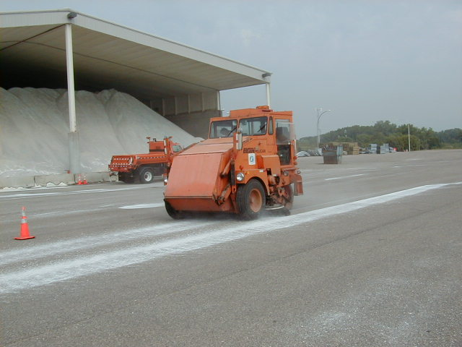
Sweep the loading area
Photo: Fortin Consulting Inc
Notes:
Keep salt in the pile and reduce the amount of salt that can be exposed to snow, rain and wind.

Slide 28
Delivery of materials
When you order rock salt or pretreated salt, consider requesting that it must be delivered to you in a tarped vehicle. This will reduce your chance of receiving a wet load.
Good idea
Notes:
Work with your vendor. Tarped loads will require a little more work for them but a better product for you. Plus the added benefit of less salt being lost in transport.

Slide 29
Storage Inspections
Notes:
Start of a mini section

Slide 30
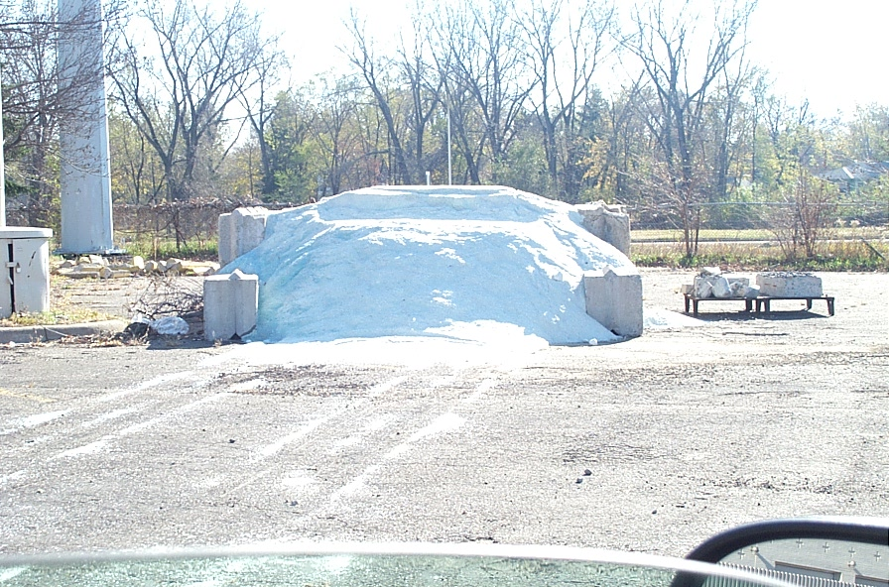
Storage Inspections
Check drainage area around the salt shed. Do not have water directed toward salt storage.
Inspect salt shed roof drainage
Make sure sheds are not overfilled
Verify surface under the salt pile and loading area is in good shape, no cracks or holes.
Look for a river (dried or running) of salt brine leaving the shed
Make sure all granular salt and salt/sand are stored indoors
Any other observations that would put your salt pile at risk for leaching
Photo: Fortin Consulting Inc
Notes:
If sheds are overfilled, protect the pile with tarps. Make it a practice to not overfill sheds. If you don’t have enough storage capacity, work with neighboring organizations to share storage facilities.
If the shed is not water tight, water will enter the shed and runout of the shed. Remember all runoff should be contained in the shed or directed to an area where runoff can be contained and not moved into ditches, lakes, rivers, ponds or stormsewer systems.
The area outside of the storage shed should be kept free of salt, sweep salt back into the pile.
Salt, when dissolved tries to move in many directions. Make sure the pad has no cracks or holes in it where the salty water can penetrate. Downward movement of salt is likely to pollute your groundwater.
Look at the roof drainage to the shed. Is the water being directed away from the salt pile or into the salt pile. Make sure all water is being directed away from the salt pile.
Test question: What should you look for on a storage inspection
Holes and cracks in the shed where water can get in (yes)
Pad has salt on it and needs sweeping (yes)
Doors are closed (yes)
No smoking sign posted in each shed (no)

Slide 31
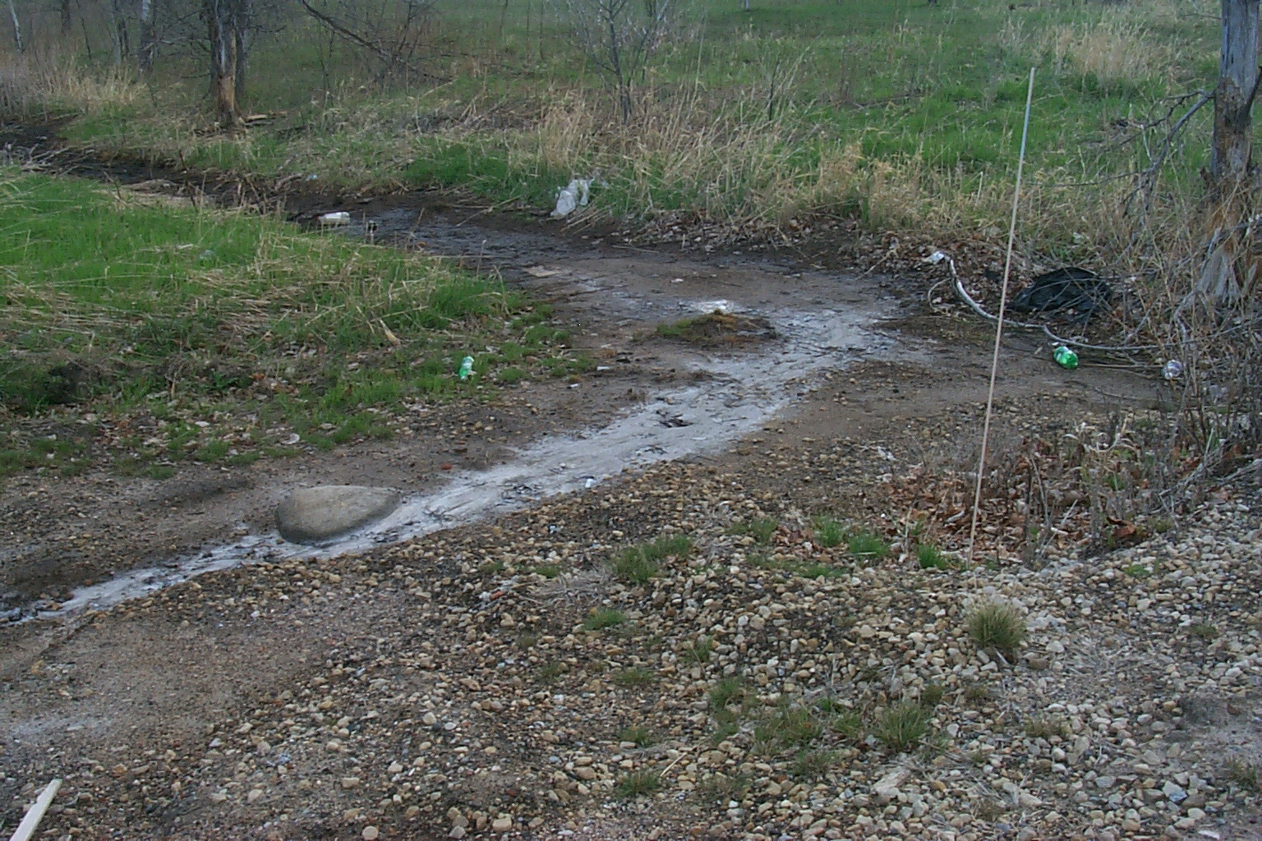
Bad example: river of salt leaving storage area
No salt leaving the site
Any rivers of white leaving your storage area? If so you still have work to do.
Photo: Fortin Consulting Inc
Notes:
Did you know that 1 teaspoon of salt contaminates about 5 gallons of water forever. Keep the salt out of the water especially in your storage area. It isnt helping with public safety, it is only creating a public nuisance if stored improperly.

Slide 32
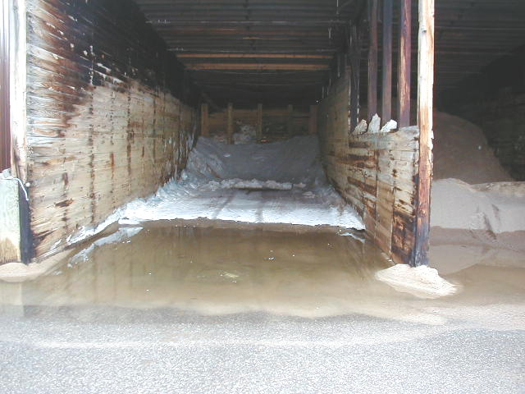
Slope pad and parking lot
Bad example: Parking lot runoff entering your shed.
Photo: Fortin Consulting Inc
Notes:
May have to re-grade parking lot or build a berm to prevent water from running into the shed.
Best to consider drainage before you build your shed or place your temporary stockpile outdoors. However if you have a problem with drainage you need to take responsibility to fix it.

Slide 33
Good example: everything contained
Photo: Fortin Consulting Inc

Slide 34
Additional resources
MN snow and ice control field handbook for snowplow operators http://www.lrrb.org/media/reports/200501REV.pdf
AASHTO, Clear Roads Computer Based training:
Winter Maintenance Management: Unit 5 covers basics of storage facilities, storing liquid chemicals, dry materials storage, abrasive storage, materials delivery
Selecting Snow and Ice Control Materials to Mitigate Environmental Impacts: Unit 8 covers Quality Assurance Documentation, Field Quality Assurance Procedures, Sample Collection Procedures, Lab testing
Deicing: Unit 3 covers loading dry materials, storage facilities, storing dry materials, storing liquid chemicals, bulk storage facilities, abrasive storage, material deliveries
Colorado DOT de-icer-sampler-program.pdf found on clear roads site under Reference Materials: Training for Supervisors and Operators

