Slide 1
Teaching Safe Bicycling
(photo coming from BikeFed video beginning Watercolor painting of Children biking by Chrys DePas)

Slide 2
Teaching Safe Bicycling
Activities and tips designed to help teach children the skills they need to avoid the most common and severe crashes involving children on bicycles and people driving.
Content developed by
in cooperation with the
Wisconsin Department of Transportation
This series of 8 two-minute videos is based on our 8 hour Teaching Safe Bicycling Train the Trainer class
Notes:
2
Children often do not know the best way to use their brakes to stop quickly and effectively.
We make a game of it by having them stop as close to a line as possible and marking how close they are to show their progress as they try new techniques.
With coaster (foot) brakes they like to skid. But sliding friction is 1) lower than rolling friction, thus skidding takes longer to stop and 2) the bike is out of control and usually no longer traveling in a straight line.
To stop a bike with coaster brakes without skidding, push back on the pedals in a circular motion using even pressure rather than jamming down on the pedals as hard as you can.
With caliper (hand) brakes, children often rely on the rear brake alone. They are afraid of using the front brake too hard and going over the handlebars, but the front brake has the most stopping power.
The best way to stop with caliper / hand brakes is to use both the front and rear brakes together.
The front brake provides the stopping power and the rear brake provides stability.
If the rear wheel starts to skid, ease up on the front brake.
Advanced:
The hover: Slightly lift your body off the seat, straighten your arms and, without raising your body, push your weight over your back wheel.
Begin practicing at slow speeds.
We like to practice these in sequence so children can see that what they are learning actually works.
Stop as close to the line as possible without going over:
1st with the right brake only
2nd with both brakes
3rd we teach then add the hover

Slide 3
Teaching Safe Bicycling
Activities and tips designed to help teach children the skills they need to avoid the most common and severe crashes involving children on bicycles and people driving.
Special thanks to the City of Appleton
for your cooperation and support and for being such a great bike friendly city!
This series of 8 two-minute videos is based on our 8 hour Teaching Safe Bicycling Train the Trainer class
Notes:
3
Children often do not know the best way to use their brakes to stop quickly and effectively.
We make a game of it by having them stop as close to a line as possible and marking how close they are to show their progress as they try new techniques.
With coaster (foot) brakes they like to skid. But sliding friction is 1) lower than rolling friction, thus skidding takes longer to stop and 2) the bike is out of control and usually no longer traveling in a straight line.
To stop a bike with coaster brakes without skidding, push back on the pedals in a circular motion using even pressure rather than jamming down on the pedals as hard as you can.
With caliper (hand) brakes, children often rely on the rear brake alone. They are afraid of using the front brake too hard and going over the handlebars, but the front brake has the most stopping power.
The best way to stop with caliper / hand brakes is to use both the front and rear brakes together.
The front brake provides the stopping power and the rear brake provides stability.
If the rear wheel starts to skid, ease up on the front brake.
Advanced:
The hover: Slightly lift your body off the seat, straighten your arms and, without raising your body, push your weight over your back wheel.
Begin practicing at slow speeds.
We like to practice these in sequence so children can see that what they are learning actually works.
Stop as close to the line as possible without going over:
1st with the right brake only
2nd with both brakes
3rd we teach then add the hover

Slide 4
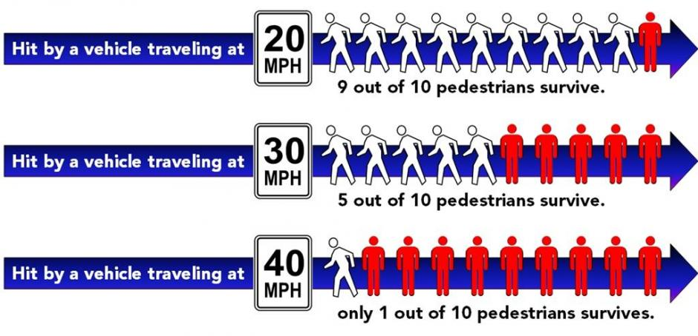
Kids moving slowly on bikes have a similar speed as a pedestrian
Pedestrian’s chance of being killed if being hit by a motor vehicle

Slide 5
Pre-Ride Safety
Helmet Fit and Basic Bike Maintenance Check

Slide 6
Most common and severe crash types and
skills needed to avoid them
Driveway or Midblock Rideout
12% of crashes 22% incapacitating or fatal
Stop Sign/Signal Rideout
17% of crashes 20% incapacitating or fatal
Sudden Swerve
7% of crashes 25% incapacitating or fatal
Skills to develop:
Helmet Fit – A helmet that fits properly will protect you if a crash does happen.
ABC Quick Check – Will make sure your bicycle is working properly and able to respond to your reactions.
Wrong way riding is not a separate crash type, but is a contributing factor in many crashes.
Notes:
6

Slide 7
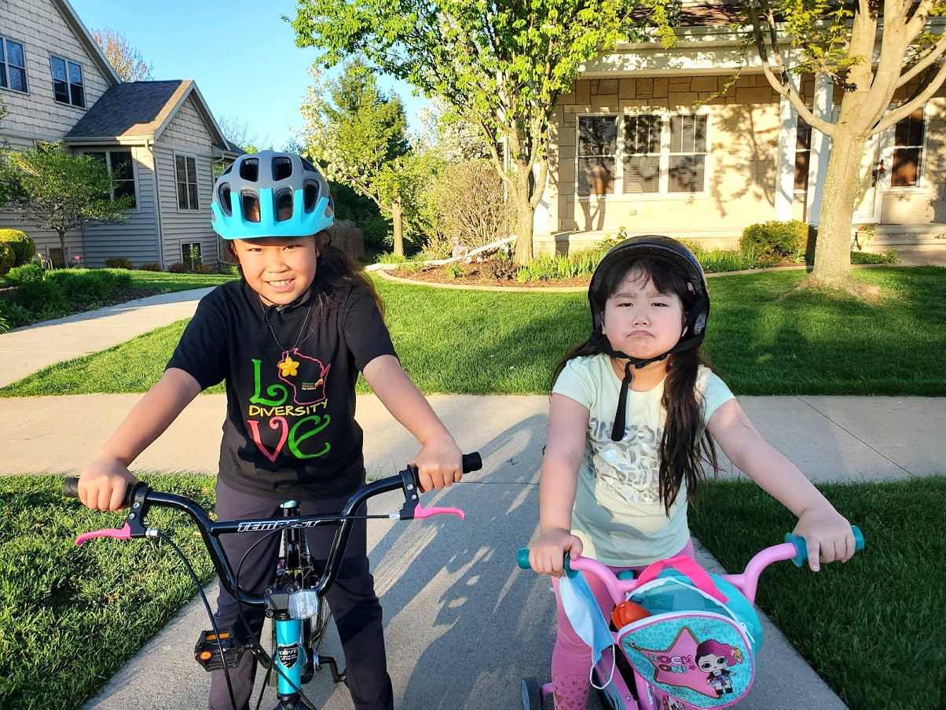
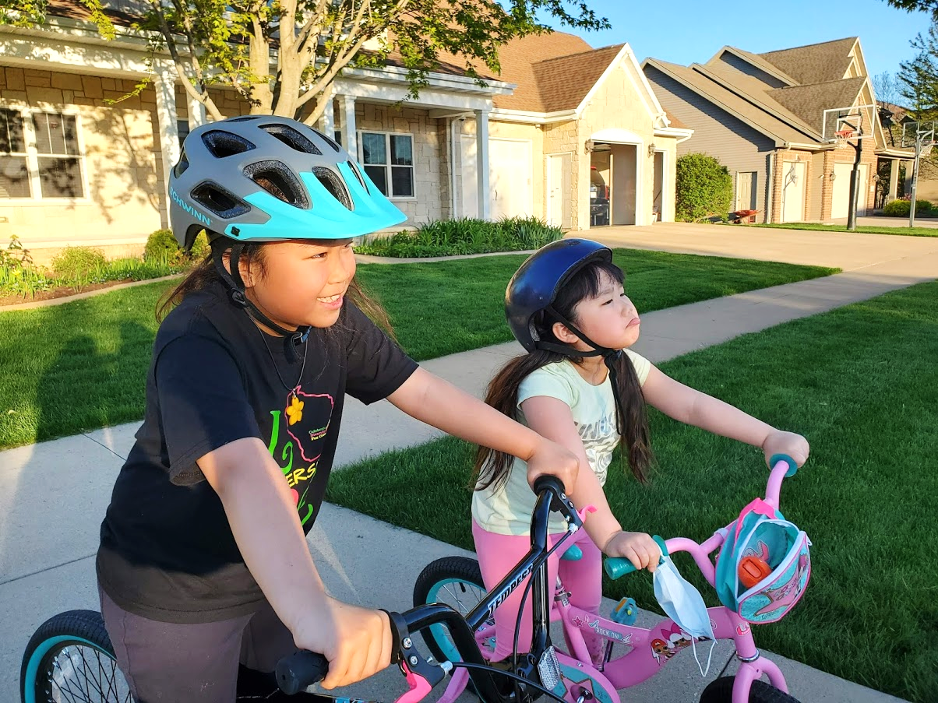
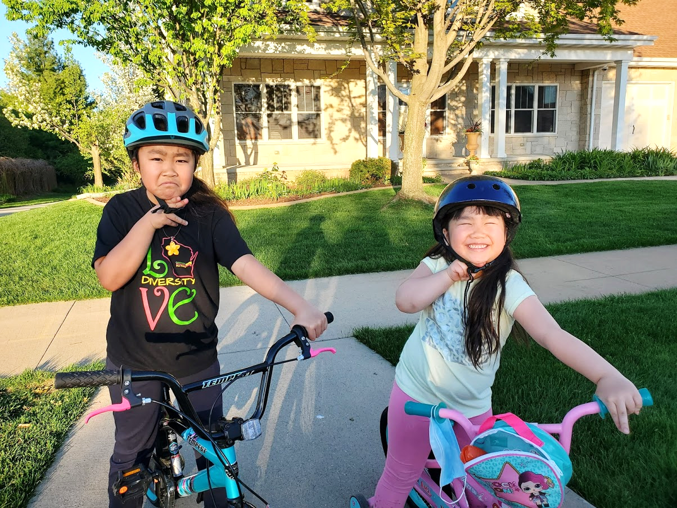
Helmet Fit
Helmet should be level. 2 fingers touching the helmet and the eyebrow at the same time
Helmet should not be tipped back, or it will not protect your head and face properly.
It will also be very uncomfortable.
2
The 2 plastic pieces on the sides should be just below the ears.
Straps:
Front = up & down
Back = front & back
The 2 plastic pieces on the sides should not be below the chin.
This does not hold the helmet in place.
2
If the 2 fingers can be turned up and down, the chin strap is too loose.
2
2 fingers should fit under the chin strap.
Flat, not up and down.

Slide 8
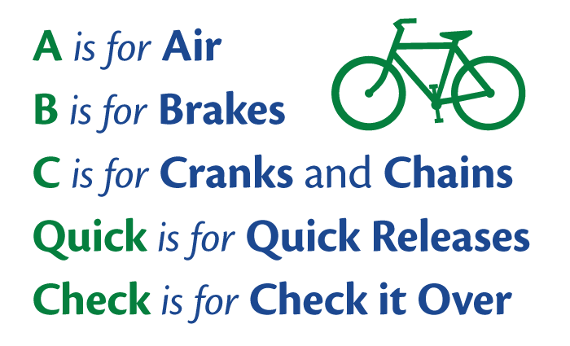
ABC Quick Check
—Check each time before you ride.

Slide 9
Most common and severe crash types and
skills needed to avoid them
Driveway or Midblock Rideout
12% of crashes 22% incapacitating or fatal
SKILL TO DEVELOP:
Stop and look all ways before entering the road: Station 4
Stop Sign/Signal Rideout
17% of crashes 20% incapacitating or fatal
SKILLS TO DEVELOP:
Effective stopping and controlled starting: Station 1
Learn signs – Communicate with other road users – Be predictable: Station 5
Scan behind – Communicate with other road users – Be predictable: Station 6
Balance – Avoid hazards without swerving into traffic: Station 7
Sudden Swerve
7% of crashes 25% incapacitating or fatal
SKILLS TO DEVELOP:
Effective stopping and controlled starting: Station 1
Signaling and Scanning: Station 2
Straight Line Riding: Station 3
All skills should be practiced until they are instinctive.

Slide 10
Station 1
Skill to develop:
Effective stopping and controlled starting

Slide 11
Most common and severe crash types and
skills needed to avoid them
Driveway or Midblock Rideout
12% of crashes 22% incapacitating or fatal
Stop Sign/Signal Rideout
17% of crashes 20% incapacitating or fatal
Skill to develop: Effective stopping
Sudden Swerve
7% of crashes 25% incapacitating or fatal
Skill to develop: Controlled starting
Wrong way riding is not a separate crash type, but is a contributing factor in many crashes.
Notes:
11

Slide 12
Station 1: Power Pedal Skills
Crash avoidance: Sudden swerve – learn straight line riding to maintain control of your bicycle.
Beginners:
Power pedal position just past the top
Practice pulling pedal up from behind with the top of their foot
Strong push down gains speed quickly with their feet securely on the pedals
Avoids unpredictable “scooter starts”
Advanced:
Practice stopping with pedals in the power pedal position
Shift down to a comfortable gear for a smooth start
Bike should fit so rider does not get off the seat at each stop
No “cowboy” starts
Drivers: Know that kids are trusting, often distracted and simply may not stop.
Kids do not have good judgement of speed, or their brakes may not work.
Notes:
12
Children often do not know the best way to use their brakes to stop quickly and effectively.
We make a game of it by having them stop as close to a line as possible and marking how close they are to show their progress as they try new techniques.
With coaster (foot) brakes they like to skid. But sliding friction is 1) lower than rolling friction, thus skidding takes longer to stop and 2) the bike is out of control and usually no longer traveling in a straight line.
To stop a bike with coaster brakes without skidding, push back on the pedals in a circular motion using even pressure rather than jamming down on the pedals as hard as you can.
With caliper (hand) brakes, children often rely on the rear brake alone. They are afraid of using the front brake too hard and going over the handlebars, but the front brake has the most stopping power.
The best way to stop with caliper / hand brakes is to use both the front and rear brakes together.
The front brake provides the stopping power and the rear brake provides stability.
If the rear wheel starts to skid, ease up on the front brake.
Advanced:
The hover: Slightly lift your body off the seat, straighten your arms and, without raising your body, push your weight over your back wheel.
Begin practicing at slow speeds.
We like to practice these in sequence so children can see that what they are learning actually works.
Stop as close to the line as possible without going over:
1st with the right brake only
2nd with both brakes
3rd we teach then add the hover

Slide 13
Station 1: Controlled Braking Skills
Crash avoidance: Stop your bike instinctively, maintain control of your bicycle.
Beginners: What do we use to stop our bikes? BRAKES (not feet!)
Pressure on brakes to stop
Avoid a skid by pressing the coaster brake in a rotating motion
Riders say “stopping” to begin the idea of communicating
Advanced:
Faster speed
Simulate crash scenarios
Signal and verbalize slowing and stopping
Hand brakes: Right vs Both
Emergency stop with the hover
Drivers: Know that kids are trusting, often distracted and simply may not stop.
Kids do not have good judgement of speed, or their brakes may not work.
Notes:
13
Children often do not know the best way to use their brakes to stop quickly and effectively.
We make a game of it by having them stop as close to a line as possible and marking how close they are to show their progress as they try new techniques.
With coaster (foot) brakes they like to skid. But sliding friction is 1) lower than rolling friction, thus skidding takes longer to stop and 2) the bike is out of control and usually no longer traveling in a straight line.
To stop a bike with coaster brakes without skidding, push back on the pedals in a circular motion using even pressure rather than jamming down on the pedals as hard as you can.
With caliper (hand) brakes, children often rely on the rear brake alone. They are afraid of using the front brake too hard and going over the handlebars, but the front brake has the most stopping power.
The best way to stop with caliper / hand brakes is to use both the front and rear brakes together.
The front brake provides the stopping power and the rear brake provides stability.
If the rear wheel starts to skid, ease up on the front brake.
Advanced:
The hover: Slightly lift your body off the seat, straighten your arms and, without raising your body, push your weight over your back wheel.
Begin practicing at slow speeds.
We like to practice these in sequence so children can see that what they are learning actually works.
Stop as close to the line as possible without going over:
1st with the right brake only
2nd with both brakes
3rd we teach then add the hover

Slide 14
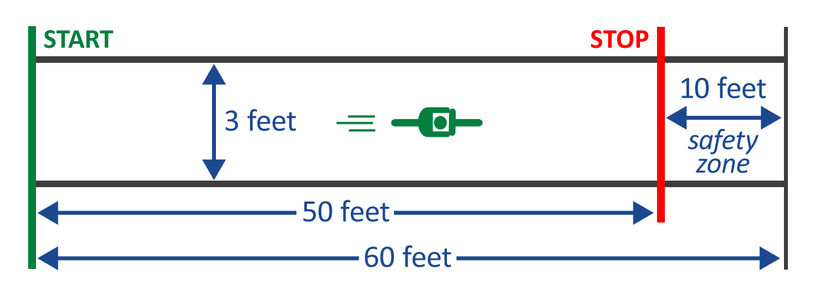
Power Pedal & Controlled Braking – Activity
Crash avoidance: A fast start helps you ride in a straight line. Know what it takes to stop your bike.
Helper: Teach kids to position power pedal with the top of their foot under the pedal. Practicing controlled braking by having the child ride down a 3-foot-wide lane and stop, as close to a line as possible, without going over.
Master then advance: 1st-right brake, 2nd-both brakes, 3rd-emergency stop hover.
A 50-foot lane with a start line, stop line, and a 10-foot buffer as a safety zone at the end.
Make it fun: Mark when the front tire is when they stop so kids can see progress in their practice! Skid length is added to the end of the final stop.
Drivers: Know that kids are distracted or trusting and simply may not stop. Kids do not have good judgement of speed, or brakes may not work.
Notes:
14
Children often do not know the best way to use their brakes to stop quickly and effectively.
We make a game of it by having them stop as close to a line as possible and marking how close they are to show their progress as they try new techniques.
With coaster (foot) brakes they like to skid. But sliding friction is 1) lower than rolling friction, thus skidding takes longer to stop and 2) the bike is out of control and usually no longer traveling in a straight line.
To stop a bike with coaster brakes without skidding, push back on the pedals in a circular motion using even pressure rather than jamming down on the pedals as hard as you can.
With caliper (hand) brakes, children often rely on the rear brake alone. They are afraid of using the front brake too hard and going over the handlebars, but the front brake has the most stopping power.
The best way to stop with caliper / hand brakes is to use both the front and rear brakes together.
The front brake provides the stopping power and the rear brake provides stability.
If the rear wheel starts to skid, ease up on the front brake.
Advanced:
The hover: Slightly lift your body off the seat, straighten your arms and, without raising your body, push your weight over your back wheel.
Begin practicing at slow speeds.
We like to practice these in sequence so children can see that what they are learning actually works.
Stop as close to the line as possible without going over:
1st with the right brake only
2nd with both brakes
3rd we teach then add the hover

Slide 15
Station 2
Skill to develop: Signaling and Scanning

Slide 16
Most common and severe crash types and
skills needed to avoid them
Driveway or Midblock Rideout
12% of crashes 22% incapacitating or fatal
Stop Sign/Signal Rideout
17% of crashes 20% incapacitating or fatal
Sudden Swerve
7% of crashes 25% incapacitating or fatal
Skill to develop: Signaling and Scanning
Wrong way riding is not a separate crash type, but is a contributing factor in many crashes.
Notes:
16

Slide 17
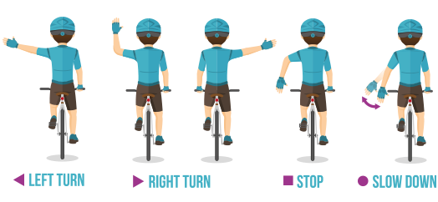
Station 2: Signals and Scanning Skills
Crash avoidance: Sudden swerve, understanding signs and habits in traffic.
Beginners:
Put your chin on your shoulder to stay steady
Hold arm straight out so your intent is very clear
Hand should be back on the handlebar before beginning the turn
Smile at everyone!
Advanced:
Remove your left hand from the handlebars to stay steady
Jazz hands — movement is more noticeable
Learn signals for road hazards and slowing down
Thumbs up and thank you wave
Drivers: Slow down, wait until it is safe to move over and pass. Be prepared for kids to swerve and turn unpredictably.
Notes:
17
Another major cause of bicycle crashes for children is the unexpected left turn or sudden left swerve.
The child forgets to look being him/her for traffic before turning left into a driveway or at an intersection, or before moving further left on the road to avoid a hazard. Scanning teaches them how to look behind them for traffic while riding a straight line. Most children quickly pick up this skill.

Slide 18
Station 2: Signals and Scanning Activity
Crash avoidance: Before you signal, always look into traffic for a safe time to move out of your predictable pattern. Scanning practice develops the habit of looking before going.
Helper: Tap kids on the left shoulder to remind them which way to look. Hold up your arm(s) away from your body and say “LOOK” Participant will shout out how many arms you are holding up. New riders look in the widest section, helper stands to the left of them. Experienced riders look in the narrowest section, helper stands directly behind them.
The first 20 feet are an opportunity to gain speed to easily ride in a straight line.
Make it fun: Use colors or any object to help their observation skills. Doing math with fingers challenges older kids and gets them multi tasking, like they will need to be in a real situation.
Drivers: Slow down, wait until it is safe to move over and pass. Be prepared for kids to swerve and turn unpredictably.
Notes:
18
Another major cause of bicycle crashes for children is the unexpected left turn or sudden left swerve.
The child forgets to look being him/her for traffic before turning left into a driveway or at an intersection, or before moving further left on the road to avoid a hazard. Scanning teaches them how to look behind them for traffic while riding a straight line. Most children quickly pick up this skill.

Slide 19
Station 3
Skill to develop: Straight Line Riding

Slide 20
Most common and severe crash types and
skills needed to avoid them
Bicyclist – Driveway or Midblock Rideout
12% of crashes 22% incapacitating or fatal
Bicyclist – Stop Sign/Signal Rideout
17% of crashes 20% incapacitating or fatal
Bicyclist – Sudden Swerve
7% of crashes 25% incapacitating or fatal
Skill to develop: Straight Line Riding
Wrong way riding is not a separate crash type, but is a contributing factor in many crashes.
Notes:
20

Slide 21
Station 3: Obstacle Avoidance – Slalom Skills
Crash avoidance: Sudden swerve. Avoiding obstacles and maintaining control of your bicycle when you see the obstacle coming and are able to plan ahead.
Beginners:
Focus far ahead, not on the obstacle
Start slow, some speed makes this easier
Mistakes are ok!
You are learning:
How to avoid obstacles
— AND —
How to recover from this sudden loss of control
Advanced:
Lean to steer. Don’t use your handlebars to steer your bicycle
Maintain as straight of line as possible
Scan and signal a turn at the end
Drivers: Slow down, wait until it is safe to move over a minimum of 3 feet and pass when safe. Be prepared for kids to swerve and turn unpredictably.
Notes:
21
Another major cause of bicycle crashes for children is the unexpected left turn or sudden left swerve.
The child forgets to look being him/her for traffic before turning left into a driveway or at an intersection, or before moving further left on the road to avoid a hazard. Scanning teaches them how to look behind them for traffic while riding a straight line. Most children quickly pick up this skill.

Slide 22
Station 3: Obstacle Avoidance – Slalom Activity
Crash avoidance: Maintain control of your bicycle, avoid a sudden swerve into traffic ride in as straight of line as possible.
Helper: Use ½ tennis balls so they know they hit the obstacle, or chalk for simplicity. Watch for any traffic and help make people driving aware as they approach from any direction. Make sure kids are looking for cars before the cross the street to circle back.
Set up on the right side of the road, participants should pedal the same direction of traffic.
Make it fun: Count the number of successful weaves out loud together as they pedal through. Take one cone off the longer end and add it to the shorter end after they make a few successful passes. Use this station to return kids to the line after completing any station.
Drivers: Slow down, wait until it is safe to move over and pass. Be prepared for kids to swerve and turn unpredictably.
Notes:
22
Another major cause of bicycle crashes for children is the unexpected left turn or sudden left swerve.
The child forgets to look being him/her for traffic before turning left into a driveway or at an intersection, or before moving further left on the road to avoid a hazard. Scanning teaches them how to look behind them for traffic while riding a straight line. Most children quickly pick up this skill.

Slide 23
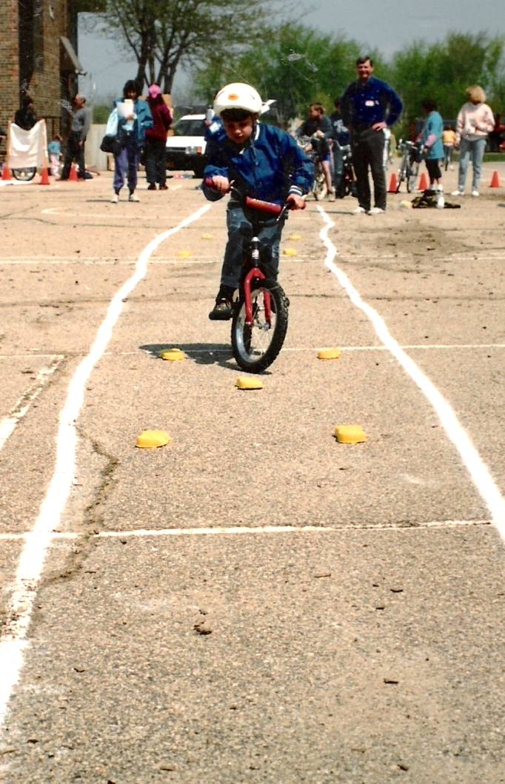
Station 3: Obstacle Avoidance – Rock Dodge Skills
Crash avoidance: Sudden swerve. Avoiding obstacles and maintaining control of your bicycle when you don’t see the obstacle until the last second.
Beginners:
This is a very fast motion, think “FLICK away-FLICK back” in one second
Start your motion as close to the obstacle as possible.
Your goal is to avoid the obstacle with your front wheel, which controls your steering.
Some speed makes this easier.
Advanced:
Start the motion as late, and close to the obstacle, as possible
Ideally the obstacle will pass between your front and back wheels without touching either
Strong fast “flick-flick” at about a 45 degree angle
Maintain as straight of line as possible
Drivers: Slow down, wait until it is safe to move over a minimum of 3 feet and pass when safe. Be prepared for kids to swerve and turn unpredictably.
Notes:
23
Another major cause of bicycle crashes for children is the unexpected left turn or sudden left swerve.
The child forgets to look being him/her for traffic before turning left into a driveway or at an intersection, or before moving further left on the road to avoid a hazard. Scanning teaches them how to look behind them for traffic while riding a straight line. Most children quickly pick up this skill.

Slide 24
Station 3: Obstacle Avoidance – Rock Dodge Activity
Crash avoidance: Maintain control of your bicycle, avoid a sudden swerve into traffic ride in as straight of line as possible.
Helper: Use ½ tennis balls so they know they hit the obstacle, or chalk for simplicity. Practice this activity while walking their bike and flicking their handlebars quickly. The bicycle maintains a straight line motion. Leave the corner balls 12 inches apart for beginners. Weaving around is not a successful completion.
Practice the motion without the balls first
Make it fun: Tally successes, give more points for the center ball going between the front and back wheels. Stand next to the balls or run by to simulate traffic and the need for this maneuver.
Drivers: Slow down, wait until it is safe to move over and pass. Be prepared for kids to swerve and turn unpredictably.
Notes:
24
Another major cause of bicycle crashes for children is the unexpected left turn or sudden left swerve.
The child forgets to look being him/her for traffic before turning left into a driveway or at an intersection, or before moving further left on the road to avoid a hazard. Scanning teaches them how to look behind them for traffic while riding a straight line. Most children quickly pick up this skill.

Slide 25
Station 4
Skill to develop: Stop and look all ways before entering the road

Slide 26
Most common and severe crash types and
skills needed to avoid them
Driveway or Midblock Rideout
12% of crashes 22% incapacitating or fatal
Skill to develop: Stop and look all ways before entering the road
Stop Sign/Signal Rideout
17% of crashes 20% incapacitating or fatal
Sudden Swerve
7% of crashes 25% incapacitating or fatal
Wrong way riding is not a separate crash type, but is a contributing factor in many crashes.
Notes:
26

Slide 27
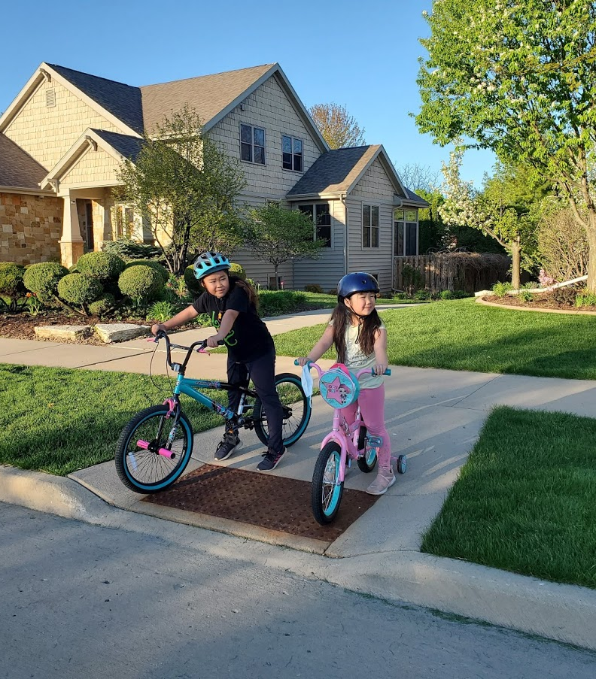
Station 4: Driveway/Mid-Block Pullout Skills
Crash avoidance: Riding into traffic. Stop completely, enter the road into the proper lane position, be predictable, learn driver habits.
Beginners:
Let kids say when they think it is safe to go, but their grown ups make the final decision
Stop, with 2 feet on the ground, in a place where they can easily see all traffic
Pull out carefully along right side of the road about 3 feet from the curb without swerving into the traffic lane
Advanced:
Slowly pull up close to the road entrance and stop completely
Make sure you have a clear view of all traffic and you can be seen
Go only when cars will have enough time to stop if you pull out too far
Thumbs up and thank you wave
Drivers: Slow down. Expect kids to be everywhere. Kids often feel safe when they can’t be seen, between parked cars or behind bushes, away from the road entrance.
Know that younger kids often follow far behind older kids onto the street.
Notes:
27
Another major cause of bicycle crashes for children is the unexpected left turn or sudden left swerve.
The child forgets to look being him/her for traffic before turning left into a driveway or at an intersection, or before moving further left on the road to avoid a hazard. Scanning teaches them how to look behind them for traffic while riding a straight line. Most children quickly pick up this skill.

Slide 28
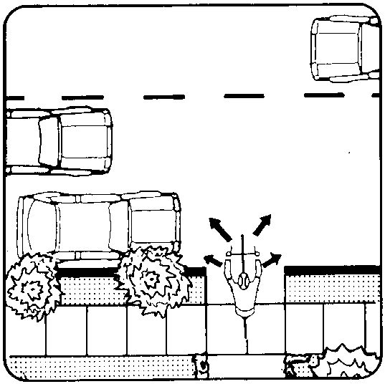
Station 4: Driveway/Mid-Block Pullout – Activity
Crash avoidance: Do not enter the road when traffic is approaching. Be seen and predictable, do not swerve into traffic lanes, stay 3 feet from the curb.
Helper:
Make sure that kids stop completely when preparing to enter any road
Look Left-Right and Left again
Timing varies, judging speed is difficult
Teach kids to wait their turn & not pull out when one driver motions it is ok
Show kids the difference of waiting where they can see and be seen vs hiding where they may feel safe
Discuss driver habits, good AND bad
Use a driveway on a quiet street, or a path that spills out of a park into the street.
The more realistic the better!
Make it fun: Use real vehicles parked to block the view. While you are driving, show kids how it can be difficult to see. have kids help watch for others playing in driveways or parks and alert you to possible Mid-Block Pullouts.
Drivers: Slow down. Expect kids to be everywhere. Kids often feel safe when they can’t be seen, between parked cars or behind bushes, away from the road entrance.
Know that younger kids often follow far behind older kids onto the street.
Notes:
28
Another major cause of bicycle crashes for children is the unexpected left turn or sudden left swerve.
The child forgets to look being him/her for traffic before turning left into a driveway or at an intersection, or before moving further left on the road to avoid a hazard. Scanning teaches them how to look behind them for traffic while riding a straight line. Most children quickly pick up this skill.

Slide 29
Station 5
SkillS to develop: Learn signs – Communicate with other road users – Be predictable

Slide 30
Most common and severe crash types and
skills needed to avoid them
Bicyclist – Driveway or Midblock Rideout
12% of crashes 22% incapacitating or fatal
Bicyclist – Stop Sign/Signal Rideout
17% of crashes 20% incapacitating or fatal
SkillS to develop: Learn signs – Communicate with other road users – Be predictable
Bicyclist – Sudden Swerve
7% of crashes 25% incapacitating or fatal
Wrong way riding is not a separate crash type, but is a contributing factor in many crashes.
Notes:
30

Slide 31
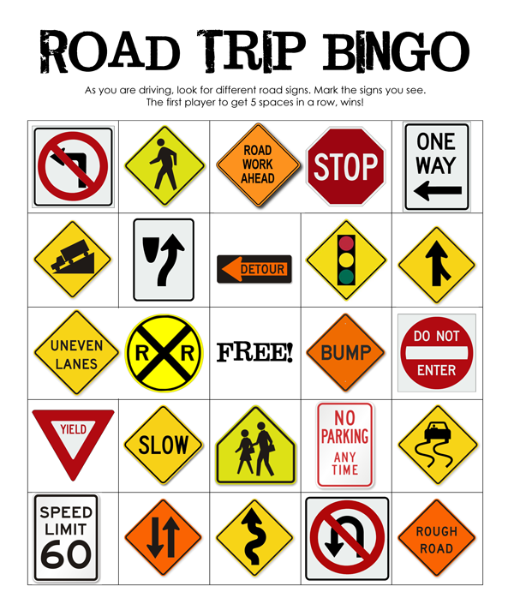
Station 5: Traffic Signs & Intersections Skills
Crash avoidance: Learn traffic signs and lights, colors and shapes. Learn communication with other road users. Be ready in your power pedal at every stop!
Beginners:
When do we stop at a stop sign? ALWAYS
Look all 4 ways:
Left
Right
In front
Behind
Wave to make sure they see you. They will wave back if they do!
Take turns with other vehicles.
Advanced:
It is important to make eye contact with others driving
If one person motions you to go, still look all 4 ways before going
Lane positioning – protect your space – don’t hide
Thumbs up and thank you wave
Drivers: Slow down, know that children do not understand or have experience with traffic rules of habits. Please do NOT stop in the middle of the street and motion for kids to cross.
Notes:
31
Another major cause of bicycle crashes for children is the unexpected left turn or sudden left swerve.
The child forgets to look being him/her for traffic before turning left into a driveway or at an intersection, or before moving further left on the road to avoid a hazard. Scanning teaches them how to look behind them for traffic while riding a straight line. Most children quickly pick up this skill.

Slide 32
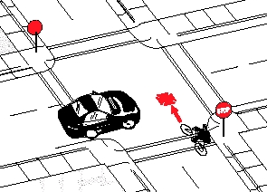
Station 5: Traffic Signs & Intersections Activity
Crash avoidance: Understand traffic and driver habits, pedal predictably. Practice good habits at quiet intersections to develop confidence for busier intersections with more lanes.
Use a quiet neighborhood intersection, recruit families to be “drivers”
Helper:
Chalk a safe 4 way stop intersection with 2 lane roads
Demonstrate and help each kid practice
Then have kids walk and communicate on their own while using hand signals
Next have kids bikes practice together
Let kids make their own decisions when to go
Help them clarify their communications
Make sure kids learn from “crashes” that happen in this safe low speed activity
Make it fun: Have an advanced child “break the rules” let the kids talk about what happens. Talk about where they are going on their bikes. Talk about what they will bring along and how they will carry it.
Drivers: Slow down, know that children do not understand or have experience with traffic rules of habits, protect them while they are learning. Expect kids to be everywhere. Please DO NOT stop in the middle of the street and motion for kids to cross.
Notes:
32
Another major cause of bicycle crashes for children is the unexpected left turn or sudden left swerve.
The child forgets to look being him/her for traffic before turning left into a driveway or at an intersection, or before moving further left on the road to avoid a hazard. Scanning teaches them how to look behind them for traffic while riding a straight line. Most children quickly pick up this skill.

Slide 33
Station 6
Skill to develop: Scan behind – Communicate with other road users – Be predictable

Slide 34
Most common and severe crash types and
skills needed to avoid them
Bicyclist – Driveway or Midblock Rideout
12% of crashes 22% incapacitating or fatal
Bicyclist – Stop Sign/Signal Rideout
17% of crashes 20% incapacitating or fatal
Skill to develop: Scan behind – Communicate with other road users – Be predictable
Bicyclist – Sudden Swerve
7% of crashes 25% incapacitating or fatal
Wrong way riding is not a separate crash type, but is a contributing factor in many crashes.
Notes:
34

Slide 35
Station 6: You Go First Skills
Crash avoidance: Sudden swerve. Maintain control of your bicycle pedal predictably in as straight a line as possible and share the road respectfully.
Beginners:
Look behind you only move over if no cars are coming
Signal and look again
Stay 3 feet from the obstacle, do not pedal into oncoming traffic lanes
Smile at everyone!
Advanced:
Look, look and signal, look signal and go if safe
Plan ahead, don’t get pinched out
Do not ride up the sidewalk and back into the street
Thumbs up and thank you wave
Drivers: Slow down, allow safe space for kids to move over, they often do not look before moving around obstacles. People biking should not have to stop and wait while you pass from behind.
Notes:
35
Another major cause of bicycle crashes for children is the unexpected left turn or sudden left swerve.
The child forgets to look being him/her for traffic before turning left into a driveway or at an intersection, or before moving further left on the road to avoid a hazard. Scanning teaches them how to look behind them for traffic while riding a straight line. Most children quickly pick up this skill.

Slide 36
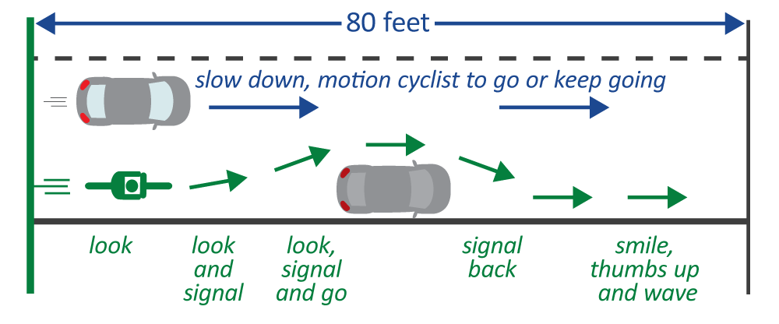
Station 6: You Go First Activity
Crash avoidance: Before you signal, always look into traffic for a safe time to move out of your predictable pattern. Scanning practice develops the habit of looking before going.
Helper: Kids love this and get good at it quickly!
Challenge: Kids do not do this consistently; they have trouble in groups and with any distractions. Mix it up and practice on all rides so they develop habits.
80-foot-long course, 20 feet to begin pedaling, mark actions and decisions about every 20 feet
Make it fun: Practice with “driver” running, sometimes let them go, sometimes pinch them out!
Drivers: Slow down, wait until it is safe to move over and pass. Be prepared for kids to swerve and turn unpredictably.
Notes:
36
Another major cause of bicycle crashes for children is the unexpected left turn or sudden left swerve.
The child forgets to look being him/her for traffic before turning left into a driveway or at an intersection, or before moving further left on the road to avoid a hazard. Scanning teaches them how to look behind them for traffic while riding a straight line. Most children quickly pick up this skill.

Slide 37
Station 7
Skill to develop: Balance – Avoid hazards without swerving into traffic practice until reaction is instinctive

Slide 38
Most common and severe crash types and
skills needed to avoid them
Bicyclist – Driveway or Midblock Rideout
12% of crashes 22% incapacitating or fatal
Bicyclist – Stop Sign/Signal Rideout
17% of crashes 20% incapacitating or fatal
Skill to develop: Balance skills, avoid hazards while staying out of traffic, practice until reaction is instinctive
Bicyclist – Sudden Swerve
7% of crashes 25% incapacitating or fatal
Wrong way riding is not a separate crash type, but is a contributing factor in many crashes.
Notes:
38

Slide 39
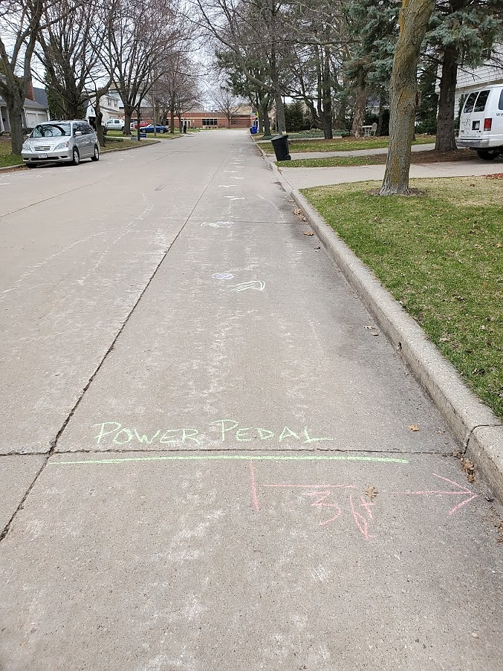
Station 7: Balance Skills
Crash avoidance: Sudden swerve, maintaining control of your bicycle and development of instinctive reaction.
Beginners:
Kids have fun with and learn these skills quickly
Smaller bikes help new riders
Learning from their mistakes strengthens familiarity with their bike
Smile while you pedal!
Advanced:
Ride the drills from both directions
Put two riders in the drill at the same time
Pedal while looking up, incorporate distractions
Ride drills one handed
Drivers: Slow down, wait until it is safe to move over and pass. Allow a minimum of 3 feet between the right most part of your can and the left-most part of the bicycle. Be prepared for kids to swerve and turn unpredictably.
Notes:
39
Another major cause of bicycle crashes for children is the unexpected left turn or sudden left swerve.
The child forgets to look being him/her for traffic before turning left into a driveway or at an intersection, or before moving further left on the road to avoid a hazard. Scanning teaches them how to look behind them for traffic while riding a straight line. Most children quickly pick up this skill.

Slide 40
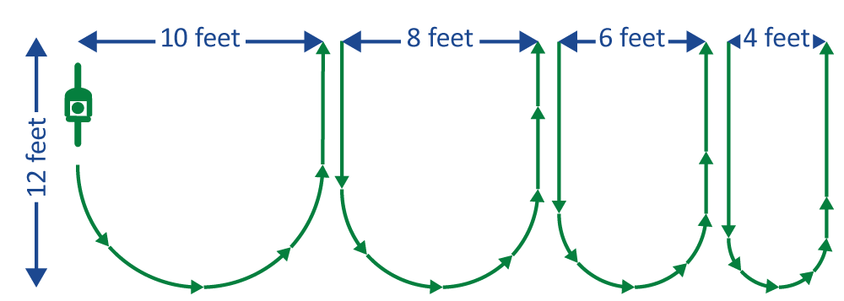
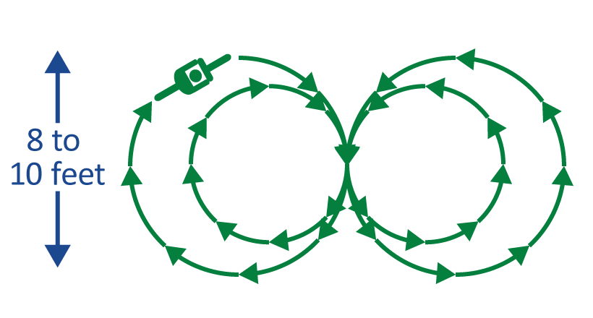
Station 7: Balance Skills Activity
Crash avoidance: Sudden swerve, maintaining control of your bicycle and development of instinctive reaction.
Helper: Give lots of positive feedback and encourage new riders. Help them learn from their mistakes, ask questions, walk through improvements. Notice the kids ability and offer additional challenges when they master a skill.
Slow Race
3-foot-wide lanes. Stay in your lane, touch the ground and you are out.
Tight Turn
Figure Eight (8)
Make it fun: Time kids and have contests. Intentionally distract kids, stand close to the edge of the drill area, hold up fingers for them to count, add an obstacle.
Drivers: Slow down, wait until it is safe to move over and pass. Be prepared for kids to swerve and turn unpredictably.
Notes:
40
Another major cause of bicycle crashes for children is the unexpected left turn or sudden left swerve.
The child forgets to look being him/her for traffic before turning left into a driveway or at an intersection, or before moving further left on the road to avoid a hazard. Scanning teaches them how to look behind them for traffic while riding a straight line. Most children quickly pick up this skill.

Slide 41
Teaching Safe Bicycling
Activities and tips designed to help teach children the skills they need to avoid the most common and severe crashes involving children on bicycles and people driving.
The Rockstars
Anika
Annaleah
Ashyra
Athena
Auggie
Edith
Evan
Julius
Lydia
Malachi
Marcus
Mason
Wren
Our parent volunteers
Emily
Jessica
LeRoy
Liz
Rachel
This series of 8 two-minute videos is based on our 8 hour Teaching Safe Bicycling Train the Trainer class
Notes:
41
Children often do not know the best way to use their brakes to stop quickly and effectively.
We make a game of it by having them stop as close to a line as possible and marking how close they are to show their progress as they try new techniques.
With coaster (foot) brakes they like to skid. But sliding friction is 1) lower than rolling friction, thus skidding takes longer to stop and 2) the bike is out of control and usually no longer traveling in a straight line.
To stop a bike with coaster brakes without skidding, push back on the pedals in a circular motion using even pressure rather than jamming down on the pedals as hard as you can.
With caliper (hand) brakes, children often rely on the rear brake alone. They are afraid of using the front brake too hard and going over the handlebars, but the front brake has the most stopping power.
The best way to stop with caliper / hand brakes is to use both the front and rear brakes together.
The front brake provides the stopping power and the rear brake provides stability.
If the rear wheel starts to skid, ease up on the front brake.
Advanced:
The hover: Slightly lift your body off the seat, straighten your arms and, without raising your body, push your weight over your back wheel.
Begin practicing at slow speeds.
We like to practice these in sequence so children can see that what they are learning actually works.
Stop as close to the line as possible without going over:
1st with the right brake only
2nd with both brakes
3rd we teach then add the hover

Slide 42
Teaching Safe Bicycling
Activities and tips designed to help teach children the skills they need to avoid the most common and severe crashes involving children on bicycles and people driving.
Photography and Edits
Lauren Gilmeister
Photography and Location
Margaret and Elizabeth City of Appleton
Voice
Bill Finn
Content Development and Voice
Michelle Bachaus Wisconsin Bike Fed – Appleton Office
Chrys DePas
Bike Fed Staff
Painting – Intro/Outro
Chrys DePas
This series of 8 two-minute videos is based on our 8 hour Teaching Safe Bicycling Train the Trainer class
Notes:
42
Children often do not know the best way to use their brakes to stop quickly and effectively.
We make a game of it by having them stop as close to a line as possible and marking how close they are to show their progress as they try new techniques.
With coaster (foot) brakes they like to skid. But sliding friction is 1) lower than rolling friction, thus skidding takes longer to stop and 2) the bike is out of control and usually no longer traveling in a straight line.
To stop a bike with coaster brakes without skidding, push back on the pedals in a circular motion using even pressure rather than jamming down on the pedals as hard as you can.
With caliper (hand) brakes, children often rely on the rear brake alone. They are afraid of using the front brake too hard and going over the handlebars, but the front brake has the most stopping power.
The best way to stop with caliper / hand brakes is to use both the front and rear brakes together.
The front brake provides the stopping power and the rear brake provides stability.
If the rear wheel starts to skid, ease up on the front brake.
Advanced:
The hover: Slightly lift your body off the seat, straighten your arms and, without raising your body, push your weight over your back wheel.
Begin practicing at slow speeds.
We like to practice these in sequence so children can see that what they are learning actually works.
Stop as close to the line as possible without going over:
1st with the right brake only
2nd with both brakes
3rd we teach then add the hover

