Slide 1
Station 6
SkillS to develop: Scan behind – Communicate with other road users – Be predictable

Slide 2
Most common and severe crash types and
skills needed to avoid them
Driveway or Midblock Rideout
12% of crashes; 22% incapacitating or fatal
Stop Sign/Signal Rideout
17% of crashes; 20% incapacitating or fatal
SkillS to develop: Scan behind – Communicate with other road users – Be predictable
Sudden Swerve
7% of crashes; 25% incapacitating or fatal
Skill to develop: Straight line riding
Wrong way riding is not a separate crash type, but is a contributing factor in many crashes.
Notes:
2

Slide 3
Station 6: You Go First skills
Crash avoidance: Do not suddenly swerve around obstacles. Control your bicycle pedal predictably in as straight a line as possible. Share the road respectfully.
Beginners:
Plan ahead. Look as far as you can see at where you are going
Before passing, look behind you. Only move over if no cars are coming
Signal and look again
Stay three feet from any obstacle. Do not move over in front of cars
Smile at everyone!
Advanced:
Look, look and signal, look signal and go if safe
Plan ahead. Don’t get pinched out
Practice judging distance and speed of vehicles
Do not ride up the sidewalk and back into the street
Thumbs up and thank you wave. Earn the respect of people driving
Drivers: Slow down, allow safe space for kids to move over, they often do not look before moving around obstacles. People biking should not have to stop and wait while you pass from behind.
Notes:
3
Another major cause of bicycle crashes for children is the unexpected left turn or sudden left swerve.
The child forgets to look being him/her for traffic before turning left into a driveway or at an intersection, or before moving further left on the road to avoid a hazard. Scanning teaches them how to look behind them for traffic while riding a straight line. Most children quickly pick up this skill.

Slide 4
Station 6: You Go First activity
Crash avoidance: Before you signal, always look behind into traffic for a safe time to move out of your predictable pattern. Scanning is a very important skill to master.
Stand behind the child, let them start pedaling three feet from the curb. Run from behind pretending to be a car.
The “driver” should simulate scenarios, sometimes let them go, sometimes pinch them out, sometimes distracted!
It is important to make this course long enough to teach how early kids should begin looking.
Make it fun: Kids love this and learn quickly but do not do it consistently. They have trouble in groups and with any distractions. Practice on all rides to become proficient.
Drivers: Slow down, wait until it is safe to move over and pass. Be prepared for kids to swerve and turn unpredictably.
Notes:
4
Another major cause of bicycle crashes for children is the unexpected left turn or sudden left swerve.
The child forgets to look being him/her for traffic before turning left into a driveway or at an intersection, or before moving further left on the road to avoid a hazard. Scanning teaches them how to look behind them for traffic while riding a straight line. Most children quickly pick up this skill.

Slide 5
Station 7
Skill to develop: Balance – Avoid hazards without swerving into traffic practice until reaction is instinctive

Slide 6
Most common and severe crash types and
skills needed to avoid them
Driveway or Midblock Rideout
12% of crashes; 22% incapacitating or fatal
Stop Sign/Signal Rideout
17% of crashes; 20% incapacitating or fatal
Skill to develop: Balance skills, avoid hazards while staying out of traffic, practice until reaction is instinctive
Sudden Swerve
7% of crashes; 25% incapacitating or fatal
Skill to develop: Balance skills, avoid hazards while staying out of traffic, practice until reaction is instinctive
Wrong way riding is not a separate crash type, but is a contributing factor in many crashes.
Notes:
6

Slide 7
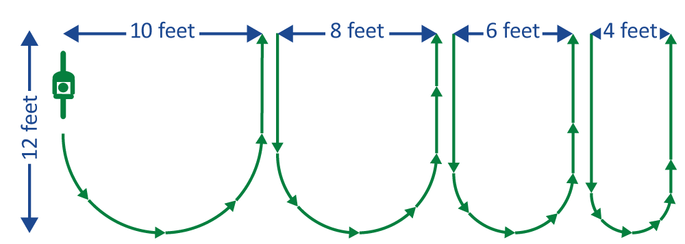
Station 7: Balance skills
Tight Turn Bay
Crash avoidance: Sudden swerve. Maintaining control of your bicycle and development of instinctive reaction.
Beginners:
Kids have fun with and learn these skills quickly
Smaller bikes help new riders
Learning from their mistakes strengthens familiarity with their bike
Smile while you pedal!
Advanced:
Ride the balance activities from both directions
Put two riders in the activity at the same time
Pedal while looking up, incorporated distractions
Ride drills one handed
Imagine hazards and reacting to them
Drivers: Slow down, wait until it is safe to move over and pass. Allow a minimum of three feet between the right most part of your can and the left-most part of the bicycle. Be prepared for kids to swerve and turn unpredictably.
Notes:
7
Another major cause of bicycle crashes for children is the unexpected left turn or sudden left swerve.
The child forgets to look being him/her for traffic before turning left into a driveway or at an intersection, or before moving further left on the road to avoid a hazard. Scanning teaches them how to look behind them for traffic while riding a straight line. Most children quickly pick up this skill.

Slide 8
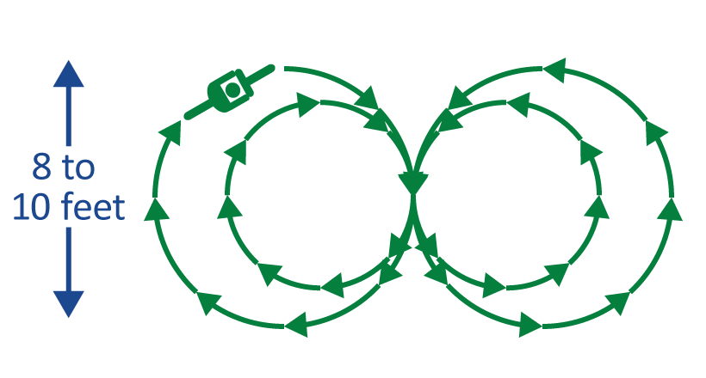
Station 7: Balance Skills Activity
Crash avoidance: Sudden swerve. Maintaining control of your bicycle and development of instinctive reaction.
Give lots of positive feedback and encourage new riders. Help them understand that mistakes help them get better, ask questions, walk through improvements. Notice each child’s ability and offer additional challenges when they begin mastering a skill.
Figure Eights
Slow Race
Draw several 3-foot-wide and 10-foot-long lanes, with start and finish lines, like a track.
Pedal as slowly as possible.
Leave your lane or touch the ground and you are out.
The last one to cross the finish line wins!
Make it fun: Time kids and have contests. Intentionally distract kids, stand close to the edge of the activity area, hold up fingers for them to count, add an obstacle.
Drivers: Slow down, wait until it is safe to move over and pass. Prepare for kids to swerve and turn unpredictably, expect the unexpected. Be patient and understanding.
Notes:
8
Another major cause of bicycle crashes for children is the unexpected left turn or sudden left swerve.
The child forgets to look being him/her for traffic before turning left into a driveway or at an intersection, or before moving further left on the road to avoid a hazard. Scanning teaches them how to look behind them for traffic while riding a straight line. Most children quickly pick up this skill.

