Slide 1
Station 4
Skill to develop:
Stop and look all ways
before entering the road

Slide 2
Most common and severe crash types and
skills needed to avoid them
Driveway or Midblock Rideout
12% of crashes; 22% incapacitating or fatal
Skill to develop: Stop and look all ways before entering the road
Stop Sign/Signal Rideout
17% of crashes; 20% incapacitating or fatal
Sudden Swerve
7% of crashes; 25% incapacitating or fatal
Wrong way riding is not a separate crash type,
but is a contributing factor in many crashes.
Notes:
2

Slide 3
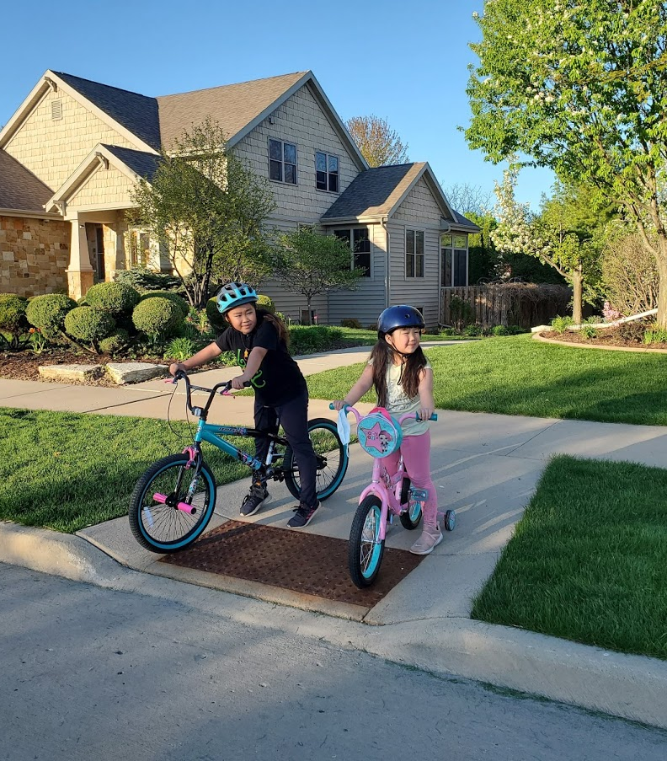
Station 4: Driveway/Mid-block pullout skills
Crash avoidance: Riding into traffic. Stop completely, enter the road into the proper lane position, be predictable, learn driver habits.
Beginners:
Let kids say when they think it is safe to go, adults remove barrier and give verbal confirmation
Stop, with two feet on
the ground, in a place where they can easily
see all traffic
Pull out carefully along right side of the road about three feet from the curb without swerving into the traffic lane
Advanced:
Kids can decide in
pairs if it is safe to go, adults give a verbal confirmation
Slowly pull up close
to the road entrance with a clear view of
all traffic. Can you
be seen?
Pull out carefully
into your lane
Thumbs up and
thank you wave
Drivers: Slow down. Expect kids to be everywhere. Kids often feel safe when they
can’t be seen, between parked cars or behind bushes, away from the road entrance.
Know that younger kids often follow far behind older kids onto the street.
Notes:
3
Another major cause of bicycle crashes for children is the unexpected left turn or sudden left swerve.
The child forgets to look being him/her for traffic before turning left into a driveway or at an intersection, or before moving further left on the road to avoid a hazard. Scanning teaches them how to look behind them for traffic while riding a straight line. Most children quickly pick up this skill.

Slide 4
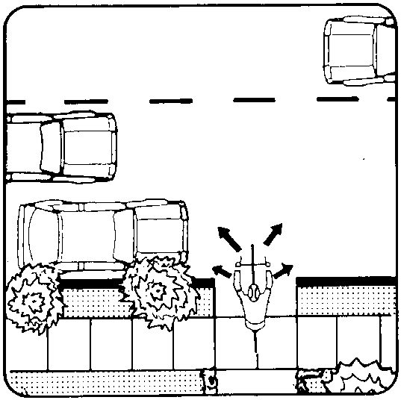
Station 4: Driveway/Mid-block pullout activity
Crash avoidance: Do not enter the road when traffic is approaching. Be seen and predictable, do not swerve into traffic lanes, stay three feet from the curb.
Use a driveway on a quiet street, or a path that spills out of a park into the street.
Check to ensure:
A complete stop
Visibility of themselves
Sightlines to see vehicles
Look all ways: Left-right and left again, in front and behind
Don’t enter the road if one driver motions
Discuss:
Show kids the difference of waiting where they can see and be seen vs hiding where they may feel safe
Timing varies, judging speed is difficult
Discuss driver habits,
good AND bad
Make it fun: Use real vehicles parked to block the view. As a parent driving, show kids how it can be difficult to see. have kids help watch for others playing in driveways or parks and alert you to possible mid-block pullouts.
Drivers: Slow down. Expect kids to be everywhere. Kids often feel safe when they
can’t be seen, between parked cars or behind bushes, away from the road entrance.
Know that younger kids often follow far behind older kids onto the street.
Notes:
4
Another major cause of bicycle crashes for children is the unexpected left turn or sudden left swerve.
The child forgets to look being him/her for traffic before turning left into a driveway or at an intersection, or before moving further left on the road to avoid a hazard. Scanning teaches them how to look behind them for traffic while riding a straight line. Most children quickly pick up this skill.

Slide 5
Station 5
SkillS to develop:
Learn signs – Communicate with
other road users – Be predictable

Slide 6
Most common and severe crash types and
skills needed to avoid them
Driveway or Midblock Rideout
12% of crashes; 22% incapacitating or fatal
Stop Sign/Signal Rideout
17% of crashes; 20% incapacitating or fatal
SkillS to develop: Learn signs – Communicate with
other road users – Be predictable
Sudden Swerve
7% of crashes; 25% incapacitating or fatal
Wrong way riding is not a separate crash type,
but is a contributing factor in many crashes.
Notes:
6

Slide 7
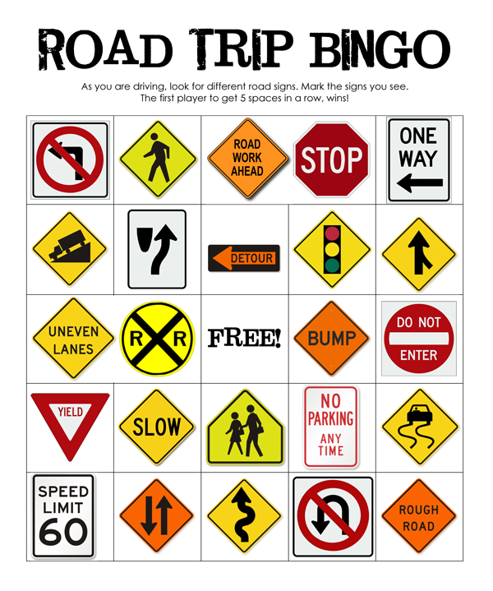
Station 5: Traffic Signs and Intersections Skills
Crash avoidance: Learn traffic signs and lights, colors and shapes. Communicate with other road users. Be ready in your power pedal and always prepared to stop!
Beginners:
When do we stop at
a stop sign? ALWAYS
Look all 4 ways:
  Left
  Right
  In front
  Behind
Wave to make sure
they see you. They will wave back if they do!
Take turns with
other vehicles
Advanced:
Make eye contact with others on the road
If one person motions you to go, still look all
4 ways before going
Lane positioning – be visible in your space
Don’t hide or ride
too close to the curb
or hazards
Thumbs up and thank you wave!
Drivers: Slow down, know that children do not understand or have experience with traffic rules or driving habits. Stop at all crosswalks. DO NOT stop in the middle of the street and motion for kids to cross.
Notes:
7
Another major cause of bicycle crashes for children is the unexpected left turn or sudden left swerve.
The child forgets to look being him/her for traffic before turning left into a driveway or at an intersection, or before moving further left on the road to avoid a hazard. Scanning teaches them how to look behind them for traffic while riding a straight line. Most children quickly pick up this skill.

Slide 8
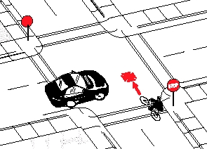
Station 5: Traffic signs and intersections activity
Crash avoidance: Understand traffic and driver habits, pedal predictably. Practice good habits at quiet intersections to develop confidence for busier intersections with more lanes.
Prepare
Chalk a safe four-way stop intersection
with two-lane roads
Demonstrate and help each kid practice
Then have kids walk and communicate
on their own while using hand signals
Use a quiet neighborhood intersection, recruit families to be “drivers”
Teach
Have kids on bikes practice together
Let kids make their own decisions when to go
Help them clarify their communications
Make sure kids learn from “crashes” that happen in this safe low speed activity
Make it fun: Have an advanced child “break the rules” let the kids talk about what happens. Talk about where they can go on their bikes, what they will bring and how to carry it.
Drivers: Slow down, know that children do not understand or have experience with traffic rules of habits, protect them while they are learning. Expect kids to be everywhere. Please DO NOT stop in the middle of the street and motion for kids to cross.
Notes:
8
Another major cause of bicycle crashes for children is the unexpected left turn or sudden left swerve.
The child forgets to look being him/her for traffic before turning left into a driveway or at an intersection, or before moving further left on the road to avoid a hazard. Scanning teaches them how to look behind them for traffic while riding a straight line. Most children quickly pick up this skill.

