Slide 1
Station 2
Skill to develop:
Signaling and scanning

Slide 2
Most common and severe crash types and
skills needed to avoid them
Driveway or Midblock Rideout
12% of crashes; 22% incapacitating or fatal
Stop Sign/Signal Rideout
17% of crashes; 20% incapacitating or fatal
Skill to develop: Signaling/Scanning
Sudden Swerve
7% of crashes; 25% incapacitating or fatal
Skill to develop: Signaling/Scanning
Wrong way riding is not a separate crash type,
but is a contributing factor in many crashes.
Notes:
2

Slide 3
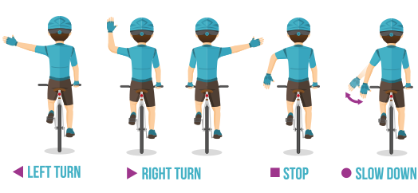
Station 2: Signals and scanning skills
Crash avoidance: Sudden swerve
Understanding signs and habits in traffic.
Beginners:
Scanning – Put your chin on your shoulder to stay steady
Signal with arm away from your body so your intent is very clear
Hand should be back on the handlebar before beginning the turn
Smile at everyone!
Advanced:
Scanning – Remove your left hand from the handlebars to stay steady
Signal with “Jazz hands” — movement is more noticeable
Learn and use
signals for road hazards and slowing
Thumbs up and
thank you wave
Drivers: Slow down, wait until it is safe to move over and pass. Be prepared for kids
to swerve and turn unpredictably.
Notes:
3
Another major cause of bicycle crashes for children is the unexpected left turn or sudden left swerve.
The child forgets to look being him/her for traffic before turning left into a driveway or at an intersection, or before moving further left on the road to avoid a hazard. Scanning teaches them how to look behind them for traffic while riding a straight line. Most children quickly pick up this skill.

Slide 4
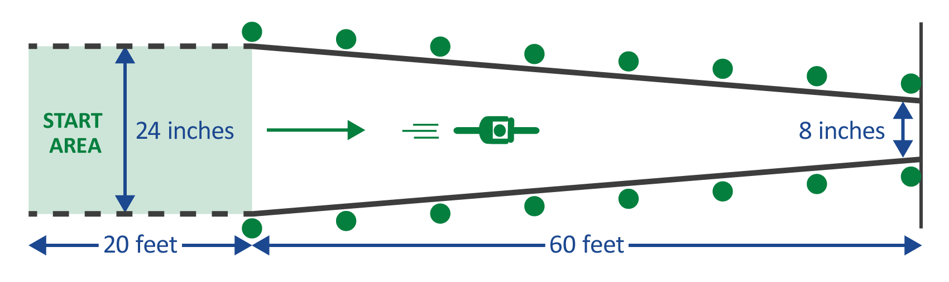
Station 2: Signals and scanning activity
  Crash avoidance: Before signaling, always look into traffic for a safe time to move out of your predictable pattern. Practice develops the habit of looking before going.
Tap kids on the left shoulder to remind them which way to look. Stand by the start area, hold up your arm(s) away from your body and say “LOOK.” Participant will shout out how many arms you are holding up.
New riders look in the widest section, helper stands far to the left to make it easy. Experienced riders look in the narrow section, helper stands directly behind the rider.
The first 20 feet are an opportunity to gain speed to easily ride in a straight line.
Make it fun: Use colors or any object to help their observation skills. Use fingers (instead of arms) and do math to challenge older kids and work on multi-tasking,
very much like a real-life situation.
Drivers: Slow down, wait until it is safe to move over and pass. Be prepared for kids
to swerve and turn unpredictably.
Notes:
4
Another major cause of bicycle crashes for children is the unexpected left turn or sudden left swerve.
The child forgets to look being him/her for traffic before turning left into a driveway or at an intersection, or before moving further left on the road to avoid a hazard. Scanning teaches them how to look behind them for traffic while riding a straight line. Most children quickly pick up this skill.

