Slide 1
Station 1
Skills to develop:
Effective stopping and controlled starting

Slide 2
Most common and severe crash types and
skills needed to avoid them
Driveway or Midblock Rideout
12% of crashes; 22% incapacitating or fatal
  SKILL TO DEVELOP: Effective stopping and controlled starting
Stop Sign/Signal Rideout
17% of crashes; 20% incapacitating or fatal
Skill to develop: Effective stopping
Sudden Swerve
7% of crashes; 25% incapacitating or fatal
Skill to develop: Controlled starting
Wrong way riding is not a separate crash type,
but is a contributing factor in many crashes.
Notes:
2

Slide 3
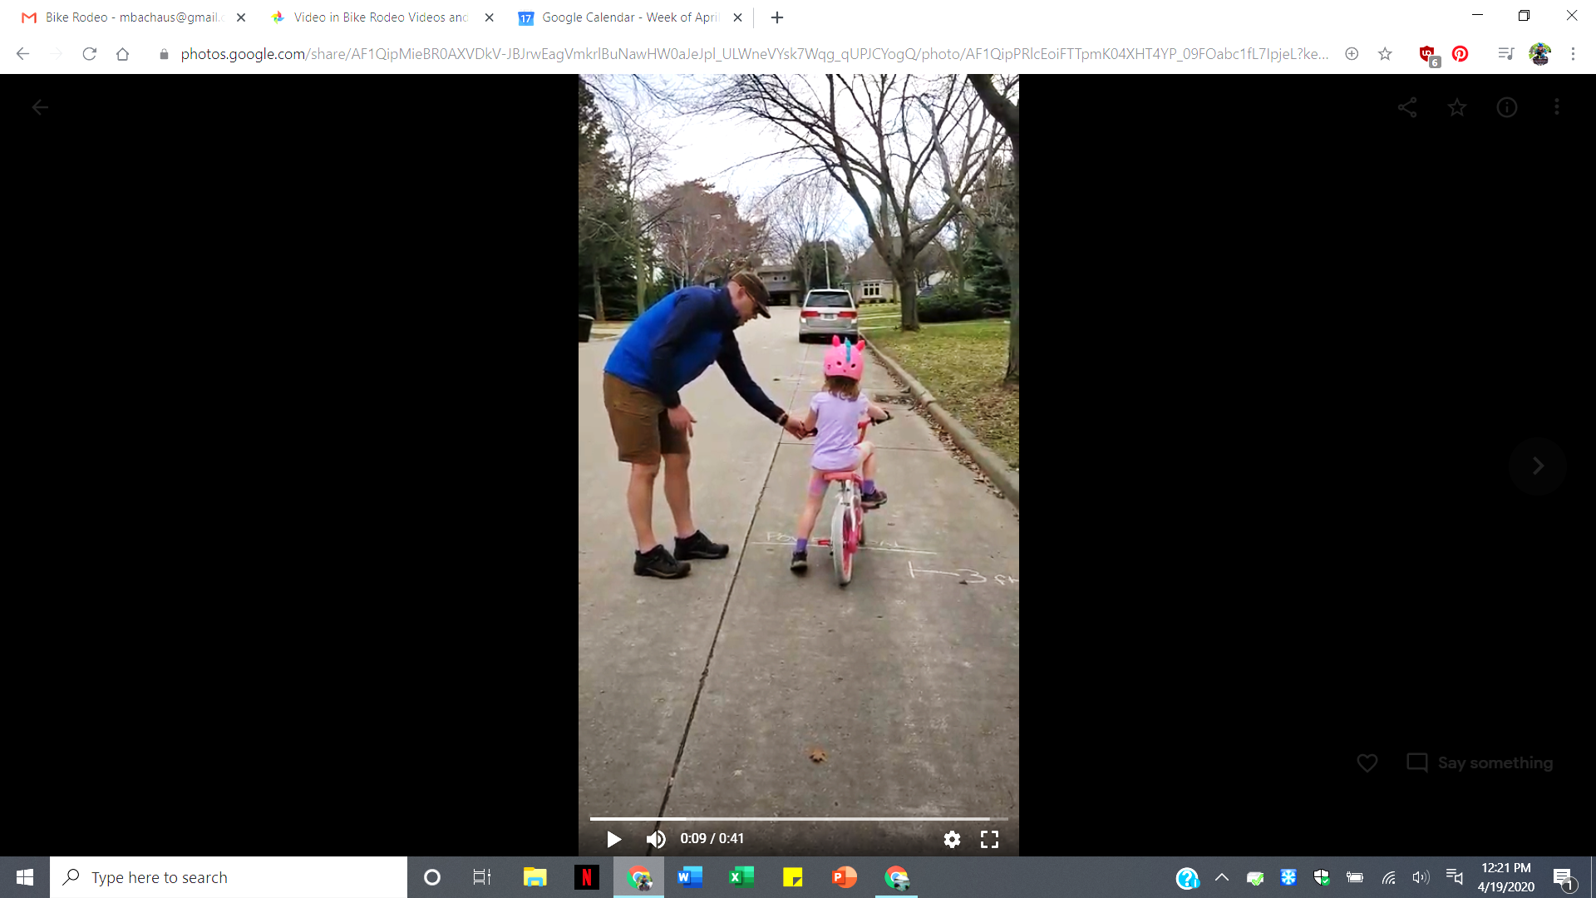
Station 1: Power Pedal Skills
Crash avoidance: Swerving into traffic.
Learn straight line riding to maintain control of the bicycle.
Beginners:
Power pedal position just past the top
Practice pulling pedal up from behind with the top of their foot
Strong push down gains speed quickly with their feet securely on the pedals
Avoid unpredictable “scooter starts”
Advanced:
Practice stopping with pedals in the power pedal position
Shift down to a comfortable gear for a smooth start
Bike should fit so rider does not get off the seat at each stop
No “cowboy” starts
Drivers: Know that kids may not start their bicycles quickly, they do not have good judgement of speed, and may be slow to react to their decision that it is safe to go.
Notes:
3
Children often do not know the best way to use their brakes to stop quickly and effectively.
We make a game of it by having them stop as close to a line as possible and marking how close they are to show their progress as they try new techniques.
With coaster (foot) brakes they like to skid. But sliding friction is 1) lower than rolling friction, thus skidding takes longer to stop and 2) the bike is out of control and usually no longer traveling in a straight line.
To stop a bike with coaster brakes without skidding, push back on the pedals in a circular motion using even pressure rather than jamming down on the pedals as hard as you can.
With caliper (hand) brakes, children often rely on the rear brake alone. They are afraid of using the front brake too hard and going over the handlebars, but the front brake has the most stopping power.
The best way to stop with caliper / hand brakes is to use both the front and rear brakes together.
The front brake provides the stopping power and the rear brake provides stability.
If the rear wheel starts to skid, ease up on the front brake.
Advanced:
The hover: Slightly lift your body off the seat, straighten your arms and, without raising your body, push your weight over your back wheel.
Begin practicing at slow speeds.
We like to practice these in sequence so children can see that what they are learning actually works.
Stop as close to the line as possible without going over:
1st with the right brake only
2nd with both brakes
3rd we teach then add the hover

Slide 4
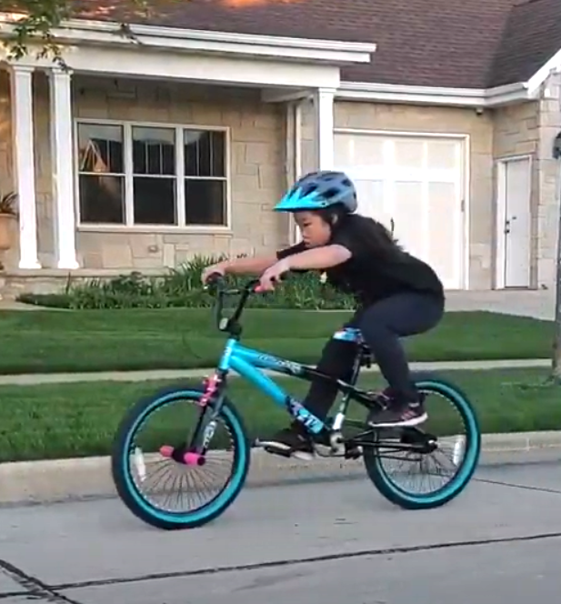
Station 1: Controlled Braking Skills
Crash avoidance:
Stop your bike instinctively, maintain control of the bicycle.
Beginners:
What do we use
to stop our bikes?
BRAKES (not feet!)
Smooth steady pressure
on brakes to stop
Avoid a skid by pressing
the coaster brake in a rotating motion
Riders say “stopping”
to begin the idea
of communicating
Advanced:
Faster speed with
a controlled stop
Simulate crash scenarios
Signal and
verbalize slowing and stopping
Hand brakes:
Right vs both
Emergency stop with the hover
Drivers: Know that kids are trusting, often distracted and simply may not stop.
Kids do not have good judgement of speed, or their brakes may not work.
Notes:
4
Children often do not know the best way to use their brakes to stop quickly and effectively.
We make a game of it by having them stop as close to a line as possible and marking how close they are to show their progress as they try new techniques.
With coaster (foot) brakes they like to skid. But sliding friction is 1) lower than rolling friction, thus skidding takes longer to stop and 2) the bike is out of control and usually no longer traveling in a straight line.
To stop a bike with coaster brakes without skidding, push back on the pedals in a circular motion using even pressure rather than jamming down on the pedals as hard as you can.
With caliper (hand) brakes, children often rely on the rear brake alone. They are afraid of using the front brake too hard and going over the handlebars, but the front brake has the most stopping power.
The best way to stop with caliper / hand brakes is to use both the front and rear brakes together.
The front brake provides the stopping power and the rear brake provides stability.
If the rear wheel starts to skid, ease up on the front brake.
Advanced:
The hover: Slightly lift your body off the seat, straighten your arms and, without raising your body, push your weight over your back wheel.
Begin practicing at slow speeds.
We like to practice these in sequence so children can see that what they are learning actually works.
Stop as close to the line as possible without going over:
1st with the right brake only
2nd with both brakes
3rd we teach then add the hover

Slide 5
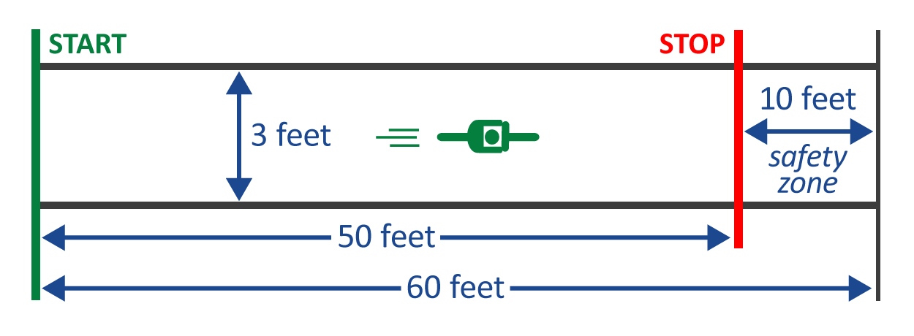
Power Pedal and Controlled Braking – Activity
Crash avoidance: A fast start helps you ride in a straight line. Practice so you know exactly what it takes to stop your bike. Stay within the 3-foot lane.
Power Pedal Start: Teach kids to position power pedal with the top of their foot under the pedal. Start without scooting the bike with a walking motion.
Stopping: Practicing controlled braking by having the child ride down a 3-foot-wide lane and stop, as close to a line as possible, without going over.
Advanced: 1st-right brake, 2nd-both brakes, 3rd-emergency stop hover.
A 50-foot long,
3-foot-wide lane with a start line, stop line, and a 10-foot buffer
as a safety zone
at the end.
Make it fun: Mark where the front tire is when they stop so kids can see progress
in their practice! Skid length is added to the end of the final stop.
Drivers: Take your foot off the accelerator when passing kids on bikes. Give a minimum of 3 feet when passing. Slow down and anticipate kids to be unpredictable.
Notes:
5
Children often do not know the best way to use their brakes to stop quickly and effectively.
We make a game of it by having them stop as close to a line as possible and marking how close they are to show their progress as they try new techniques.
With coaster (foot) brakes they like to skid. But sliding friction is 1) lower than rolling friction, thus skidding takes longer to stop and 2) the bike is out of control and usually no longer traveling in a straight line.
To stop a bike with coaster brakes without skidding, push back on the pedals in a circular motion using even pressure rather than jamming down on the pedals as hard as you can.
With caliper (hand) brakes, children often rely on the rear brake alone. They are afraid of using the front brake too hard and going over the handlebars, but the front brake has the most stopping power.
The best way to stop with caliper / hand brakes is to use both the front and rear brakes together.
The front brake provides the stopping power and the rear brake provides stability.
If the rear wheel starts to skid, ease up on the front brake.
Advanced:
The hover: Slightly lift your body off the seat, straighten your arms and, without raising your body, push your weight over your back wheel.
Begin practicing at slow speeds.
We like to practice these in sequence so children can see that what they are learning actually works.
Stop as close to the line as possible without going over:
1st with the right brake only
2nd with both brakes
3rd we teach then add the hover

