Slide 1
Pre-ride Safety
Helmet fit and basic bike maintenance check

Slide 2
Kids biking and people driving: Crash types
The most common and severe crash types and skills to avoid them
Driveway or Midblock Rideout
12% of crashes; 22% incapacitating or fatal
Stop Sign/Signal Rideout
17% of crashes; 20% incapacitating or fatal
Sudden Swerve
7% of crashes; 25% incapacitating or fatal
Skills to develop:
Helmet fit – A helmet that fits and is adjusted properly each time you put it on will protect you if a crash does happen.
ABC Quick Check – Will make sure your bicycle is working properly and able to respond to your reactions.
Wrong way riding is not a separate crash type, but is a contributing factor in many crashes.
Notes:
2

Slide 3
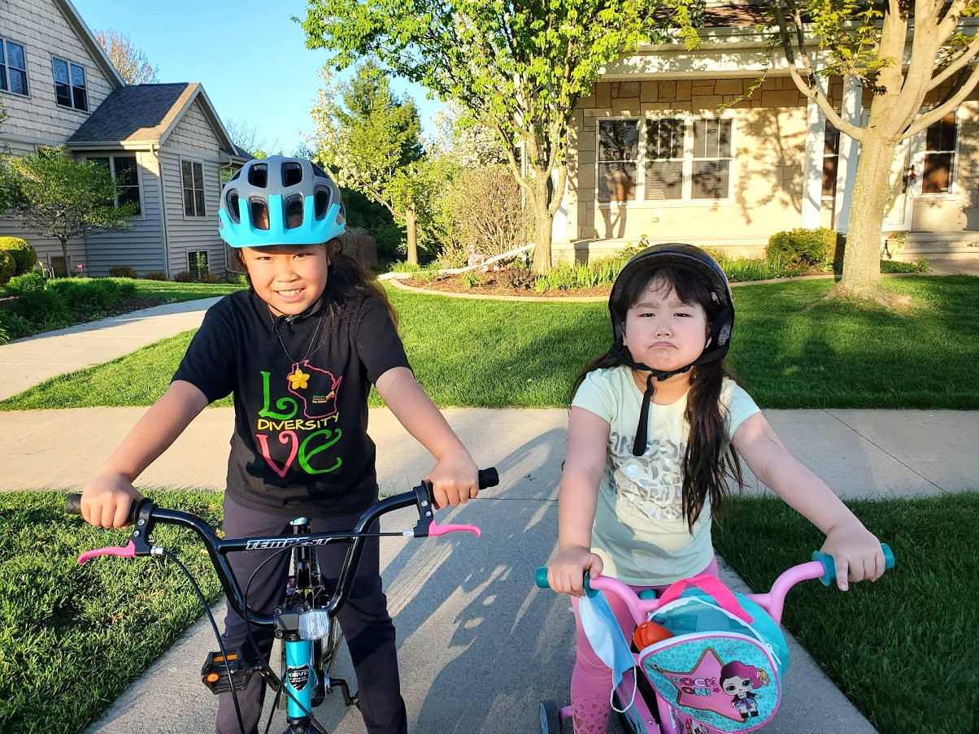
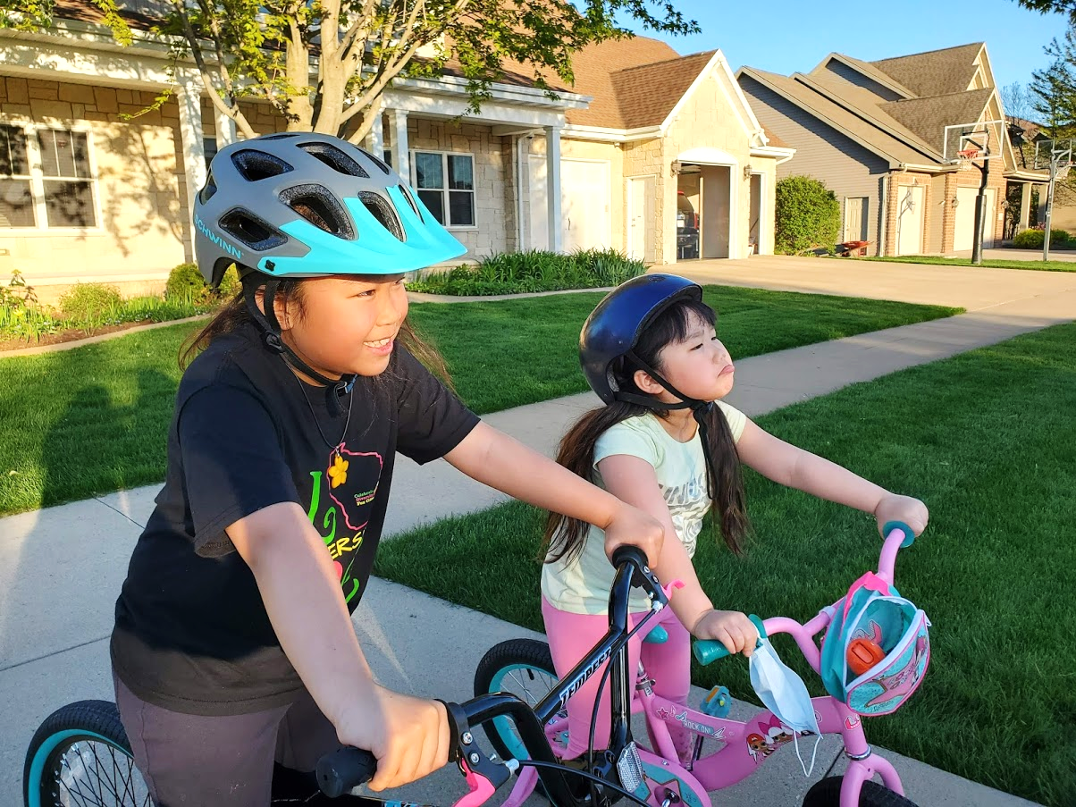
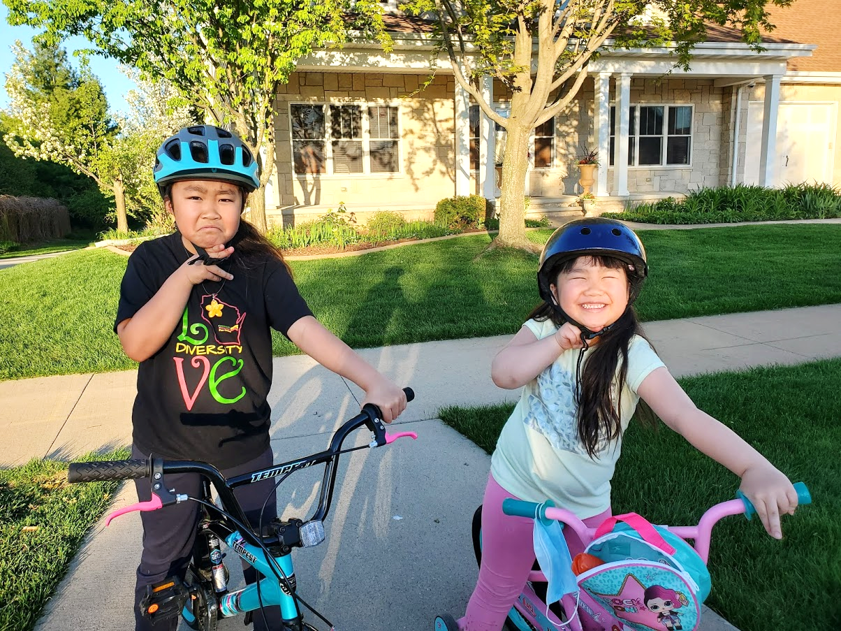
Helmet fit
Helmet should be level. 2 fingers touching the helmet and the eyebrow at the same time.
Helmet should not be tipped back, or it will not protect your head and face properly.
It will also be very uncomfortable.
2
The 2 plastic pieces on the sides should be just below the ears.
Straps:
Front = up & down
Back = front & back
The 2 plastic pieces on the sides should not be below the chin.
This does not hold the helmet in place.
2
If the 2 fingers can be turned up and down, the chin strap is too loose.
2
2 fingers should fit under the chin strap.
Flat, not up and down.

Slide 4
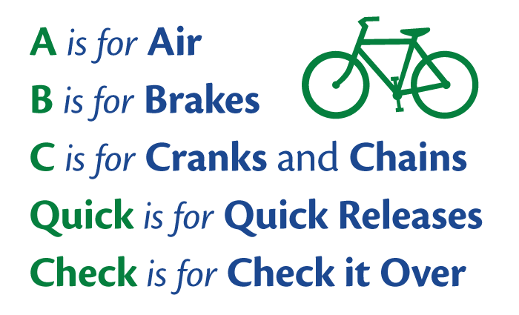
ABC Quick Check
—Check each time before you ride.

