Slide 1
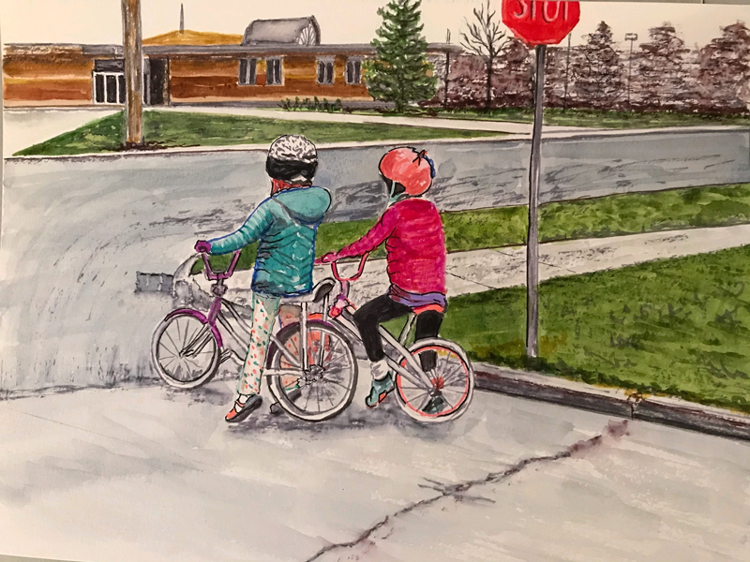
Teaching Safe Bicycling

Slide 2
TEACHING SAFE BICYCLING
Activities and tips designed to help teach children the skills they need to avoid the most common and severe crashes involving children on bicycles and people driving.
Content developed by
in cooperation with the
Wisconsin Department of Transportation
This series of two-minute videos is based on the BikeFed TEACHING SAFE BICYLING Train the Trainer class
Notes:
2
Children often do not know the best way to use their brakes to stop quickly and effectively.
We make a game of it by having them stop as close to a line as possible and marking how close they are to show their progress as they try new techniques.
With coaster (foot) brakes they like to skid. But sliding friction is 1) lower than rolling friction, thus skidding takes longer to stop and 2) the bike is out of control and usually no longer traveling in a straight line.
To stop a bike with coaster brakes without skidding, push back on the pedals in a circular motion using even pressure rather than jamming down on the pedals as hard as you can.
With caliper (hand) brakes, children often rely on the rear brake alone. They are afraid of using the front brake too hard and going over the handlebars, but the front brake has the most stopping power.
The best way to stop with caliper / hand brakes is to use both the front and rear brakes together.
The front brake provides the stopping power and the rear brake provides stability.
If the rear wheel starts to skid, ease up on the front brake.
Advanced:
The hover: Slightly lift your body off the seat, straighten your arms and, without raising your body, push your weight over your back wheel.
Begin practicing at slow speeds.
We like to practice these in sequence so children can see that what they are learning actually works.
Stop as close to the line as possible without going over:
1st with the right brake only
2nd with both brakes
3rd we teach then add the hover

Slide 3
TEACHING SAFE BICYCLING
Activities and tips designed to help teach children the skills they need to avoid the most common and severe crashes involving children on bicycles and people driving.
Special thanks to the City of Appleton
for your cooperation and support and for being such a great bike friendly city!
This series of two-minute videos is based on the BikeFed TEACHING SAFE BICYLING Train the Trainer class
Notes:
3
Children often do not know the best way to use their brakes to stop quickly and effectively.
We make a game of it by having them stop as close to a line as possible and marking how close they are to show their progress as they try new techniques.
With coaster (foot) brakes they like to skid. But sliding friction is 1) lower than rolling friction, thus skidding takes longer to stop and 2) the bike is out of control and usually no longer traveling in a straight line.
To stop a bike with coaster brakes without skidding, push back on the pedals in a circular motion using even pressure rather than jamming down on the pedals as hard as you can.
With caliper (hand) brakes, children often rely on the rear brake alone. They are afraid of using the front brake too hard and going over the handlebars, but the front brake has the most stopping power.
The best way to stop with caliper / hand brakes is to use both the front and rear brakes together.
The front brake provides the stopping power and the rear brake provides stability.
If the rear wheel starts to skid, ease up on the front brake.
Advanced:
The hover: Slightly lift your body off the seat, straighten your arms and, without raising your body, push your weight over your back wheel.
Begin practicing at slow speeds.
We like to practice these in sequence so children can see that what they are learning actually works.
Stop as close to the line as possible without going over:
1st with the right brake only
2nd with both brakes
3rd we teach then add the hover

Slide 4
Most common and severe crash types and
skills needed to avoid them
Driveway or Midblock Rideout
12% of crashes; 22% incapacitating or fatal
SKILLS TO DEVELOP:
Effective stopping and controlled starting: Station 1
Stop and look all ways before entering the road: Station 4
Stop Sign/Signal Rideout
17% of crashes; 20% incapacitating or fatal
SKILLS TO DEVELOP:
Effective stopping and controlled starting: Station 1
Learn signs – Communicate with other road users – Be predictable: Station 5
Signaling/Scanning – Communicate with other road users – Be predictable: Stations 2 and 6
Balance – Avoid hazards without swerving into traffic: Station 7
Sudden Swerve
7% of crashes; 25% incapacitating or fatal
SKILLS TO DEVELOP:
Effective stopping and controlled starting: Station 1
Signaling/Scanning – Communicate with other road users – Be predictable: Stations 2 and 6
Straight Line Riding: Station 3
Balance – Avoid hazards without swerving into traffic: Station 7
All skills should be practiced until they are instinctive.

